Slide 1
Supported by
NIDCR and NIBIB R01DE024450

Slide 2
Software engineering – NAMIC

Slide 3
FUNDED NIDCR and NIBIB R01DE024450
Specific Aims
Superimposition- registration – voxel, surface, landmarks
CMF specific registration module ported to Slicer4 capabilities
Quantify individual changes overtime – work in progress
Quantify populational variability – work in progress

Slide 4
Our clinical group
in 2012 was using:

Slide 5
Image analysis - 2012
Open image: Dicom – gipl format ITK-SNAP
Downsize Imagine
Construct surface model Intensity Segmenter/ITK- SNAP
Registration Imagine
Convert surface formats ITK-SNAP
Superimpose/Overlay Slicer
Quantify changes overtime MeshValmet

Slide 6
What has been updated in
2013 with the new software development in collaboration with NA-MIC ?….

Slide 7
Open Source Dental Tools- 2013
Open image: Dicom– gipl format ITK-SNAP/Slicer
Downsize not needed- Resample Imagine/Slicer
Construct 3D surface models ITK-SNAP/Slicer-Int.Seg.
Register Imagine/Slicer
Convert Surface formats ITK-SNAP/Slicer
Superimpose/Overlay Slicer
Quantify ind. changes overtime MeshValmet-work in progress
Quantify populational changes MeshValmet-work in progress

Slide 8
and 3DErrorMetric:

Slide 9
Have provide ground work and open source code for Slicer extensions such as in the following clinical
applications:

Slide 10
Cranial base registration semi-transparent overlays
9y
11y

Slide 11
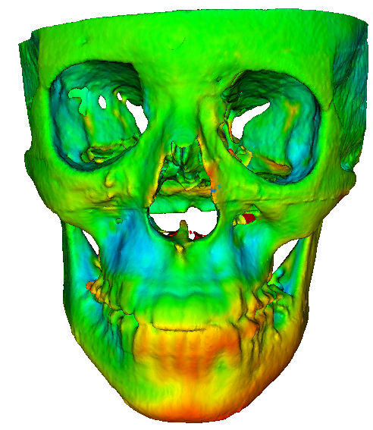
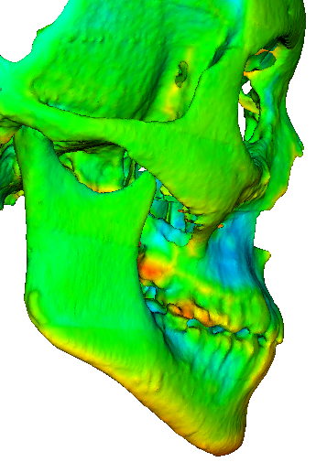
Diagnosis of Asymmetry
Cranial base registration surface distances color maps showing the mandibular displacement with growth
- 6mm
6mm
0

Slide 12
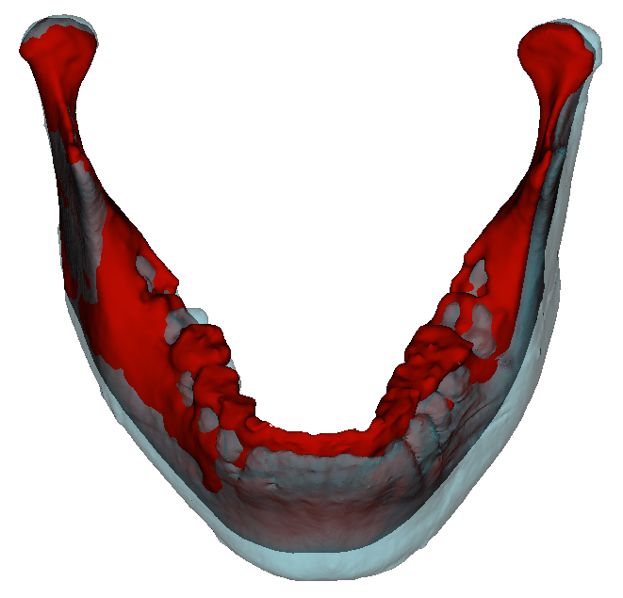
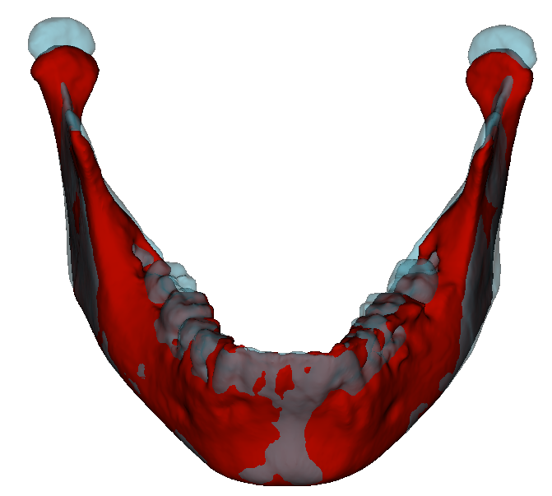
Mandibular displacement relative to the cranial base
Mandibular bone growth registered relative to the mandible itself
11y
13y

Slide 13
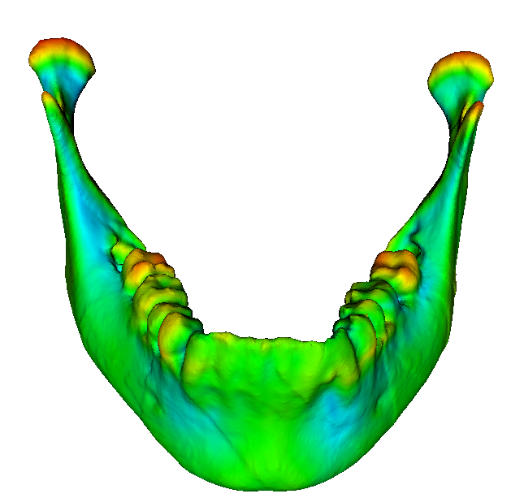
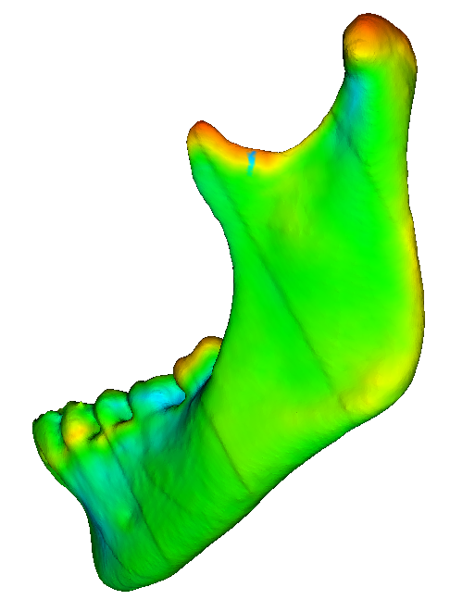
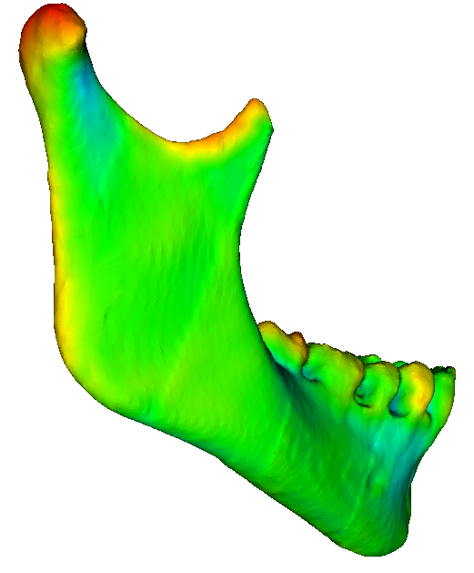
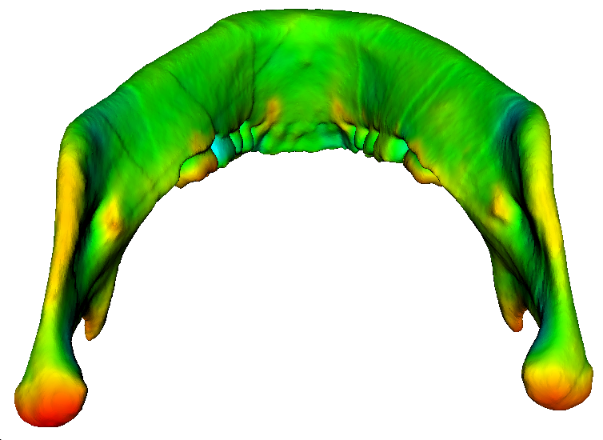
Asymmetry case
Mandibular voxel based best fit registration – Surface distances color maps showing the areas of bone apposition/resorption with growth
- 6mm
4
0
4
6mm

Slide 14
Mandibular voxel based best fit registration – Surface distances color maps detection of with 1mm bone resorptive/apposition changes with growth
- 6mm
1
0
1
6mm

Slide 15
Currently color-code tables in Slicer are been further developed as part of the NAMIC project week.

Slide 16
Where are we going?

Slide 17
As we work on Software development
DISSEMINATION EFFORTS are essential

Slide 18
DISSEMINATION EFFORTS
. Hands on workshops
. Online video tutorials

Slide 19
Online video tutorials
will include simple clinician friendly videos following examples of

Slide 20
ITK-SNAP – Youtube training
Yushkevich- UPenn and Gerig- UofUtah

Slide 21
STOP here if you want next slides are clinical examples of applications of our work ☺
THANK YOU!

Slide 22
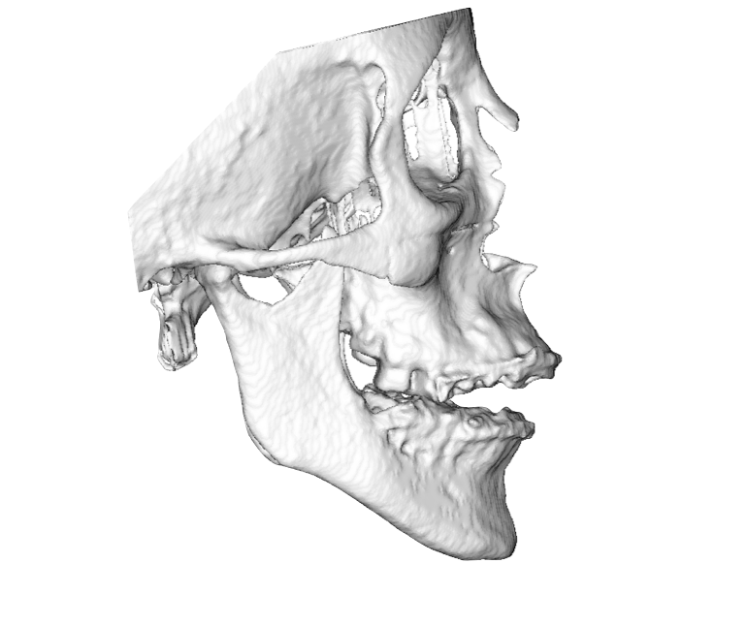
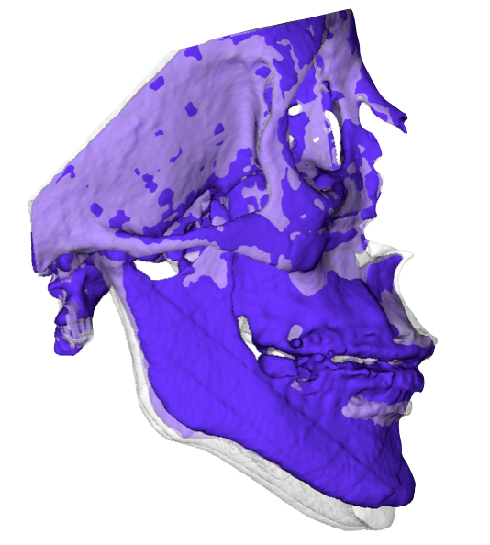
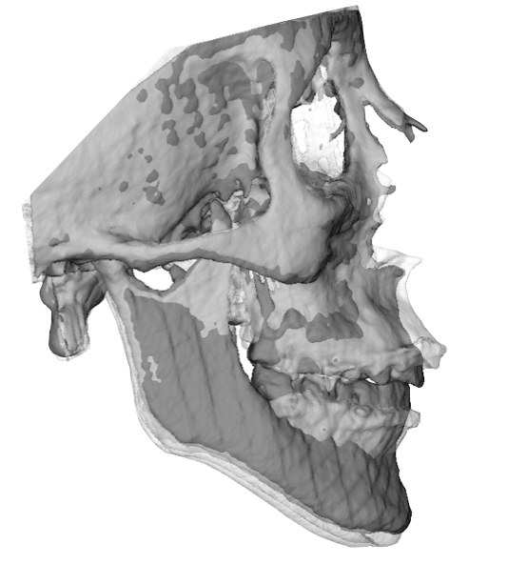
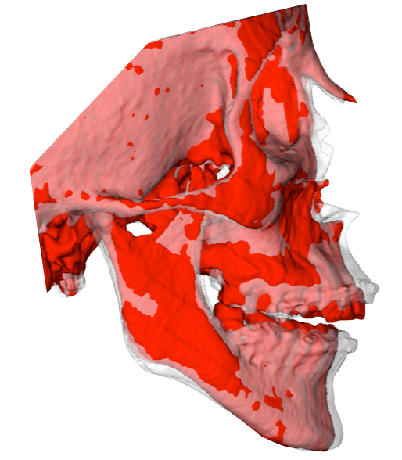
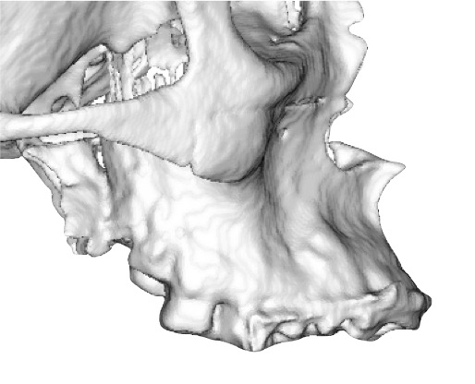
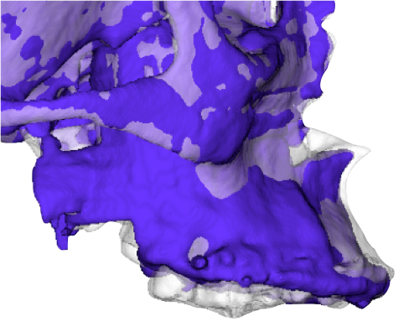
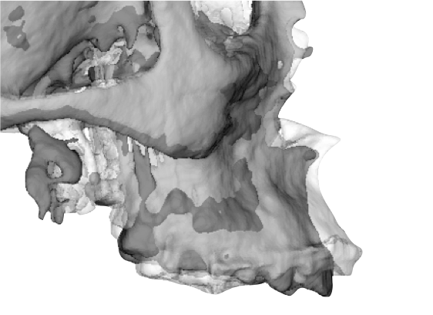
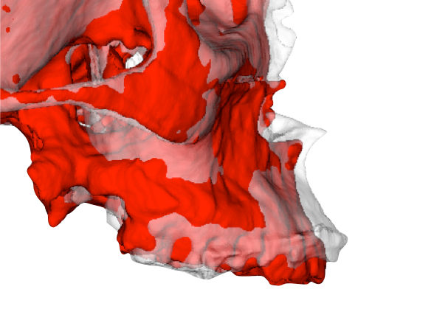
Cranial Base Registration
Pre-
surgery
Splint
removal
1 year post-
surgery - end of orthodontics
6 years post-
surgery

Slide 23
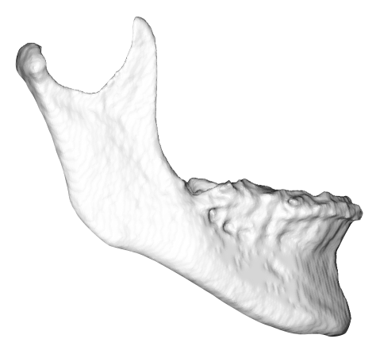
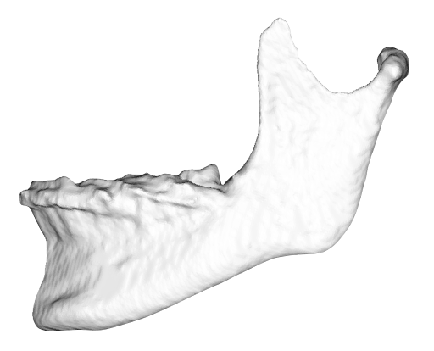
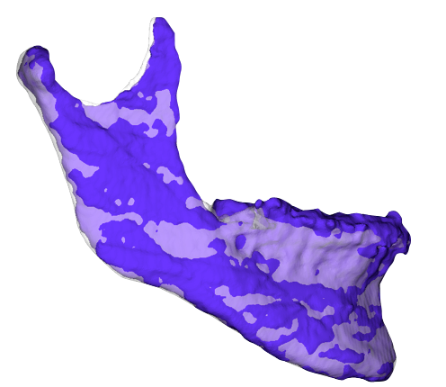
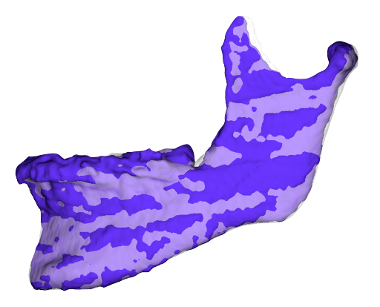
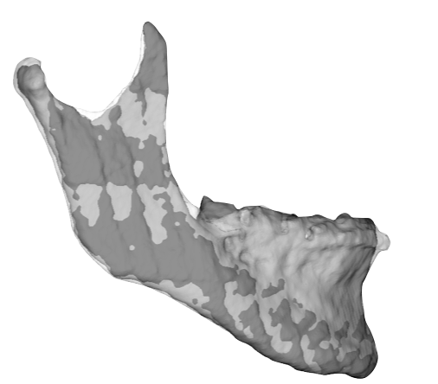
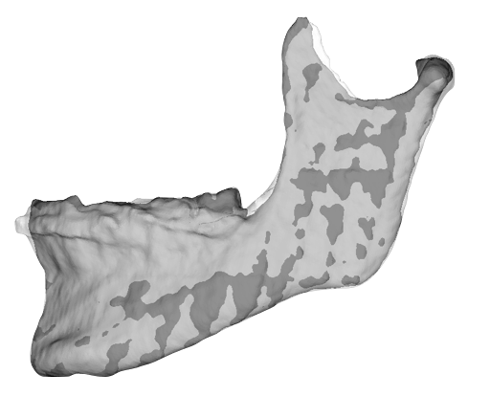
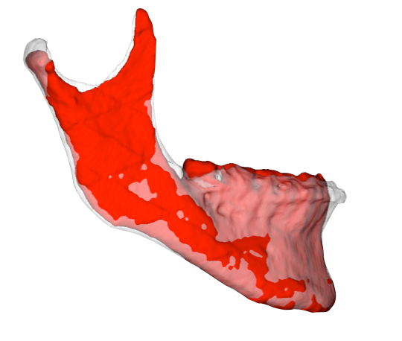
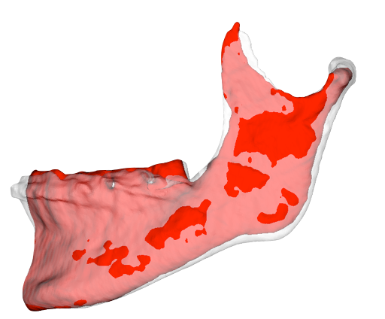
Regional Mandibular Registration
Pre-surgery
Splint removal
1 year post-surgery-
end of orthodontics
6 years post-surgery

Slide 24
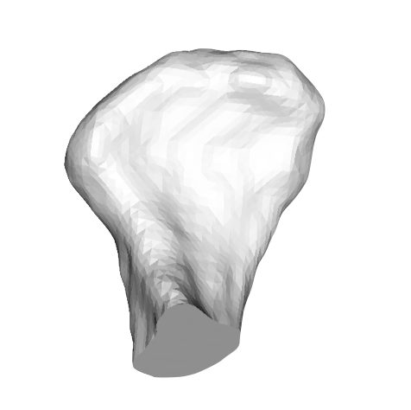
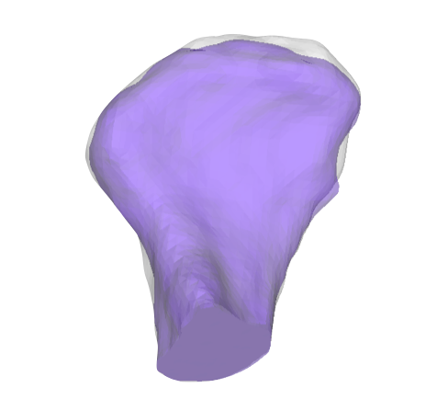
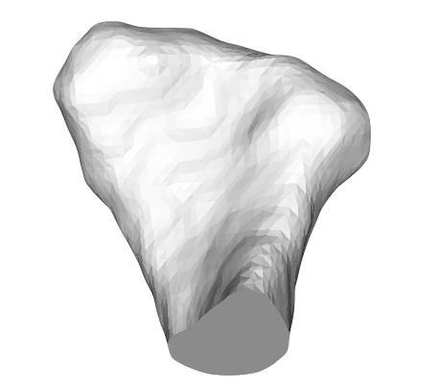
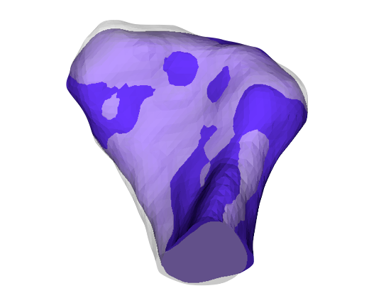
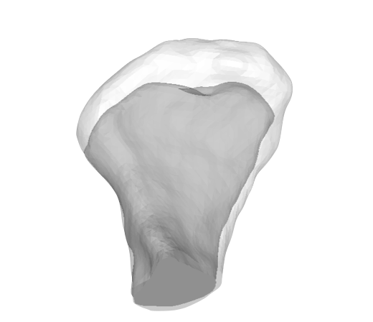
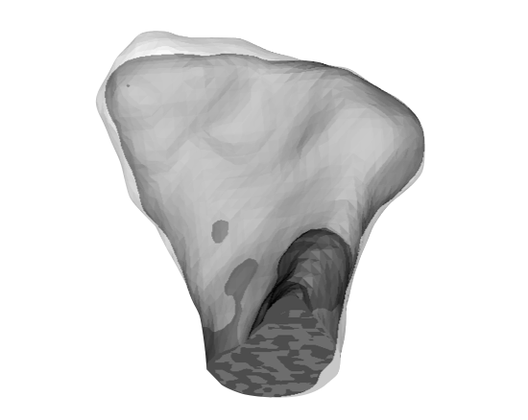
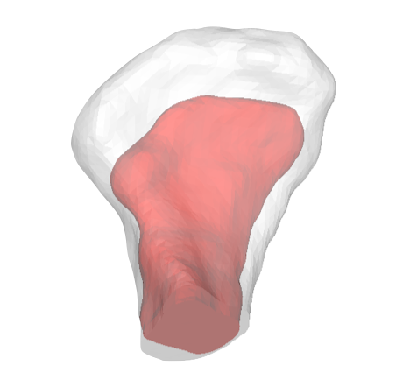
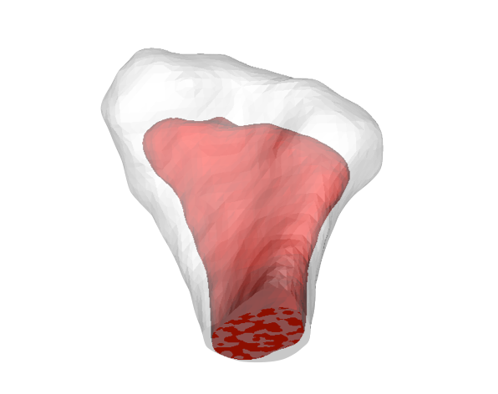
Regional Condylar Registration
T1
T2
R
L
R
L
T3
T4
R
L
R
L

Slide 25
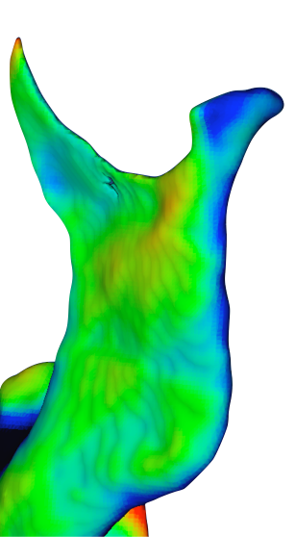
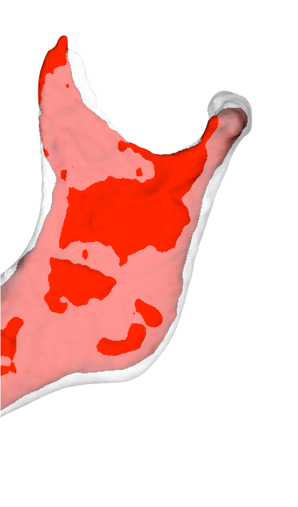
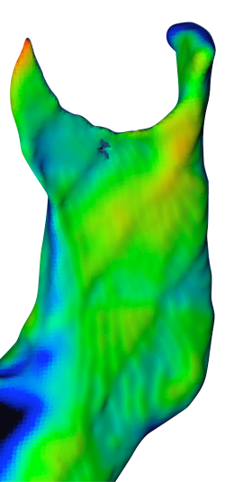
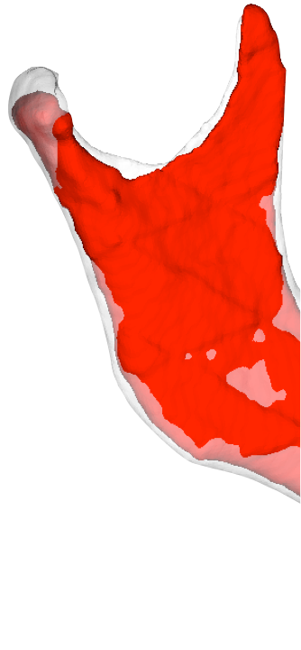
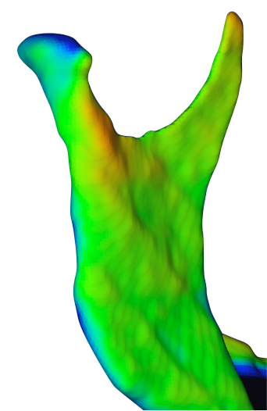
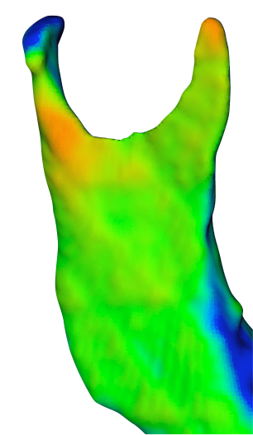
Closest point surface differences :
pre surgery to 6 years after surgery
-5
0
5

Slide 26
Preliminary project week work with Fisbaugh, Gerig, Boen, Cevidanes

Slide 27
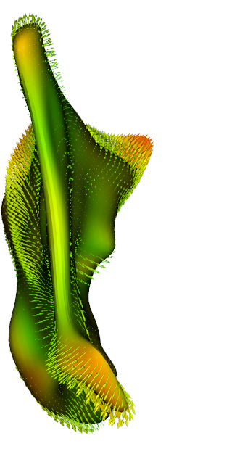
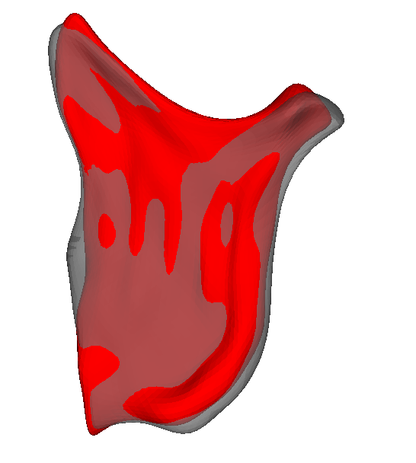
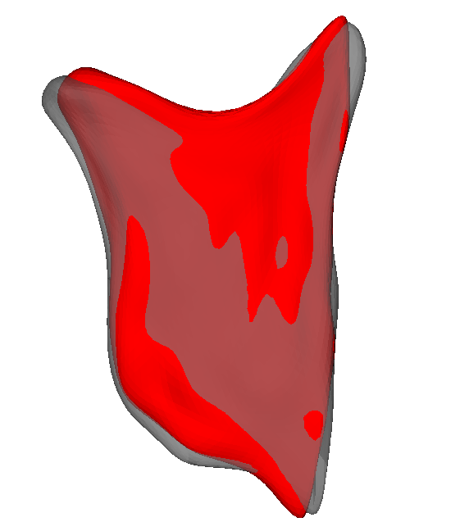
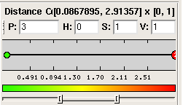
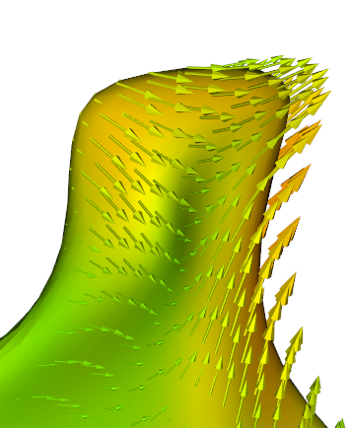
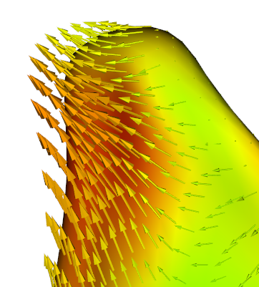
4/2001
7/2004
8/2005
11/2007
2005
2004
Notes:
DEGENATRIVE JOINT DISEASE

Slide 28
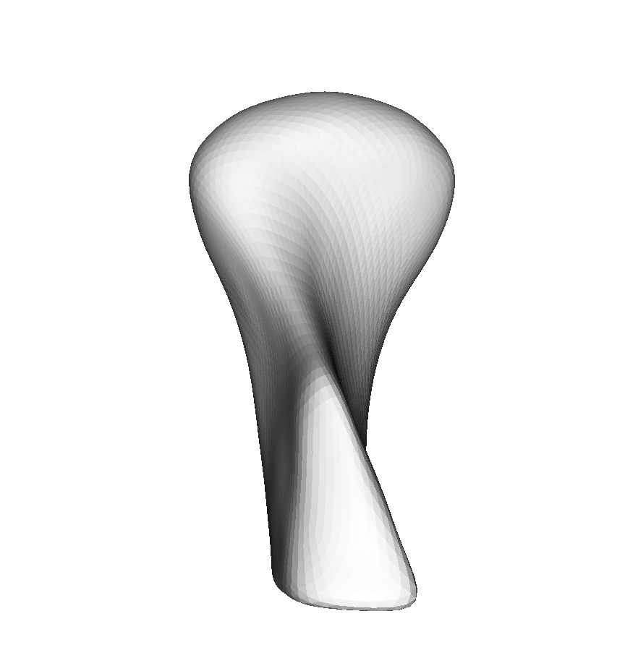
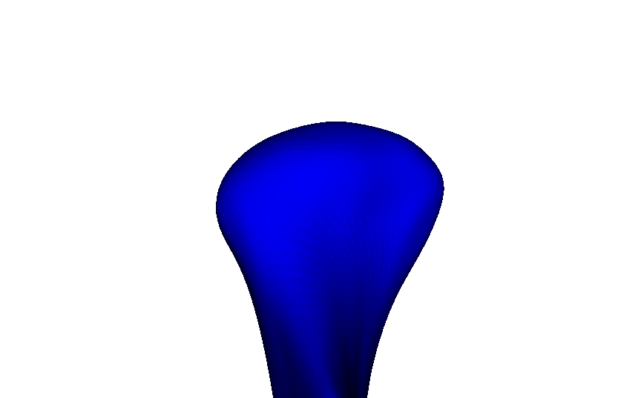
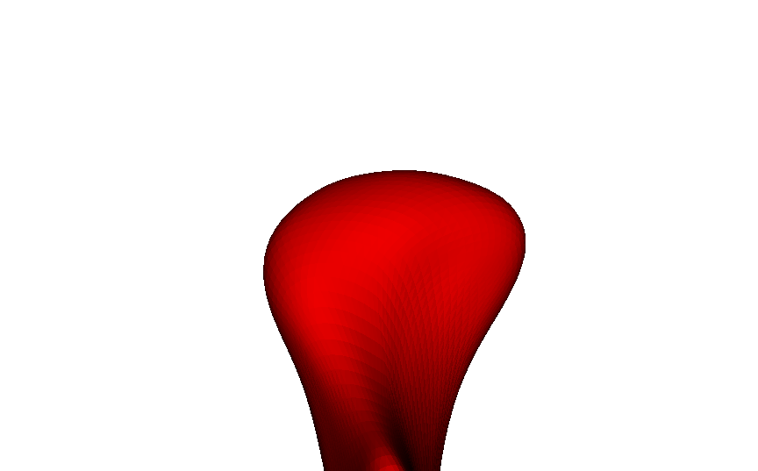
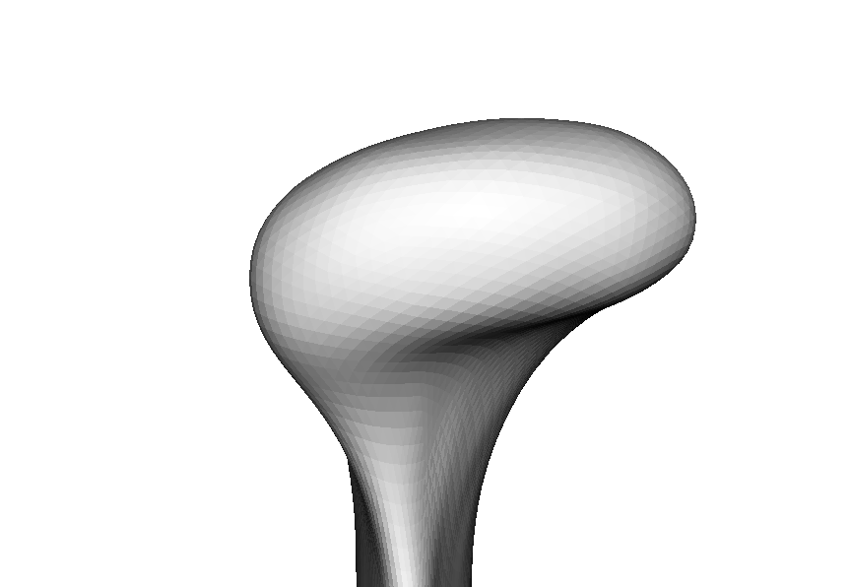
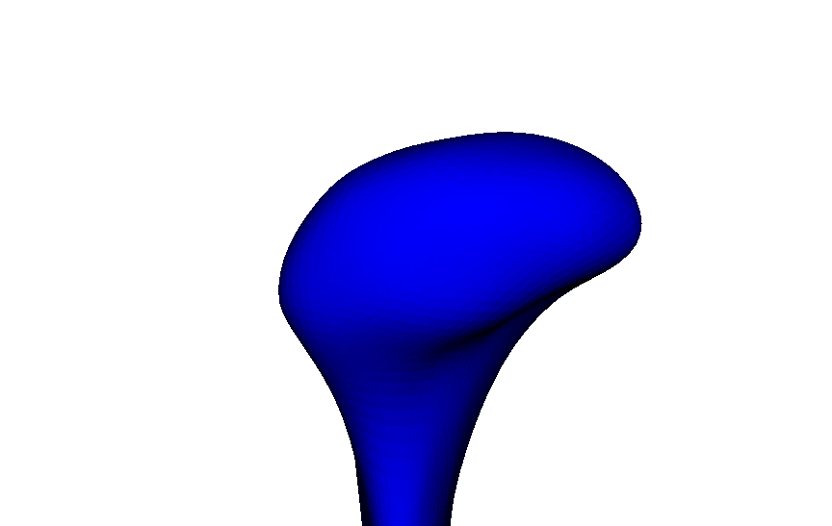
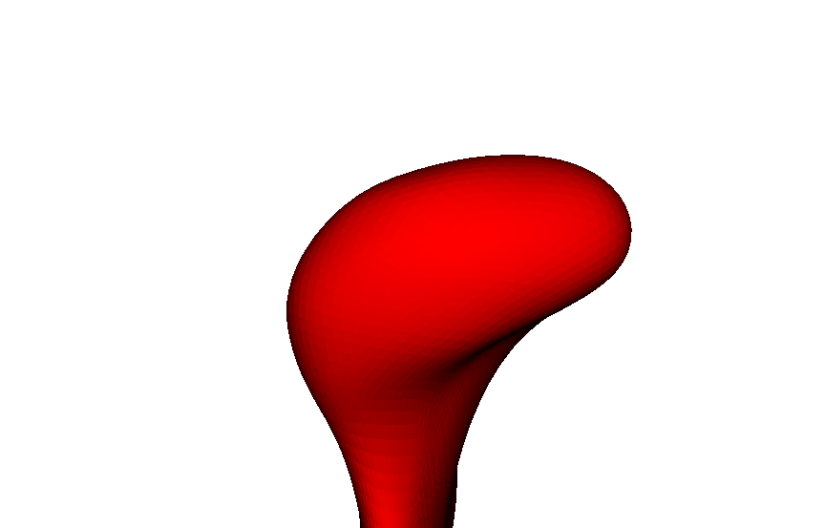
Condylar Morphology in
Temporomandibular Joint Osteoarthritis (OA)
Initial diagnosis of OA average of 24 condyles
Long term history
of OA average of 56 condyles
Control: average of 22 condyles

Slide 29
Surface distances between average models (mm)
Control
–
Initial diagnosis of TMJ OA
Control
–
Long term history of TMJ OA
-2.3
0
1.7
-3.4
0
2.7

Slide 30
Mancova group comparisons:
hotelling t-tests corrected for false discovery rate
Control vs
Long term
Control vs
Initial diagnosis
Initial diagnosis vs
Long term
0
0.05
1
Significance level p < 0.05

Slide 31
Biological markers
of health and disease

