Slide 1
MIT Algorithms
Polina Golland
MIT Computer Science and Artificial Intelligence Laboratory

Slide 2
Project overview
Non-parametric segmentation
  Exemplar-based priors, label fusion segmentation
  Radiotherapy planning, atrial fibrillation
Brain connectivity modeling
  Joint models of anatomical and functional connectivity
  Huntington’s disease
Models of pathology evolution
  Segmentation and time series modeling
  Traumatic brain injury

Slide 3
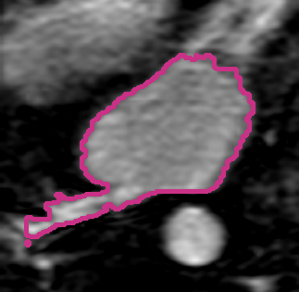
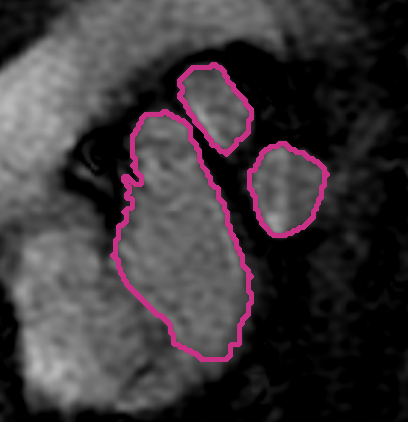
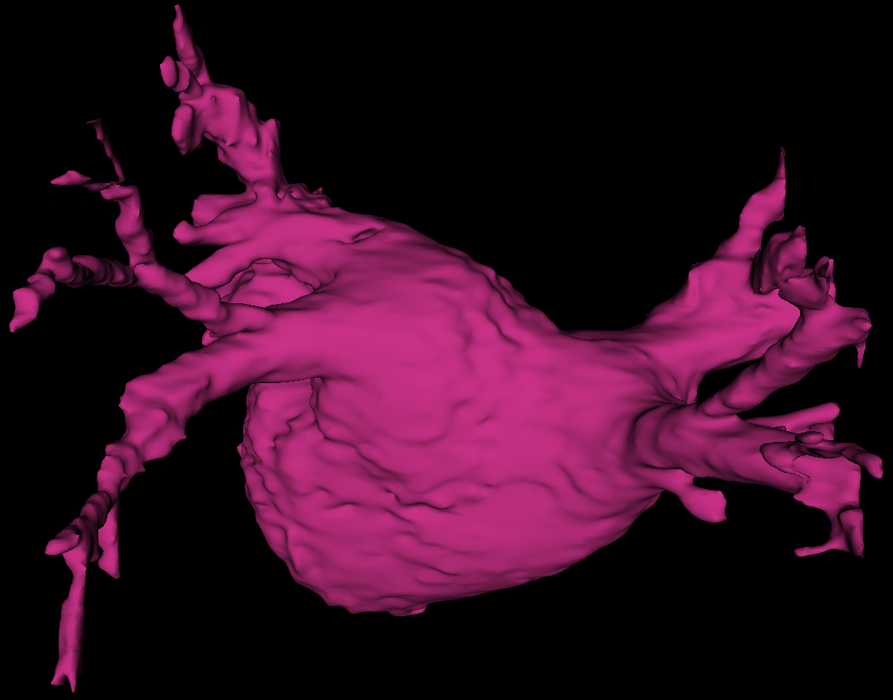
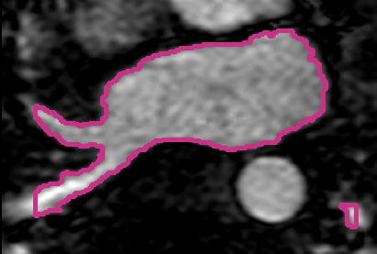
Non-Parametric Segmentation
Generative model for label fusion
  Segmentation algorithms
Applications: brain, left atrium of the heart
Volume Overlap
Sabuncu ‘09, ‘10; Depa ‘10

Slide 4
Efficient Label Fusion
Pre-align all training images
Use one registration to align new image
Perform label fusion
Depa ‘11

Slide 5
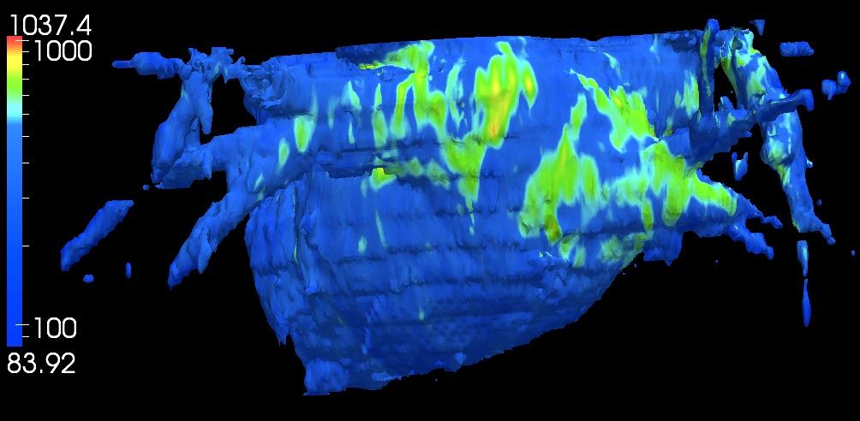
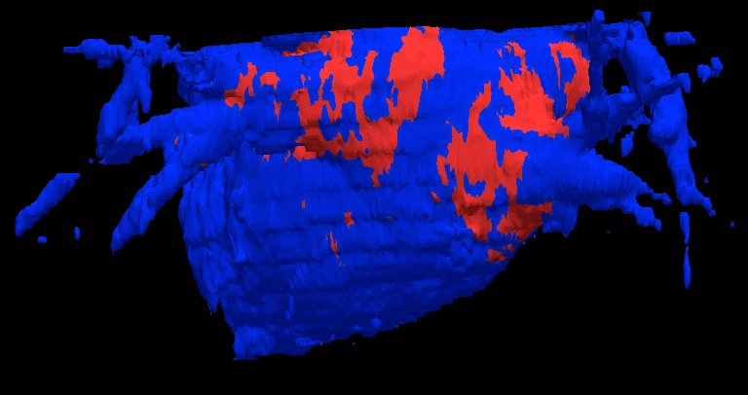
Scar Localization
Segment left atrium in the blood pool images
Register with DCE images
Use endocardium outline as a spatial prior for scar
Map onto the surface and threshold

Slide 6
Going Forward
Common coordinate frame
  Registration uncertainty
  Towards full generative model
Application to radiotherapy planning
  Main challenge: accurate registration
    Sliding deformations– Utah 1, UNC
    Allowing variable smoothness – BU
    Joint registration of images and surfaces – Utah 2
  Registration in the presence of pathology and artifacts
    Selecting close matches – Utah 1
  Alternative – interactive segmentation, BU

Slide 7
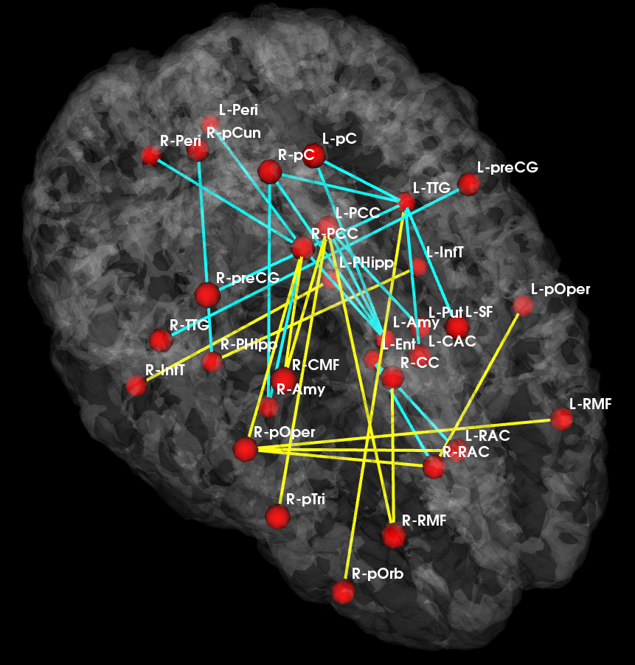
Brain Connectivity Modeling
Joint model for anatomical and functional connectivity
  Latent group connectivity template
  Signal likelihood shared across subjects
Application to population studies
  Changes in the connectivity template
Reduced
Increased
_{Control Template}
_{Disease Template}
Venkataraman ‘10, ‘12

Slide 8
Current and Future Directions
A model of disease foci
  Region-based model of connectivity changes
  From connection-based to region-based
Going forward
  Application to a broad range of diseases, including HD
    Tractography analysis - UNC

Slide 9
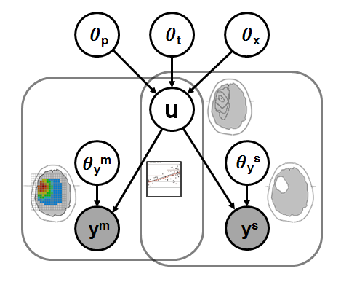




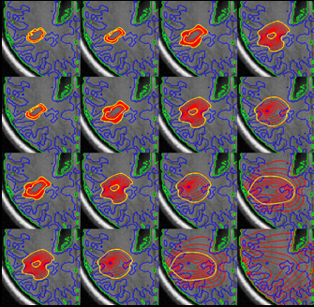
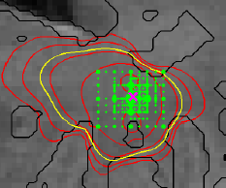
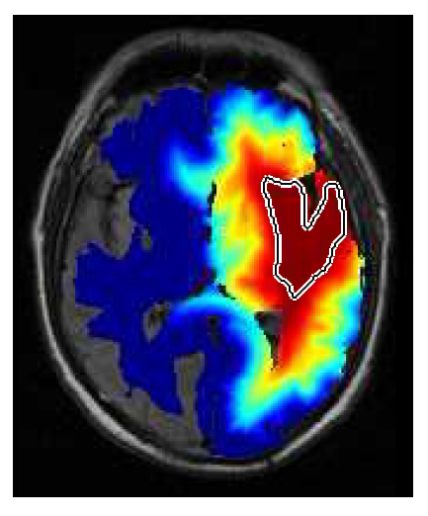
Evolution of Pathology
Physical model of evolution
  Diffusion, proliferation
Statistical model of imaging
  Segmentations and spectroscopy
    TBI – Utah 2
Output: model parameters and prediction
Menze ‘10, ‘11

Slide 10
Conclusions
Methodological developments
  Exemplar-based segmentation
  Connectivity analysis
  Segmentation and evolution of pathology
DBP challenges
  Registration in the presence of pathology
  Connection between physiological and neurobiological models and image analysis
Going forward
  Joint work with the DBPs

