Slide 1
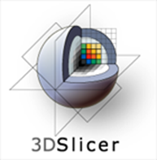
Core 1b: Engineering Extension Framework
Stephen Aylward
Kitware

Slide 2
Themes from 2012
Data
DICOM
Integration with clinical environments
Components
User experience capabilities
Extension framework
Dynamic Coding Environment
Coding primitives
Python

Slide 3
Topics
Goals
Status
Future Plans

Slide 4
Goals
Developer Goals
Have impact
Build collaborations
User Goals
Solve their problem
Use methods they see demonstrated
Direct the method customization
Process
Release early
Distribute widely
Send and receive feedback
Update frequently
Foster collaboration and derivations

Slide 5
Slicer Extension Catalog
Follows the “App Store” paradigm
Extensions built nightly dashboards or contributed by users
Manage revisions and dependencies
Multiple CLI, Loadable, Python modules per extension

Slide 6
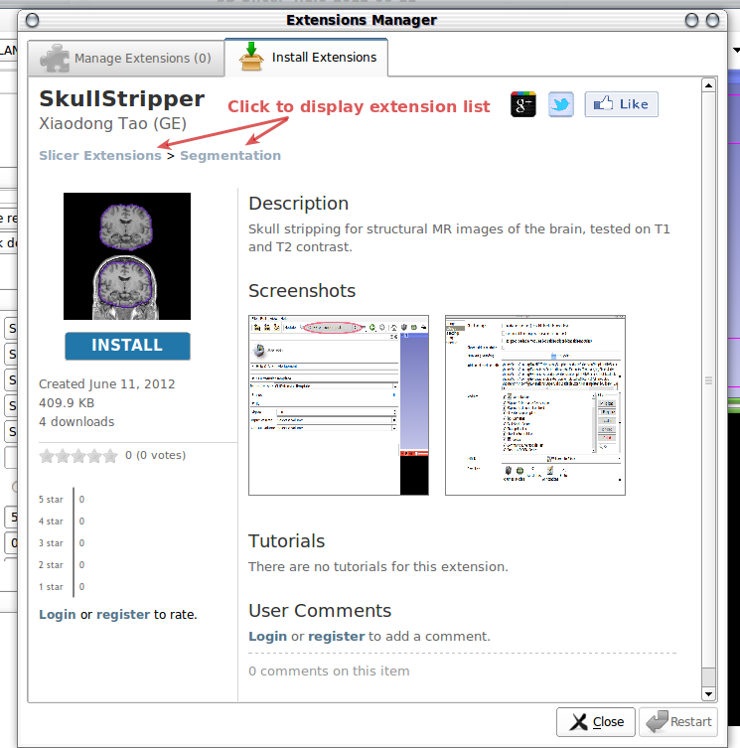
Interacting with extensions
Components
Title
Author, Institution
Creation date
Icon
Description
Screenshots
Links to tutorials
Creation date
Other user’s comments and ratings
Your comments and ratings
Install / uninstall button

Slide 7
Anatomy of an extension
Three levels of compliance
Category 1: Fully compliant: Slicer license, open source, maintained.
Category 2: Open source, contact exists.
Category 3: All other extensions (work in progress, beta, closed source etc).
Developer components (for CLI modules in an extension)
Top-level CMakeLists.txt file
Extension title, author, logo, screenshots, …
SlicerExecutionModel toolkit handles
Command-line definition, parsing, and conversion to shared library
CMake macros define build targets for build, package, and upload
ExtensionDescriptionFile
Uploaded to Slicer Extension Server defines git repo of source, revision…

Slide 8
Goals and Future work
Extensions for algorithms and collaboration
Release early
Distribute widely
Send and receive feedback
Update frequently
Foster collaboration and derivations
Developer Goals
Have impact
Build collaborations
User Goals
Solve their problem
Use methods they see demonstrated
Direct method customization
Future = Refinement for Users and Developers

