Slide 1
Algorithms MIT
PI: Polina Golland

Slide 2
Outline
Highlights
EM segmentation
Brain connectivity
This year’s developments
Segmentation
Interactive tools for population analysis

Slide 3
EM Segmentation
Kilian Pohl (MIT/BWH), Lilla Zollei (MIT), Brad Davis (Kitware), Sylvain Bouix (BWH), Mareck Kubici (BWH), Martha Shenton (BWH), Sandy Wells (BWH), Polina Golland (MIT)

Slide 4
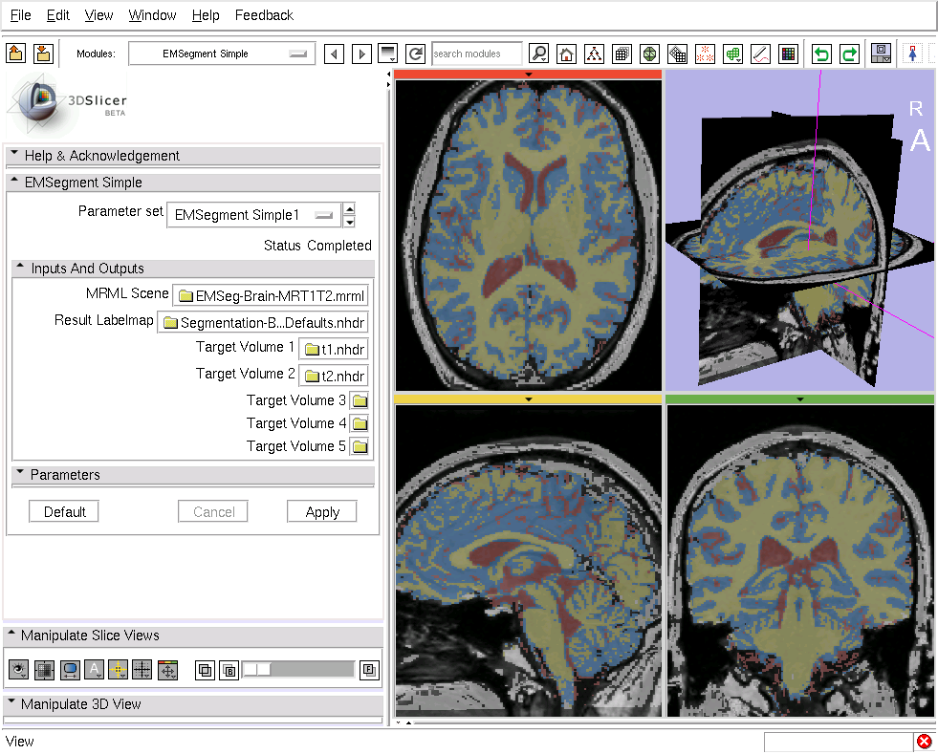
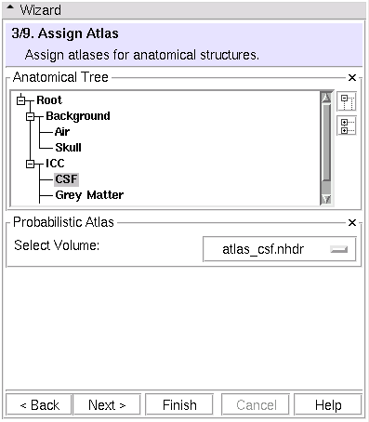
Slicer 3 Module
Structure hierarchy
Registration
Atlas-to-subject
Multimodal

Slide 5
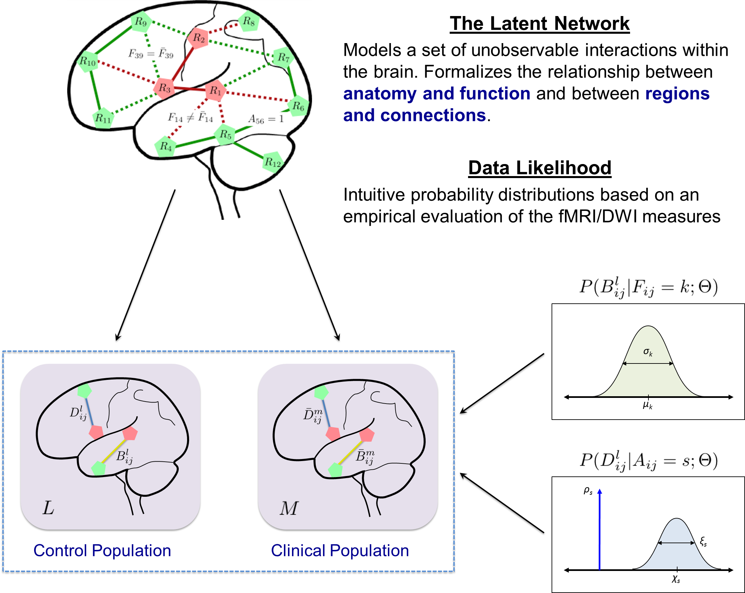
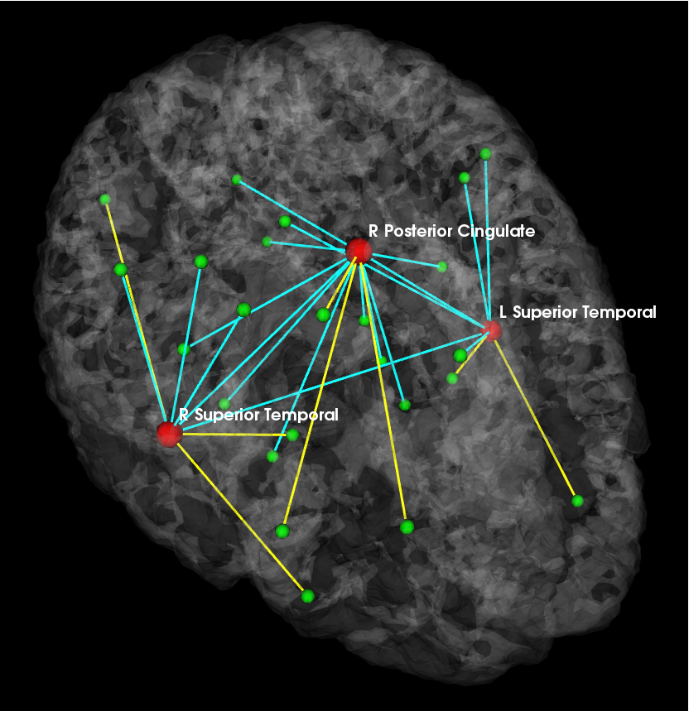
Brain Connectivity Modeling
Theoretical framework:
Joint inference across all connections
From connectivity measures to implicated regions
Aggregate connectivity changes due to disease into information about regions
P
L
R
A

Slide 6
Publications
A. Venkataraman, M. Kubicki, and P. Golland: From Connectivity Models to Region Labels: Identifying Foci of a Neurological Disorder. IEEE TMI 32(11): 2078-2098, 2013.
A. Sweet, A. Venkataraman, S.M. Stufflebeam, H. Liu, N. Tanaka, J.R. Madsen, and P. Golland: Detecting Epileptic Regions Based on Global Brain Connectivity Patterns. MICCAI (1) 2013: 98-105.
A. Venkataraman, T.J. Whitford, C-F. Westin, P. Golland and M. Kubicki. Whole Brain Resting State Functional Connectivity Abnormalities in Schizophrenia. Schizophrenia Research, 139(1-3):7-12, 2012.
A. Venkataraman, Y. Rathi, M. Kubicki, C.-F. Westin, and P. Golland. Joint Modeling of Anatomical and Functional Connectivity for Population Studies. IEEE TMI, 31(2):164-182, 2012.
A. Venkataraman, M. Kubicki and P. Golland. From Brain Connectivity Models to Identifying Foci of a Neurological Disorder. MICCAI, LNCS 7510:715-722, 2012.
A. Venkataraman, Y. Rathi, M. Kubicki, C-F. Westin and P. Golland. Joint Generative Model for fMRI/DWI and its Application to Population Studies. MICCAI, LNCS 6361:191-199, 2010.
A. Venkataraman, M. Kubicki, C.-F. Westin, and P. Golland. Robust Feature Selection in Resting-State fMRI Connectivity Based on Population Studies. MMBIA: IEEE Computer Society Workshop on Mathematical Methods in Biomedical Image Analysis, 2010.

Slide 7
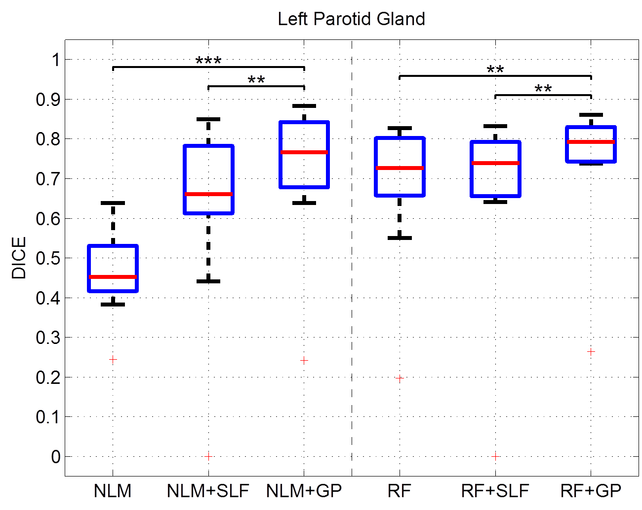
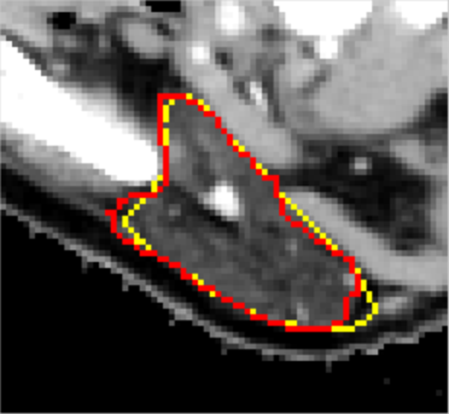
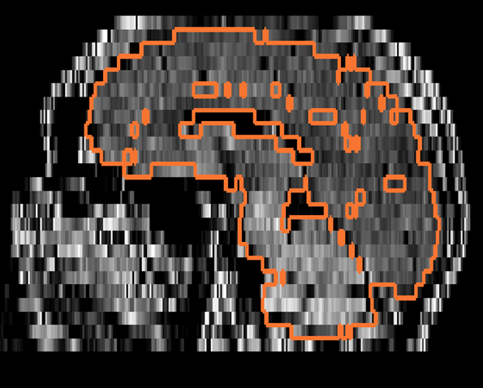
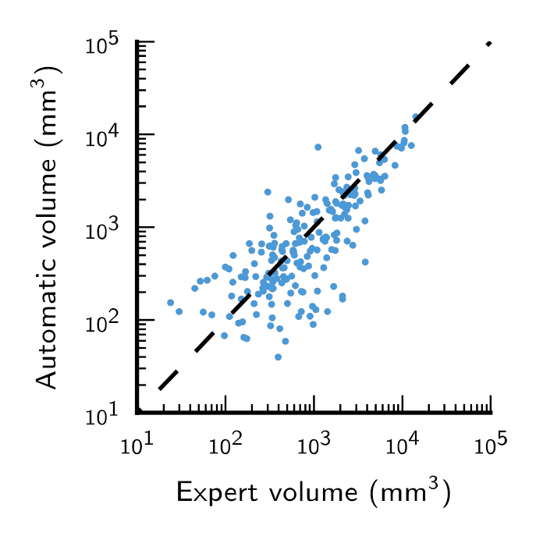
Segmentation
Improving atlas-based segmentation based on local intensity information
Improved segmentation of parotid glands in head-and-neck tumors
Segmentation of clinical multimodal stroke MRI scans
1,000 patients from the NINDS Stroke Study
Highly anisotropic voxels, clinical scans

Slide 8
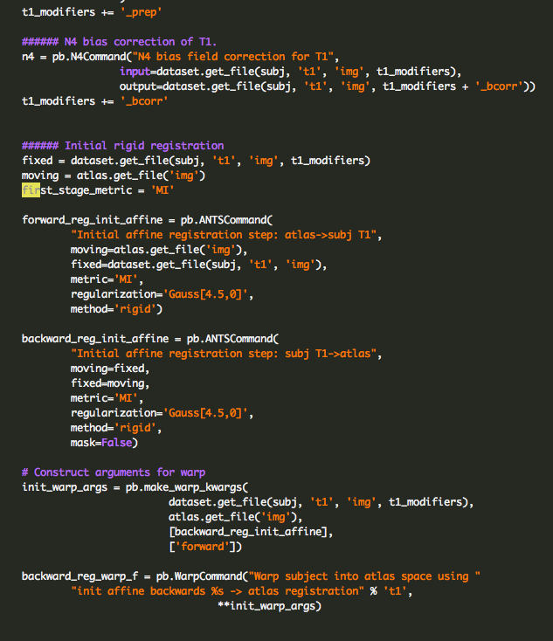
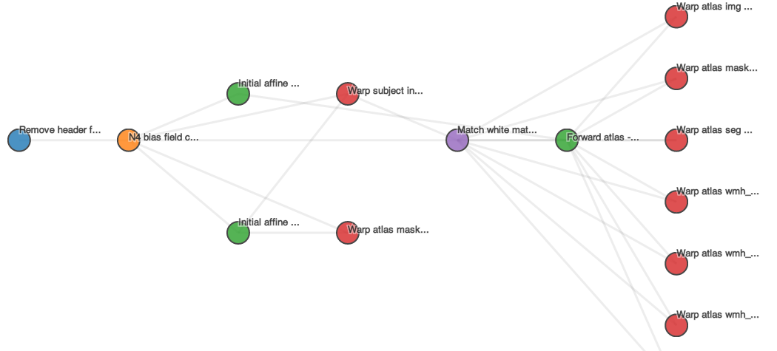
Code Visualization

Slide 9
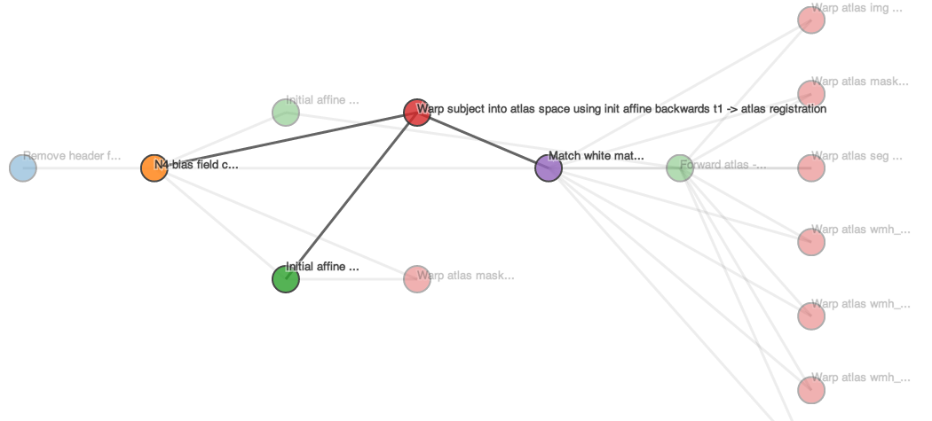
Code Visualization

Slide 10
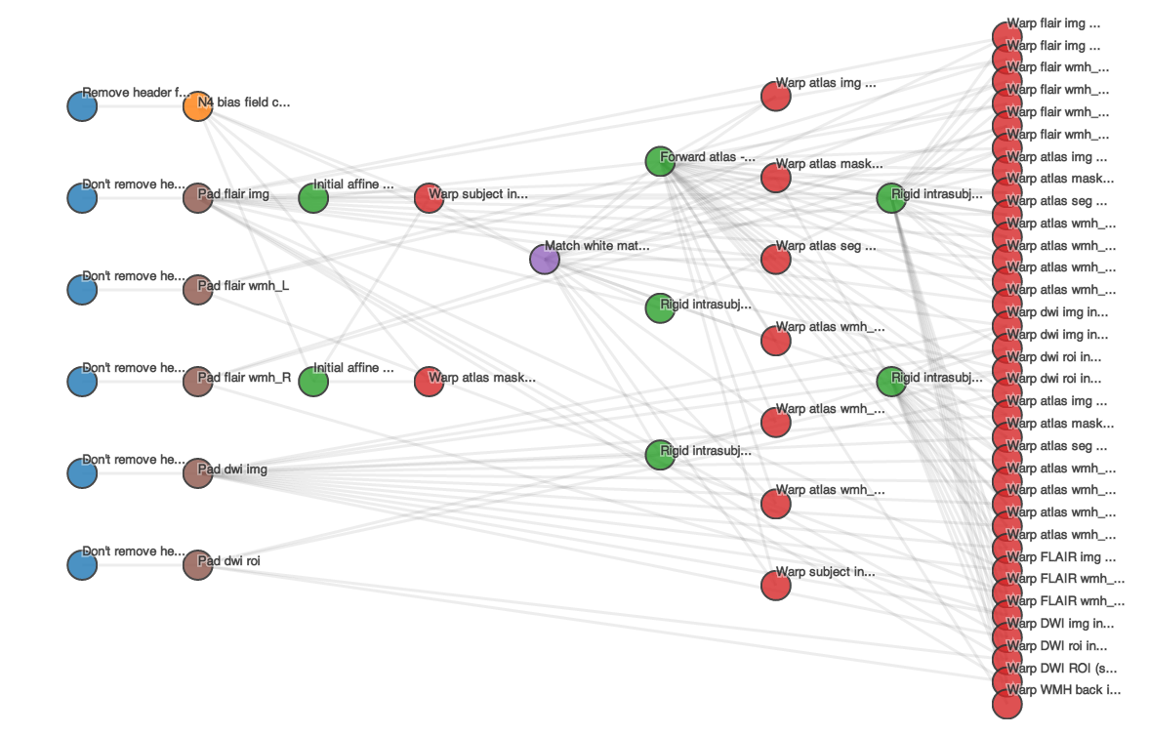
Code visualization

Slide 11
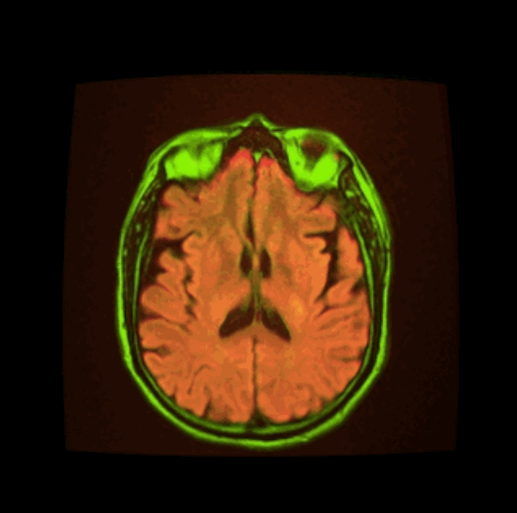
Results visualization – tipiX

Slide 12
Conclusions
From algorithms to prototypes to tools
Anatomical segmentation
Research quality scans
Clinical scans
Pathology
Module in Slicer
Functional image analysis
Analysis of connectivity
Collaborative projects with the DBPs
Interactive tools
Integrating users into the analysis pipeline

