Slide 1
UNC Methods Overview
Martin Styner, Aditya Gupta, Mahshid Farzinfar, Yundi Shi, Beatriz Paniagua, Ravi

Slide 2
Overview
DTI/DWI
  DTI Quality control via orientation entropy
  Registration with pathology
  DWI atlas (two tensor tractography)
  Fiber tract analysis framework
Validation
  DTI tractography challenge MICCAI 2010
  Synthetic human-like DTI/DWI phantom
Shape
  Normal consistency in surface correspondence
  Interactive surface correspondence
  Longitudinal analysis
Longitudinal atlas building with intensity changes
TBI
HD

Slide 3
Normal consistency in entropy-based particle systems
Martin Styner, Beatriz Paniagua, Steve Pizer, Sungkyu Jung, Ross Whitaker, Manasi Datar, Josh Cates

Slide 4
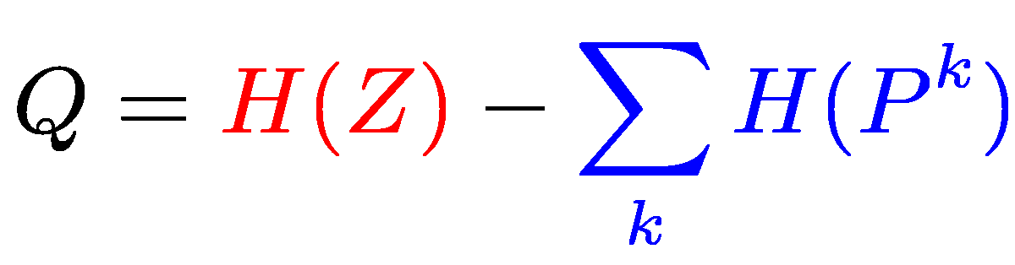
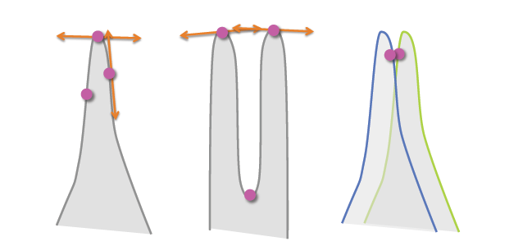
Entropy-based particle correspondence
Cates et al. 2007
  Balance between model simplicity via minimum entropy and geometric accuracy of the surface representations.
  Relies on Euclidean distance to control particle interactions
  Medical or biological shapes, present often challenging geometry
Ensemble entropy
(small = simple)
Surface entropy
(large = accurate)
Image: Datar et al. 2011
Notes:
k: shape id
P: particle locations
Z: ensemble distribution

Slide 5
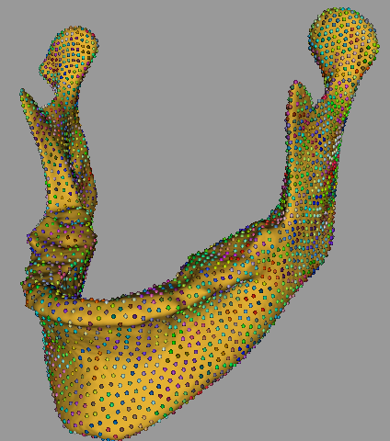

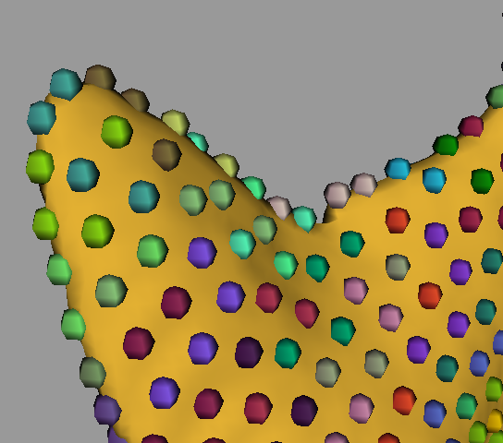
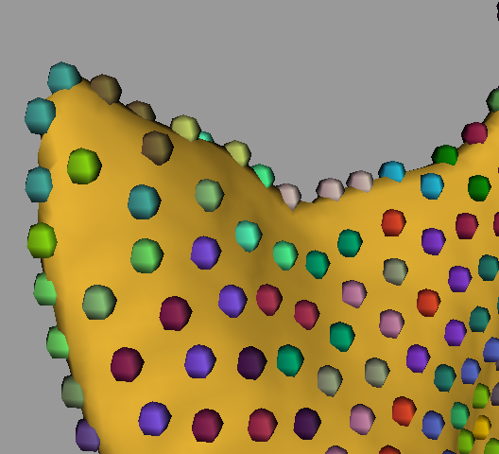
Pre-surgery model
Post-surgery model
Notes:
The problem comes when trying to optimize particle positions in Thin areas i.e. Coronoid process,
In the current implementation of the program particle positions are optimized only taking into account the euclidean interparticle distance
In such thin areas might happen that in a time step update particles switch from one side of the surface to the other, causing this flipped particles.
These are the results during the optimization process, but if with this particle configuration we intend to do registration….
Include normal directions in the optimization can help in this sense.

Slide 6
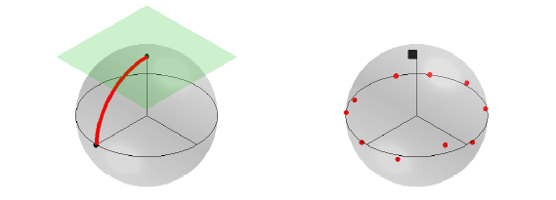
The solution v1.0
Datar et al. MICCAI 2011
  Use geodesic distances
  Also establish consistency of normals
    Add inter-object normal penalty term to optimization
    Normal penalty based on projections in tangent space
Image: Jung et al. 2011
Notes:
Fig. 1 (Left) The usual unit sphere S2 with a geodesic segment (great circle segment) joining the
north pole and a point in the equator. The tangent plane at the north pole is also depicted. (Right)
Plot of 10 points along the equator with random perturbation and the geodesic mean (black square)
near the north pole illustrates the case where the geodesic means on S2 does not represent the data
well

Slide 7
Our proposal - v2.0
Compute normal discrepancies using Principal Nested Spheres (PNS)
  Normals projected into the unit sphere
  Great circle that approximates the data
  Frechet mean in the great circle
  Residuals
Residuals are included as attribute data
No penalty, normals handled in entropy
In development

Slide 8
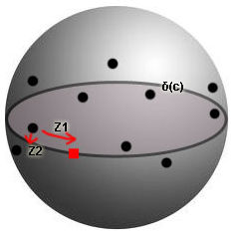
Principal Nested Spheres
K sample points, N samples, v_{nk} is the k_{th} normal for the n_{th} sample
Main idea - Evaluate entropy across different objects for the k_{th} correspondent normal
Given v_{1k}, …, v_{nk} in unit sphere S², fit a great circle δ(c) to minimize the sum of squared deviations of v_{nk} from the great circle
Find the Frechet mean on δ(c)
PCA on S²->Compute principal scores
Add Z to the covariance matrix, to be included in the entropy computation of the system.
Notes:
unit normal vectors vk1, …, vkn (they are already in the unit sphere S2)
Z isa 2KxN matrix of Zk of principal scores for K = 1..K

Slide 9
DWI/DTI QC via orientation entropy
Mahshid Farzinfar, Yinpeng Li, Martin Styner

Slide 10
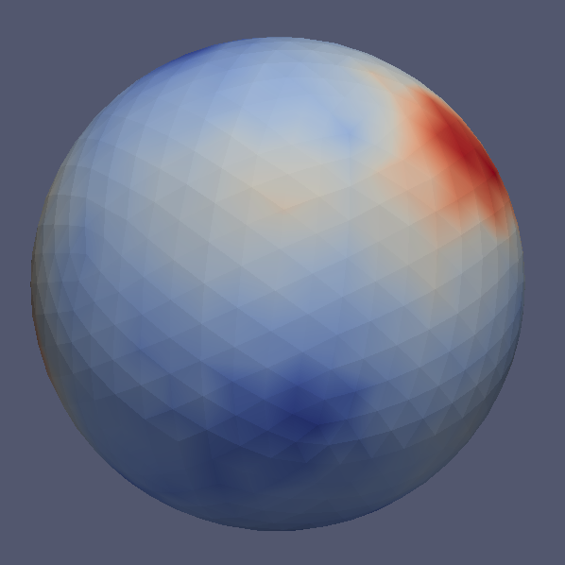
Orientation Entropy
Main idea:
  Assess entropy from spherical orientation histogram over principal directions
    Icosahedron subdivision for histogram
Objective:
  DTI QC based on principal directions
    Unusual clusters in orientation histogram
    Unusual uniform distribution.
  In DTIPrep, comprehensive DTI QC platform

Slide 11
Orientation Entropy for QC
  Detection:
    Is entropy in Brain/WM/GM within expected range?
  Correction (if not in expected range):
    Compute change in entropy when leaving out each DWI image.
    Remove DWI with largest change towards expected range.
    Continue the above process until within expected range, or not enough DWI

Slide 12
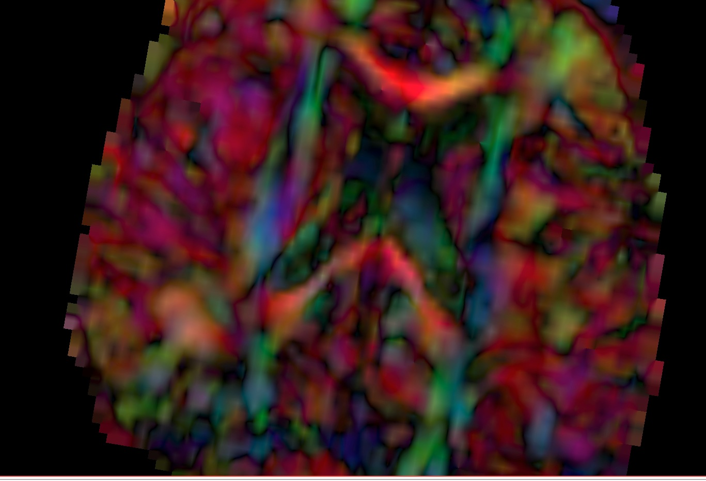
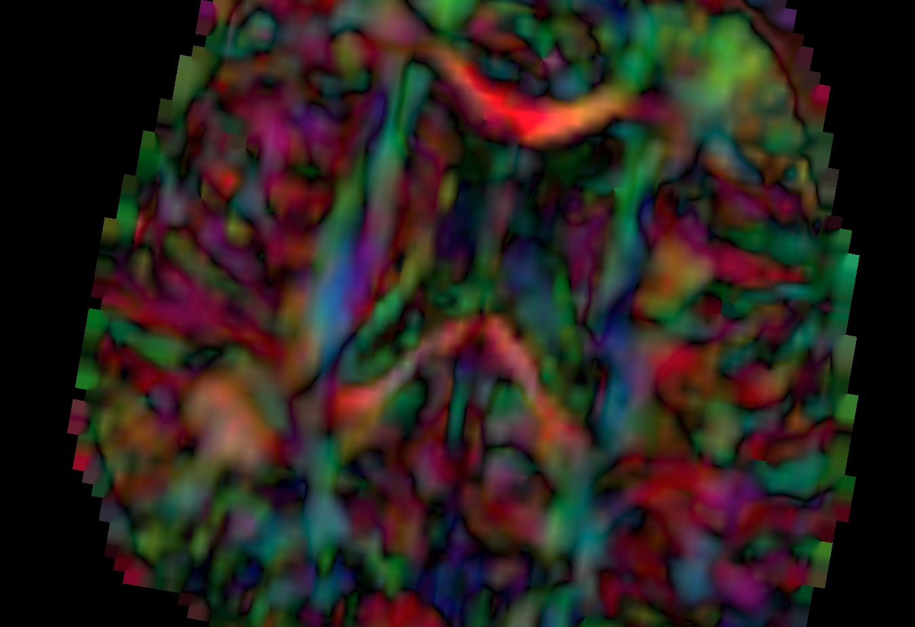
Example result
Left: before correction, large red-artifact
Right: after correction, more detail and reduced red dominance. Cingulum and fornix tracts can be identified only in corrected data.

Slide 13
Evaluation
Tested on pediatric and adult population
  Different entropy expected range
Detects efficiently “directional artifacts”
  80/20 successful correction
Detects high noise level
Detects directional artifacts in gray matter
Correction leads to higher FA in general
ISBI submission in prep

Slide 14
Atlas based fiber analysis
Splenium
Genu

Slide 15
DTI Tensor Normalization
Aditya Gupta, Martin Styner

Slide 16
Motivation
Deformable registration of DTI
DTI registration – old style
  scalar images derived from the DTI, like FA
  Metric is sum-of-squared-differences
  Normalization standard: Histogram based
DTI registration – new style
  DTI-TK, MedINRIA, FTIMER => partial/full tensor
  Metric is difference between tensors
  No normalization
  Fails/underpeforms in pathology (e.g. Krabbe, TBI etc) or large changes due to development

Slide 17
Tensor Normalization
Tensor normalization algorithm for DTI images
  For tensor based registration algorithms.
Algorithm tested
  4 x neonates and 4 x 1-2 year subjects
  Atlas based genu, splenium, internal capsules (L&R), uncinates (L&R) analysis
  DTI-TK registration

Slide 18
λ_{2_case}
λ_{2_atlas}
n_{i}
λ_{3_case}
m_{i}
m_{i}
λ_{3_atlas}
n_{i}
CDF_{case,i} plane
n_{i}
CDF_{atlas,i} plane
m_{i}
λ_{1_case}
Set of points with similar FA
λ_{1_atlas}
(λ_{1_case,i} , λ_{2_case,i} , λ_{3_case,i} )
Define CDF planes on case and target/atlas space
CDF(λ_{1i}, λ_{2i}, λ_{3i}) = prob{(0≤ λ₁≤ λ_{1i} ), (0≤ λ₂≤ λ_{2i} ), (0≤ λ₃≤ λ_{3i} )}
For each tensor i in case => find corresponding CDF plane in target
    Very similar to scalar histogram normalization, underdetermined
Find points on the CDF_{atlas,i} plane with similar FA values to tensor i.
  Set of points on ellipse on CDF plane.
Select the point with closest Euclidean distance to the tensor i.
  Map λ₁, λ₂ , λ₃ to original tensor i.
Future: Regularization of mapping

Slide 19
Results in Registration
For all the tracts, tensor normalization results in considerable increase in FA values (5 to 8%) in mapped/registered data
Local dominant tracts studied
  Higher FA => better registration.
Higher correlation with tensor normalization and manual tracts
  Average +0.3 in correlation
ISBI submission in prep
Fig. FA profiles for Genu tract: with (red) and without (blue) tensor normalization and from manual tractography (green).

Slide 20
DTI tractography phantom
Gwendoline Rogers, Martin Styner, Yundi Shi, Clement Vachet, Sylvain Gouttard

Slide 21
DTI tractography phantom
Current software phantoms are quite abstract, quite far from human brain
Goal: Create software phantom that is human brain like for evaluating tractography algorithms
Allow for simulating pathology, such as tumors, TBI, lesions
Single fiber set, does not allow for multiple fiber topologies

Slide 22
Approach Tract Phantom
Create high res atlas
  6 young adults scanned at 1.5mm³, 42 dir
  High res DWI atlas
  Full brain filtered two tensor tractography
    Millions of fibers
Co-registered structural atlas with shape space
  100 healthy (20 in each 18-29, 30-39, 40-49, 50-59, and 60+)
  Isomap vs (PCA + local mean)
Create “random-sample” phantoms in shape space
  Pathology simulation here
Apply to fiber geometry in atlas space
Create DWI with different models (bias!)
  Initial model is CHARMED only

Slide 23
DWI Atlas
Yundi Shi, Marc Niethammer, Martin Styner

Slide 24
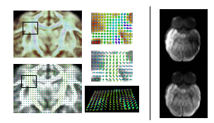
DWI Atlas
Provides more information than tensor atlas
  Resolve complex fiber settings in atlas space
Robust signal reconstruction
  Voxel-wise resampling along any prior gradient set
  Need to correct bias field
  Rician noise model
Notes:
Left is without bias-field correction with dwi atlas building and right is with bias-field correction

Slide 25
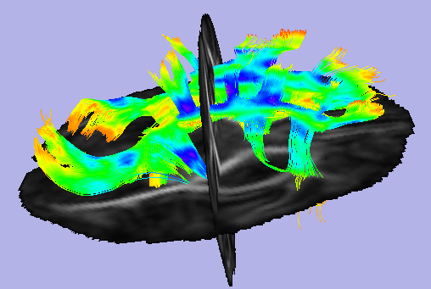
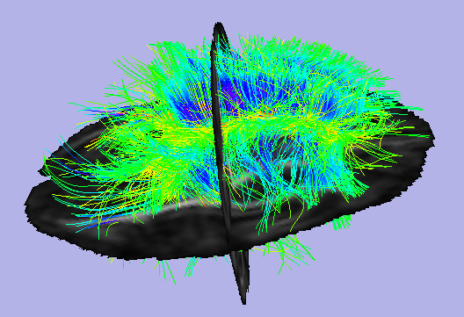
DWI Atlas v.s. DTI Atlas
Perform higher-order tractography
Connectivity (stochastic, graph-based)

Slide 26
Atlas based DTI fiber tract analysis
Guido Gerig, Jean-Baptiste Berger, Yundi Shi, Martin Styner, Anuja Sharma, Aditya Gupta

Slide 27
DTI Atlas based analysis
UNC/Utah Analysis framework
Atlas based fiber analysis
  Atlas building (AtlasWorks, DTI-TK)
  Fibertracking in Slicer
  FiberViewerLight (new) for fiber cleanup/cluster
  DTIAtlasFiberAnalyzer (new) for tract stats
  Stats by statistician (package in prep)
  MergeFiberStats (new) for stats on fibers
  Visualization in Slicer

Slide 28
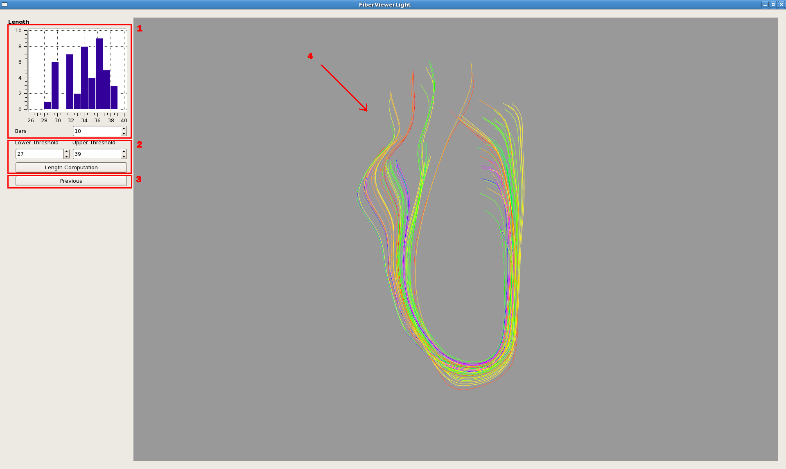
FiberViewerLight
  Light version of the FiberViewer tool, QT 4.X
  Clustering methods: Length, Gravity, Hausdorff, Mean and Normalized Cut
  Faster 3D visualization than original
  VTK file handling
  Slicer external module
    Separate Qt4 GUI

Slide 29
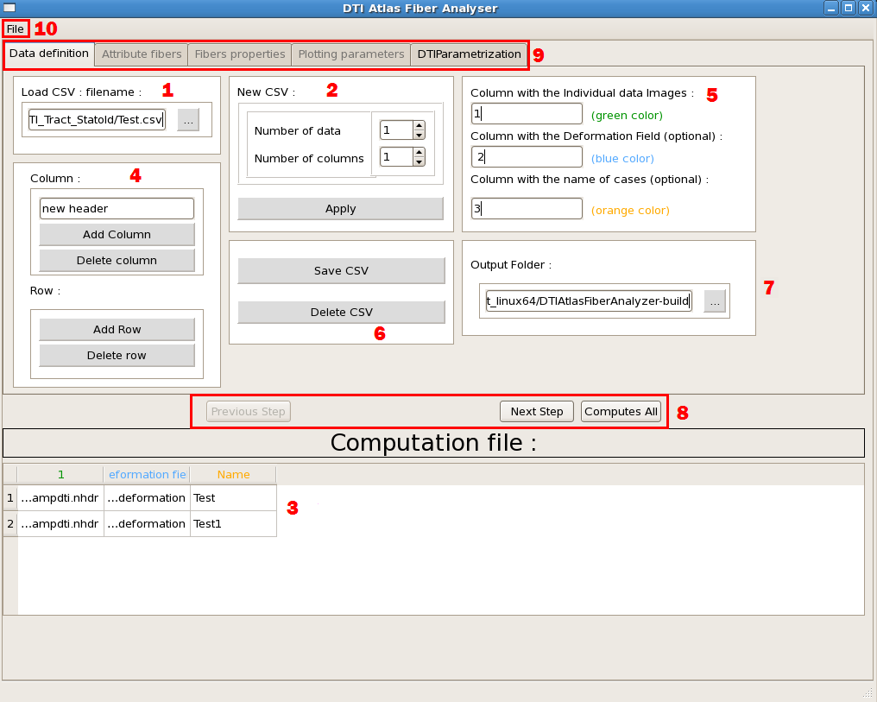
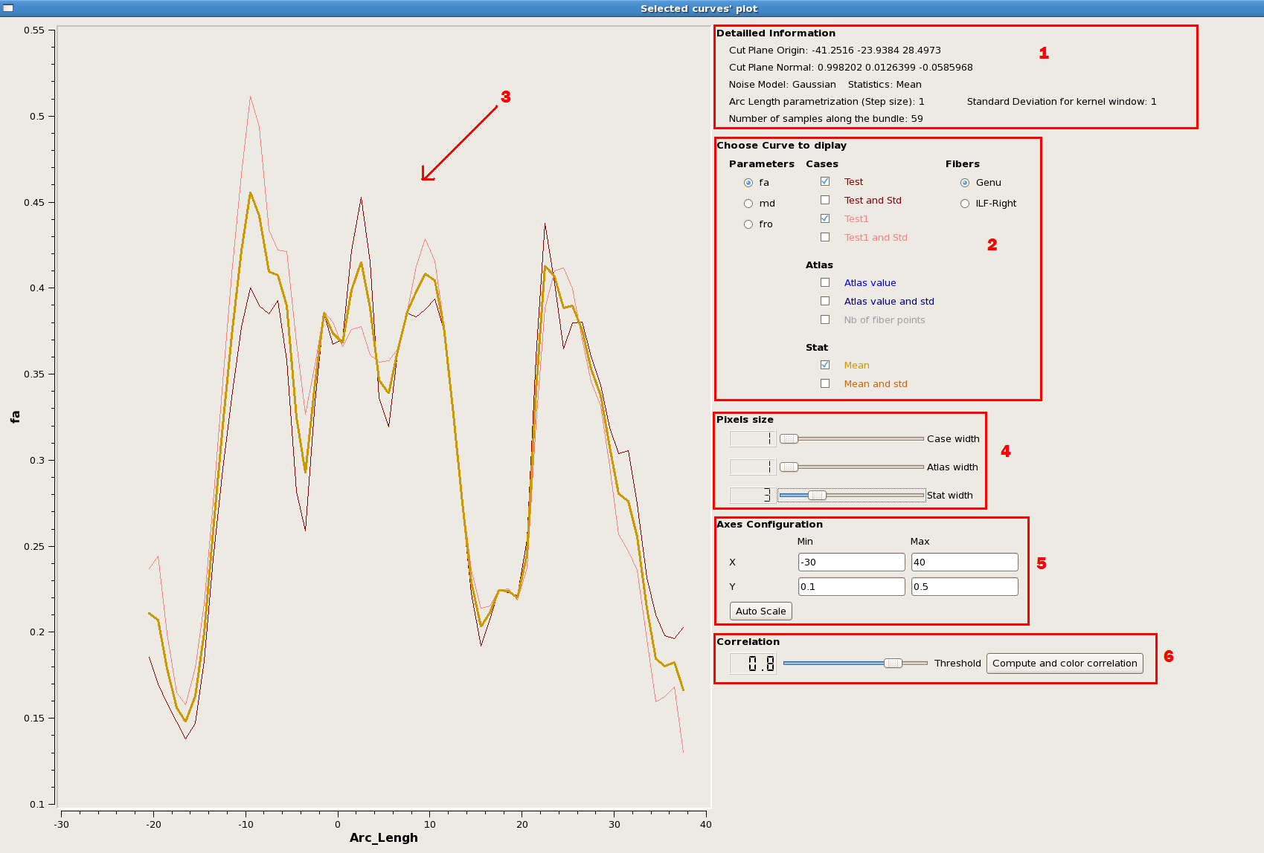
DTIAtlasFiberAnalyzer
  Applies atlas fiber to datasets, extracts fiber profiles and gathers all information
  Full population
    CSV description
  Data plotting
  Slicer external module

