Slide 1
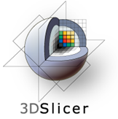
Predicting The Future
Ron Kikinis, M.D.
Robert Greenes Distinguished Director of Biomedical Informatics Professor of Radiology, Harvard Medical School
Founding Director, Surgical Planning Laboratory, Brigham and Women’s Hospital
Principal Investigator, National Alliance for Medical Image Computing (a National Center for Biomedical Computing), and Neuroimage Analysis Center (a NIBIB National Resource Center)
Research Director, National Center for Image Guided Therapy

Slide 2
Predicting the Future
There is no reason for any individual to have a computer in his home.
Ken Olson, president, chairman and founder of Digital Equipment Corporation (DEC), in a talk given to a 1977 World Future Society meeting in Boston. This is widely quoted but Olsen claims it is taken out of context, that he was not referring to personal computers but to a household computer that would control the home. Reference: "Ken Olsen", Snopes, includes bibliography.
http://en.wikiquote.org/wiki/Incorrect_predictions
Predicting the future is not easy

Slide 3
MIC Research
~1990
Medical Image Computing
Segmentation
Registration
Time series analysis
Modeling of physiology
Interaction and Integration
Software packages
Devices: trackers, robots
~2010
Medical Image Computing
Segmentation
Registration
Time series analysis
Modeling of physiology
Interaction and Integration
Software packages
Devices: trackers, robots

Slide 4
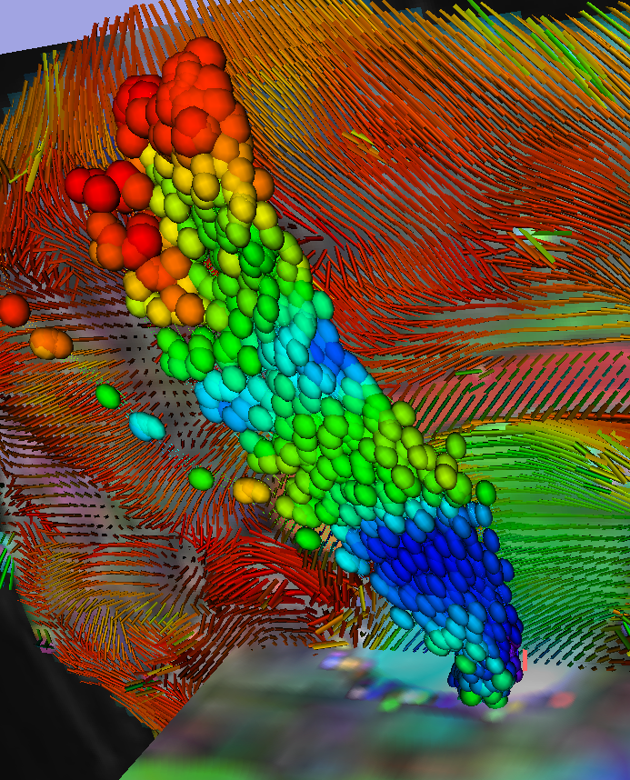
What Is My Science?
Research concepts “flow” from one field to the other
Applied math to computer vision to biomedical
The basic science of one field is the applied science in a different field
Image provided by Kikinis

Slide 5
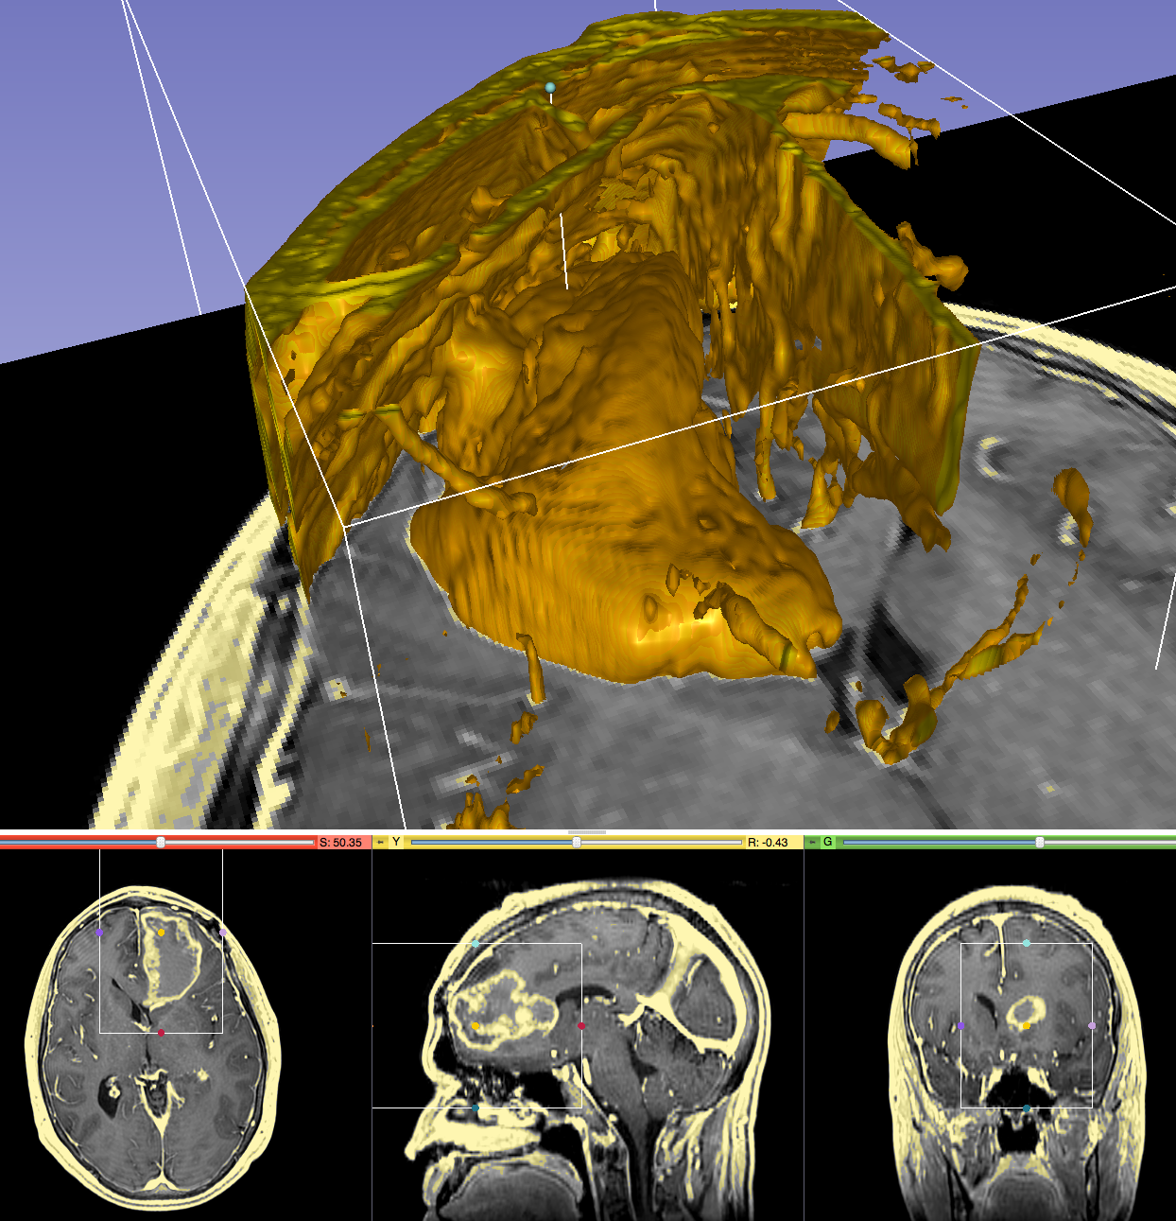
The Translational Pipeline
Can it be done?
Prototypes for technology research
Is it worth doing?
Tools for translational research
Standard of care
Commercially available clinical “devices” with regulatory approval
Image provided by Kikinis

Slide 6
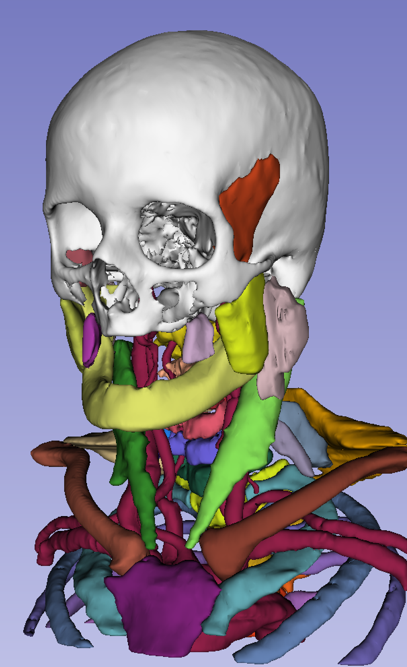
Prototypes versus Tools
A prototype will work only in the environment of the researcher
Not portable
Unstable
A tool will work in YOUR environment
Easy to install
Easy to use
Robust
Atlas provided by M. Jakab

Slide 7
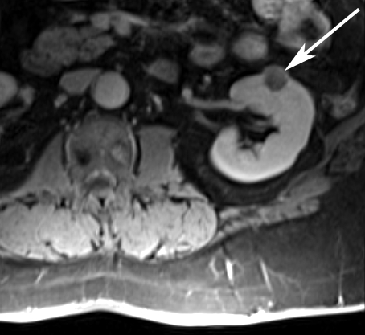
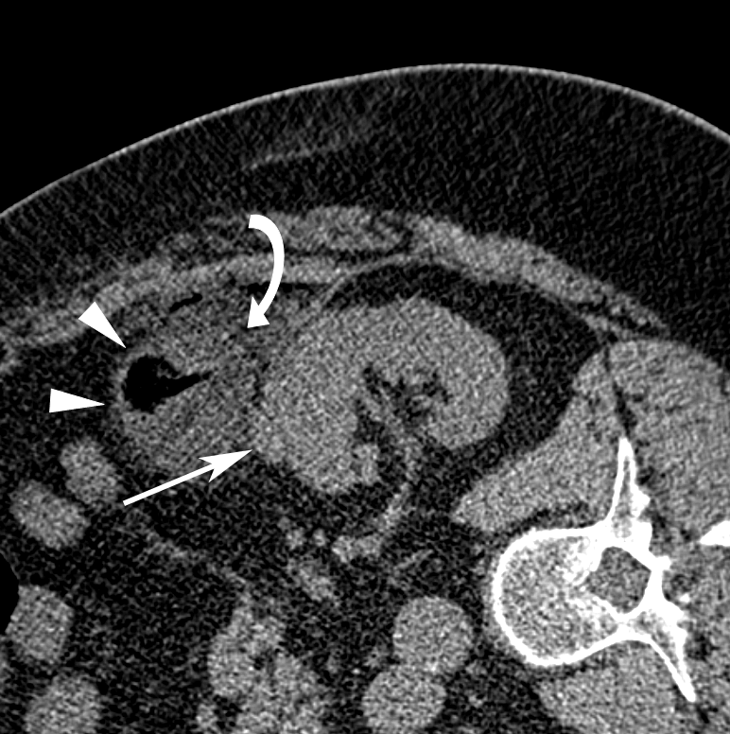
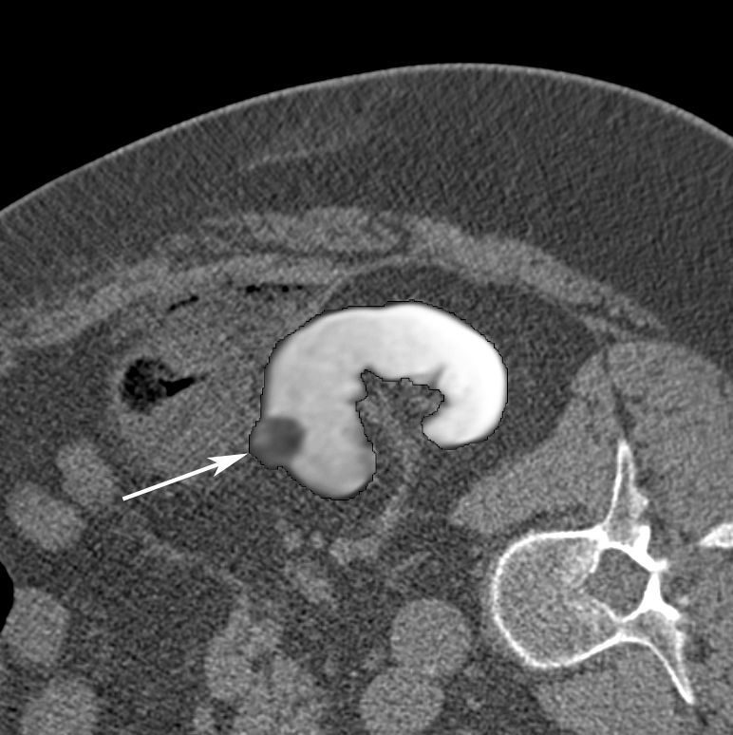
The Valley of Death
Well-engineered software tools are needed to enable translational clinical research in image analysis
Creating tools is expensive and does not fit traditional funding mechanisms
Science agencies: its not innovative
Companies: no proven clinical utility, patents do not work, its too risky
Pre-procedural MRI
Intra-procedural CT
Registered MRI
Oguro et al, Int J Comput Assist Radiol Surg, 2011
Elhawary et al, Acad Rad, 2010

Slide 8
URL’s
National Alliance for Medical Image
Computing
www.na-mic.org
Neuroimage Analysis Center
Nac.spl.harvard.edu
Surgical Planning Laboratory,
Brigham and Women’s Hospital
spl.harvard.edu
National Center For Image Guided Therapy
www.ncigt.org

