Slide 1
SlicerRT Hands-on tutorial
Csaba Pinter
Laboratory for Percutaneous Surgery, Queen’s University, Canada

Slide 2
Preparations
Prepare the environment
Install 3D Slicer
Install SlicerRT
Load test data
If you do not have a computer, please team up with somebody
Those who fall behind, please signal
Nothing is lost for those who start late, please ask

Slide 3
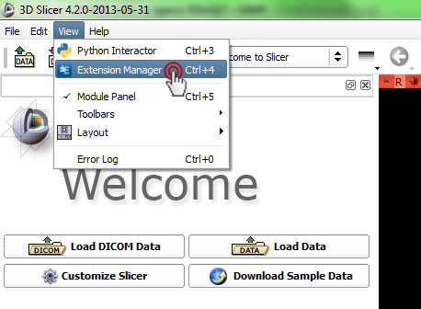
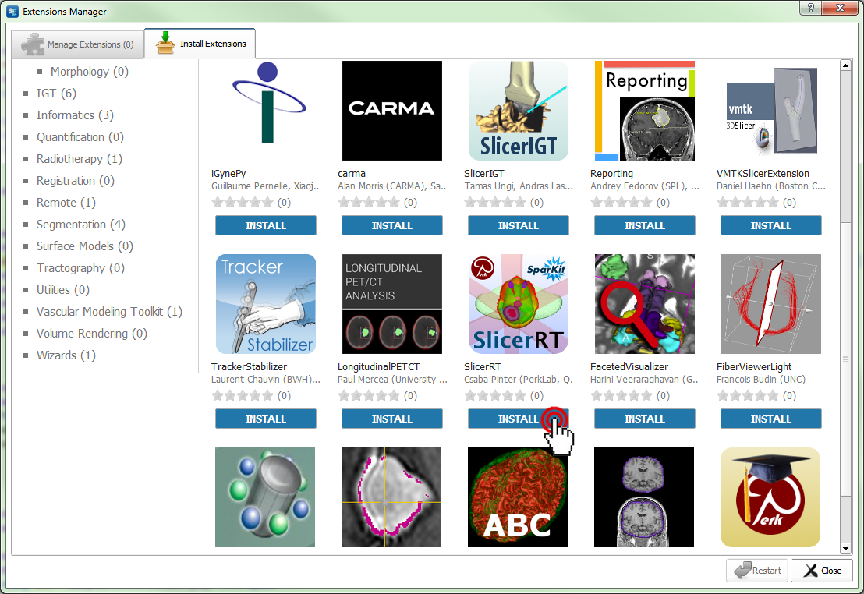
Preparation: Install SlicerRT extension

Slide 4
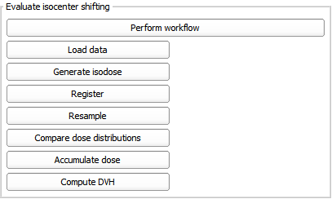
Preparation: Load test data
Notes:
Explain that the steps can be automatically performed if needed

Slide 5
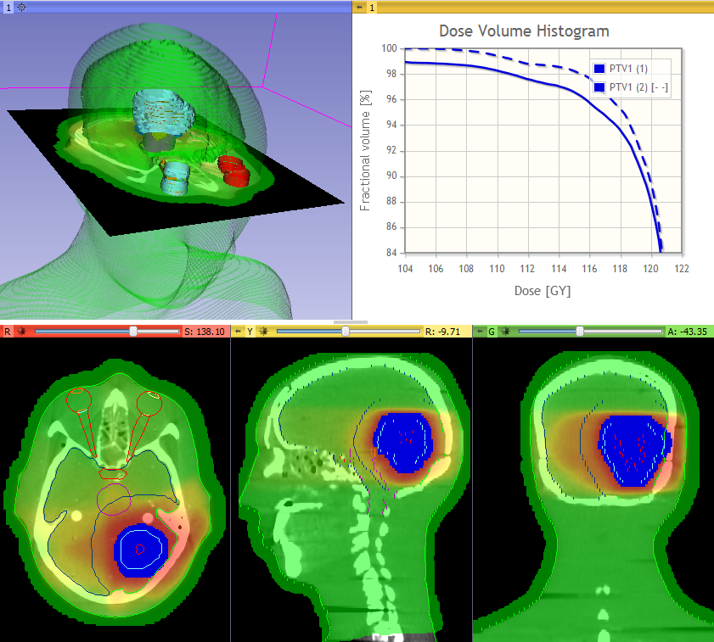
Learning objective
This tutorial demonstrates how to perform a radiation therapy research workflow using the SlicerRT extension:
Evaluation of the isocenter shifting adaptation method
[picture to illustrate
the learning objective]
© 2013, All Rights Reserved

Slide 6
Evaluation of adaptation techniques through dose accumulation and DVH
Import, load, and visualize DICOM-RT data
Register planning CT to day 2 CT Rigid and deformable → three scenarios
No registration = no adaptation
Rigid registration ≈ isocenter shifting
Deformable registration ≈ re-planning
Accumulate dose
Compute DVH
Compare DVH curves and metrics for the methods

Slide 7
1/1. Load data
Due to short time, we have the data loaded automatically
Notes:
The loaded data is from an ENT phantom with a sample plan. The day 2 data has been manually created using a synthetic deformation field.

Slide 8
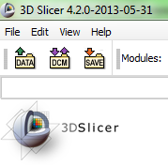
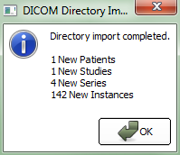
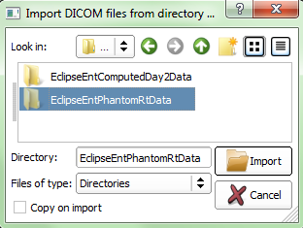
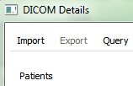
1/2. Optional: load data manually
Download from: http://slicer.kitware.com/midas3/download/item/ 101019/EclipseEntPhantomRtData.zip
Browse
Notes:
Don’t do this now, just explaining for later, when own data is to be used.

Slide 9
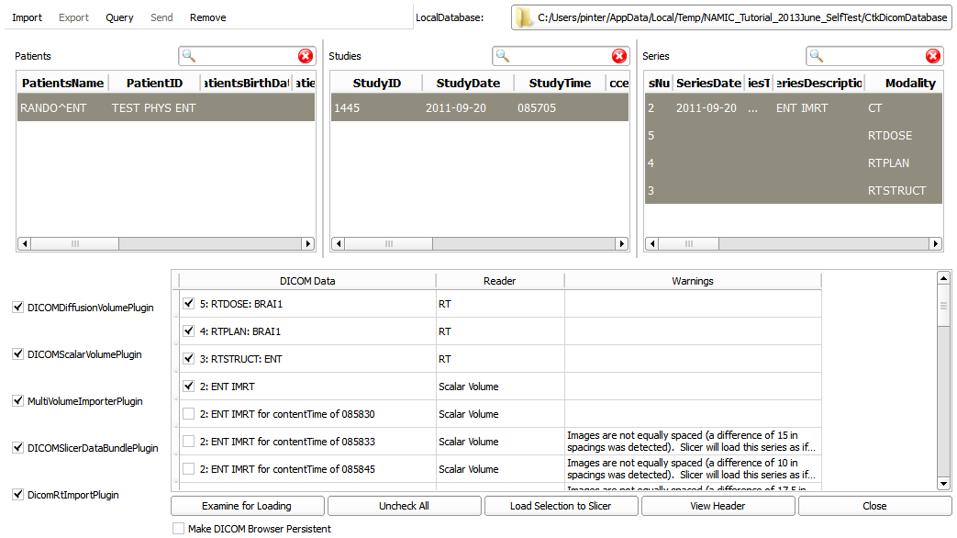
1/2. Load data manually cont’d
1
2: Select all
3
4

Slide 10
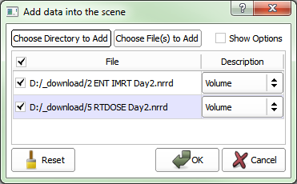
1/2. Load data manually cont’d #2
Download: http://slicer.kitware.com/midas3/download?items=10702 http://slicer.kitware.com/midas3/download?items=10703
Select both files and drag&drop into Slicer
Notes:
Nodes loaded from local files can be manually added to Subject hierarchy (create study, drag&drop).

Slide 11
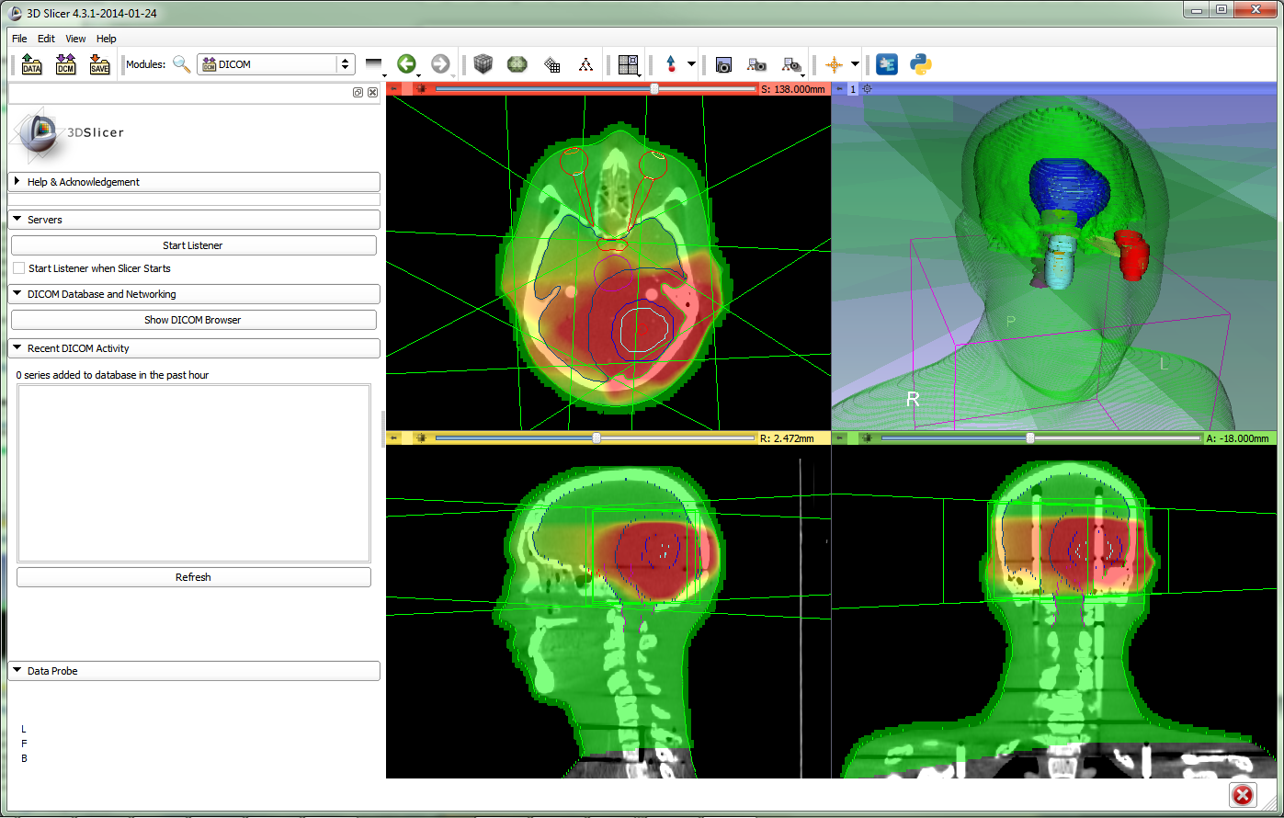
1/3. Data loaded
Notes:
Isodose lines can be easily generated if needed

Slide 12
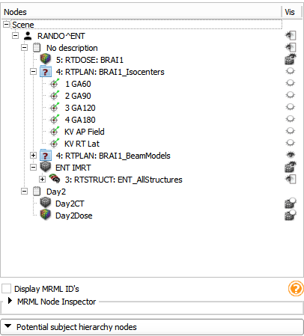
1/4. Explore loaded data
Go to Subject Hierarchy module
Show/hide data using eye icons
Notes:
Explain that the steps can be automatically performed if needed

Slide 13
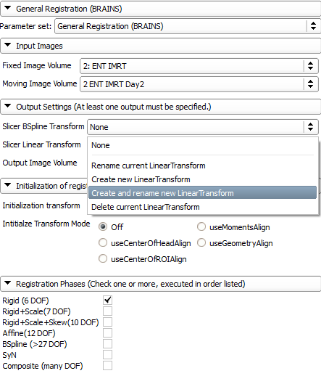
2/1: Register
1. Go to module Registration / General Registration (BRAINS)
2
3
Set up parameters as shown: 2. Choose planning CT as fixed image 3. Choose day 2 CT as
moving image 4. Create transform and rename it to Transform_Day2ToDay1_Rigid 5. Choose ‘Rigid (6 DOF)
4
5
6. Click ‘Apply’
Notes:
Deformable registration is very similar:
4: BSpline transform needs to be created
5. Choose BSpline

Slide 14
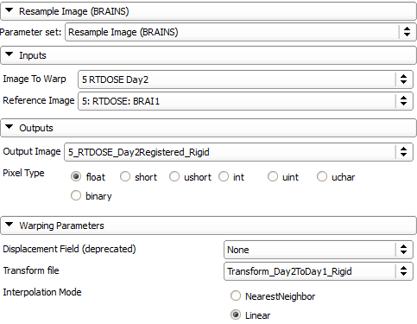
2/2: Resample day 2 dose
1. Go to module Registration / Resample Image (BRAINS)
2. Set parameters as indicated (output image needs to be created and renamed)
3. Click ‘Apply’
Notes:
Subject hierarchy feature that unifies and simplifies this two-step registration process coming up.
The registered dose volumes

Slide 15
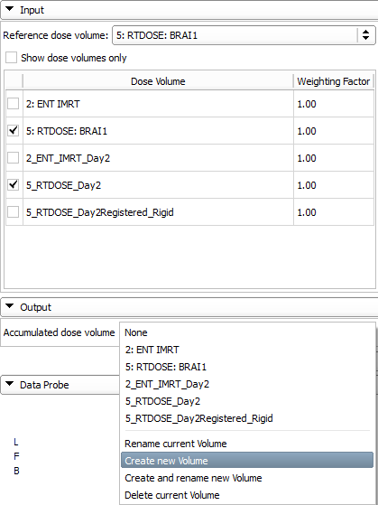
3/1: Accumulate dose Unregistered = no adaptation
3
1. Go to module Radiotherapy / Dose Accumulation
2
3
2. Uncheck ‘Show dose volumes only’ (dose attributes are not yet automatically added to the nodes)
3
3. Choose reference, then planning and day 2 dose volumes
4. Create output volume
4
5. Click ‘Apply’

Slide 16
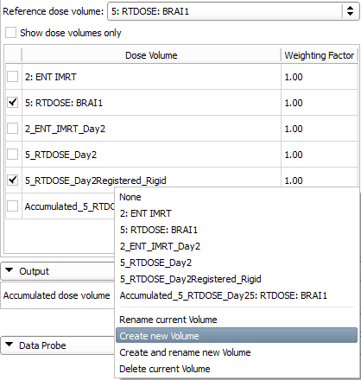
3/2: Accumulate dose Rigid registered ≈ isocenter shifting
1. Uncheck day 2 dose volume
2. Select registered day 2 dose
3. Create output volume
4. Click ‘Apply’

Slide 17
4/1: Compute dose volume histogram for unregistered
1. Go to module Radiotherapy / Dose Volume Histogram
2
3
4
2. Choose unregistered accumulated dose
3. Choose ‘3: RTSTRUCT: ENT_AllStructures_SubjectHierarchy’
4. Click ‘Compute DVH’
Notes:
Structure models disappear as the contours are automatically rasterized

Slide 18
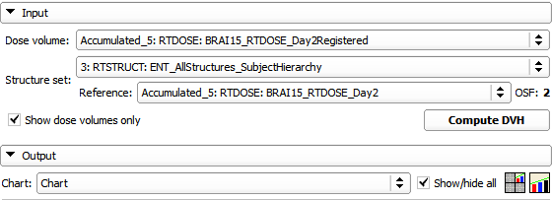
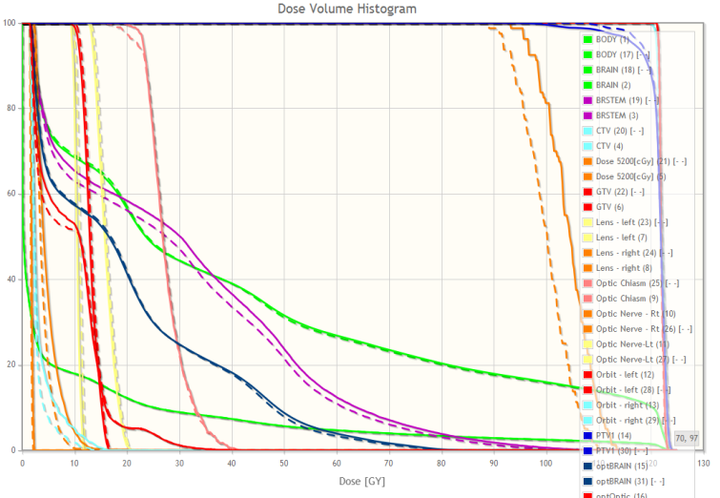
4/2: Compute dose volume histogram for registered
1. Choose registered accumulated dose
1
2
2. Click ‘Compute DVH’
3
4
3. Create chart
4. Click ‘Show/hide all’
5. DVH curves appear

Slide 19
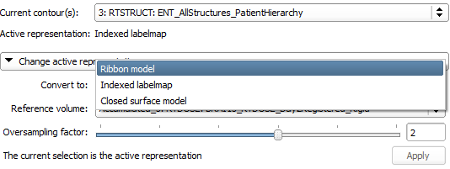
Note: Structures have been automatically rasterized
Structures are automatically rasterized during DVH computation. In this state, they can be seen as labelmaps over the volumes in the 2D viewers. To show the models again, convert back in the Radiotherapy / Contours module.

Slide 20
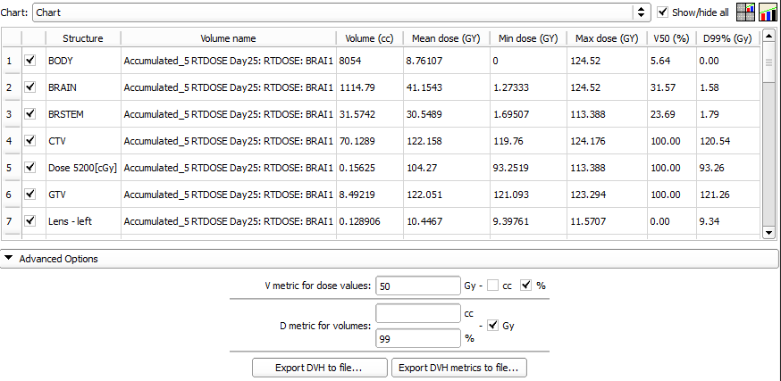
5/1: Quantify improvement
Laboratory for Percutaneous Surgery – Copyright © Queen’s University, 2013
- 20 -

Slide 21
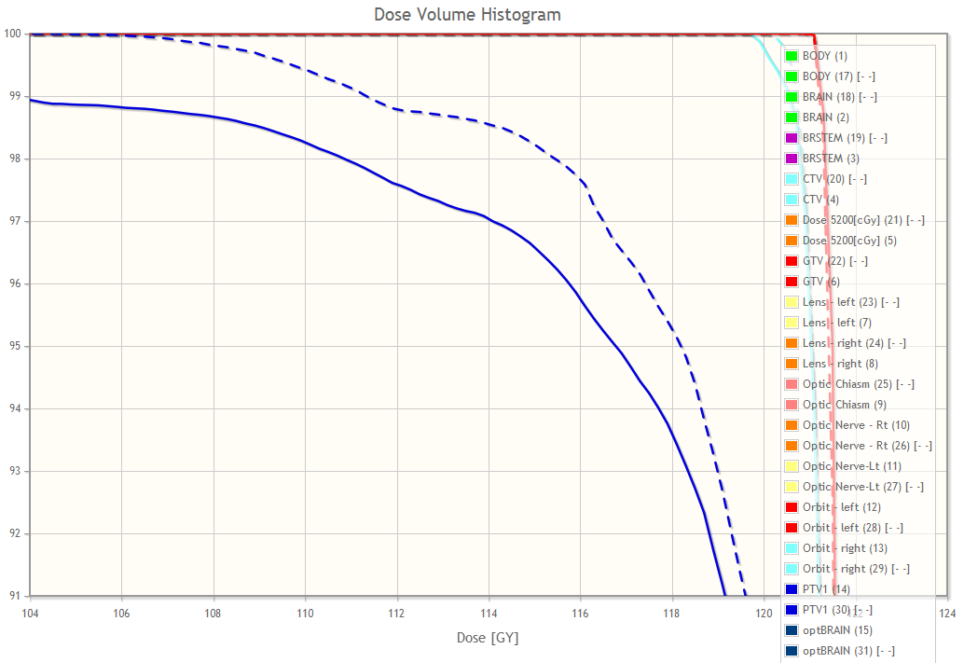
5/2: Visualize improvement
Zoom
Laboratory for Percutaneous Surgery – Copyright © Queen’s University, 2013
- 21 -

Slide 22
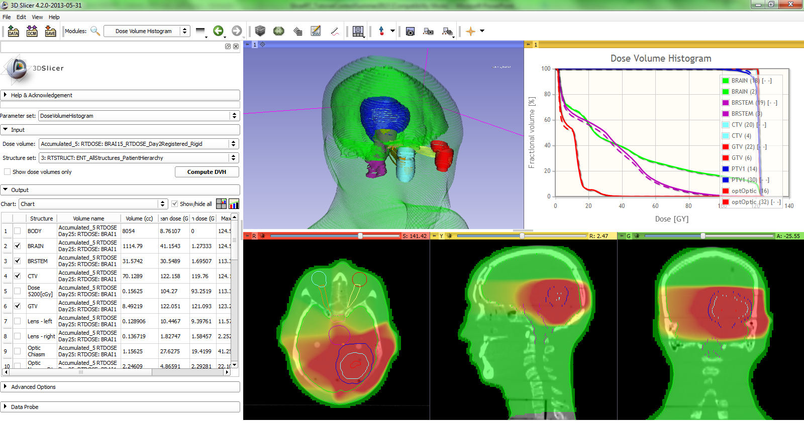
Reference and webpage
Overview paper: C Pinter, A Lasso, A Wang, D Jaffray, and G Fichtinger, “SlicerRT: Radiation therapy research toolkit for 3D Slicer”, Med. Phys. 39 (10), October 2012
Project homepage: http://www.SlicerRT.org/
Laboratory for Percutaneous Surgery – Copyright © Queen’s University, 2013
- 22 -

Slide 23
Acknowledgments
National Alliance for Medical Image Computing
NIH U54EB005149
Cancer Care Ontario
SparKit (Software Platform and Adaptive Radiotherapy Kit)
Laboratory for Percutaneous Surgery – Copyright © Queen’s University, 2013
- 23 -

Slide 24
Thank you for participating!

