Slide 1

NAMIC UNC Site Update
Site PI: Martin Styner
UNC Site NAMIC: C Vachet/F Budin, G Roger, JB Berger, A Kaiser, R Janardhana, M Farzinfar, A Gupta, S Kim, B Paniagua, M Niethammer, I Csapo

Slide 2
NAMIC Activities at UNC
Image Analysis
  DTI QC: error estimation via MC
  DTI Registration with pathology
  Longitudinal atlases with intensity changes
  Fiber tract analysis framework: Atlas builder, DTIReg modules
Shape Analysis
  Interactive surface correspondence
  Longitudinal shape correspondence
  Normal consistency in surface correspondence
  Brain shape regression (application)
Validation
  Human-like DTI/DWI software phantom
  DTI tractography challenge MICCAI 2012
Methods
Engineering

Slide 3
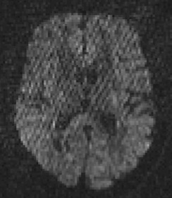
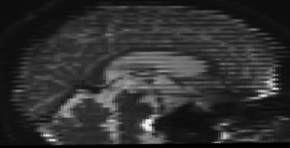
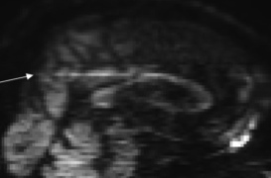
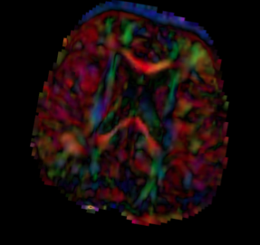
DTI QC
  DTI/DWI noisy, artifact rich => QC needed
    Correct motion & eddy currents
    Reject bad gradients
  How much rejection is still okay?
    Simple threshold on numbers of rejected DWI?
  Goal: Estimate errors in DTI wrt local direction
  Use of Monte Carlo simulation at given SNR

Slide 4
Uniformity of Directions
Different sequences
No rejection
Same SNR ~ 10
ΔFA: Average error in FA (SimFA = 0.4)
ΔPD: Average error in local orientation
Non-uniform Philips sequence worst
  ~50% higher orientation & ~75% higher FA error
42 dir
30 dir Philips
6 dir

Slide 5
Rejection Affects Uniformity
Clustered rejection 25% larger error in orientation and 20% larger FA error
Allows specification of threshold wrt Error

Slide 6
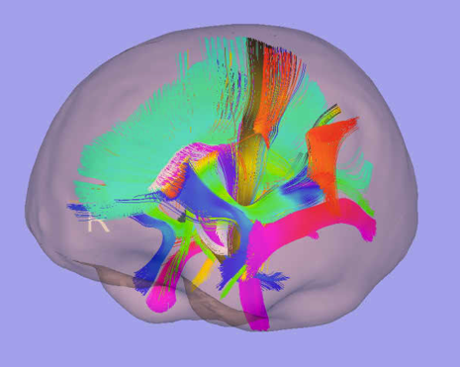
Validation: Tractography
Soft/hardware DTI phantoms not realistic
  Goal: Create human brain like phantom
Inspiration: MNI-Brainweb
  Use real data to create a synthetic phantom
    Estimate fiber anatomy from real data
    Estimate brain morphometry population
  Sample/simulate brain morphometry
  Apply morphometry to fiber anatomy
  Compute DWI from simulated fiber anatomy
Evaluate tractography vs known ground truth

Slide 7
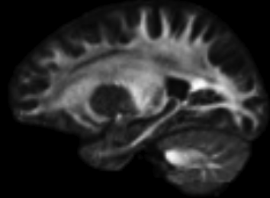
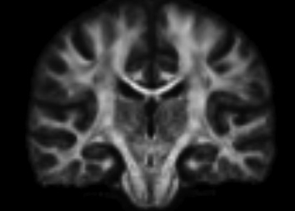
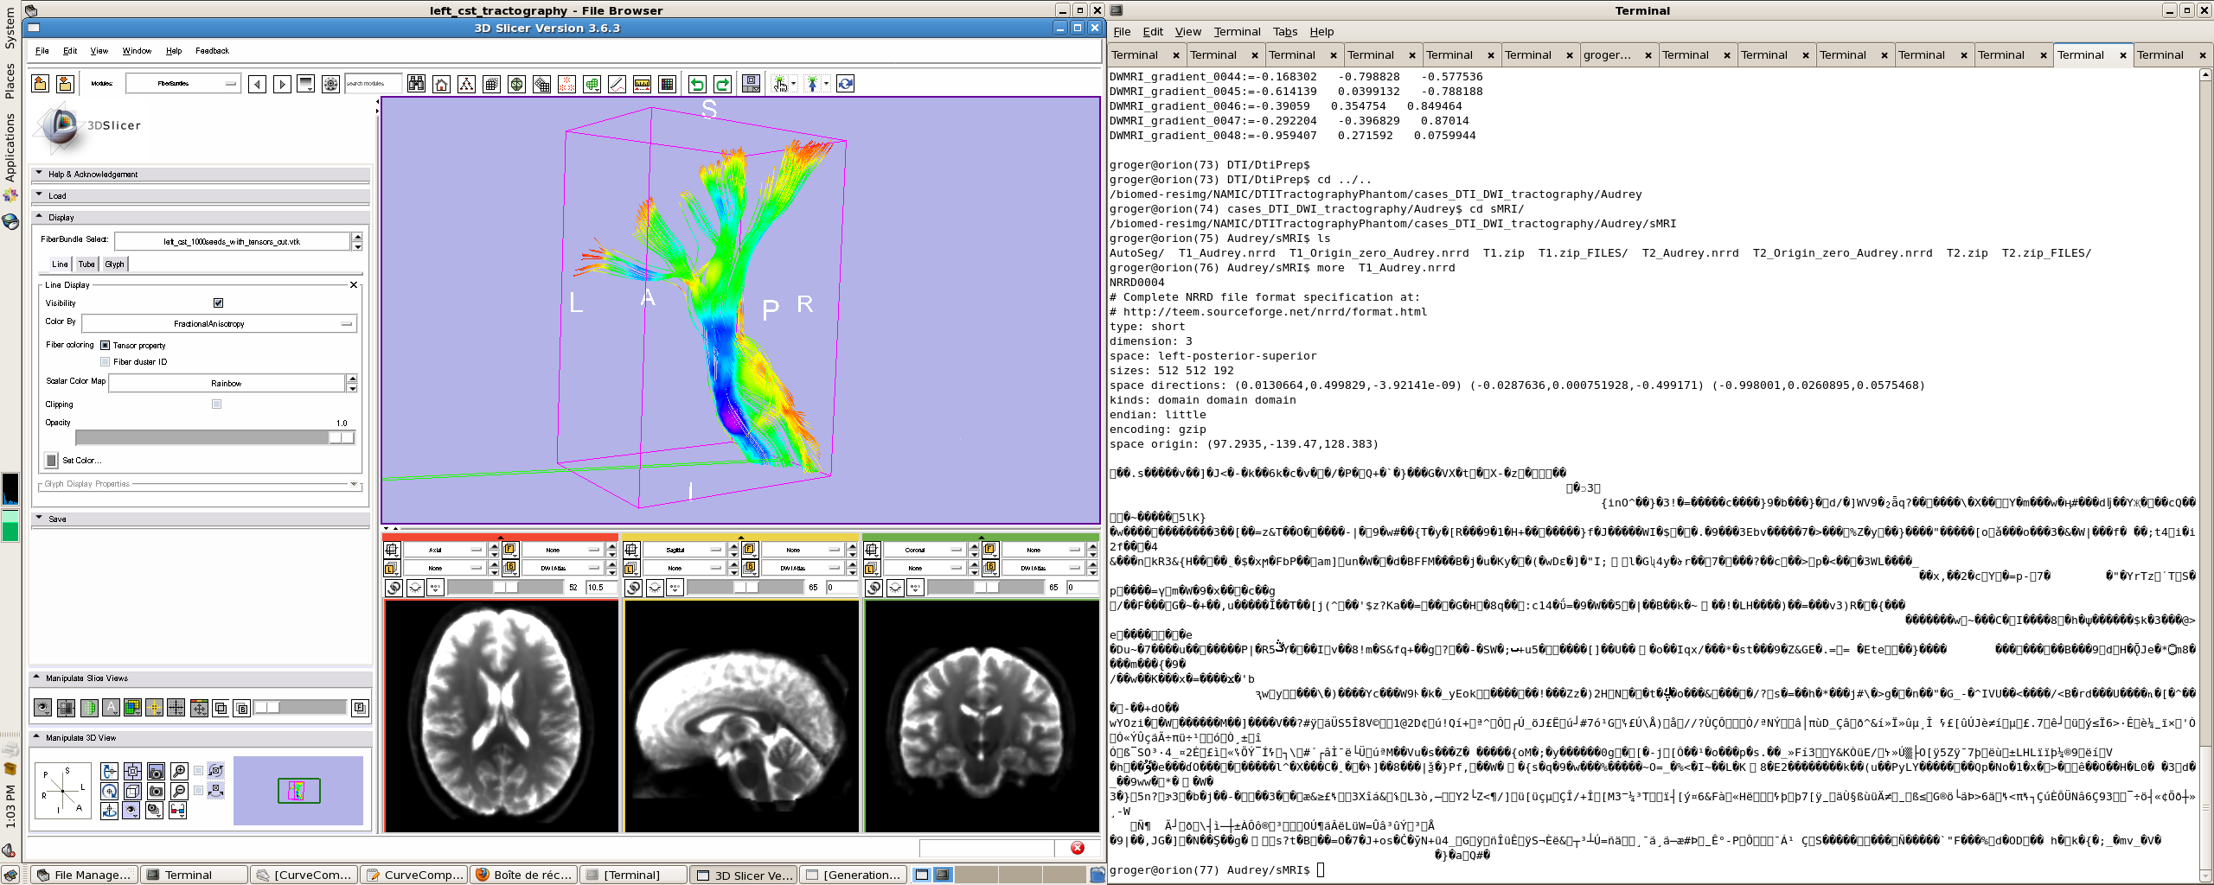
Fiber Anatomy
MICCAI 2012 workshop
Fiber Anatomy
  6 subjects at 1.5mm³ & 42 dir
  High resolution atlas via unbiased group-wise registration
  DWI atlas
  Two-fiber tractography
    Whole brain for overall anatomy
      20 GB of fibers…
    Merge with individual tracts
      Cerebro-spinal tract

Slide 8
Brain Shape Space
Training data: T1 UNC Normal Study
  100 subjects 20-60
Brain Shape Space
  Deformation fields to prior template
  PCA over deformation fields
  Gaussian generative sampling in PCA space
  Find 3 closest training samples
    Weighted unbiased atlas building
    Weights relative to distance between training and generated sample
  Simple, imperfect, but appear realistic

Slide 9
Validation/Evaluation
Simulate via CHARMED (Assaf/Basser)
  Restricted diffusion within fibers (cylindrical) and hindered diffusion outside fibers (tensor)
  Different Noise levels, DWI resolution, Gradient sampling scheme
  Amazingly this was the hardest…
Evaluate geometry (Fillard/Gouttard)
  CurveCompare tool
    Dice overlap, probabilistic fiber-dice, error in position, tangent vector & curvature
  Accuracy & Reliability

Slide 10
Next
Improve brain shape space
  Explicitly model subcortical and cortical shape
    Stats on inflated cortical surface via magnitude and orientation to original cortex
    Partial nested sphere stats, PCA on principal components
Simulate pathology, tumors, TBI
  Utah tumor simulator
  How can we simulate TBI?

Slide 11
Other stuff…
Other NAMIC ongoing projects
  DTI registration with pathology
    Incorporating full brain tractography
    Incorporating intracranial cavity landmarks
  Brain shape regression for craniosynostosis
  Cortex correspondence via SPHARM spherical registration of sulcal curves
  MR Texture feature for disease appearance quantification

Slide 12
Pubs
MICCAI: 2 conf & 3 workshop papers
8 SPIE submissions
2012 NAMIC journal papers:
H. C. Hazlett, H. Gu, R. C. McKinstry, D. W. W. Shaw, K. N. Botteron, S. R. Dager, M. Styner, C. Vachet, G. Gerig, S. J. Paterson, R. T. Schultz, A. M. Estes, A. C. Evans, J. Piven, the IBIS Network, “Brain Volume Findings in 6-Month-Old Infants at High Familial Risk for Autism.,” Am J Psychiatry, vol. 169, no. 6, pp. 601–608, Jun. 2012.
X. Geng, S. Gouttard, A. Sharma, H. Gu, M. Styner, W. Lin, G. Gerig, and J. H. Gilmore, “Quantitative Tract-Based White Matter Development from Birth to Age Two Years,” NeuroImage, pp. 1–44, Mar. 2012.
O. Lindberg, M. Walterfang, J. C. L. Looi, N. Malykhin, P. Ostberg, B. Zandbelt, M. Styner, B. Paniagua, D. Velakoulis, E. Orndahl, and L.-O. Wahlund, “Hippocampal Shape Analysis in Alzheimer's Disease and Frontotemporal Lobar Degeneration Subtypes.,” J Alzheimers Dis, Mar. 2012.
J. J. Wolff, H. Gu, G. Gerig, J. T. Elison, M. Styner, S. Gouttard, K. N. Botteron, S. R. Dager, G. Dawson, A. M. Estes, A. C. Evans, H. C. Hazlett, P. Kostopoulos, R. C. McKinstry, S. J. Paterson, R. T. Schultz, L. Zwaigenbaum, and J. Piven, “Differences in White Matter Fiber Tract Development Present From 6 to 24 Months in Infants With Autism.,” Am J Psychiatry, Feb. 2012.
Y. Li, J. Gilmore, J. Wang, M. Styner, W. Lin, and H. Zhu, “TwinMARM: Two-stage Multiscale Adaptive Regression Methods for Twin Neuroimaging Data.,” IEEE Trans Med Imaging, Jan. 2012.
Y. Shi, S. J. Short, R. C. Knickmeyer, J. Wang, C. L. Coe, M. Niethammer, J. H. Gilmore, H. ZHU, and M. Styner, “Diffusion Tensor Imaging-Based Characterization of Brain Neurodevelopment in Primates.,” Cerebral cortex (New York, N.Y. : 1991), Jan. 2012.
E. Maltbie, K. Bhatt, B. Paniagua, R. G. Smith, M. M. Graves, M. W. Mosconi, S. Peterson, S. White, J. Blocher, M. El-Sayed, H. C. Hazlett, and M. Styner, “Asymmetric bias in user guided segmentations of brain structures.,” NeuroImage, vol. 59, no. 2, pp. 1315–1323, Jan. 2012.
A. E. Lyall, S. Woolson, H. M. Wolfe, B. D. Goldman, J. S. Reznick, R. M. Hamer, W. Lin, M. Styner, G. Gerig, and J. H. Gilmore, “Prenatal isolated mild ventriculomegaly is associated with persistent ventricle enlargement at ages 1 and 2.,” Early Hum. Dev., Mar. 2012.

Slide 13
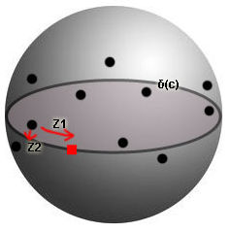
Principal Nested Spheres
K sample points, N samples, v_{nk} is the k_{th} normal for the n_{th} sample
Main idea - Evaluate entropy across different objects for the k_{th} correspondent normal
Given v_{1k}, …, v_{nk} in unit sphere S², fit a great circle δ(c) to minimize the sum of squared deviations of v_{nk} from the great circle
Find the Frechet mean on δ(c)
PCA on S²=>Compute principal scores
Normals projected into the unit sphere
Great circle that approximates the data
Notes:
unit normal vectors vk1, …, vkn (they are already in the unit sphere S2)
Z isa 2KxN matrix of Zk of principal scores for K = 1..K

