Slide 1
Utah II: NAMIC Methodologies and Tools for Longitudinal Image Analysis
Guido Gerig, Marcel Prastawa, Sylvain Gouttard, Stanley Durrleman, Bo Wang, James Fishbaugh, Anuja Sharma
SCI Institute, University of Utah
Jack van Horn, Andrei Irimia, Paul M. Vespa, Paul Hovda
UCLA LONI, Neurosurgery, Neurology
Hans Johnson, University of Iowa
Joseph Piven, Heather Hazlett, UNC Chapel Hill

Slide 2
NAMIC Activities Utah II
Motivation spatiotemporal image analysis:
Increasing use of longitudinal/serial imaging for prediction, diagnosis and assessment of disease progression and therapeutic success.
Personalized health care (PHC): Individual trajectories/profiles.
Current analysis: Independent processing of serial data.
Need: Tools for joint processing of (3D,t) data → 4D Analysis.
Utah II: 4D image analysis for longitudinal image data:
4D segmentation of acute/follow-up incl. lesions
4D shape analysis
4D tract-based analysis of white matter properties
4D segmentation of serial image data

Slide 3
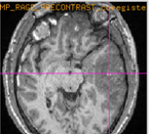
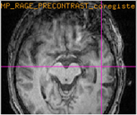
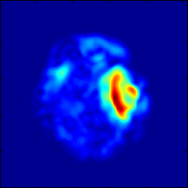
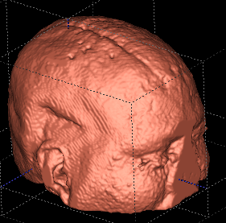
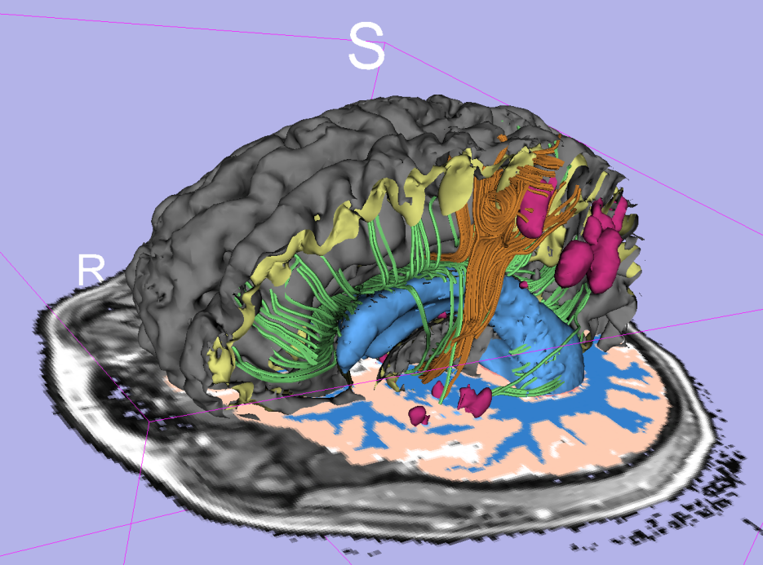
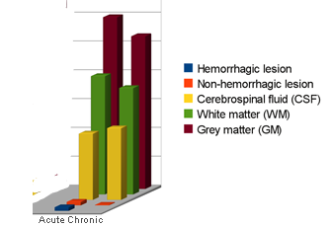
Patient-Specific Segmentation of Longitudinal MR Images of TBI
A) Methodology and tool for efficient segmentation of brain anatomy and lesions from multimodal MRI with minimal user input.
B) Joint segmentation of acute & chronic long. image data → Assessment of change due to rehabilitation.
No automated tool available.
acute
chronic
change map
Quantitative description of change
impact
3D modeling/vis.

Slide 4
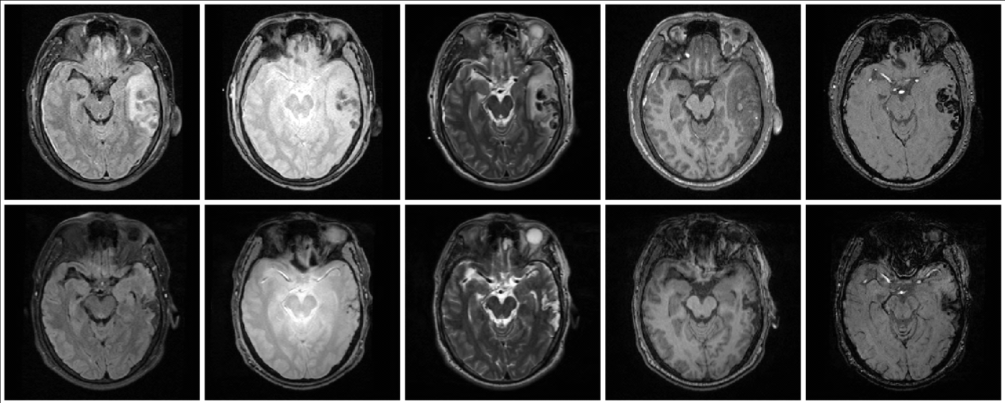
TBI Pathology multimodal MRI
FLAIR GRE T2 T1 SWI
acute
chronic (+3-6 months)
Acute images
- Non-hemorrhagic lesion/edema
- Hemorrhagic lesion/bleeding
- Extracerebral lesion
- Diffuse axonal injury
Chronic images
- Lesion (Non-hemorrhagic)
- Necrosis
- Bleed

Slide 5
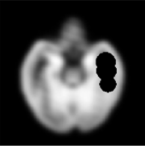
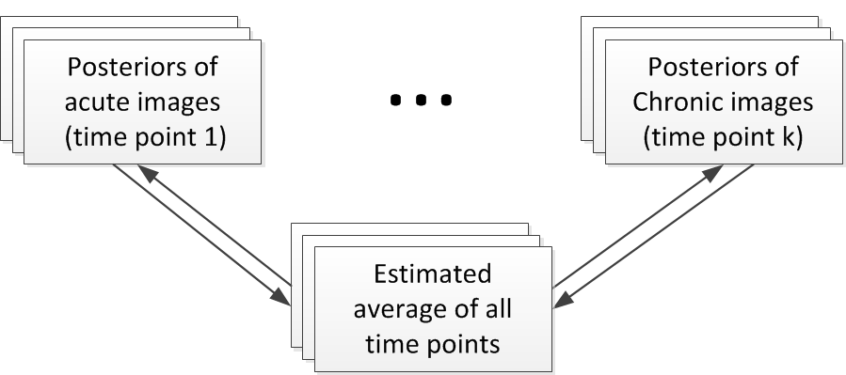
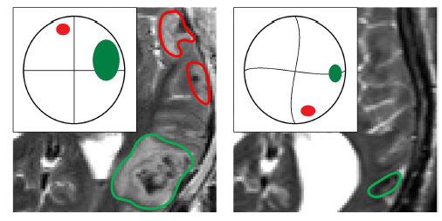
Methodology
Expert initialization of primary lesion sites and types:
Challenge: Lesions deform, disappear & appear. Construction of persona-lized spatiotemporal atlas using diffeomorphic and non-diffeomorphic components.
To be presented SPIE’12, Wang et al.
submitted ISBI’12, Wang et al.
Collaboration Niethammer/Aylward UNC/Kitware
Other Core1 work: registration (Tannenbaum)

Slide 6
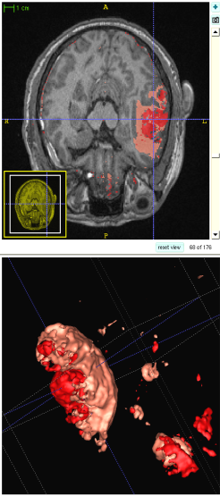
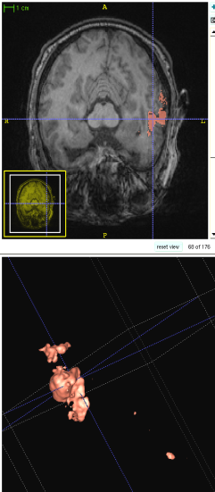
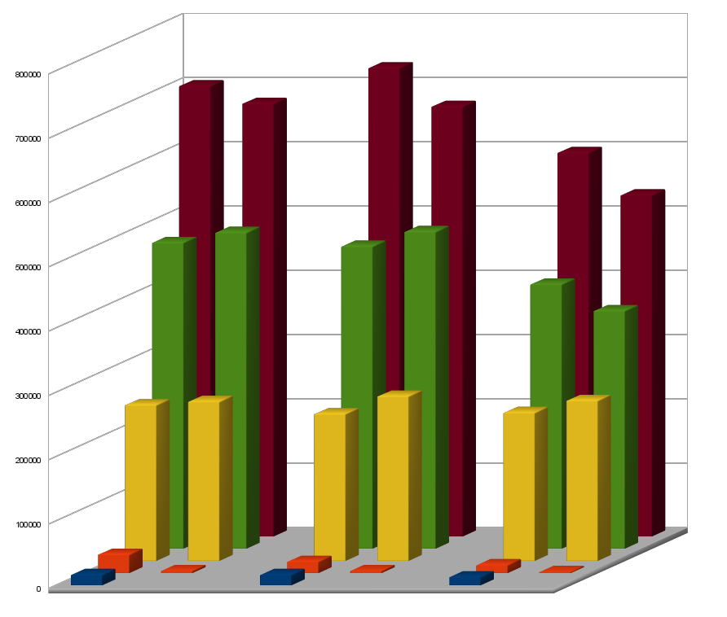
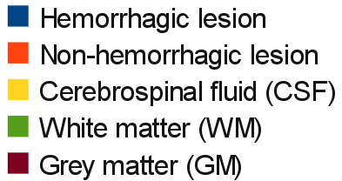
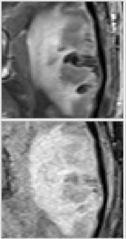
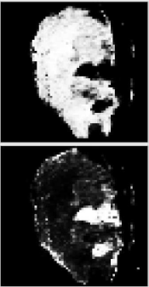
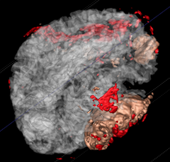
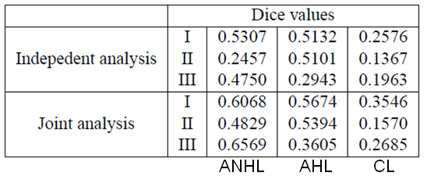
Preliminary Results and Validation on 3 Cases
Acute Chronic
New Jan’12: Apply new tools to TBI data Shenton/Savadjiev BWH

Slide 7
Longitudinal Shape Modeling
Concept: Given a set of discrete shapes, interpolate a continuous growth model via shape regression.
Assumption: Evolution of biological tissue is inherently smooth in space and time. Growth is nonlinear, locally varying process.
Method: Continuous flow of diffeomorphisms via correspondence-free “currents” (Younes, Durrleman). Cost function = Data Matching + Regularity.
Durrleman, Pennec, Trouve, Gerig, MICCAI ‘09
Fishbaugh, Durrleman, Gerig, MICCAI ’11
Fishbaugh, Durrleman, Gerig, SPIE ’12
Sadeghi, Prastawa, Gilmore, Lin, Gerig, IEEE Asilomar 2010

Slide 8
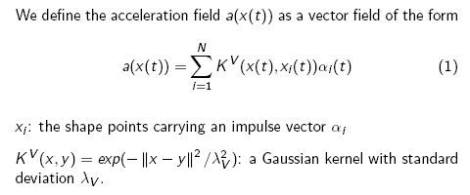
4D Shape Regression
From discrete 3D shapes (6m,12m,24m) to continuous 4D shape model

Slide 9
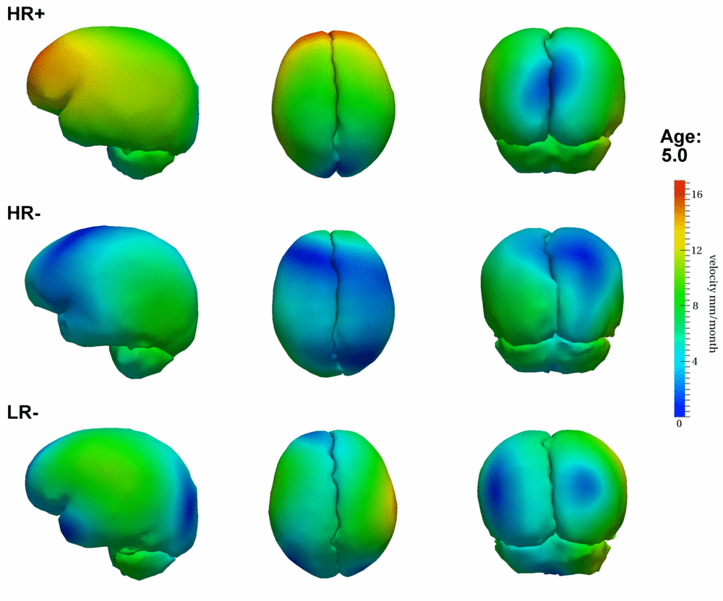
4D Growth Profiles (Group-wise)
Autism Research Collab. former NAMIC DBP UNC (Piven, Hazlett)
HR+: High risk infant ADOS pos.
HR-: High risk infants ADOS neg.
LR-: Low risk healthy infants
MICCAI’11 (Fishbaugh et al.)
To appear SPIE’12 (Fishbaugh et al.)

Slide 10
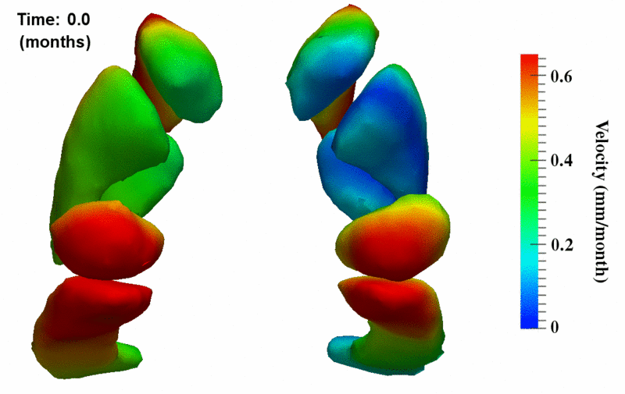
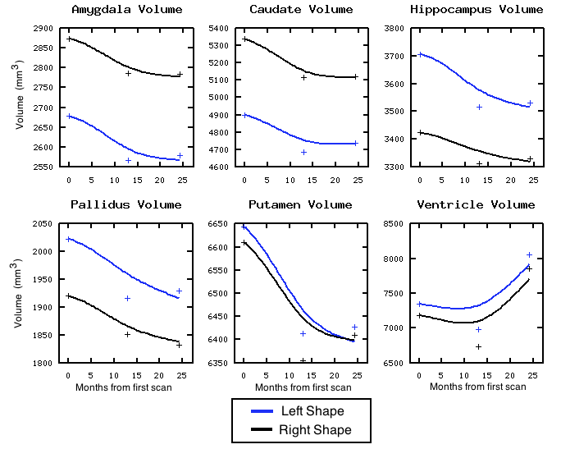
Clinical Application: Neurodegeneration in Huntington Disease
Continuous individual subjects’ growth model
Quantitative information derived from 4D shapes
Colllaboration Hans Johnson, U-Iowa,
Whitaker Utah I, Styner UNC

Slide 11
Tract-Based Longitudinal Modeling of DWI/DTI data
Spatial tract model:
FA(s)
FA
Spatio-temporal model:
FA(s,t)
time

Slide 12
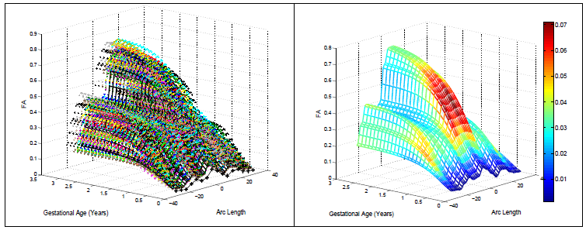
Spatiotemporal Model
Modeling FA age 0 – 3 years (10 subjects).
Non-parametric kernel regression along tracts.
Temporal changes captured by logistic function (initial fct., growth rate, asymptote) → statistics
Submitted ISBI ’12, tests with Huntington Dis. DTI data in progress
Group statistics
Results: Change parameters

Slide 13
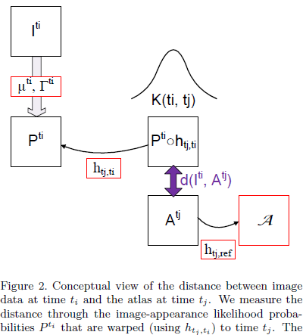
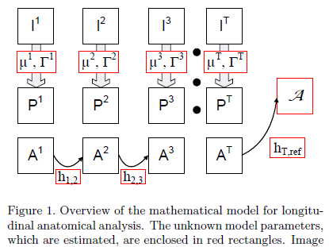
Spatiotemporal anatomical models: Joint 4-D Segmentation, Registration & Atlas Estimation

Slide 14
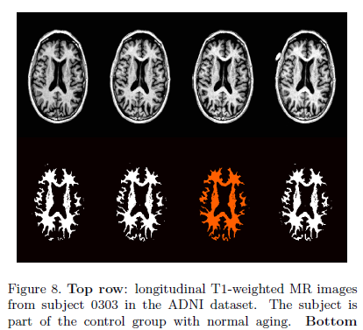
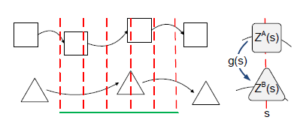
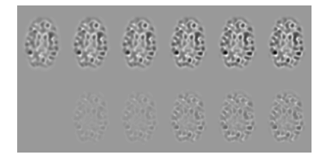
Test Application: Longitudinal ADNI Data
Prastawa, Awate, Joshi, Gerig, MMBIA ’12
In progress: application to Huntington Data

Slide 15
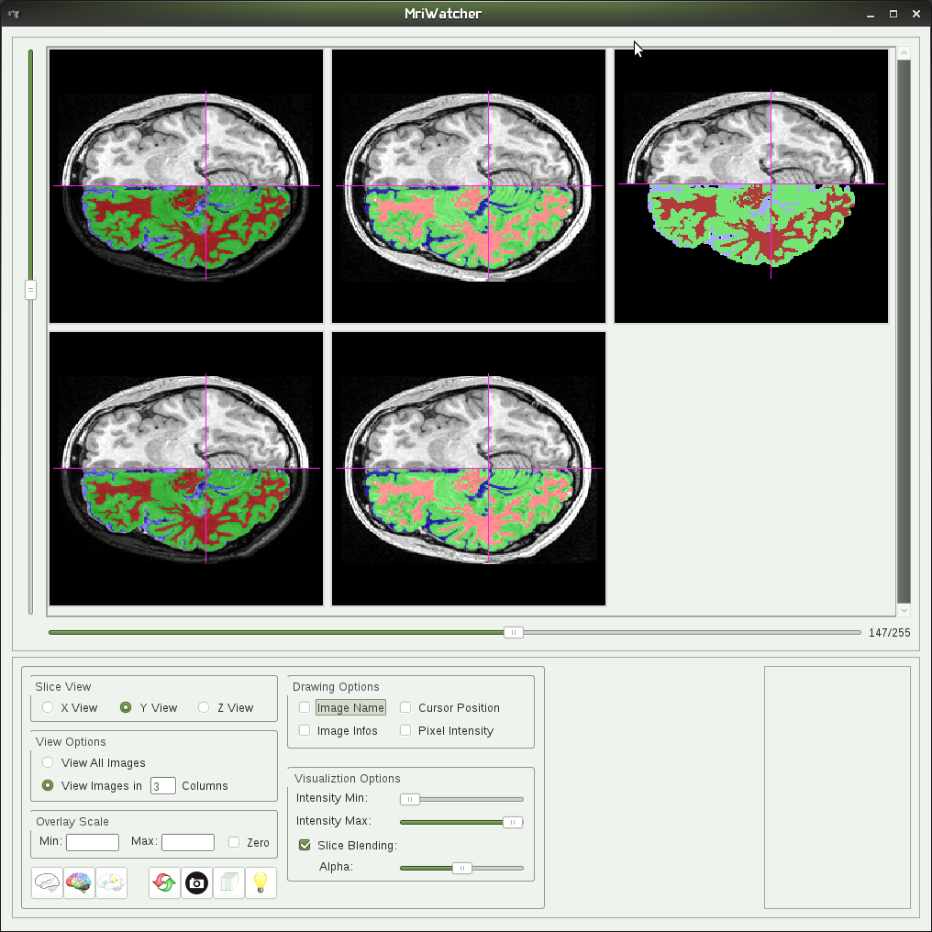
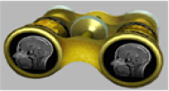
Engineering
MRIwatcher Tool in QT4
Efficient display of arbitrary # of 3D images
Platform-independent, cmake, ITK, QT4, openGL
Coupled cursors & voxel info
Overlay of labelmaps
Split-screen overlay
Easy drag/drop/select. files
Used for QC, quick review of large image sets, multi-modal longitudinal data, sets of DWIs, check of co-registration
In progress: plug-in for Slicer 4.0

Slide 16
Summary
Publications:
Methodology:
Prastawa, Awate, Joshi, Gerig, MMBIA ’12
Gouttard, Kubicki, Goodlett, Gerig, SPIE ‘12
Fishbaugh, Durrleman, Gerig, SPIE ‘12
Wang, Prastawa, Irimia, Chambers, Vespa, Van Horn, Gerig, SPIE ‘12
Fishbaugh, Durrleman, Gerig, MICCAI ’11
Durrleman, Prastawa, Gerig, Joshi, IPMI ‘11
Collaborative Res. and Clinical Applications:
Vachet et al., SPIE ‘012
Irimia et al., J Neurotrauma. Nov. 2011
Zhu et al., FADTTS, Neuroimage. 2011
Wang et al., Neuroimage. 2011
Hazlett et al., Arch Gen Psychiatry. 2011
Gerig, Oguz, Gouttard, ,, Styner, Frontiers, 2011
Knickmeyer et al., Twin Res Hum Genet. 2011
Workshops:
MICCAI ‘11 DTI Challenge (2mo engineering/appl).
Tools/Engineering:
Slicer plug-in ‘ABC’
ITK Toolkit DTI validation
NITRIC tool tract-based statistics
Prototype ITK-C++ 4D segmentation
Prototype ITK-C++ 4D shape regression
Prototype MATLAB 4D brain and pathology segmentation
MRIWatcher QT4/ITK

