Slide 1
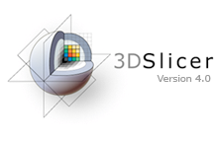
Exploring Peritumoral White Matter Fibers for Neurosurgical Planning
Sonia Pujol, Ph.D.
Ron Kikinis, M.D.
Surgical Planning Laboratory
Harvard University

Slide 2
Clinical Goal
Diffusion Tensor Imaging (DTI) Tractography has the potential to bring valuable spatial information on tumor infiltration and tract displacement for neurosurgical planning of tumor resection.
Image Courtesy of Dr. Alexandra Golby, Brigham and Women’s Hospital, Boston, MA..
White Matter Exploration for Neurosurgical Planning

Slide 3
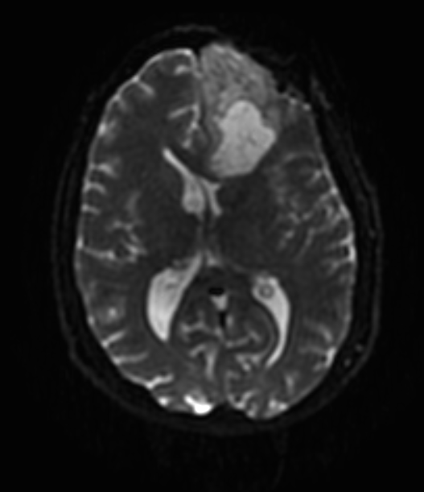
Clinical Case
35 year-old male diagnosed with Glioblastoma multiforme (GBM)
Diffusion Weighted Imaging (DWI) acquisition for neurosurgical planning
White Matter Exploration for Neurosurgical Planning

Slide 4
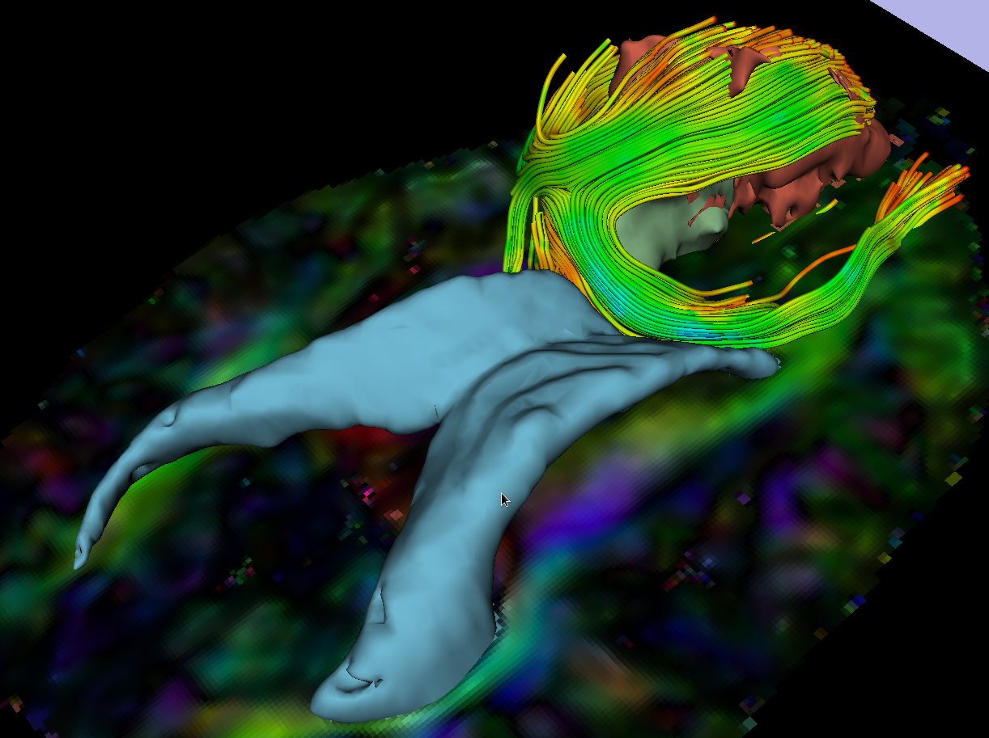
Clinical Goal
The goal of this tutorial is
to explore white matter
fibers surrounding a
tumor using Diffusion
Tensor Imaging (DTI)
Tractography.
White Matter tracts
Tumor
Ventricles
White Matter Exploration for Neurosurgical Planning

Slide 5
Image Analysis Pipeline
The image analysis pipeline
described in this tutorial uses three
different algorithms: the “Grow Cut”
algorithm for segmentation of the
tumor parts, the Marching Cube
algorithm for surface modeling,
and the single tensor
streamline tractography algorithm
for tract generation.
White Matter Exploration for Neurosurgical Planning

Slide 6
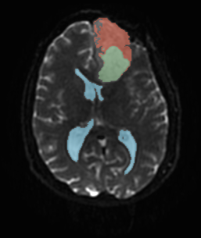
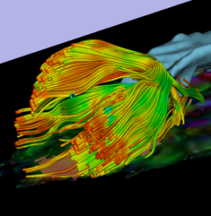
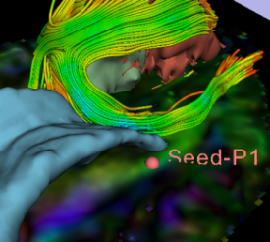
Overview of the analysis pipeline
Part 1: Loading &Visualization of Diffusion Data
Part 2: Segmentation of the ventricles, and solid and cystic parts of the tumor
Part 3: Tractography reconstruction of the white matter fibers in the peri-tumoral volume
Part 4: Tractography exploration of the ipsilateral and contralateral side
White Matter Exploration for Neurosurgical Planning

Slide 7
Part 1: Loading and Visualization of Diffusion Data
White Matter Exploration for Neurosurgical Planning

Slide 8
Diffusion Tensor Imaging
(Stejskal and Tanner 1965, Basser 1994 )
D
D
D
xx
xy
xz
D=
D
D
D
yx
yy
yz
D
D
D
zx
zy
zz
White Matter Exploration for Neurosurgical Planning

Slide 9
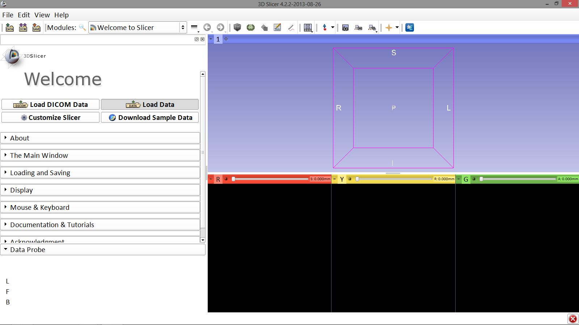
Loading DTI and Baseline Data
First, click on Load Data
Image Courtesy of Dr. Alexandra Golby, Brigham and Women’s Hospital, Boston, MA..
White Matter Exploration for Neurosurgical Planning

Slide 10
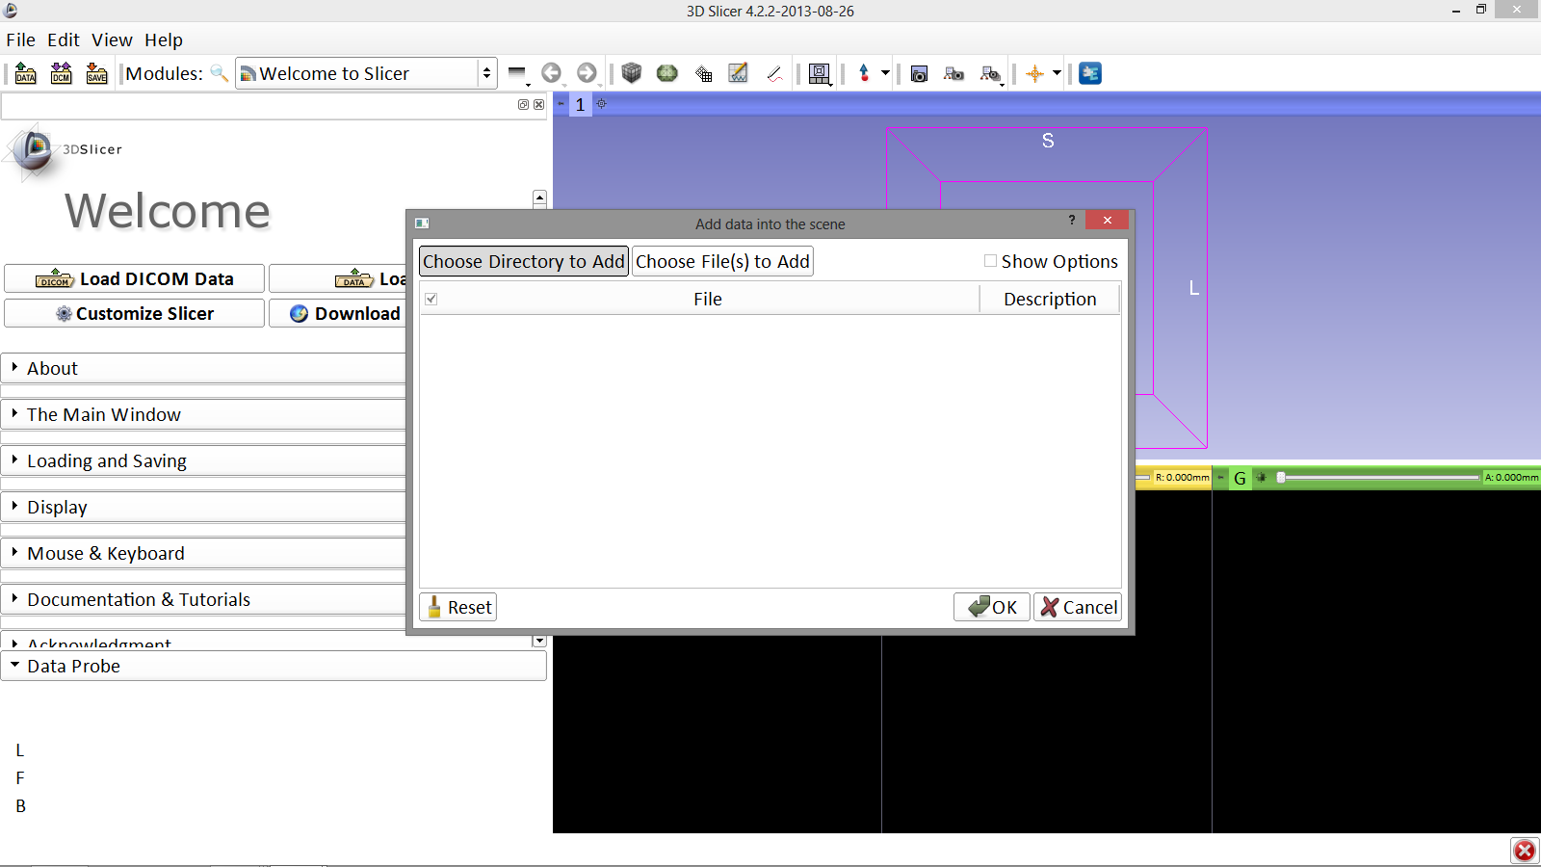
Loading DTI and Baseline Data
The “Add data into the scene” window appears. Click Choose Directory to Add
Image Courtesy of Dr. Alexandra Golby, Brigham and Women’s Hospital, Boston, MA..
White Matter Exploration for Neurosurgical Planning

Slide 11
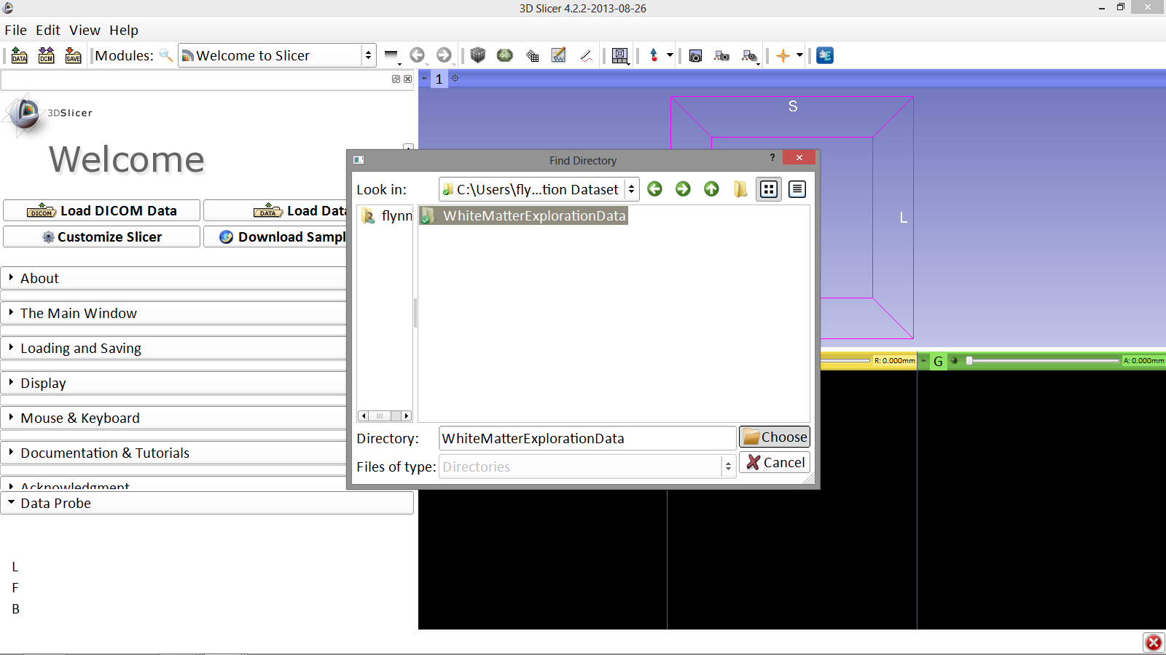
Loading DTI and Baseline Data
Locate and select the file WhiteMatterExplorationData and click Choose
Image Courtesy of Dr. Alexandra Golby, Brigham and Women’s Hospital, Boston, MA..
White Matter Exploration for Neurosurgical Planning

Slide 12
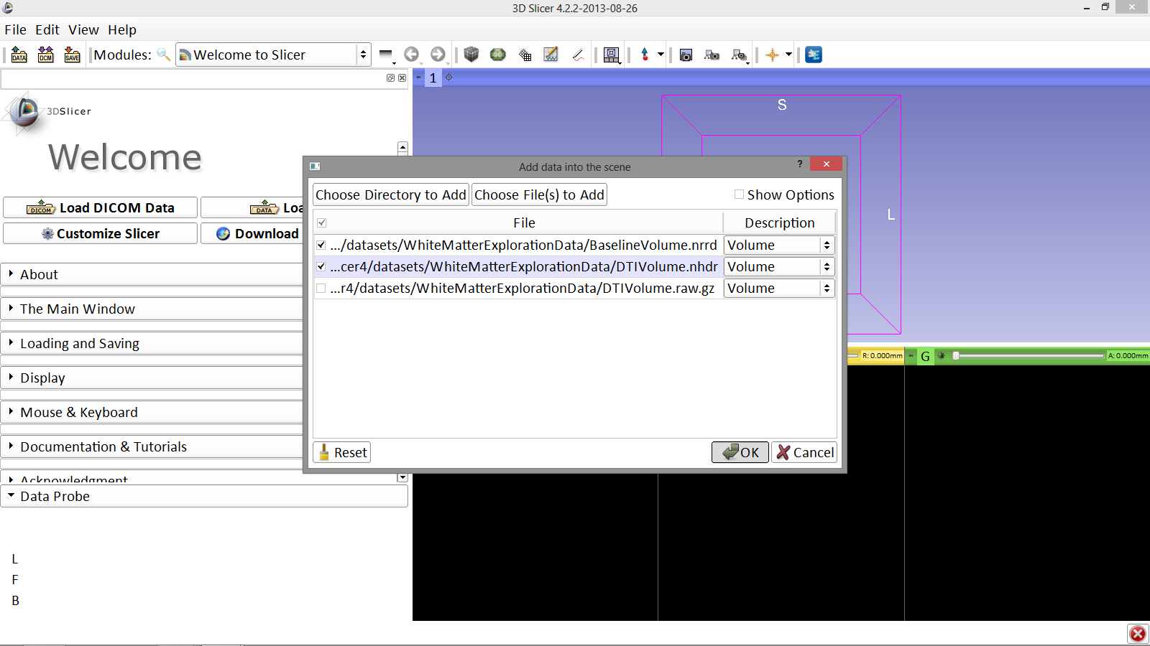
Loading DTI and Baseline Data
Image Courtesy of Dr. Alexandra Golby, Brigham and Women’s Hospital, Boston, MA..
Check off the Volumes BaselineVolume.nrrd and DTIVolume.nhdr click OK
White Matter Exploration for Neurosurgical Planning

Slide 13
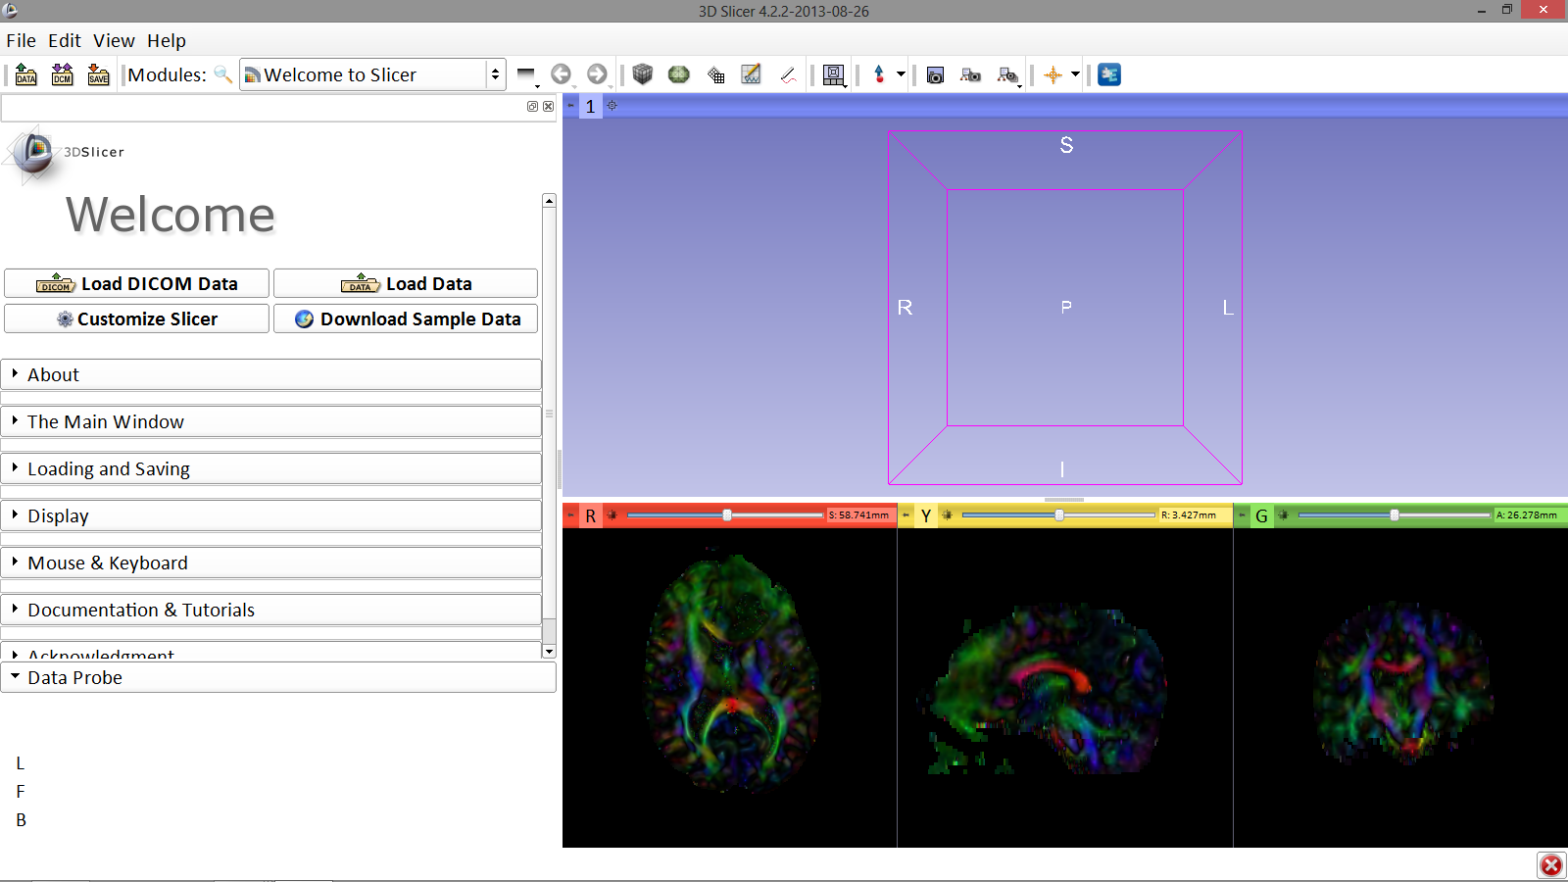
Loading DTI and Baseline Data
Slicer displays the elements of the scene, which contains the MR volume of the brain and a series of 3D surface models
Image Courtesy of Dr. Alexandra Golby, Brigham and Women’s Hospital, Boston, MA..
White Matter Exploration for Neurosurgical Planning

Slide 14
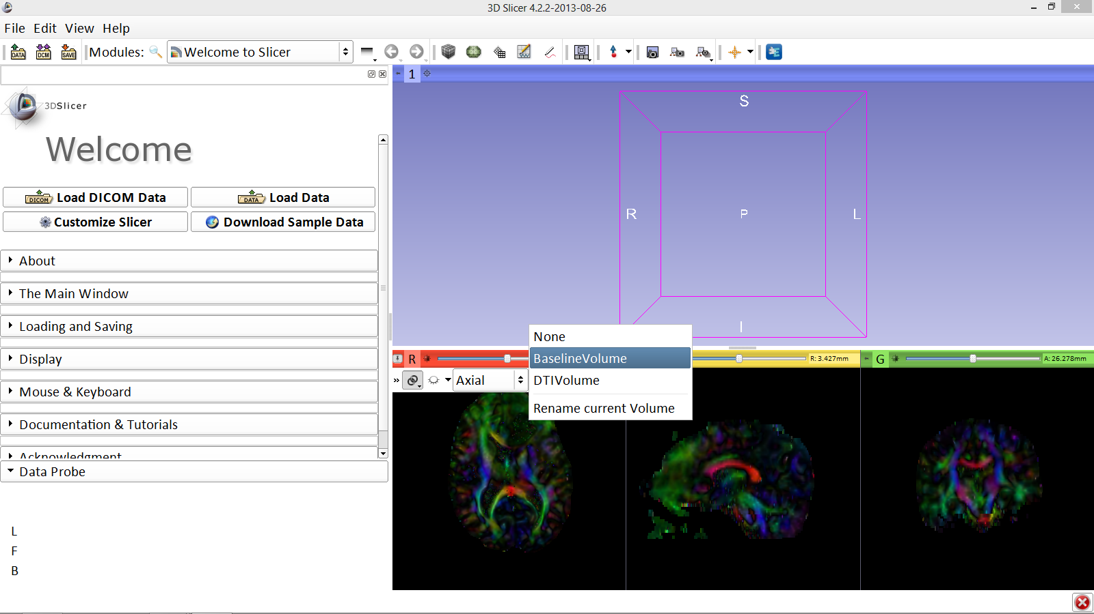
Loading DTI and Baseline Data
Click on the pin icon to display the slice menu, then click on the link icon to link the 3 anatomical viewers. Then change the background so it is set to BaselineVolume
Image Courtesy of Dr. Alexandra Golby, Brigham and Women’s Hospital, Boston, MA..
White Matter Exploration for Neurosurgical Planning

Slide 15
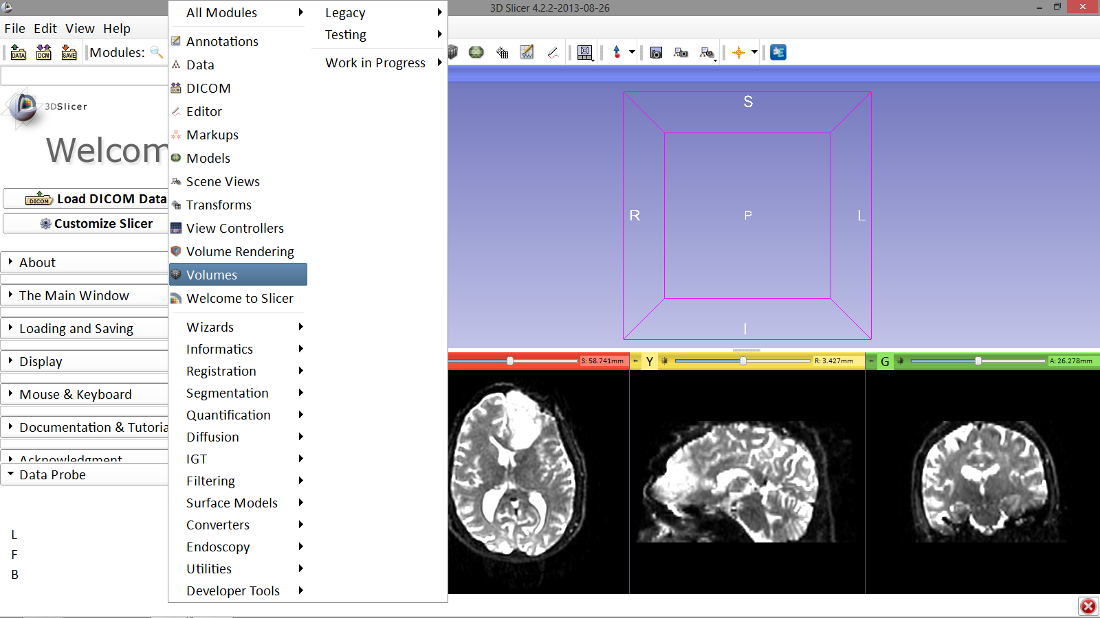
Loading DTI and Baseline Data
Select the Volumes module from the Modules menu
Image Courtesy of Dr. Alexandra Golby, Brigham and Women’s Hospital, Boston, MA..
White Matter Exploration for Neurosurgical Planning

Slide 16
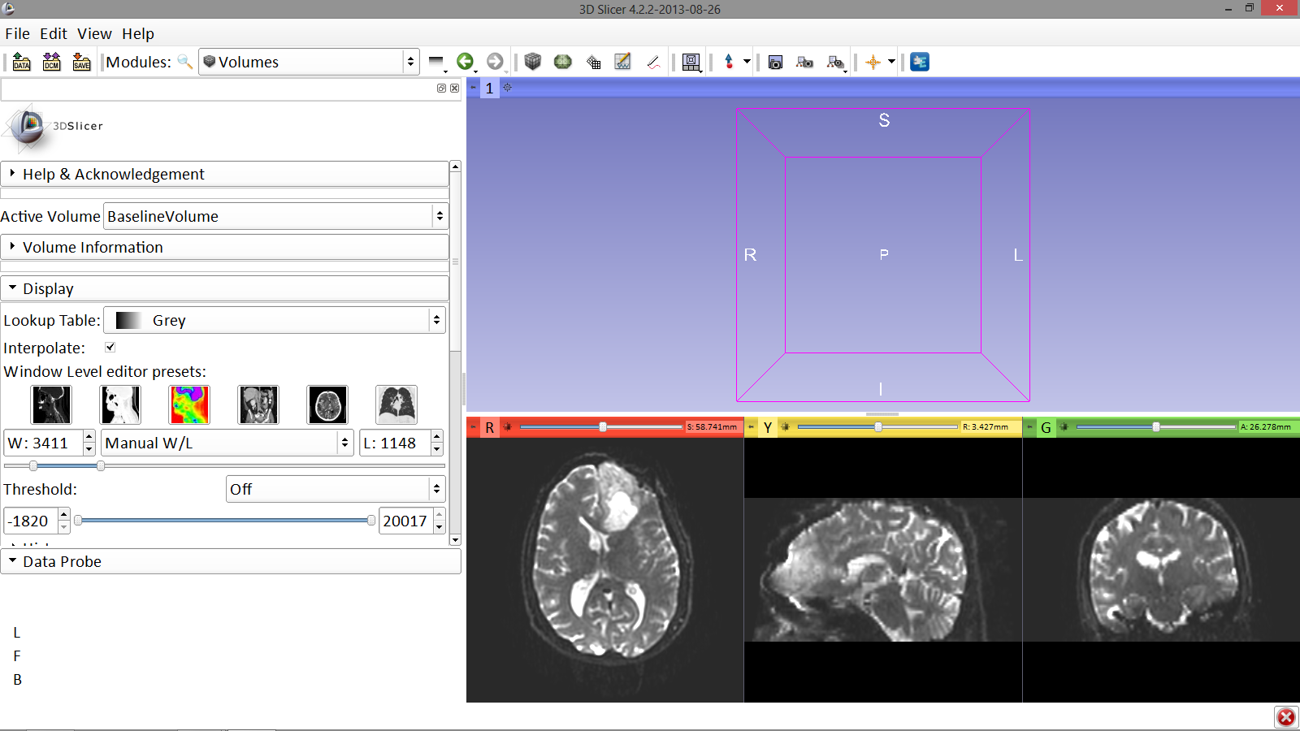
Loading DTI and Baseline Data
The user can manually adjust the Window Level editor presets with the Volume module menu
Image Courtesy of Dr. Alexandra Golby, Brigham and Women’s Hospital, Boston, MA..
White Matter Exploration for Neurosurgical Planning

Slide 17
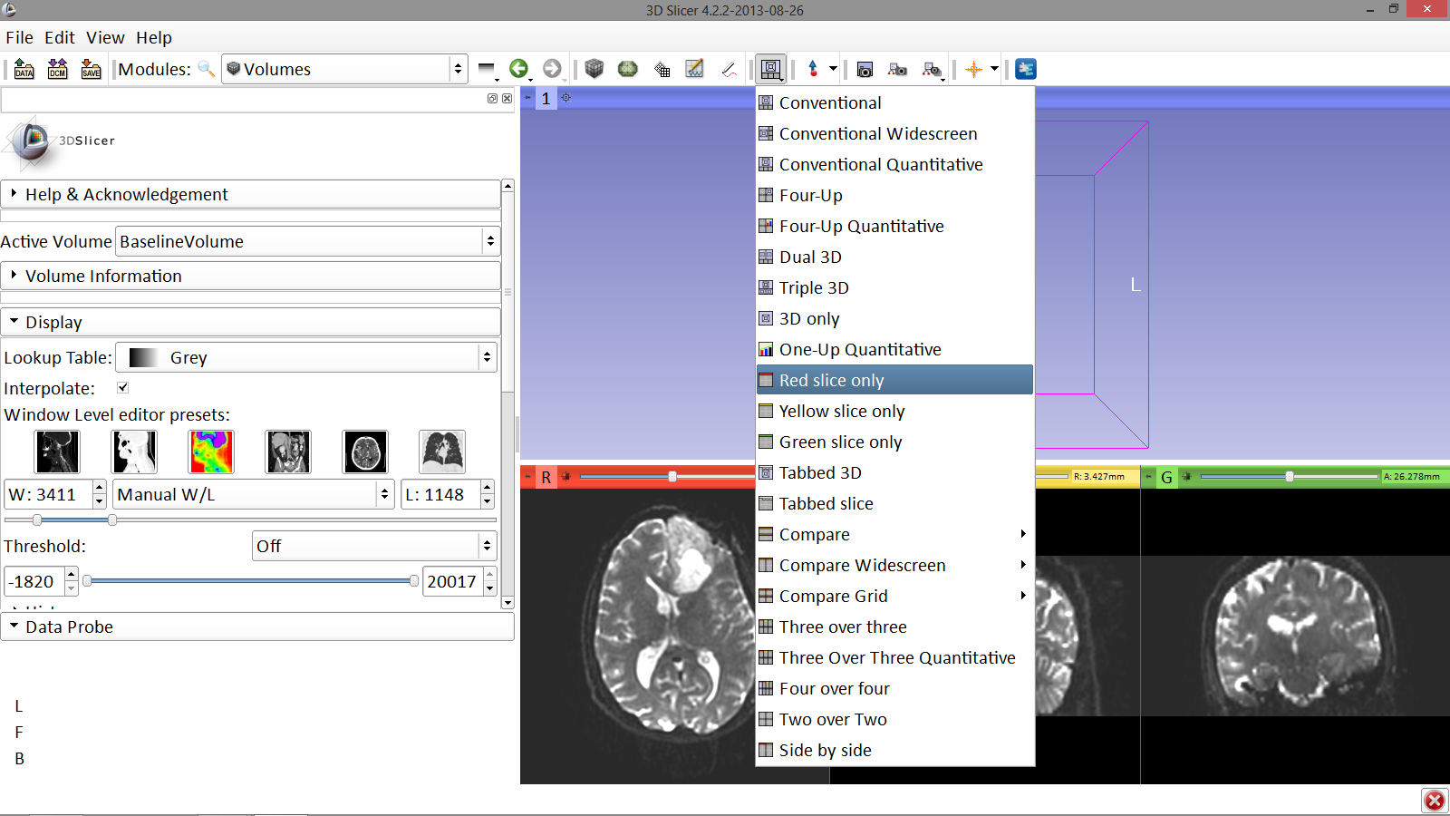
Loading DTI and Baseline Data
Click on the Layout menu and select the layout Red slice only
Image Courtesy of Dr. Alexandra Golby, Brigham and Women’s Hospital, Boston, MA..
White Matter Exploration for Neurosurgical Planning

Slide 18
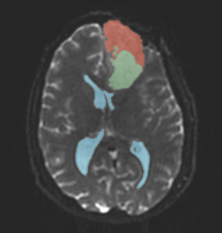
Part 1: Segmenting the tumor and ventricles
White Matter Exploration for Neurosurgical Planning

Slide 19
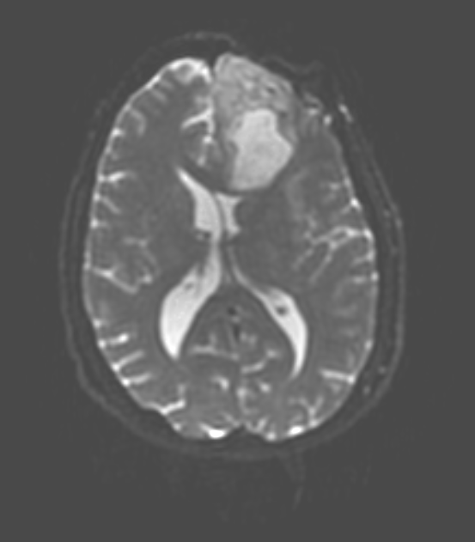
Tumor Segmentation
Solid part
Tumor
The tumor in this clinical case is composed of two parts: a solid part, and a cystic part.
In this section, we will segment the different parts of the tumor using a Grow Cut Segmentation algorithm.
Cystic part
White Matter Exploration for Neurosurgical Planning

Slide 20
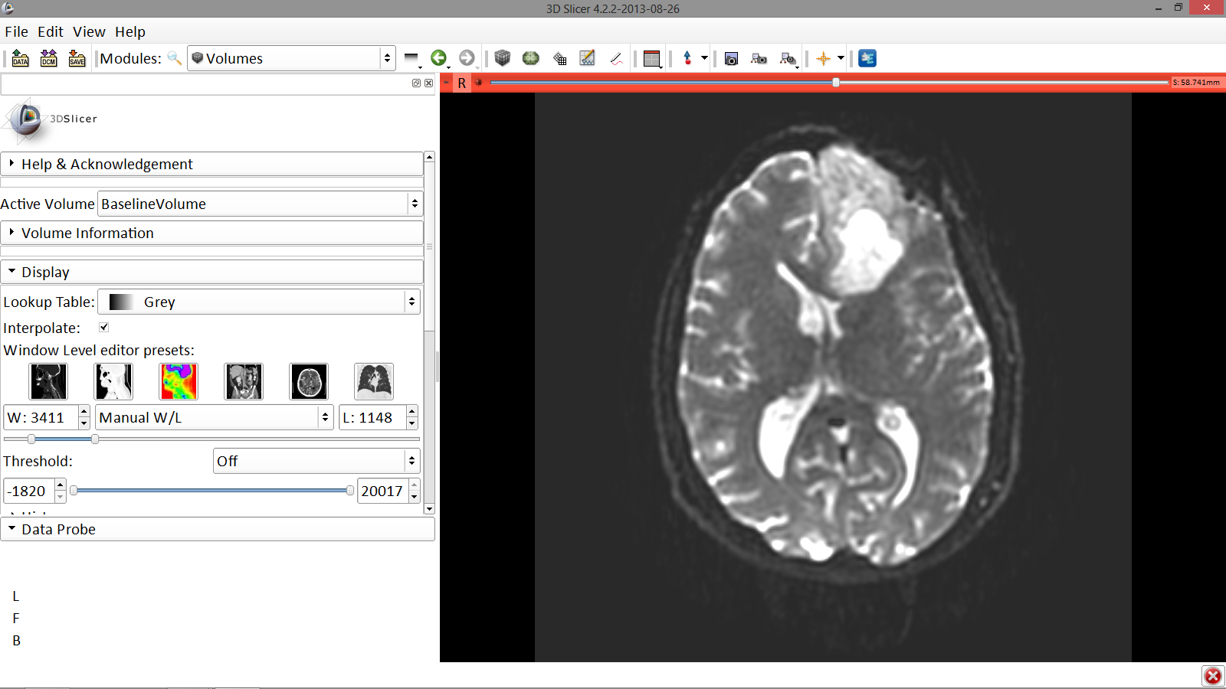
Tumor Segmentation
Slicer displays only the Axial anatomical slice in the Viewer
Image Courtesy of Dr. Alexandra Golby, Brigham and Women’s Hospital, Boston, MA..
White Matter Exploration for Neurosurgical Planning

Slide 21
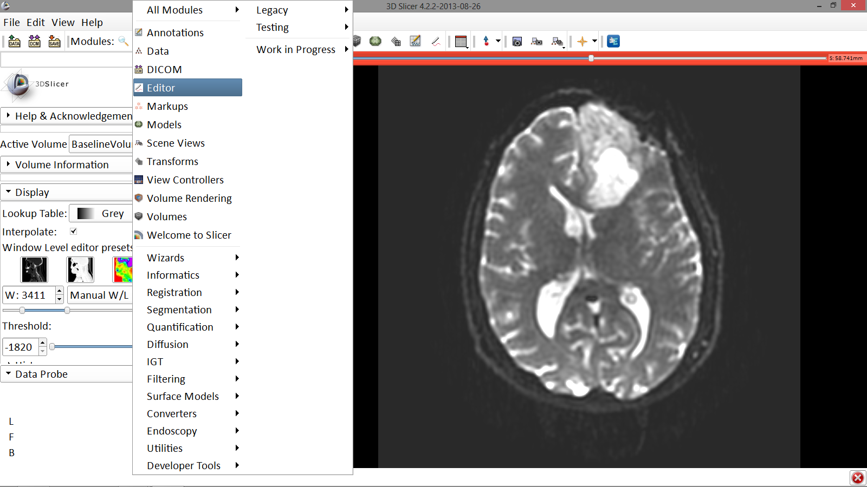
Tumor Segmentation
Click on the Modules menu and select the module Editor
Image Courtesy of Dr. Alexandra Golby, Brigham and Women’s Hospital, Boston, MA..
White Matter Exploration for Neurosurgical Planning

Slide 22
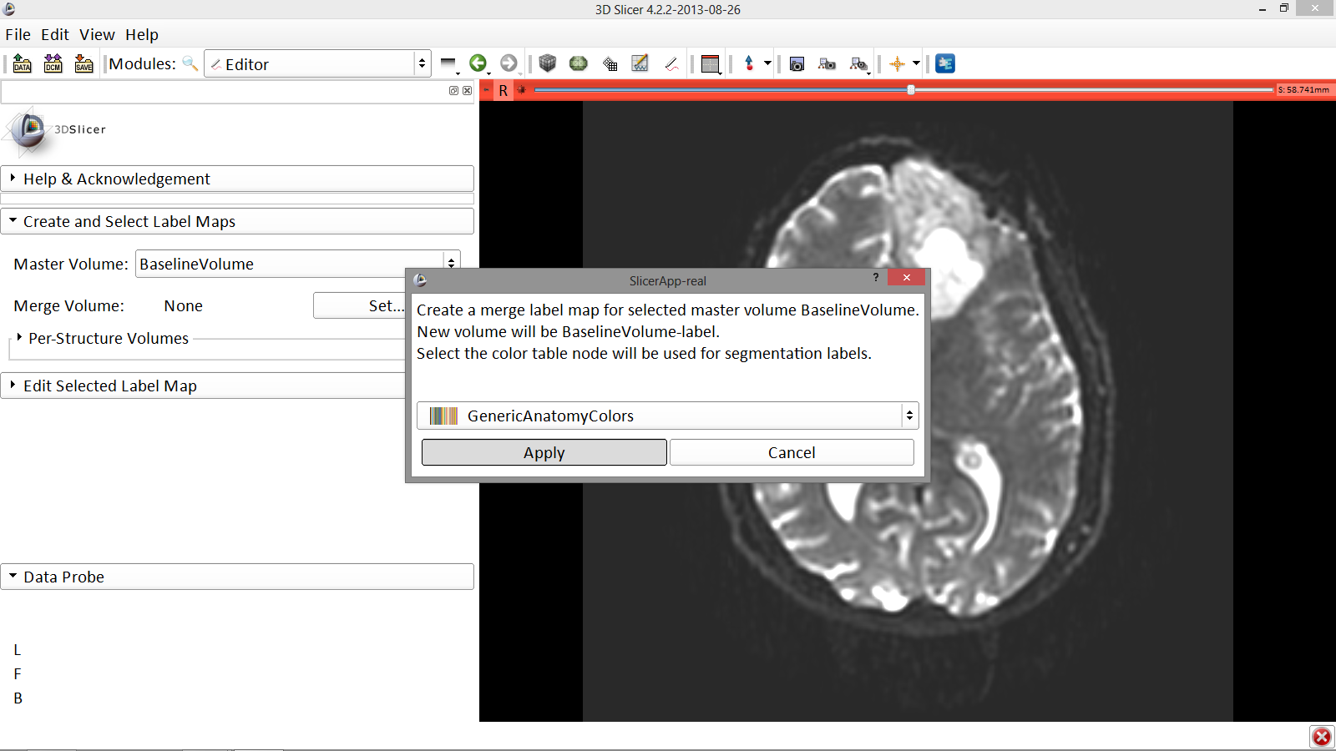
Tumor Segmentation
Image Courtesy of Dr. Alexandra Golby, Brigham and Women’s Hospital, Boston, MA..
The ‘SlicerApp-real’ window appears. Select the label map GenericAnatomyColors and click Apply
White Matter Exploration for Neurosurgical Planning

Slide 23
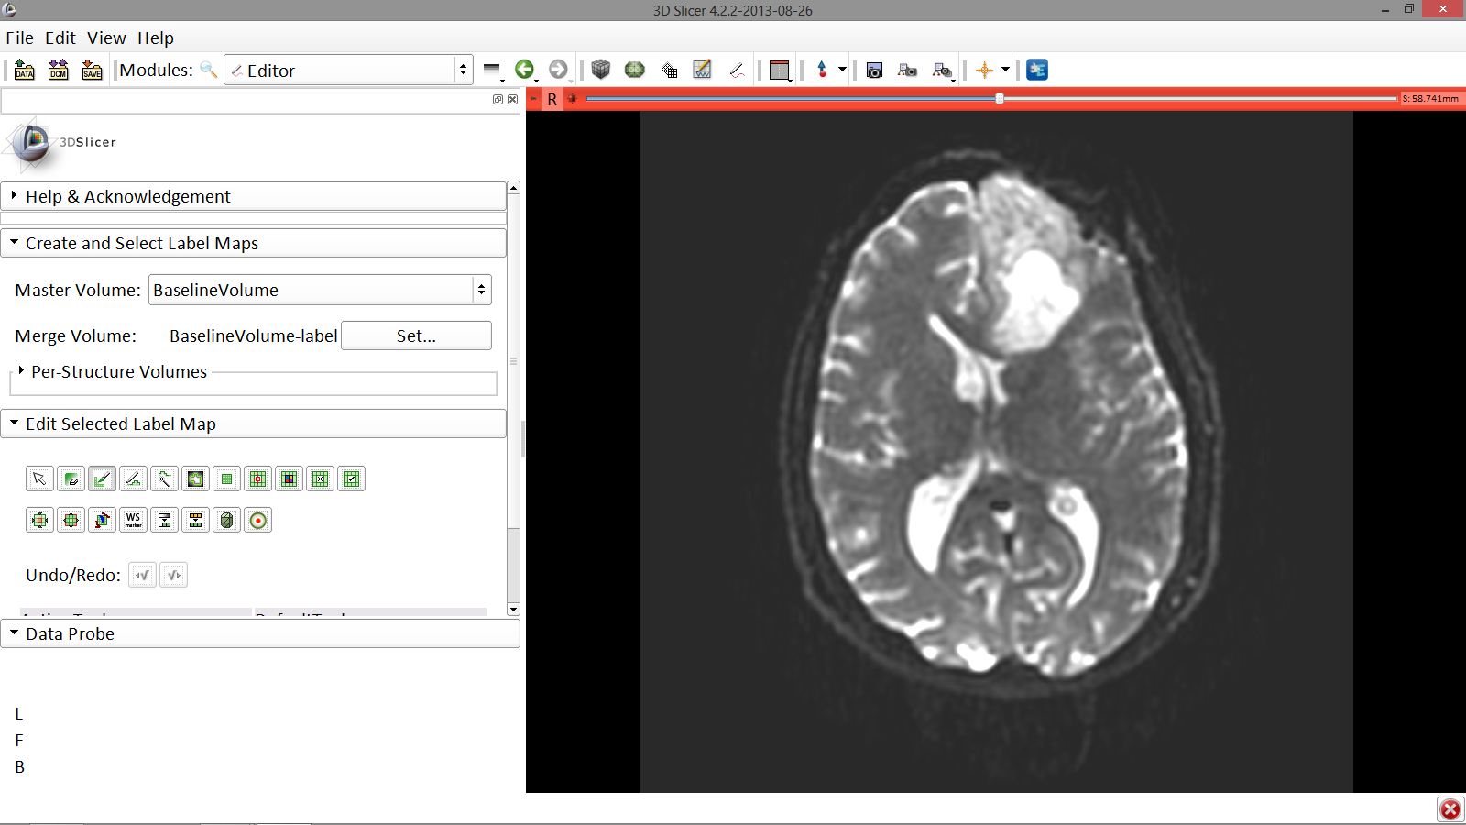
Tumor Segmentation
Select the PaintEffect tool
Image Courtesy of Dr. Alexandra Golby, Brigham and Women’s Hospital, Boston, MA..
White Matter Exploration for Neurosurgical Planning

Slide 24
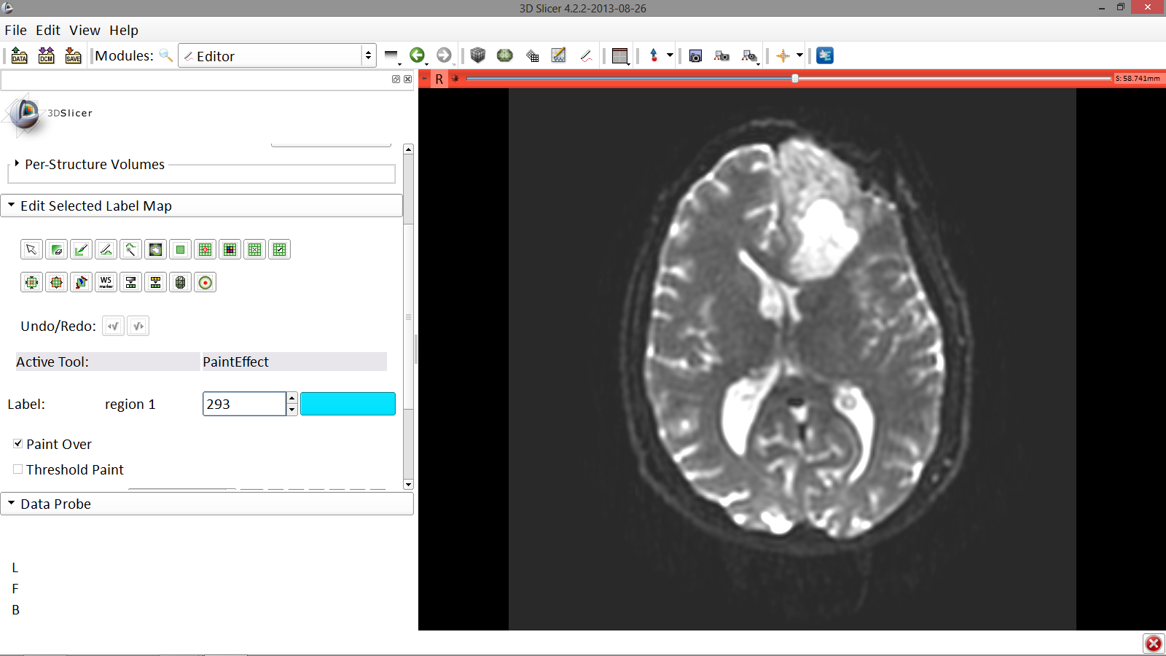
Tumor Segmentation
Image Courtesy of Dr. Alexandra Golby, Brigham and Women’s Hospital, Boston, MA..
Scroll down the Editor module and choose color #293 for the region 1 label
White Matter Exploration for Neurosurgical Planning

Slide 25
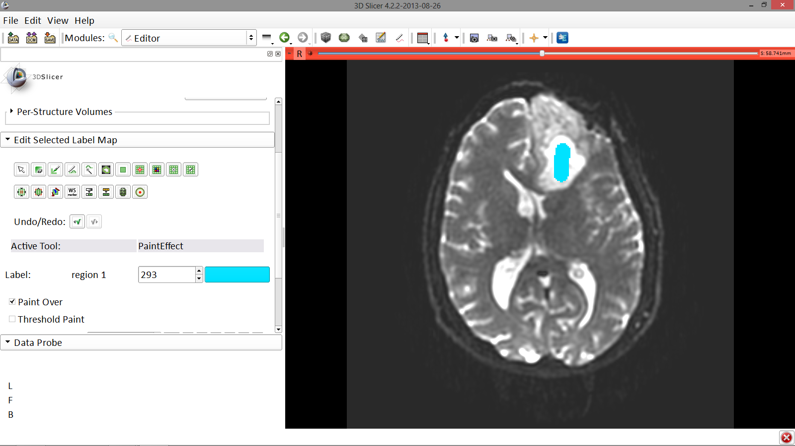
Tumor Segmentation
In a single motion, draw a short line in the cystic part of the tumor
Image Courtesy of Dr. Alexandra Golby, Brigham and Women’s Hospital, Boston, MA..
White Matter Exploration for Neurosurgical Planning

Slide 26
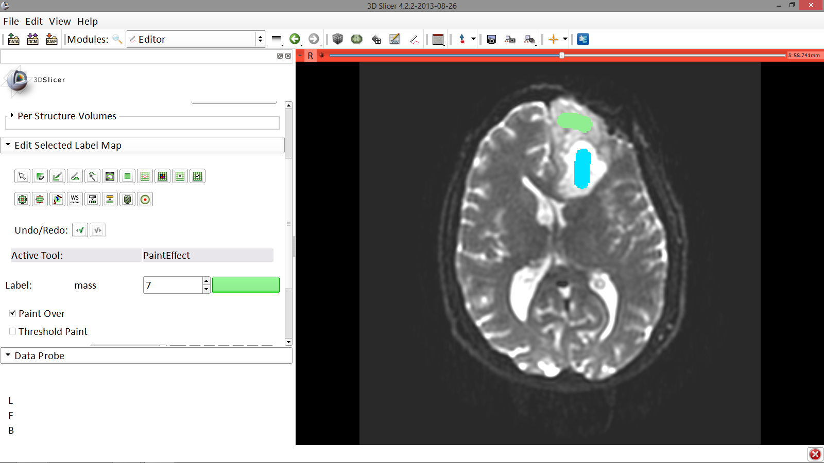
Tumor Segmentation
Select color #7 for the mass label and, again in a single motion, draw a short line in the solid part of the tumor
Image Courtesy of Dr. Alexandra Golby, Brigham and Women’s Hospital, Boston, MA..
White Matter Exploration for Neurosurgical Planning

Slide 27
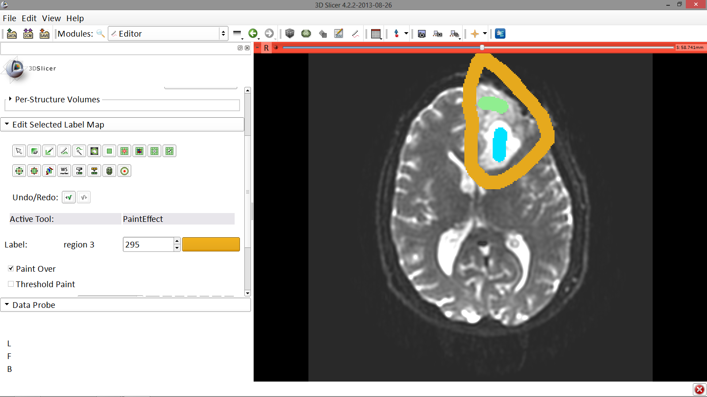
Tumor Segmentation
Select color #295 for region 3 and draw a circle around the tumor
Image Courtesy of Dr. Alexandra Golby, Brigham and Women’s Hospital, Boston, MA..
White Matter Exploration for Neurosurgical Planning

Slide 28
Tumor Segmentation
Image Courtesy of Dr. Alexandra Golby, Brigham and Women’s Hospital, Boston, MA..
Select the GrowCutEffect tool
White Matter Exploration for Neurosurgical Planning

Slide 29
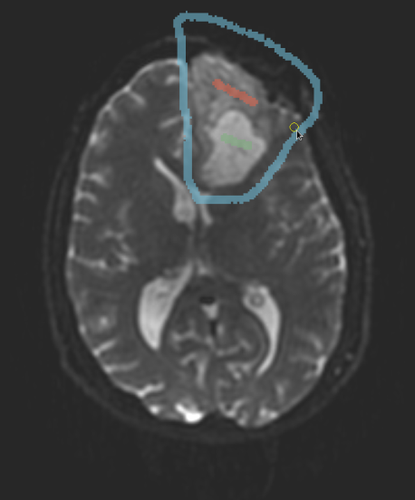
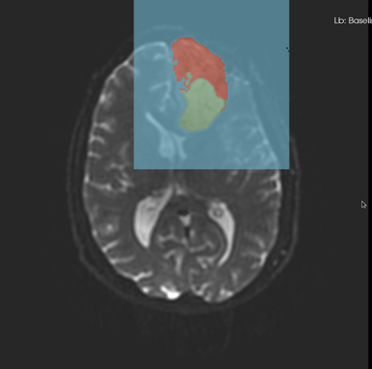
Grow Cut Segmentation
The Grow Cut Segmentation method is a competitive region growing algorithm using Cellular Automata.
The algorithm performs multi-label image segmentation using a set of user input scribbles.
V. Vezhnevets, V. Konouchine. "Grow-Cut" - Interactive Multi-Label N-D Image Segmentation". Proc. Graphicon. 2005 . pp. 150–156.
White Matter Exploration for Neurosurgical Planning
Notes:
The pixel labelling process can be seen as
growth and struggle for domination of K types of bacteria. The bacteria
start to spread (grow) from the seed pixels and try to occupy
all the image.

Slide 30
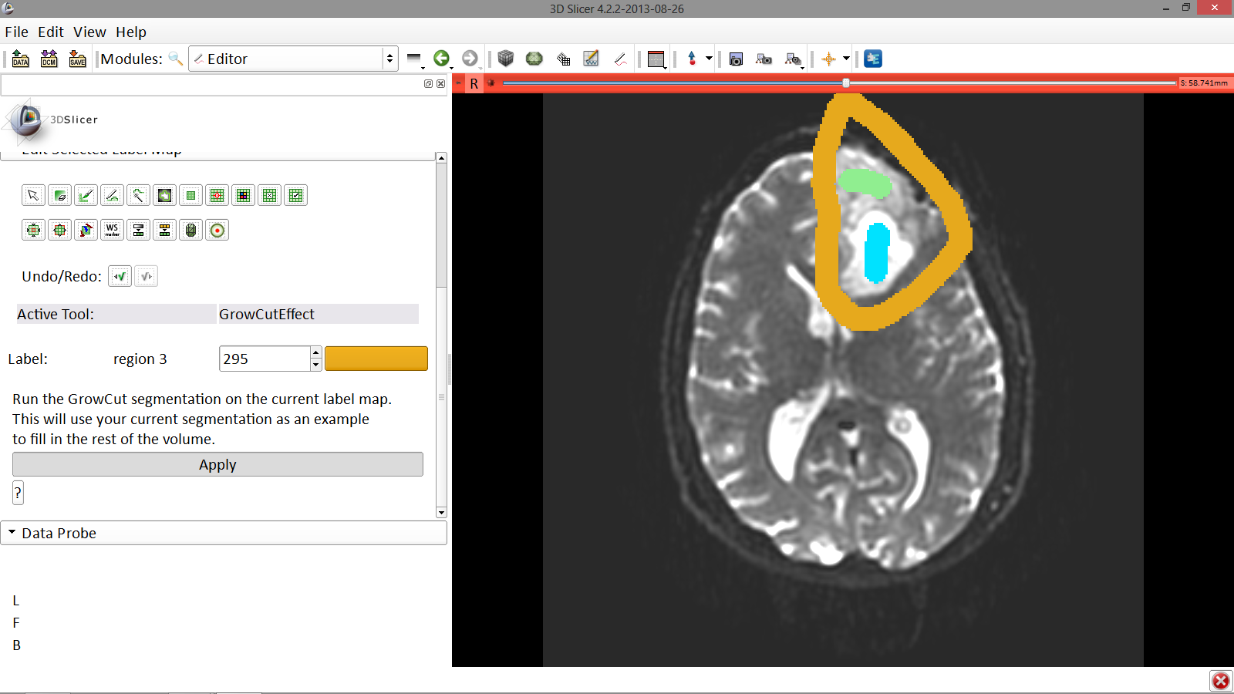
Tumor Segmentation
Image Courtesy of Dr. Alexandra Golby, Brigham and Women’s Hospital, Boston, MA..
Click Apply to apply the GrowCutEffect segmentation algorithm
White Matter Exploration for Neurosurgical Planning

Slide 31
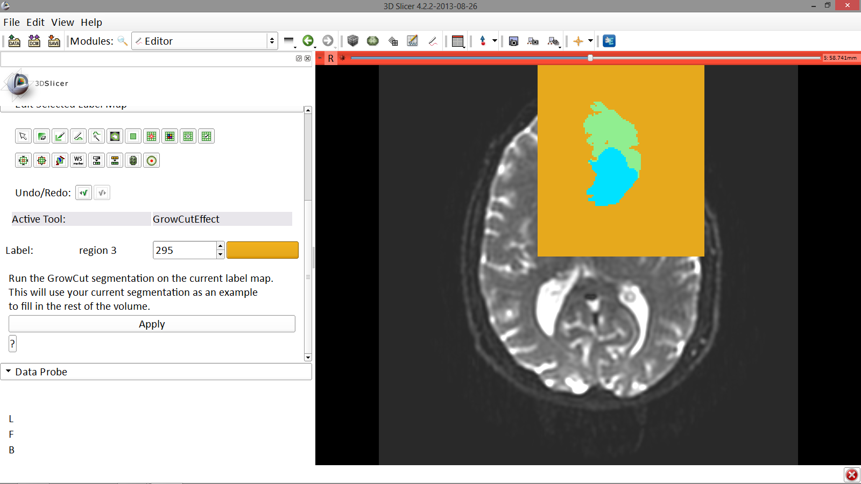
Tumor Segmentation
Solid part
Slicer displays the results from the segmentation
Cystic part
Image Courtesy of Dr. Alexandra Golby, Brigham and Women’s Hospital, Boston, MA..
White Matter Exploration for Neurosurgical Planning

Slide 32
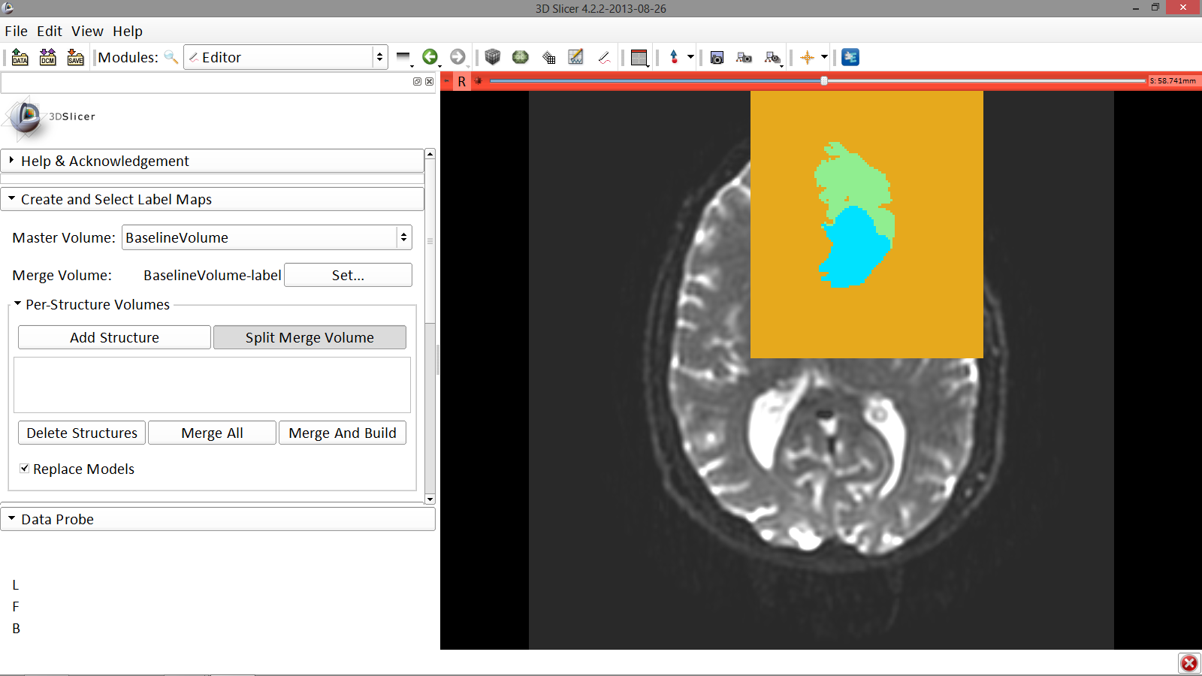
Tumor Segmentation
Scroll up the Editor menu and select the tab Per-Structure Volumes. Then click Split Merge Volume
Image Courtesy of Dr. Alexandra Golby, Brigham and Women’s Hospital, Boston, MA..
White Matter Exploration for Neurosurgical Planning

Slide 33
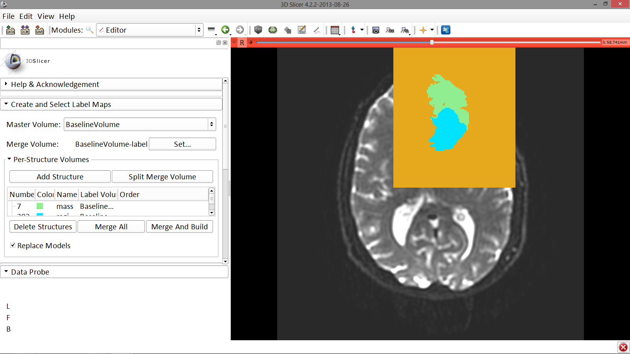
Tumor Segmentation
The label map BaselineVolume-label has been split into three volumes:
BaselineVolume-mass-label: solid part of the tumor
BaselineVolume-region_1-label: cystic part of the tumor
BaselineVolume-region_3-label: surrounding structures
Image Courtesy of Dr. Alexandra Golby, Brigham and Women’s Hospital, Boston, MA..
White Matter Exploration for Neurosurgical Planning

Slide 34
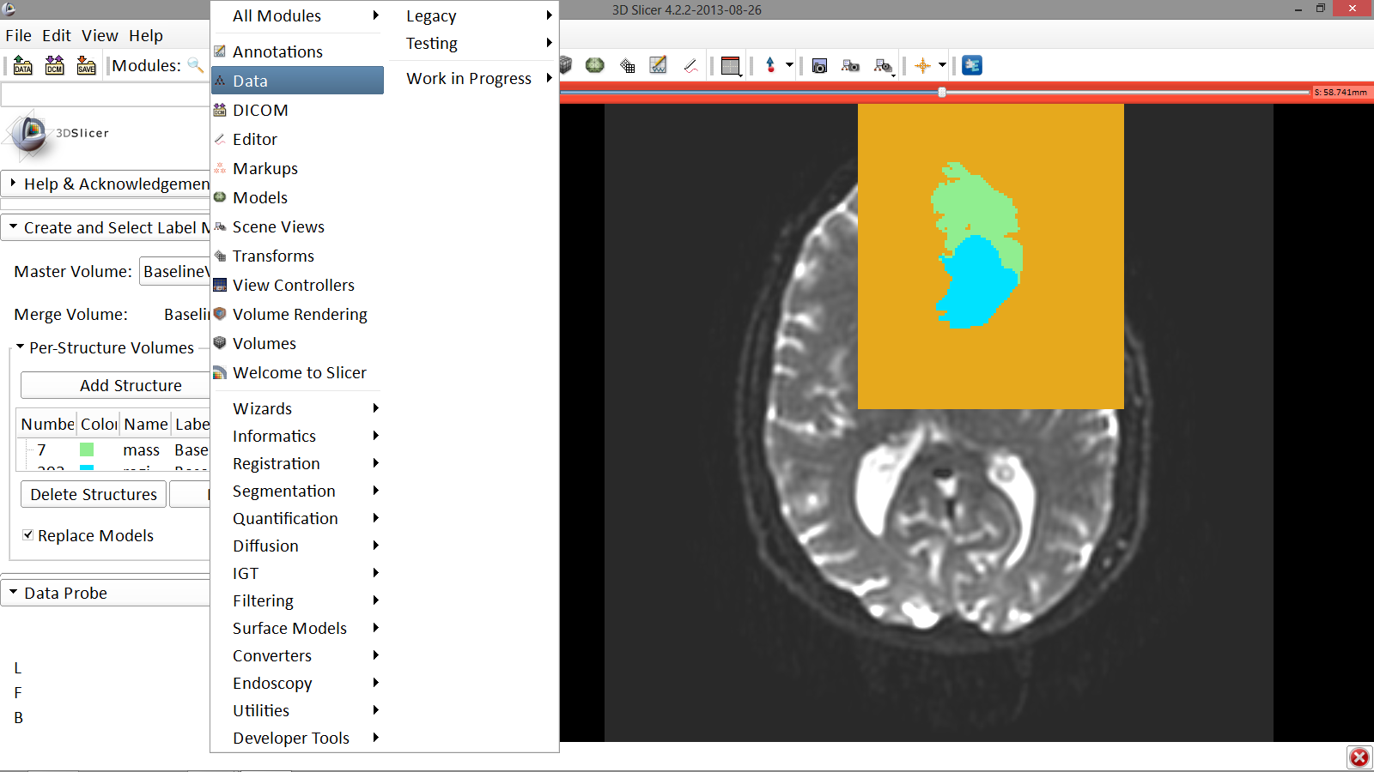
Tumor Segmentation
Click on the Modules menu and select the Module Data
Image Courtesy of Dr. Alexandra Golby, Brigham and Women’s Hospital, Boston, MA..
White Matter Exploration for Neurosurgical Planning

Slide 35
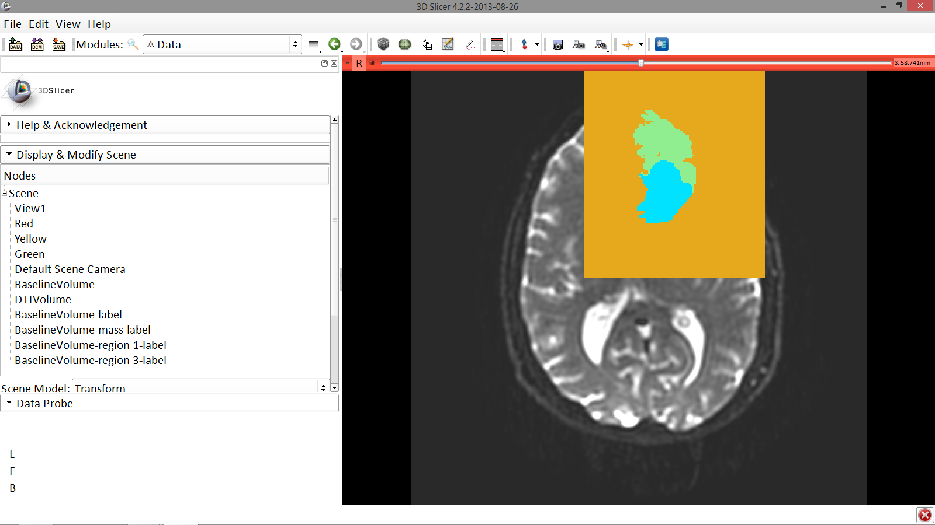
Tumor Segmentation
The different label maps have been generated
Image Courtesy of Dr. Alexandra Golby, Brigham and Women’s Hospital, Boston, MA..
White Matter Exploration for Neurosurgical Planning

Slide 36
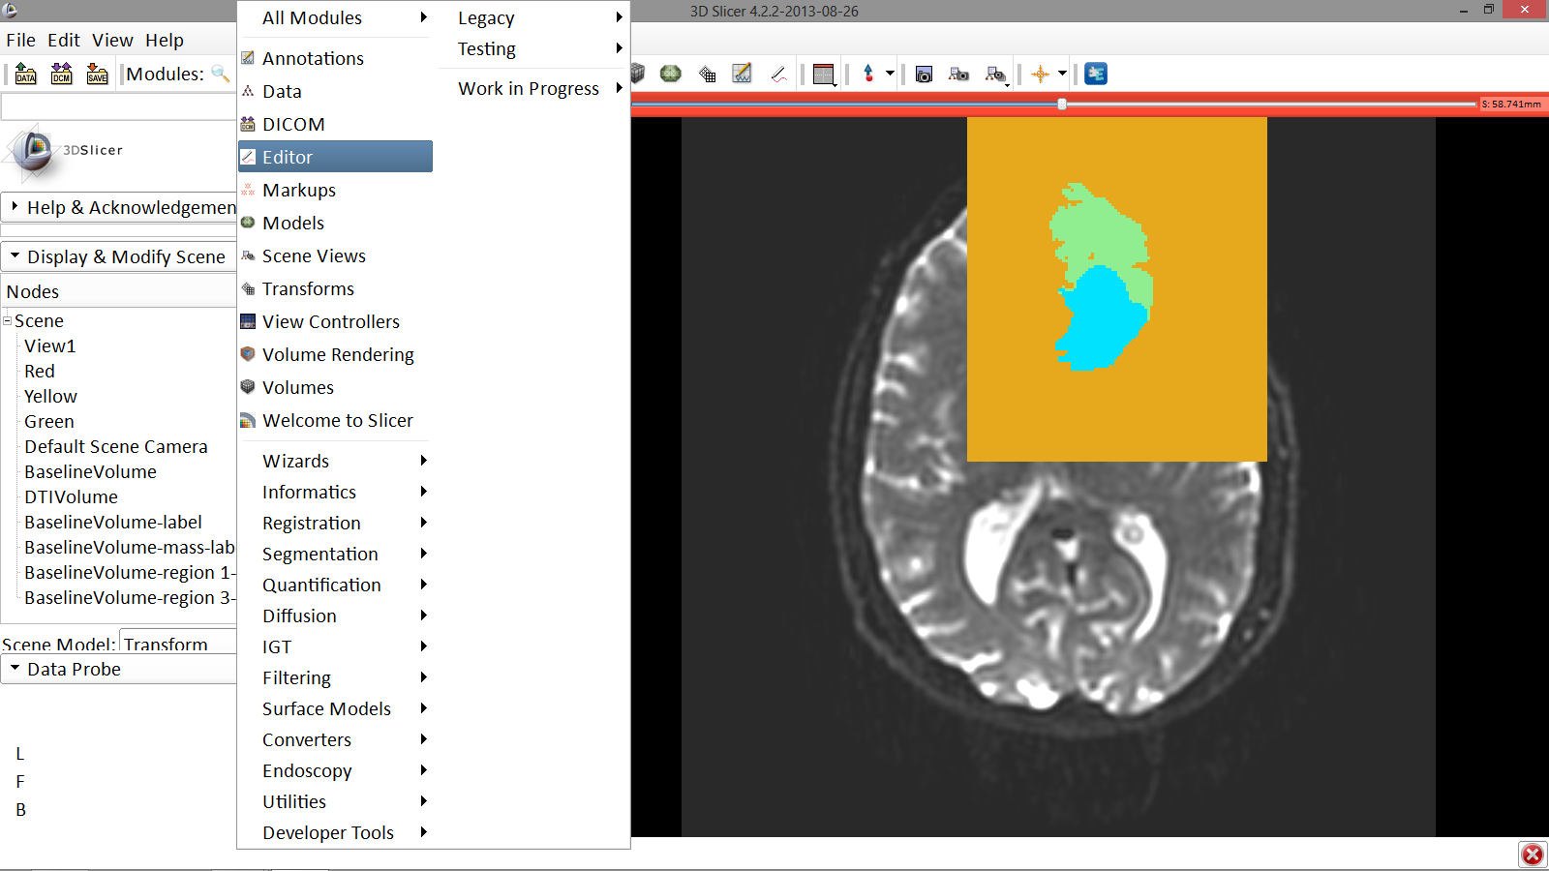
Ventricles Segmentation
Go back to the Editor module
Image Courtesy of Dr. Alexandra Golby, Brigham and Women’s Hospital, Boston, MA..
White Matter Exploration for Neurosurgical Planning

Slide 37
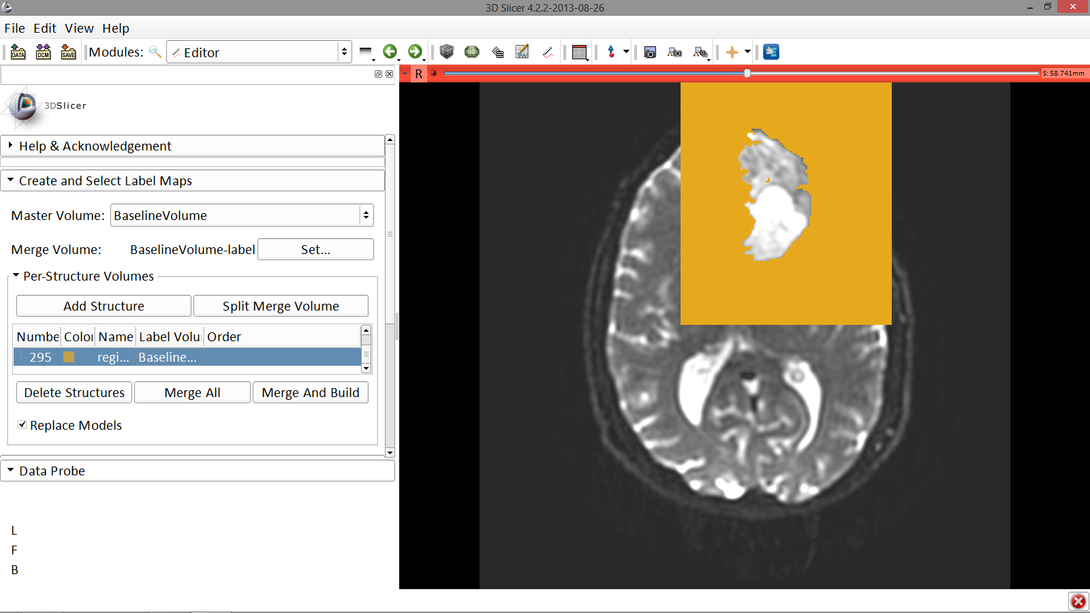
Ventricles Segmentation
Select the volume
BaselineVolume-region_3-label so that it is highlighted and that the yellow region is visible in the viewer
Image Courtesy of Dr. Alexandra Golby, Brigham and Women’s Hospital, Boston, MA..
White Matter Exploration for Neurosurgical Planning

Slide 38
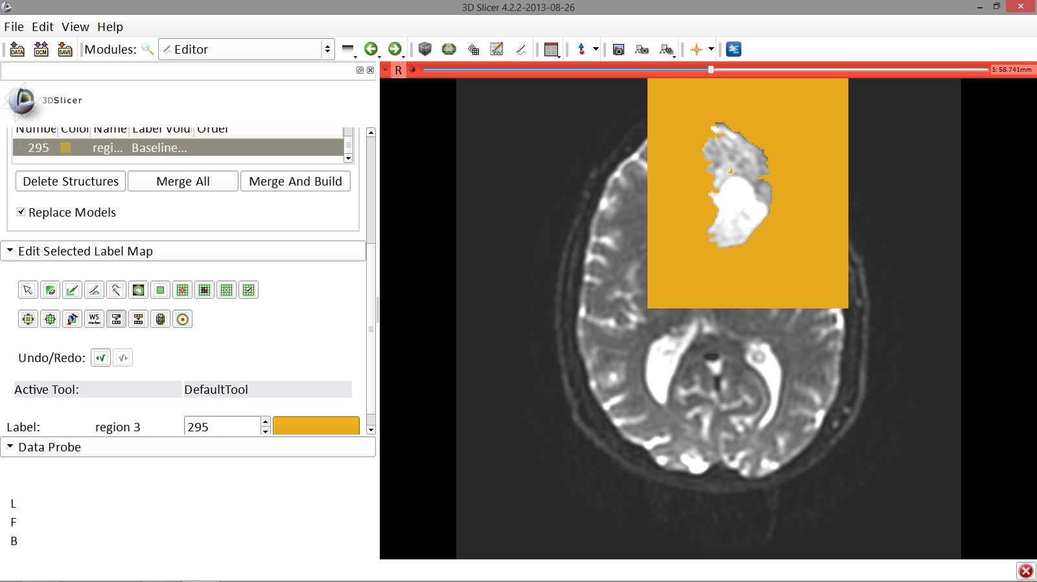
Ventricles Segmentation
Image Courtesy of Dr. Alexandra Golby, Brigham and Women’s Hospital, Boston, MA..
Select the ThresholdEffect tool
White Matter Exploration for Neurosurgical Planning

Slide 39
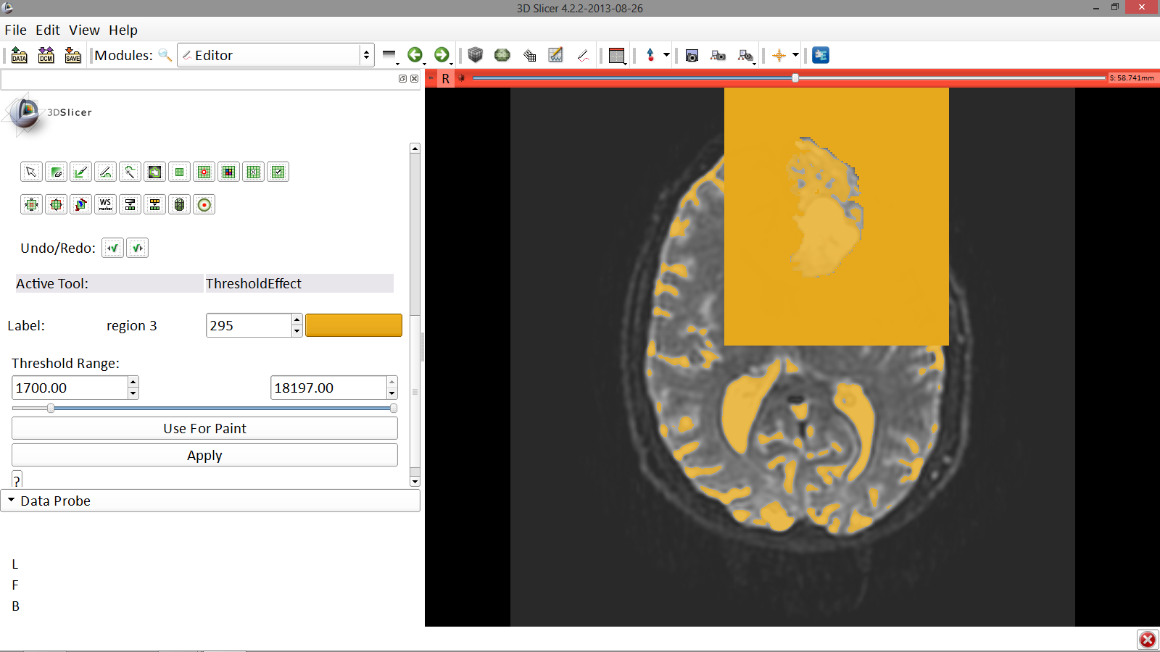
Ventricles Segmentation
Scroll down the Editor module and set the lower Threshold Range to 1700 and click Apply
Image Courtesy of Dr. Alexandra Golby, Brigham and Women’s Hospital, Boston, MA..
White Matter Exploration for Neurosurgical Planning

Slide 40
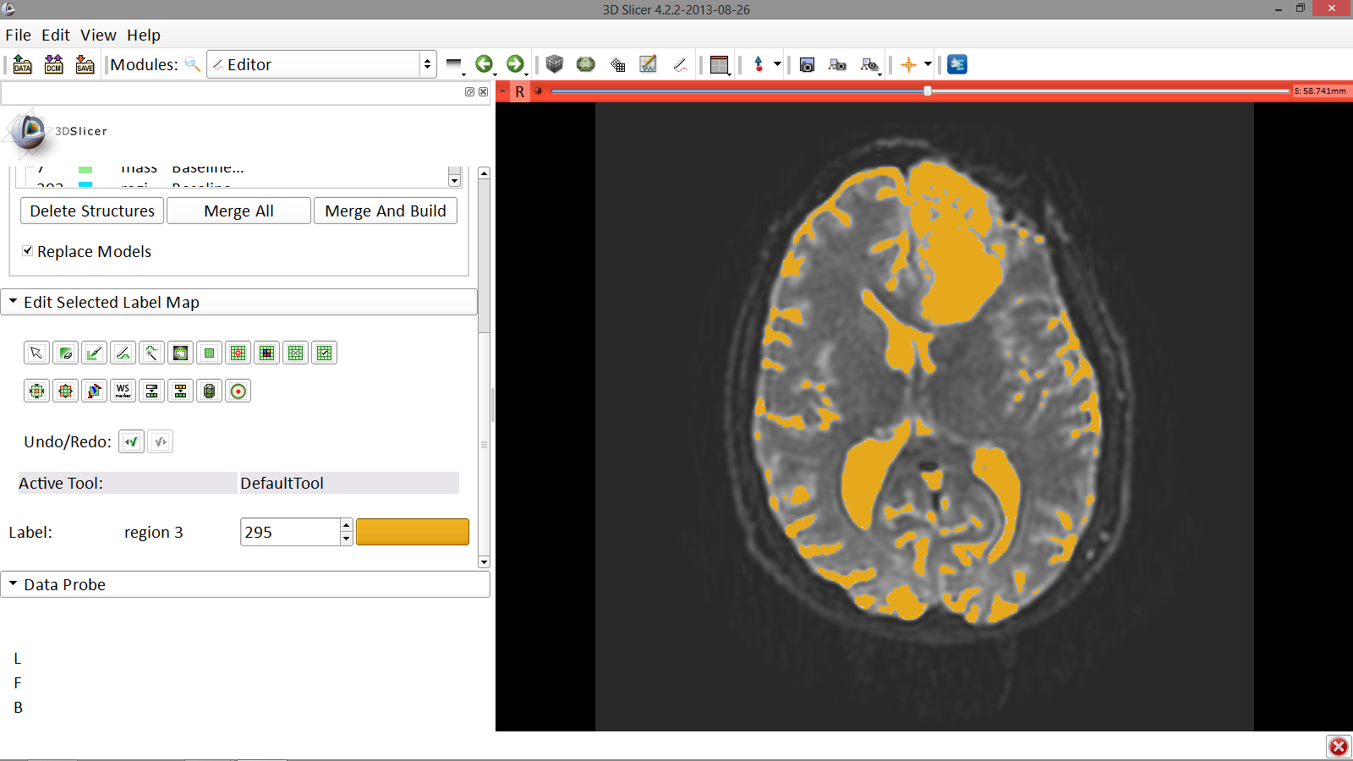
Ventricles Segmentation
Slicer displays the result of the threshold
Image Courtesy of Dr. Alexandra Golby, Brigham and Women’s Hospital, Boston, MA..
White Matter Exploration for Neurosurgical Planning

Slide 41
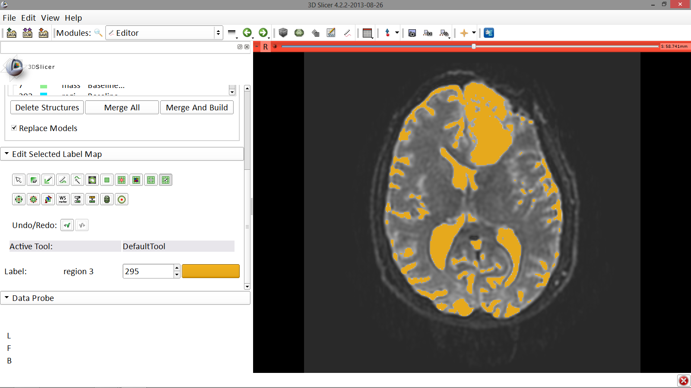
Ventricles Segmentation
Select the SaveIslandEffect in the Editor module
Image Courtesy of Dr. Alexandra Golby, Brigham and Women’s Hospital, Boston, MA..
White Matter Exploration for Neurosurgical Planning

Slide 42
Ventricles Segmentation
With the SaveIslandEffect tool equipped, click in the occipital horn of the ventricle
Image Courtesy of Dr. Alexandra Golby, Brigham and Women’s Hospital, Boston, MA..
White Matter Exploration for Neurosurgical Planning

Slide 43
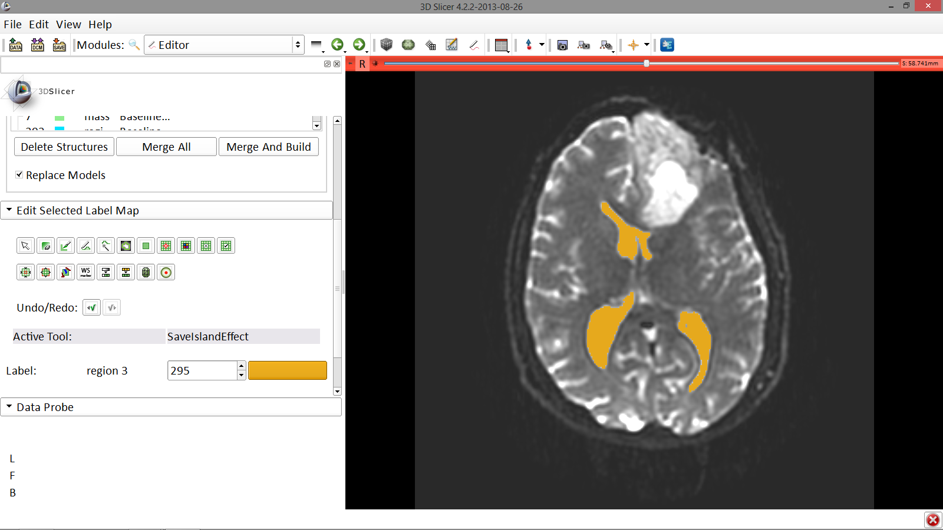
Final Result of Segmentation
Slicer displays the result of the segmentation of the ventricles.
Image Courtesy of Dr. Alexandra Golby, Brigham and Women’s Hospital, Boston, MA..
White Matter Exploration for Neurosurgical Planning

Slide 44
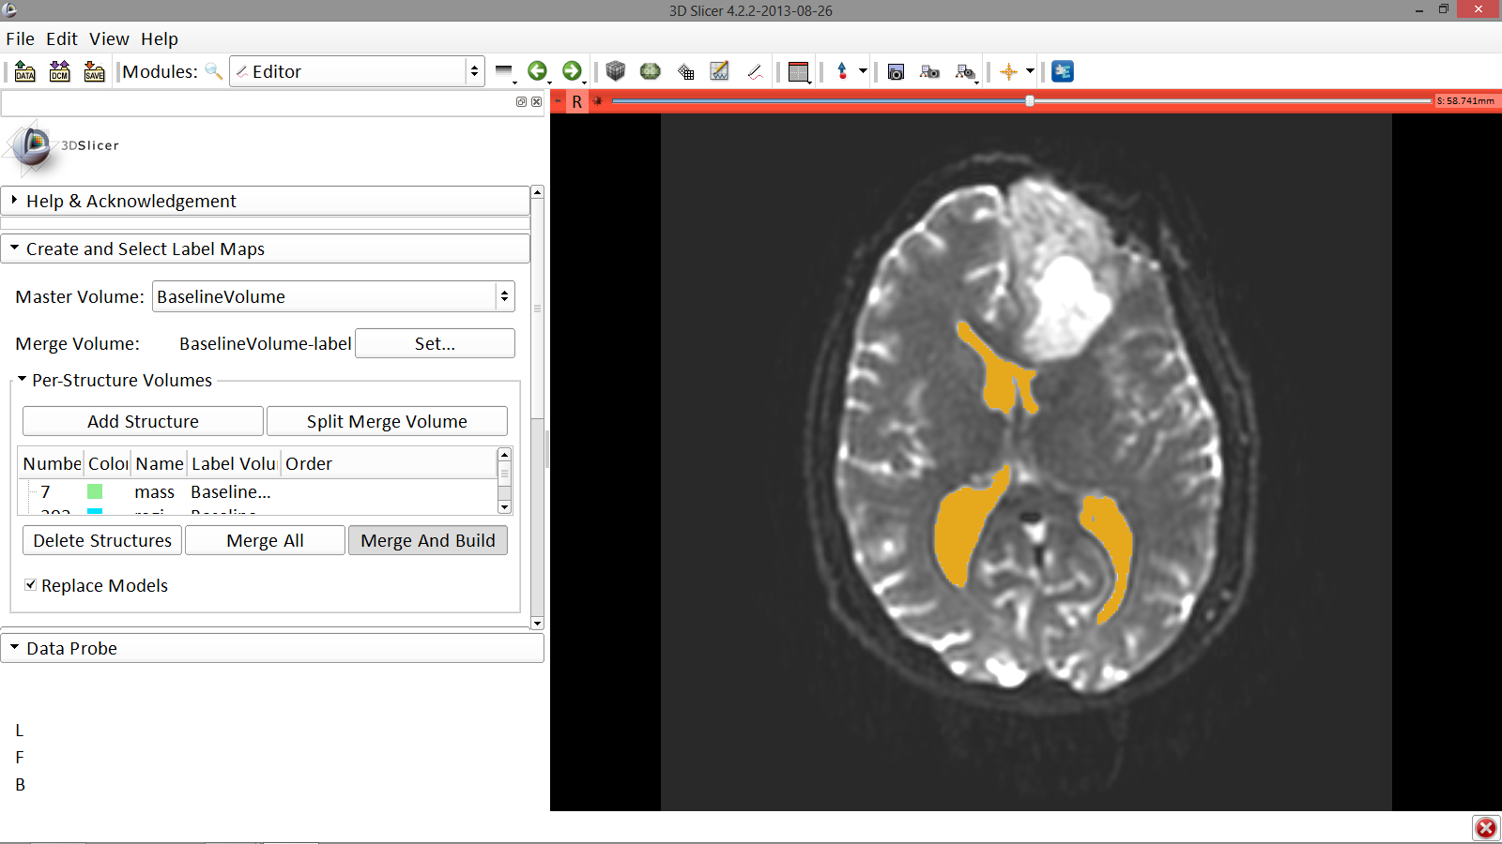
Final Result of Segmentation
Scroll back up and click on Merge and Build to merge the different label maps, and generate the 3D models of the tumor and ventricles using a Marching Cubes algorithm
Image Courtesy of Dr. Alexandra Golby, Brigham and Women’s Hospital, Boston, MA..
White Matter Exploration for Neurosurgical Planning

Slide 45
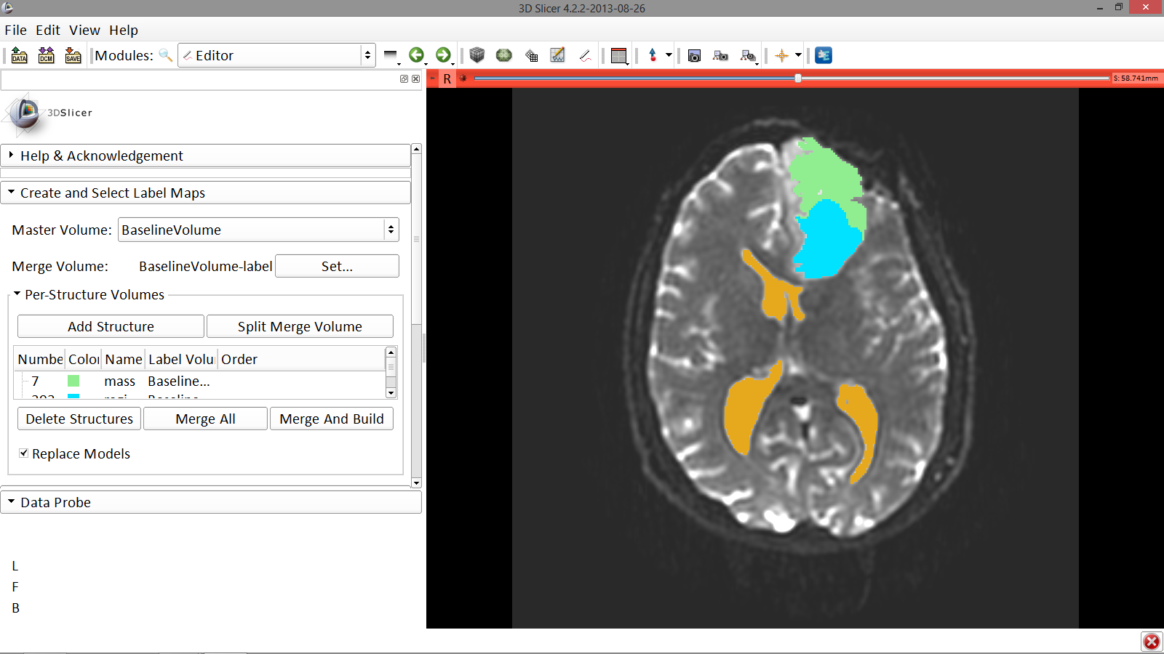
Final Result of Segmentation
Slicer displays the results of the merging of the segmentations of the ventricles and the tumor in the Viewer
Image Courtesy of Dr. Alexandra Golby, Brigham and Women’s Hospital, Boston, MA..
White Matter Exploration for Neurosurgical Planning

Slide 46
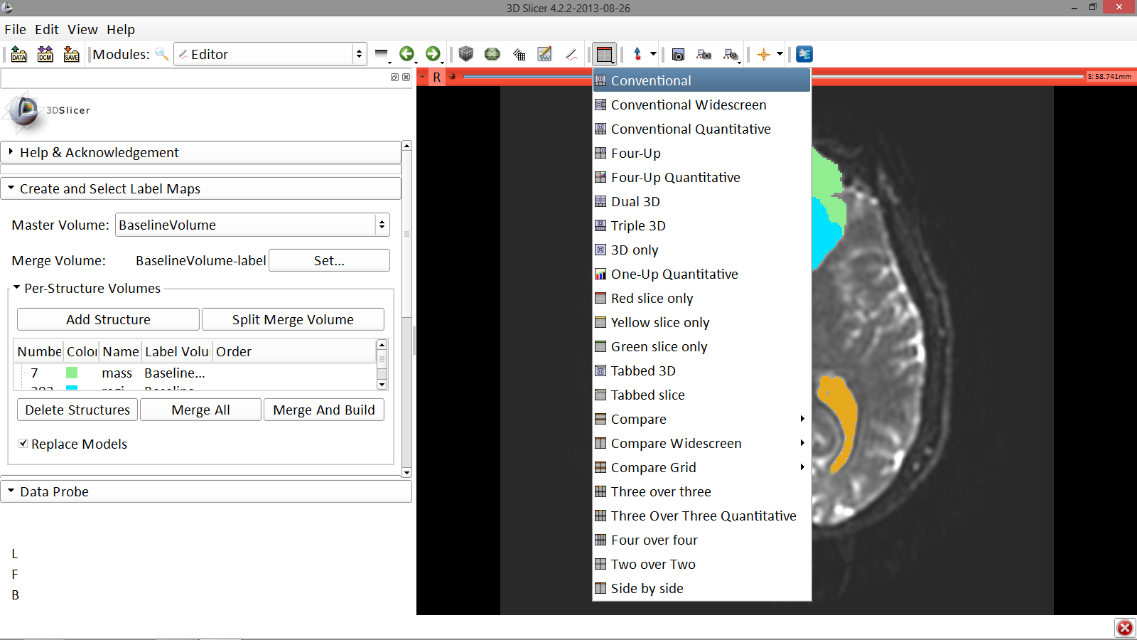
Final Result of Segmentation
Click on the Layout menu and select Conventional
Image Courtesy of Dr. Alexandra Golby, Brigham and Women’s Hospital, Boston, MA..
White Matter Exploration for Neurosurgical Planning

Slide 47
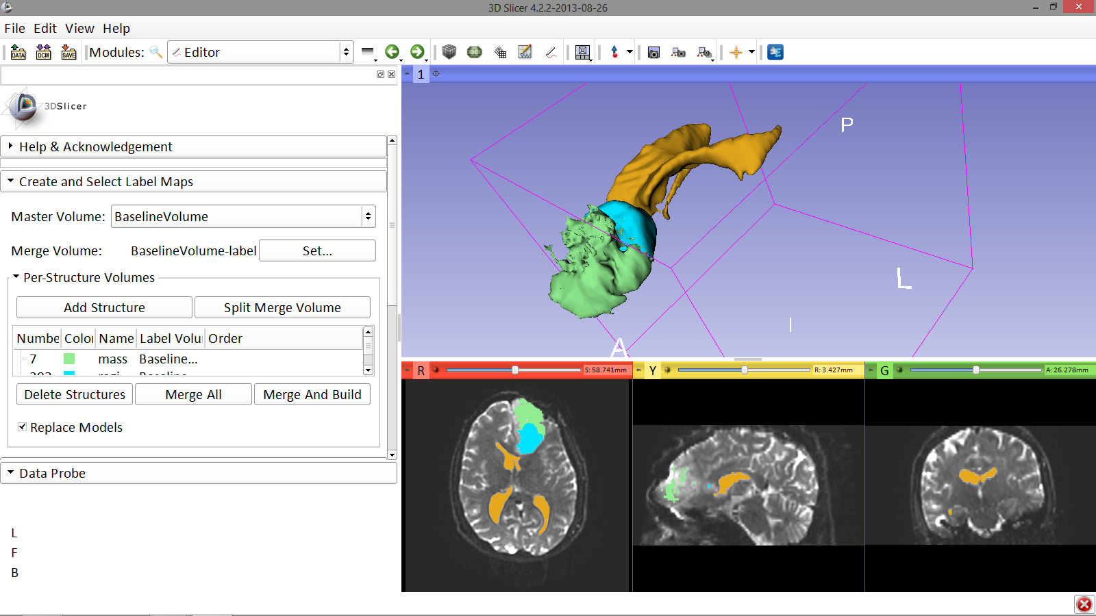
Final Result of Segmentation
Slicer displays the 3D surface reconstructions of the ventricles, and solid and cystic parts of the tumor.
Image Courtesy of Dr. Alexandra Golby, Brigham and Women’s Hospital, Boston, MA..
White Matter Exploration for Neurosurgical Planning

Slide 48
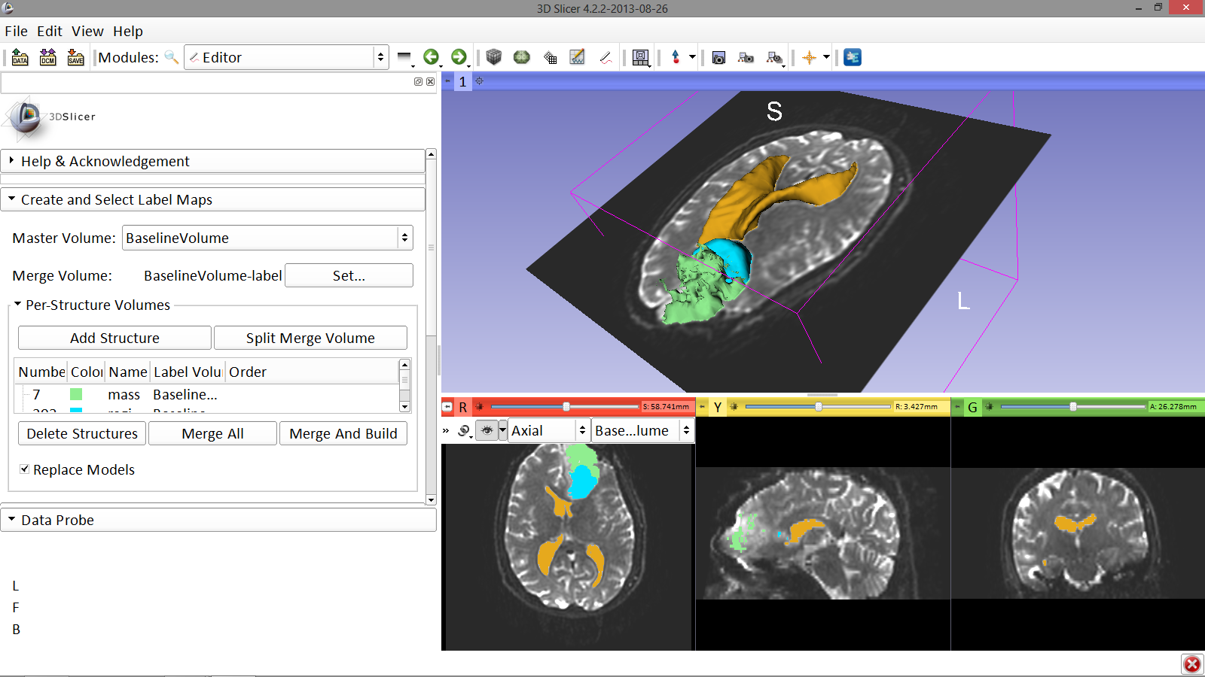
Definition of peri-tumoral volume
Position the mouse over the pin icon, deselect the link icon, and select the eye icon to view just the axial slice in the 3D Viewer
Image Courtesy of Dr. Alexandra Golby, Brigham and Women’s Hospital, Boston, MA..
White Matter Exploration for Neurosurgical Planning

Slide 49
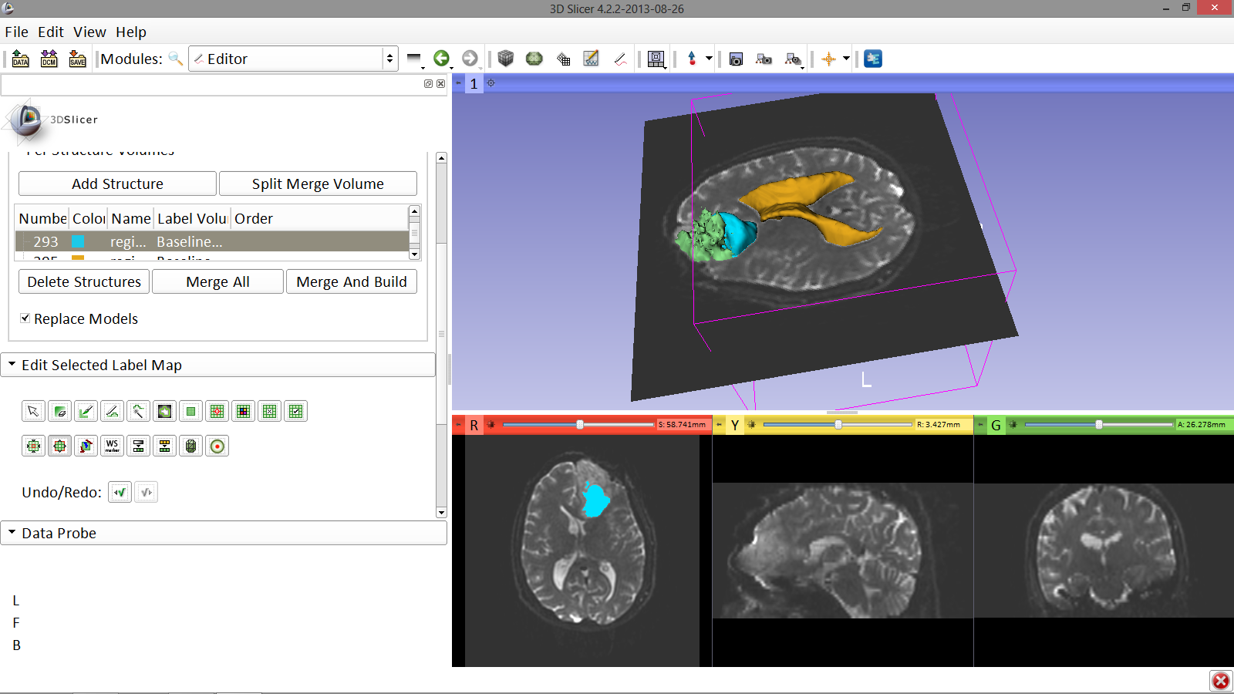
Definition of peri-tumoral volume
Select the label map BaselineVolume-region_1-label (blue) and select the DilateEffect tool
Image Courtesy of Dr. Alexandra Golby, Brigham and Women’s Hospital, Boston, MA..
White Matter Exploration for Neurosurgical Planning

Slide 50
Part 2: Tractography exploration of peri-tumoral white matter fibers
White Matter Exploration for Neurosurgical Planning

Slide 51
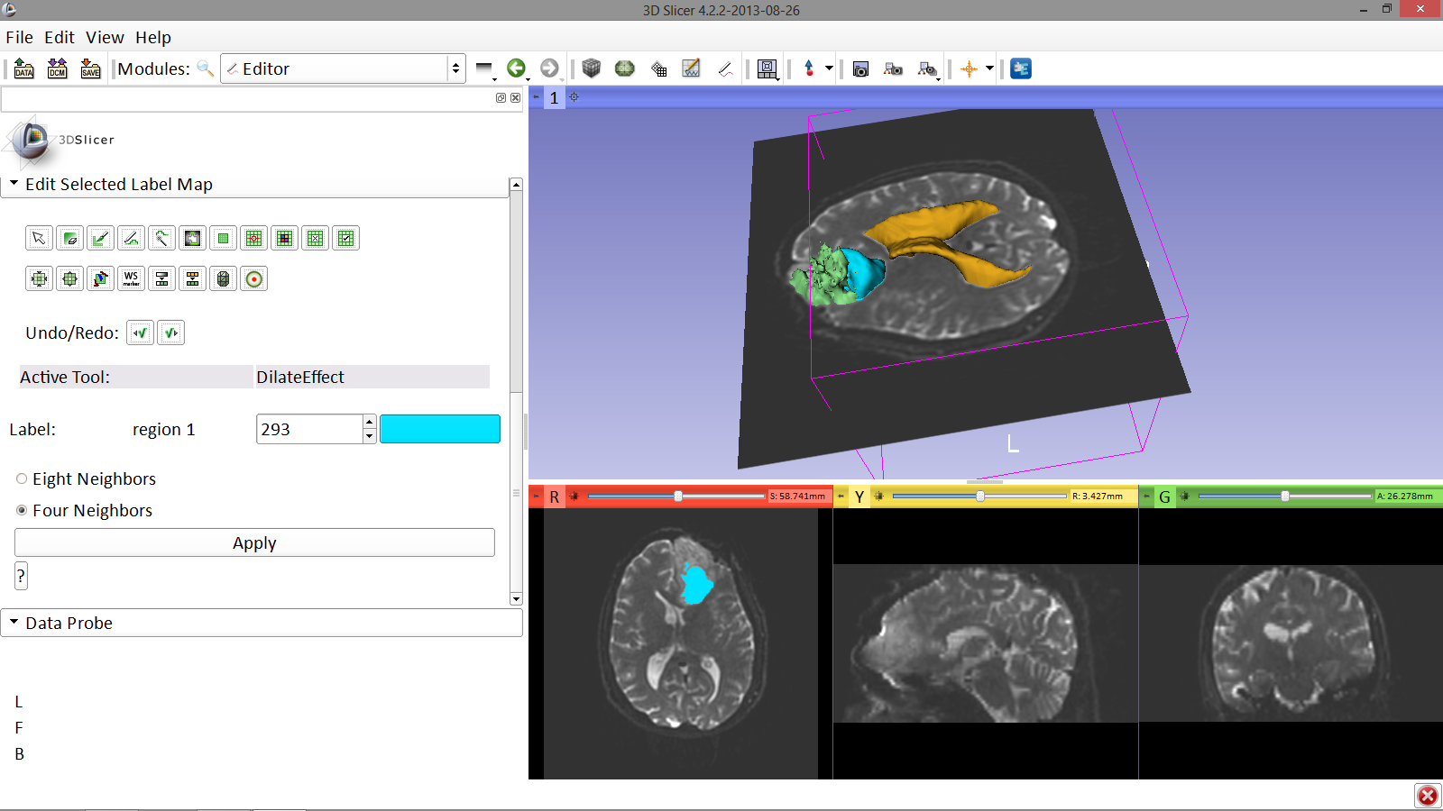
Definition of peri-tumoral volume
With the DilateEffect tool equipped, click on the cystic part of the tumor in the axial slice viewer once, then select Apply 3 times to generate the peritumoral volume
Image Courtesy of Dr. Alexandra Golby, Brigham and Women’s Hospital, Boston, MA..
White Matter Exploration for Neurosurgical Planning

Slide 52
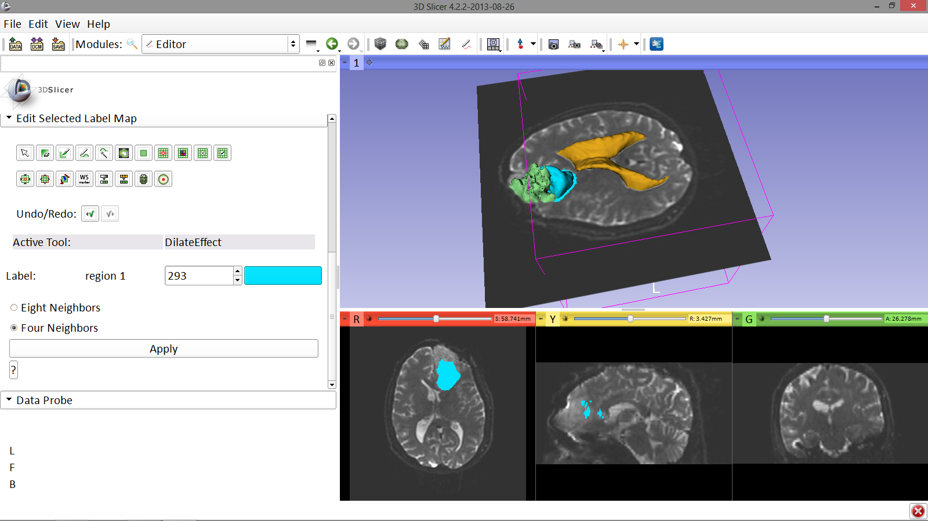
Definition of DTI volume
Note the dilatation of the cystic part of the tumor in the 3D viewer
Image Courtesy of Dr. Alexandra Golby, Brigham and Women’s Hospital, Boston, MA..
White Matter Exploration for Neurosurgical Planning

Slide 53
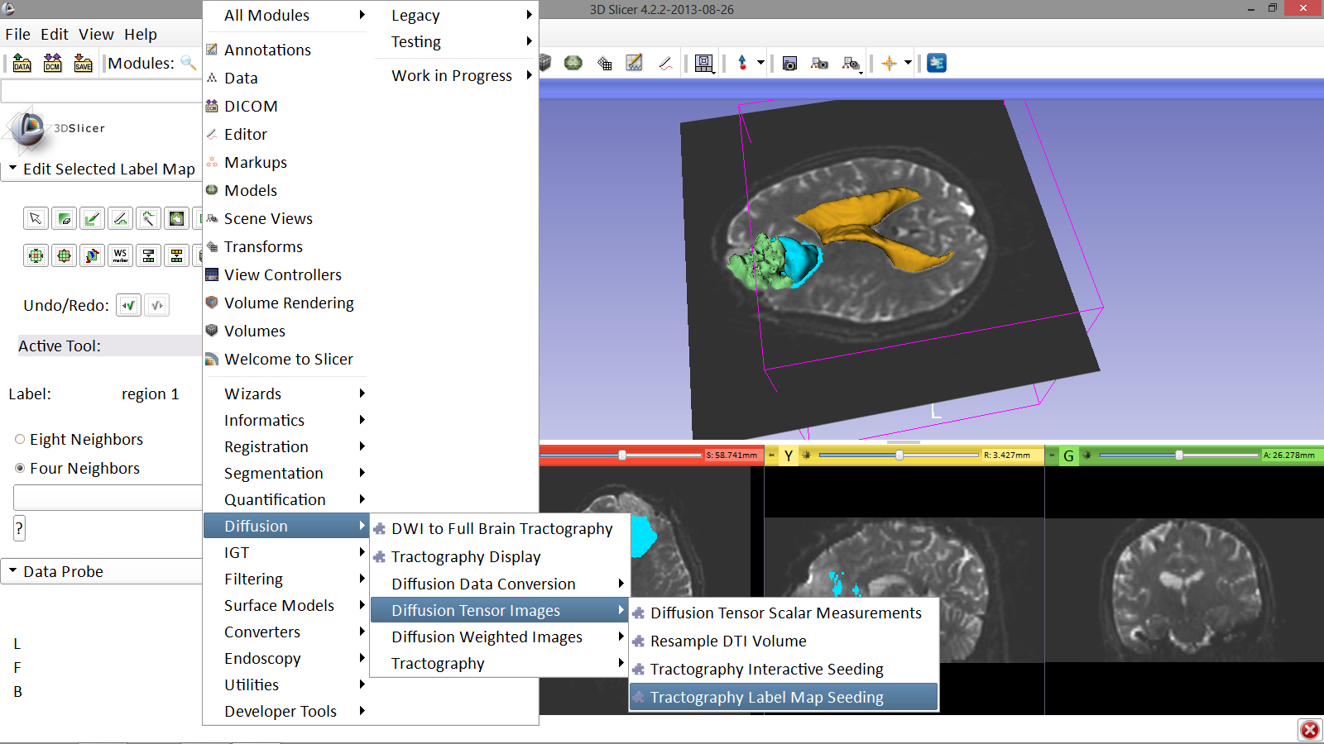
Final Result of Segmentation
Select the module Tractography Label Map Seeding
Image Courtesy of Dr. Alexandra Golby, Brigham and Women’s Hospital, Boston, MA..
White Matter Exploration for Neurosurgical Planning

Slide 54
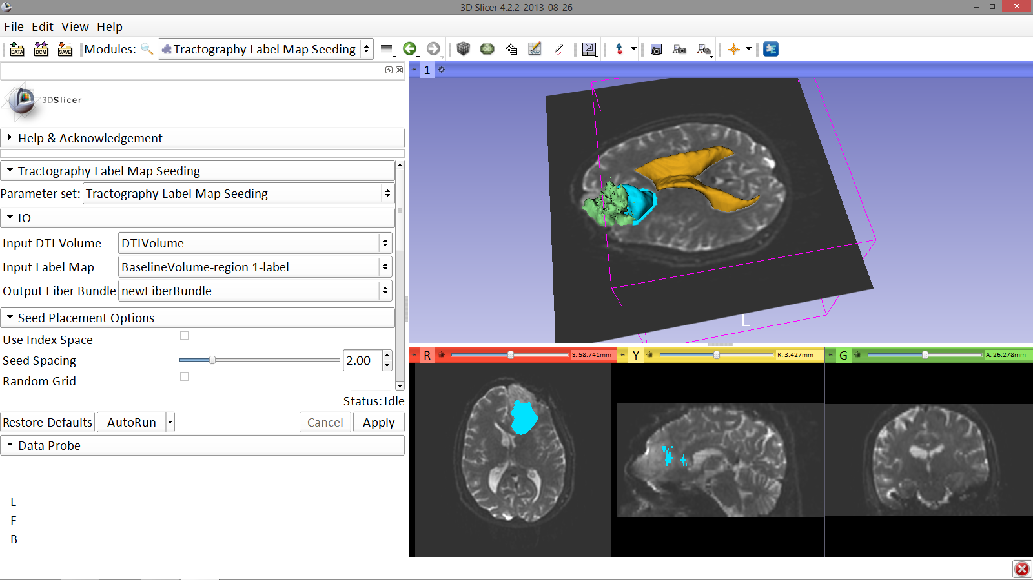
Final Result of Segmentation
- I/O: Set the following input and output volume:
Input DTI Volume: DTIVolume
Input Label Map: BaselineVolume-region_1-label
Output Fiber Bundle: Create and rename newFiberBundle
Image Courtesy of Dr. Alexandra Golby, Brigham and Women’s Hospital, Boston, MA..
White Matter Exploration for Neurosurgical Planning

Slide 55
Final Result of Segmentation
Scroll down and set the following values:
- Seed Placement Options:
Check Use Index Space
Stopping Value
Set the FA threshold to 0.15
- Label Definition:
Enter Seeding Label 293, and Click on Apply
Image Courtesy of Dr. Alexandra Golby, Brigham and Women’s Hospital, Boston, MA..
White Matter Exploration for Neurosurgical Planning

Slide 56
Final Result of Segmentation
Slicer displays the white matter fibers surrounding the tumor
Image Courtesy of Dr. Alexandra Golby, Brigham and Women’s Hospital, Boston, MA..
The fibers are colored according the fractional anisotropy values
(red = low ; blue,green = high)
White Matter Exploration for Neurosurgical Planning

Slide 57
Part 4: Tractography exploration of the ipsilateral and contralateral side
White Matter Exploration for Neurosurgical Planning

Slide 58
Tractography on-the-fly
Click on the Modules menu and select the module Tractography Interactive Seeding
Image Courtesy of Dr. Alexandra Golby, Brigham and Women’s Hospital, Boston, MA..
White Matter Exploration for Neurosurgical Planning

Slide 59
Tractography on-the-fly
Position the mouse over the pin icon in the axial slice viewer and change the volume to DTIVolume
Image Courtesy of Dr. Alexandra Golby, Brigham and Women’s Hospital, Boston, MA..
White Matter Exploration for Neurosurgical Planning

Slide 60
Tractography on-the-fly
Select the Fiducial icon, and position it next to the cystic part of the tumor by clicking near it in the 3D viewer
Image Courtesy of Dr. Alexandra Golby, Brigham and Women’s Hospital, Boston, MA..
White Matter Exploration for Neurosurgical Planning

Slide 61
Tractography on-the-fly
Image Courtesy of Dr. Alexandra Golby, Brigham and Women’s Hospital, Boston, MA..
Set Input DTI Volume to DTIVolume
Set Fiducial List or Model to F
Set Output Fiber Bundle to Create new Fiber Bundle
White Matter Exploration for Neurosurgical Planning

Slide 62
Tractography on-the-fly
Scroll down the module and set the Minimum Path Length to 10.0 mm and the FA Stopping Value at 0.15
Image Courtesy of Dr. Alexandra Golby, Brigham and Women’s Hospital, Boston, MA..
White Matter Exploration for Neurosurgical Planning

Slide 63
Fiducial Seeding
Image Courtesy of Dr. Alexandra Golby, Brigham and Women’s Hospital, Boston, MA..
Position the fiducial in the cingulum on the contralateral side opposite to the tumor
White Matter Exploration for Neurosurgical Planning

Slide 64
Tractography on-the-fly
Image Courtesy of Dr. Alexandra Golby, Brigham and Women’s Hospital, Boston, MA..
Explore the aspect of the cingulum in the contralateral and ipsilateral sides
White Matter Exploration for Neurosurgical Planning

Slide 65
Conclusion
Fully integrated pipeline for semi-automated tumor segmentation and white matter tract reconstruction
3D interactive exploration of the white matter tracts surrounding a tumor (peri-tumoral tracts) for neurosurgical planning
White Matter Exploration for Neurosurgical Planning

Slide 66
Acknowledgments
National Alliance for Medical Image Computing (NA-MIC)
NIH U54EB005149
Neuroimage Analysis Center (NAC)
NIH P41RR013218
Parth Amin, WIT ’16
Matthew Flynn, WIT ‘16
White Matter Exploration for Neurosurgical Planning

