Slide 2
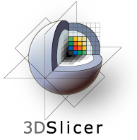
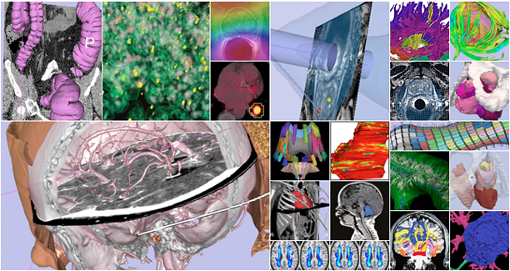
An end-user application for image analysis and visualization
An open-source environment for software development
A software platform that is both easy to use for clinical researchers and easy to extend for programmers
CTSA at RSNA 2010
--

Slide 3
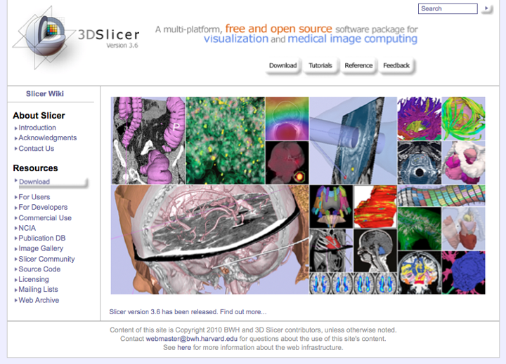
www.slicer.org
3D Slicer version 3 is a multi-platform software running on Windows, Linux, and Mac OSX.
Disclaimer
It is the responsibility of the user of 3DSlicer to comply with both the terms of the license and with the applicable laws, regulations and rules. Slicer is a tool for research, and is not FDA approved.
CTSA at RSNA 2010
--

Slide 4
This workshop uses the newest release of 3D Slicer (version 3.6.2).
Visit the Slicer download page for Slicer 3.6 stable release, or for Slicer nightly builds.
CTSA at RSNA 2010
--

Slide 5
Tutorial Overview
Getting Started: Slicer3 Minute Tutorial
Quantitative Measurement of Volumetric Change: ChangeTracker Tutorial
Quantitative Measurements for Functional Imaging: PETCTFusion Tutorial
All Tutorial Datasets are located in C:\slicer_data
CTSA at RSNA 2010
--

Slide 6
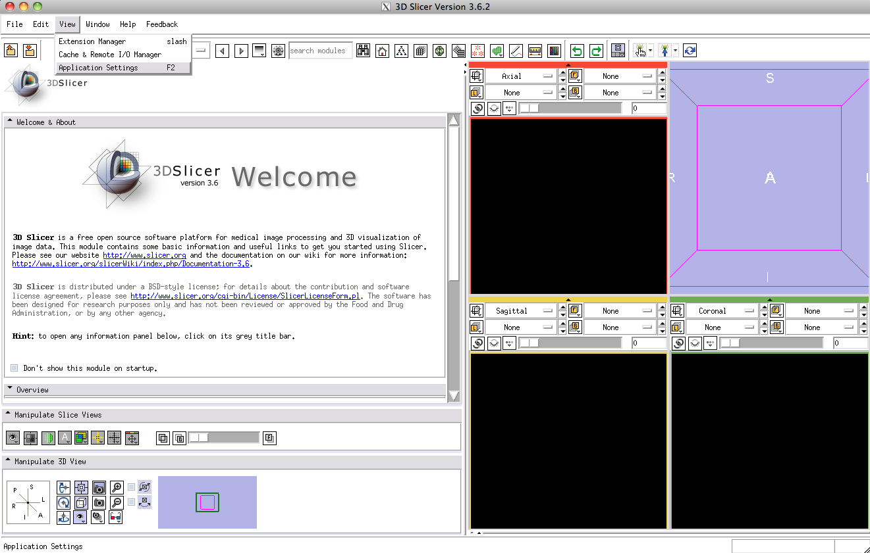
Tuning up…
Setting Font Size
In Slicer’s main menu, select
View->Application Settings
CTSA at RSNA 2010
--

Slide 7
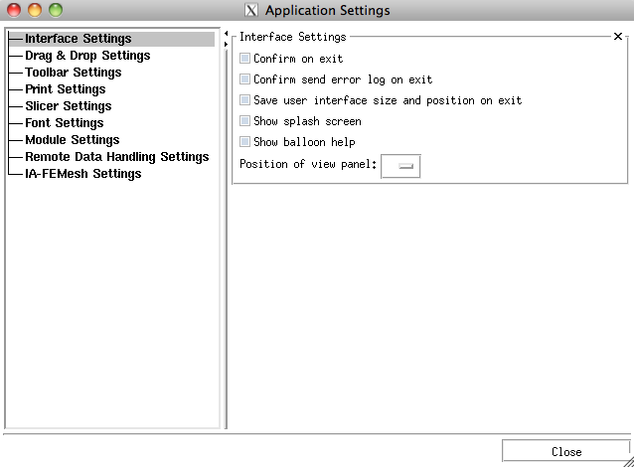
Tuning up…
Setting Font Size
This raises Slicer’s Application Settings Interface
In the left panel, select
Font Settings
CTSA at RSNA 2010
--

Slide 8
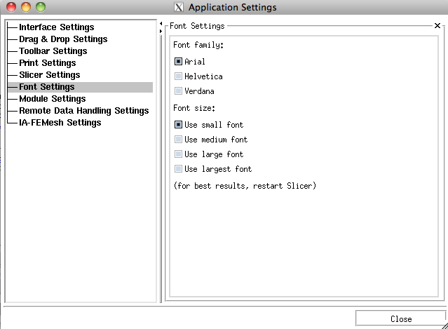
Tuning up…
Setting Font Size
This displays Slicer’s Font Family and Font Size options
Choose among options until you find a font-size that works well for you.
Slicer will remember these settings next time you start the application.
CTSA at RSNA 2010
--

Slide 9
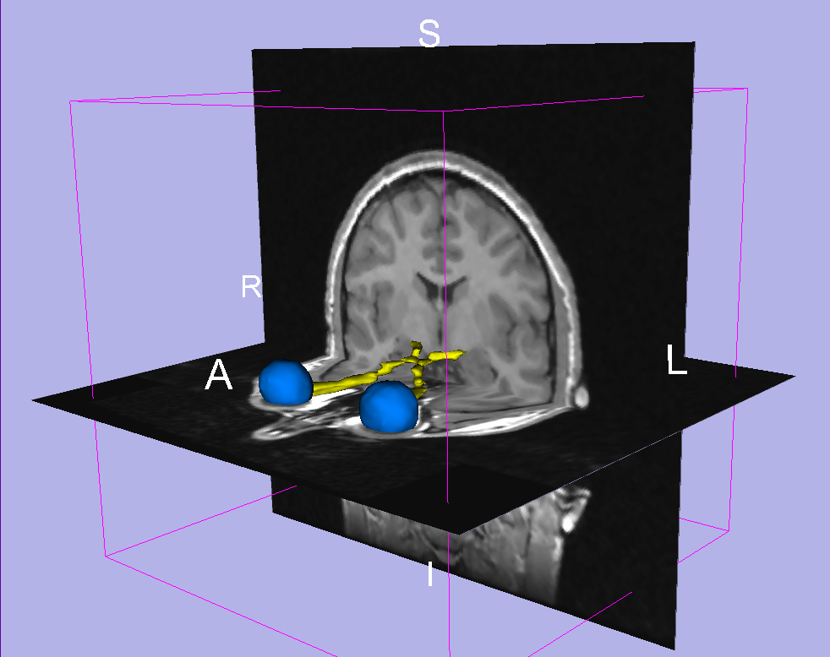
Slicer3 Minute Tutorial
Part I: Slicer3 Minute Tutorial
Sonia Pujol, PhD
Wendy Plesniak, PhD
This tutorial is a short introduction to the advanced 3D visualization capabilities of the Slicer3 software for medical image analysis.
It is designed to quickly build a basic level of comfort with the Slicer software.
CTSA at RSNA 2010
--

Slide 10

Slicer3 Minute Tutorial
The Slicer3Minute dataset is composed of
An MR scan of the brain and 3D surface
Reconstructions of anatomical structures.
The data are part of the SPL-PNL Brain Atlas
Developed by Talos et al. The atlas is available at:
http://www.spl.harvard.edu/publications/item/view/1265
CTSA at RSNA 2010
--

Slide 11
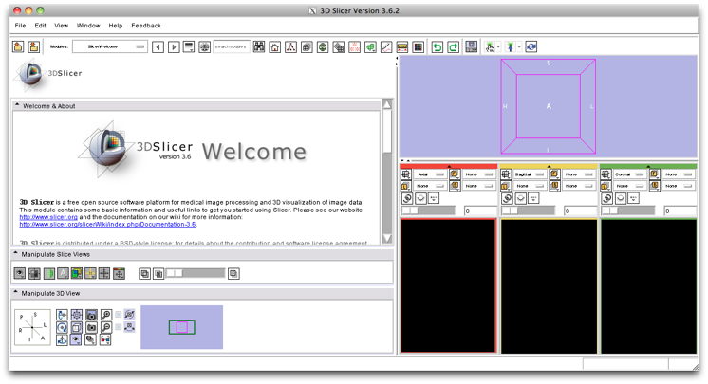
Slicer3 Minute Tutorial: Launch the Application
Windows users:
Double-Click the Shortcut to Slicer3.exe on the Desktop
or Select
Start ->All Programs ->Slicer3 3.5.2009-11-06->Slicer
CTSA at RSNA 2010
--

Slide 12
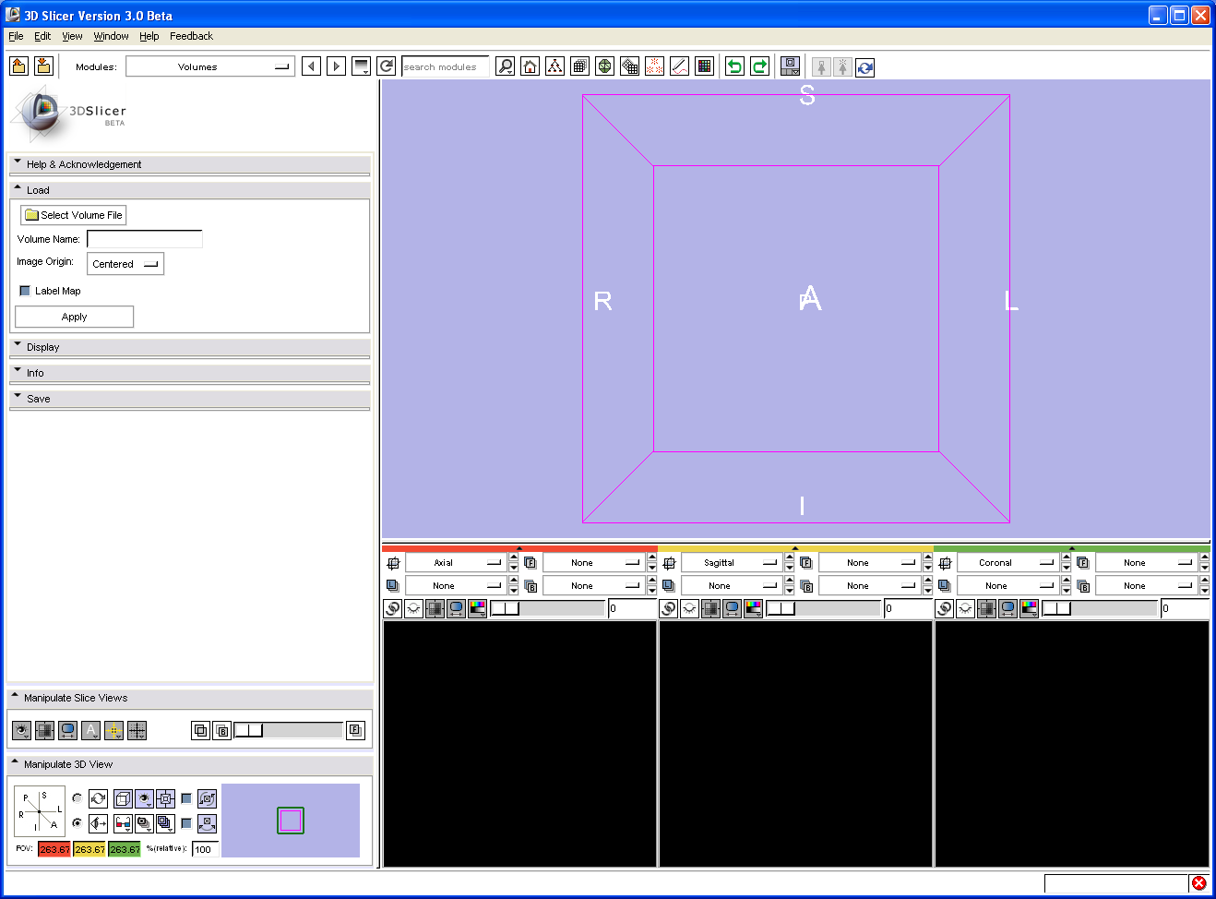
Slicer3 Minute Tutorial: Navigating the Application GUI
Menu & Toolbar
The Graphical User Interface (GUI) of Slicer3 integrates five components:
the Menu Toolbar
the Module GUI Panel
the 3D Viewer
the Slice Viewer
the Slice and 3D View Controller
Module GUI Panel
3D Viewer
Slice and 3D View Controller
Slice Viewers
CTSA at RSNA 2010
--

Slide 13
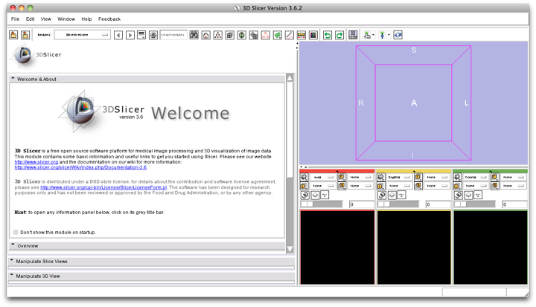
Slicer3 Minute Tutorial: Welcome Module
The SlicerWelcome module is the module displayed by default.
This module gives an overview of the GUI of Slicer3, and data loading & saving functionalities.
CTSA at RSNA 2010
--

Slide 14
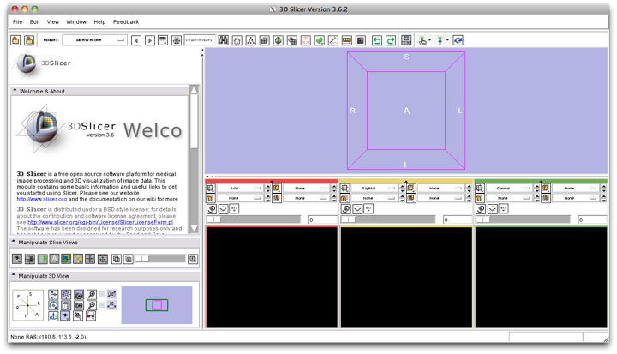
Slicer3 Minute Tutorial: GUI Basics
Expand or shrink the GUI panel with the arrows at the frame top, or by clicking and dragging the vertical separator
Expand or collapse any sub-panel by clicking on its grey title bar.
CTSA at RSNA 2010
--

Slide 15
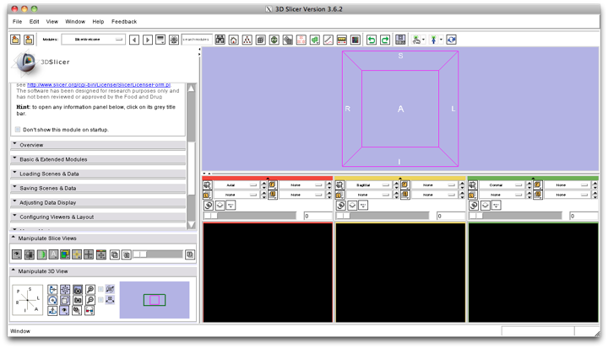
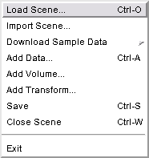
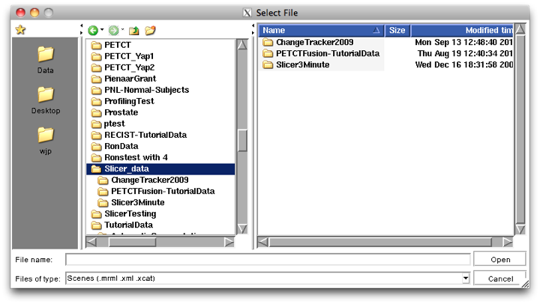
Slicer3 Minute Tutorial: Load A Scene
Select File-> Load Scene from the File menu
Browse to the location of the Slicer_data directory.
Select that directory and select the Add To Favorites
icon
This will make the directory easier to find later...
CTSA at RSNA 2010
--

Slide 16
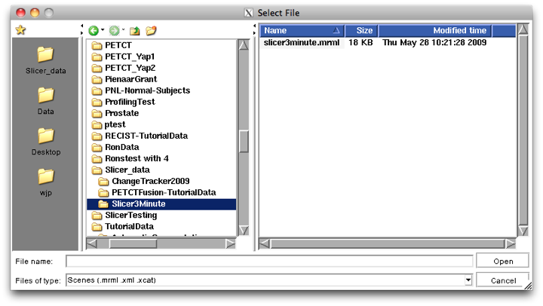
Slicer3 Minute Tutorial: Load A Scene
Browse to the location of the Slicer3MinuteDataset directory.
Select the scene file slicer3minute.mrml
Click on Open to load the scene
CTSA at RSNA 2010
--

Slide 17
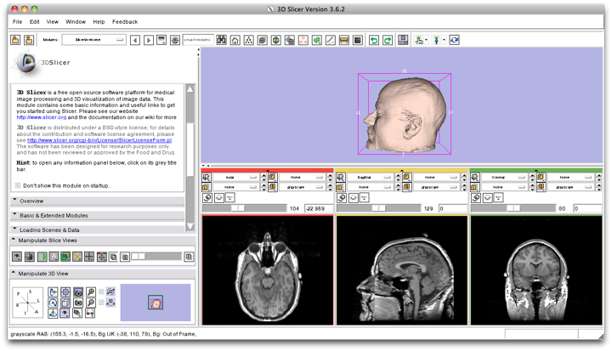
Slicer3 Minute Tutorial: Viewing the Scene
When the scene is finished loading, Slicer displays:
a 3D model of the head in the 3D Viewer, and
anatomical MR slices of the brain in the 2D Slice Viewers.
3D Viewer
2D Slice Viewers
CTSA at RSNA 2010
--

Slide 18
Slicer3 Minute Tutorial: Viewing the Scene
Note:
We have pre-adjusted the window and level settings for these volumes so that they are appropriate for display on most laptops.
If display is not satisfactory on your machine or projector, the Volumes Module may be used to refine these settings.
CTSA at RSNA 2010
--

Slide 19
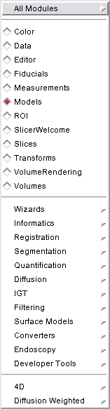
Slicer3 Minute Tutorial: Exploring Slicer’s functionality
Left click and hold the Modules menubutton.
Select All Modules to display the many modules available for image processing, analysis and 3D visualization.
CTSA at RSNA 2010
--

Slide 20
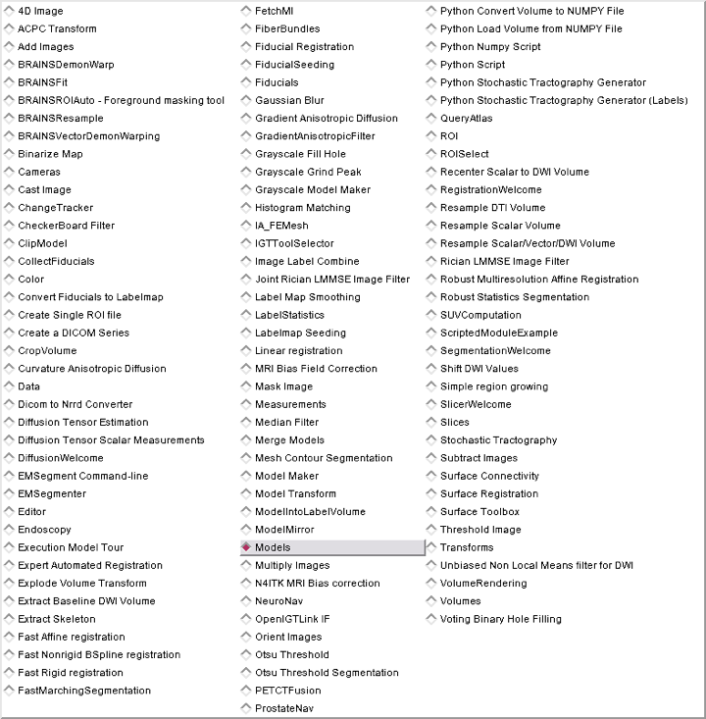
Slicer3 Minute Tutorial: Exploring Slicer’s functionality
To access the Models module, browse through the list of modules...
...or click on the models icon in the toolbar
CTSA at RSNA 2010
--

Slide 21
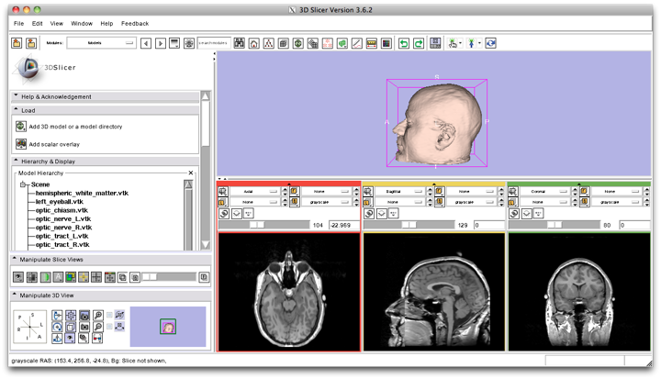
Slicer3 Minute Tutorial: Switching to the Models Module
Slicer displays the GUI of the Models module.
CTSA at RSNA 2010
--

Slide 22
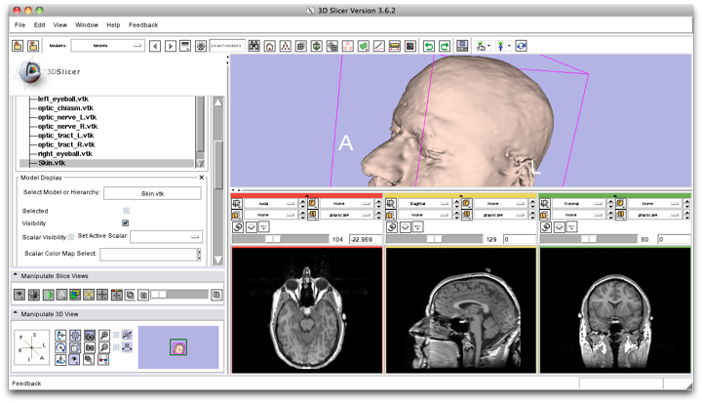
Slicer3 Minute Tutorial: Basic 3D Interaction
Left-click & drag
Position the mouse in the 3D Viewer.
Hold down the left mouse button and drag to rotate the model.
CTSA at RSNA 2010
--

Slide 23
Slicer3 Minute Tutorial: Viewing Slices in the 3D Viewer
Click on the Slice Visibility icon
to display the Axial Slice in the 3D Viewer
CTSA at RSNA 2010
--

Slide 24
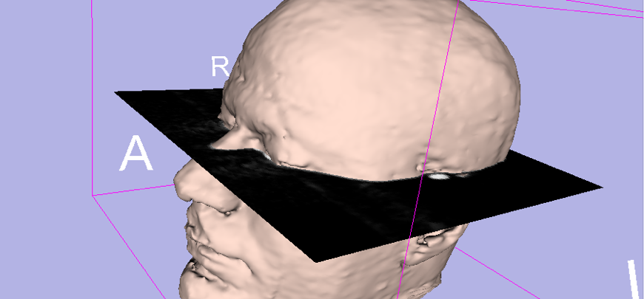
Slicer3 Minute Tutorial: 3D Visualization
Slicer adds a view of the Axial slice in the 3D View.
CTSA at RSNA 2010
--

Slide 25
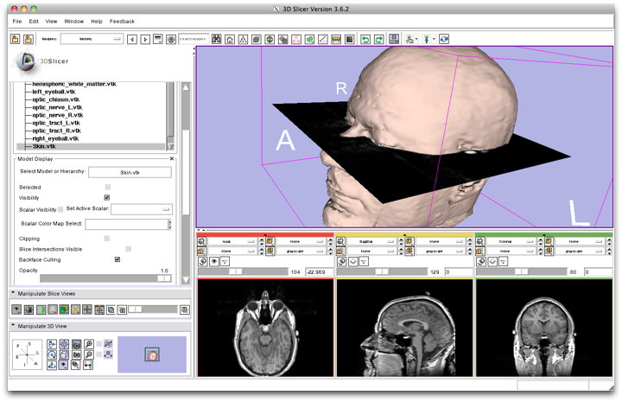
Slicer3 Minute Tutorial: 3D Visualization
Select the Skin model.
Change the opacity of the model from 1.0 to 0.0.
CTSA at RSNA 2010
--

Slide 26
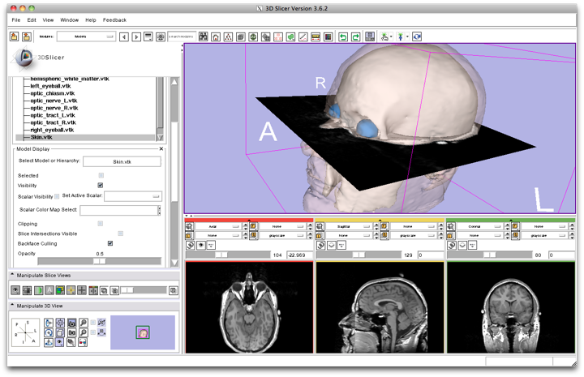
Slicer3 Minute Tutorial: 3D Visualization
The model of the skull bone and eyeballs become visible through the model of the skin in the 3D viewer.
(skin model opacity = 0.5)
CTSA at RSNA 2010
--

Slide 27
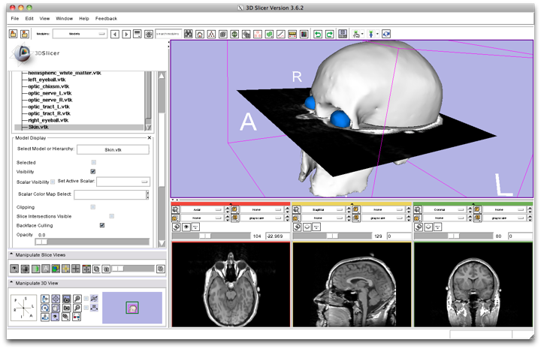
Slicer3 Minute Tutorial: 3D Visualization
The model of the skin becomes invisible in the 3D viewer.
(skin model opacity = 0.0)
(skull model opacity = 1.0)
CTSA at RSNA 2010
--

Slide 28
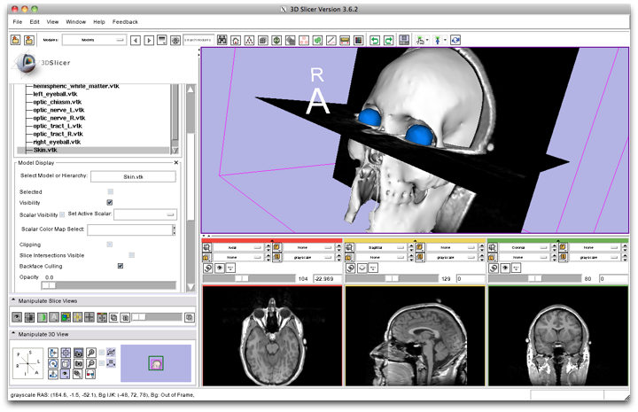
Slicer3 Minute Tutorial: 3D Visualization
Click on the Slice Visibility icon in the Green Slice Viewer
to display the Coronal Slice in the 3D Viewer.
CTSA at RSNA 2010
--

Slide 29
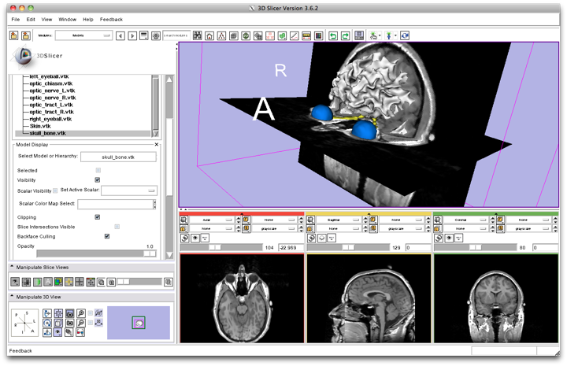
Slicer3 Minute Tutorial: 3D Visualization
Select the 3D model skull_bone.vtk in the Model Hierarchy and turn on the Clipping option.
CTSA at RSNA 2010
--

Slide 30
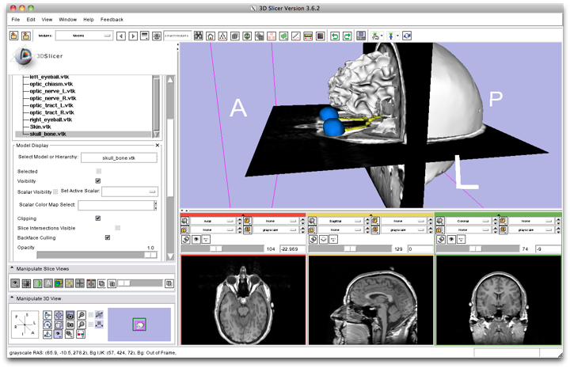
Slicer3 Minute Tutorial: 3D Visualization
Browse through the coronal slices to expose the 3D model of the white matter, and the left and right optic nerves.
CTSA at RSNA 2010
--

Slide 31
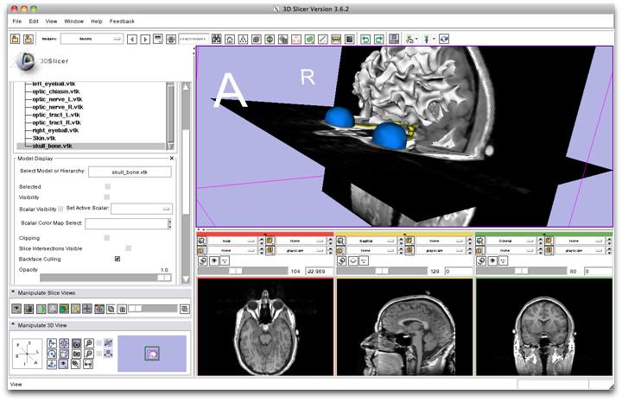
Slicer3 Minute Tutorial: 3D Visualization
Select the 3D model “skull_bone” in the Model Hierarchy, and turn off its Visibility
CTSA at RSNA 2010
--

Slide 32
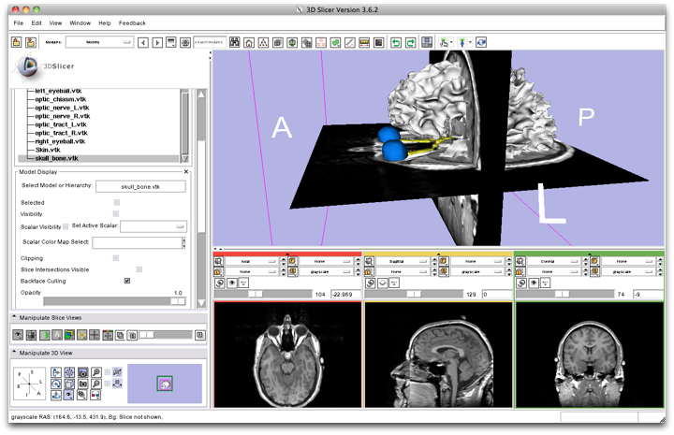
Slicer3 Minute Tutorial: 3D Visualization
Scroll the Coronal Slices to display the hemispheric white matter model in the context of the image data in the 3D Viewer.
CTSA at RSNA 2010
--

Slide 33
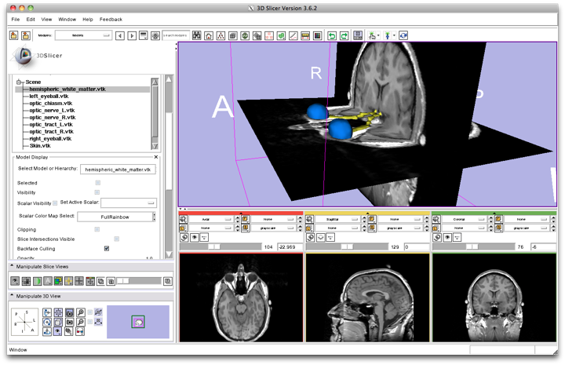
Slicer3 Minute Tutorial: 3D Visualization
Select the hemispheric white matter model called
hemispheric_white_matter.vtk
Turn off its visibility.
CTSA at RSNA 2010
--

Slide 34
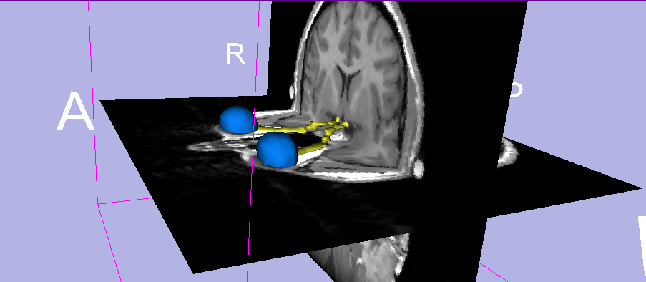
Slicer3 Minute Tutorial: 3D Visualization
Slicer displays the optic nerve, optic chiasm and optic tracts overlaid on the MR images of the brain.
CTSA at RSNA 2010
--

Slide 35
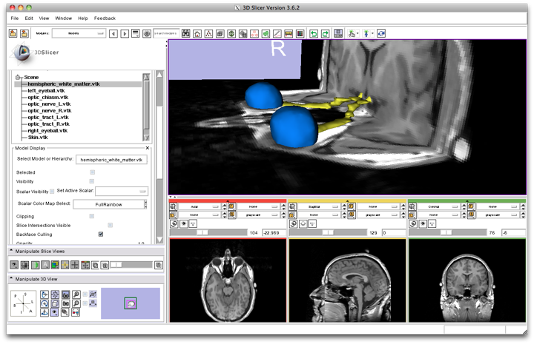
Slicer3 Minute Tutorial: 3D Visualization: Zoom the view
Windows/Linux users: Position the mouse in the 3D Viewer, hold down the right mouse button and move the mouse down to zoom in.
Mac users: Position the mouse in the 3D Viewer, hold down the apple button and the mouse button and move the mouse down to zoom in.
CTSA at RSNA 2010
--

Slide 36
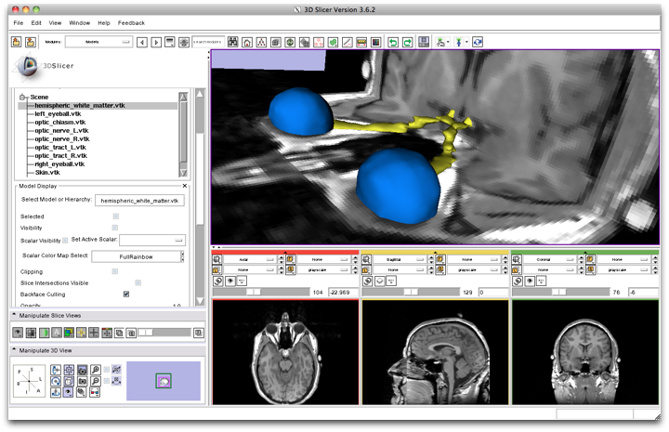
Slicer3 Minute Tutorial: 3D Visualization
Slicer3 displays a closer view of 3D anatomical structures overlaid on 2D MR slices
CTSA at RSNA 2010
--

Slide 37
Slicer3 Minute Tutorial: Summary
This tutorial has demonstrated:
Basic description of the Slicer3 Application Interface
How to load a scene containing volumes and models
How to visualize these different datasets together
Next, we will use these building blocks to perform image analysis and visualize quantitative results.
CTSA at RSNA 2010
--

Slide 38
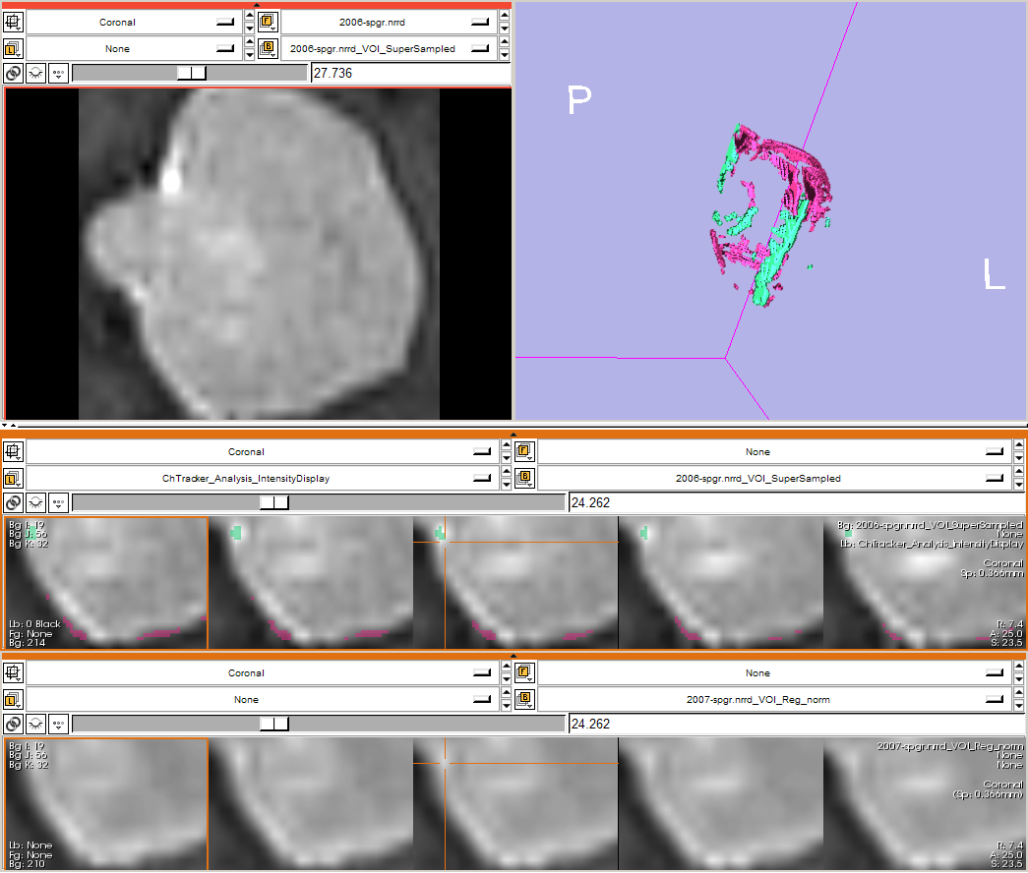
ChangeTracker: exploring small volumetric changes
Part II: Analyzing Small Volumetric Changes using the ChangeTracker Module
Kilian M Pohl, PhD
Ender Konugolu, PhD
Andriy Fedorov, PhD
The module described in this tutorial was tested on Axial 3D SPGR T1 post Gadolinium scans (Voxel dimension: 0.94mm x 0.94mm x 1.20mm, FOV: 240mm, Matrix: 256 x 256)
CTSA at RSNA 2010
--

Slide 39
ChangeTracker: Conventional measures of tumor response
Conventional anatomic imaging using CT or MRI are often used to evaluate tumor size and shape
Most clinical trials that evaluate new chemotherapeutic drugs use changes in uni-dimensional or bi-dimensional measurements to assess response (e.g. RECIST)
Slicer has several tools for applying RECIST methodologies
CTSA at RSNA 2010
--

Slide 40
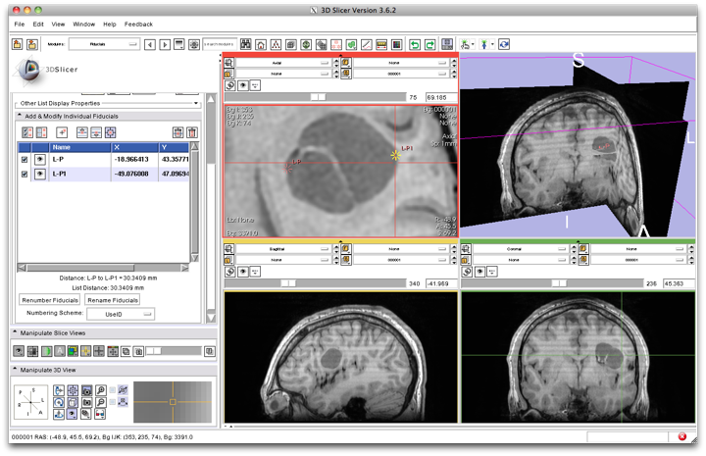
Quantifying tumor change: Conventional measures of tumor response
3D Slicer’s Fiducials Module can be used to measure the longest diameter
in a tumor cross section.
Two fiducials may be used to mark the tumor’s extent.
The distance measurement (mm) between fiducials will be updated in the Fiducial’s GUI.
CTSA at RSNA 2010
--

Slide 41
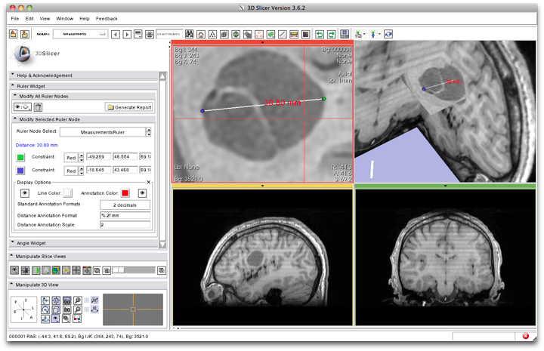
Quantifying tumor change: Conventional measures of tumor response
3D Slicer’s Measurements module, provides interactive measurement tools that operate in the 3D Viewer and the Slice Viewers.
Interactive ruler can be used to measure the longest diameter and provides numerical annotations
CTSA at RSNA 2010
--

Slide 42
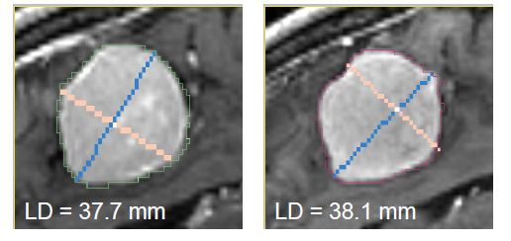
Quantifying tumor change: Conventional measures of tumor response
3D Slicer’s LabelDiameterEstimation (extension) module will automatically compute the largest tumor diameter and orthogonal dimension.
This analysis requires an initial segmentation (VOI).
Baseline: June 2006 Follow-up: June 2007
CTSA at RSNA 2010
--

Slide 43
ChangeTracker: rationale for new approaches
However, more accurate and precise methods for understanding volume changes may be useful when:
benign tumor change is being monitored, or
where small changes may be clinically significant but difficult to assess with RECIST
ChangeTracker Module is a tool to measure volumetric change at the voxel level.
CTSA at RSNA 2010
--

Slide 44
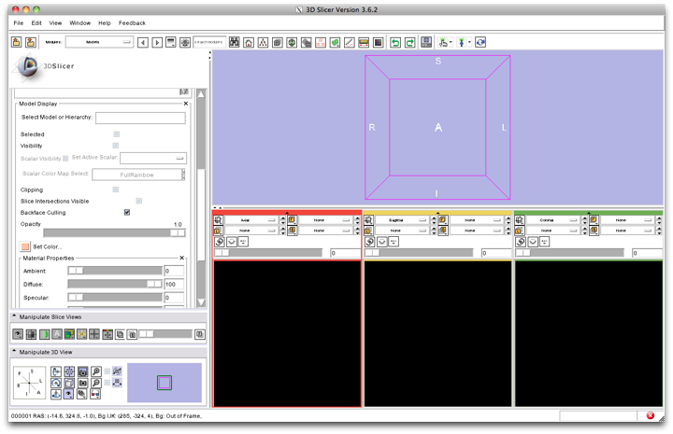
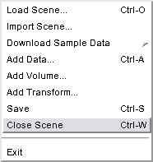
ChangeTracker: exploring small volumetric changes
First, close any previous scene.
Select File->Close Scene
This removes any datasets previously loaded into Slicer.
CTSA at RSNA 2010
--

Slide 45
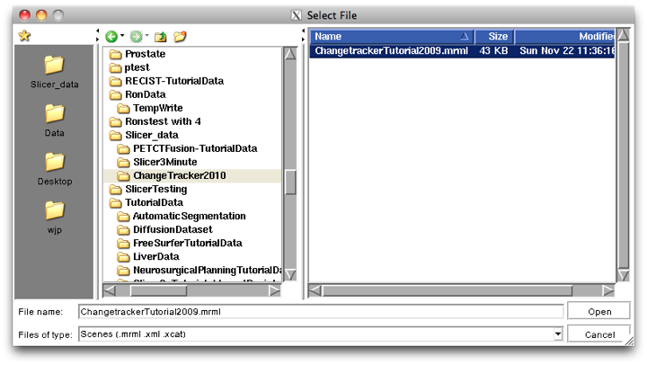
ChangeTracker: Load the training dataset
Select File->Load Scene
This raises the Load Scene Interface
Select Slicer_data from favorites panel.
Select the ChangeTracker2010 directory
And select the scene file: ChangetrackerTutorial2009.mrml
double click the file, or click Open
CTSA at RSNA 2010
--

Slide 46
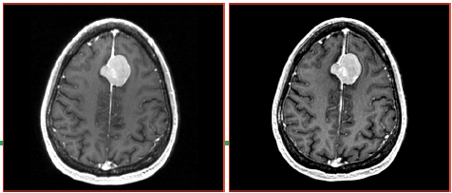
ChangeTracker: about the data...
This course is built upon two scans of a patient with meningioma:
MR Scan 1
MR Scan 2
Please note: we have pre-adjusted the window and level settings for these volumes so that they are appropriate for display on most laptops. If display is not satisfactory on your machine or projector, the Volumes Module may be used to refine these settings.
CTSA at RSNA 2010
--

Slide 47
ChangeTracker: Clinical context
Meningoma
Usually benign slow-growing tumors
Baseline radiologist’s clinical impression:
large falcine lesion is identified.
measures 3.1 cm anteroposteriorly, 3.05 cm from side-to-side, 3.5 cm in height.
enhances moderately on post gadolinium imaging.
Follow-up radiologist’s clinical impression:
left frontal lobe mass appears unchanged on all series.
measures 3.3 x 3.2 cm in maximum dimension.
enhances moderately on post gadolinium imaging.
How has the tumor changed?
Baseline: June 2006
Follow-up: June 2007
CTSA at RSNA 2010
--

Slide 48
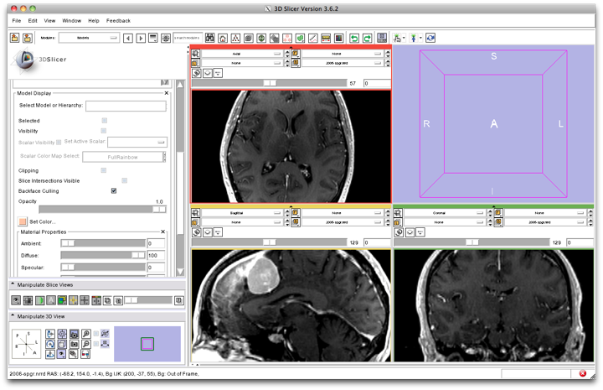
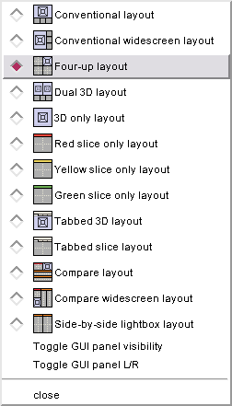
ChangeTracker: exploring small volumetric changes
Change Layout to “Four-up”:
Using the Layout Menubutton,
Select Four-up layout.
CTSA at RSNA 2010
--

Slide 49
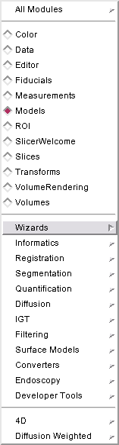

ChangeTracker: exploring small volumetric changes
Using the Modules Menubutton,
Select the ChangeTracker Module from the Wizards category.
CTSA at RSNA 2010
--

Slide 50
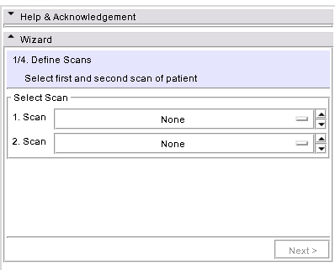
ChangeTracker: a note about the Workflow Wizard
Step Panel--
User Panel--
Navigation Panel--
A Workflow Wizard guides the user through a sequence of steps and has the following components:
the Step Panel
the User Panel
the Navigation Panel
CTSA at RSNA 2010
--

Slide 51
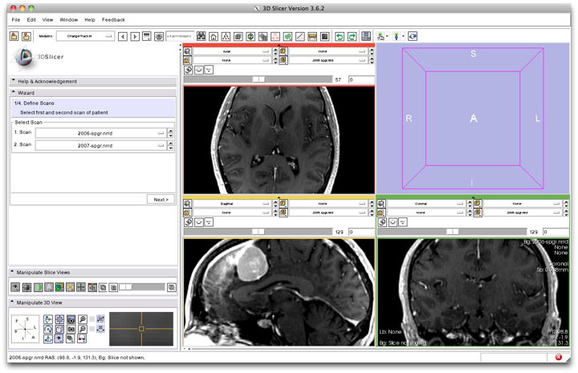
ChangeTracker: First step: select scans
Select baseline & follow-up studies:
Scan 1 = 2006-spgr
Scan 2 = 2007-spgr
CTSA at RSNA 2010
--

Slide 52
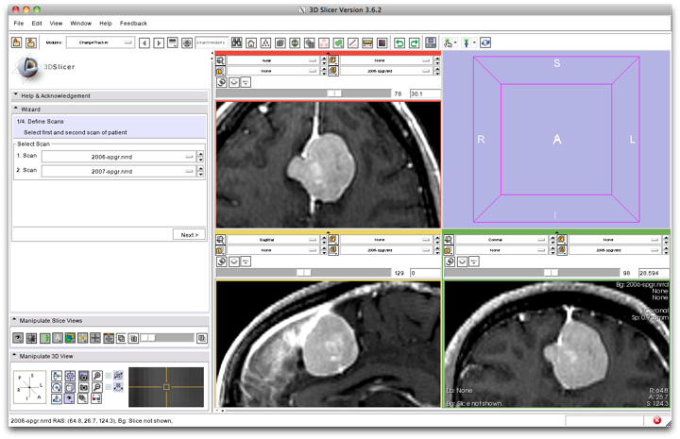
ChangeTracker: inspect the tumor
Move sliders in Slice Viewer Control panels to get a close-up view of tumor in Axial, Sagittal and Coronal slice viewers.
Zoom in (Right mouse down and push/pull).
Pan (Middle mouse down and move).
Press Next
CTSA at RSNA 2010
--

Slide 53
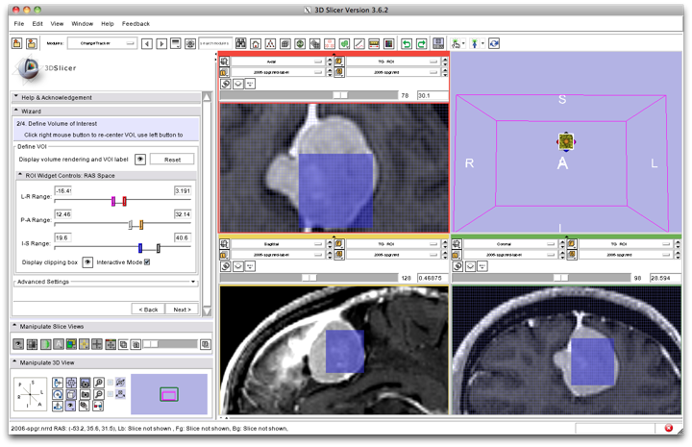
ChangeTracker: Step 2. Define a volume of interest
A VOI Box Widget is positioned within the image volume in the 3D viewer, and the VOI’s intersection with each slice is shown in blue.
Center the VOI first:
Right mouse click in the tumor center to position the VOI displayed in blue in each Slice Viewer.
CTSA at RSNA 2010
--

Slide 54
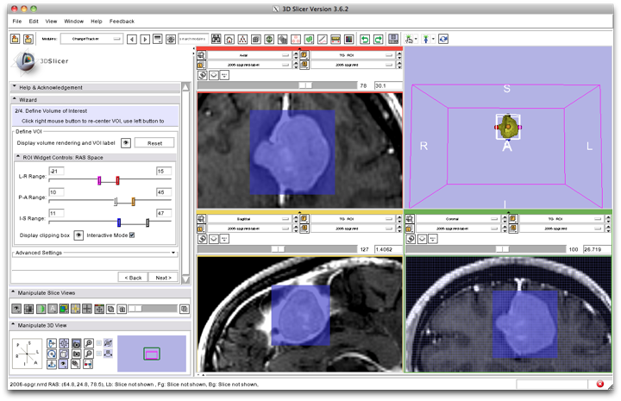
ChangeTracker: Step 2. Define a volume of interest
View the VOI box widget and volume rendering of tumor in yellow in the 3D Viewer
Next, resize the VOI:
Left mouse click in any Slice Viewer to change the VOI extent
CTSA at RSNA 2010
--

Slide 55
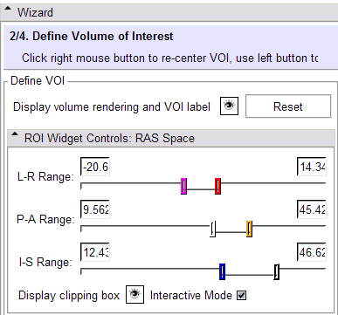

ChangeTracker: Step 2. Define a volume of interest
Fine-tune the VOI using the VOI Widget range sliders or by moving the VOI Widget handles in 3D view
Note: VOI Widget range sliders are color-coded to match VOI box Widget handles in 3D Viewer
CTSA at RSNA 2010
--

Slide 56
ChangeTracker: Step 2. Define a volume of interest
Scroll through slices to ensure that tumor boundaries are included in the VOI.
Click Next
CTSA at RSNA 2010
--

Slide 57

ChangeTracker: Step 3. Segment the tumor
Make sure that the volume called 2006_spgr.nrrd_VOI_Supersampled is selected in the background layer
...and...2006_spgr.nrrd_VOI_PresSegmented is selected in the label layer.
CTSA at RSNA 2010
--

Slide 58

ChangeTracker: Step 3. Segment the tumor
3D Viewer shows model of tumor
Slice Viewers show VOI with current segmentation overlay in light yellow
Modify the segmentation by moving threshold range slider
CTSA at RSNA 2010
--

Slide 59

ChangeTracker: Step 3. Segment the tumor
Scroll through the slices until the segmentation appears optimal.
Press Next.
CTSA at RSNA 2010
--

Slide 60

ChangeTracker: Step 3. Segment the tumor
Press the Slice option to view the volume rendered segmentation with the axial slice together.
If you need to reset the 3D View, try using the Axis Navigator Widget.
CTSA at RSNA 2010
--

Slide 61

ChangeTracker: Final step: Select Metric
Metric Options:
Detect change by analyzing intensity pattern (fast)
Measure change by analyzing deformation map (slow)
Select fast and press Analyze
CTSA at RSNA 2010
--

Slide 62
CTSA at RSNA 2010
--

Slide 63

ChangeTracker: Results: change in pathology
Change in volume is shown overlaying the tumor image and in the 3D Viewer:
magenta = growth
green = shrinkage
Note: Analysis is displayed in the “Compare View” layout with linked control for the compare Viewers.
CTSA at RSNA 2010
--

Slide 64
ChangeTracker: Results: change in pathology
Select visibility icon to show axial slice in the 3D Viewer.
CTSA at RSNA 2010
--

Slide 65

ChangeTracker: Results: change in pathology
“Compare View” layout displays:
Axial slice & 3D View
Five corresponding consecutive slices for the VOI in the baseline (top row), and
in the followup (bottom row).
CTSA at RSNA 2010
--

Slide 66


ChangeTracker: Results: change in pathology
Crosshairs in Compare View show corresponding voxels in baseline and followup scan for voxel-wise comparison.
CTSA at RSNA 2010
--

Slide 67










ChangeTracker: Exploring small volumetric changes
sensitive
Modify sensitivity of intensity pattern analysis
moderate
robust
CTSA at RSNA 2010
--

Slide 68

ChangeTracker: Exploring small volumetric changes
Click on the colored bar at the top of any Slice Viewer to show or hide the controls.
This allows more display space for viewing the image data.
CTSA at RSNA 2010
--

Slide 69
ChangeTracker: Exploring small volumetric changes
Tested on Axial 3D SPGR T1 post Gadolinium scans (Voxel dimension: 0.94mm x 0.94mm x 1.20mm, FOV: 240mm, Matrix: 256 x 256).
Tumor boundary should be clear.
Only for contrast enhanced images.
Need homogenous enhancement across timepoints.
Not tested for tumors with changing necrosis.
Correspondence between Intensity-based and deformation mapping-based analyses should be checked.
CTSA at RSNA 2010
--

Slide 70
ChangeTracker: exploring small volumetric changes
This tutorial demonstrated:
a method to quantify small volumetric changes in pathology.
visualization of these changes in the anatomical context
use of Slicer’s “Compare Viewer” to simultaneously explore baseline and followup studies.
Next, we will demonstrate combined visualization of PET/CT studies and SUV computation.
CTSA at RSNA 2010
--

Slide 71

PET/CT Visualization and Analysis
Part III: PET/CT Analysis using 3D Slicer
Jeffrey Yap PhD
Ron Kikinis MD
Wendy Plesniak PhD
CTSA at RSNA 2010
--

Slide 72
PET/CT Visualization and Analysis: Start fresh.
First, close any previous scene.
Select File->Close Scene
This removes any datasets previously loaded into Slicer.
CTSA at RSNA 2010
--

Slide 73


PET/CT Visualization and Analysis: Load the new scene
Select File->Load Scene
This raises the Load Scene Interface
select the file called
PETCTFusion-Tutorial-Scene.mrml
Double click the file, or click Open
CTSA at RSNA 2010
--

Slide 74
PET/CT Visualization and Analysis: About the data
Non small cell lung cancer patient
Two PET studies: baseline acquired before treatement, and followup acquired 1 month after chemotherapy
Two non-diagnostic CT images are acquired without the use of contrast
FDG-PET scans acquired 60 minutes after intravenous injection of approximately 20 mCi of 18FDG
Two VOIs have been created using Slicer’s Editor Module.
CTSA at RSNA 2010
--

Slide 75
CTSA at RSNA 2010
--

Slide 76

PET/CT Visualization and Analysis: Select baseline study
Note: Module requires DICOM format data
In the Data Fusion panel, select:
CT volume: CT1
PET volume: PET1
Tumor Mask: PET1-label
When the PET volume is selected, a “wait message” will be displayed while parameters are read from DICOM header.
CTSA at RSNA 2010
--

Slide 77
PET/CT Visualization and Analysis: Information displayed in “Layers”
Note: this stacks the PET, CT and VOI in three layers:
Background = CT1
Foreground = PET1
Overlay (Label) = PET1-label
where they can be blended into a single visualization
CTSA at RSNA 2010
--

Slide 78

PET/CT Visualization and Analysis: Adjust display of the baseline study
In the Display Panel, choose a colorization option for the PET volume from among
Grey, Heat, or Spectrum.
Adjust the window and level for CT1 and PET1 volumes.
Adjust the Slices Fade Scale to jointly display the datasets in the foreground and background layers.
CTSA at RSNA 2010
--

Slide 79

PET/CT Visualization and Analysis: Explore the visualization
Explore:
in the Slice Viewers, scroll through the slices to locate the green Tumor label and the yellow Liver label.
Note: (the yellow label is used only to demonstrate multiple-VOI functionality).
CTSA at RSNA 2010
--

Slide 80

PET/CT Visualization and Analysis: View tumor in all slice viewers
Shortcut: To view the Tumor Label in all Slice Viewers:
Enter –740 in the Axial Slice Viewer’s Slice Number Entry
…and…
-54 (Sagittal)
103 (Coronal).
These are (mm) positions within the reference frame of the image volumes.
CTSA at RSNA 2010
--

Slide 81

PET/CT Visualization and Analysis: Compute SUV for all VOIs in baseline
In the Quantitative Measures panel, click the Compute/Refresh button.
SUVmax and SUVmean for each VOI (represented by a different color in the label map) will be displayed in the table.
CTSA at RSNA 2010
--

Slide 82

PET/CT Visualization and Analysis: Compute SUVbw for follow-up study
Look for response to treatment in the follow-up study:
In the Data Fusion panel, set:
CT volume = CT2,
PET volume = PET2 and Tumor Mask = PET2-label.
This dataset contains two VOIs that correspond to the segmentations the baseline study.
CTSA at RSNA 2010
--

Slide 83

PET/CT Visualization and Analysis: Modify display of the follow-up
Adjust the display for the follow-up study.
You may want to adjust the Slices Fade Slider and manipulate the 3D View to refresh them.
CTSA at RSNA 2010
--

Slide 84

PET/CT Visualization and Analysis: Compute SUVbw for follow-up
In the “Quantitative Measures” Panel:
select Compute/Refresh to compute SUVbw for the green Tumor volume (and yellow liver volume).
CTSA at RSNA 2010
--

Slide 85
PET/CT Visualization and Analysis: Assess response wrt this VOI
Pre-Treatment Max SUVbw =
Post-Treatment Max SUVbw =
8.0
9.4
+16.61% (SD)
CTSA at RSNA 2010
--

Slide 86
PET/CT Visualization and Analysis: Appropriate Use
Still validating this module against performance of commercial systems.
Appropriate only for DICOM PET studies only
Not compatible with Philips datasets
CTSA at RSNA 2010
--

Slide 87
Workshop Summary
This workshop has demonstrated:
Basic scene loading and visualization using 3D Slicer
Use of Slicer’s ChangeTracker module to assess small changes in tumor size
Workflow to make quantitative measurements of SUV (body weight) in Slicer’s PETCTFusion module
CTSA at RSNA 2010
--

Slide 88
Workshop Summary: Slides and Datasets
Tutorial Slides:
http://wiki.na-mic.org/Wiki/images/4/4e/Combined-RSNA09-WJP.ppt
Tutorial Data:
http://wiki.na-mic.org/Wiki/images/5/51/Slicer3MinuteDataset.zip
http://wiki.na-mic.org/Wiki/images/f/f8/RSNA-ChangeTracker-Tutorial-Data.zip
http://wiki.na-mic.org/Wiki/images/7/73/PETCTFusion-Tutorial-Data.zip
Tutorial Software:
http://www.na-mic.org/Slicer/Download/Snapshots/win32/Slicer3-3.5-RSNA-2009-11-06-win32.exe
More Information:
http://www.slicer.org
CTSA at RSNA 2010
--

Slide 89







Acknowledgements
Harvard Clinical and Translational Science Center
National Alliance for Medical Image Computing
NIH U54EB005149
Brain Science Foundation
INRIA, France
Neuroimage Analysis Center (NAC)
National Center for Image-Guided Therapy (NCIGT)
Surgical Planning Laboratory, Brigham and Women’s Hospital
CTSA at RSNA 2010
--

