Slide 1
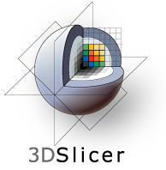
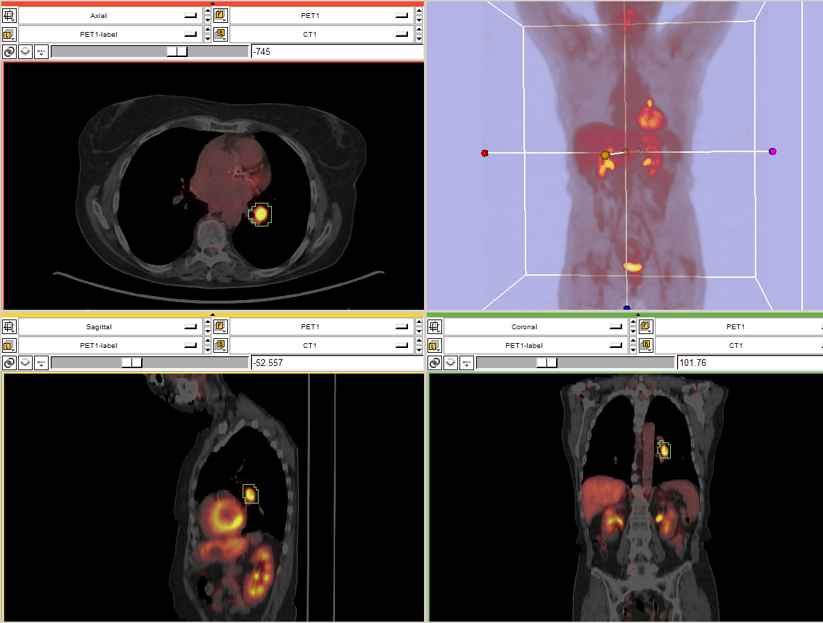
PET/CT Visualization and Analysis
PET/CT Analysis using 3D Slicer
Jeffrey Yap PhD
Ron Kikinis MD
Wendy Plesniak PhD
CTSA at RSNA 2010
--

Slide 2
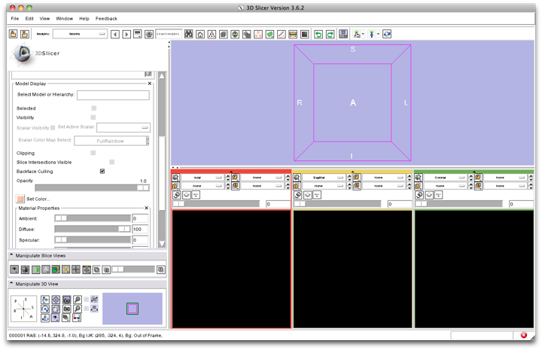
PET/CT Visualization and Analysis: Start fresh.
First, close any previous scene.
Select File->Close Scene
This removes any datasets previously loaded into Slicer.
CTSA at RSNA 2010
--

Slide 3
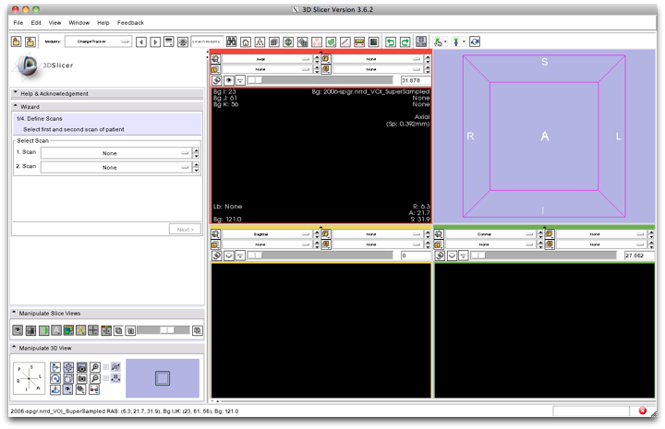
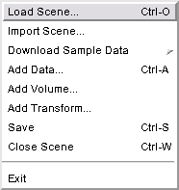
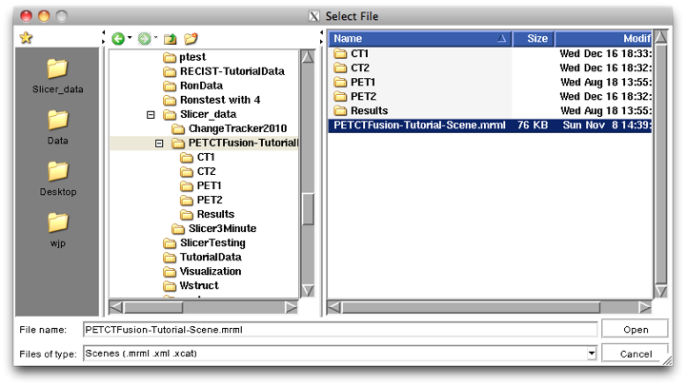
PET/CT Visualization and Analysis: Load the new scene
Select File->Load Scene
This raises the Load Scene Interface
select the file called
PETCTFusion-Tutorial-Scene.mrml
Double click the file, or click Open
CTSA at RSNA 2010
--

Slide 4
PET/CT Visualization and Analysis: About the data
Non small cell lung cancer patient
Two PET studies: baseline acquired before treatement, and followup acquired 1 month after chemotherapy
Two non-diagnostic CT images are acquired without the use of contrast
FDG-PET scans acquired 60 minutes after intravenous injection of approximately 20 mCi of 18FDG
Two VOIs have been created using Slicer’s Editor Module.
CTSA at RSNA 2010
--

Slide 5
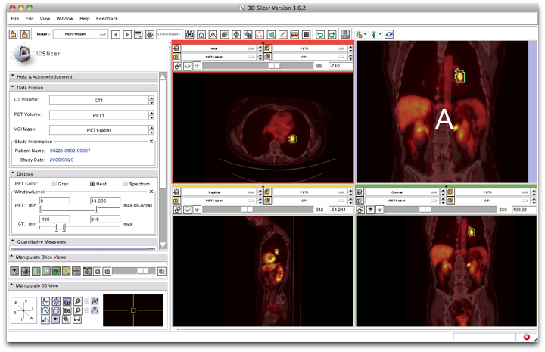
PET/CT Visualization and Analysis: Select baseline study
Note: Module requires DICOM format data
In the Data Fusion panel, select:
CT volume: CT1
PET volume: PET1
Tumor Mask: PET1-label
When the PET volume is selected, a “wait message” will be displayed while parameters are read from DICOM header.
CTSA at RSNA 2010
--

Slide 6
PET/CT Visualization and Analysis: Information displayed in “Layers”
Note: this stacks the PET, CT and VOI in three layers:
Background = CT1
Foreground = PET1
Overlay (Label) = PET1-label
where they can be blended into a single visualization
CTSA at RSNA 2010
--

Slide 7
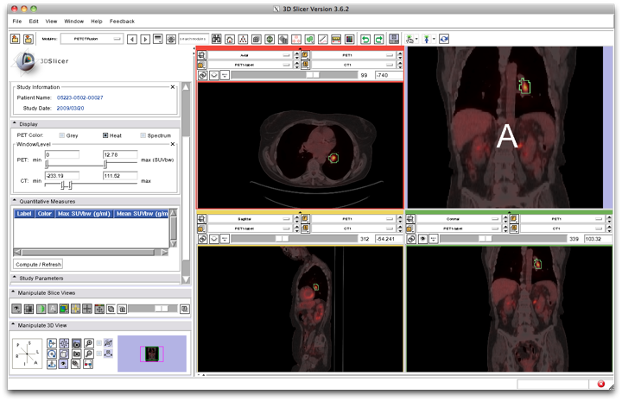
PET/CT Visualization and Analysis: Adjust display of the baseline study
In the Display Panel, choose a colorization option for the PET volume from among
Grey, Heat, or Spectrum.
Adjust the window and level for CT1 and PET1 volumes.
Adjust the Slices Fade Scale to jointly display the datasets in the foreground and background layers.
CTSA at RSNA 2010
--

Slide 8
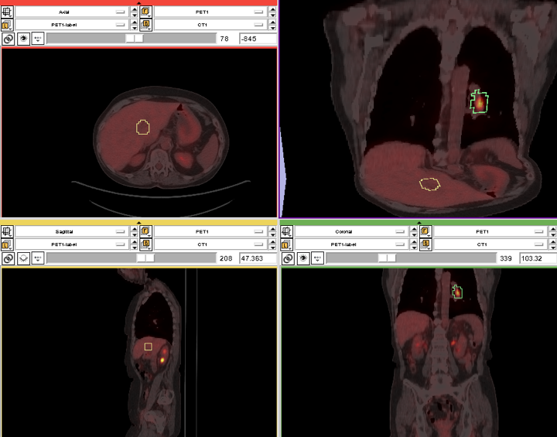
PET/CT Visualization and Analysis: Explore the visualization
Explore:
in the Slice Viewers, scroll through the slices to locate the green Tumor label and the yellow Liver label.
Note: (the yellow label is used only to demonstrate multiple-VOI functionality).
CTSA at RSNA 2010
--

Slide 9
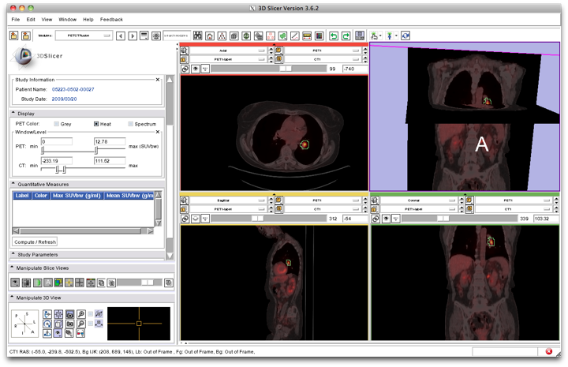
PET/CT Visualization and Analysis: View tumor in all slice viewers
Shortcut: To view the Tumor Label in all Slice Viewers:
Enter –740 in the Axial Slice Viewer’s Slice Number Entry
…and…
-54 (Sagittal)
103 (Coronal).
These are (mm) positions within the reference frame of the image volumes.
CTSA at RSNA 2010
--

Slide 10
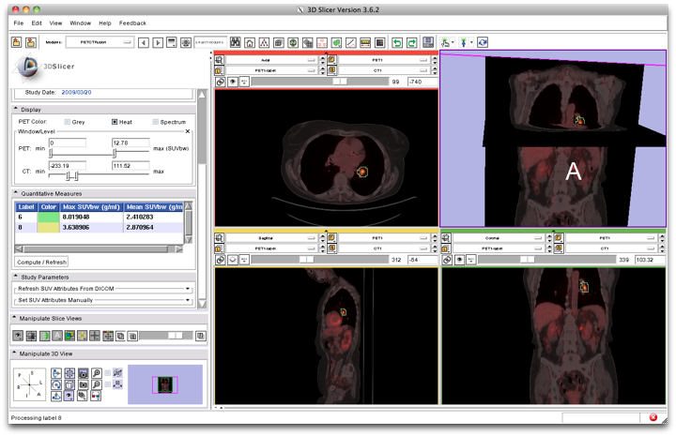
PET/CT Visualization and Analysis: Compute SUV for all VOIs in baseline
In the Quantitative Measures panel, click the Compute/Refresh button.
SUVmax and SUVmean for each VOI (represented by a different color in the label map) will be displayed in the table.
CTSA at RSNA 2010
--

Slide 11
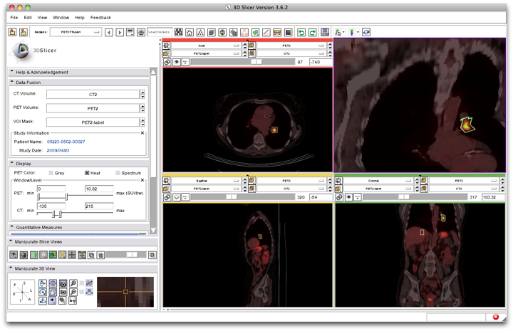
PET/CT Visualization and Analysis: Compute SUVbw for follow-up study
Look for response to treatment in the follow-up study:
In the Data Fusion panel, set:
CT volume = CT2,
PET volume = PET2 and Tumor Mask = PET2-label.
This dataset contains two VOIs that correspond to the segmentations the baseline study.
CTSA at RSNA 2010
--

Slide 12
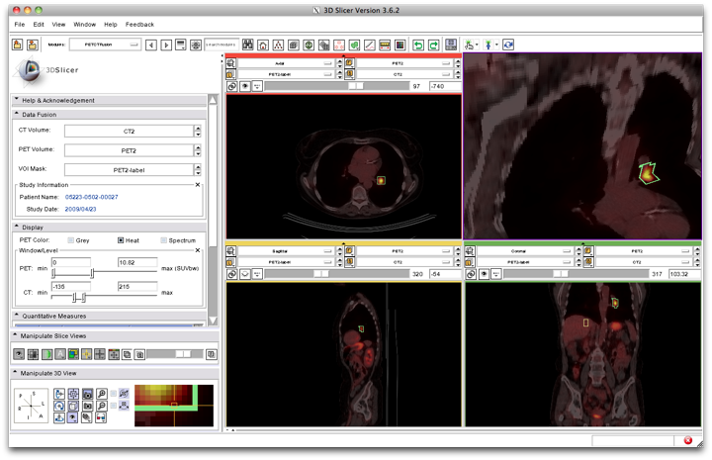
PET/CT Visualization and Analysis: Modify display of the follow-up
Adjust the display for the follow-up study.
You may want to adjust the Slices Fade Slider and manipulate the 3D View to refresh them.
CTSA at RSNA 2010
--

Slide 13
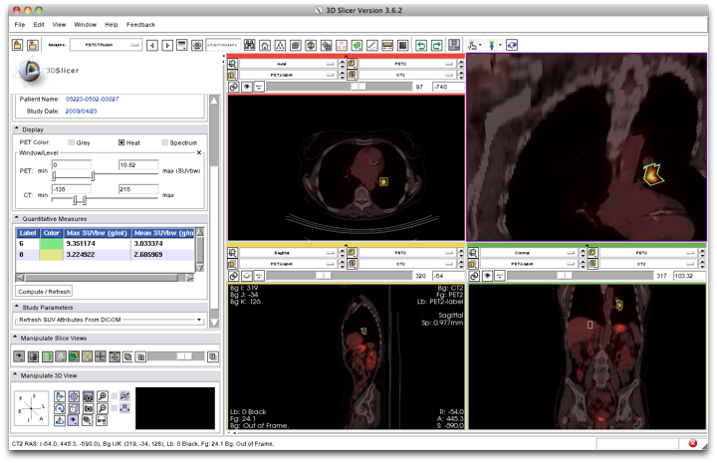
PET/CT Visualization and Analysis: Compute SUVbw for follow-up
In the “Quantitative Measures” Panel:
select Compute/Refresh to compute SUVbw for the green Tumor volume (and yellow liver volume).
CTSA at RSNA 2010
--

Slide 14
PET/CT Visualization and Analysis: Assess response wrt this VOI
Pre-Treatment Max SUVbw =
Post-Treatment Max SUVbw =
8.0
9.4
+16.61% (SD)
CTSA at RSNA 2010
--

Slide 15
PET/CT Visualization and Analysis: Appropriate Use
Still validating this module against performance of commercial systems.
Appropriate only for DICOM PET studies only
Not compatible with Philips datasets
CTSA at RSNA 2010
--

Slide 16
Workshop Summary
This workshop has demonstrated:
Basic scene loading and visualization using 3D Slicer
Use of Slicer’s ChangeTracker module to assess small changes in tumor size
Workflow to make quantitative measurements of SUV (body weight) in Slicer’s PETCTFusion module
CTSA at RSNA 2010
--

Slide 17
Workshop Summary: Slides and Datasets
Tutorial Slides:
http://www.na-micr.org/Wiki/index.php/File:PETCTTutorial.pptx
Tutorial Data:
http://wiki.na-mic.org/Wiki/images/7/73/PETCTFusion-Tutorial-Data.zip
Tutorial Software:
www.slicer.org/Downloads
More Information:
http://www.slicer.org
CTSA at RSNA 2010
--

Slide 18
Acknowledgements
Harvard Clinical and Translational Science Center
National Alliance for Medical Image Computing NIH U54EB005149
Brain Science Foundation
INRIA, France
Neuroimage Analysis Center (NAC)
National Center for Image-Guided Therapy (NCIGT)
Surgical Planning Laboratory, Brigham and Women’s Hospital
CTSA at RSNA 2010
--

