Slide 1
SlicerRT
3D Slicer extension for image-guided radiation therapy research

Slide 2
SparKit project overview
Funding by Cancer Care Ontario till 2016
PI & co-PI: Gabor Fichtinger (Queen’s), David Jaffray (Toronto UHN), Terry Peters (Robarts)
Team: Csaba Pinter, Andras Lasso (Queen’s), Kevin Wang (Toronto UHN)
Themes:
SlicerRT: radiotherapy toolkit for 3D Slicer
SlicerIGT: Image-guided therapy with 3D Slicer

Slide 3
Theme
Motivation:
commercial treatment planning software: closed, expensive
existing research tools (CERR, PLUNC, dicompyler, etc): limited
Goal:
“hub” for RT data analysis and comparison
Free, open-source, BSD license
Approach:
leverage existing tools and parallel efforts
3D Slicer
RT import (DICOM)
Visualization (volumes, models, 2D/3D, etc.)
Processing (registration, segmentation, etc.)
Analysis (error metrics, measurements, image fusion, etc.)
RT-specific analysis (dose comparison, DVH, …)
RT export (DICOM, Matlab, …)
Notes:
Use 3DSlicer as platform
DICOM-RT data import: mapping RT data structures to existing 3DSlicer data types
Utilize existing 3DSlicer features: registration, visualization, ...
Develop missing RT-specific functionalities: DVH analysis, ...
Export results to commercial treatment planning system or research software (Matlab, etc.)

Slide 4
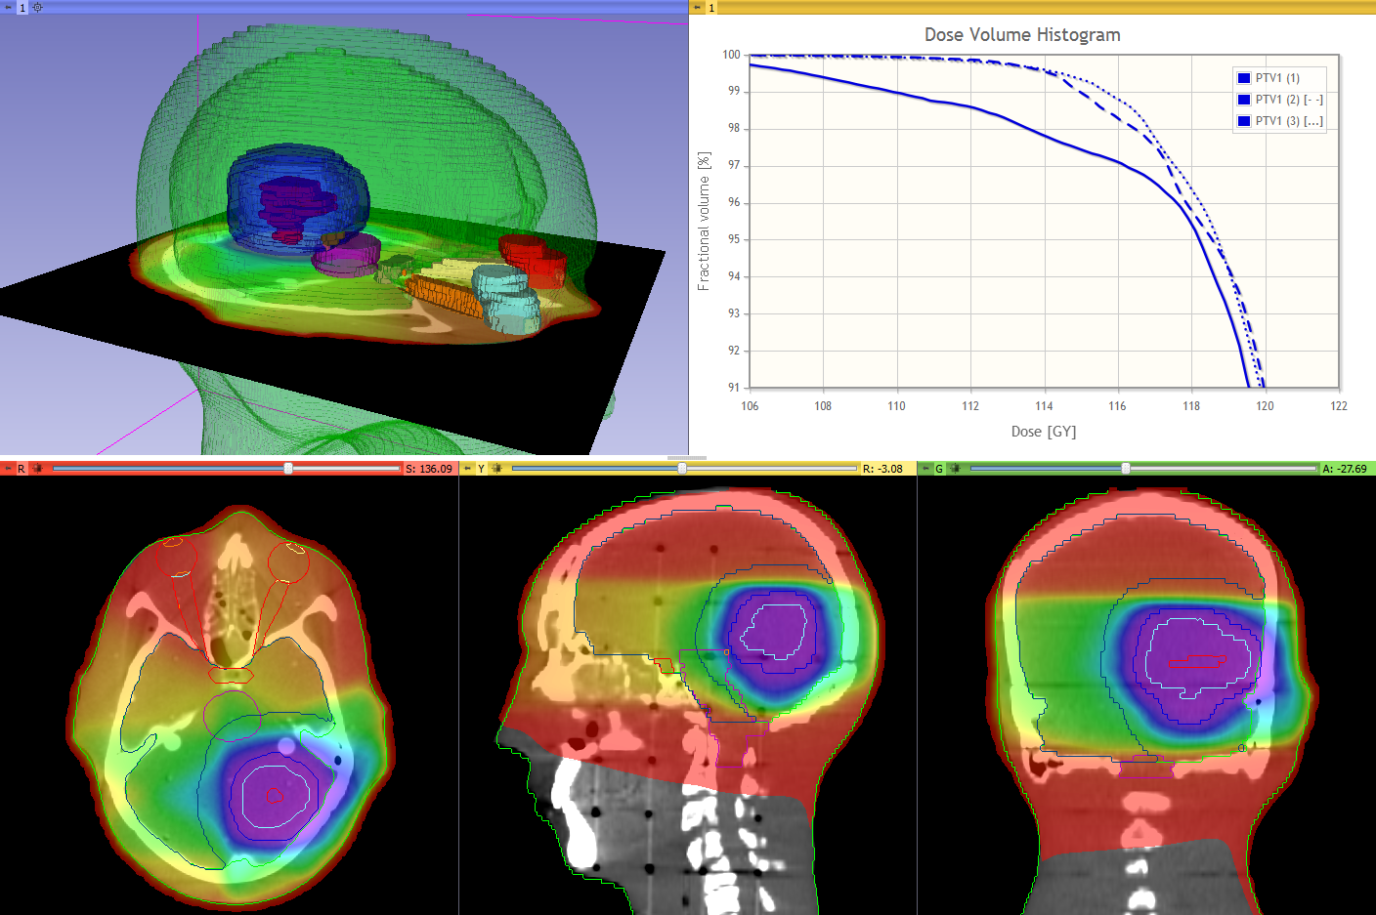
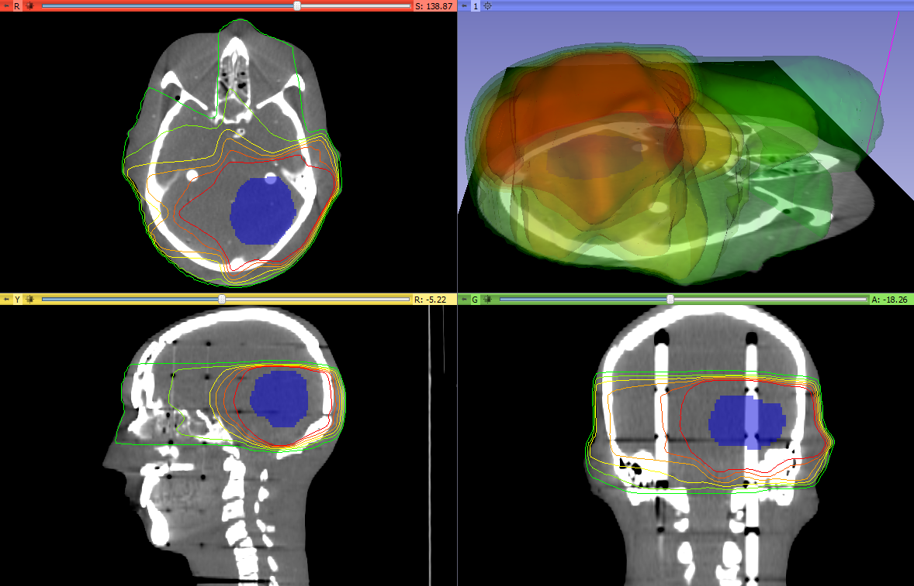
Features overview
Import/Export: DICOM-RT import, Matlab bridge^{E}
Contours analysis: multiple representations (model, labelmap; auto convert), editing, contour comparison^{E}, grow/shrink^{E}, combine^{E}
Dose analysis: dose volume histogram, accumulation, comparison (gamma), isodose contours visualization, proton dose computation^{E}
Registration: BSpline registration^{P}, Landwarp registration^{P}
^{E} = Experimental ^{P} = Through Plastimatch

Slide 5
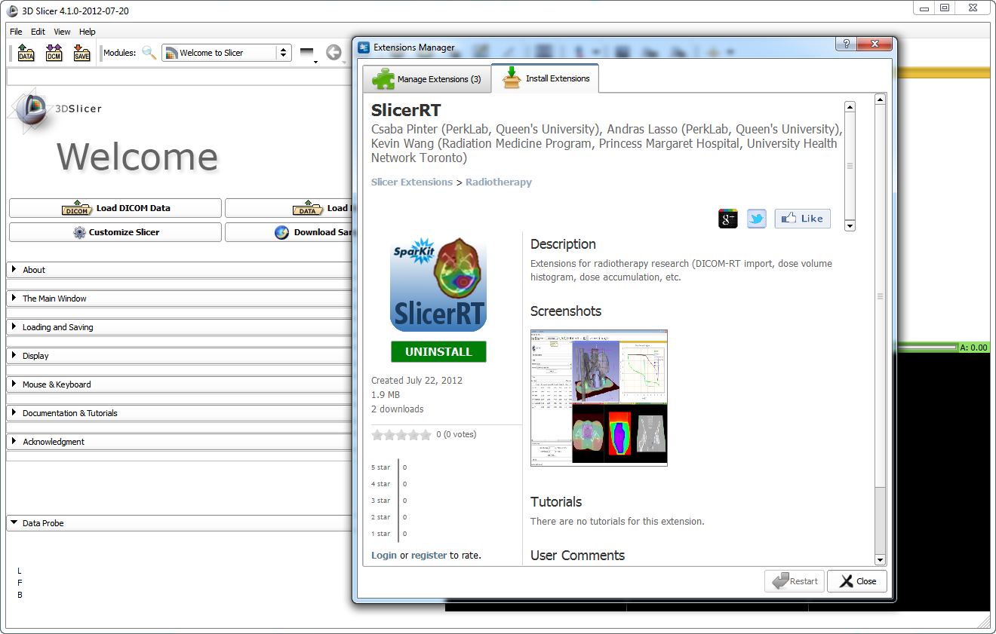
SlicerRT extension for 3D Slicer
Collection of RT-specific modules, includes
Distributed as a 3D Slicer extension: can be downloaded, installed, upgraded using the extension manager in Slicer
SlicerRT extension in the 3D Slicer app store (free)

Slide 6
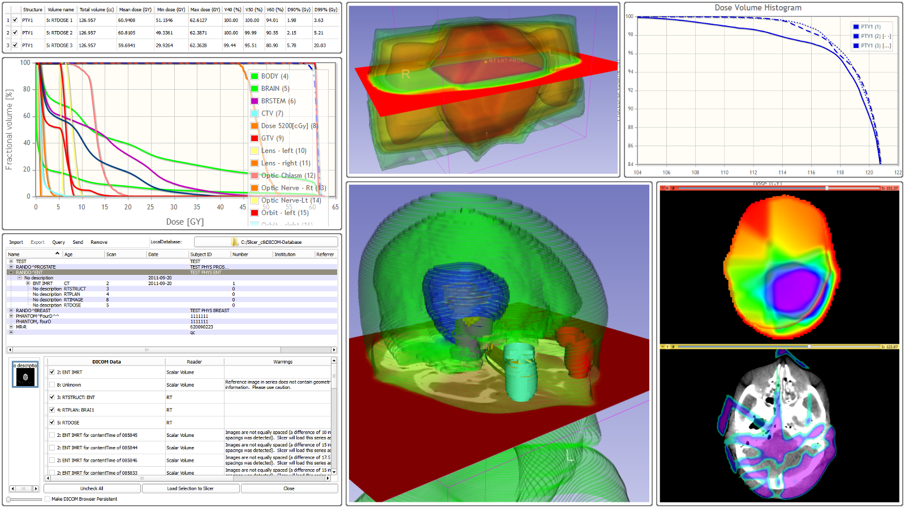
References
Overview paper: Csaba Pinter, Andras Lasso, An Wang, David Jaffray, and Gabor Fichtinger, “SlicerRT: Radiation therapy research toolkit for 3D Slicer”, Med. Phys. 39 (10), October 2012
Project homepage: https://www.assembla.com/spaces/slicerrt/
Contact: Andras Lasso (lasso@cs.queensu.ca)

