Slide 1


Boolean Remove Filter
Alan Morris, Salma Bengali, Greg Gardner,
Josh Cates, Rob MacLeod
SCI Institute/CARMA Center
University of Utah
© 2012, All Rights Reserved

Slide 2
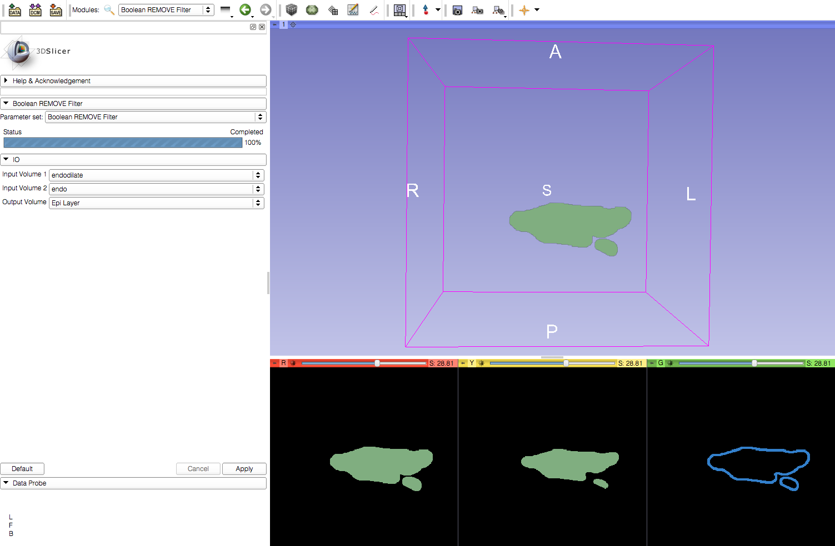
Learning Objective
Boolean Remove Filter in Slicer
© 2012, All Rights Reserved

Slide 3

Current Workflow
Left Atrium Dilated Endo Layer
Left Atrium Endo Layer
Left Atrium Wall Layer
© 2012, All Rights Reserved

Slide 4

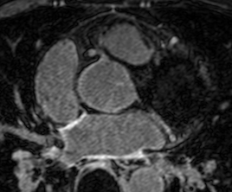
Required Materials
Slicer: Release 4.1
http://www.slicer.org/pages/Downloads/
Data: CARMA Slicer Extension Tutorial Data
http://hdl.handle.net/1926/1765
© 2012, All Rights Reserved

Slide 5

Additional Sample Data
60 patients
http://hdl.handle.net/1926/1757
© 2012, All Rights Reserved

Slide 6
Pre-requisite Tutorial
http://www.slicer.org/slicerWiki/index.php/Documentation/4.0/Training
© 2012, All Rights Reserved

Slide 7


Platforms
Developed
Tested
© 2012, All Rights Reserved

Slide 8
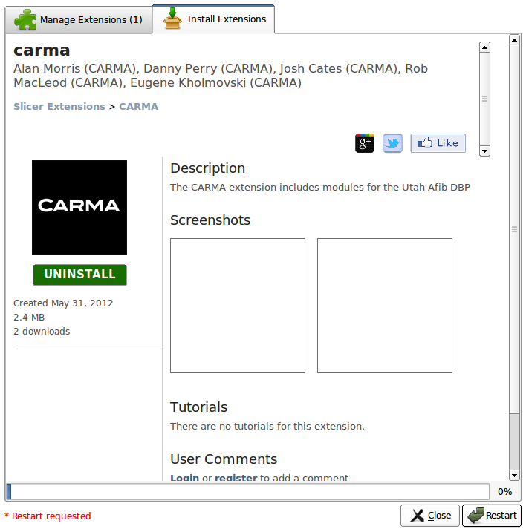
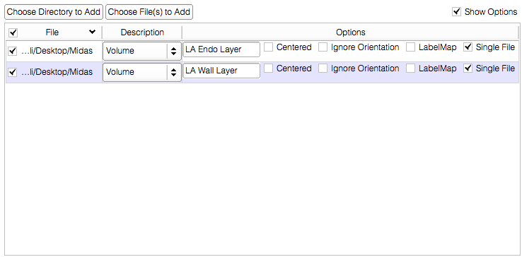
Overview
Load the module
Load the dataset
Boolean Remove
© 2012, All Rights Reserved

Slide 9
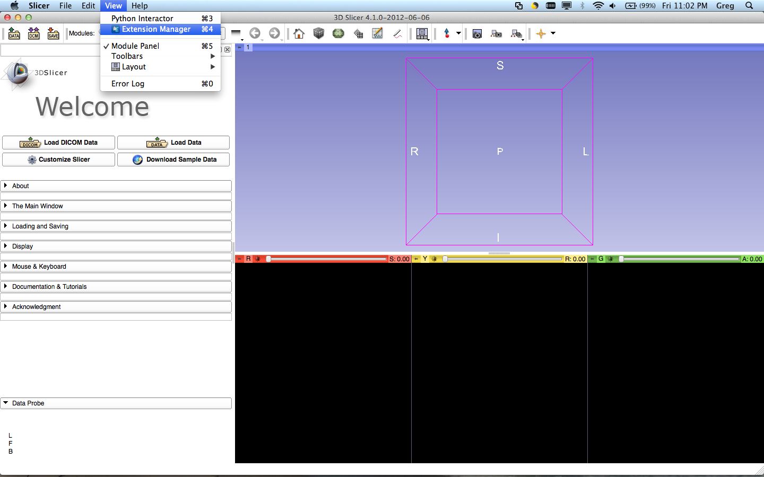
Loading the Module
Select View>Extension Manager in the menu bar (or push ⌘4)
If the Extension Manager isn’t revealed, see the next 2 slides; otherwise, skip them
© 2012, All Rights Reserved

Slide 10
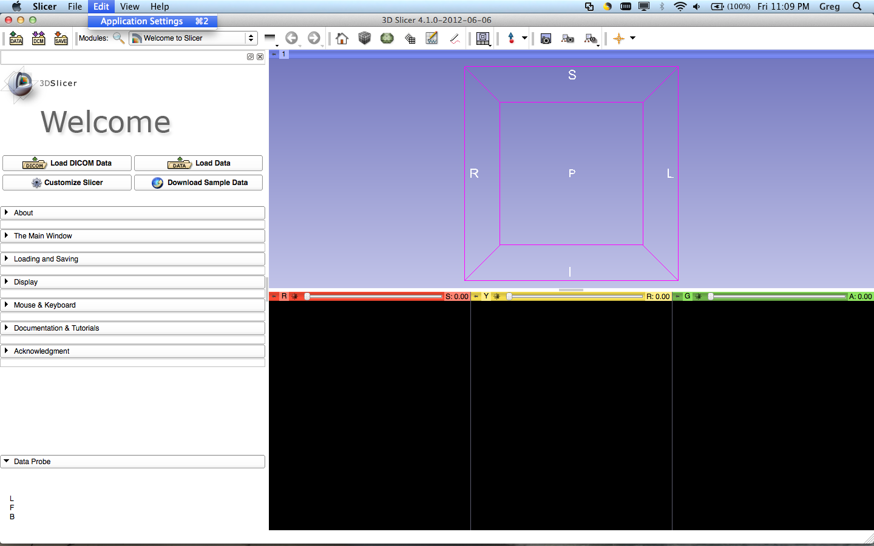
Loading the Module
To load the Extension Manager, Select Edit>Application Settings in the menu bar (or push ⌘2)
© 2012, All Rights Reserved

Slide 11
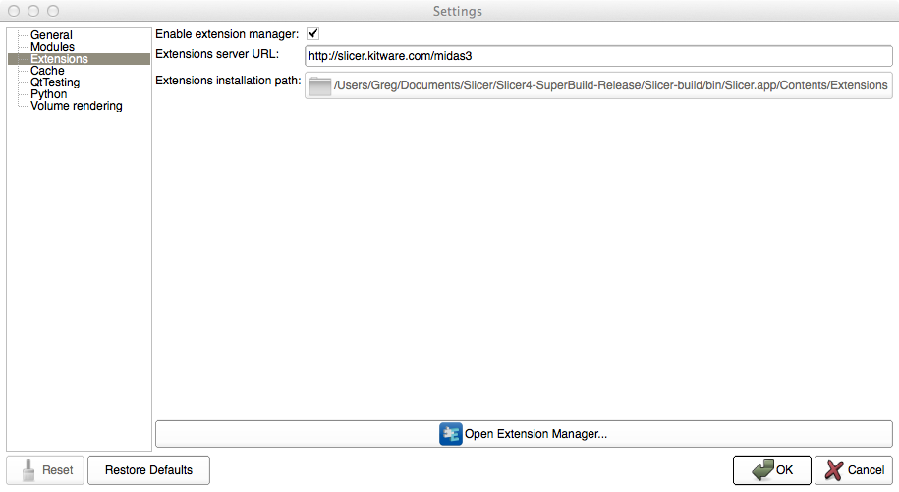
Loading the Module
Under the Extension menu, make sure ‘Enable extension manager’ is checked
© 2012, All Rights Reserved

Slide 12
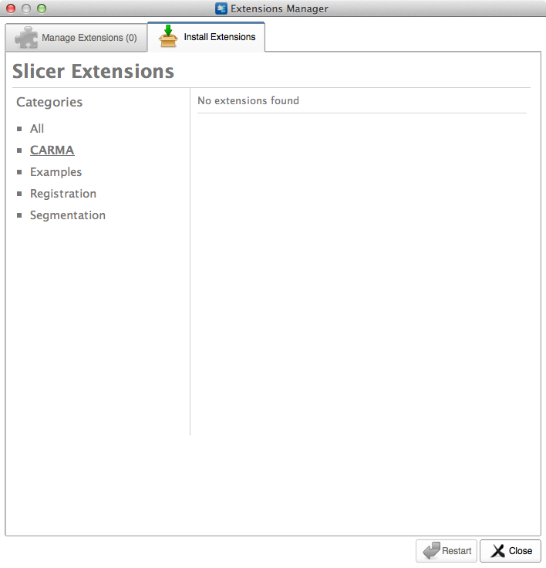
Loading the Module
Select CARMA in the sidebar and click the extensions
© 2012, All Rights Reserved

Slide 13
Loading the Module
Restart to install the extension
© 2012, All Rights Reserved

Slide 14
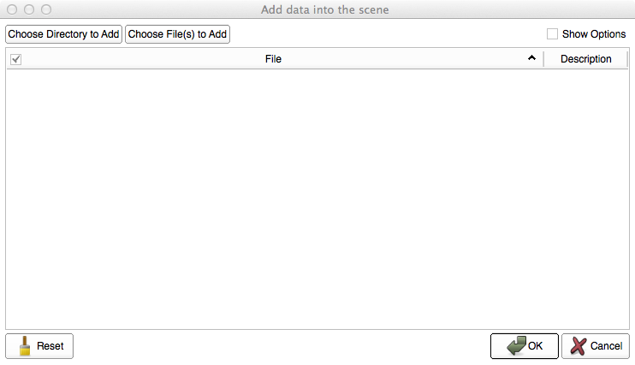
Loading the Data
Select ‘Choose Directory to Add’ in the pop-up menu
© 2012, All Rights Reserved

Slide 15
Loading the Data
Select the directory containing your dataset
© 2012, All Rights Reserved

Slide 16
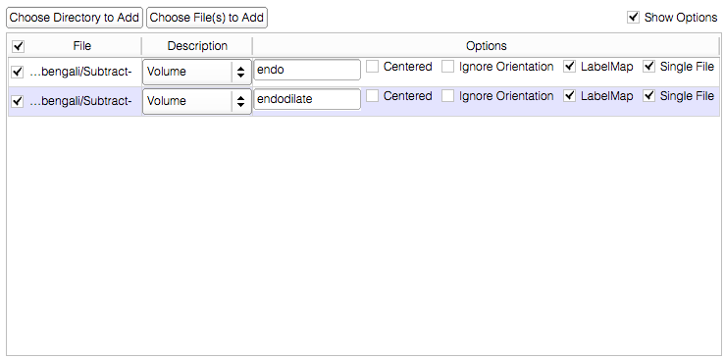
Loading the Data
1. Select ‘show options’
2. Select the label map option
© 2012, All Rights Reserved

Slide 17
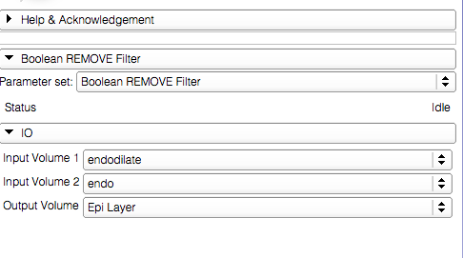
Boolean Remove
{
Input volumes
Output volume

Slide 18
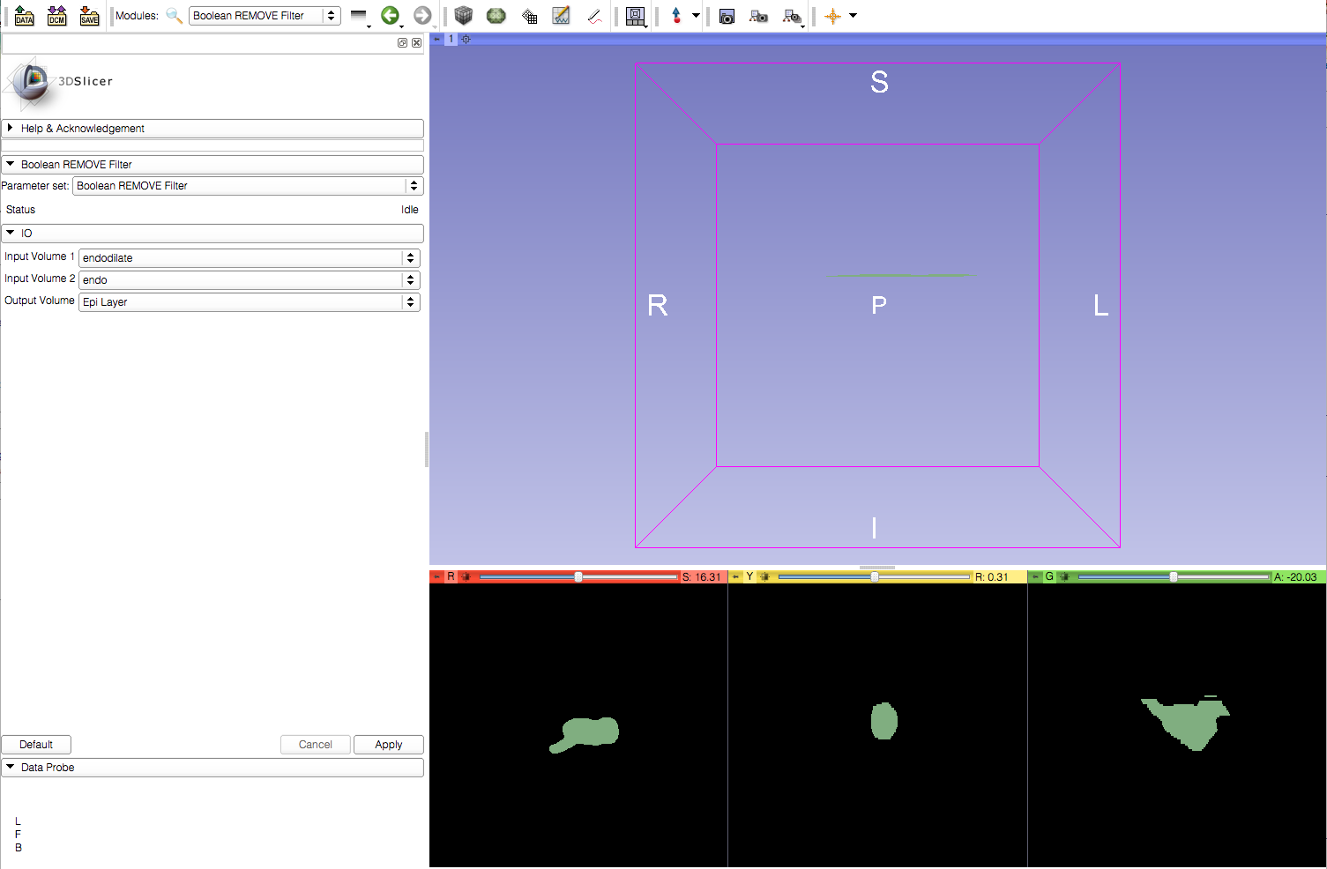
Boolean Remove
Apply the filter

Slide 19
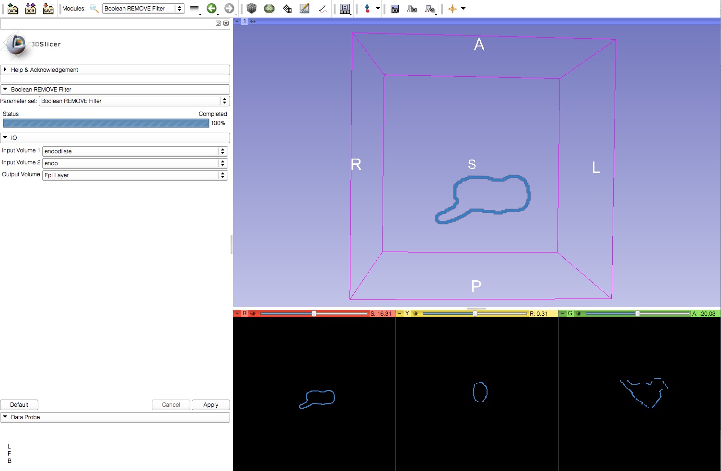
Boolean Remove
Viewer automatically updates to show the resulting output

Slide 20
Conclusion
This module can be used to subtract two segmentation layers.

