Slide 1
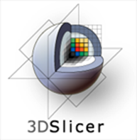
Core 1b – Engineering Introduction
Will Schroeder
Kitware, Inc.

Slide 2
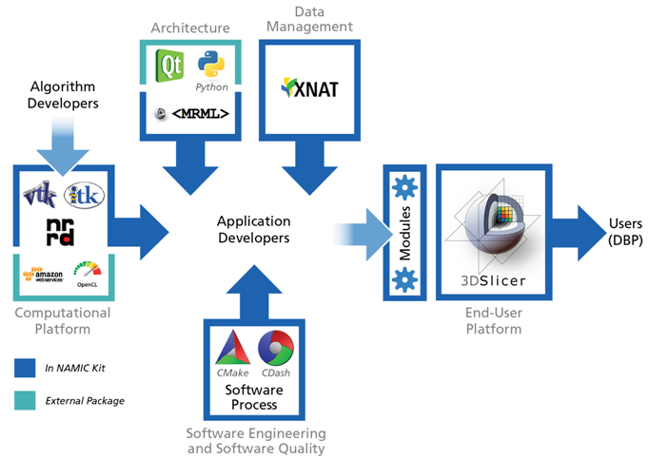
Architecture

Slide 3
Greatest Achievement
I’m Happy!

Slide 4
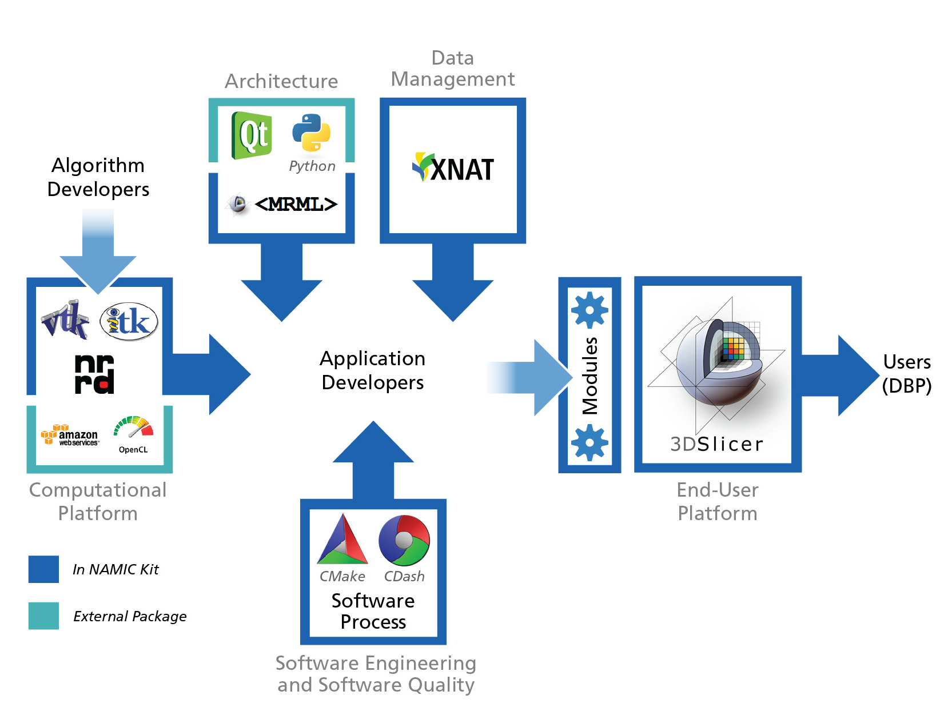
Core 1b – Engineering 5 Aims / 5 Platforms
Architecture – tools, operating paradigms, reporting mechanisms, integration points
End-user platform – interactive methods and information visualization for longitudinal analysis, exploratory data analysis, and translational research
Computational platform – stream processing, cloud computing, statistical analysis, informatics, machine learning
Data management – non-imaging and derived data, DICOM and cloud services
Software engineering and software quality – navigable timeline for revision control, build, test, documentation and release
1
4
3
2
5

