Slide 1
3D Slicer hands-on tutorial
Csaba Pinter Kingston, ON, Canada
http://perk.cs.queensu.ca

Slide 2
Platform and hardware
Developed and maintained on Windows 64bit, Mac OSX, and Linux 64bit & 32bit
Slicer requires
Minimum 2GB RAM
Graphics accelerator with 64MB of memory
64 bit strongly suggested

Slide 3
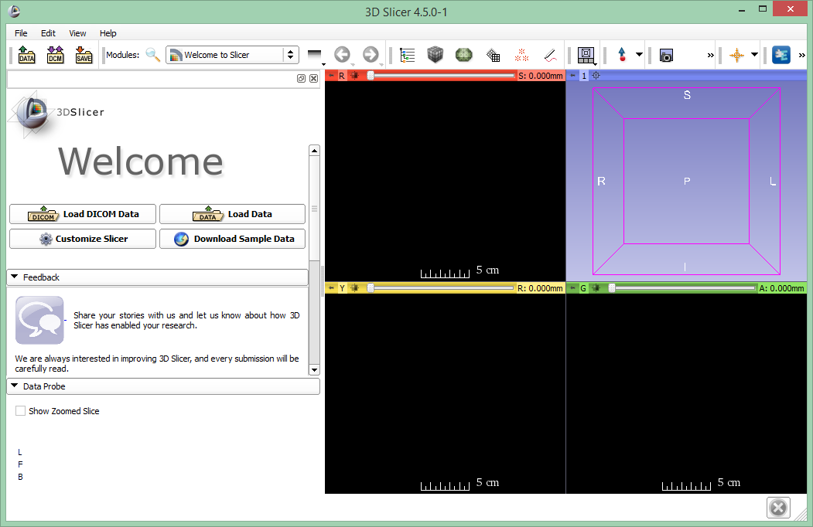
3D Slicer version 4.5
The Welcome module appears at start-up

Slide 4
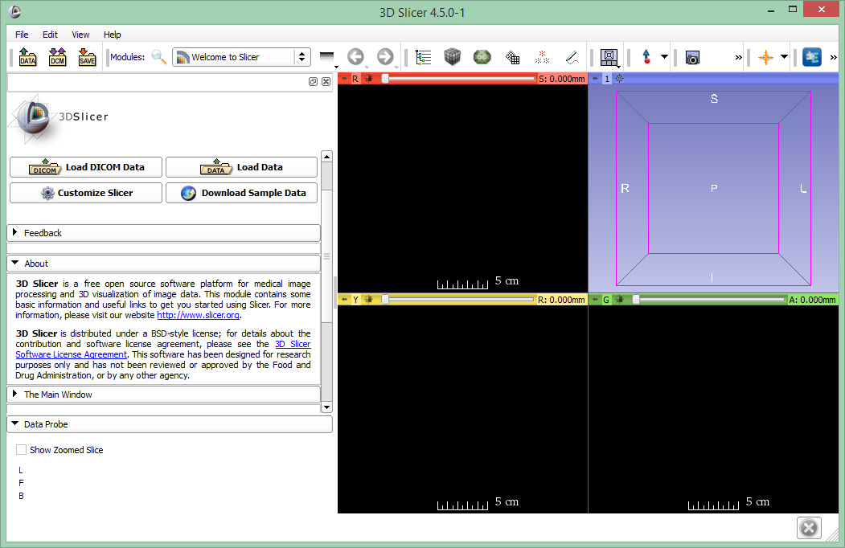
Welcome to Slicer
Each module includes a series of sections, which give access to different functionalities.
Click on the arrow to open

Slide 5
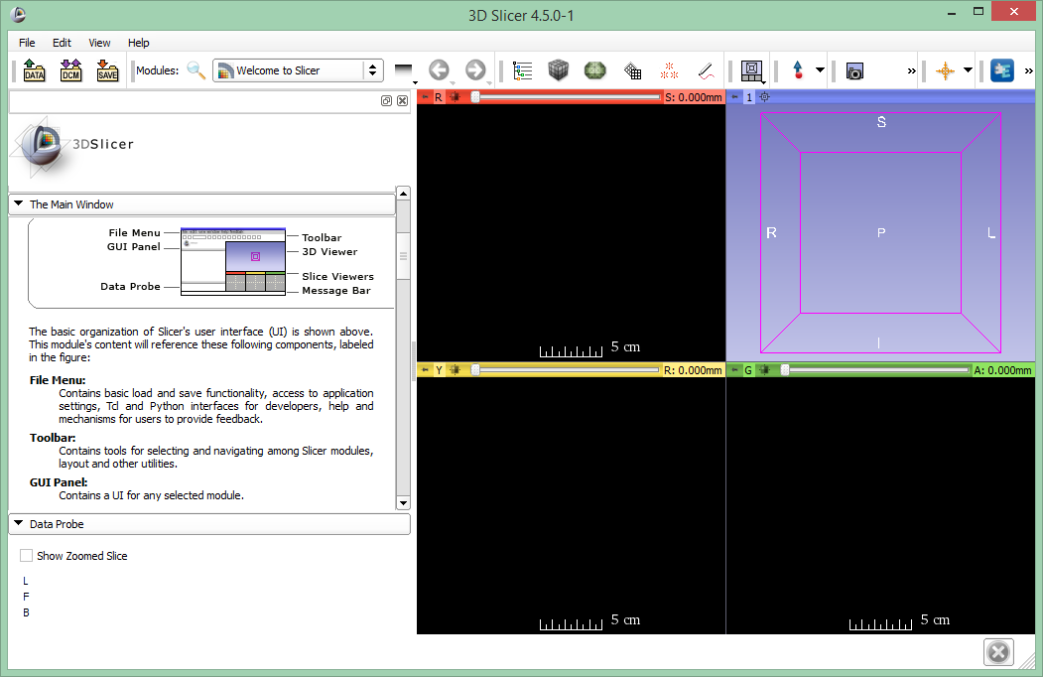
Welcome to Slicer
The Main Window section contains information on the basic organization of Slicer’s user interface

Slide 6
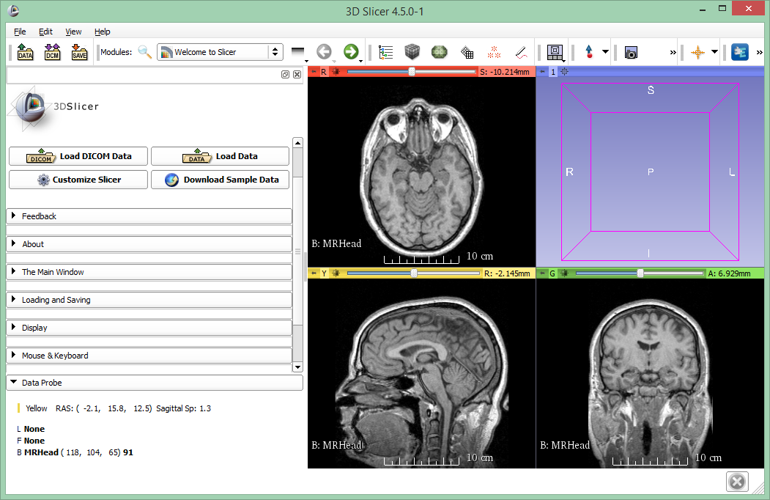
Slicer user interface
Main menu
Toolbar
3D viewer
Module panel
Data probe
2D anatomical viewers

Slide 7
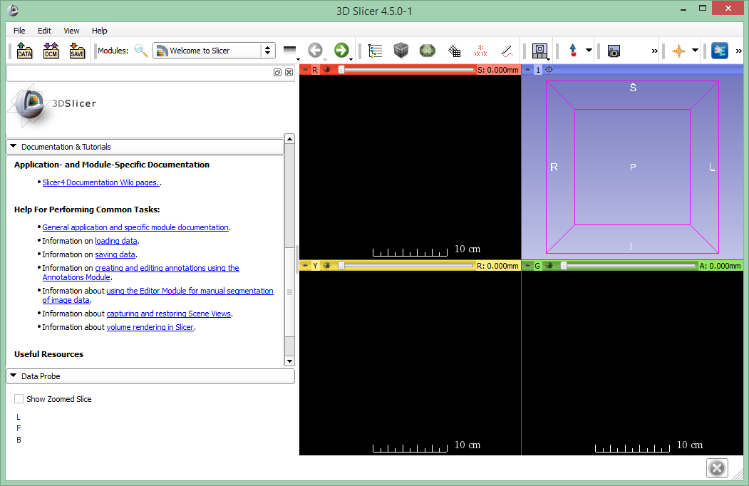
Welcome module
The Documentation & Tutorial section contains links to the Slicer training compendium and documentation

Slide 8
Welcome module
The Welcome module panel contains shortcuts for loading different types of data. A series of sample data are also available.
Click on Download Sample Data to access the Sample Data Module

Slide 9
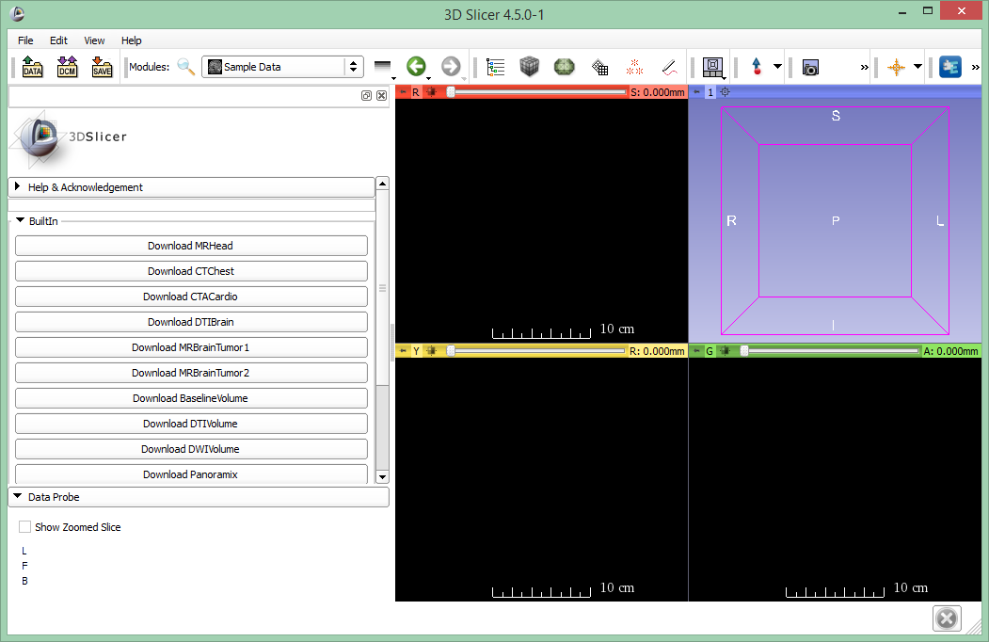
Sample Data
The Sample Data module contains links to 12 different sample datasets that can be downloaded into Slicer

Slide 10
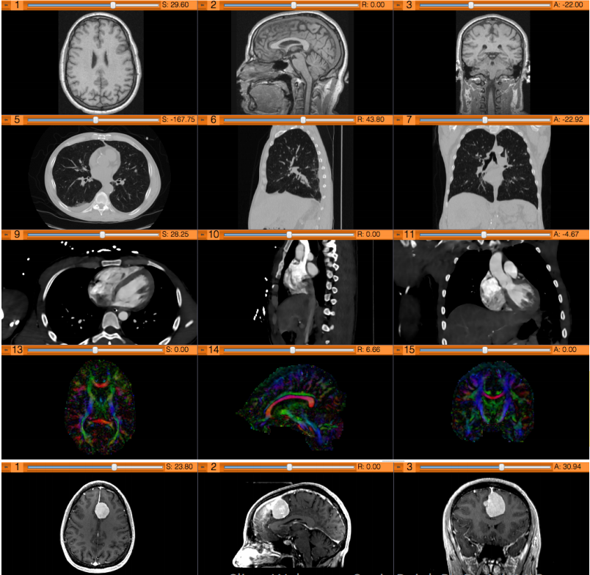
Sample Data
Brain MRI
Chest CT
Cardiac CT
Diffusion Tensor Imaging
Brain MRI (tumor patient)
Image is courtesy of Sonia Pujol, PhD

Slide 11
Sample Data
Click on Download MRHead to download the dataset in Slicer

Slide 12
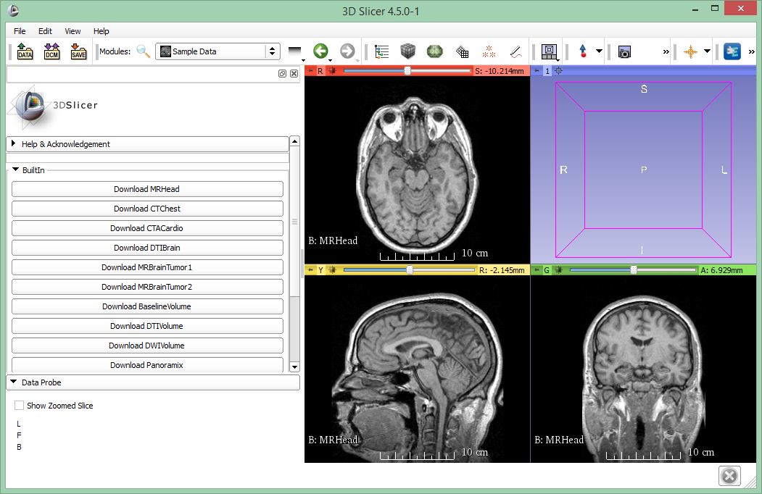
Sample Data
The brain MR image appears in the 2D viewers

Slide 13
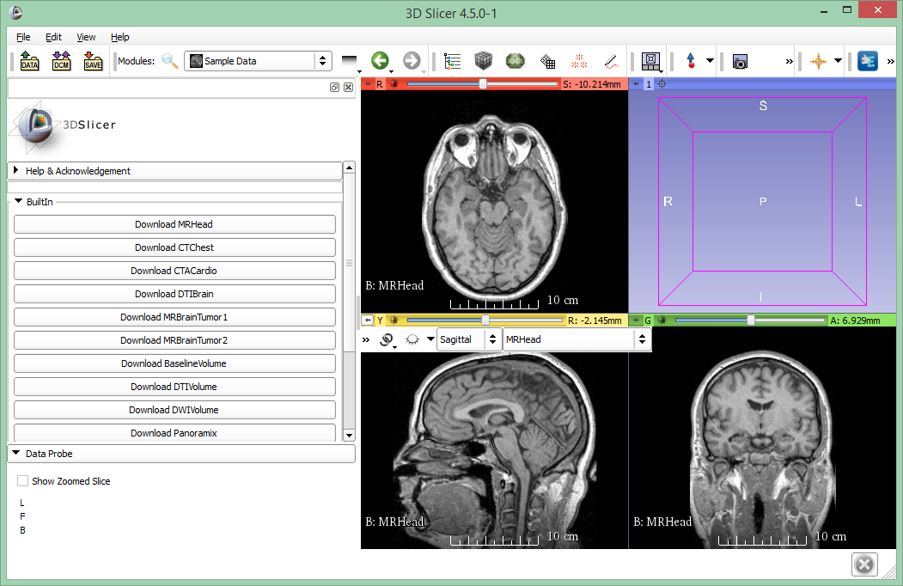
MR Brain Sample Dataset
Position the mouse on the little pin icon in the top left corner of a 2D viewer to display the viewer menu

Slide 14
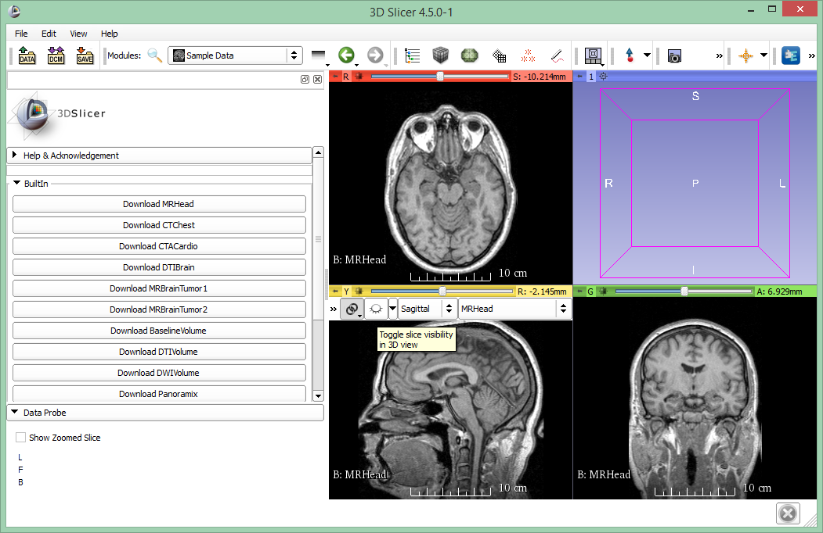
MR Brain Sample Dataset
Click on the link icon to link 2D viewers, then on the eye icon to display slices in the 3D viewer

Slide 15
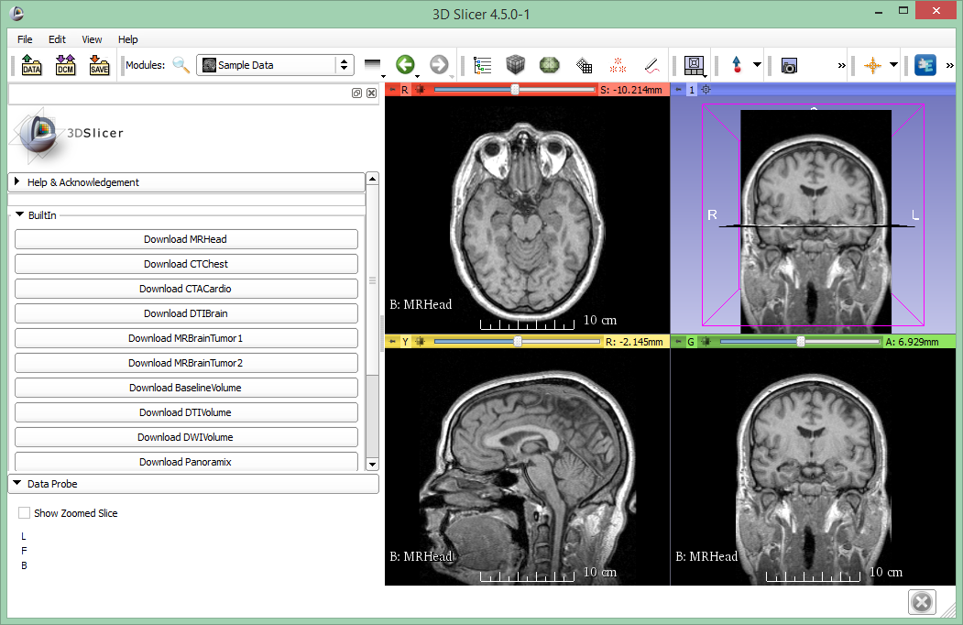
MR Brain Sample Dataset
The axial, coronal, and sagittal slices appear in the 3D view. Go back to the Welcome module using the green arrow in the toolbar

Slide 16
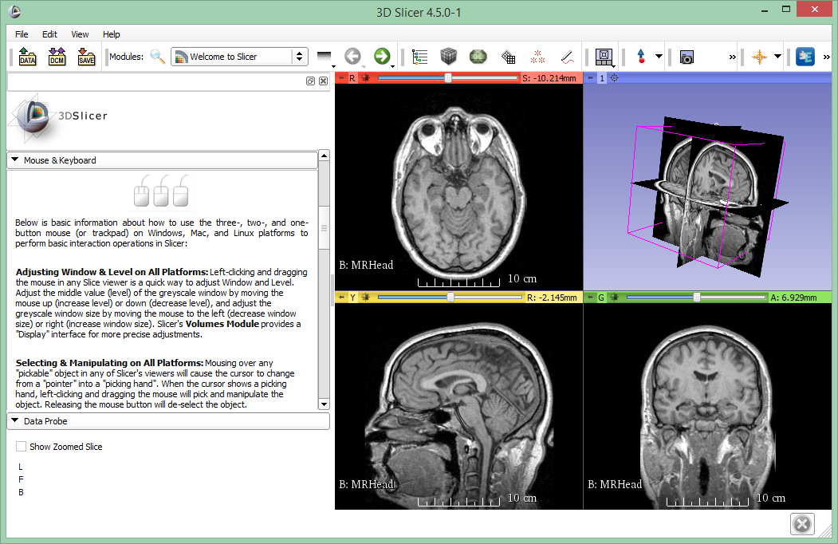
MR Brain Sample Dataset
Click on the Mouse & Keyboard section to learn the different mouse actions to rotate and zoom

Slide 17
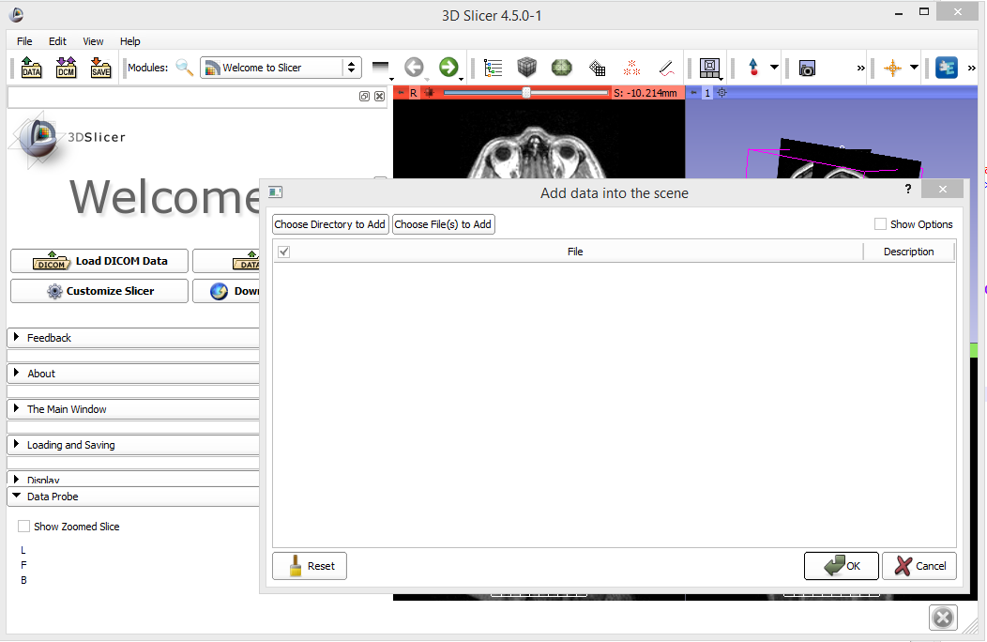
Load data from file
Data can be loaded from files using the Add data dialog, or by drag&dropping files onto the Slicer window

Slide 18
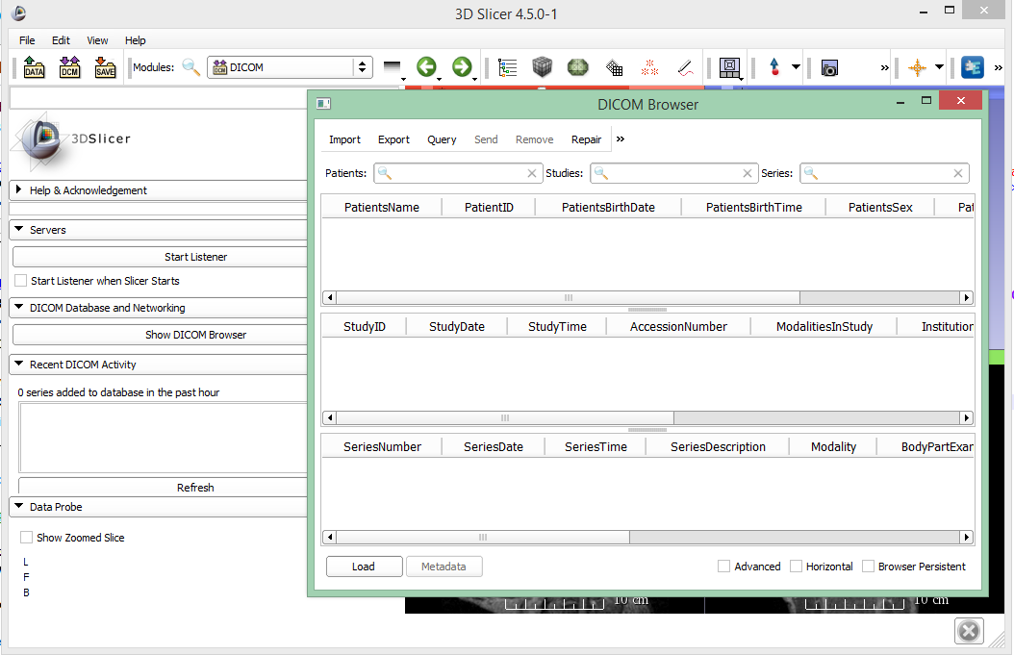
Load DICOM data
DICOM data can be loaded using the DICOM browser after importing it to the DICOM database

Slide 19
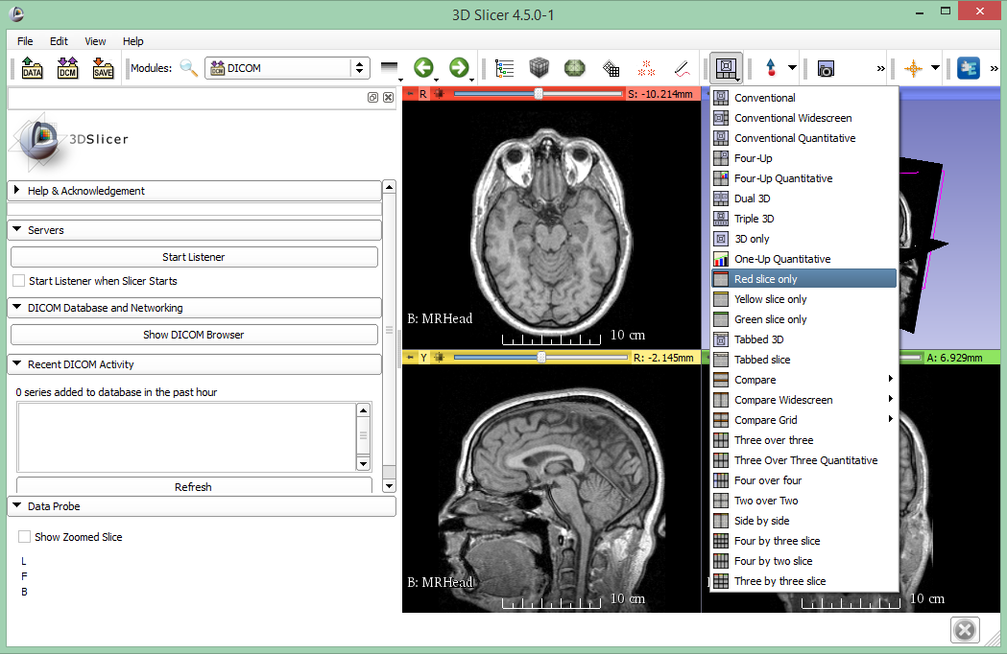
Changing layout
Choose Red slice only

Slide 20
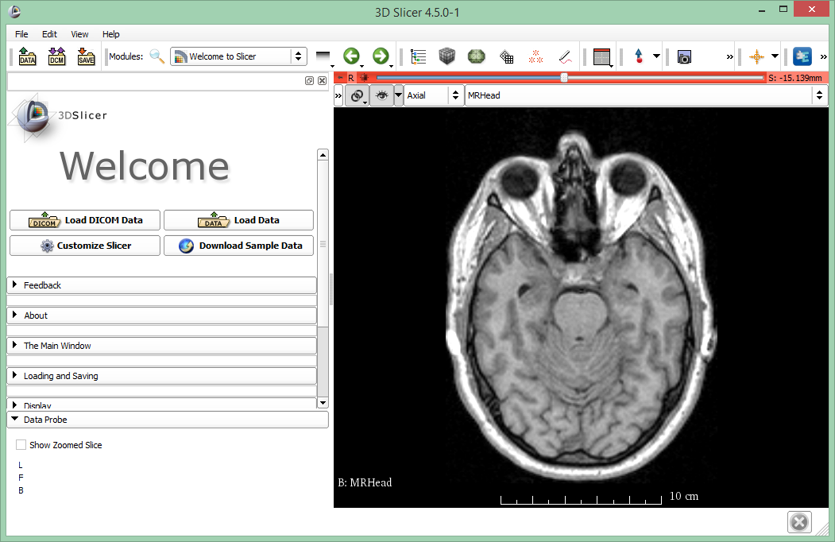
Slice viewer toolbar cont’d
Hover the pin again, and once the slice viewer toolbar is displayed, click on “>>”

Slide 21
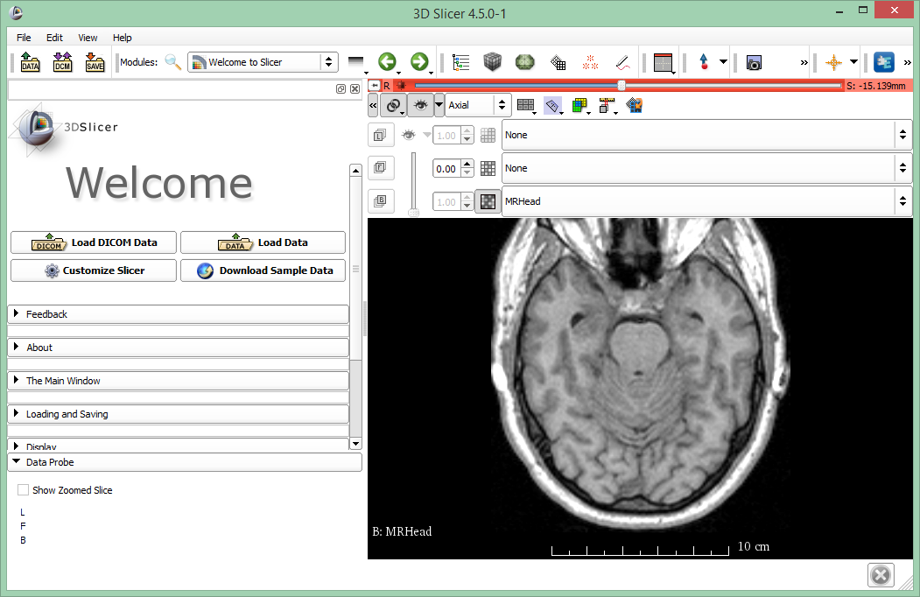
Slice viewer toolbar cont’d
This menu will appear once the “>>” button is pressed

Slide 22
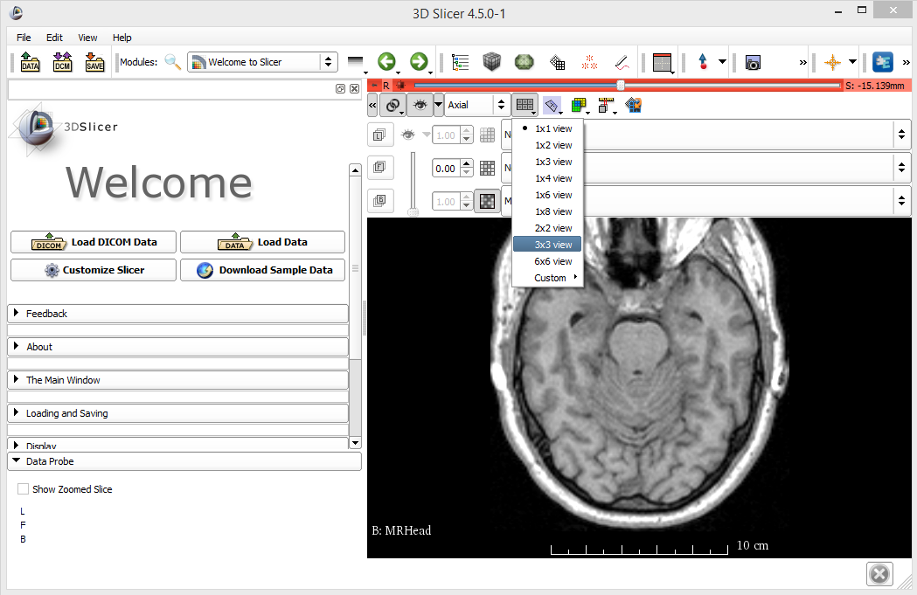
Lightbox view
Click on the Lightbox menu choose the “3x3 view”

Slide 23
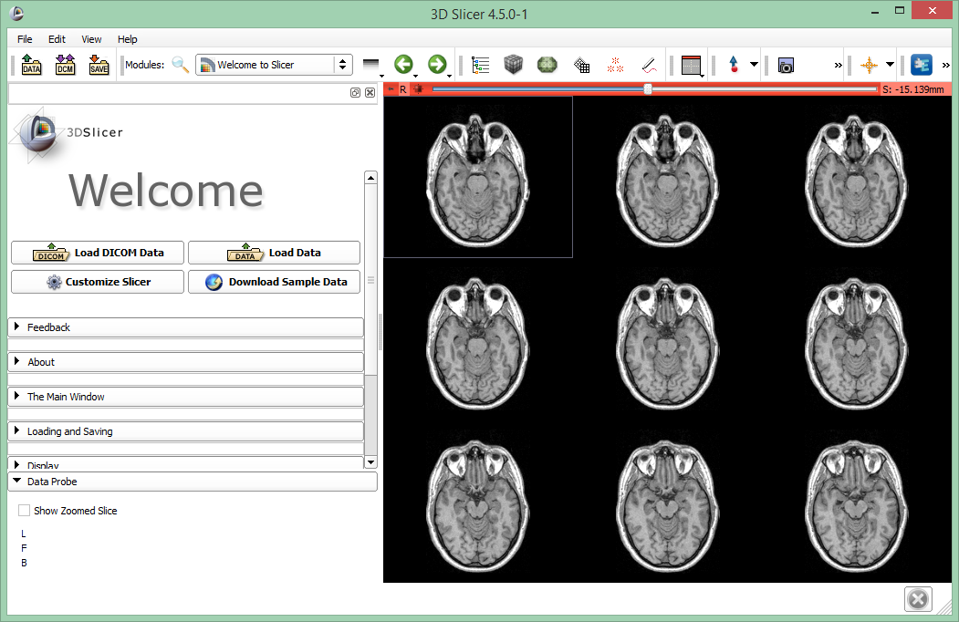
Lightbox view
9 consecutive images of the DICOM volume are displayed. Use the red slice slider (or the mouse wheel) to browse through the data

Slide 24
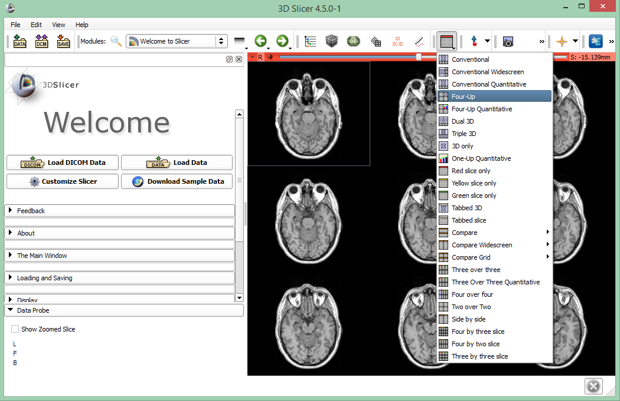
Switch back the layout
Choose Four-up

Slide 25
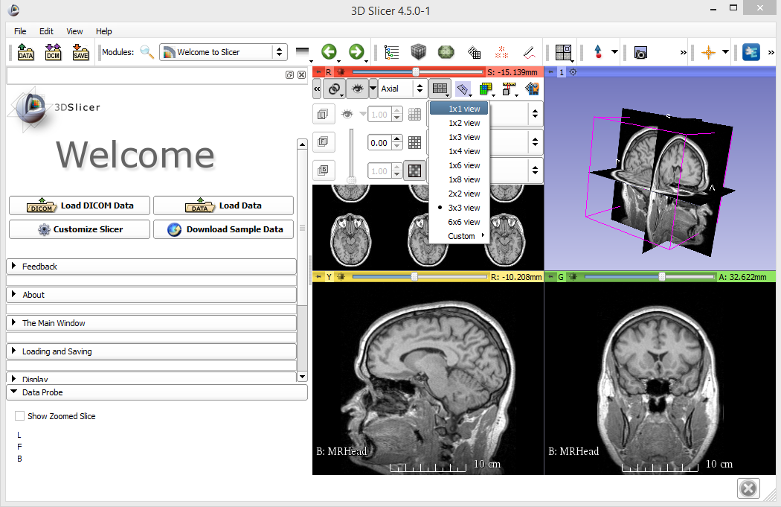
Turn off lightbox view
Choose 1x1 view

Slide 26
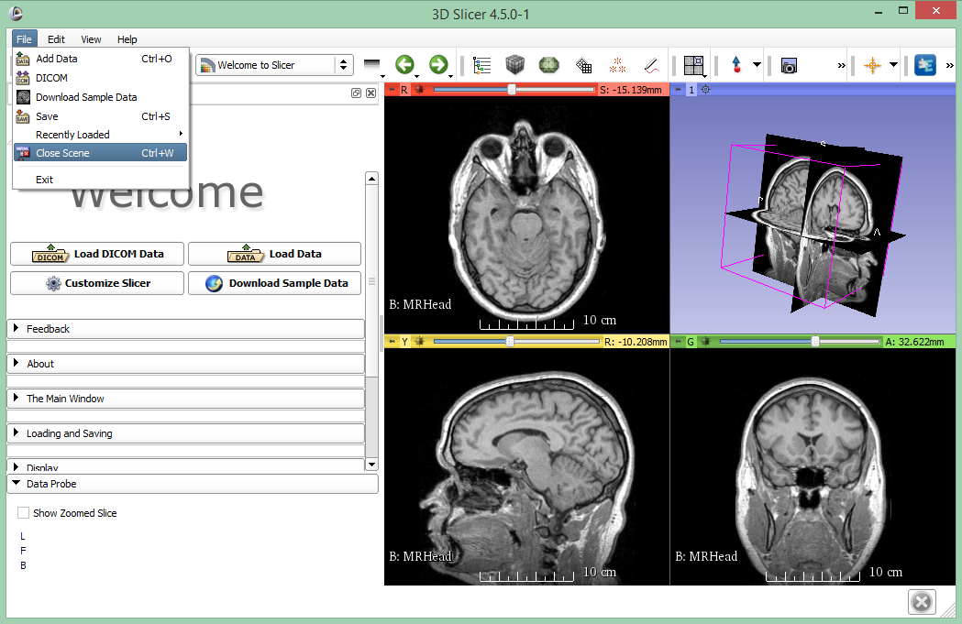
Close Slicer scene

Slide 27
Download Slicer scene
Download file http://www.slicer.org/slicerWiki/images/c/c4/Slicer4minute.zip
A Slicer scene is a MRML (Medical Reality Modeling Language) file containing a list of elements loaded into Slicer (volumes, etc.)
The scene file and datasets have been saved as an MRB (Medical Reality Bundle) file
MRB is Slicer’s archive file format

Slide 28
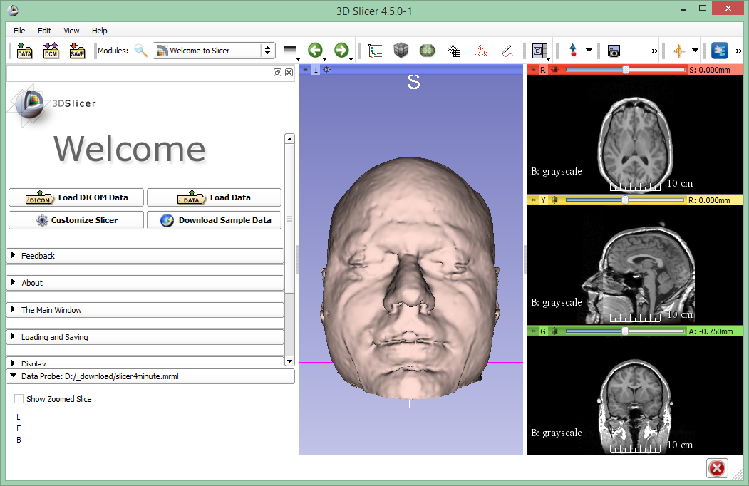
Load scene
Load slicer4minute.mrb into Slicer using the Add data dialog or drag&drop

Slide 29
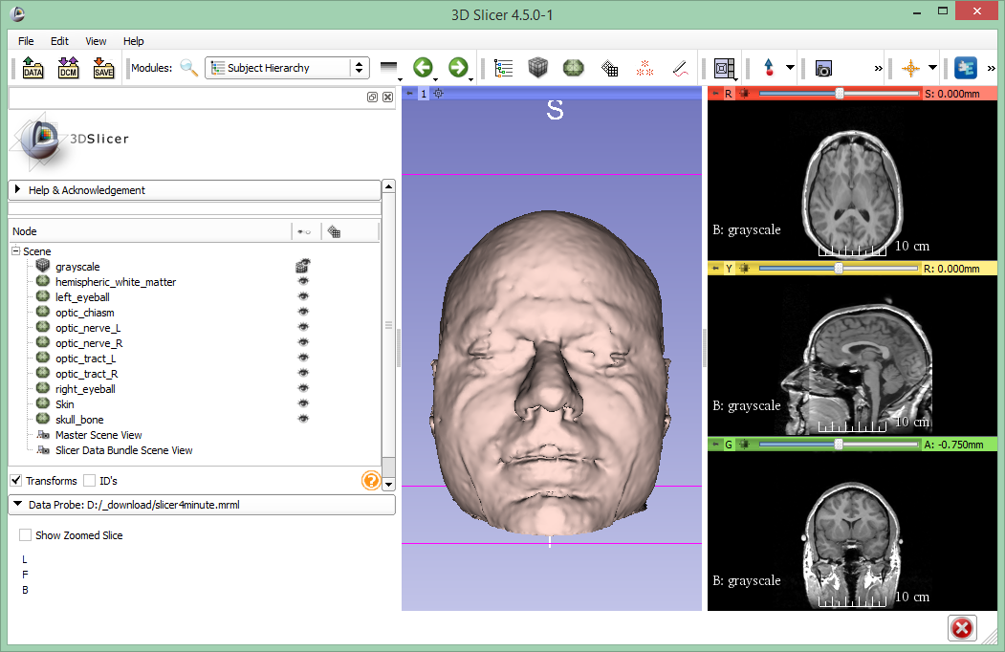
Subject hierarchy
Switch to the Subject hierarchy module and choose “Yes to All”

Slide 30
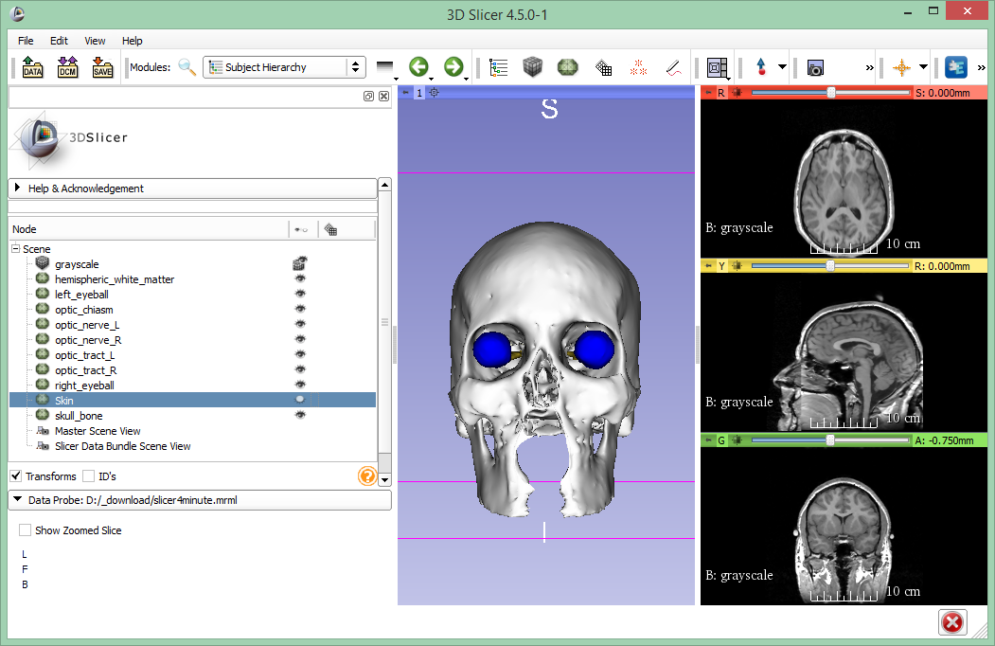
Subject hierarchy
Show/hide objects by clicking the eye icon

Slide 31
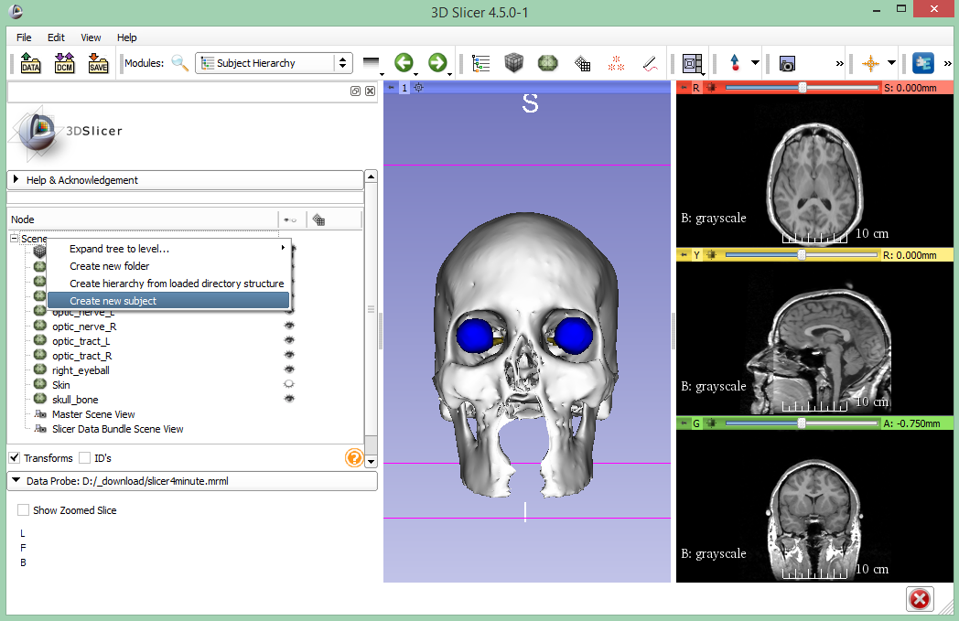
Subject hierarchy
Organize data into hierarchies: Create subject after right-clicking the Scene

Slide 32
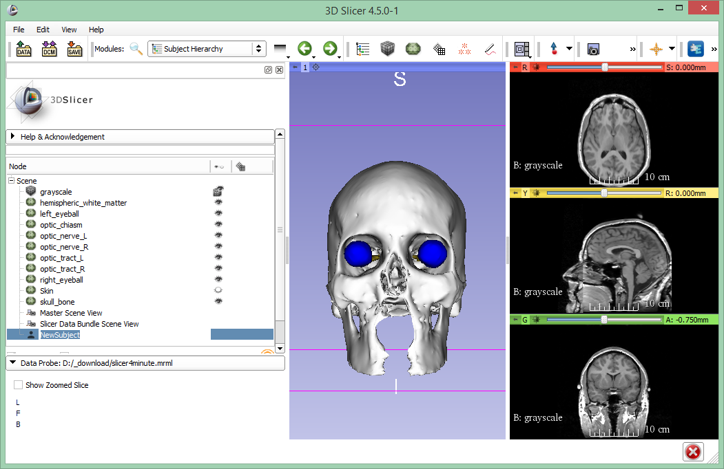
Subject hierarchy
Rename objects by double clicking their names

Slide 33
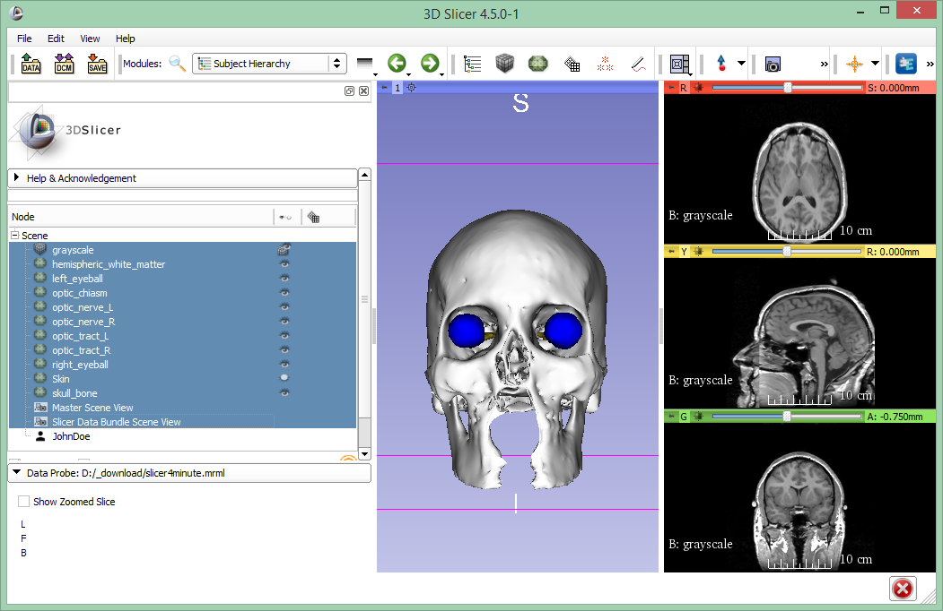
Subject hierarchy
Select multiple items by holding down shift
Move objects by drag&drop

Slide 34
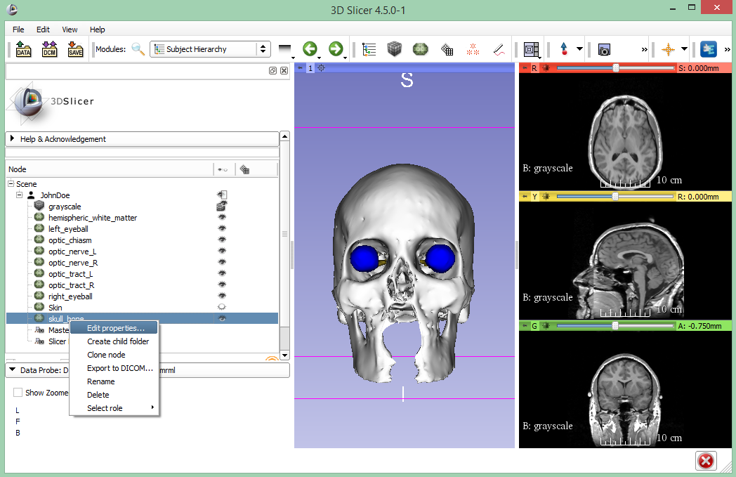
Subject hierarchy
Find object-specific actions in the context menus by right-clicking the different items. Right-click skull_bone and select “Edit properties...”

Slide 35
Subject hierarchy
Edit properties switched to the Models module and selected the object. Models module also can be reached from the toolbar or the module list

Slide 36
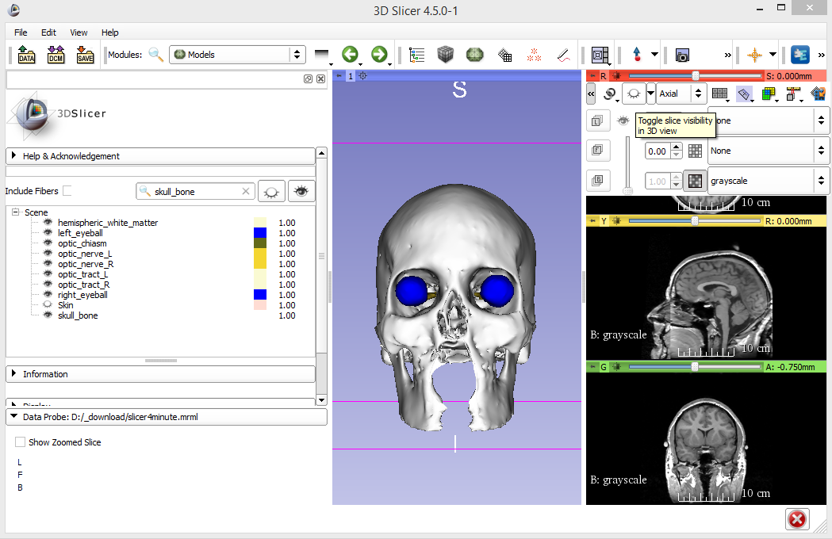
3D visualization
Turn on slice display for only the red slice

Slide 37
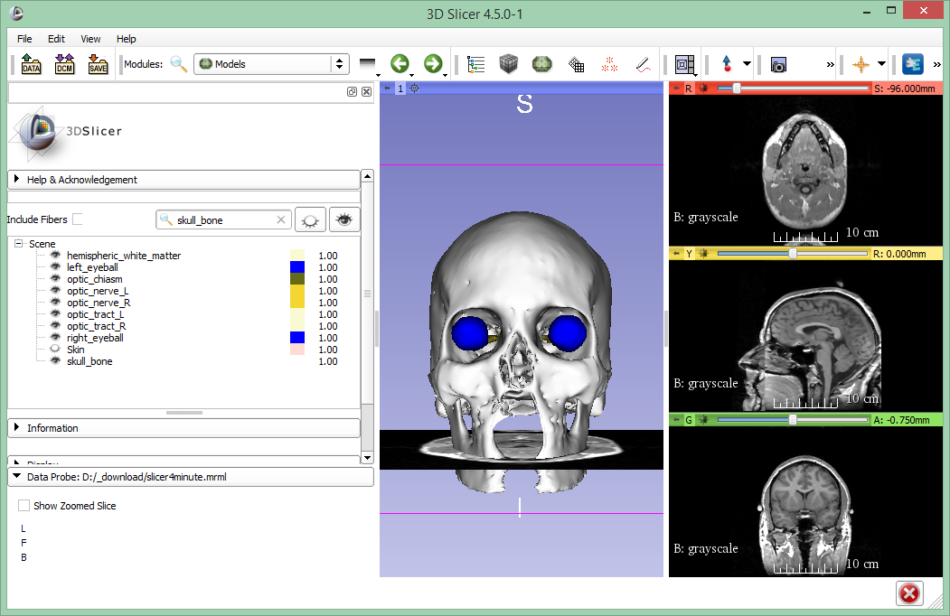
3D visualization
Use the slider or the mouse wheel to browse through the axial MR slices

Slide 38
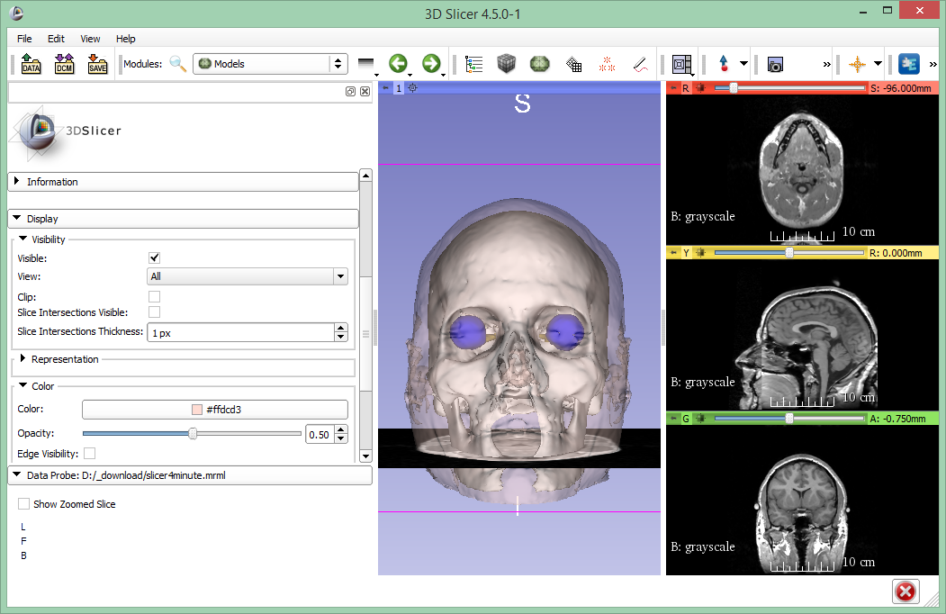
3D visualization
Show skin again by clicking the eye icon
Open the display tab
Use Opacity slider to make the skin semi-transparent

Slide 39
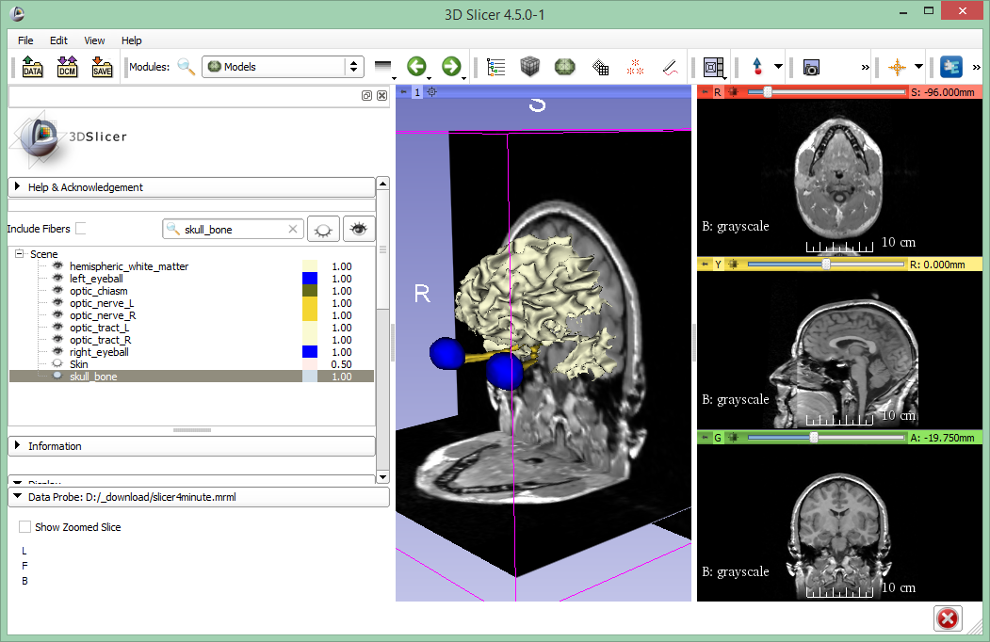
3D visualization
Hide skin and skull bone
Turn on coronal slice visibility

Slide 40
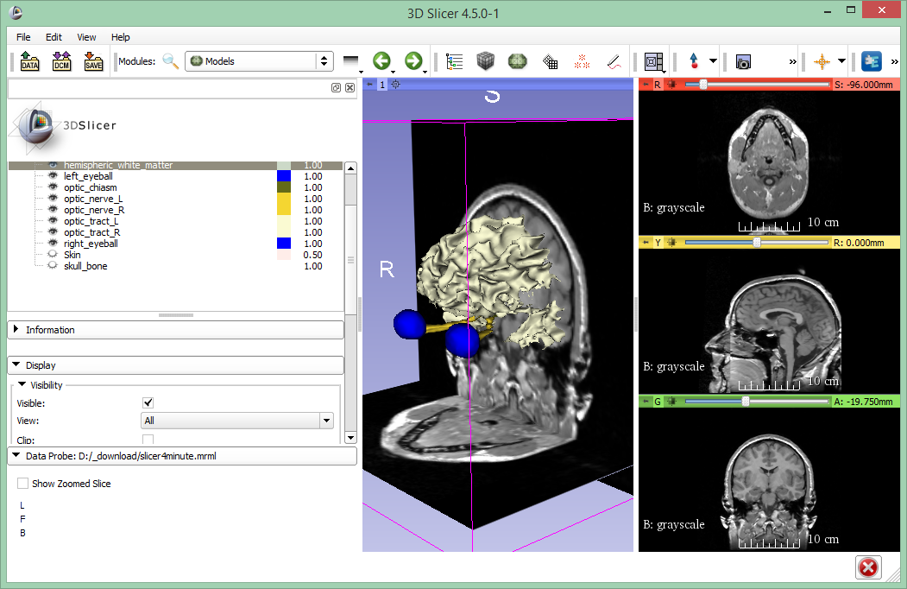
3D visualization
Select hemispheric_white_matter
Turn on Clip in the Display options

Slide 41
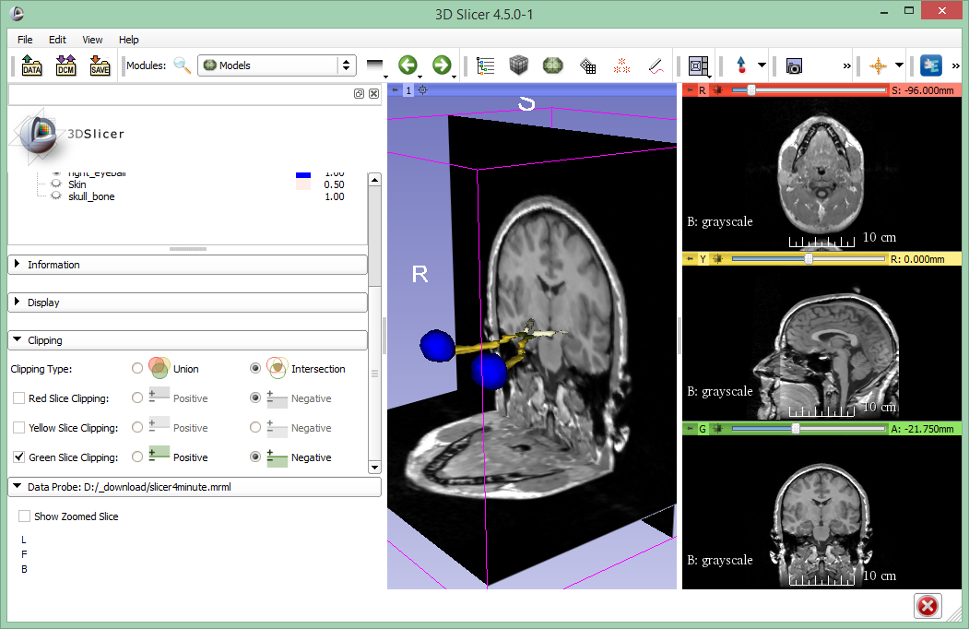
3D visualization
In the Clipping section, select Green Slice Clipping: Negative.
Scroll coronal slice to reveal the optic chiasm

Slide 42
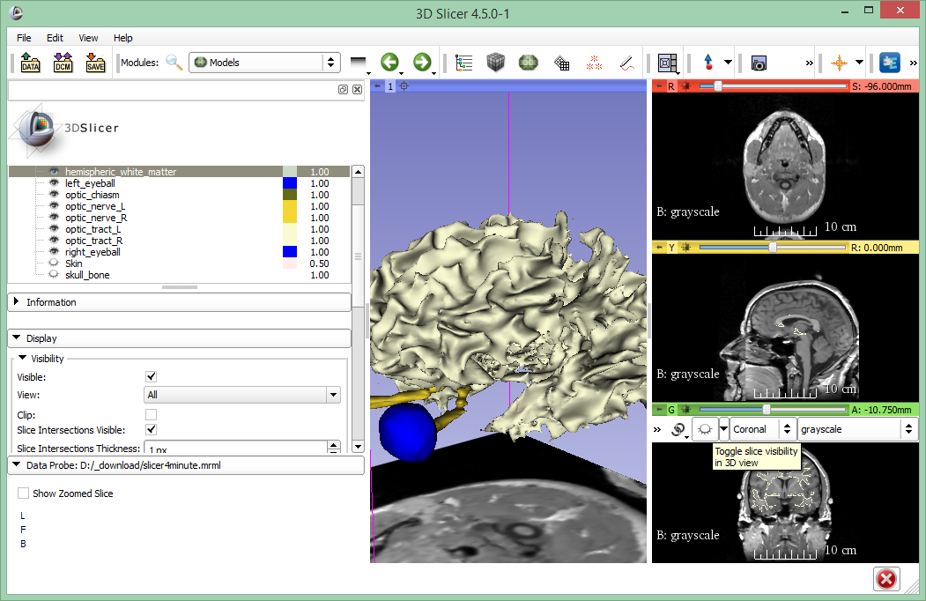
3D visualization
Turn off clipping
Turn on Slicer Intersections Visible
Hide coronal slice from 3D view

Slide 43
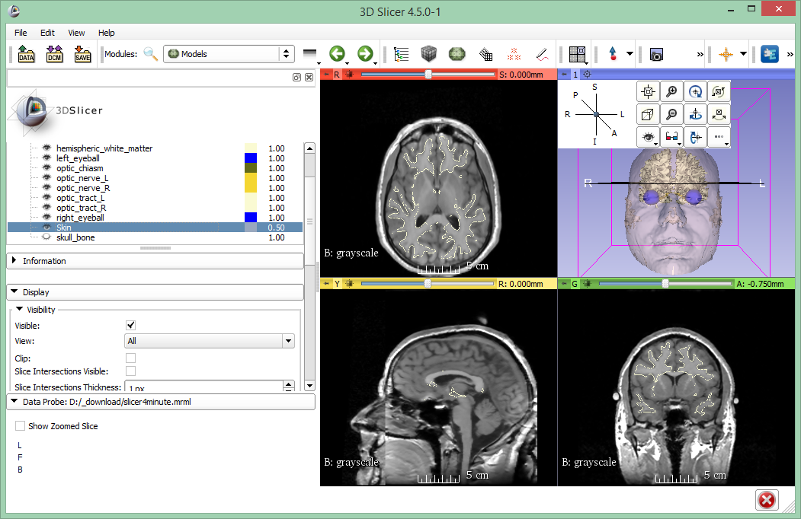
3D visualization
Switch to Four-Up layout
Show skin
Move the mouse over the pin in the corner of the 3D view
Select A (Anterior) view
Notes:
You can reset the view by clicking the little button to the left of the slice view sliders

Slide 44
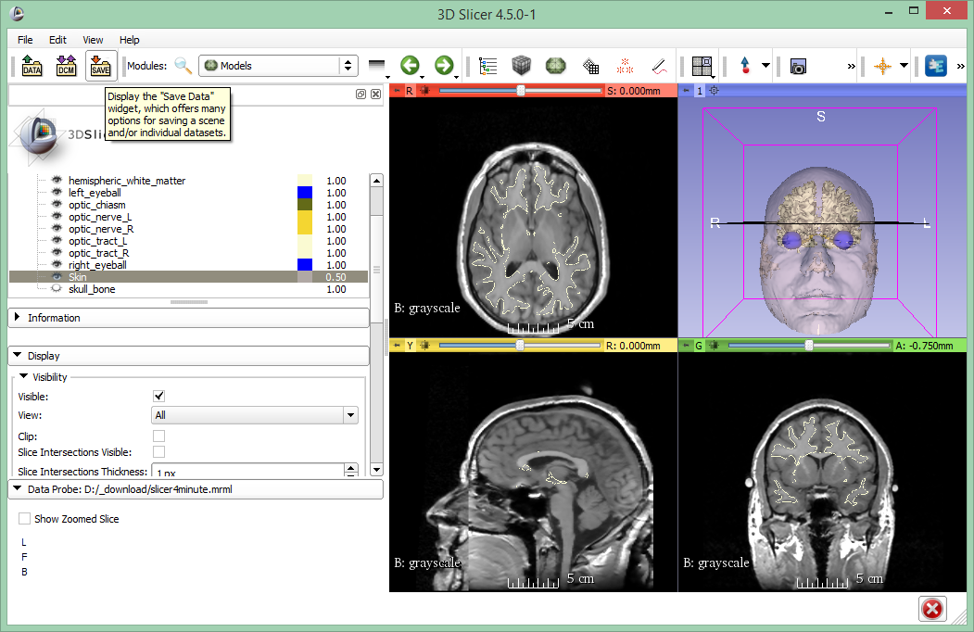
Saving a scene
Click on Save button

Slide 45
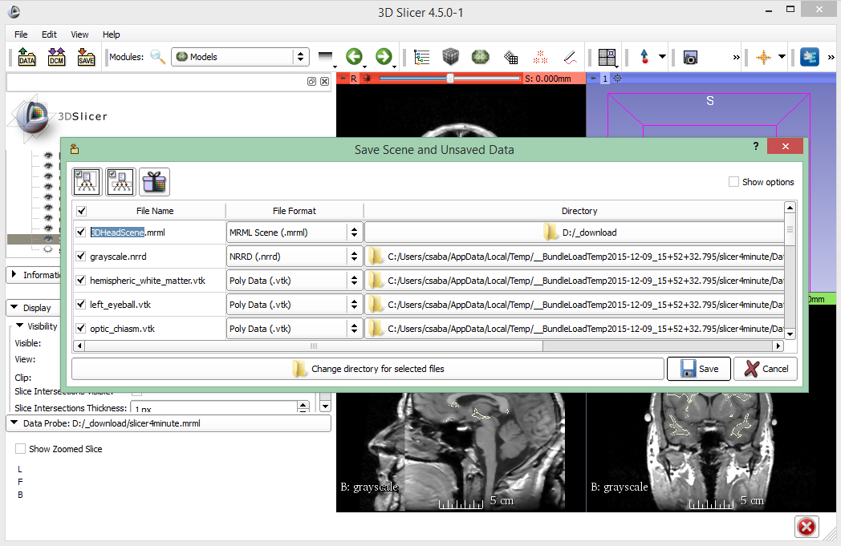
Saving a scene
Rename scene

Slide 46
Thank you for your attention!

Slide 48
Appendix

