Slide 1


CARMA Inhomogeneity Correction Filter
Alan Morris, Eugene Kholmovski, Josh Cates,
Rob MacLeod
SCI Institute/CARMA Center
University of Utah
© 2012, All Rights Reserved

Slide 2
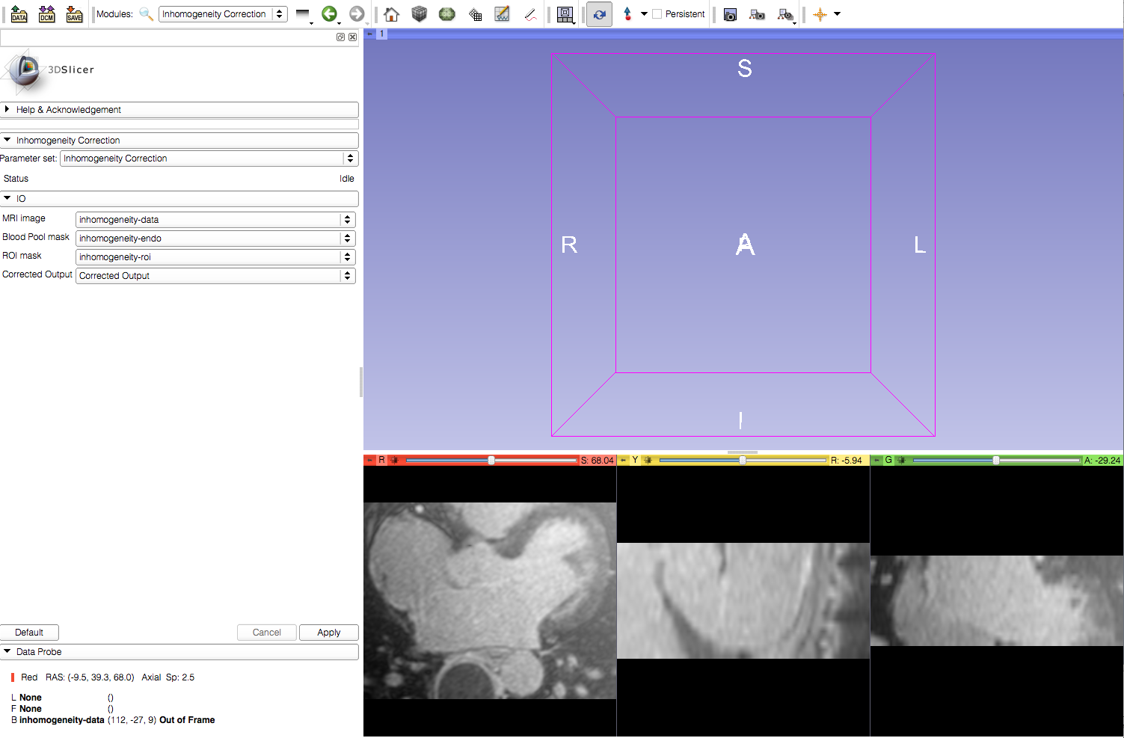
Learning Objective
Inhomogeneity correction filter in Slicer
© 2012, All Rights Reserved

Slide 3
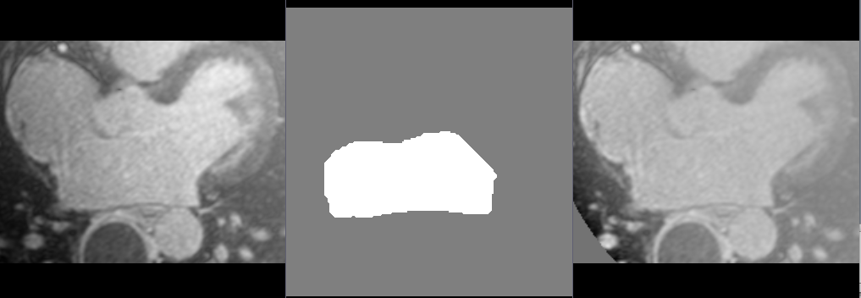
Current Workflow
Original (uncorrected) Image
Blood Pool Mask
Corrected Image

Slide 4
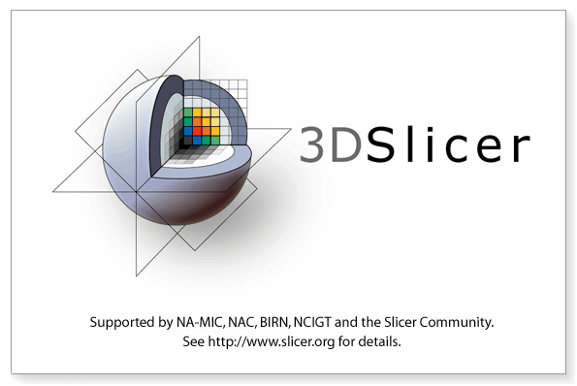
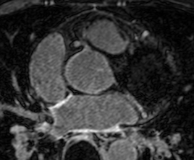
Required Materials
Slicer: Release 4.1
http://www.slicer.org/pages/Downloads/
Data: CARMA Slicer Extension Tutorial Data
http://hdl.handle.net/1926/1765
© 2012, All Rights Reserved

Slide 5

Additional Sample Data
60 patients
http://hdl.handle.net/1926/1757

Slide 6
Pre-requisite Tutorial
http://www.slicer.org/slicerWiki/index.php/Documentation/4.0/Training
© 2012, All Rights Reserved

Slide 7


Platforms
Developed
Tested
© 2012, All Rights Reserved

Slide 8
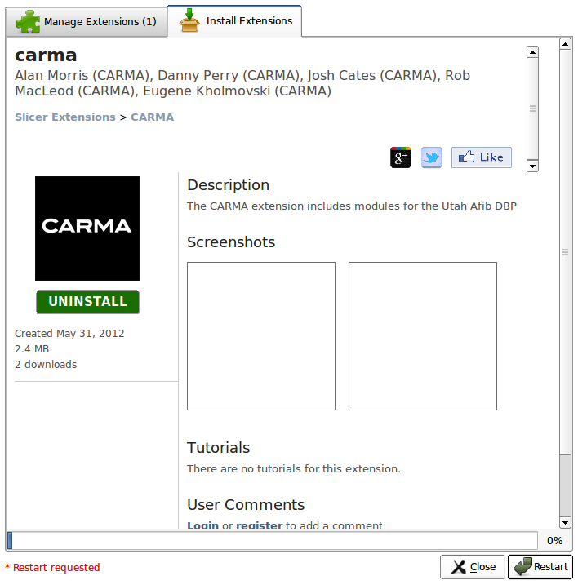
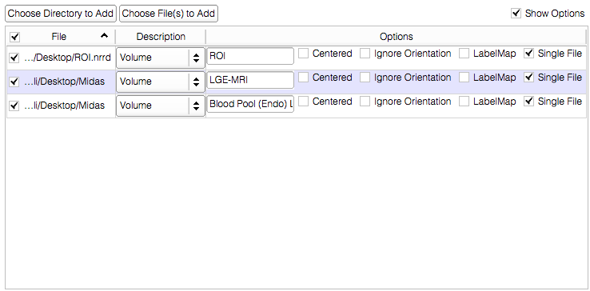
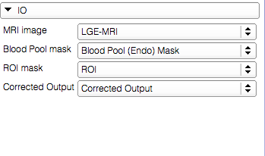
Overview
Load the module
Load the dataset
Inhomogeneity Correction
© 2012, All Rights Reserved

Slide 9
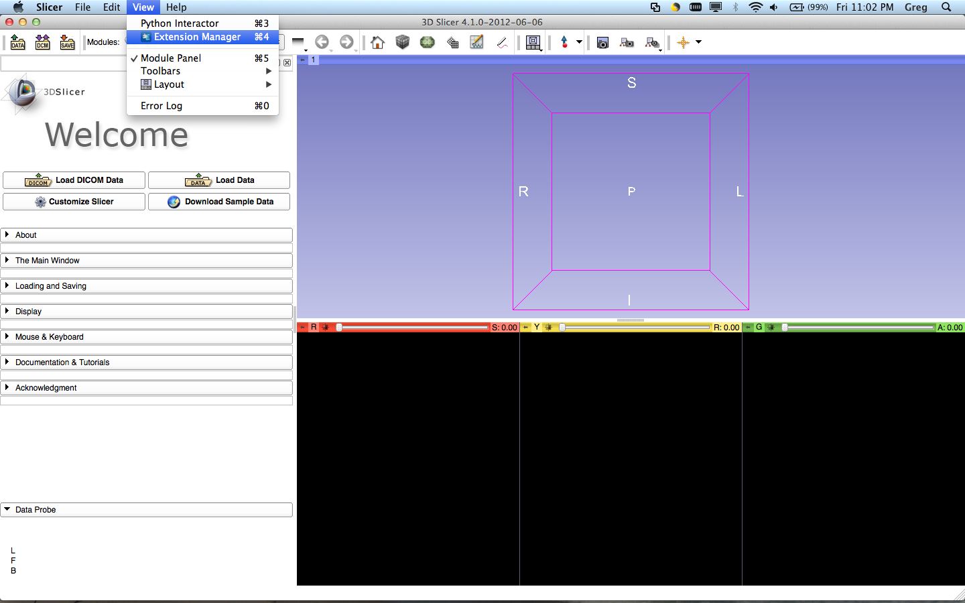
Loading the Module
Select View>Extension Manager in the menu bar (or push ⌘4)
If the Extension Manager isn’t revealed, see the next 2 slides; otherwise, skip them

Slide 10
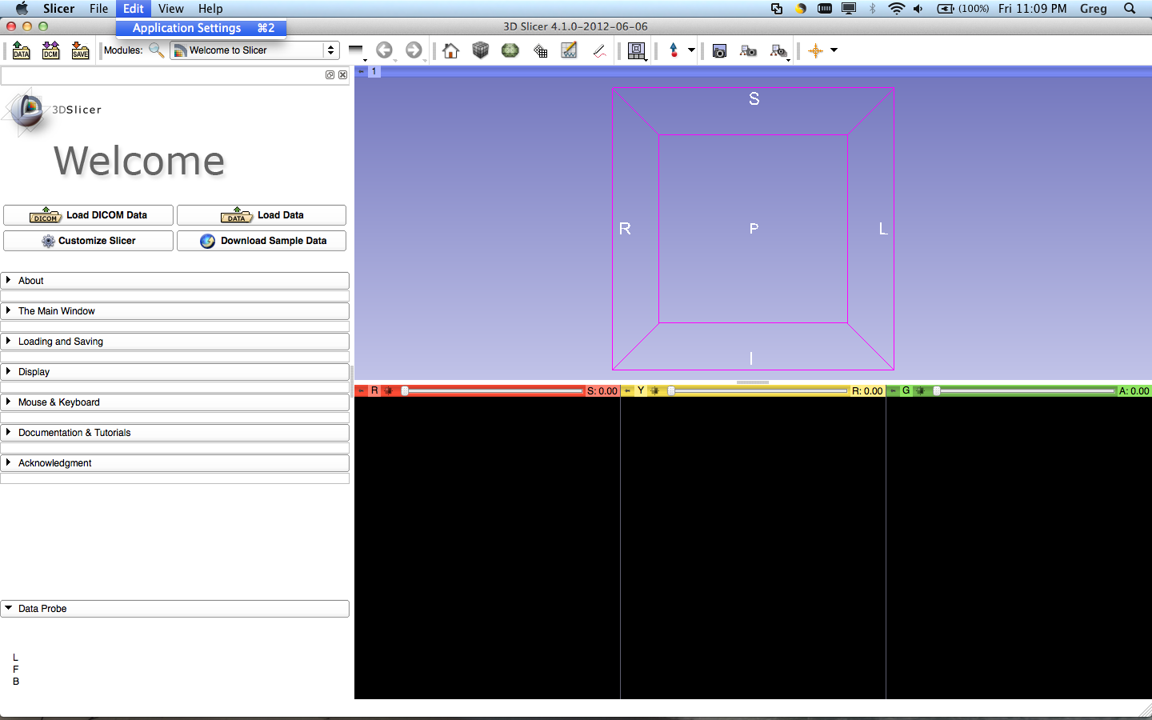
Loading the Module
To load the Extension Manager, Select Edit>Application Settings in the menu bar (or push ⌘2)

Slide 11
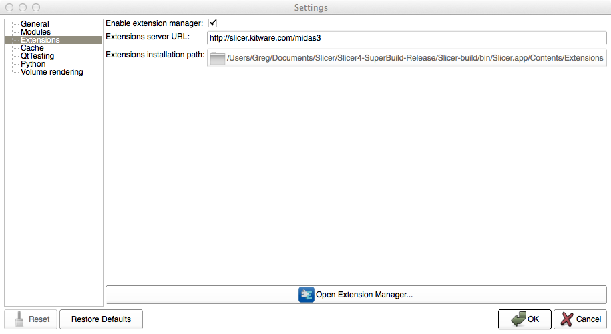
Loading the Module
Under the Extension menu, make sure ‘Enable extension manager’ is checked

Slide 12
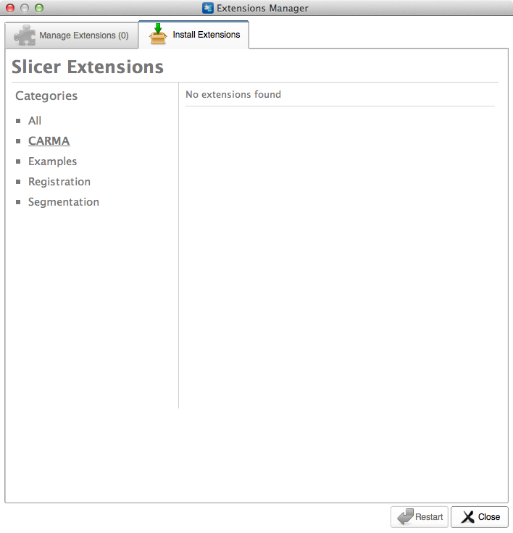
Loading the Module
Select CARMA in the sidebar and click the extensions

Slide 13
Loading the Module
Restart to install the extension

Slide 14
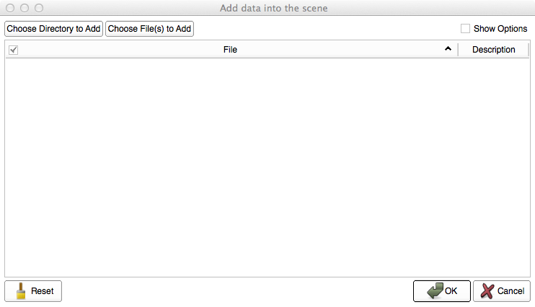
Loading the Data
Select ‘Choose Directory to Add’ in the pop-up menu

Slide 15
Loading the Data
Select the directory containing your dataset

Slide 16
Loading the Data

Slide 17
Inhomogeneity Correction
Input volumes
{
A black image the same size as the input image was used as the ROI in this example
Output volume
The input image and blood pool mask have been cropped in this example.

Slide 18
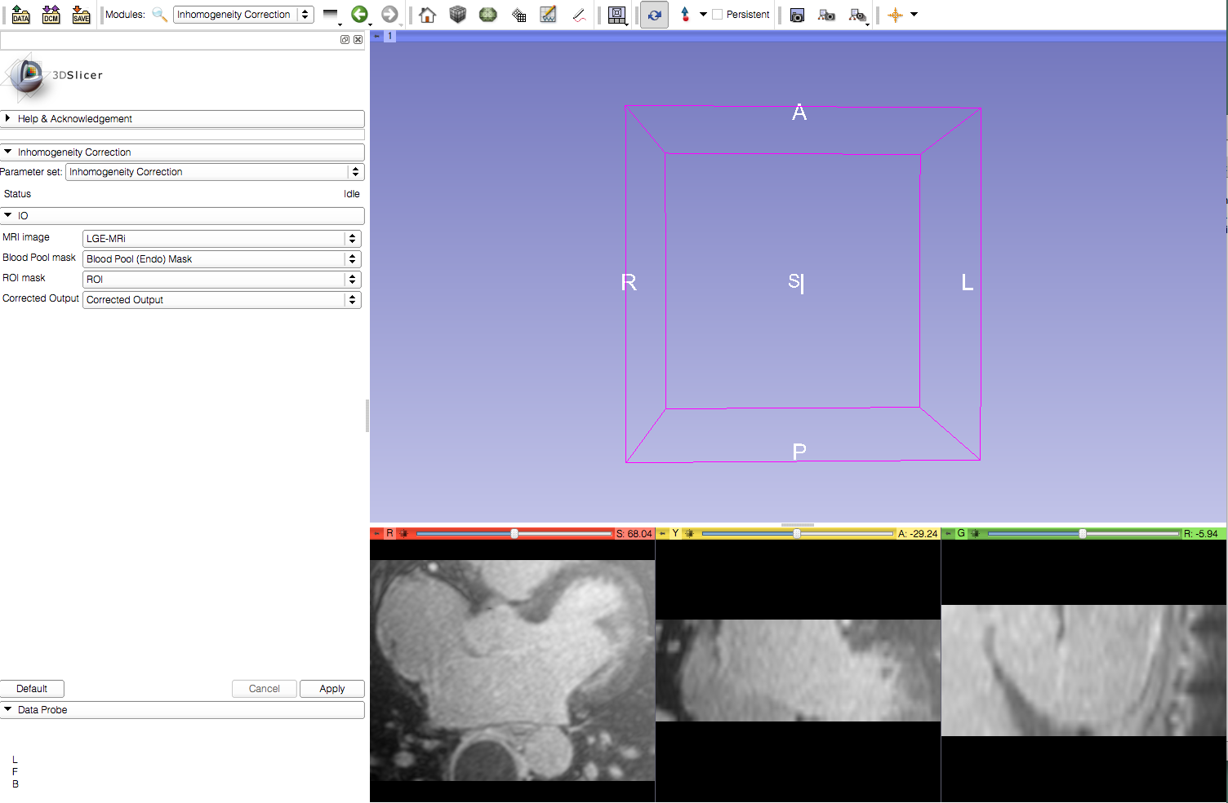
Inhomogeneity Correction
Apply the filter

Slide 19
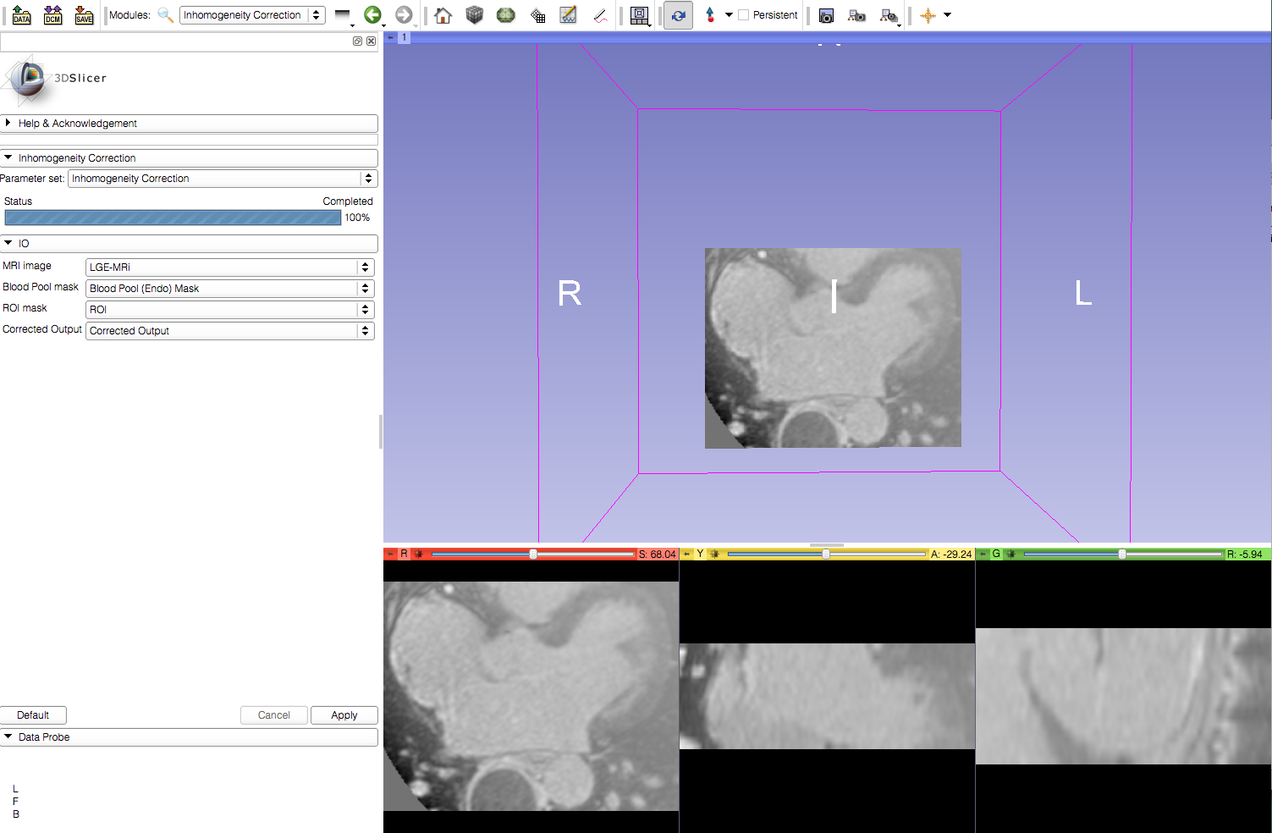
Inhomogeneity Correction
Viewer automatically updates to show the resulting corrected output

Slide 20
Conclusion
This module can be used for local inhomogeneity correction in cardiac MRI image volumes.

