Slide 1
Modeling Populations and Pathology
Kayhan N. Batmanghelich
PI: Polina Golland
MIT

Slide 2
Modeling Populations and Pathology
Pathology deviates from normative atlases
Our solution:
Atlases for normal anatomy and function
Explicit models of pathology
Projects:
Brain connectivity in clinical populations (HD)
Image segmentation in pathology
Anatomy segmentation for radiotherapy (head-and-neck)
Refined boundary finding (left atrium)

Slide 3
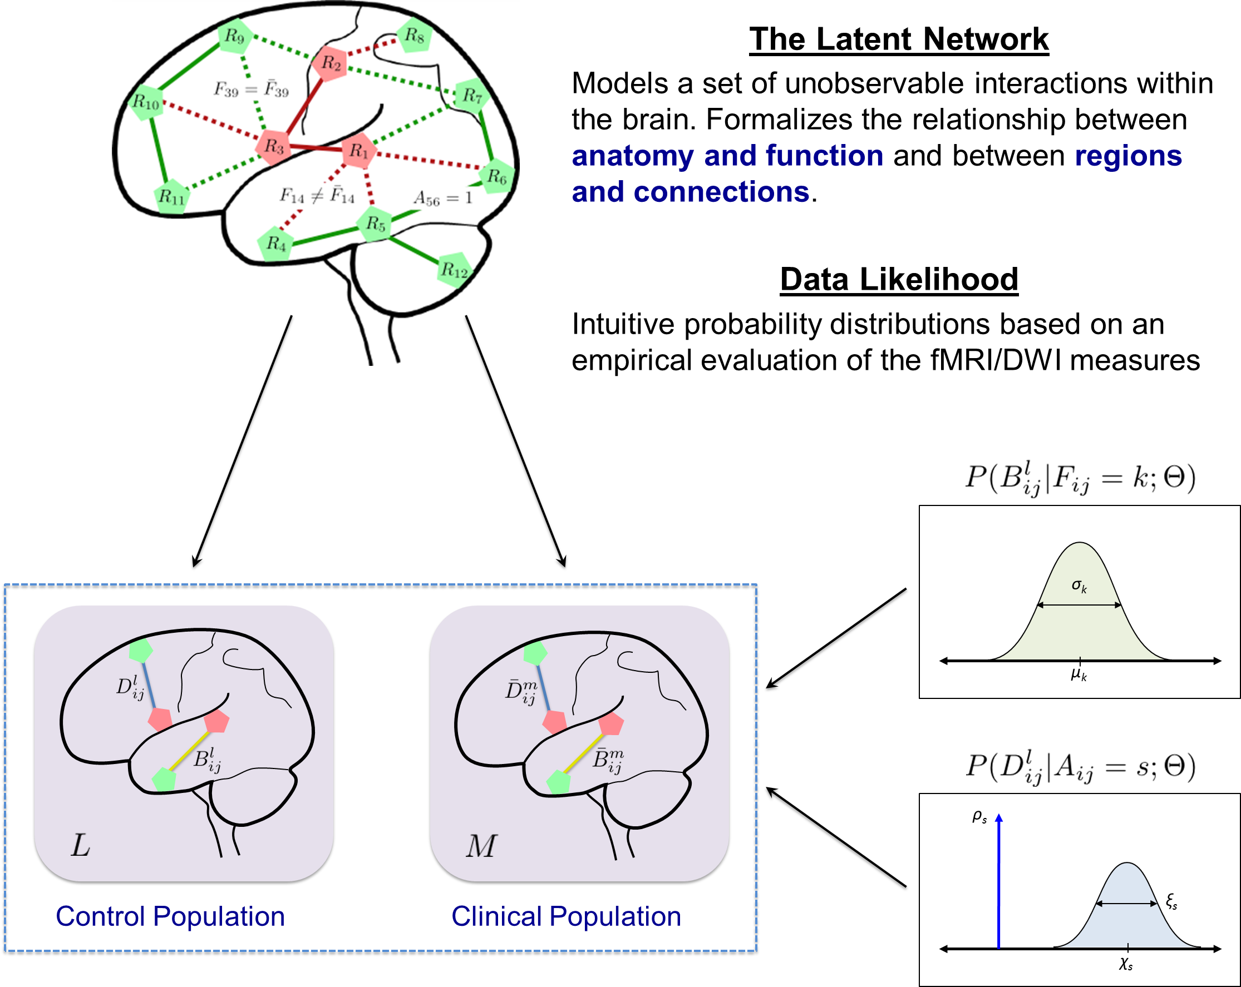
Brain Connectivity Modeling
Theoretical framework:
Joint inference across all connections
New model: disease foci
Aggregate connectivity changes due to disease into information about regions

Slide 4
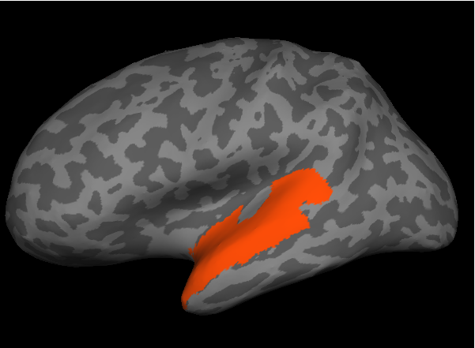
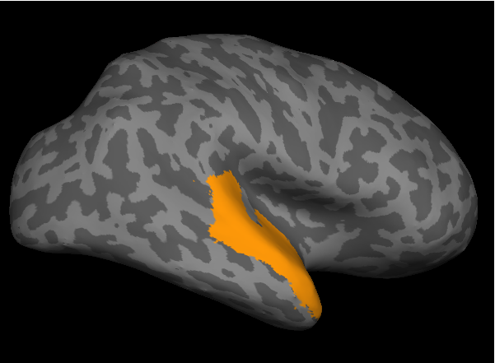
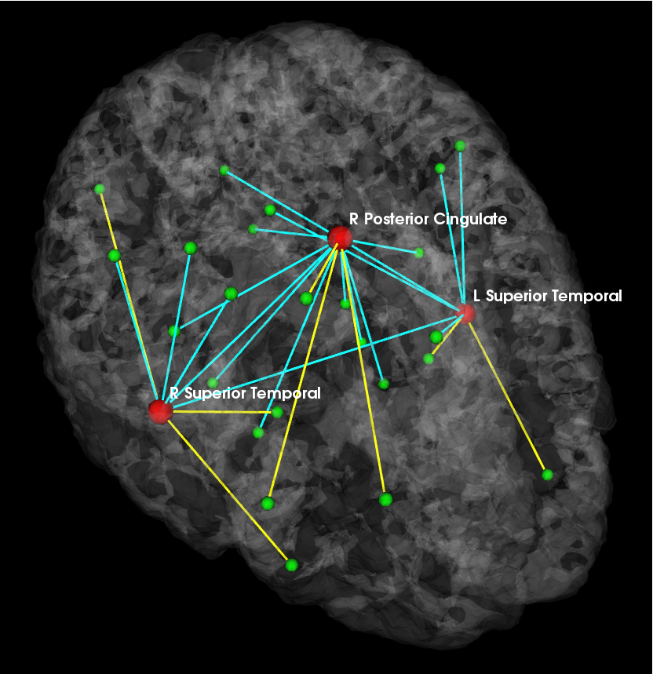
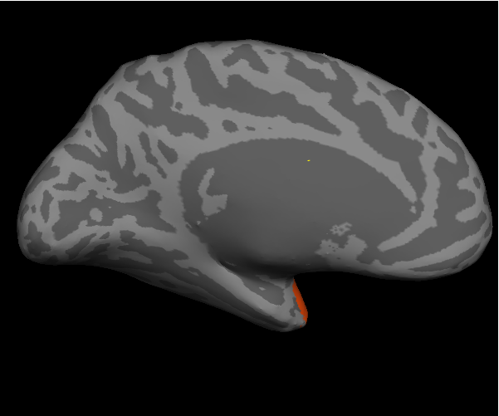
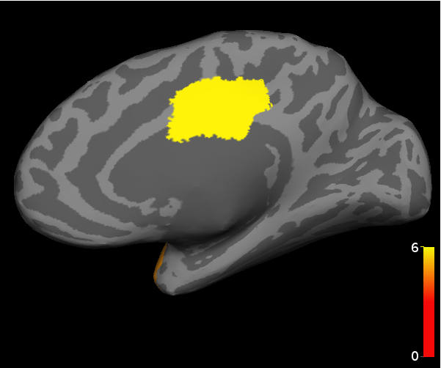
Results in a Schizophrenia Study
Detected Regions
Abnormal Connectivity
P
L
L STG
R STG
R
R PCC
A
Reduced connectivity in schizophrenia
Increased connectivity in schizophrenia
Venkataraman MICCAI ‘12, submitted to IEEE TMI

Slide 5
Summary
Connectivity differences in schizophrenia
Implicated regions and associated connections Venkataraman MICCAI ‘12, IEEE TMI ‘12, IEEE TMI submitted, Schizophrenia Research ’12
This year: apply our algorithms to HD data
Close discussions with HD DBP (Hans Jonson)
Identified a subject set of HD patients and normal controls with fMRI and DWI data
Additional funding from CHDI Foundation

Slide 6
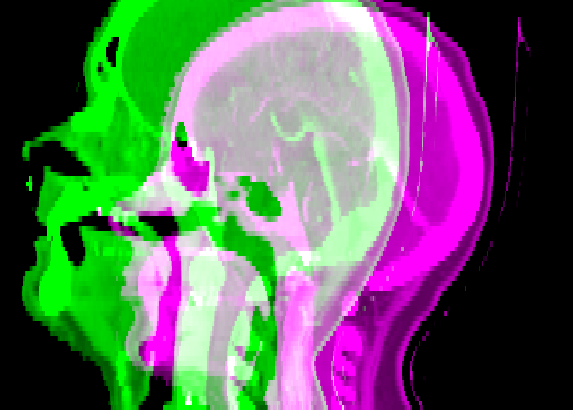
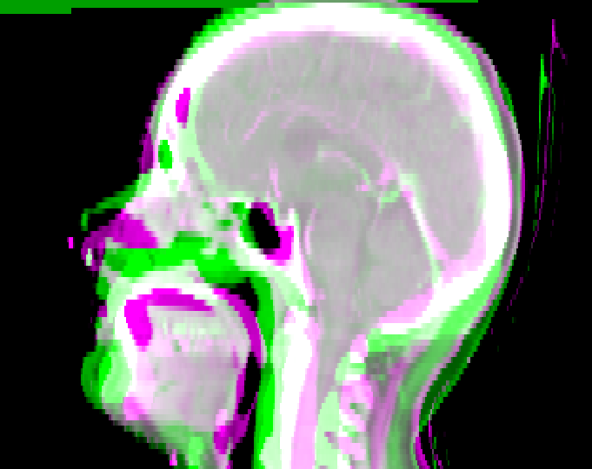
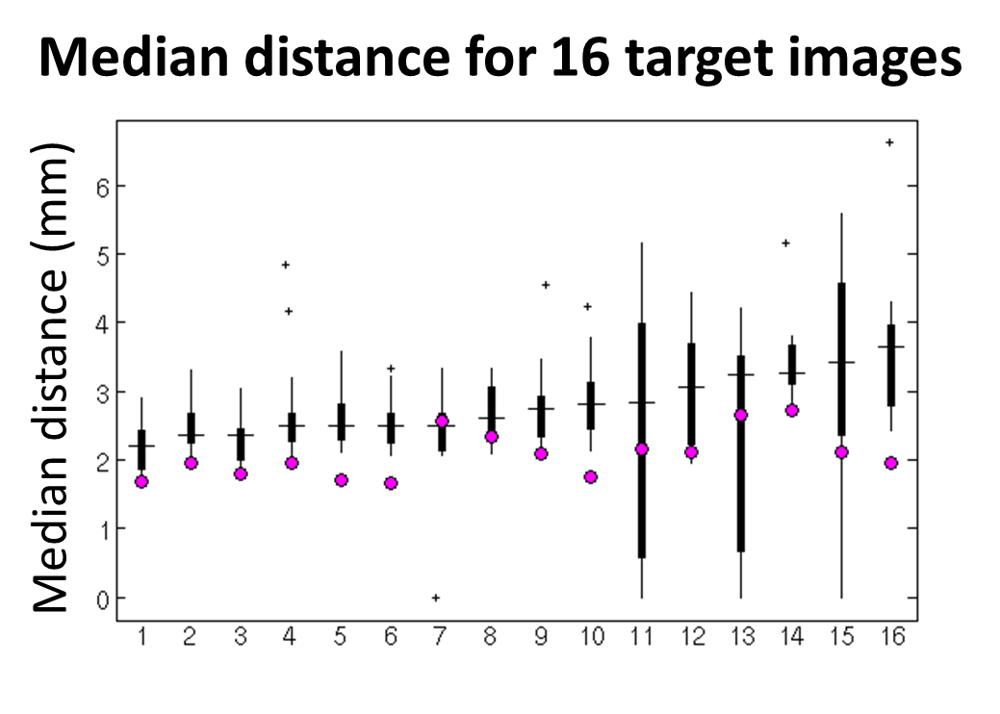
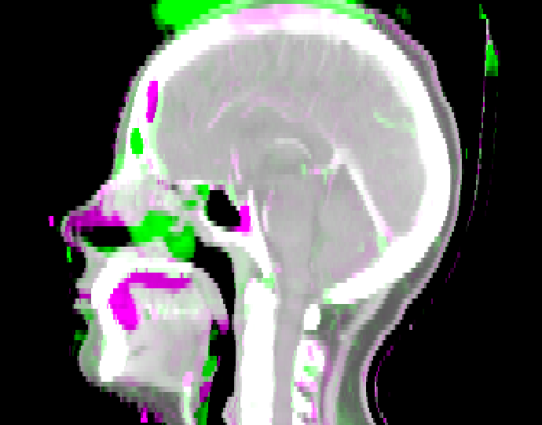
Atlas-based Segmentation in the Presence of Pathology
before registration
Use atlas priors to segment anatomy around the tumor
Atlas methodology: label fusion
Application: head-and-neck
after linear alignment
left parotid
brainstem
right parotid
after non-rigid deformation (final)

Slide 7
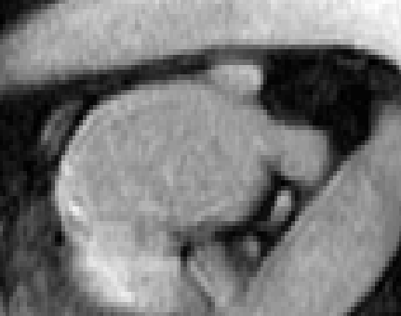
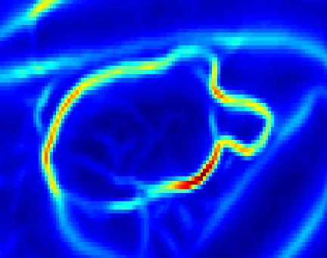
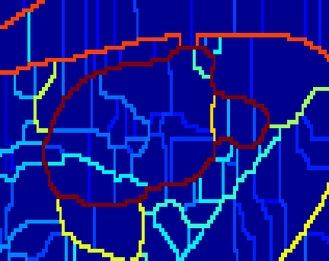
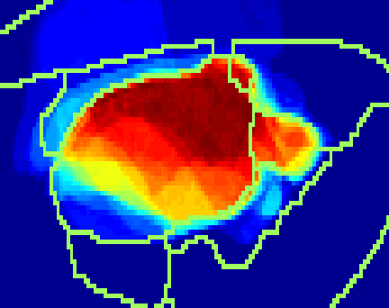
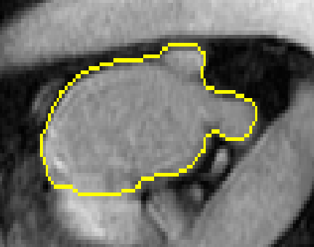
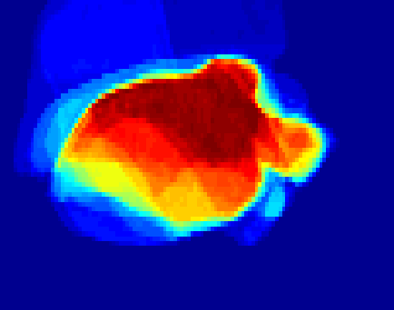
Local Data Influence in Segmentation
Contour information in atlas-based segmentation
Application: left atrium segmentation
Spectral Label Fusion
Image
1. Contours
2. Regions
3. Region vote
Segmentation
Label map
Wachinger MICCAI ‘12

Slide 8
Conclusions
Generative modeling of populations
Population differences
Subject-specific analysis
Applications to DBPs
Brain connectivity
Venkataraman Schizophrenia Research ’12, MICCAI ’12, IEEE TMI ’12, IEEE TMI submitted
Anatomical segmentation (head-and-neck, left atrium)
Wachinger MICCAI ’12

