Slide 1
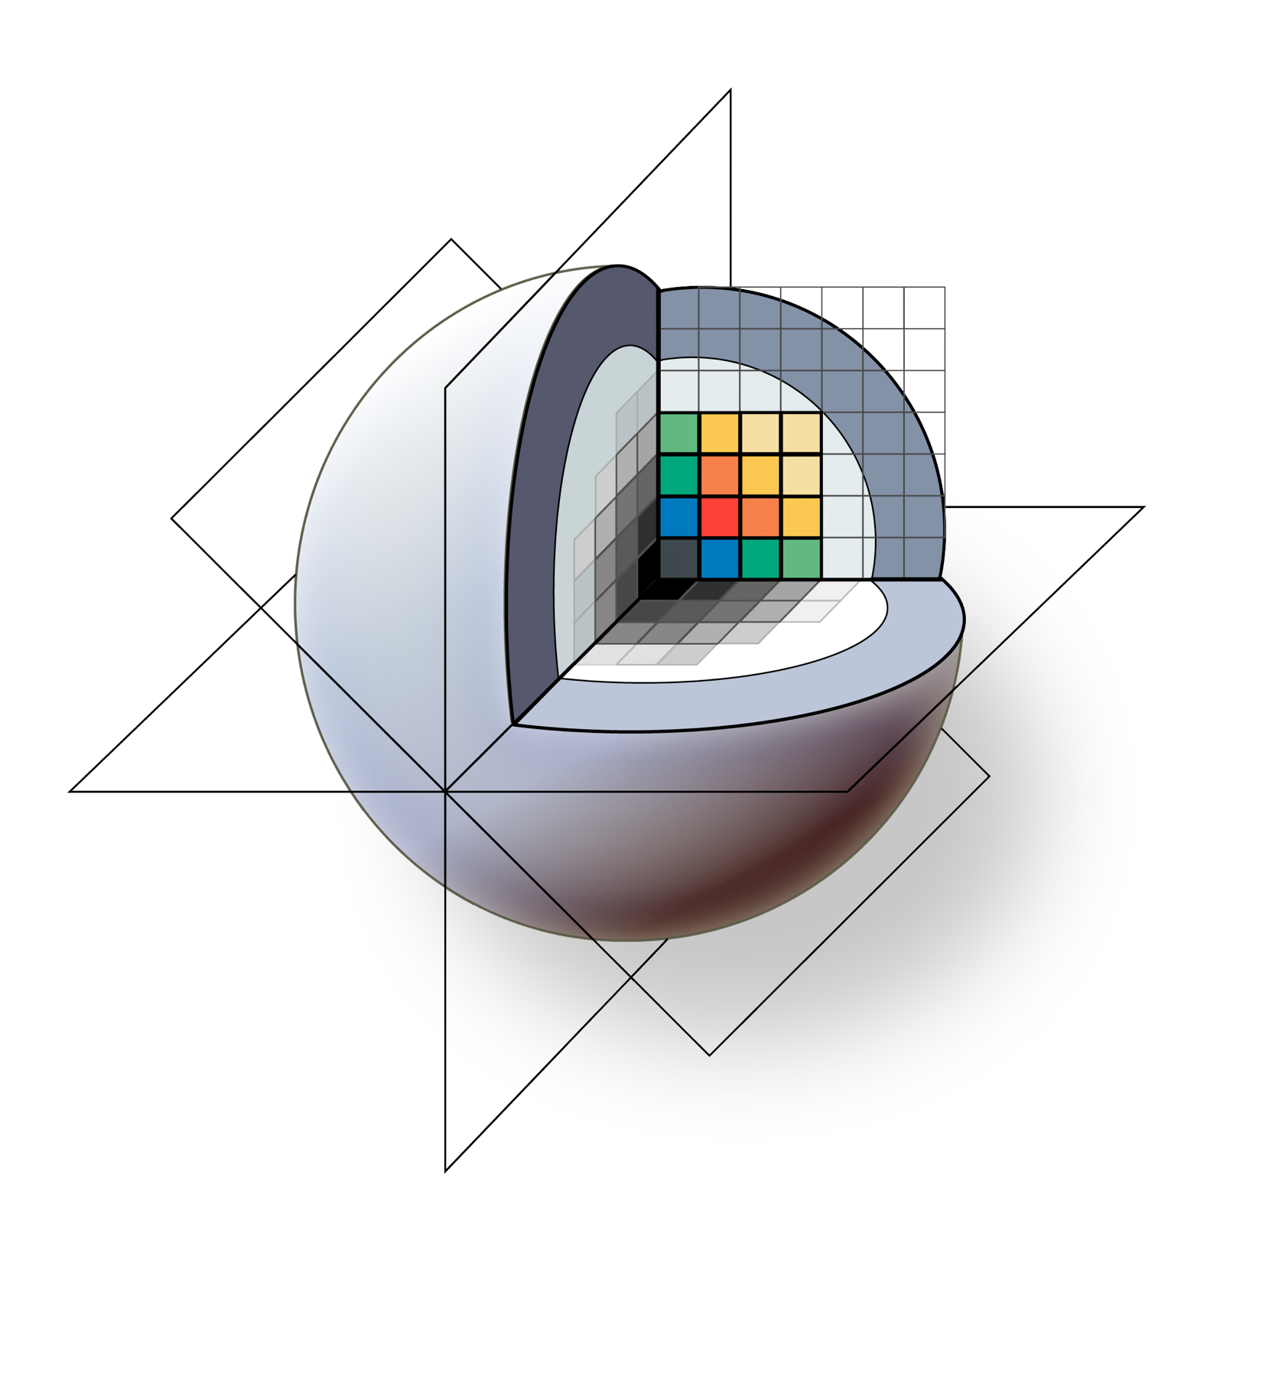
3D Slicer: A Free & Open Source Platform For Medical Image Analysis and Visualization
Brigham and Women’s Hospital

Slide 2
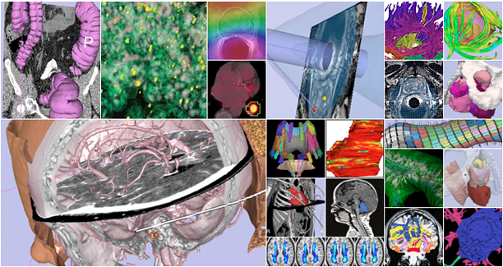
3D Slicer: An overview
3D Slicer is a multi-platform, free and open source software package for visualization and medical image computing.
www.slicer.org
Notes:
(Content slide)

Slide 3
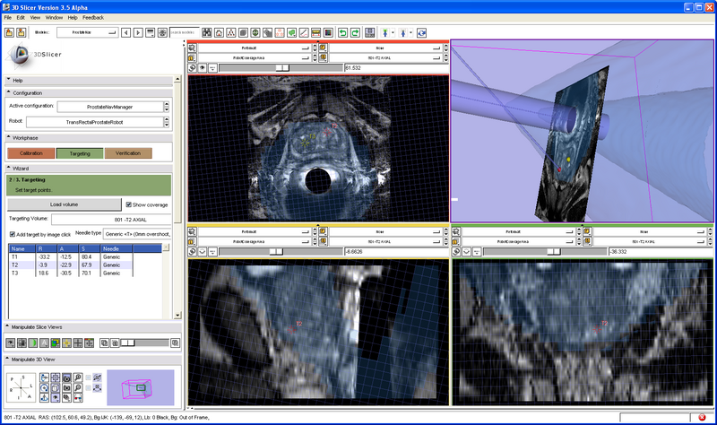
3D Slicer: An overview
The software platform is community created for the purpose of subject specific medical image analysis and visualization. Slicer includes support for:
Multi-modality imaging including, MRI, CT, US, nuclear medicine, and microscopy
Multi organ from head to toe
Bidirectional interface for devices
Expandable and interfaced to multiple toolkits
(Sample screenshot of the ProstateNav module: targeting using the transrectal robot device. Slicer3 visualizes the target planning image, target point, needle trajectory, transrectal probe, and robot coverage area.)

Slide 4

3D Slicer: An overview
Types of users:
Algorithm researchers (who work within 3DSlicer's development environment and with associated toolkits)
Biomedical engineers (who rely on 3DSlicer's interactive enironment and scripting capabilities)
Application scientists (who use 3DSlicer as a desktop application and turnkey system)
Core use scenarios:
Longitudinal and multi-channel dataset analysis
Individual and group analysis
Real-time control and tracking in the operating theater
Neurosurgical planning and guidance

Slide 5
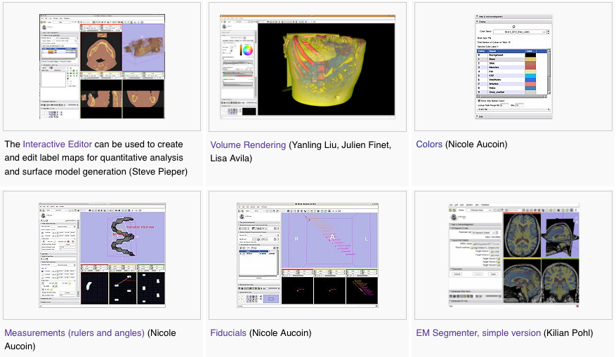
3D Slicer: Version 3.6 Highlights

Slide 6
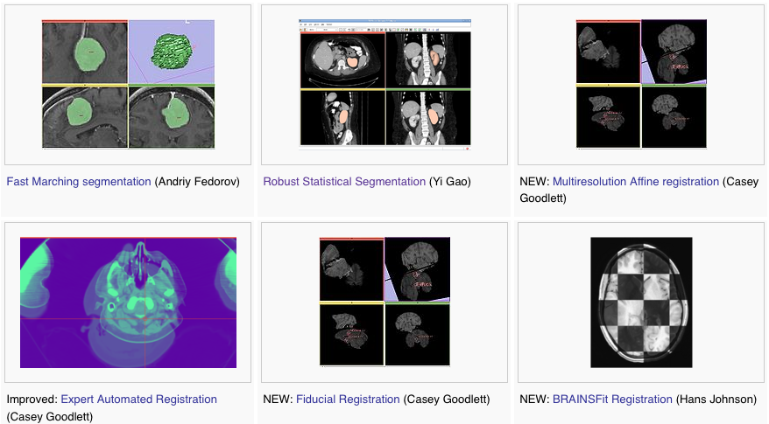
3D Slicer: Version 3.6 Highlights

Slide 7
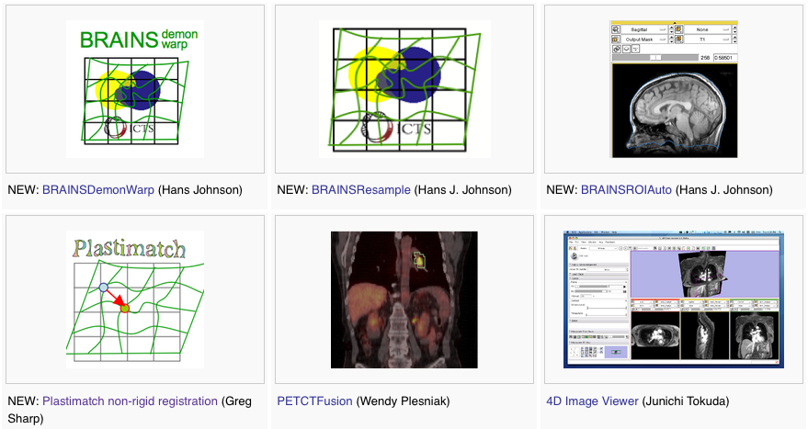
3D Slicer: Version 3.6 Highlights

Slide 8
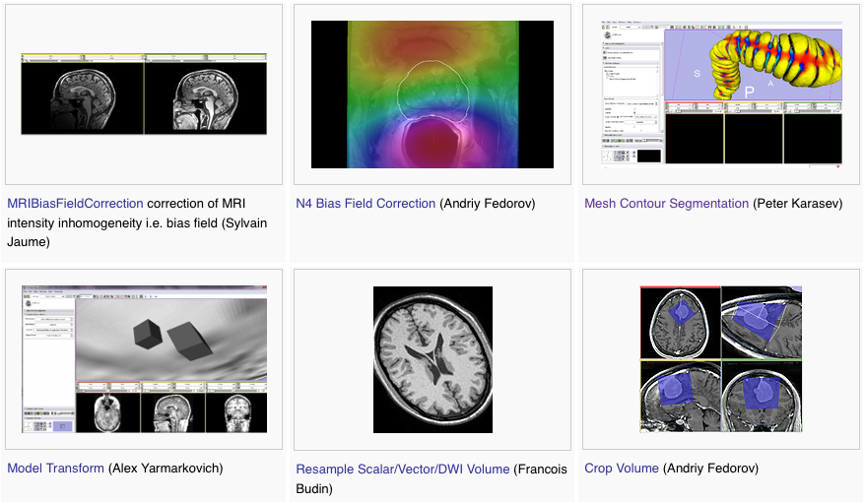
3D Slicer: Version 3.6 Highlights

Slide 9
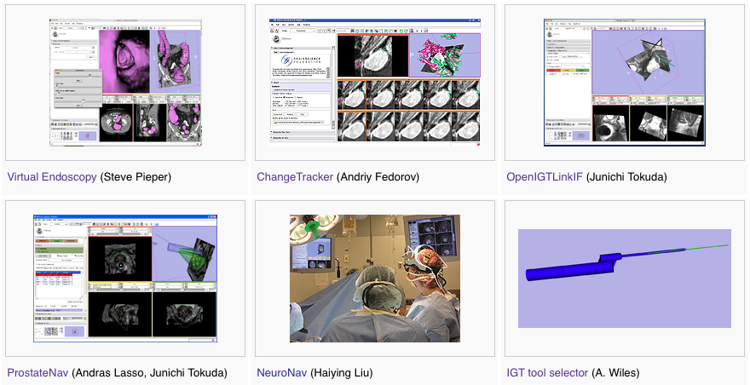
3D Slicer: Version 3.6 Highlights

Slide 10
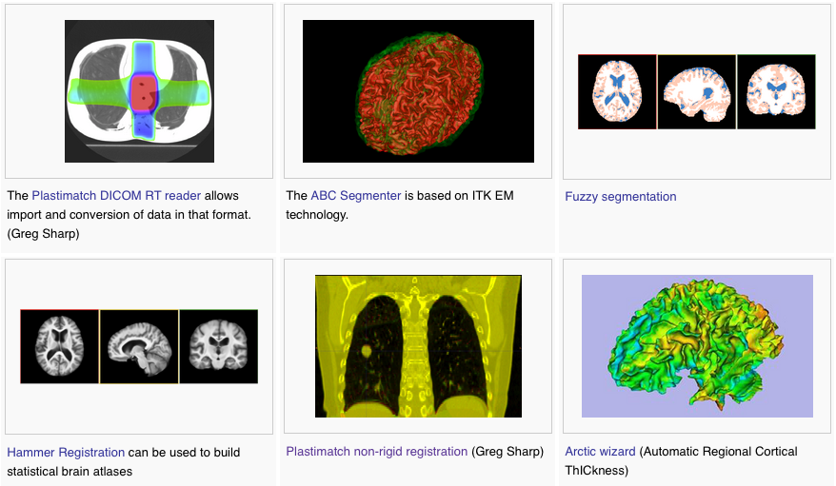
3D Slicer: Version 3.6 Extensions

Slide 11
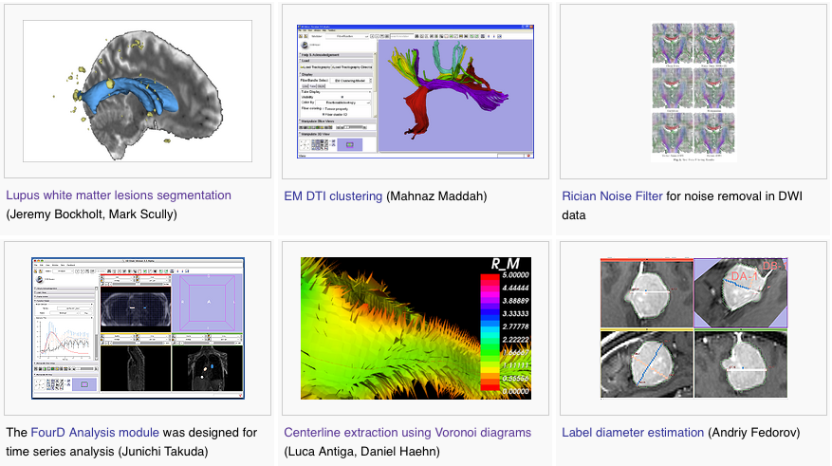
3D Slicer: Version 3.6 Extensions

Slide 12
3D Slicer: What extensions afford...
Keep the base package “lean and mean”
Modules have individual identity
  Per-module web site, svn, downloads, mailing lists, wiki…
Users can customize their own subset of tools
Easy to download compatible extensions
  Analogous to Firefox extensions
  Integrate extension builds into developer/nightly/release processs
NITRC Supplement to NA-MIC providing additional infrastructure (Neuroimaging Informatics Tools and Resources Clearinghouse)
  NITRC can host neuroimaging projects (gforge implementation)

Slide 13
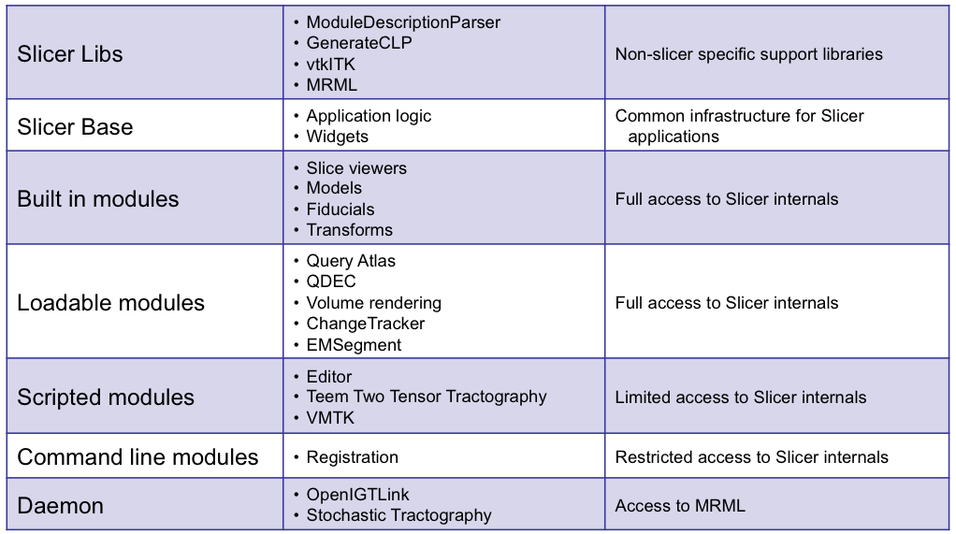
3D Slicer: Integration options

Slide 14
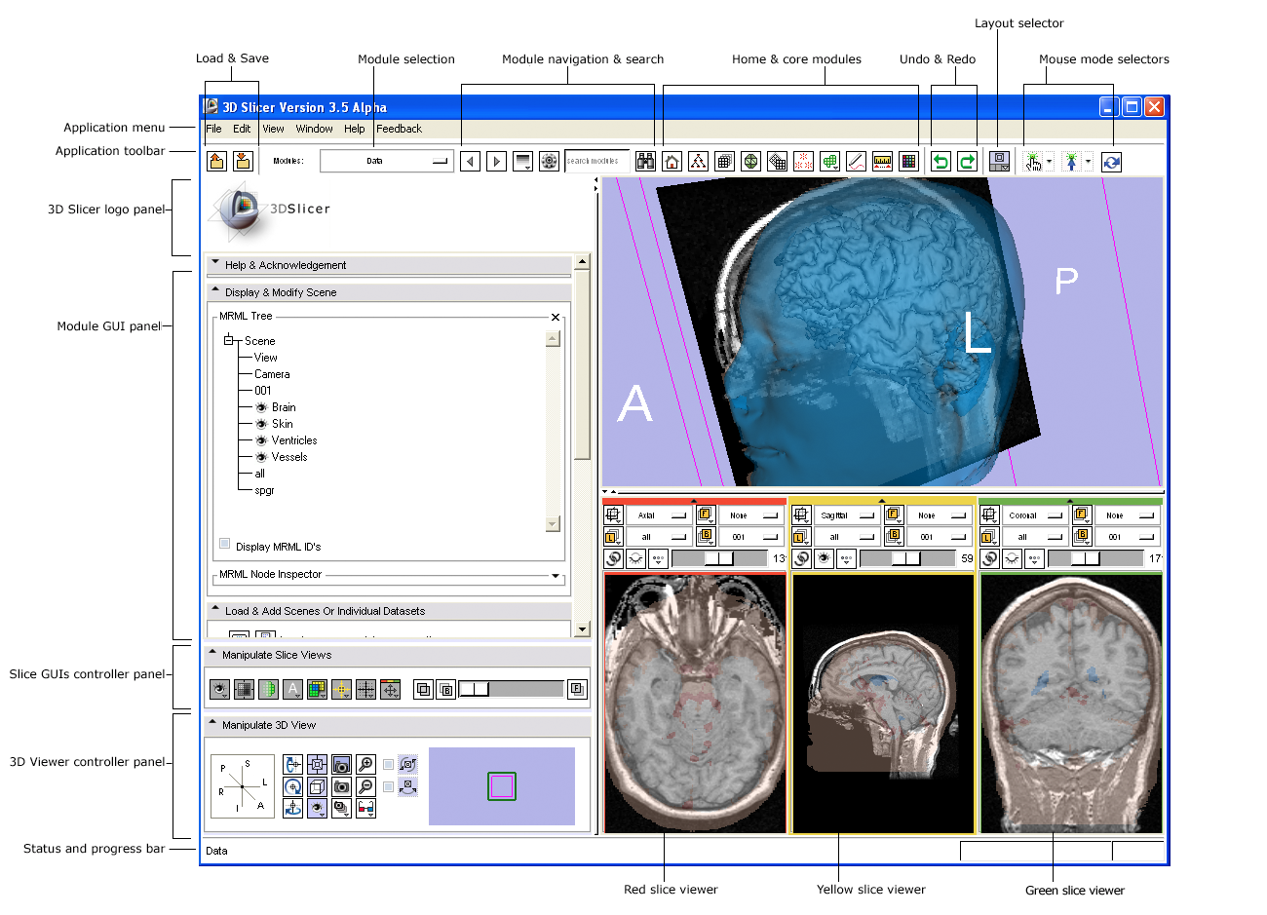
3D Slicer: Application Interface
User-centered design:
User guidance and feedback incorporated into design process where possible
KWWidgets-based thin GUI layer
Presentation layer independent of application logic & state
Architecture supports scripting and command-line use

Slide 15

3D Slicer: Quick Start for New Users
Greetings and guidance from Slicer’s Welcome Module
Default start-up module for new users:
Brief friendly overview of the application interface
Describes core modules
Describes basic data loading and saving
Provides tips for adjusting data display
Describes how to change layouts
Points users to more detailed resources
and more...

Slide 16
3D Slicer: Advance Visualization in Use

Slide 17
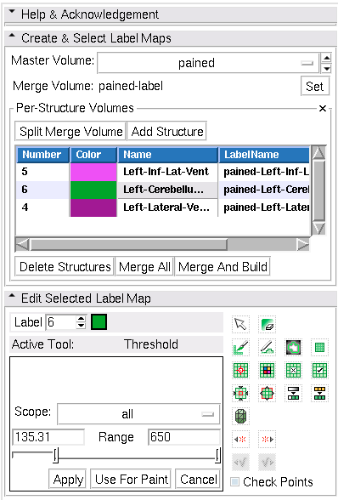
3D Slicer: Interactive Editor
Tools for manual segmentation & model building
Tools include:
Paint
Draw
Rectangle
Level Tracing
Change Label
Identify Islands
Remove Islands
Save Island
Erode
Dilate
Model Maker
Undo / Redo

Slide 18
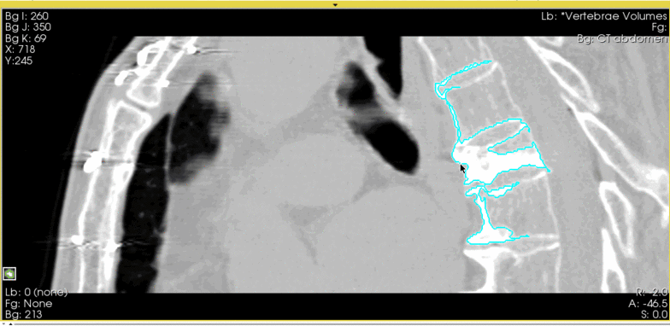
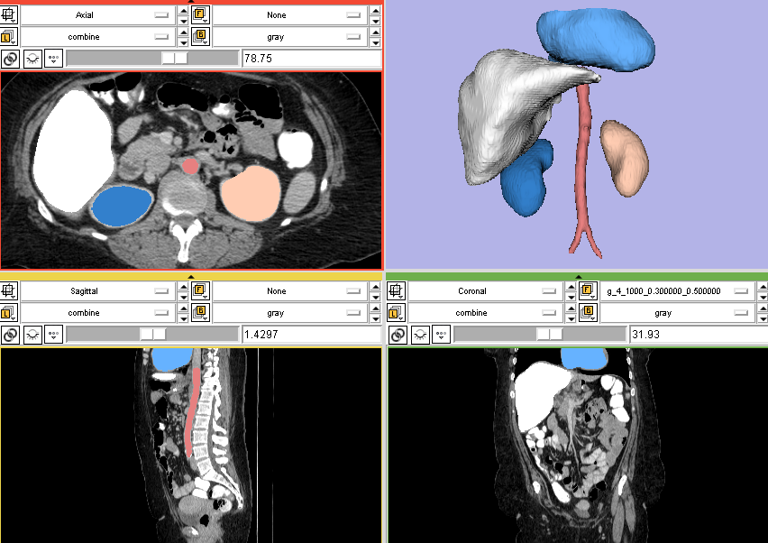
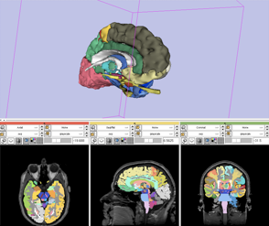
3D Slicer: Interactive Editor
Tools for manual segmentation & model building

Slide 19
3D Slicer: Tractography Tools

Slide 20
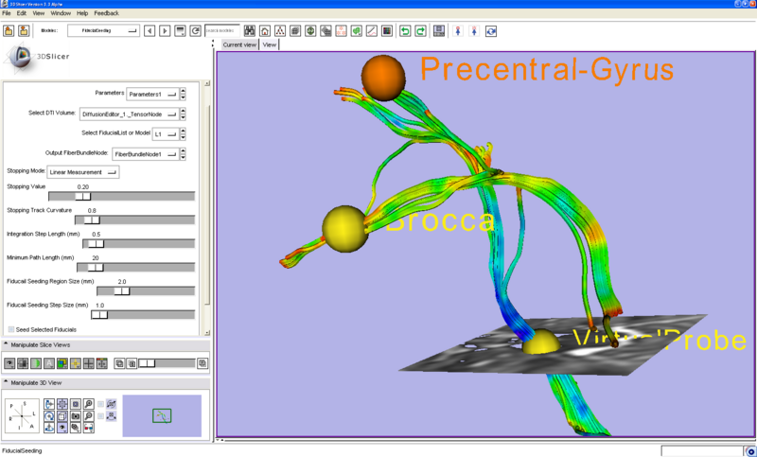
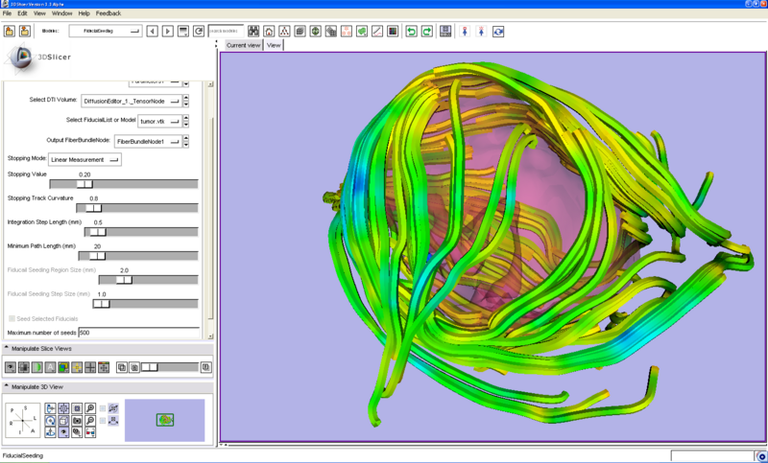
3D Slicer: Tractography Tools
Seeding tracks interactively generated from fiducial markers.
Seeding tracks from models.

Slide 21
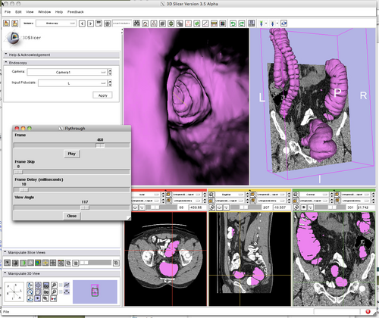
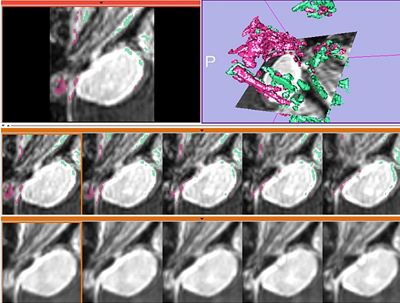
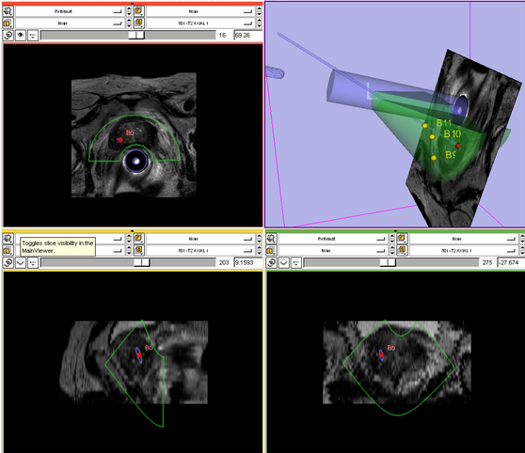
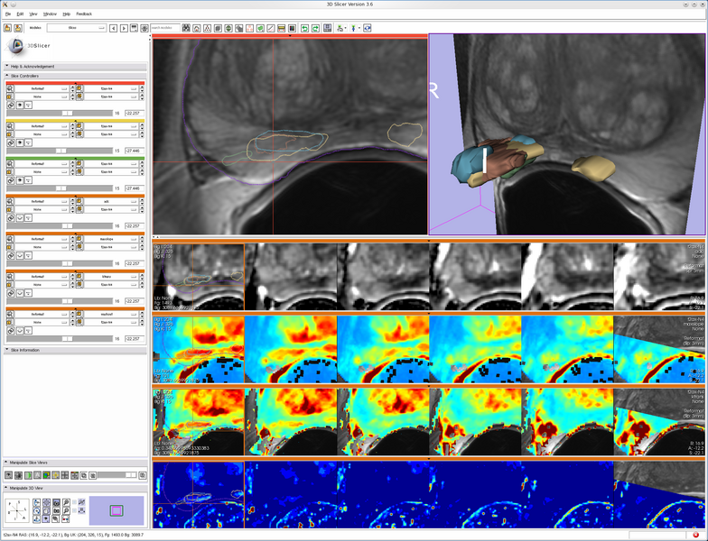
3D Slicer: Layouts
A variety of standard and specialized layouts are available including:
Lightbox view
Study comparison view
Dual 3D view
Large slice viewer
and others...

Slide 22
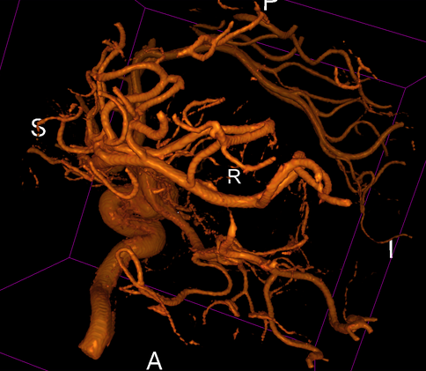
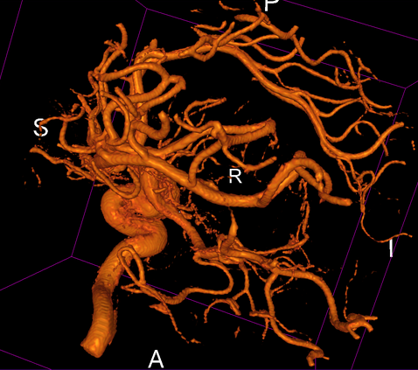
3D Slicer: Volume Rendering
Rendering Methods
VTK CPU Ray Casting
  Uses the CPU for volume rendering,
  is parallelized and can take advantage of multi-core capabilities.
  Uses level-of-detail approach where low resolution is rendered while moving, and high resolution is rendered once motion ceases.
  Allows zbuffer compositing with texture map cross sections and non-transparent triangulated surface model.
VTK GPU Ray Casting
  Uses GPU accelerated ray caster.
  Allows z-buffer compositing with non-transparent polygon models only.
  This is currently working on Linux and Win32, but not on Mac (bug in the OpenGL drivers).
VTK OpenGL 3D Texture Mapping
  Uses texture mapping approach to volume rendering
  compared to the two render methods above, it has slightly lower performance and slightly coarser appearance.
NCI GPU Ray Casting
  This is a GLSL-based ray caster with several experimental mapping techniques.
  No z-buffer compositing with polygon models.
  Good performance and quality.
  No hardware restrictions on this method.
NCI GPU Ray Casting (Multi-Volume)
  Note: this is a newly added mode that should be considered experimental.
  Allows two volumes to be volume rendered and performs an alpha blend between the two volumes.
  This method requires enough graphics memory to hold all data for stable performance.

Slide 23
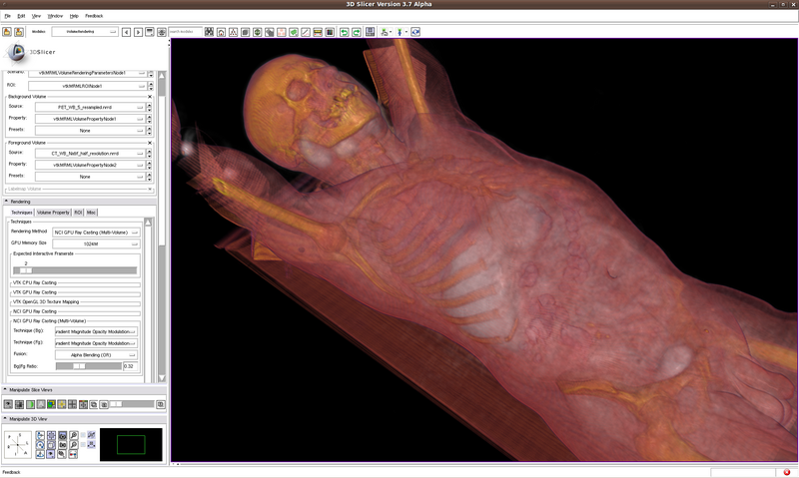
3D Slicer: GPU Volume Rendering
VTK supports several volume rendering techniques for both regular rectilinear grids and tetrahedral meshes.
The vtkKWEGPURayCastMapper in VTKEdge uses the latest advancements available on recent GPUs including fragment programs with conditional and loop operations, multi-texturing and frame buffer objects in order to deliver significantly improved performance over the CPU-based ray casting, while still maintaining high rendering quality.
  Dedicated GPUs with dedicated GPU memory are recommended for GPU accelerated methods.

Slide 24
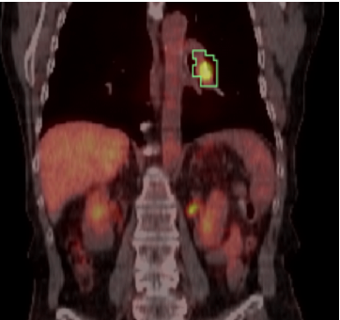
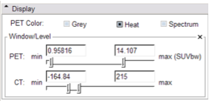
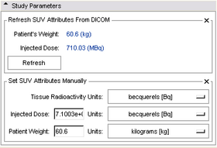
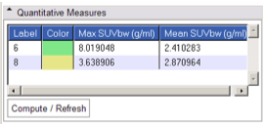
3D Slicer: PET/CT SUV computation
Combined visualization of structural and colorized functional images
VOIs defined in Slicer’s Editor Module
extracted DICOM study parameters used in computation
Computation of Standardized Uptake Value (based on patient body weight) per VOI.

Slide 25
3D Slicer: Image-Guided Therapy
3D Slicer has been used in clinical research, with IRB clinical protocols appropriately created and managed.
In image-guided therapy (IGT) research, Slicer is frequently used to construct and visualize collections of MRI data that are available pre- and intra-operatively, and to display the tracked spatial position of surgical instruments.

Slide 26
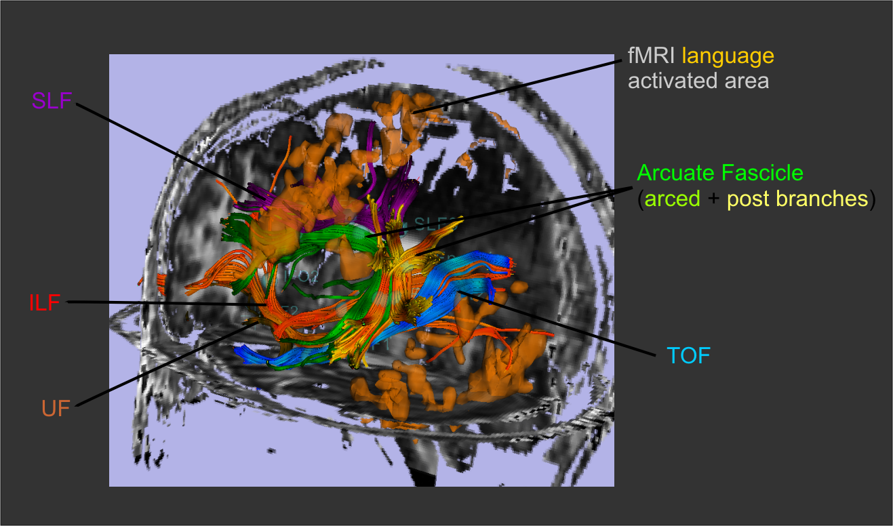
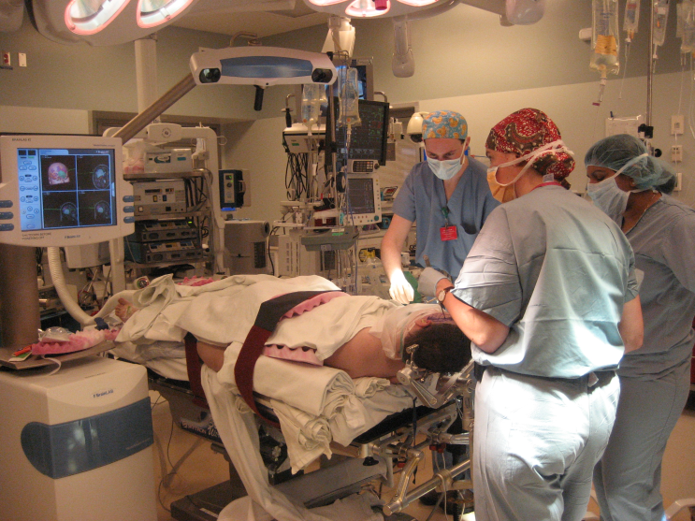
3D Slicer: Image-Guided Therapy
3D Slicer has been used extensively for brain tumor resection planning and guidance during surgery.
Integration of 3D Slicer with the surgical navigation BrainLab system allows to track surgical instruments in real-time, and transfer the position to 3D Slicer.
This project is a joint collaboration between BWH, Yale University and BrainLab.

Slide 27
3D Slicer: Image-Guided Therapy

Slide 28
3D Slicer: Registration Tools

Slide 29
3D Slicer: Segmentation Tools
Segmentation is required for defining features of interest in imaging data for quantification and analysis.
3D Slicer has a variety of interactive and automated segmentation methods:
Editor Module for manual contouring and editing
region growing and level sets
graph cuts with gesture support
skull stripping and hierarchical brain segmentation for morphological studies

Slide 30
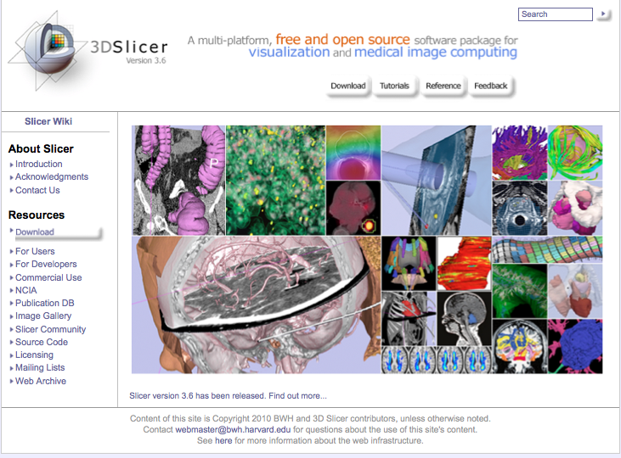
3D Slicer: Get the software
www.slicer.org

Slide 31
3D Slicer: Find Tutorials & More
www.slicer.org

Slide 32
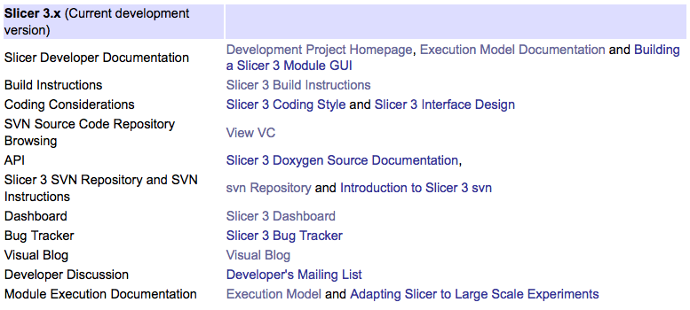
3D Slicer: Information for Developers
www.slicer.org/pages/DeveloperOrientation

Slide 33
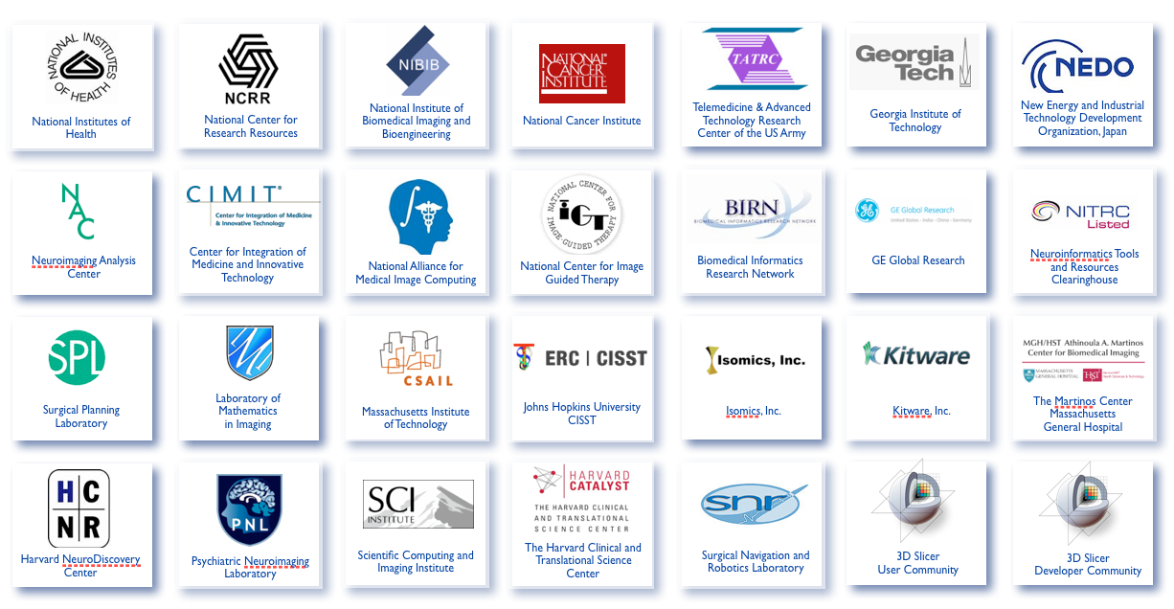
3D Slicer: Acknowledgements
Major Sponsors & Contributors

