Slide 1





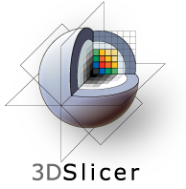

3D Slicer
Ron Kikinis M.D.
Robert Greenes Distinguished
Director of Biomedical Informatics, Dept. of Radiology, BWH
Professor of Medical Image Computing, FB 3, Uni Bremen
Professor of Radiology, Harvard Medical School
Founding Director, Surgical Planning Laboratory, Brigham and Women’s Hospital
Institutsleiter, Fraunhofer MEVIS
Principal Investigator, National Alliance for Medical Image Computing, and Neuroimage Analysis Center,
Research Director, National Center for Image Guided Therapy

Slide 2
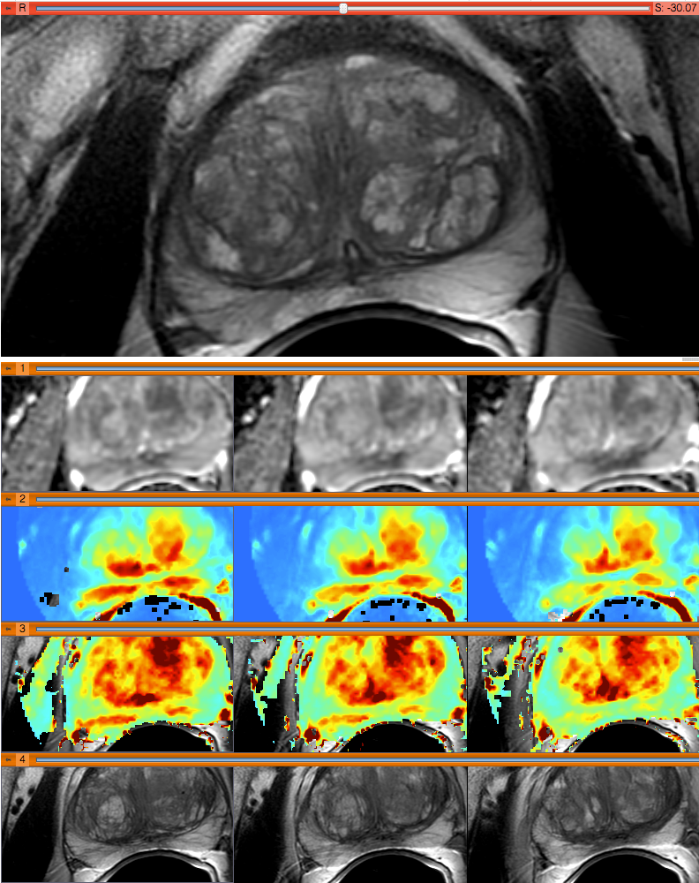
Medical Image Computing
The investigation and use of computational and mathematical methods for solving problems in the field of medical imaging.
Examples of topics in the field of medical image computing include:
  Segmentation
  Registration and image fusion
  Tensor & vector field analysis
  Generation and use of atlas concepts
  Time series analysis
  Analysis of functional imaging data
  Multimodal image analysis
  Visualization
  Probabilistic modeling
Image provided by A. Fedorov et al.

Slide 3
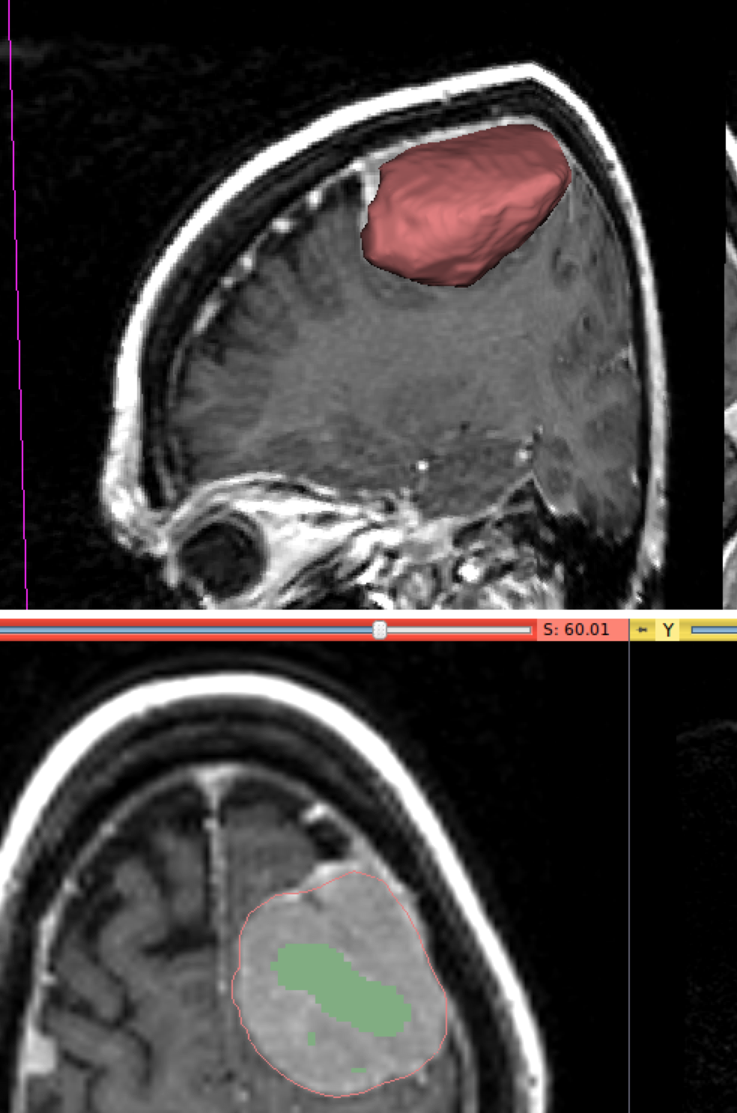
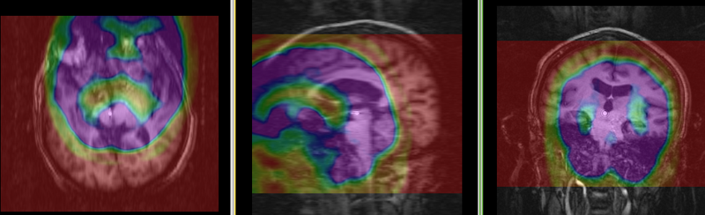
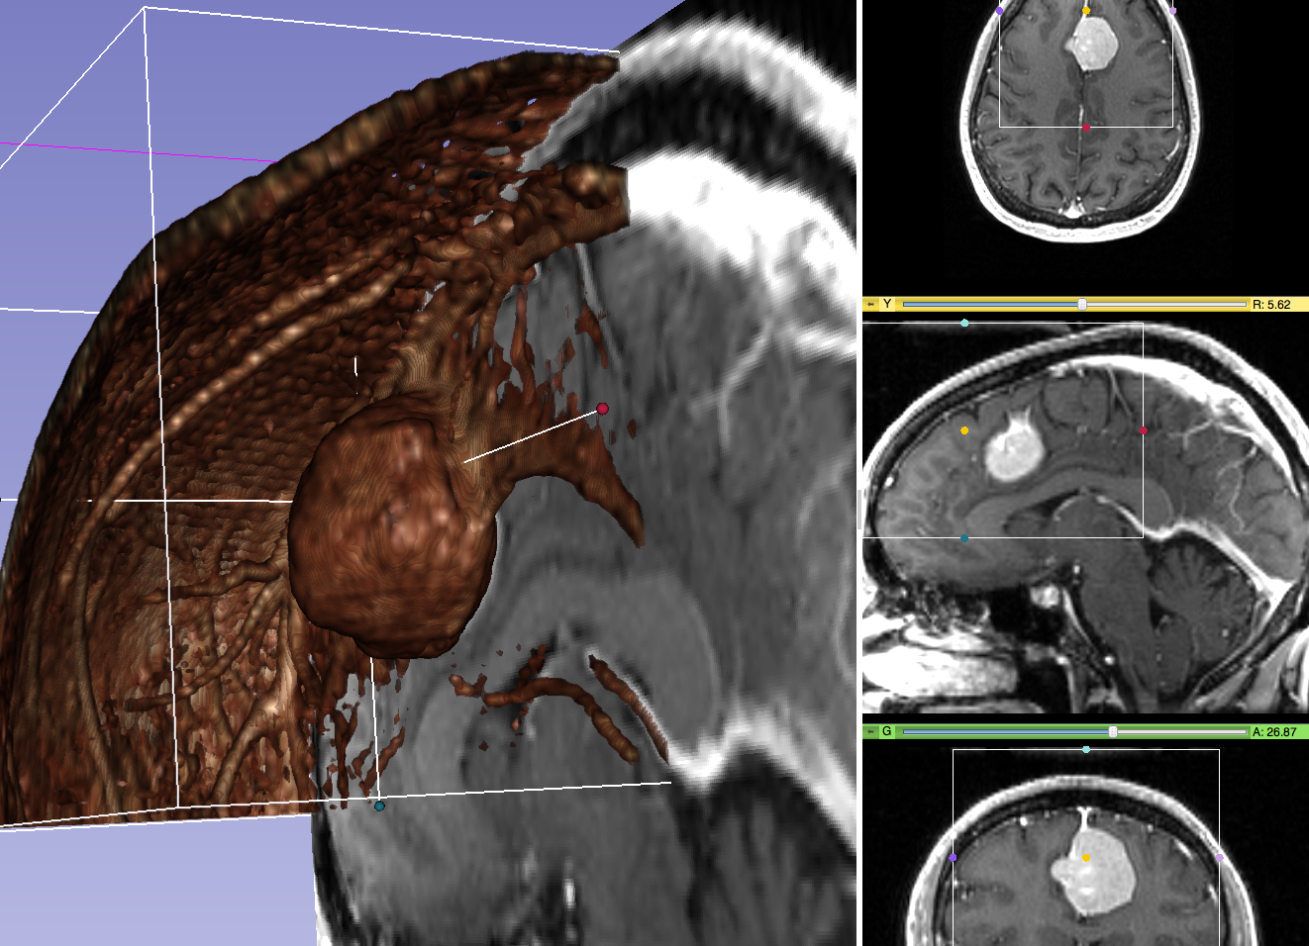
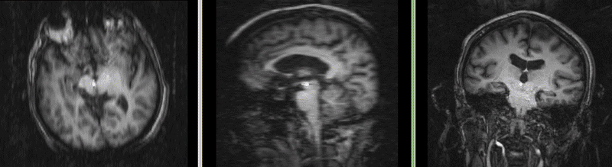
What is MIC
The investigation and use of computational and mathematical methods for solving problems in the field of medical imaging:
  image segmentation
  image registration
  image-based physiological modeling
  visualization
http://wiki.slicer.org/slicerWiki/index.php/Documentation/Nightly/Modules/RobustStatisticsSegmenter
result
initialization
before
after
Volume rendering
http://wiki.slicer.org/slicerWiki/index.php/Documentation:Nigh
tly:Registration:RegistrationLibrary:RegLib_C14

Slide 4
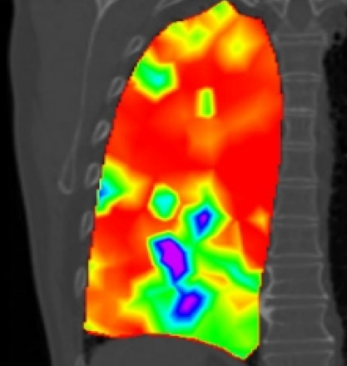
The Increasing Importance of MIC
  More data and modalities:
  gigabytes to terabytes
  More complexity
    fMRI, molecular
    imaging dMRI, 4DUS
  More applications
    Discovery, Diagnosis
    Therapy monitoring
Risholm P., Ross J., Washko G.R., Wells III W.M. Probabilistic Elastography: Estimating Lung Elasticity. Inf Process Med Imaging. 2011;22:699-710. PMID: 21761697. PMCID: PMC3249413.

Slide 5
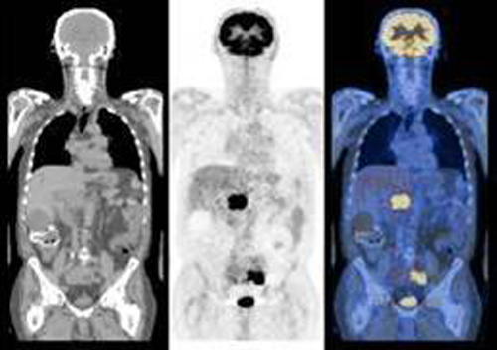
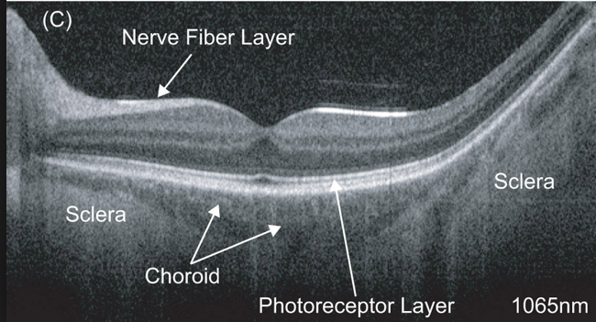
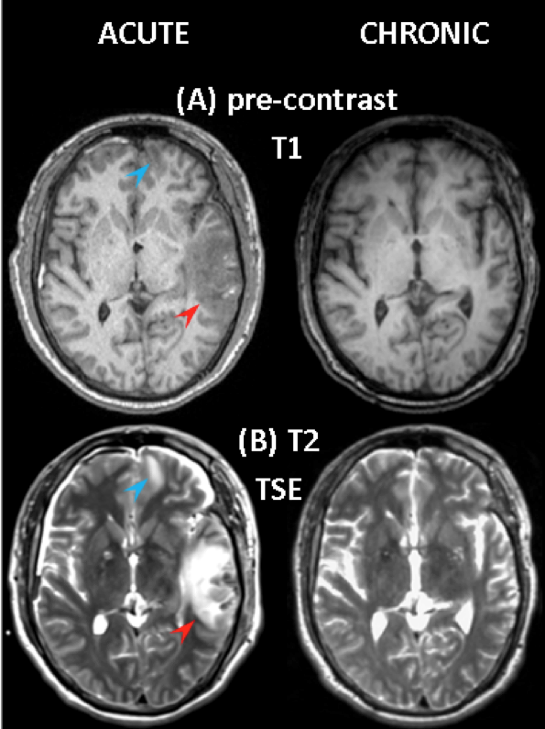
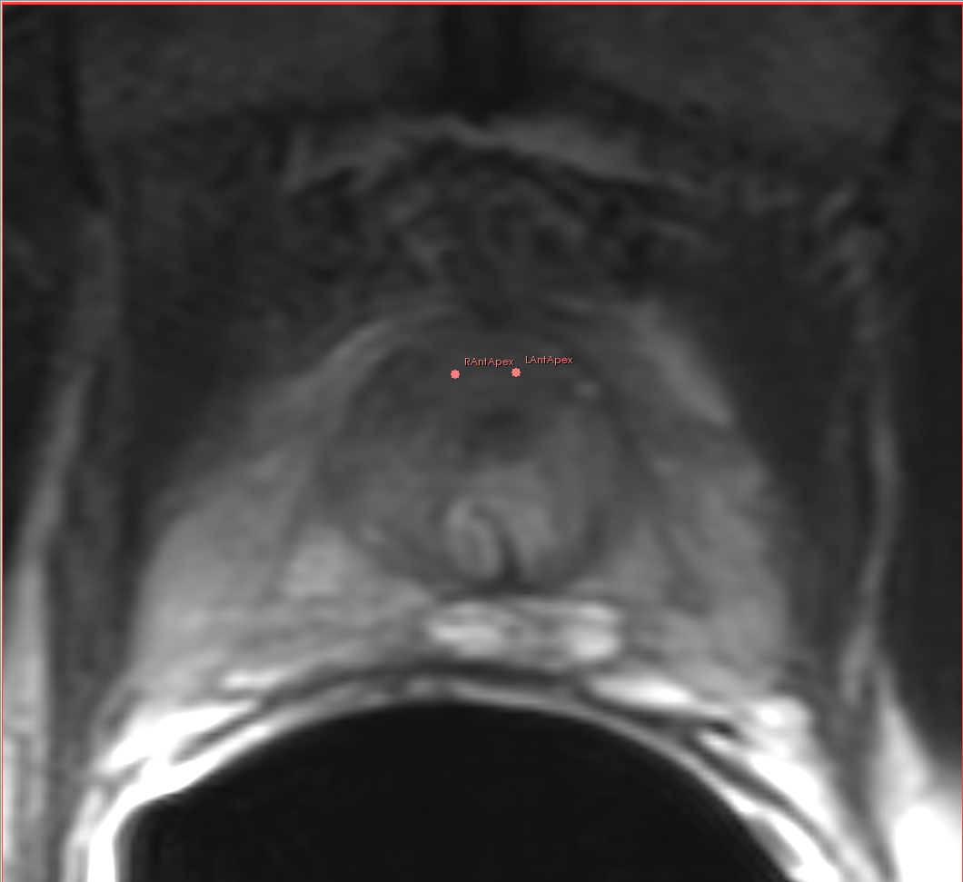
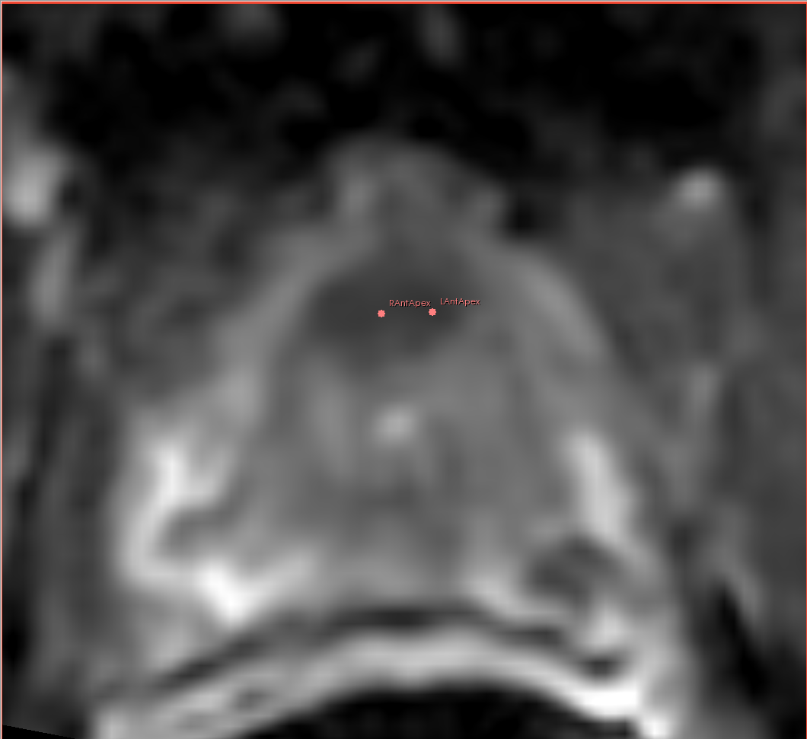
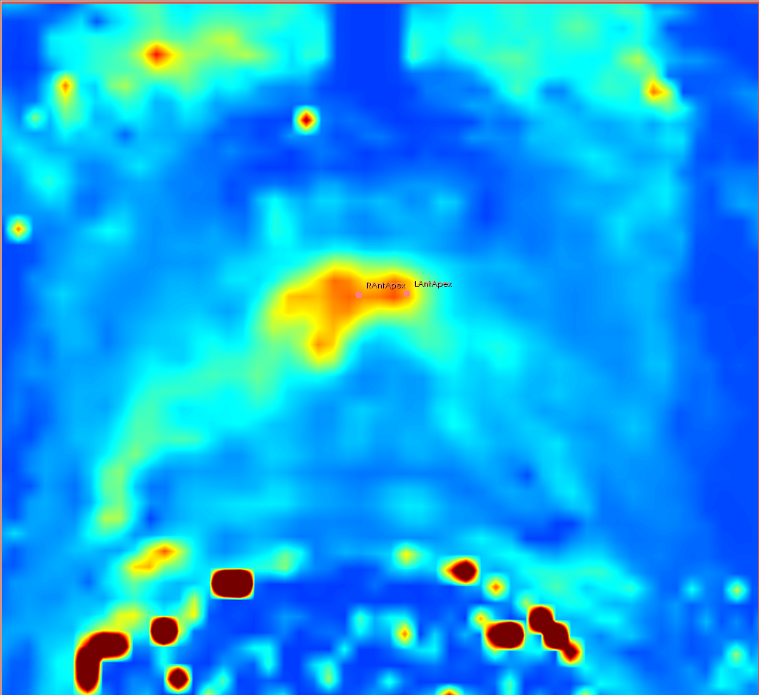
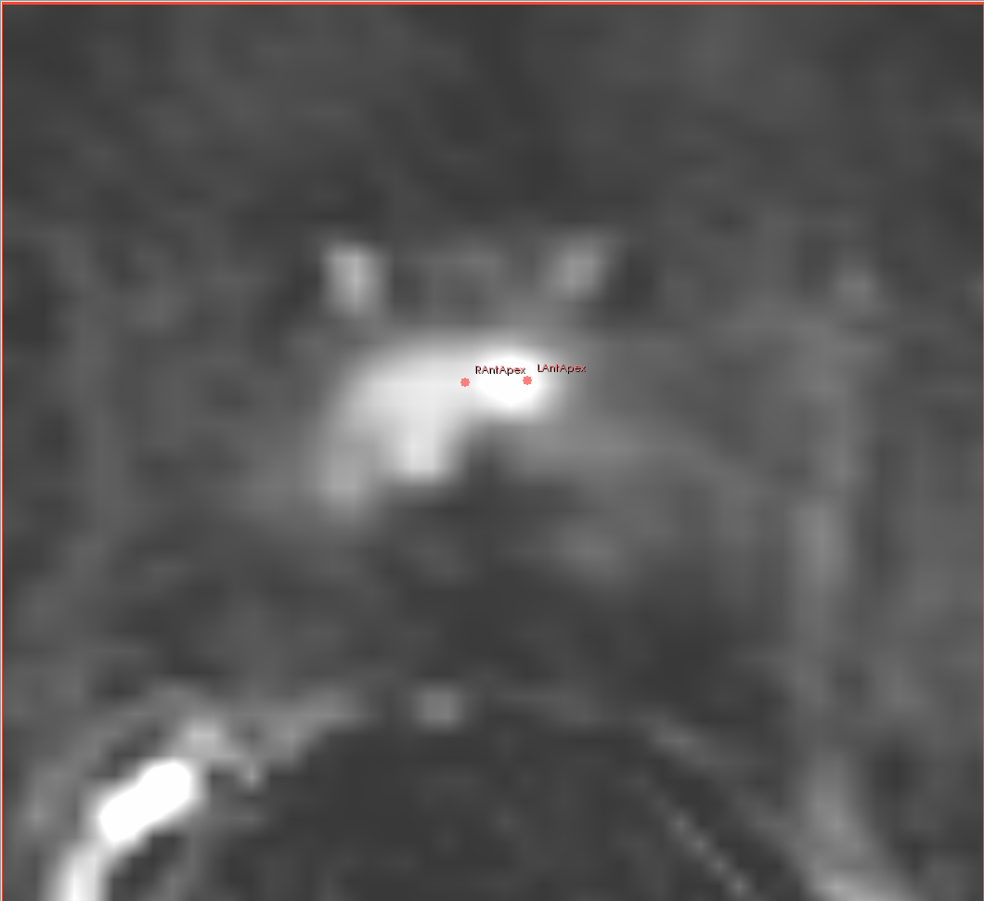
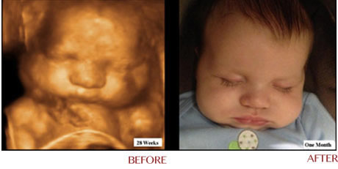
Imaging Modalities
PET CT:
http://nucmed.wikispaces.com/Wendt+Talk+6
MR Images:
P. Vespa,
J. Alger,
UCLA
OCT: http://spie.org/x88950.xml?pf=true&ArticleID=x88950
T2w
ADC
This is just a partial list
Complex MRI:
Fedorov et al. 2012. JMRI. 36(4):987–992.
X ray radiography
Magnetic resonance imaging (MRI)
Nuclear medicine
Computed Tomography
Tomography
Ultrasound
Optical Coherence Tomography
Photoacoustic imaging
Thermography
Light Microscopy
  Bright, dark field
  Phase contrast
  Fluorescence
  Confocal
K^{trans}
subtract
4D Ultrasound: http://ultrasoundcarespecialist.com/html/anib_3d4d.html
Chubby
Cheeks

Slide 6
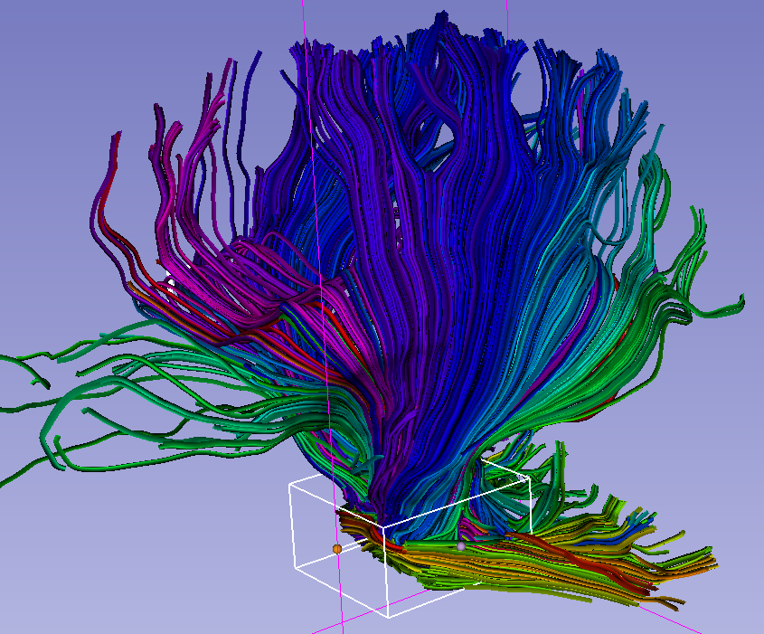
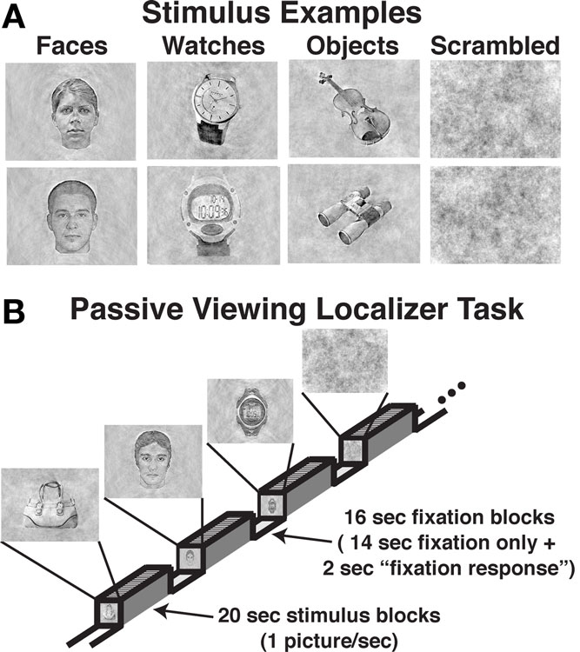
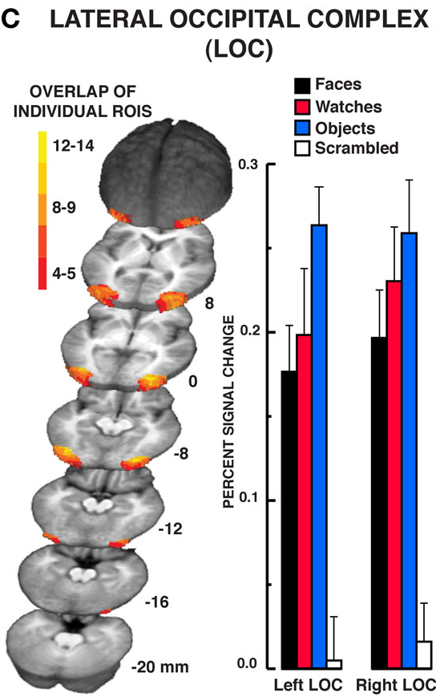
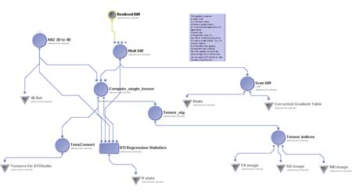
Examples of Complexity
fMRI dMRI
DTI streamlines: http://wiki.slicer.org/slicerWiki/index.php/Slicer4:VisualBlog
http://www.frontiersin.org/human_neuroscience/10.3389/fnhum.2010.00181/full
DTI processing: http://www.loni.ucla.edu/~ophillip/DTIPipelines.html

Slide 7
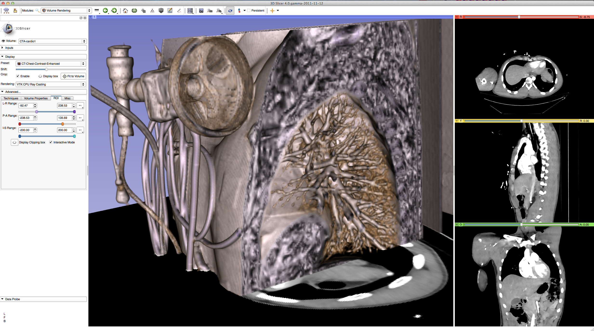
Post-Processing Is Needed
From data to information
From information to knowledge
Image provided by Kikinis

Slide 8
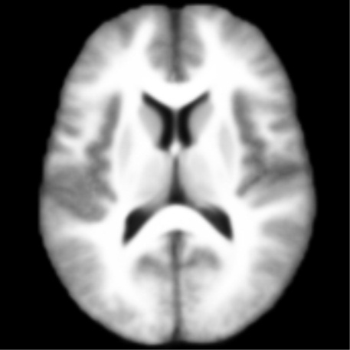
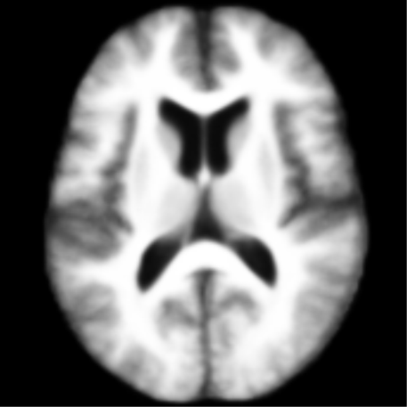
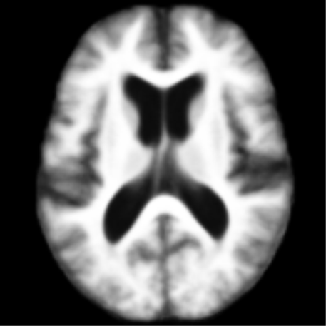
Basic Science in Neuroimaging
MIC research in neuroscience
  Where is a function or structure typically located
  What is the variability in a population?
Group analysis in healthy looking brains
3 Templates
M.R. Sabuncu, S.K. Balci, M.E. Shenton, and P. Golland. Image-Driven
Population Analysis Through Mixture Modeling. IEEE Transactions on
Medical Imaging, 28(9):1473 - 1487, 2009
Young
Middle
Old
Golland, et al - MIT
Notes:
http://surfer.nmr.mgh.harvard.edu/fswiki/FsTutorial/QdecGroupAnalysis

Slide 9
Applied Science in Neuroimaging
MIC in neurosurgery
    Where is the pathology?
    What are important surrounding structures
Subject specific analysis in the presence of pathology (brain tumors)
Golby A.J., Kindlmann G., Norton I., Yarmarkovich A., Pieper S., Kikinis R. Interactive Diffusion Tensor Tractography Visualization for Neurosurgical Planning. Neurosurgery. 2011 Feb; 68(2):496-505. PMID: 21135713
Golby, Norton, BWH Neurosurgery

Slide 10
Basic Versus Translational Science
Basic science
  Group comparisons
  Months to years per study
  Automation is more important, than speed
  Large computational resources
Translational
  Subject specific
  Minutes to hours per case
  Automation is less important than speed
  Limited computational resources

Slide 11
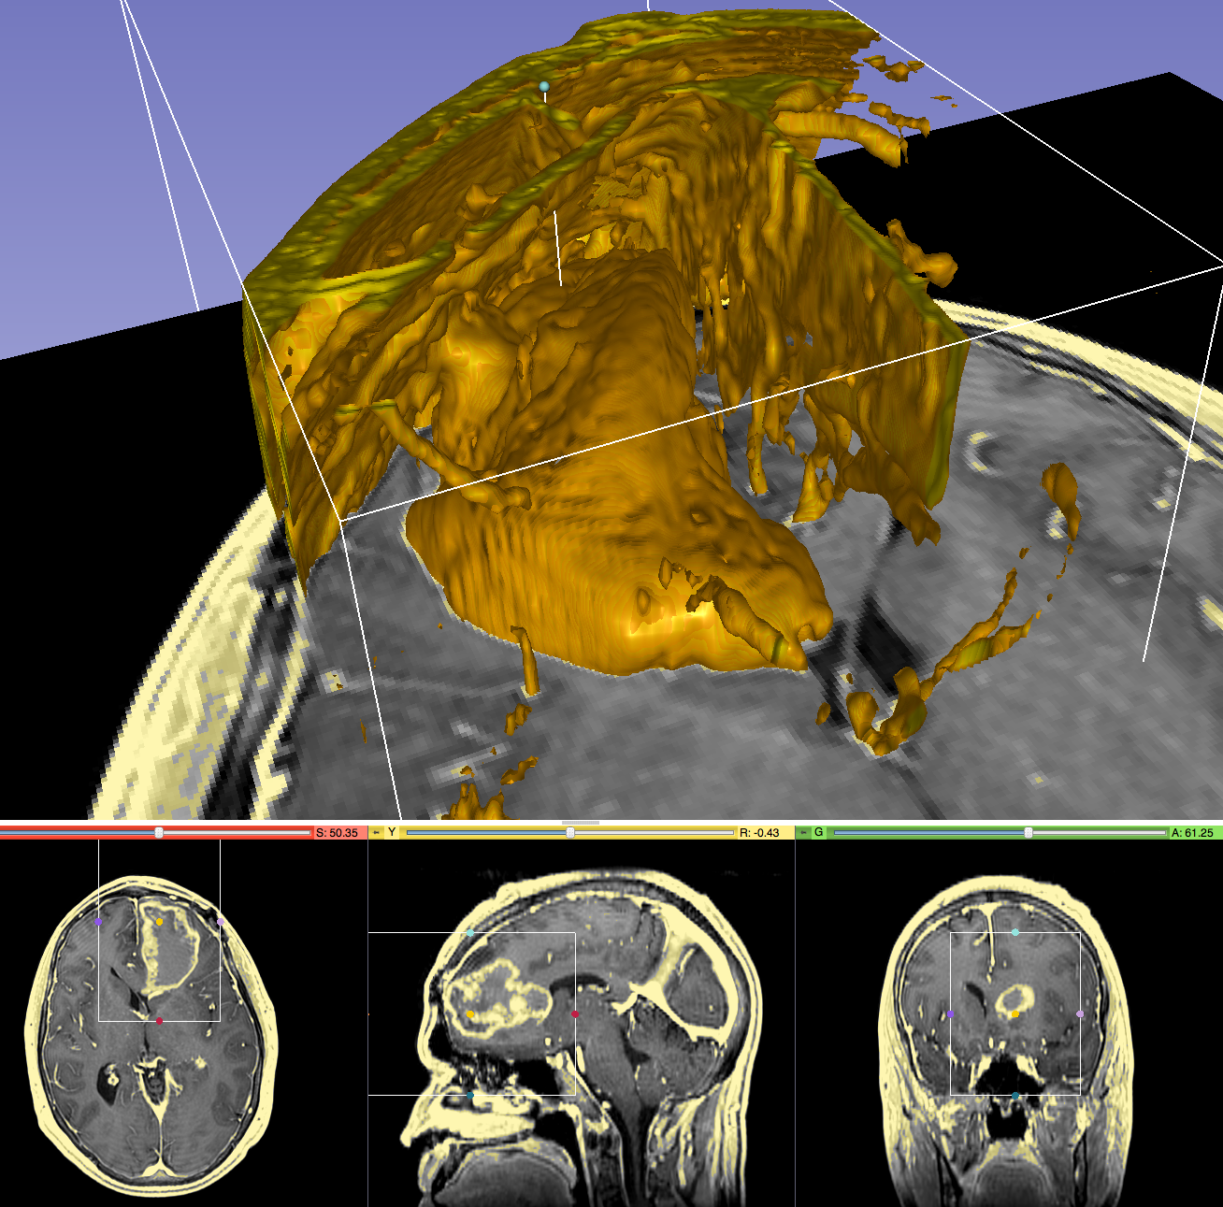
From Algorithms To Tools
Progression of a concept in MIC
  Can it be done?
    Basic science →Prototype
  Is it worth doing?
    Applied Science →Tool for translational clinical research
  Standard of care
    Commercial tool: Clinical “device” with
    regulatory approval
Image provided by Kikinis

Slide 12
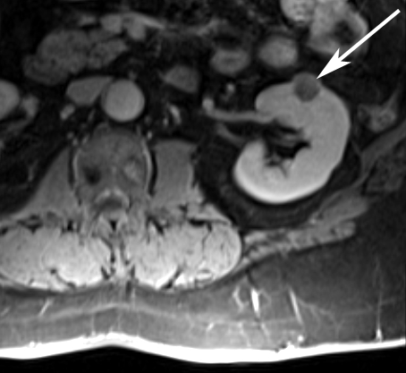
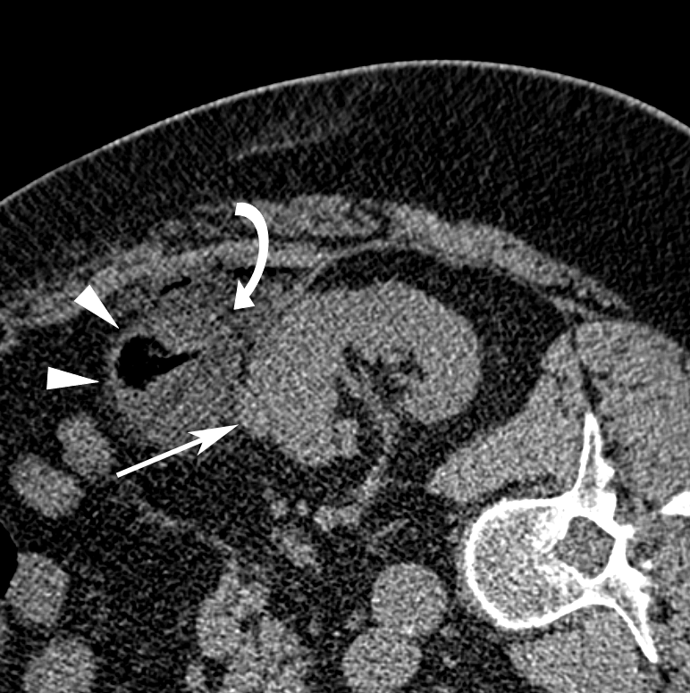
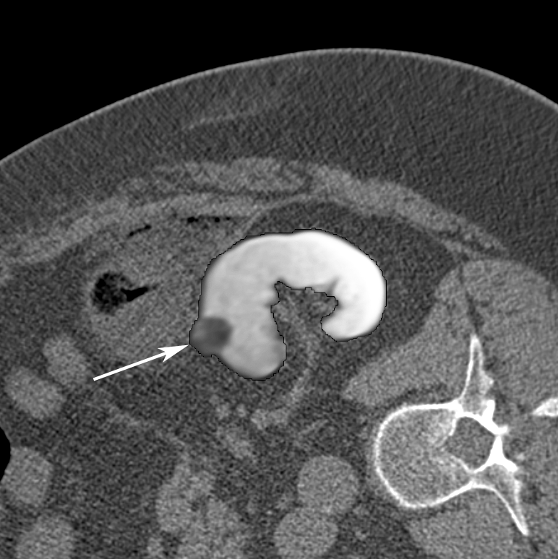
Translational Research
Well-engineered, full-featured software tools are needed
But it does not fit traditional science funding mechanisms: “Valley of Death”
Pre-procedural MRI
Intra-procedural CT
Registered MRI
Oguro et al, Int J Comput Assist Radiol Surg, 2011
Elhawary et al, Acad Rad, 2010

Slide 13
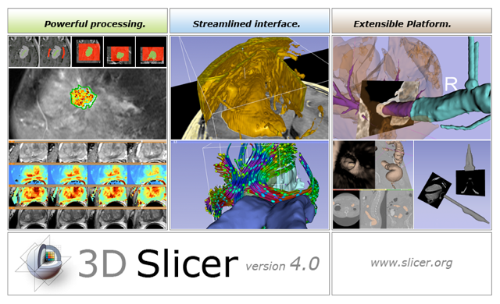
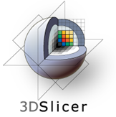
3D Slicer
3D Slicer bridges the
“valley of death” for
subject specific analysis
  Free open source software
    Enables scientific collaboration
    Painless translation to proprietary clinical tools
  Well-engineered high-performance core
    Software engineering methodology, multi-platform
  Many options for extensions
Picture courtesy Wendy Plesniak

Slide 14
Subject Specific Analysis
Quick and good enough is better than slow and perfect!
Image processing problems cannot be compensated by adding subjects (you have only one)
Interactive work is the norm
"Ron's rules for tools" is an informal set of rules that developers should keep in mind when working on interactive tools for translational clinical research. If you follow them, you will create tools that many people will use.
You make it, I break it.
Your tool does not exist, until it works on my laptop with my data.
I am lazy. I do not like to move the mouse or to type.
No more than one simple parameter.
I have Attention deficit disorder: Make your algorithm fast.

Slide 15
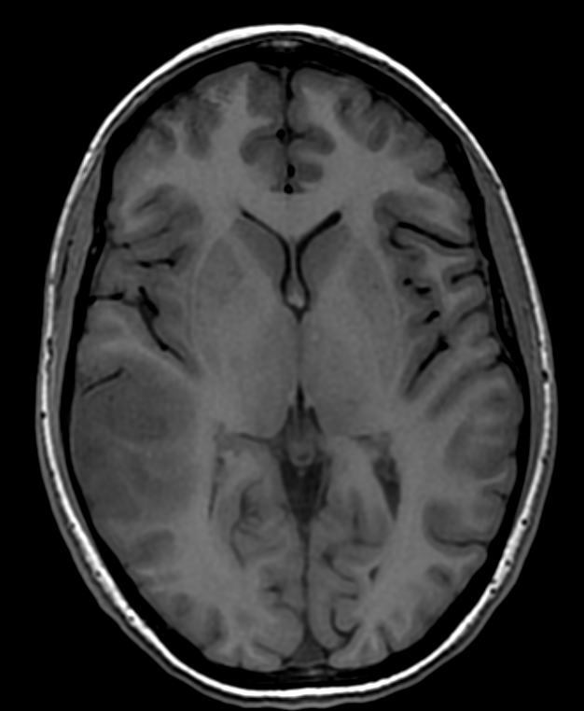
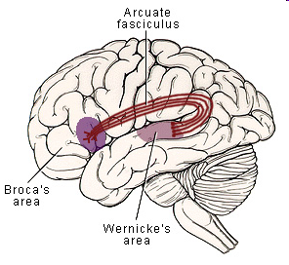
Tumor and Language
Where is Wernicke’s area?
Lesions affecting the arcuate fasciculus, a white matter tract connecting Wernicke's and Broca's speech regions, result in conduction aphasia.
  (from http://www.lib.mcg.edu/edu/eshuphysio/program/section8/8ch15/s8c15_14.htm)

Slide 16
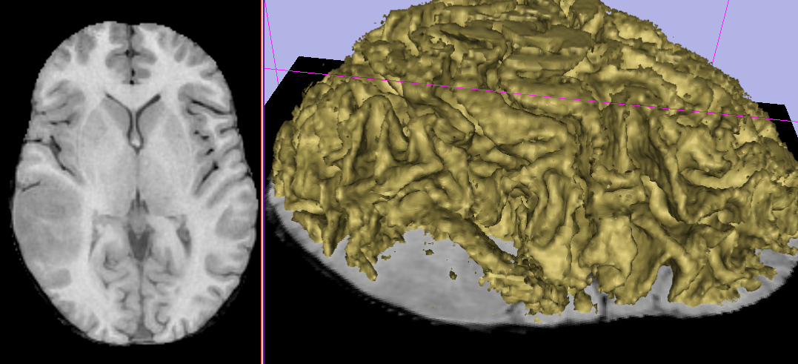
White Matter Surface On The Quick
Where are Broca, Wernicke?
Skullstrip → Volume render
from http://www.lib.mcg.edu/edu/eshuphysio/program/section8/8ch15/s8c15_14.htm
Slicer image taken by R. Kikinis

Slide 17
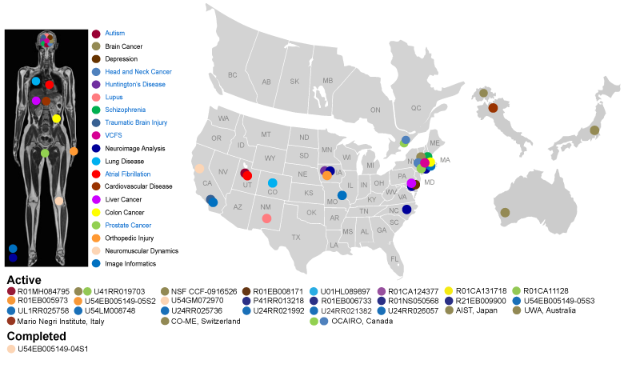
Slicer Business Model
Increase impact through FOSS, broad application space
Fund continued development through
  grant applications
  Leverage other people’s money (OPM)
Picture 2011, courtesy Kapur, Jakab, Kikinis

Slide 18
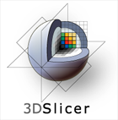
Slicer for Translational Research
3D Slicer: a cross platform system for translating innovative algorithms into clinical research applications
Developer Needs
Clinical Grade IO and UI
Rich Utility Libraries
Extensible and Reconfigurable
Stable Base
Easily Deployable
User Needs
Easy Install and Upgrade
“Standard” Clinical Behavior
Consistent Interface
Advanced Functionality
Courtesy S. Pieper

Slide 19
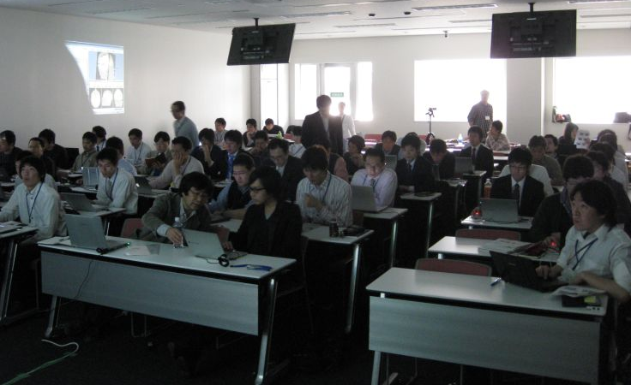
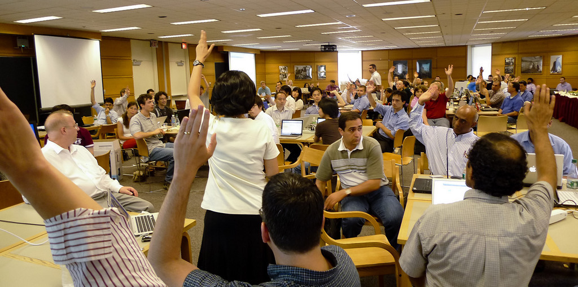
Slicer Is Open
Tokyo 2010, hosted by H. Iseki
Open Science
=
Open Source
+
Open Data
+
Open Community
Boston 2010

Slide 20
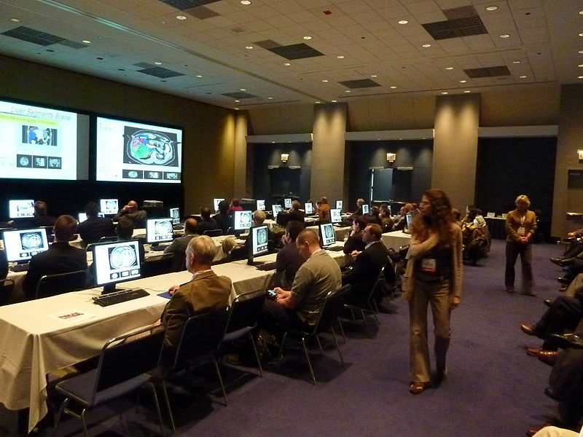
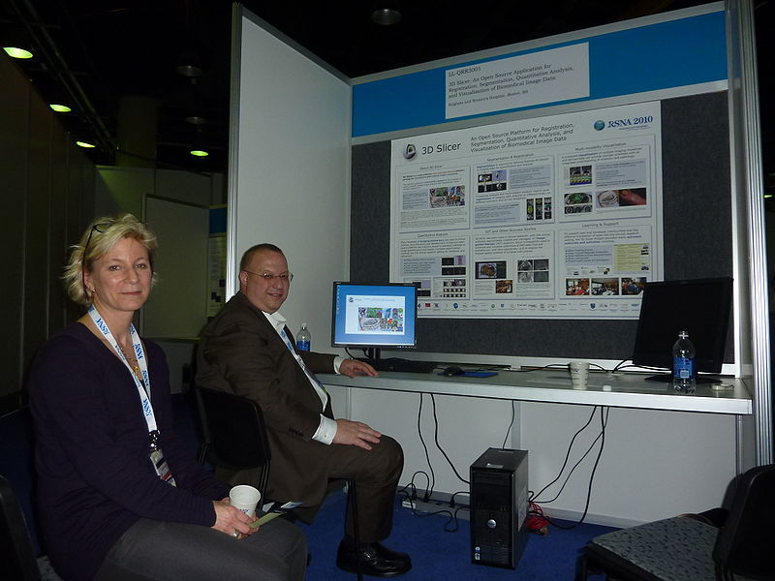

Slicer Is Accessible
Designed from scratch for:
  Multi-platform support
  Multi-site development
International developer community
International
user community

Slide 21
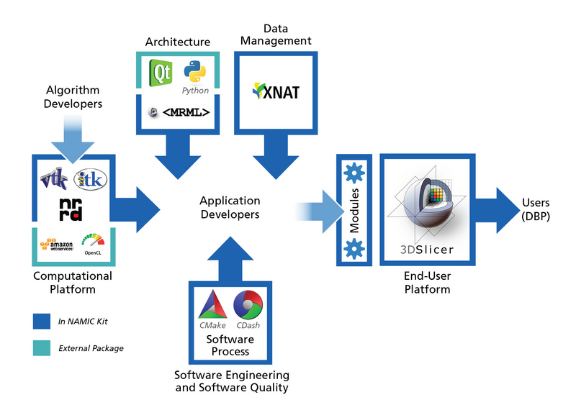
Slicer Is Engineered
Modular platform based on best-of-breed FOSS packages
Principled software engineering methodology
Plug-ins:
  Python
  C++
  XML
Picture courtesy W. Schroeder

Slide 22
Slicer is Extensible
Many options for plug-ins:
  Developer startup time and control of Slicer
    Scripted module: TCL or Python scripts
      simple, no compilation needed
      limited access to Slicer internals
    Command-line module: .exe file
      simple, executable without Slicer
      no access to Slicer internals, Slicer compilation needed
    Loadable (interactive) module: .dll
      full access to Slicer internals
      Slicer compilation needed, requires Slicer core knowledge
Sharing plug-ins through the extension manager
Less → More

Slide 23
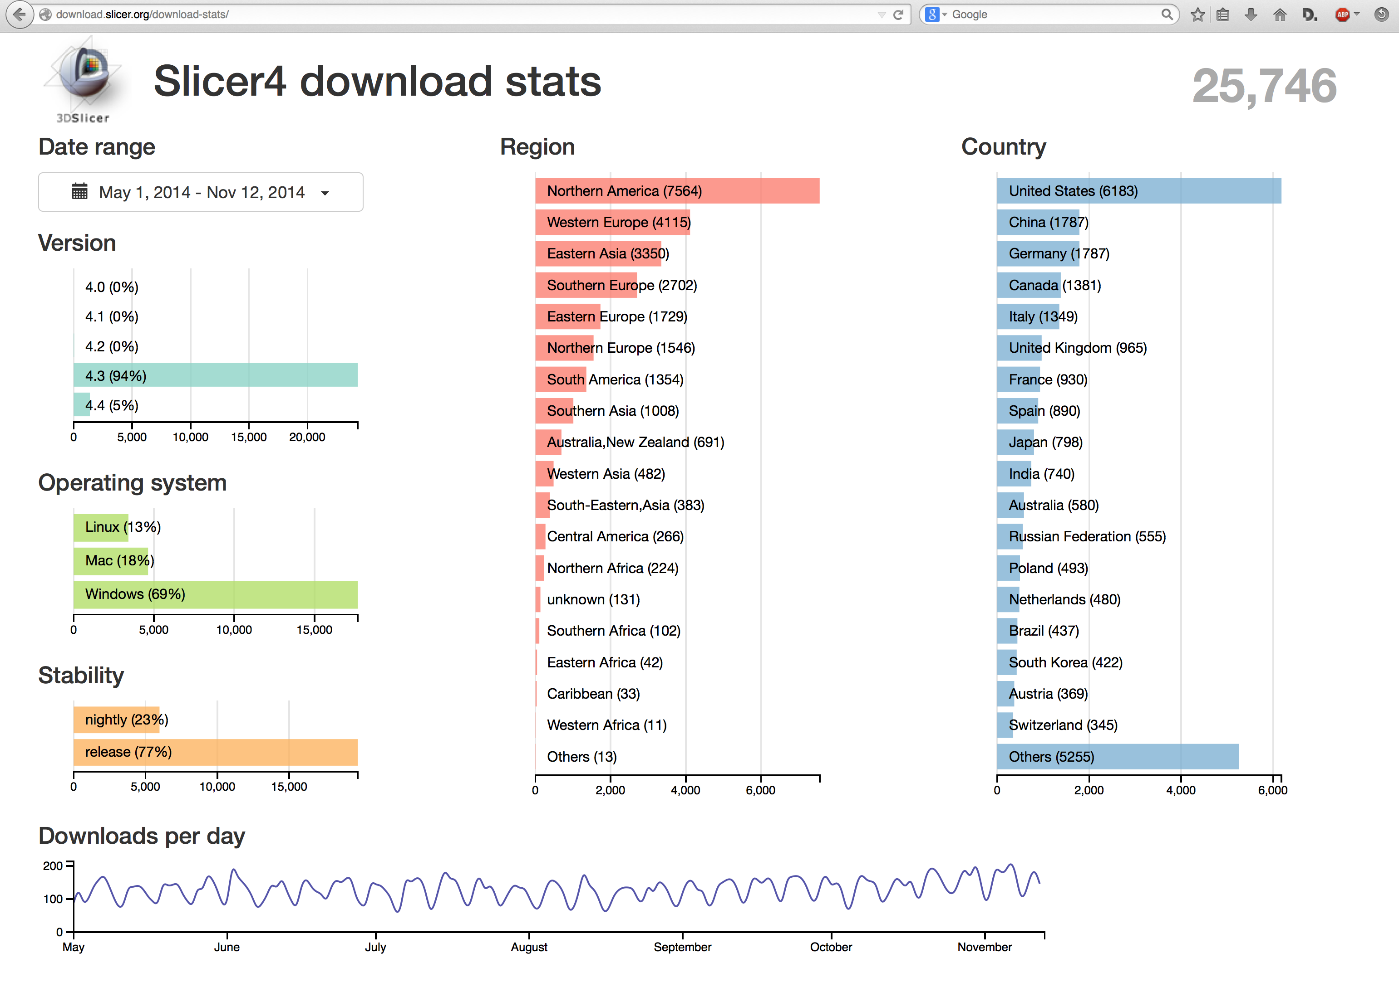
Slicer Impact: slicer.org
Picture courtesy M. Jakab, T. Kapur

Slide 24
Slicer 4.4: For Users
Faster Interaction
More Stable
64 Bit on Linux, Mac, and Windows
DICOM Networking and Database
New Layouts
Charts
Improved Modules
App store for extensions
Courtesy S. Pieper

Slide 25
Slicer 4.4: For Developers
Improved Software Process and Testing
Ports to up-to-date libraries and toolkits
  OS: MAC, Ubuntu, Windows
  Toolkits: VTK 6, ITKv4, Qt 4.8.6, CTK
Courtesy S. Pieper

Slide 26
Slicer 4.4 Features
See website:
  http://wiki.slicer.org/slicerWiki/index.php/Documentation/Nightly/Announcements

Slide 27
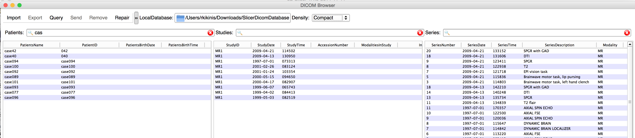
Slicer 4.4: DICOM Support
DICOM Networking and Database
  Based on DCMTK
  DICOM Listener, Query/Retrieve, Send
  Local Cache, Series Selection…
  WIP: support for modern objects such as: segmentation, transformation, multiframe, and SR
Courtesy R. Kikinis

Slide 28
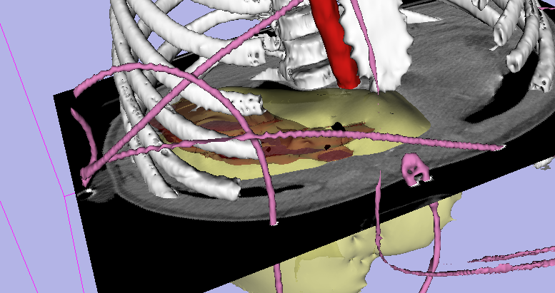
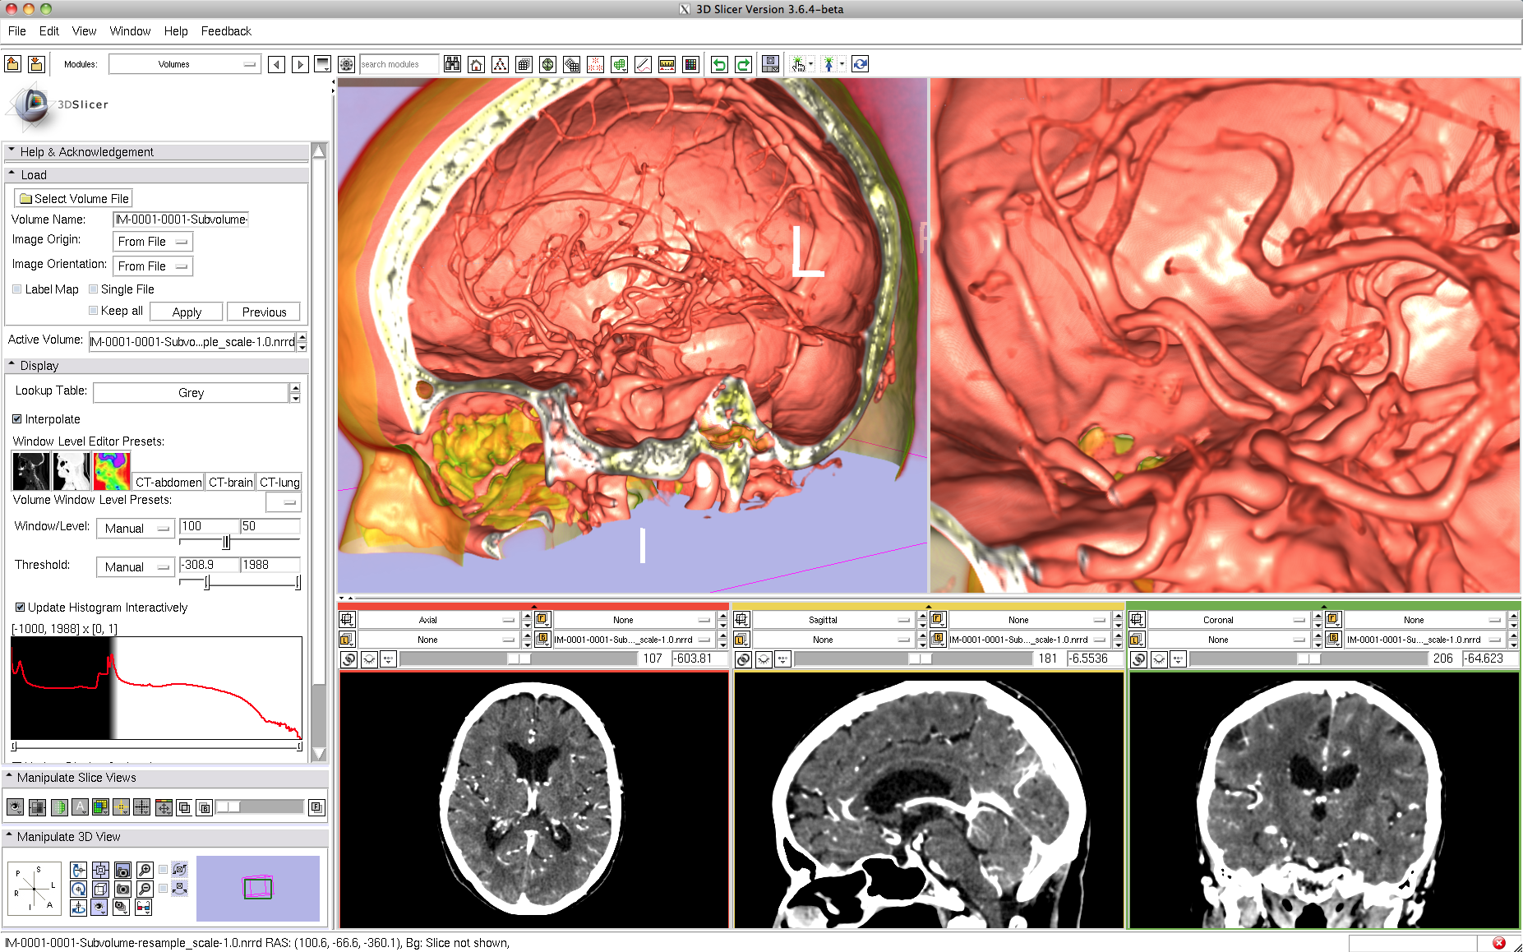
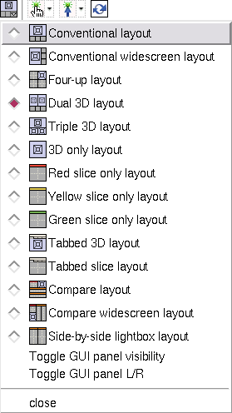
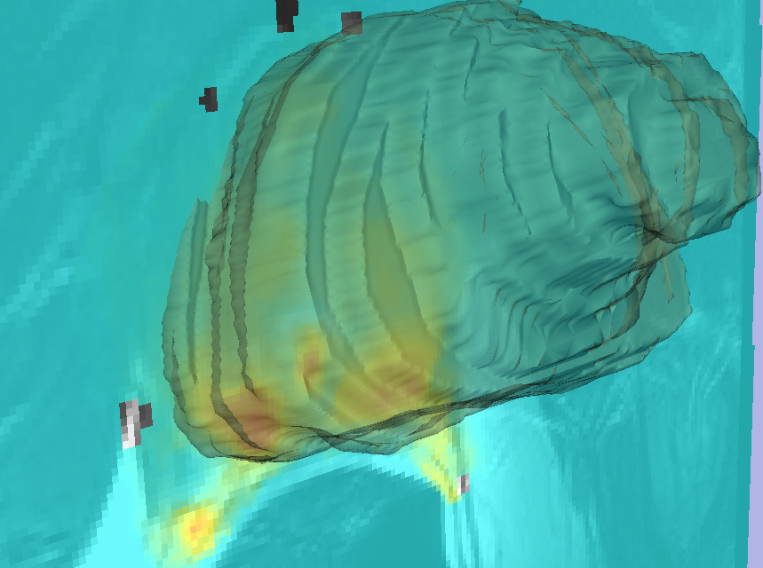
Visualization: Data → Information
1
Interactivity for Rapid Assessment of Large Collections of Images
Surface models
Volume rendering
2D/3D Combination
Library of layouts
2
4
3
Picture courtesy Shaffer, Pujol, Kikinis, Fenessy, Fedorov

Slide 29
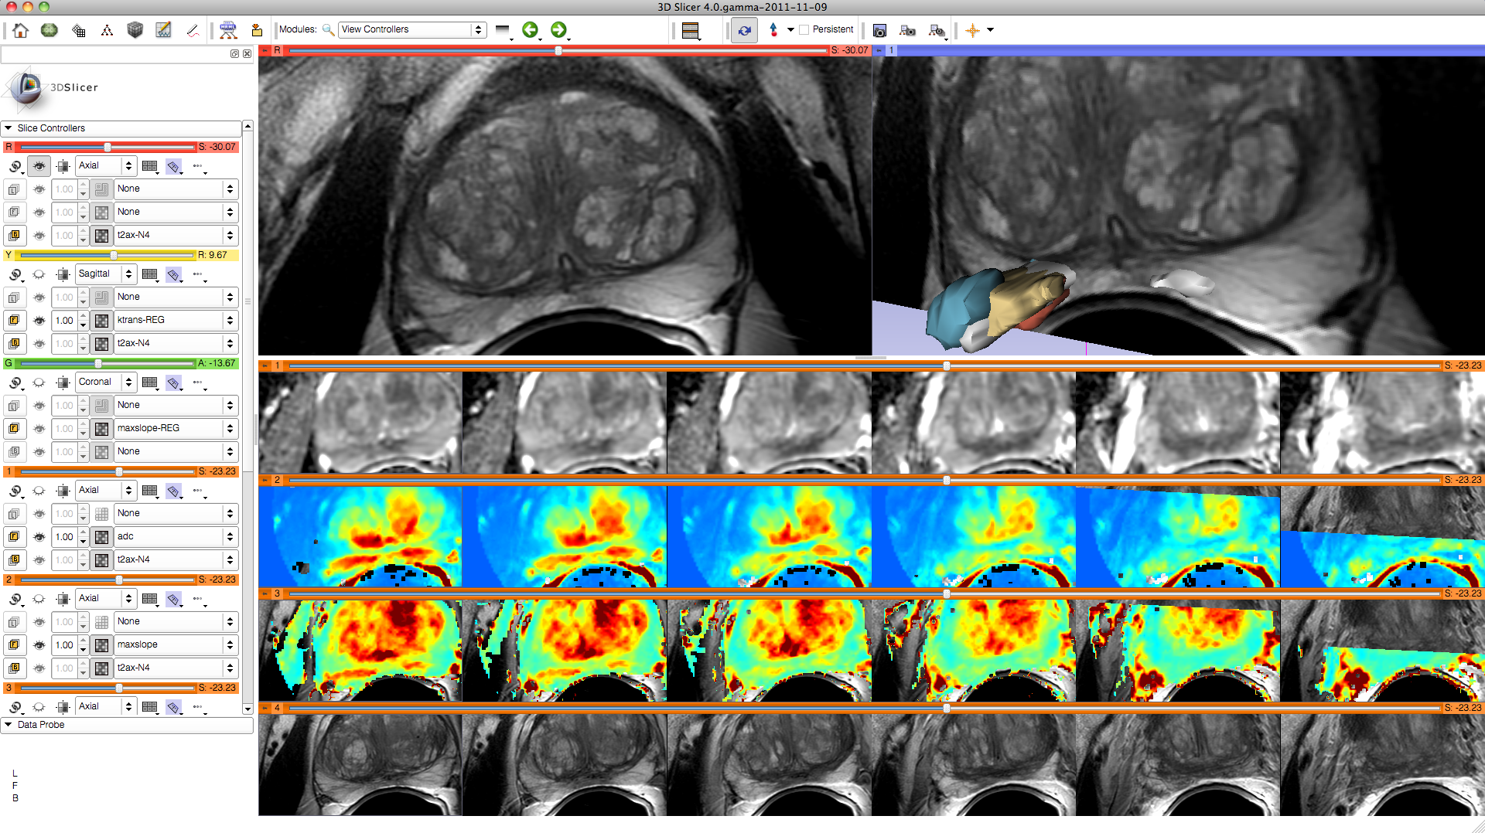
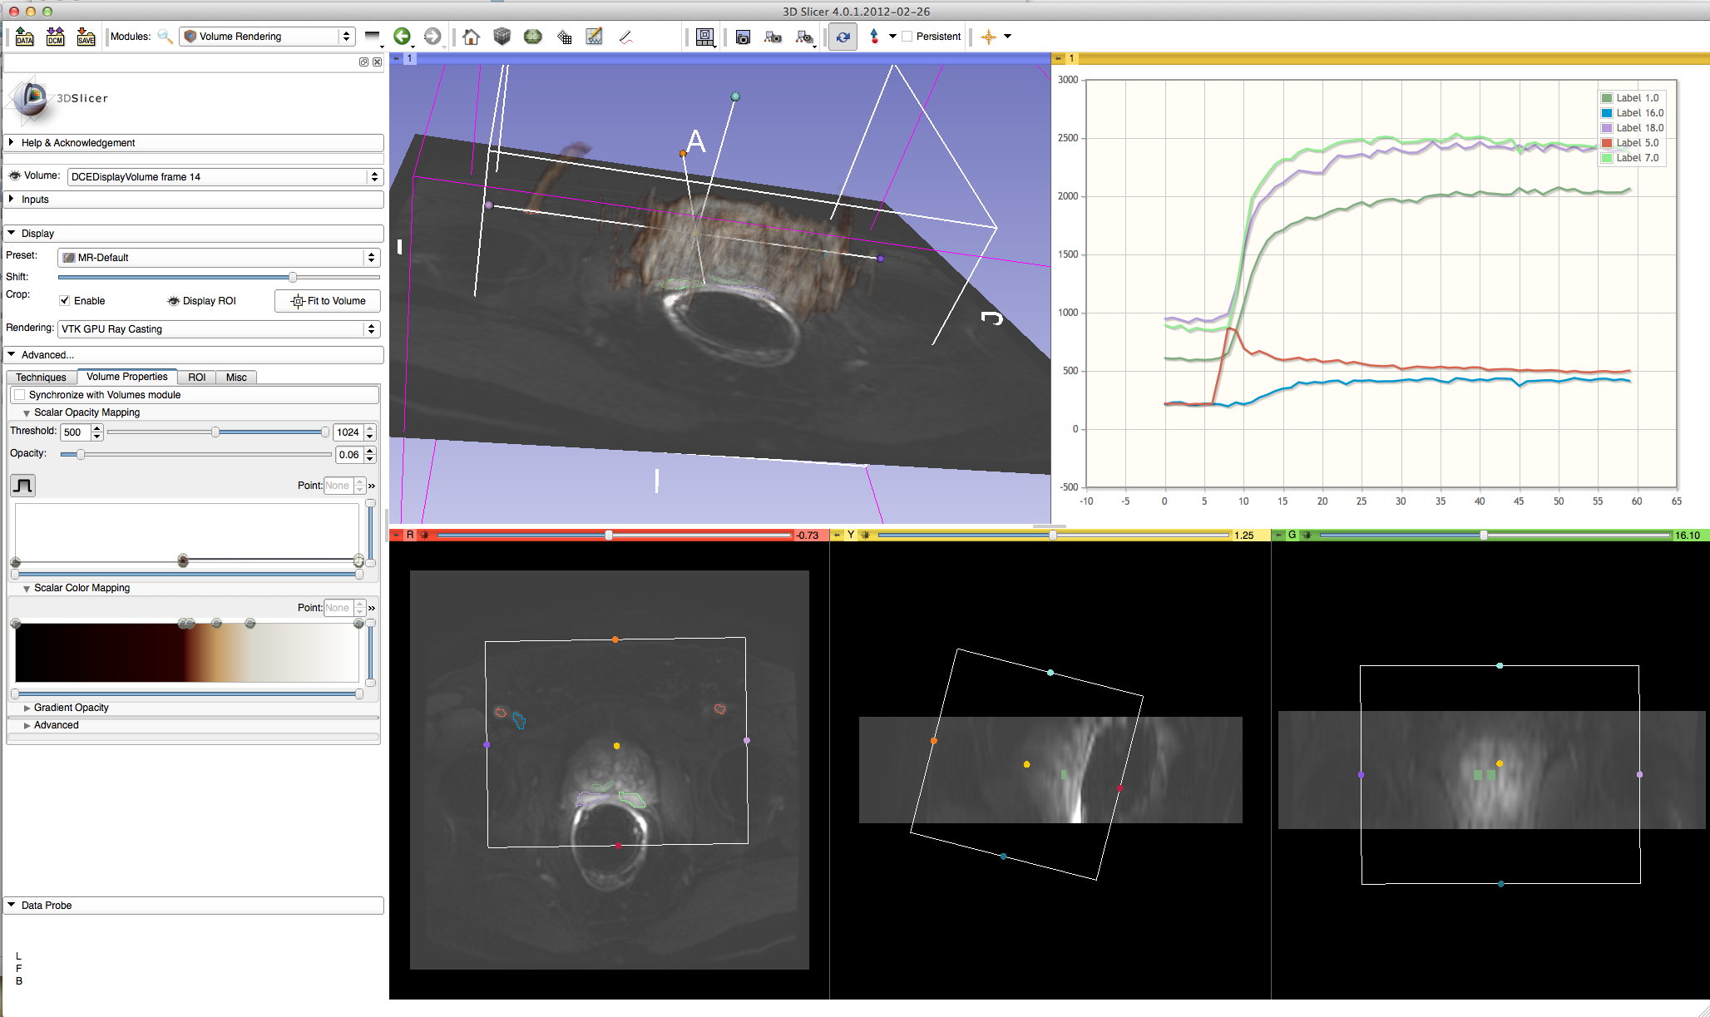
Slicer 4.4: Powerful Layouts
QIN Multiparametric Prostate Imaging (Fedorov, Fennessy)
Using CompareView
Charts
  Bars
  Lines
  Scatterplots

Slide 30
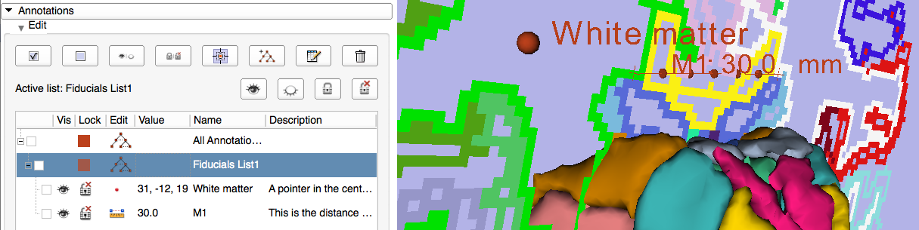
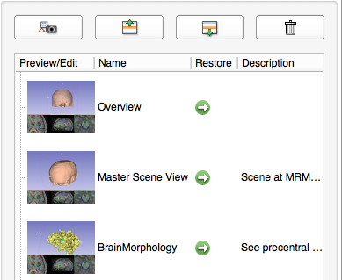
Slicer 4.4: Reporting
Markups
Sceneviews
Courtesy N. Aucoin

Slide 31
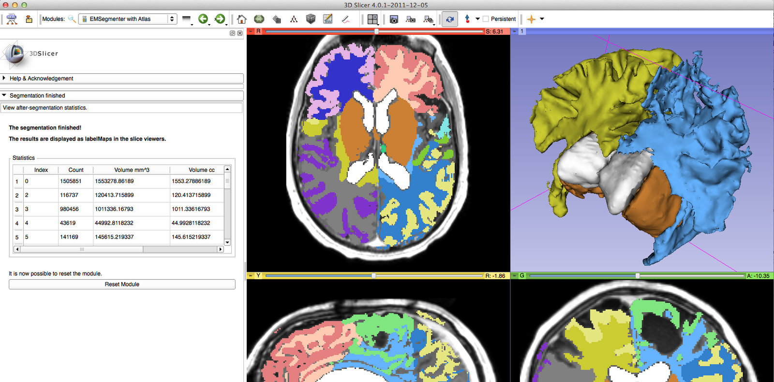



Slicer 4.4: Processing
Segmentation
Registration
dMRI
Courtesy K. Pohl, D. Meier, D. Wassermann

Slide 32




OpenIGTLink: Device API
Communication protocol for IGT
  Intraoperative imaging
  Optical tracking devices
  Robotic devices
  More
Image
Navigation software
Transform
Status
Command
Scanner
Tracking devices
Robot
Slide courtesy J. Tokuda

Slide 33
Conclusions
Medical Image Computing is a field with growing importance
Slicer is a versatile platform for subject specific analysis of biomedical image data
    www.slicer.org

Slide 34




URL’s
National Alliance for Medical Image
Computing
www.na-mic.org
Neuroimage Analysis Center
Nac.spl.harvard.edu
Surgical Planning Laboratory,
Brigham and Women’s Hospital
spl.harvard.edu
National Center For Image Guided Therapy
www.ncigt.org

