Slide 1


CARMA Registration
Salma Bengali, Alan Morris, Greg Gardner,
Josh Cates, Rob MacLeod
SCI Institute/CARMA Center
University of Utah
© 2012, All Rights Reserved

Slide 2
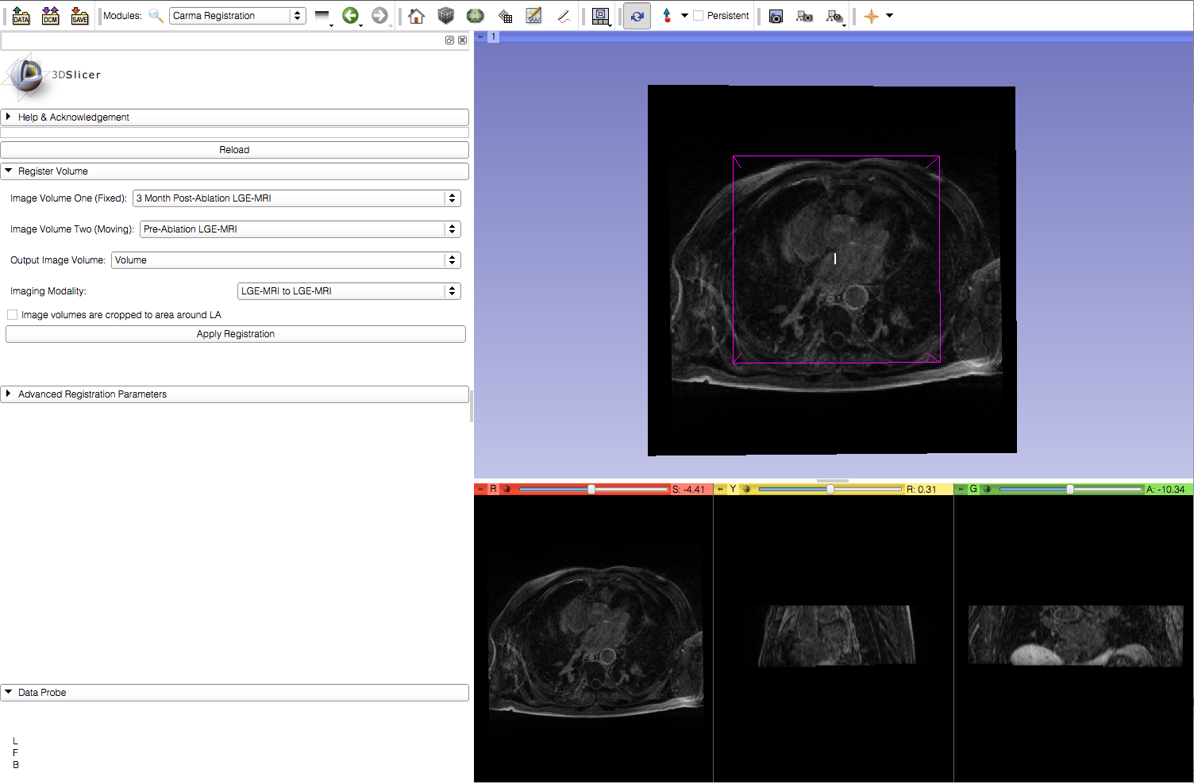
Learning Objective
Cardiac MRI image registration using BRAINSFit in Slicer
© 2012, All Rights Reserved

Slide 3
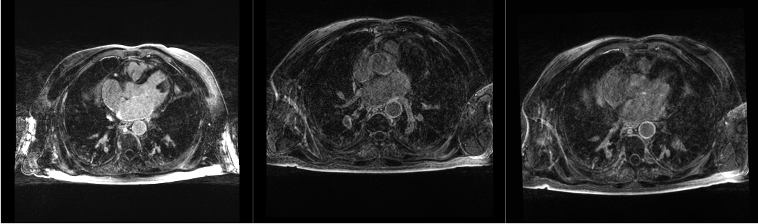
Current Workflow
Fixed Image
Moving Image
Registered Image

Slide 4
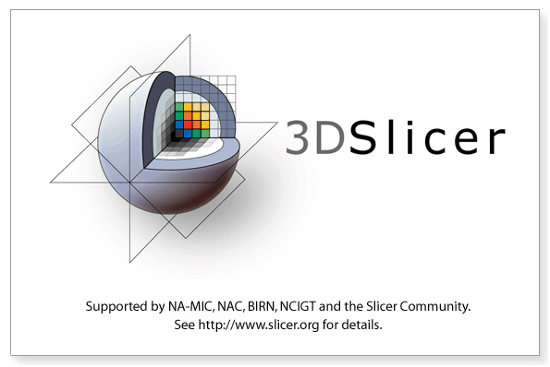
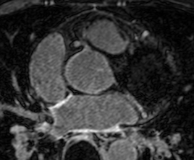
Required Materials
Slicer: Release 4.1
http://www.slicer.org/pages/Downloads/
Data: CARMA Slicer Extension Tutorial Data
http://hdl.handle.net/1926/1765
© 2012, All Rights Reserved

Slide 5

Additional Sample Data
60 patients
http://hdl.handle.net/1926/1757

Slide 6
Pre-requisite Tutorial
http://www.slicer.org/slicerWiki/index.php/Documentation/4.0/Training
© 2012, All Rights Reserved

Slide 7


Platforms
Developed
Tested
© 2012, All Rights Reserved

Slide 8
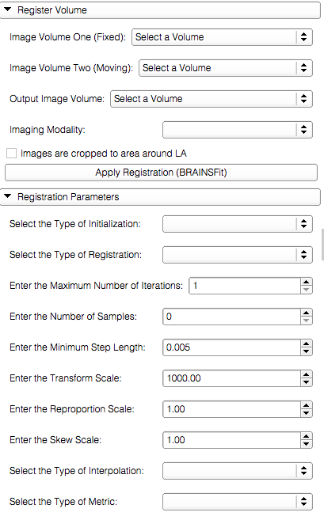
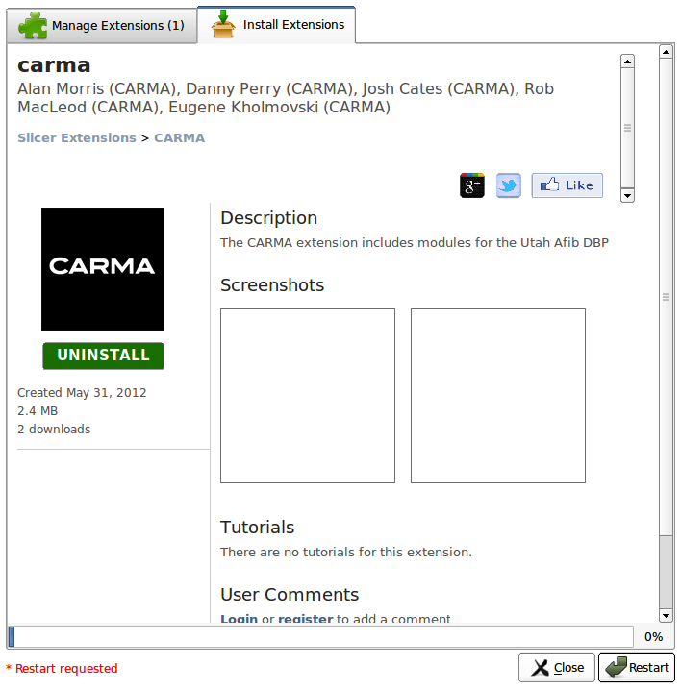
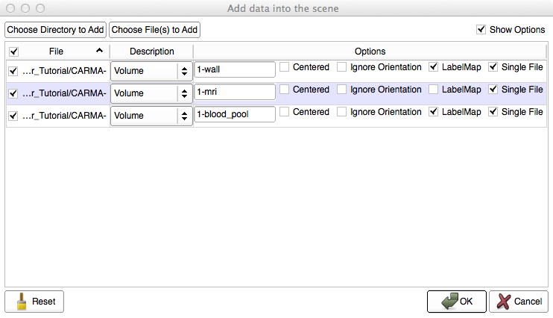
Overview
Load the module
Load the dataset
Image registration
© 2012, All Rights Reserved

Slide 9
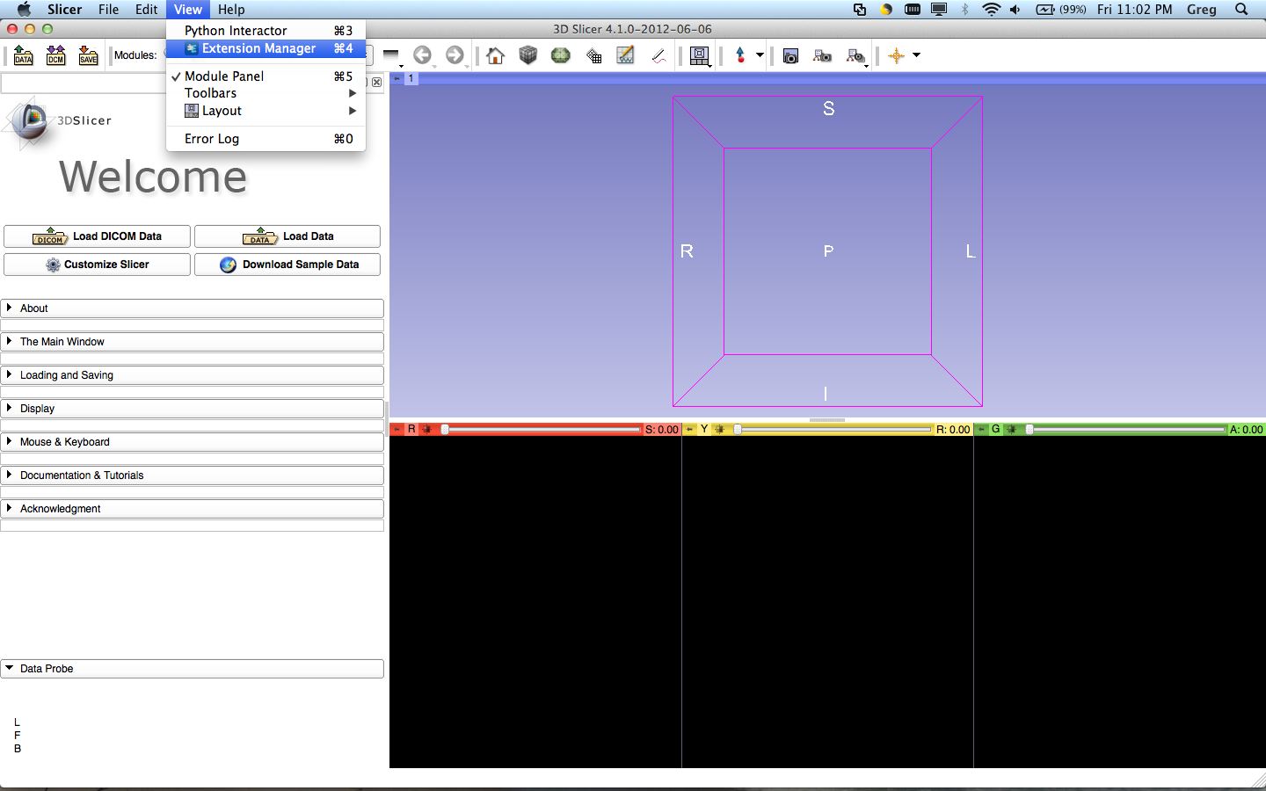
Loading the Module
Select View>Extension Manager in the menu bar (or push ⌘4)
If the Extension Manager isn’t revealed, see the next 2 slides; otherwise, skip them

Slide 10
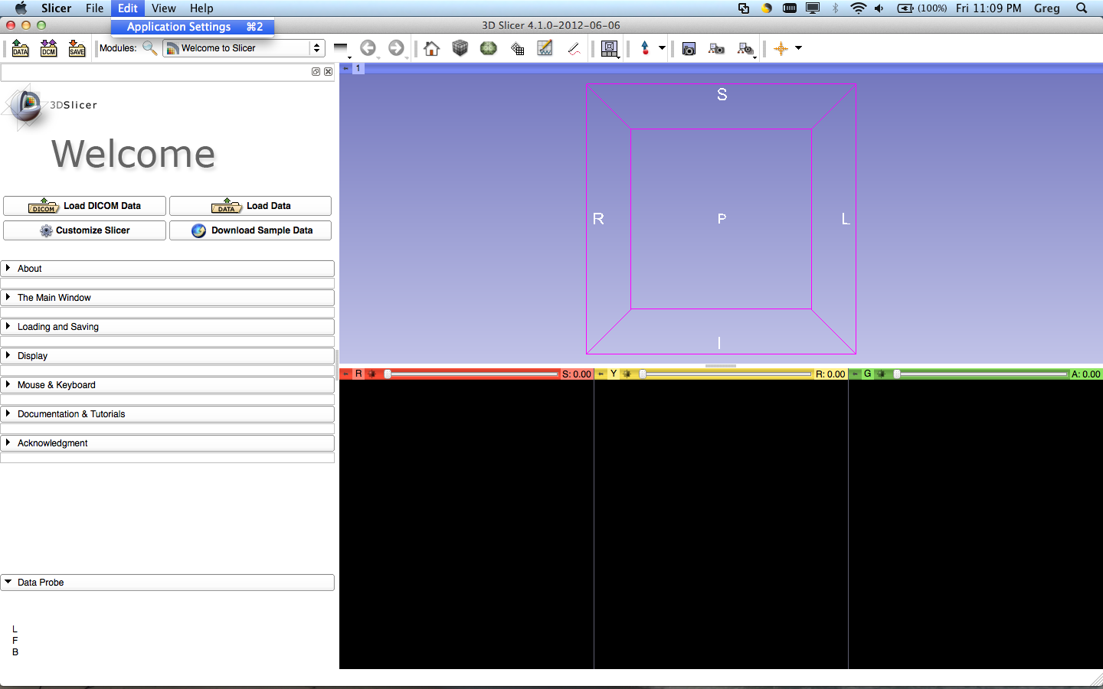
Loading the Module
To load the Extension Manager, Select Edit>Application Settings in the menu bar (or push ⌘2)

Slide 11
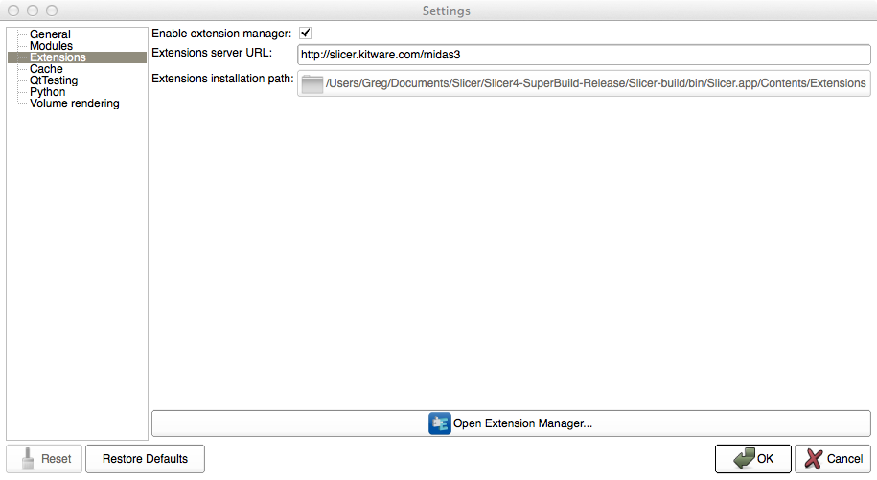
Loading the Module
Under the Extension menu, make sure ‘Enable extension manager’ is checked

Slide 12
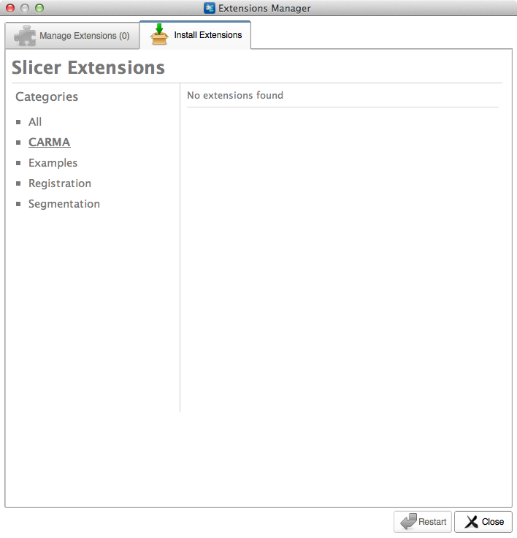
Loading the Module
Select CARMA in the sidebar and click the extensions

Slide 13
Loading the Module
Restart to install the extension

Slide 14
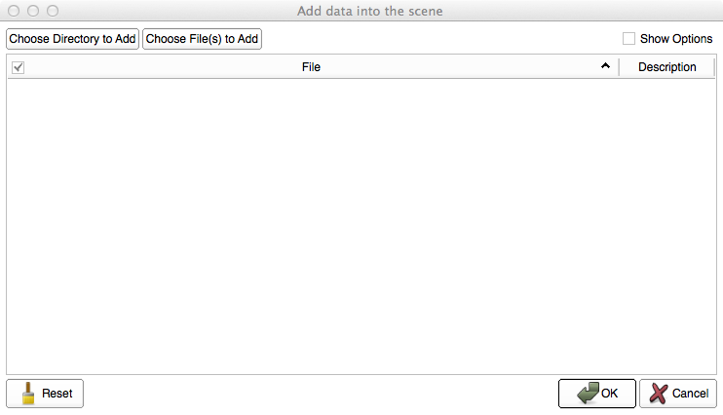
Loading the Data
Select ‘Choose Directory to Add’ in the pop-up menu

Slide 15
Loading the Data
Select the directory containing your dataset

Slide 16
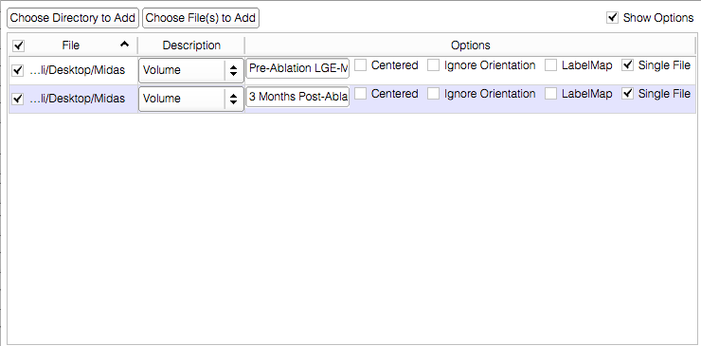
Loading the Data

Slide 17
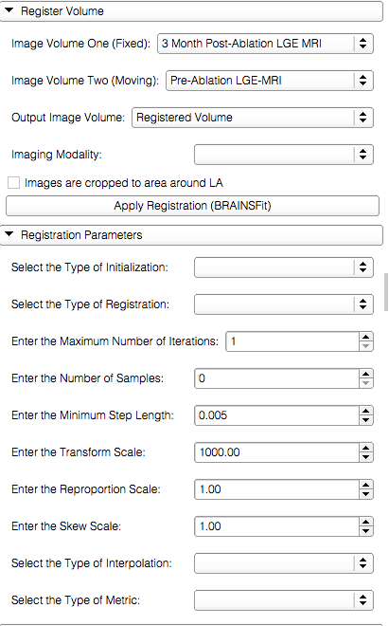
Image Registration
{
Input volumes
Output volume
Parameter Sets

Slide 18
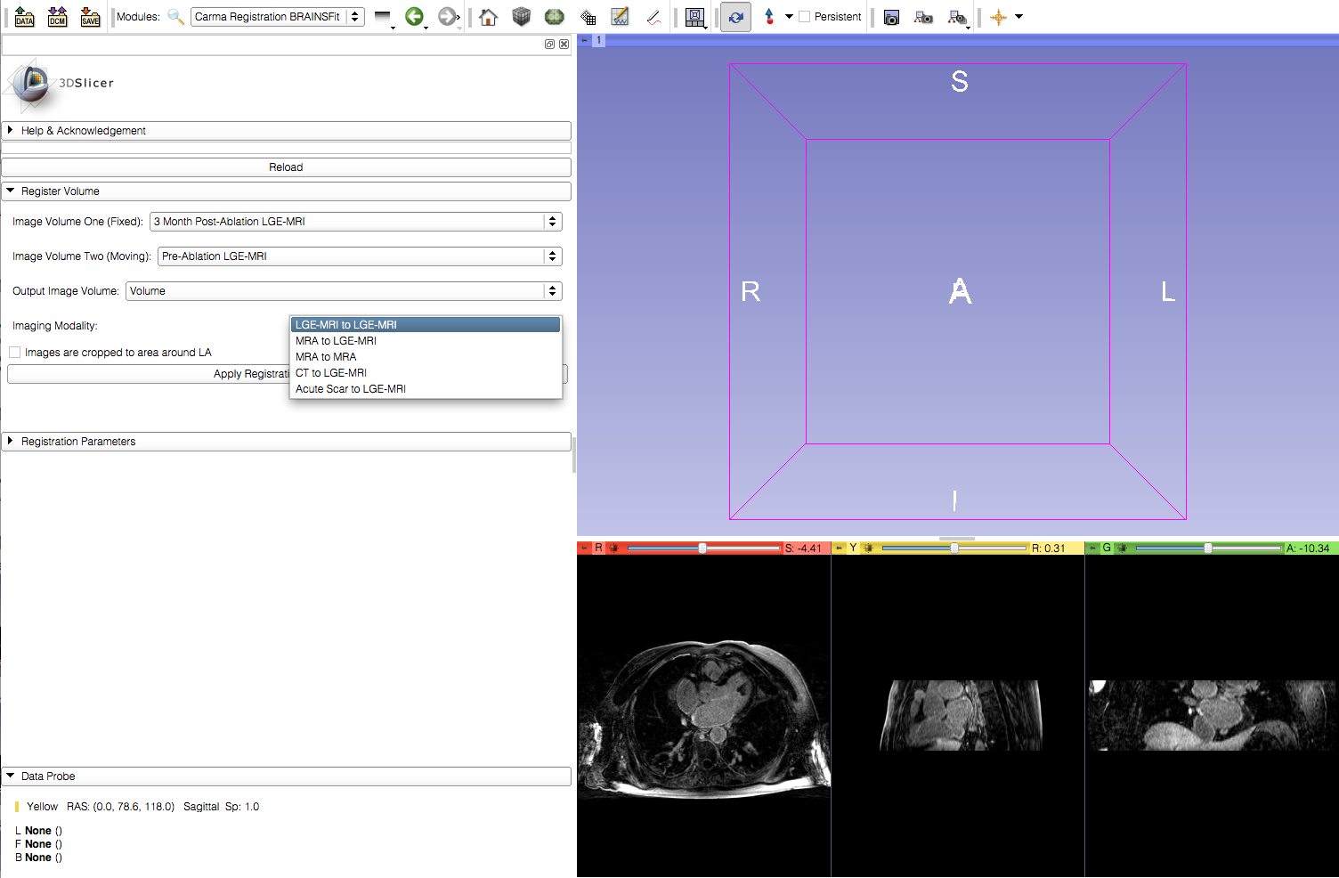
Image Registration
Under the Imaging Modality, select the appropriate option. (In this example it is LGE-MRI to LGE-MRI)

Slide 19
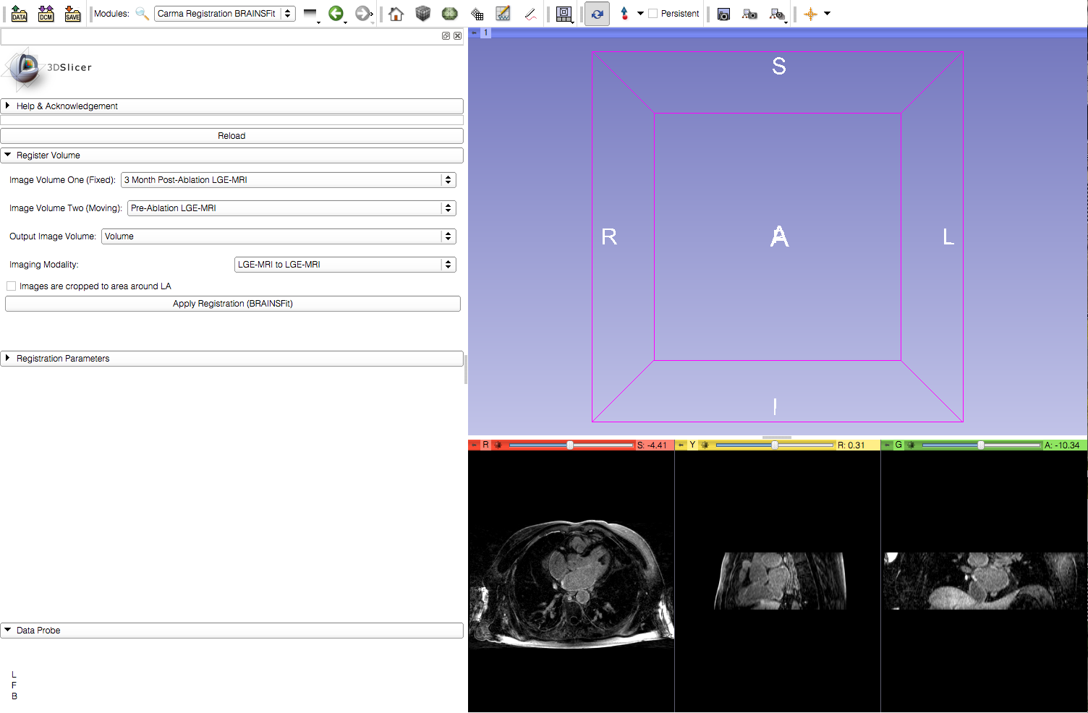
Image Registration
Indicate if input image volumes are cropped

Slide 20
Image Registration
Apply the registration

Slide 21
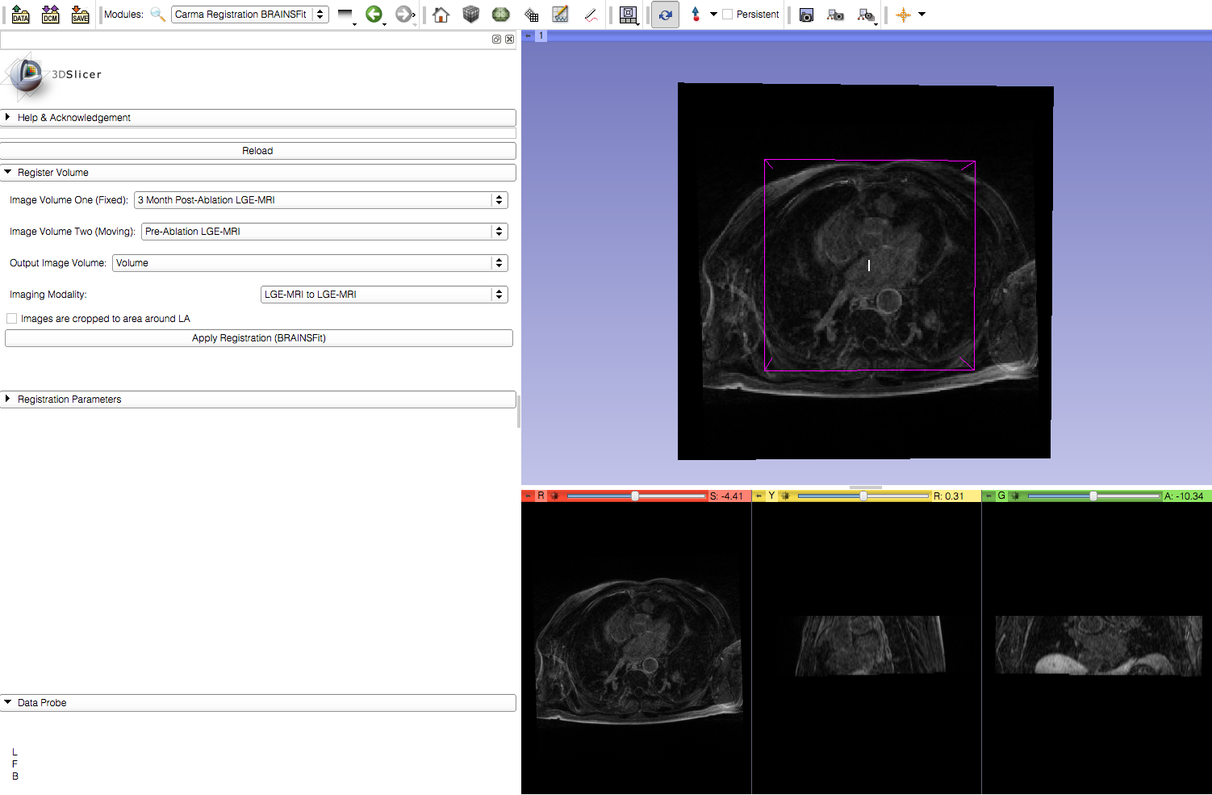
Image Registration
Viewer automatically updates to show the resulting output

Slide 22
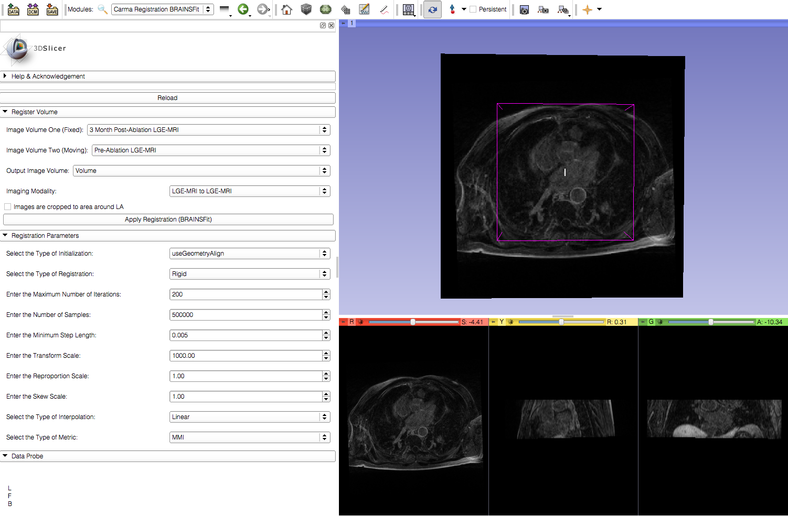
Image Registration
Advanced registration parameters can be adjusted to check for improvements in the registration result.

Slide 23
Conclusion
This module can be used to register two cardiac MRI image volumes using BRAINSFit.

