Slide 1

DTI Atlas Registration via 3D Slicer and DTI-Reg
Guido Gerig, UUtah
Martin Styner, UNC
Clement Vachet, UNC

Slide 2
DTI Registration
This tutorial teaches you how
  Load DTI datasets & masks
  Perform a pair-wise registration to a prior atlas via DTI-Reg
    Affine transform and deformable transform
  Save the transformed images and the deformable transform

Slide 3
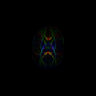
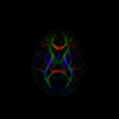
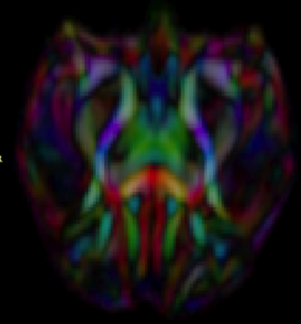
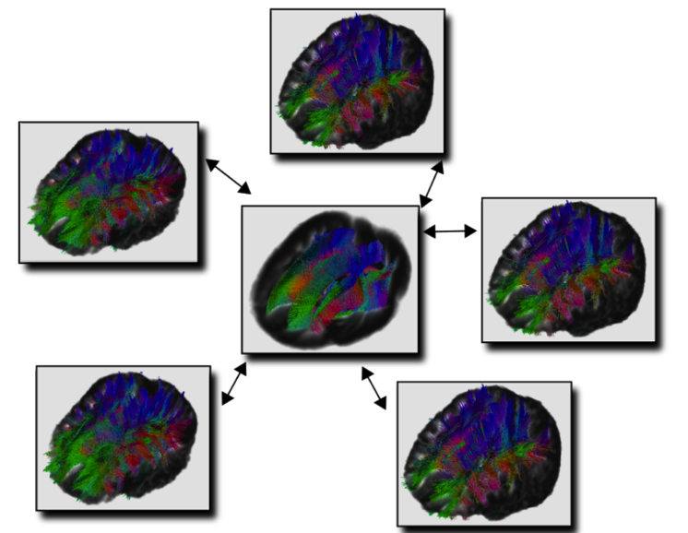
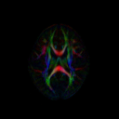
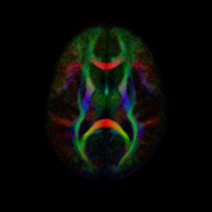
DTI Population Atlases
Definition of standard space
SNR increase
Better tractography
Neonate
1 year
Rhesus (15mo)
2 year
Adult

Slide 4

Dataset
For this tutorial you will need some DTI data files that can be found on this link :
http://hdl.handle.net/1926/1759

Slide 5
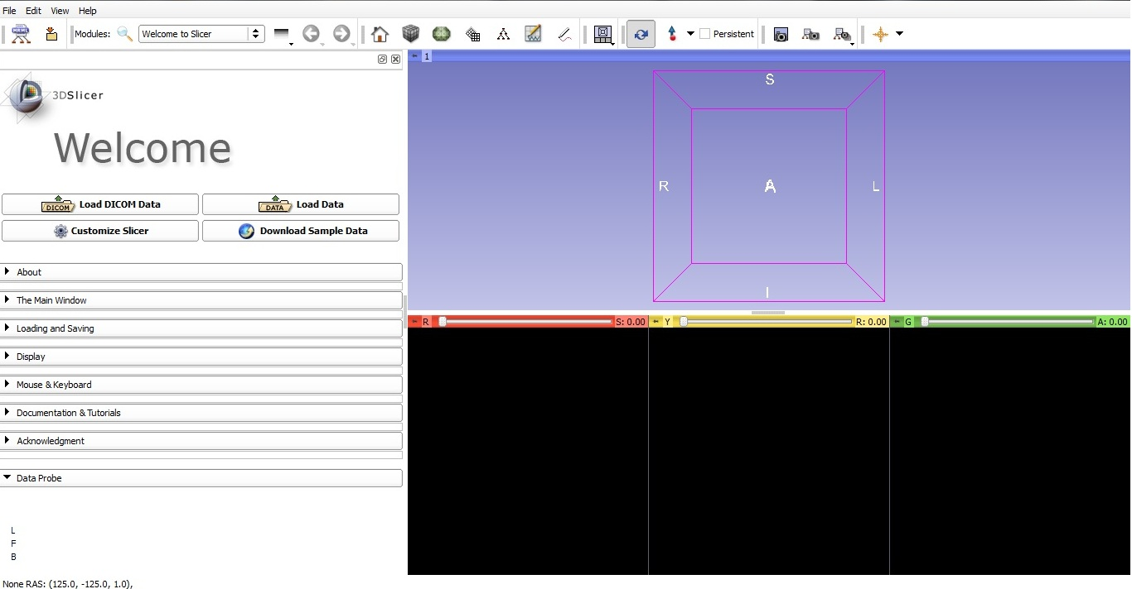
Start Slicer 4
Linux/Mac users :
Launch the Slicer
executable located in
the Slicer4 directory
Windows users :
Select Start→All Programs→Slicer4.0.1→Slicer
Or launch the Slicer executable from Slicer4 directory

Slide 6
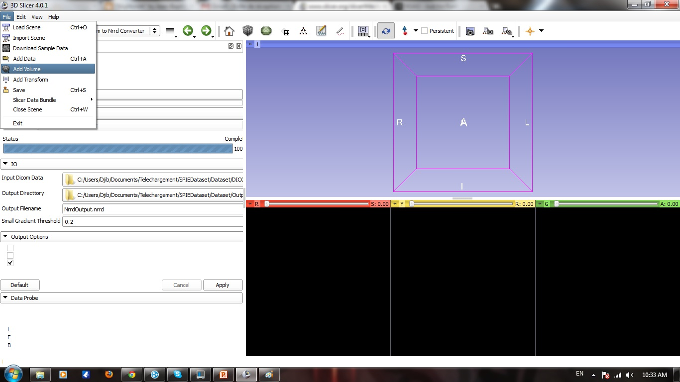
Loading DTI Atlas
Left click on file menu
Left click on Add Volume

Slide 7
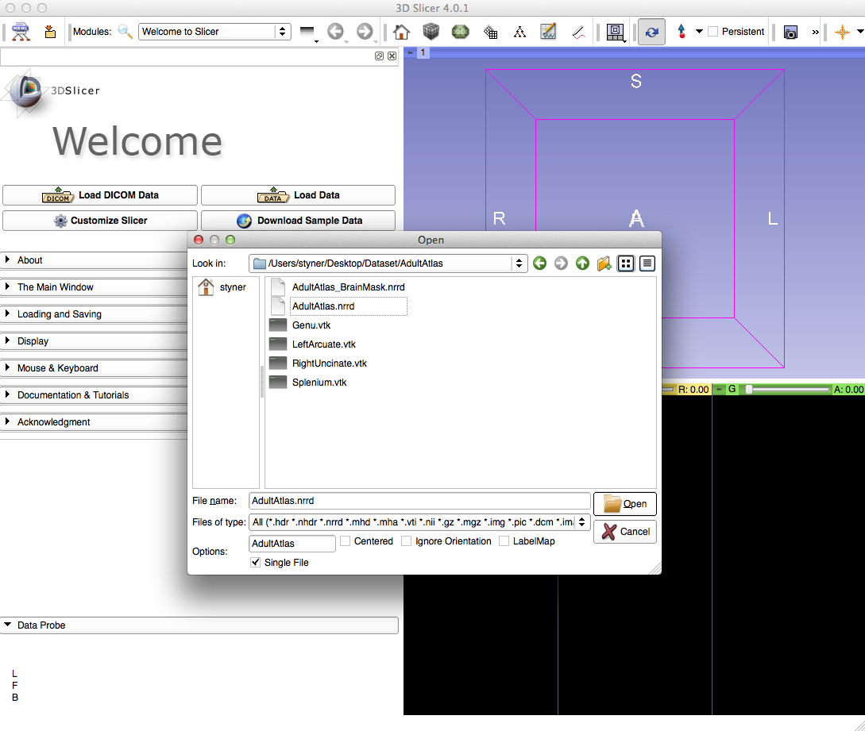
Loading DTI Atlas
Select the AdultAtlas.nrrd volume

Slide 8
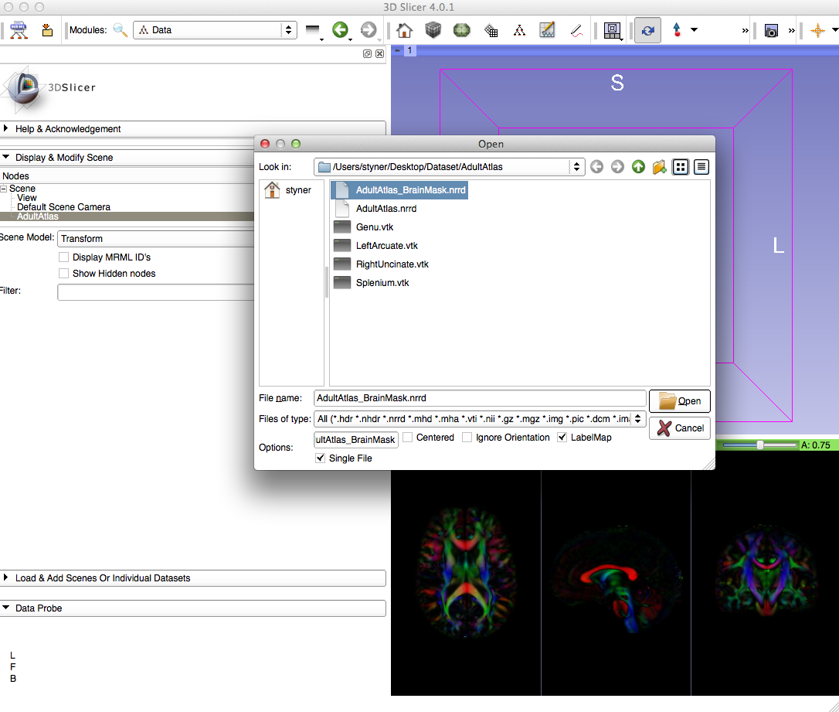
Loading DTI Atlas Mask
Load AdultAtlas_BrainMask.nrrd label map

Slide 9
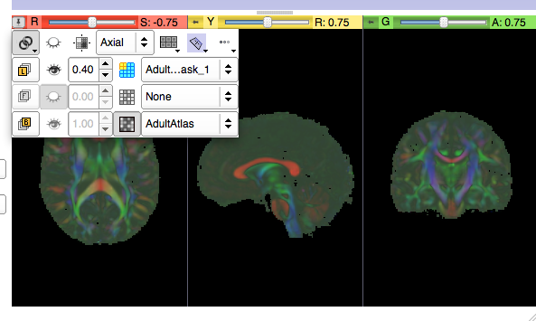
Adjust View
Adjust view to see both mask and atlas
Link all 3 viewers
Opacity change
1
2

Slide 10
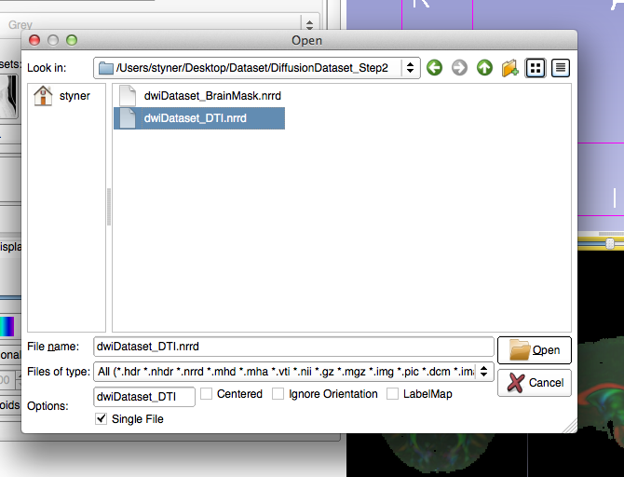
Loading DTI dataset
File Menu =>Add Volume (or use from previous tutorial)
DiffusionDataset_Step2
Load DTI NRRD

Slide 11
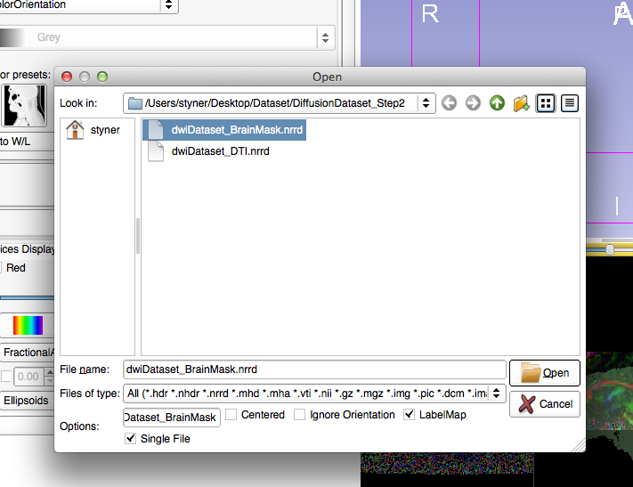
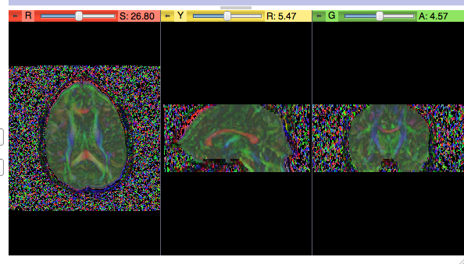
Loading DTI dataset mask
File Menu =>Add Volume (or use from previous tutorial)
DiffusionDataset_Step2
Load BrainMask
“LabelMap” checkbox

Slide 12
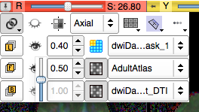
Overlay DTI datasets
How can we check alignment?
Overlay the DTI images!
Select AdultAtlas for Foreground
Set Opacity to 0.5
2
1

Slide 13
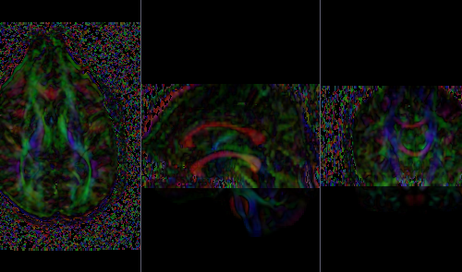
Overlay
Bad alignment: 2 separate corpus callosum

Slide 14
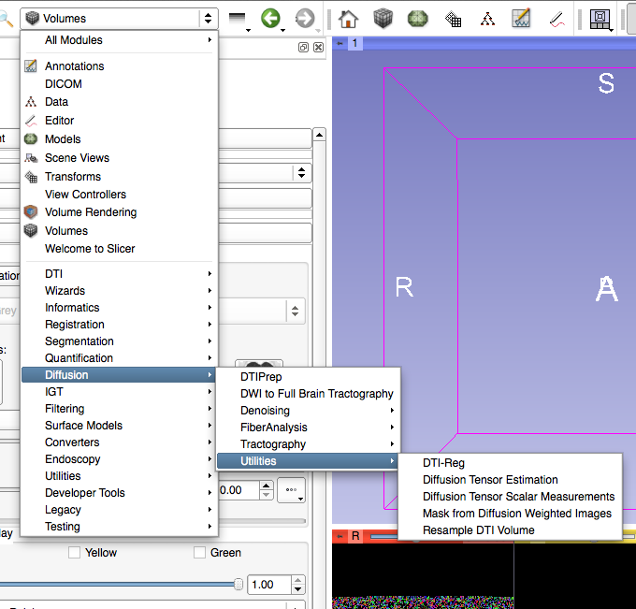
Select DTI-Reg Module
Slicer modules
  Diffusion
  Utilities
  DTI-Reg
Pairwise DTI registration module

Slide 15
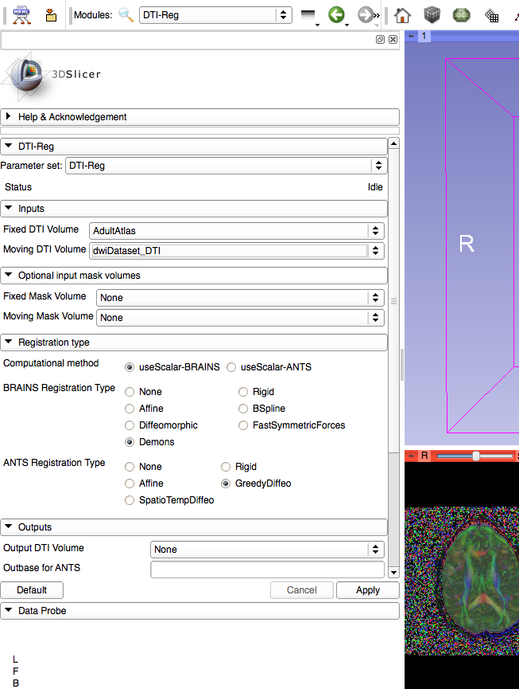
Volumes for Registration
Fixed Volume = Target of registration = Atlas DTI
Moving Volume = DTI dataset
1
2

Slide 16
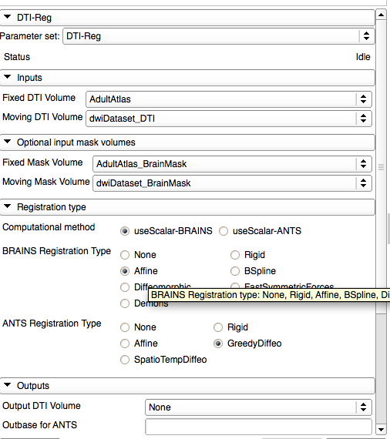
Set Masks for Registration
Set Fixed Mask to Atlas Mask
Set Moving Mask to dwiDataset Mask
1
2

Slide 17
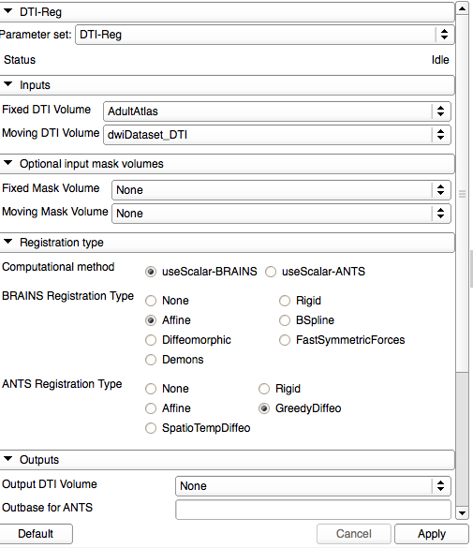
Set Transform to Affine
Set registration transform to Affine
Registration is performed in 2 steps
Future versions: all in 1 step
If you have ANTS pre-installed => select it!

Slide 18
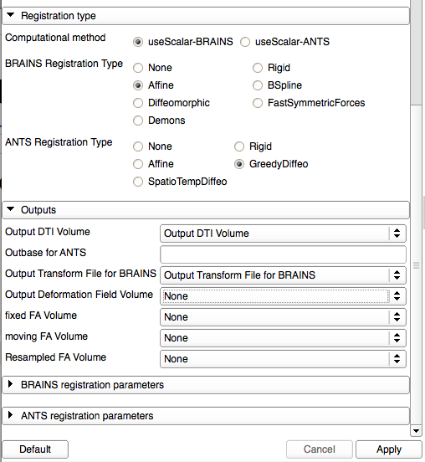
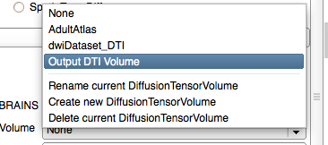
Select Outputs
Create & rename volumes for output
Affinely registered DTI dataset
Affine transform
Apply to run & wait
1
2

Slide 19
Registration
Many pairwise methods exist
DTI-Reg supports several registration methods based on calibrated FA image
    Affine, B-spline, Demons-variants from within Slicer
    ANTS as external call (necessitates ANTS installation)
Future versions will also support DTI-TK
  Registration based on full tensor

Slide 20
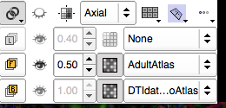
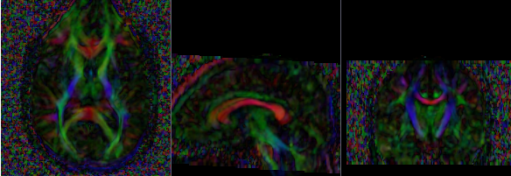
Affine Results
Select DTI-Reg result as background
Result: single corpus callosum, but fuzzy, insufficient registration

Slide 21
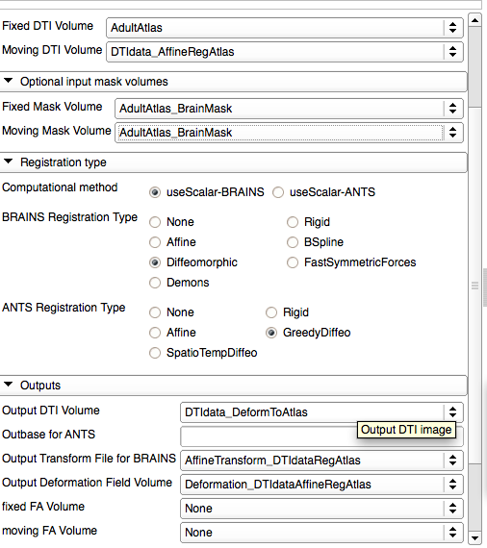
Deformable Registration
Change moving volume to affinely registered data
Change moving mask to atlas mask
Change registration to Diffeomorphic (Demons)
Add Deformation volume outputs
1
2
3
4
5

Slide 22
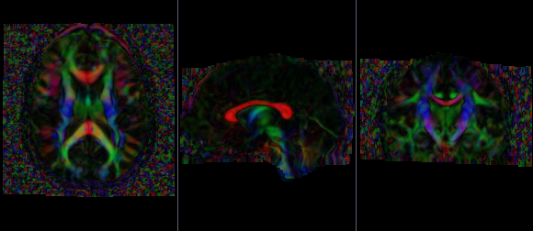
Deformable Results
Select DTI-Reg deformable result as background
Result: No longer fuzzy, great registration

Slide 23
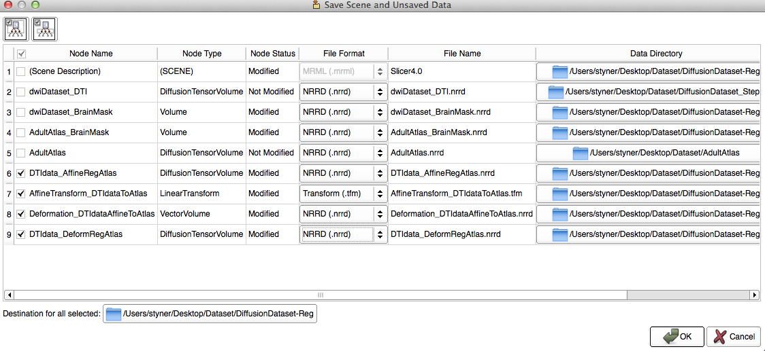
Save Outputs and Done
Save all volumes and transform
  Need: Affinely registered volume & Deformation field

Slide 24
Conclusions
DTI registration is available in Slicer
2-step process currently, to be improved soon
Brainmasks are needed (unless data is skull stripped already)
This tutorial taught you how to register to an atlas
  Next step: how to use the atlas for fiber base analysis

Slide 25
Acknowledgment
National Alliance for Medical Image Computing
NIH U54EB005149
UNC: Jean-Baptiste Berger, Clement Vachet

