Slide 1
CARMA Shrink Wrap Filter Tutorial
CARMA Center
The University of Utah

Slide 2
Overview
This module generates a mask that includes the left atrium endocardial region minus the pulmonary veins
The output of this module can be used to calculate the early diastolic (peak) volume of the left atrium

Slide 3
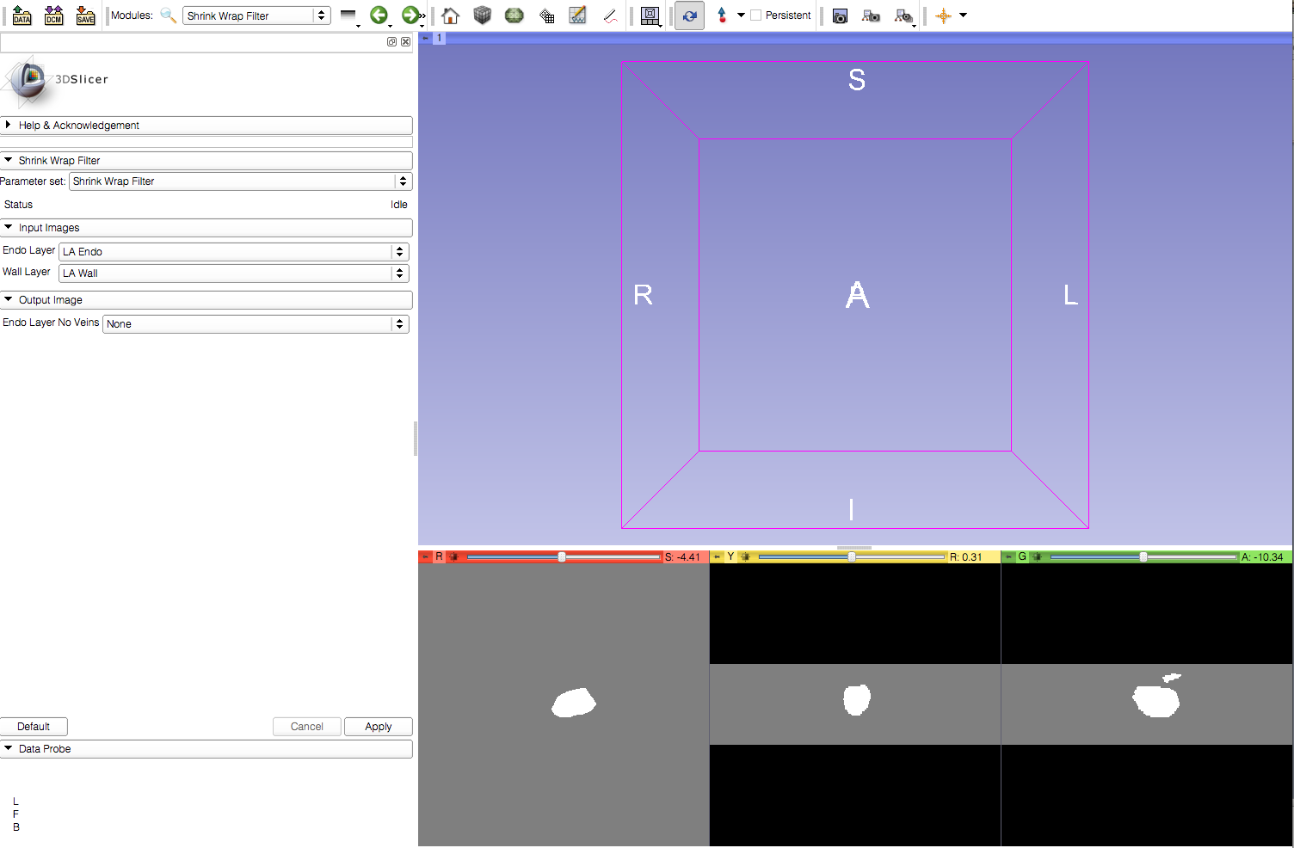
Step 1: Load Images

Slide 4
Step 2: Create Output Image File

Slide 5
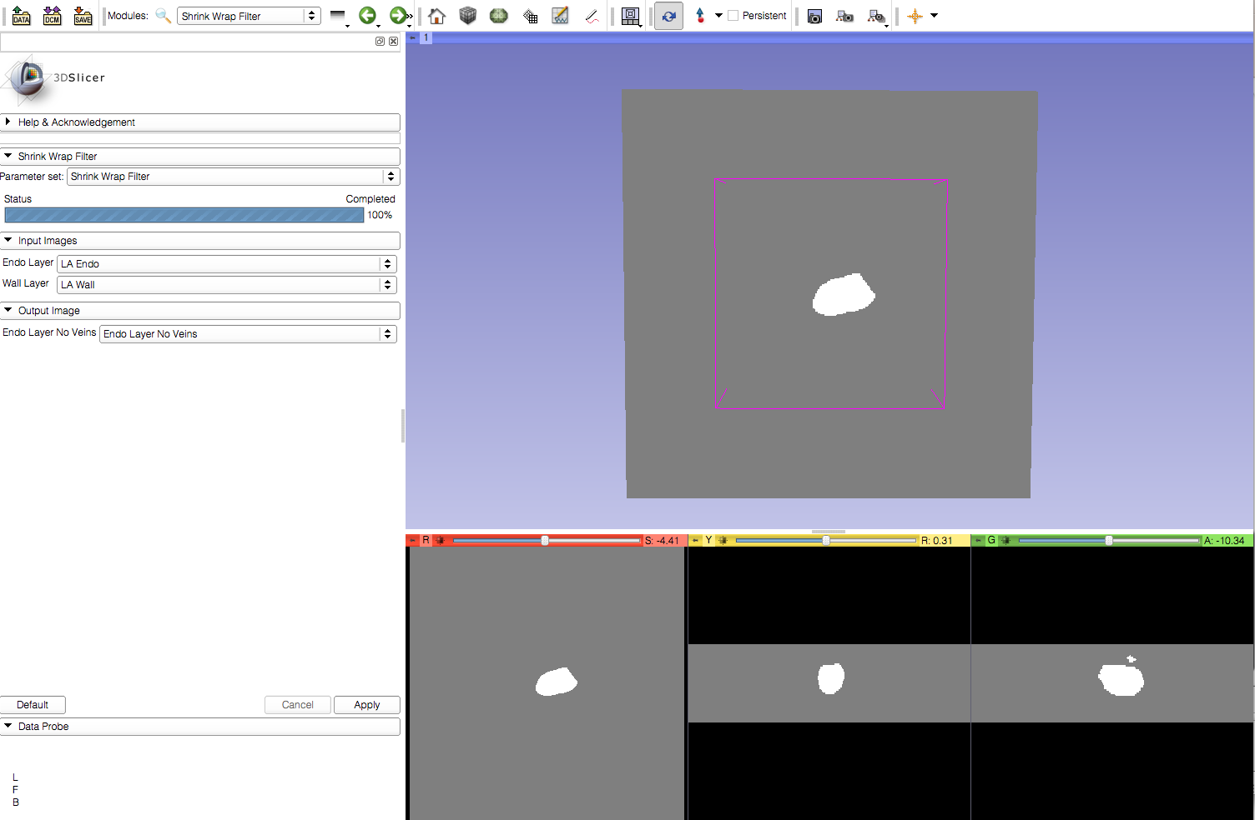
Step 3: Apply Shrink Wrap Filter

