Slide 1
Algorithms Core (C1a)
Five investigators:
A. Tannenbaum (BU), P. Golland (MIT), M. Styner (UNC), G. Gerig (Utah), R. Whitaker (Utah)
Regular interactions with DBPs
In total: ~5 formal in-person visits, ~10 tcons, lots of informal meetings and correspondence
Engineering Core Interactions
PIs, students, staff at Project Weeks
Ad hoc t-con participation

Slide 2
Algorithms Core (C1a)
Core 1 Interactions
Project weeks
Monthly t-cons
Annual retreat (Oct. 2011, Mass; Aug. 2012, Utah)
Includes students, fellows, guests
Conference venues
IPMI 2011, MICCAI 2011

Slide 3
NAMIC Activities – Utah
Image/Shape Analysis
Volumetric tractography and DTI atlases
Robust correspondences for shape
Longitudinal shape analysis
Segmentation
Globally optimal surface estimation
Fast, feature/shape-based image lookup
Registration
Robust metrics for image match
Nonsmooth regularizers
HD
AF
HNC
TBI

Slide 4
Volume Tractography
DTI Atlases to define ROIs
Goodlet et al.
Volumetric tractography for white matter regions
Fletcher et al.
Group analysis on volumetric regions

Slide 5
Robust Shape Correspondences
Datar et al. 2011
Statistics of points and normals
Geodesic distances for point-to-point interactions
LV – Ischemic vs normal controls

Slide 6
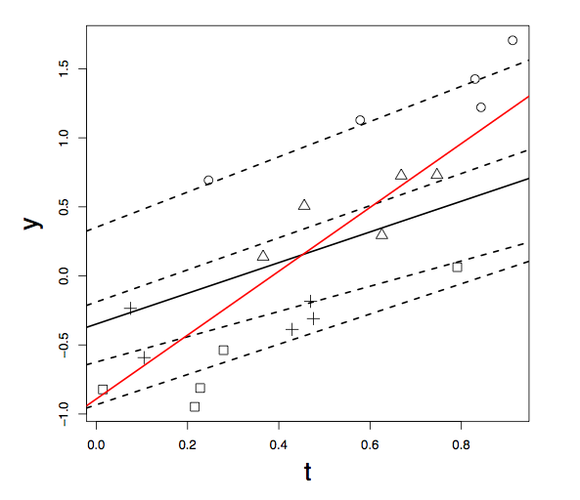
Longitudinal Shape Parameterization with T. Fletcher, M. Datar
Mixed effects model
Hierarchical–properly accounts for staggered/missing data in individuals
Left atrium trend – before and after ablation

Slide 7
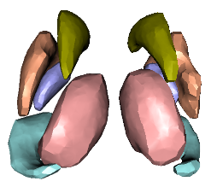
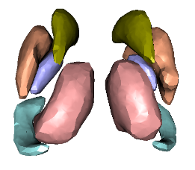
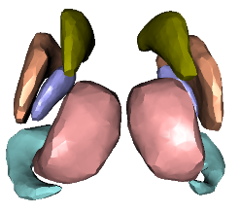
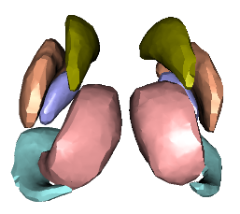
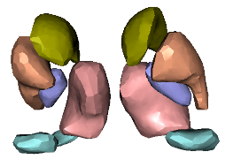
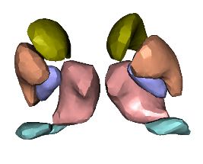
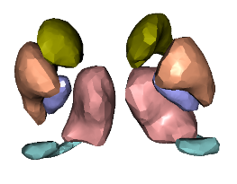
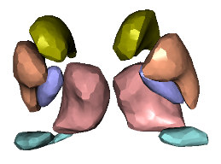
Applications: Iowa/HD

Slide 8
Segmentation
Graph-based image segmentation
Represent surfaces a min-cut in properly ordered graph
Liu et al. 2009
Challenges
Objective functions that capture features, smoothness, coupled surfaces
Generalizations to 3D shapes

Slide 9
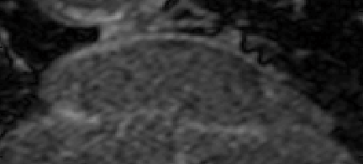
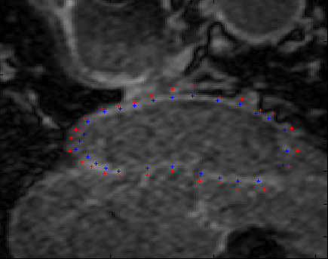
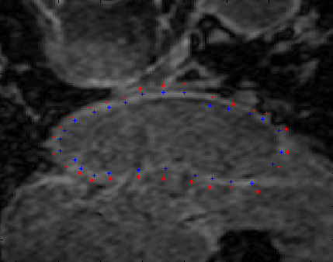
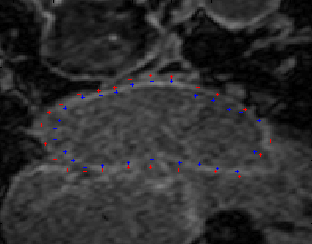
Segmentation: Afib/Utah

Slide 10
Fast Nearest Neighbor Lookup
Problem: from a large database of images, most similar images combine to form best segmentation
Label voting or nonparametric modeling paradigm
Especially important for heterogeneous data
Head&neck, cardiac
How to find similar shapes?
Deformation (slow)
Feature-based query (fast)
Zhu et. al, MICCAI 2010

Slide 11
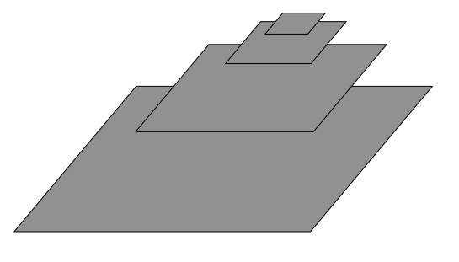
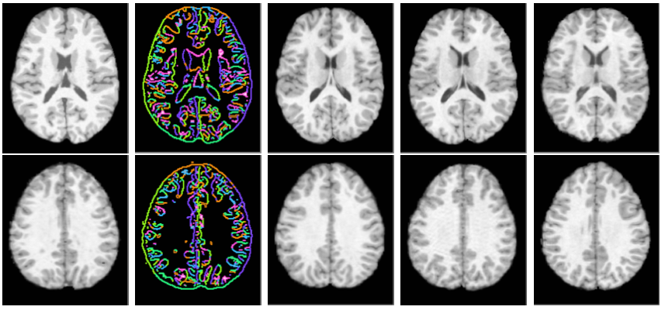
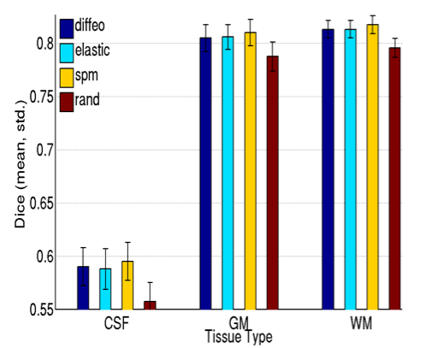
Feature-Based Lookup
Strategy
Detect features and compare hierarchically
Pyramid matching (Grauman 2006)
Brain MRI for label-based segmentation

Slide 12
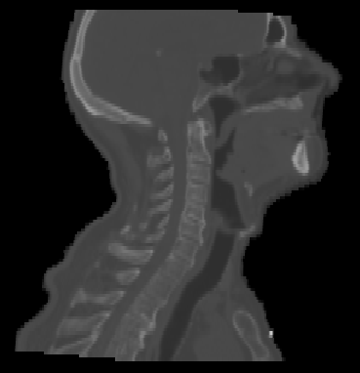
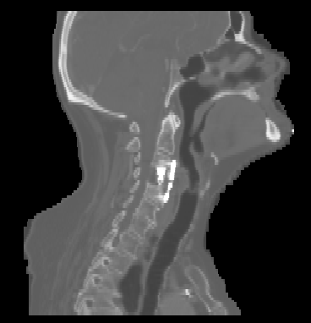
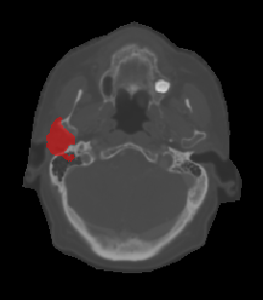
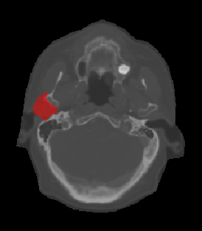
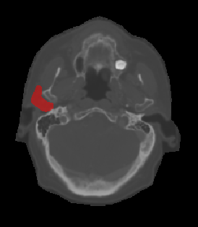
Fast Image Lookup: HNC
parotid
gland
9 images
3 best images
ground truth

Slide 13
Robust Image Registration
Applications
Correspondence or coordinate system for comparing different individuals or times
E.g. recovery from TBI, Afib before and after ablation
Segmentation from atlases or label voting
E.g. head and neck, endocardium from DCE
Challenges
Nonsmooth transformations
Singularities, tearing, sliding
Outliers/mismatches

Slide 14
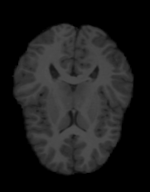
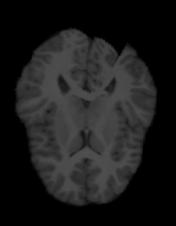
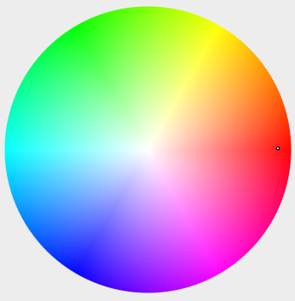
Registration Formulation

Slide 15
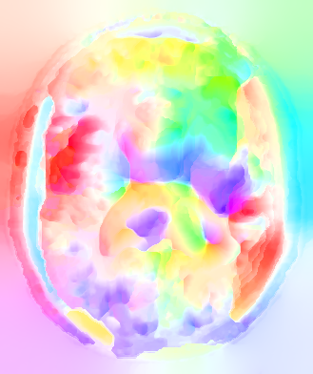
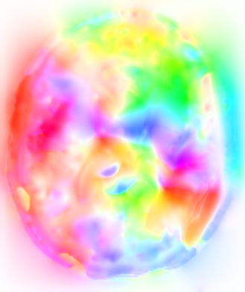
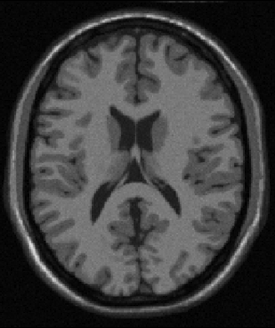
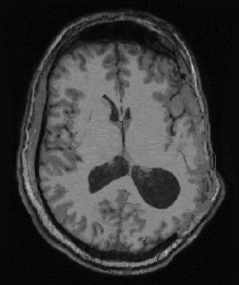
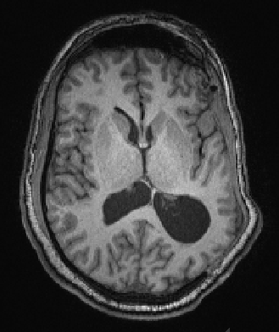
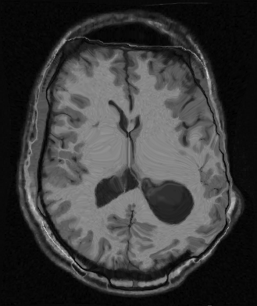
Registration: TBI/UCLA
TV Regularization
Elastic
Control/Template
TBI Patient
TV Regularization
Elastic

