Slide 1
CARMA Registration (BRAINSFit)
CARMA Center
The University of Utah

Slide 2
Overview
Implementation of case-specific registration for cardiac LGE-MRI, MRA and CT images using the BRAINSFit module
User selects the imaging modalities and the registration parameters are automatically set
Parameters can be adjusted if required to check improvements in registration

Slide 3
Steps to Registration
Step 1: Load image volumes to be registered
Step 2: Select imaging modality
Step 3: Indicate whether or not image volumes are cropped to area around left atrium
Step 4: Apply BRAINSFit registration
Step 5: (Optional) Adjust advanced registration parameters if required

Slide 4
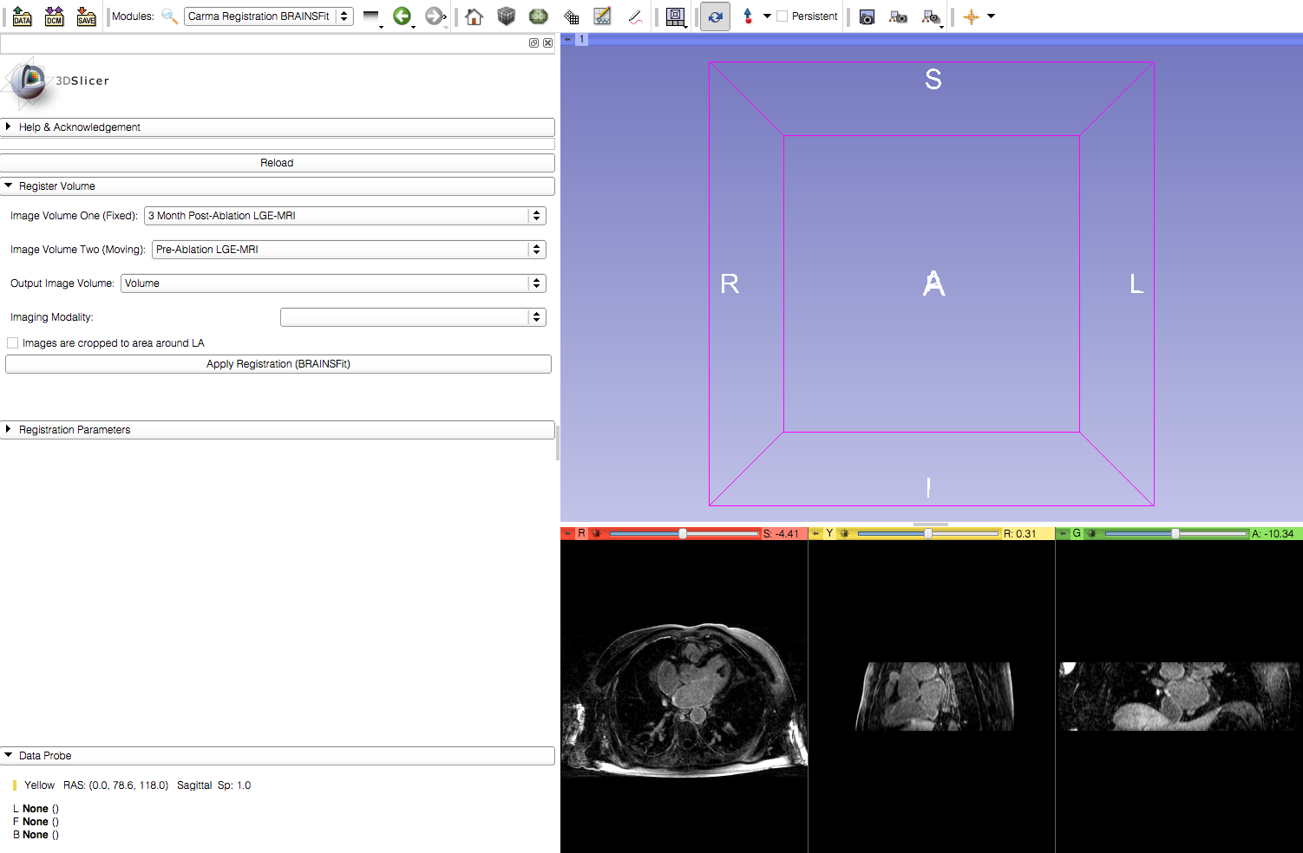
Step 1: Load Image Volumes

Slide 5
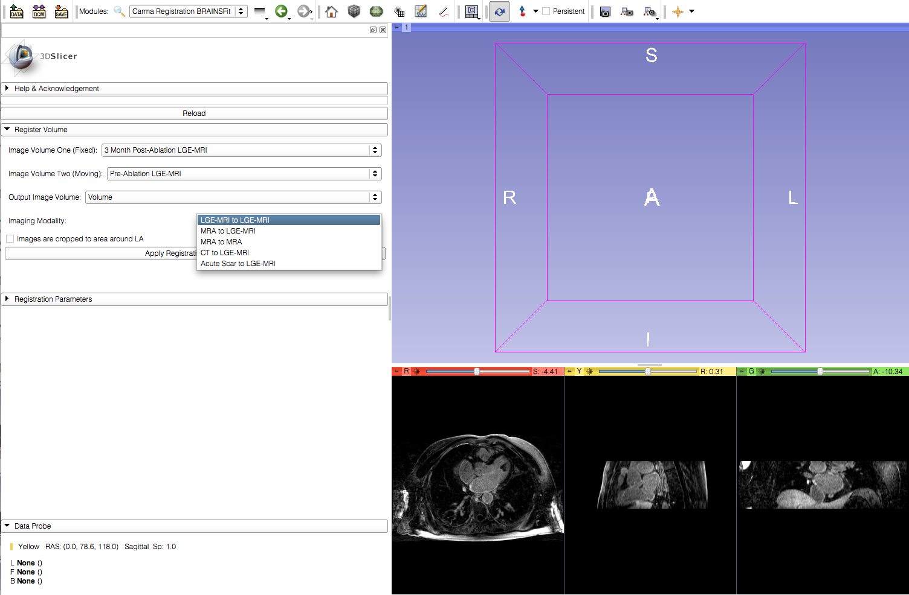
Step 2: Select Imaging Modality

Slide 6
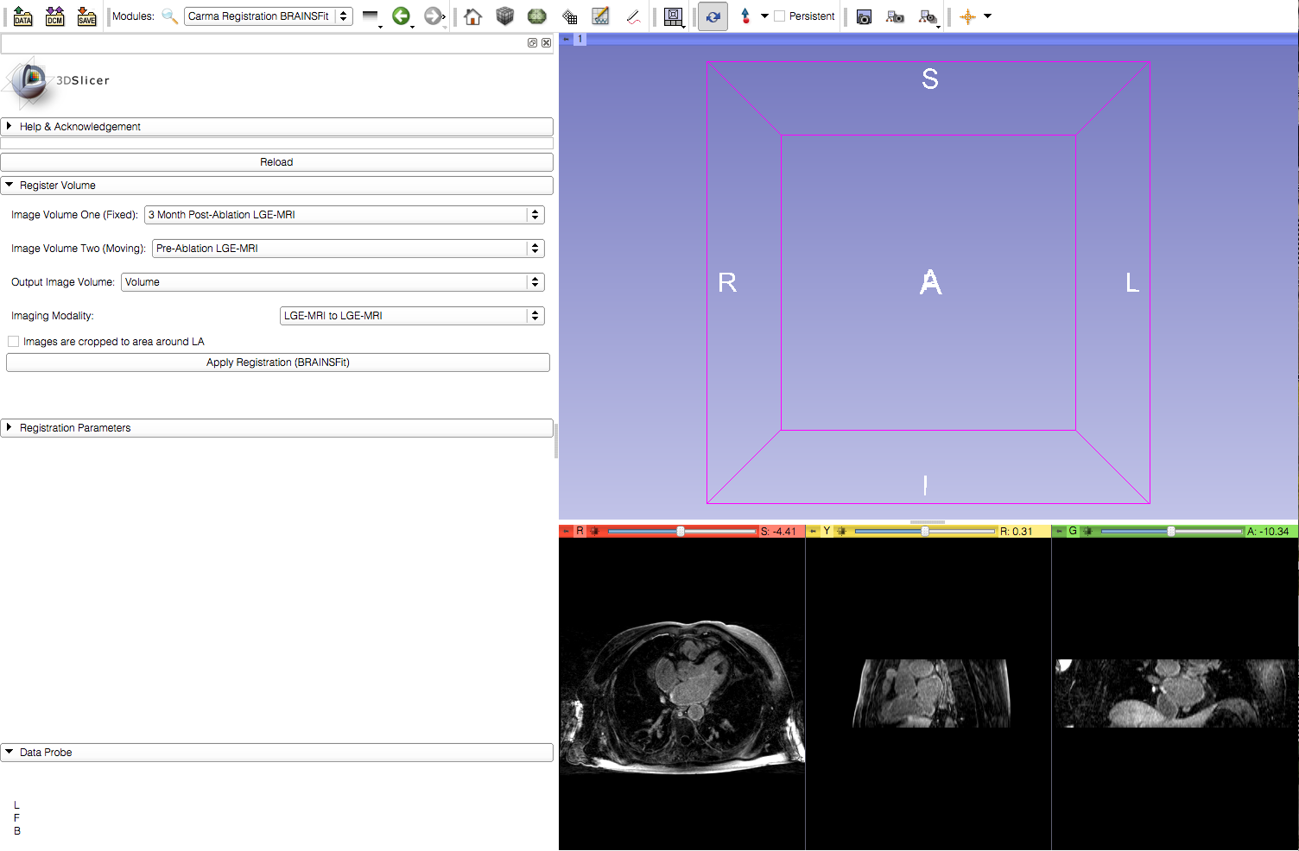
Step 3: Indicate If Images Are Cropped

Slide 7
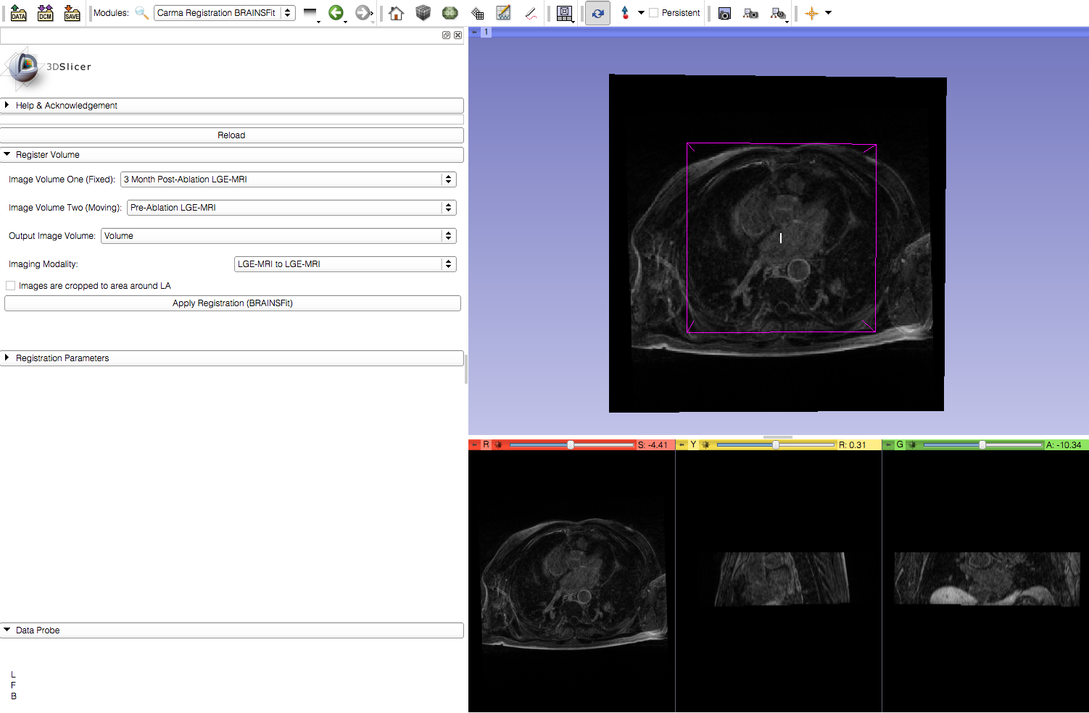
Step 4: Apply Registration

Slide 8
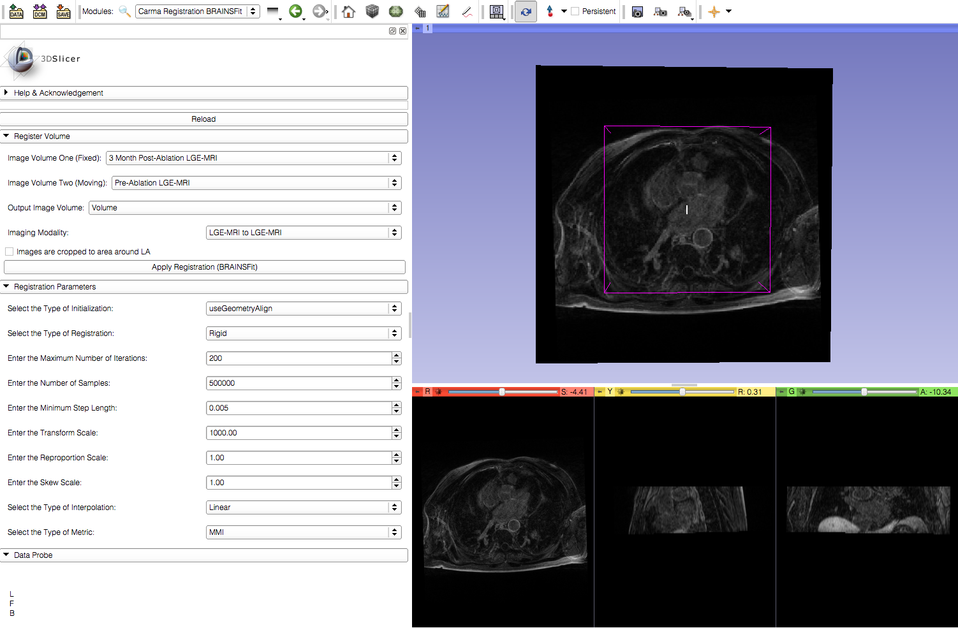
Step 5: (Optional) Adjust Advanced
Parameters

