Slide 1
Longitudinal and Time-Series Analysis
Everyone in NA-MIC Core 1 and 2

Slide 2
Main goal
“Methods and tools for statistical and geometric analysis that operate on multiple images acquired over time.”
Longitudinal & Time series analysis
Joint segmentation at multiple times
Joint evaluation of shape and function
Notes:
the statistical power of comparisons benefit from subject-specific analysis, and allow one to apply time-series analysis (9, 32-35). Second, the availability of longitudinal data presents an opportunity to leverage images at multiple time points for segmentation (36-40) and evaluations of shape and function (41-43), and thus adds a dynamic aspect to the process that can be useful in recognition

Slide 3
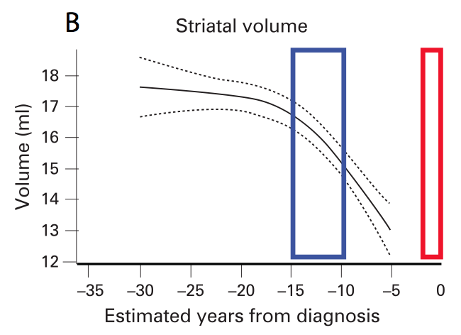
DBP Goals
In all DPB’s
Longitudinal data
Monitor change across time
Analysis of recovery for each patient (TBI)
Predict onset of clinical symptoms (HD)
Effect of treatment (Cancer/Atrial Fib)
Consolidate individual changes into a population model of change.
Notes:
First, when the progression or time behavior of a condition is an important component of the differences between groups, the statistical power of comparisons benefit from subject-specific analysis, and allow one to apply time-series analysis (9, 32-35). Second, the availability of longitudinal data presents an opportunity to leverage images at multiple time points for segmentation (36-40) and evaluations of shape and function (41-43), and thus adds a dynamic aspect to the process that can be useful in recognition (44). Longitudinal image analysis is important for all four DBPs in this project. The TBI DBP, for instance, will monitor the progress of patients during recovery, and tools for systematically analyzing these changes will be essential. Likewise, the Head and Neck Cancer DBP, the Atrial Fibrillation DBP, and the Huntington's Disease DBP all will require comparisons of patients across multiple time points (45, 46), and the ability to consolidate these longitudinal models across collections of patients in comparison to healthy controls.

Slide 4
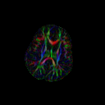
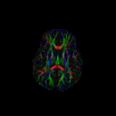
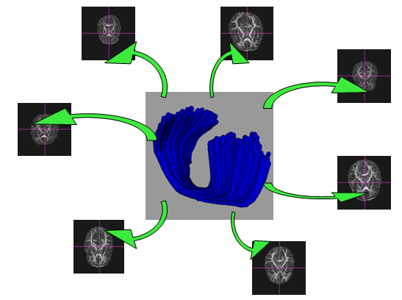
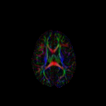
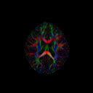
Longitudinal DTI Analysis
I1
I2
Atlas
Î
I5
I3
I4
Step 1: Atlas Building Mapping DWI into common unbiased atlas coordinate frame
Step 2: Tract measurement Definition of wm tracts of interest, map back to collect subject info

Slide 5
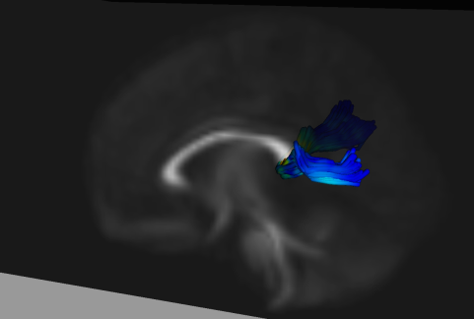
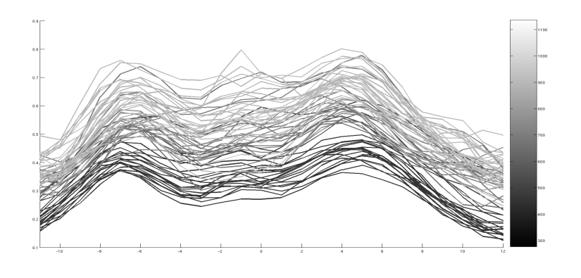
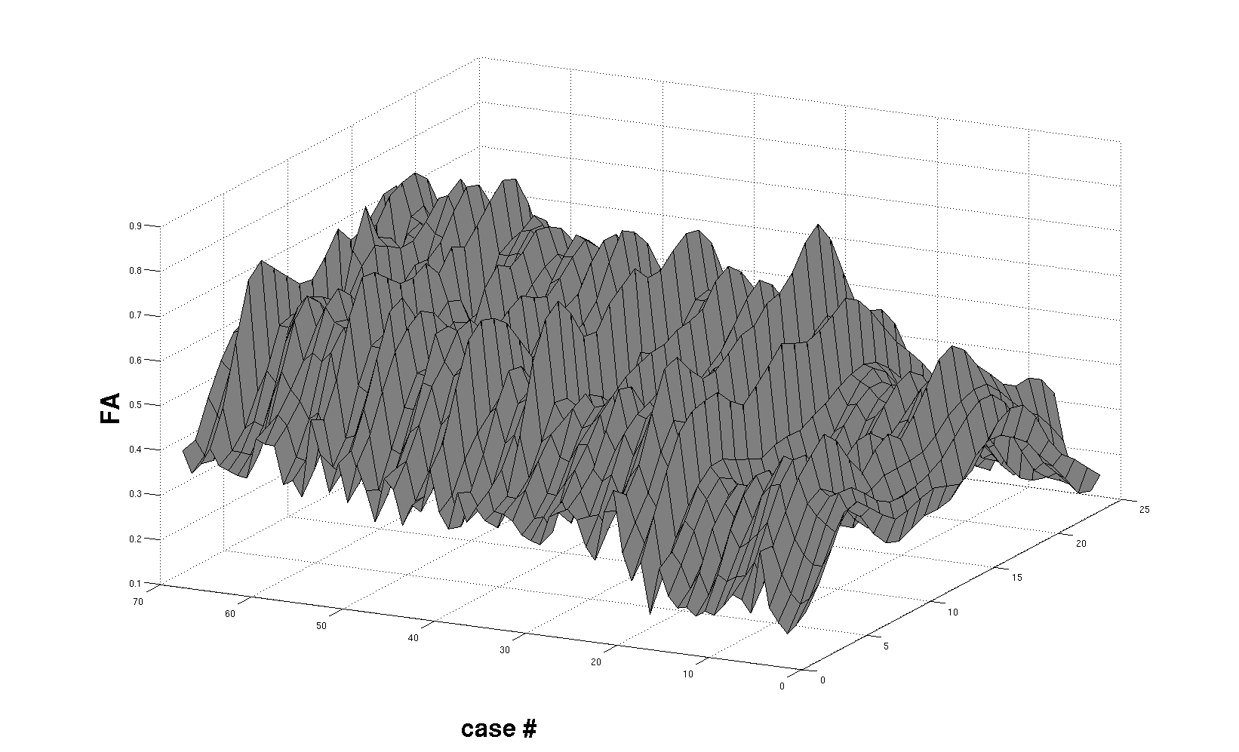
Trajectory of Change via Regression of Tract functions
Diffusivity along tract as function of time
time
arc-length
arc-length
time
Constrained data decomposition and regression (c-PCA) for modeling longitudinal change (here infants 0 to 2 years)

Slide 6
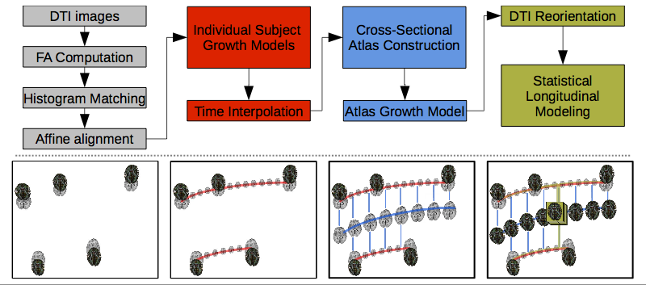
Longitudinal Atlases
Replace 3D atlas by 4D atlas

Slide 7
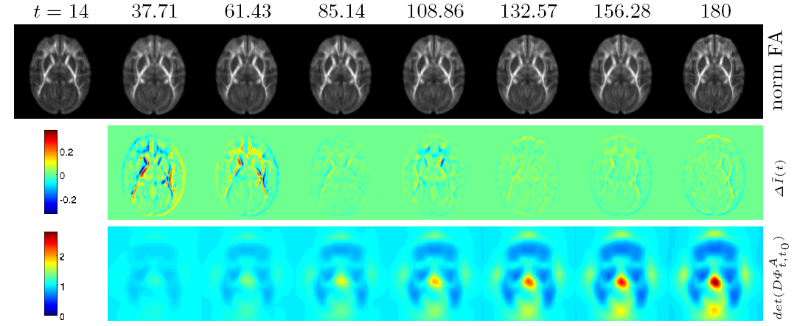
Longitudinal Brain Change
Here: Macaque brain development
Model includes age, gender, birth weight
NA-MIC: HD brain change
FA change
Size

Slide 8
Segmentation of 4D MRI
Problem:
Serial data often segmented independently
No use of inherent subject-specific correlation
New: 4D segmentation using joint priors across time points
Example shown: Early development of infant brain
NAMIC:
Acute → follow-up in TBI
Serial MRI in HD
T1
Tissue Segment.
6 month 12 month 24 month

Slide 9
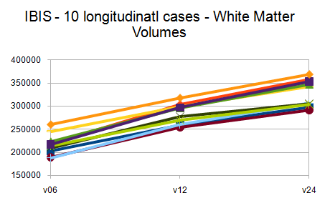
4D Segmentation to Analysis
4D Segmentation results in sets of 3D models:
Quantitative analysis of subject-specific trajectories

Slide 10
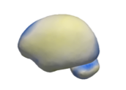
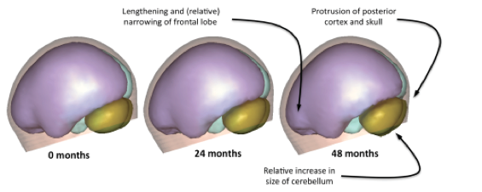
Joint Evaluation of Shape
Mixed Effect
Particle shape correspondence
Intra-subject & inter-subject
Linear mixed-effect model of shape
Correspondence on residuals
Iterate over correspondence and stats
Brain change: 10 x 0-2 years
Random Effect

Slide 11
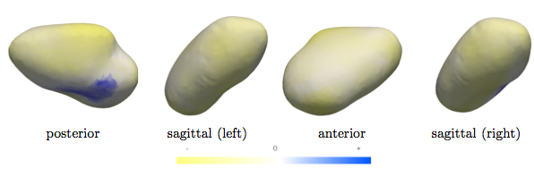
Atrial Fibrillation
Left atrium shape change after successful fibrillation
12 x pre-ablation + 3mo postablation
Same mixed effect model
Pulmonary veins
-
+

Slide 12
Conclusions
Longitudinal/Time series analysis crucial to DBP’s
Not same old, new methods needed
NA-MIC solutions are on the way to save the day…
Jointly across NA-MIC (Core 1 & 2)

Slide 13
Longitudinal and time-series analysis
Content:
Guido/?: images at multiple time points for segmentation & analysis (DBP UCLA & Iowa), DTI & tissue segmentation
Ross/Martin: longitudinal shape correspondence for improved analysis (Application to DBP Iowa (subcortical structures) & UCLA (ventricles) & Utah (atrial shape) )
Guido/Martin: longitudinal DTI atlas (DBP Iowa), Prelim data from Monkey.

