Slide 1
3D VISUALIZATION OF DICOM IMAGES FOR RADIOLOGICAL APPLICATIONS
Sonia Pujol, PhD
Brigham and Women’s Hospital, Harvard Medical School
Kitt Shaffer, MD, PhD
Boston University School of Medicine
Ron Kikinis, MD,
Brigham and Women’s Hospital, Harvard Medical School

Slide 2
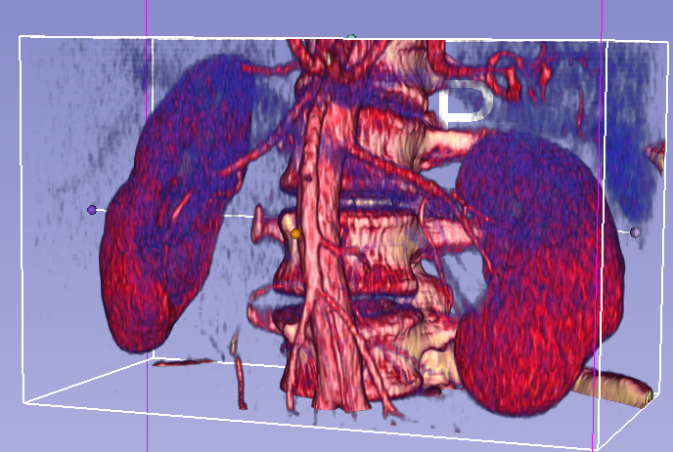
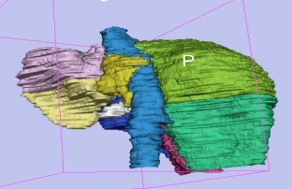
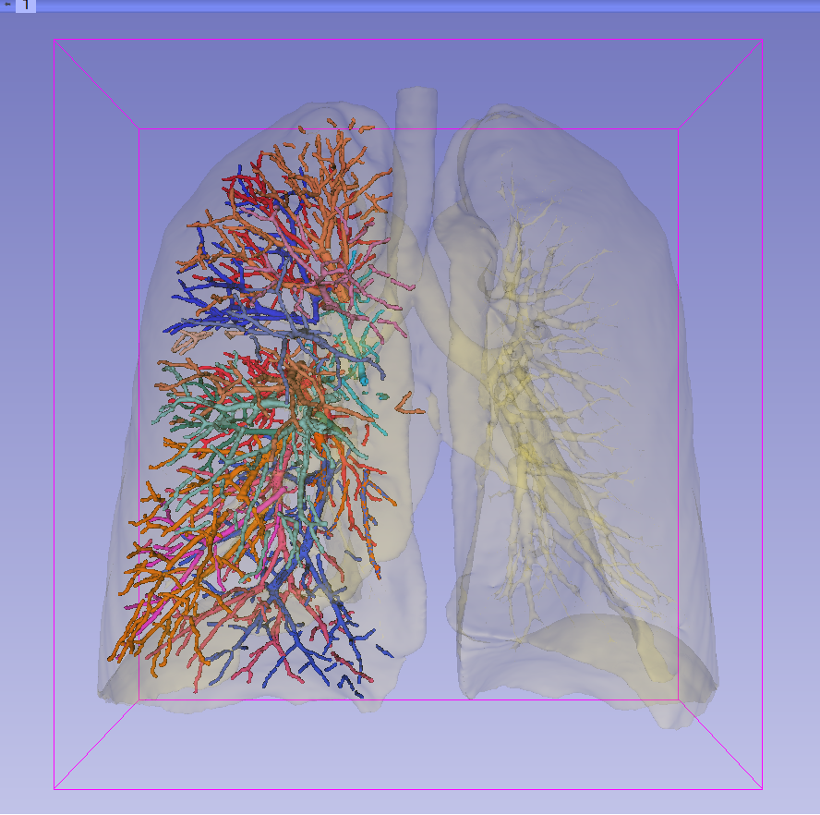
3D Visualization of DICOM images for Radiological applications
Following this tutorial, you will be able to load and visualize DICOM volumes with 3D Slicer, and to interact in 3D with structural images and models of the anatomy.

Slide 3
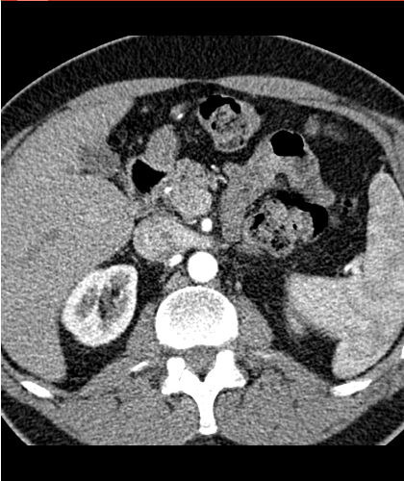
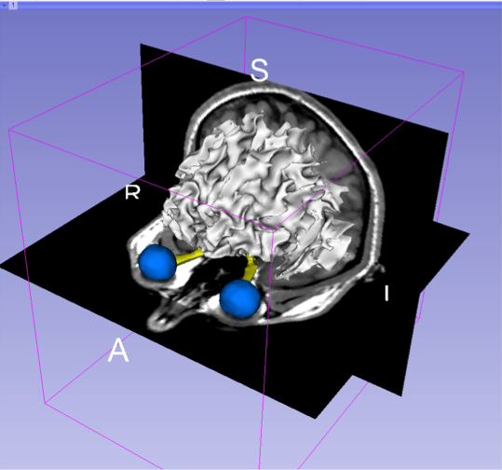
Overview
Part I: Introduction to the 3DSlicer software
Part II: 3D Data Loading and visualization of DICOM images
- Volume Rendering of thoraco-abdominal CT data
- Surface Rendering of MR head data
Part III: 3D interactive exploration of the anatomy
- Exploration of the Segments of the liver
- Exploration of the Segments of the lung

Slide 4
Overview
Part I: Introduction to the 3DSlicer software
Part II: 3D Data Loading and visualization of DICOM images
- Volume Rendering of thoraco-abdominal CT data
- Surface Rendering of MR head data
Part III: 3D interactive exploration of the anatomy
- Exploration of the Segments of the liver
- Exploration of the Segments of the lung

Slide 5
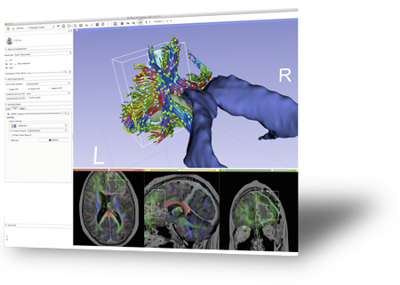
Introduction to the 3DSlicer software

Slide 6
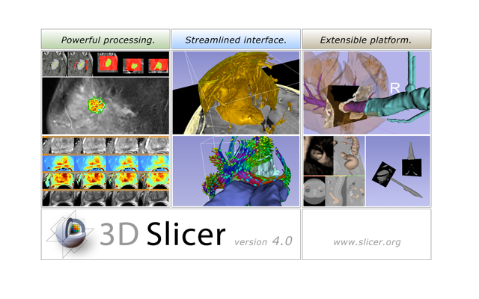
3DSlicer
3DSlicer is a freely available open-source platform for segmentation, registration and 3D visualization of medical imaging data.
3DSlicer is a multi-institutional effort supported by the National Institute of Health.

Slide 7
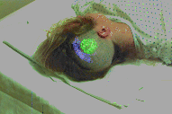

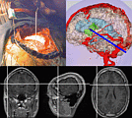
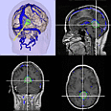
3DSlicer History
1997: Slicer started as a research project between the Surgical Planning Lab (Harvard) and the CSAIL (MIT)
Image Courtesy of the CSAIL, MIT

Slide 8
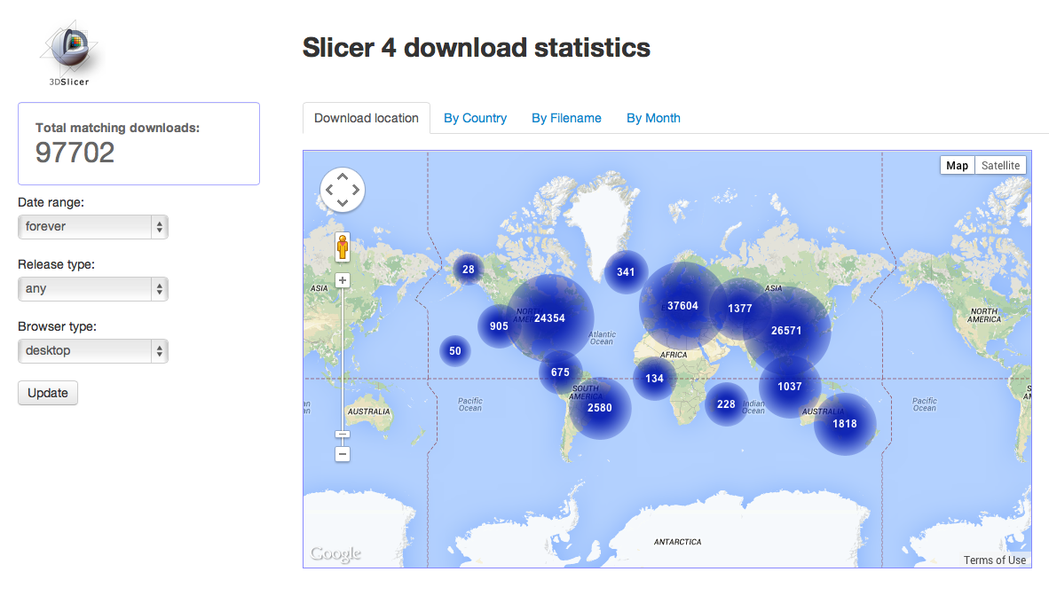
3DSlicer History
1997: Slicer started as a research project between the Surgical Planning Lab (Harvard) and the CSAIL (MIT)
2013: Multi-institution effort to share the latest advances in image analysis with the clinical and scientific community

Slide 9

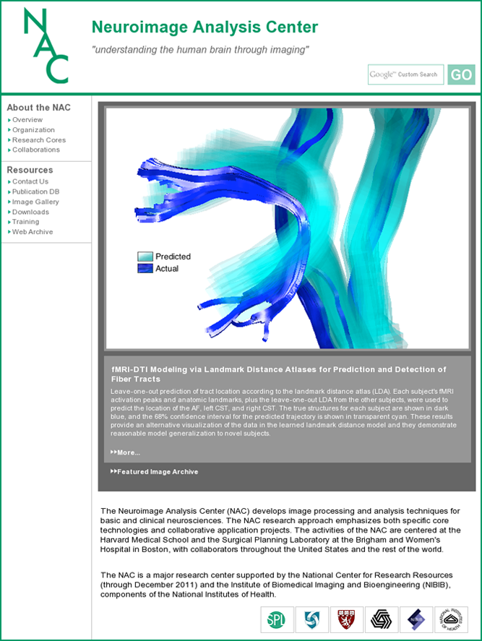
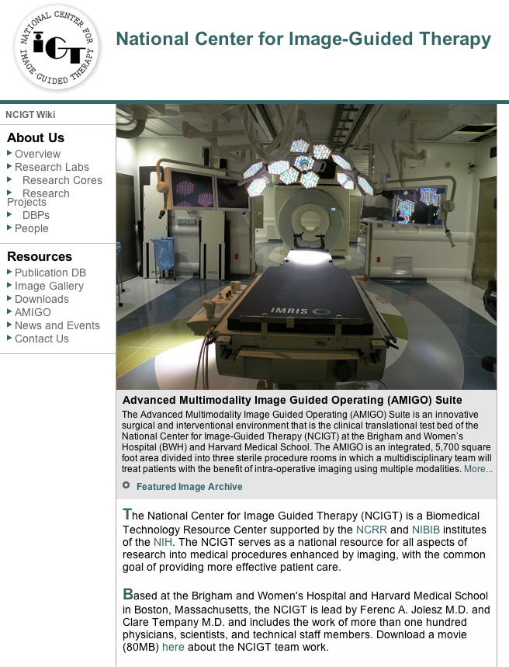
A multi-institution effort
PIs: Ferenc Jolesz, M.D., Clare Tempany, M.D.
PI: Ron Kikinis, M.D.

Slide 10
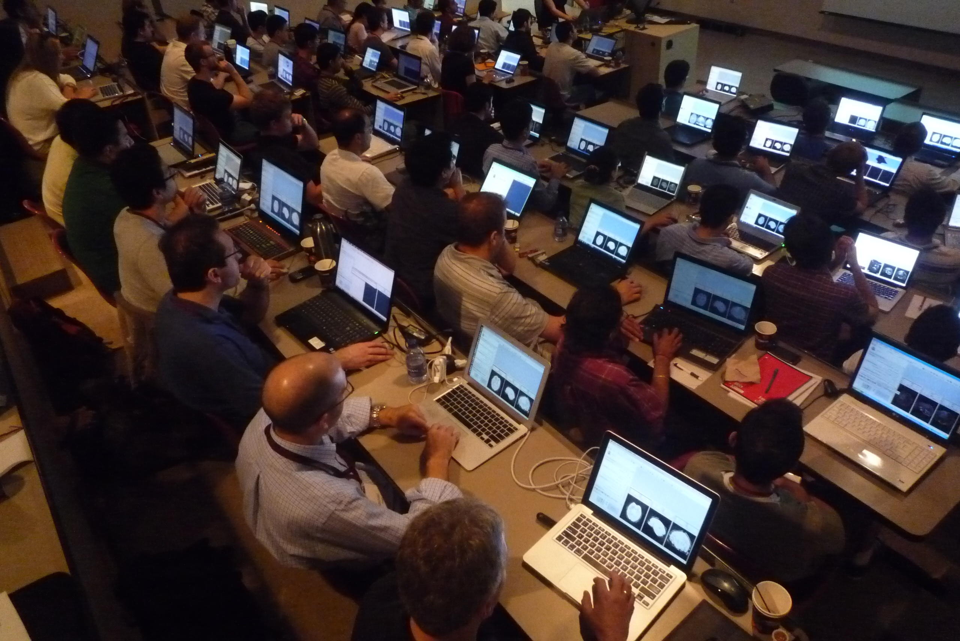
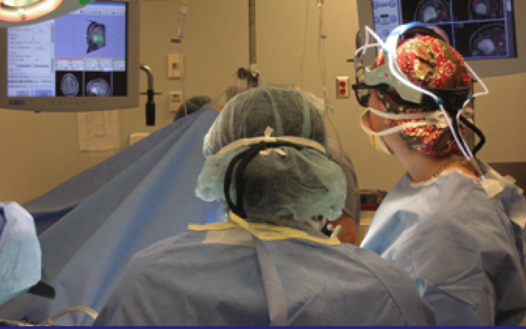
An interdisciplinary platform
An open-source environment for software developers
An end-user application for
clinical investigators and scientists
A software platform that is both easy to use for clinical researchers and easy to extend for programmers

Slide 11
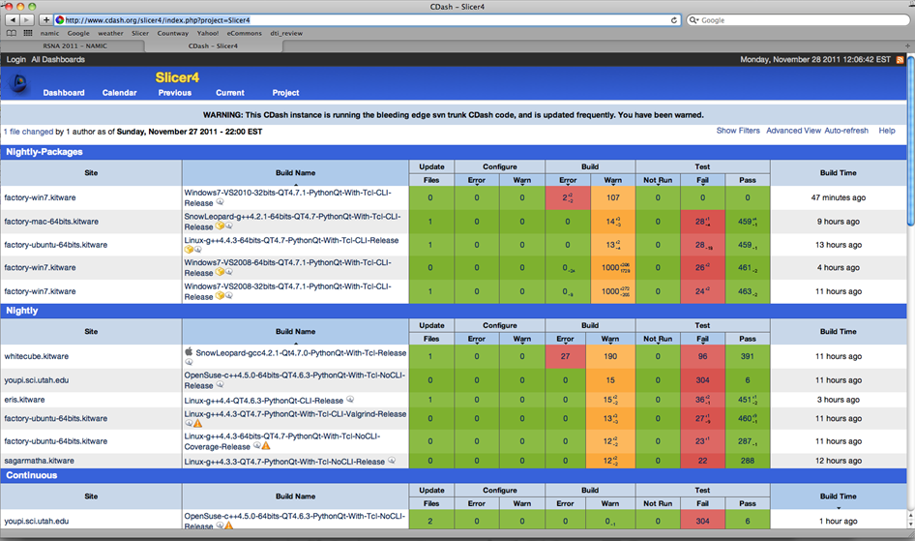
Slicer: Behind the scenes
Slicer is built every night on Windows, Mac and Linux platforms

Slide 12

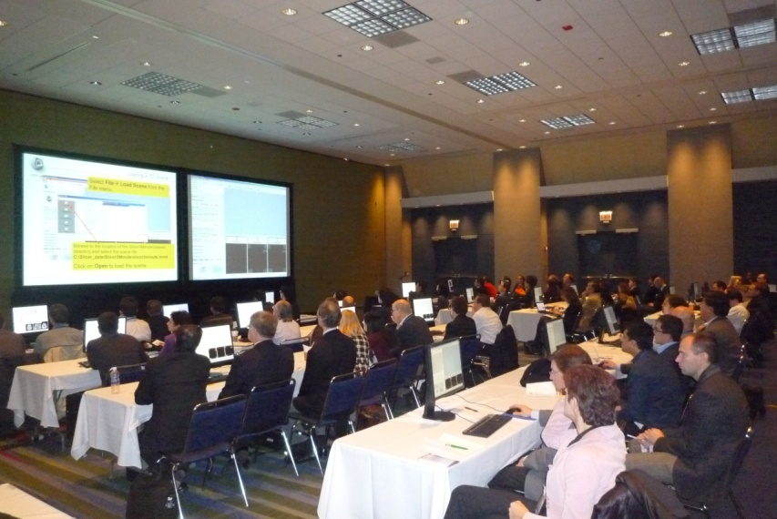
Slicer Training events
Hands-on training workshops at national and international venues
More than 2,700 clinicians, clinical researchers and scientists trained since 2005

Slide 13
Slicer Training events
Major international conferences
  RSNA 2008, 2009, 2010, 2011, 2012,2013
  MICCAI 2008, 2009, 2011, 2012,2013
  SfN 2009, 2011
  SPIE 2012, 2013
  CAOS 2010
  CARS 2010, 2012, 2013
RSNA 2011

Slide 14
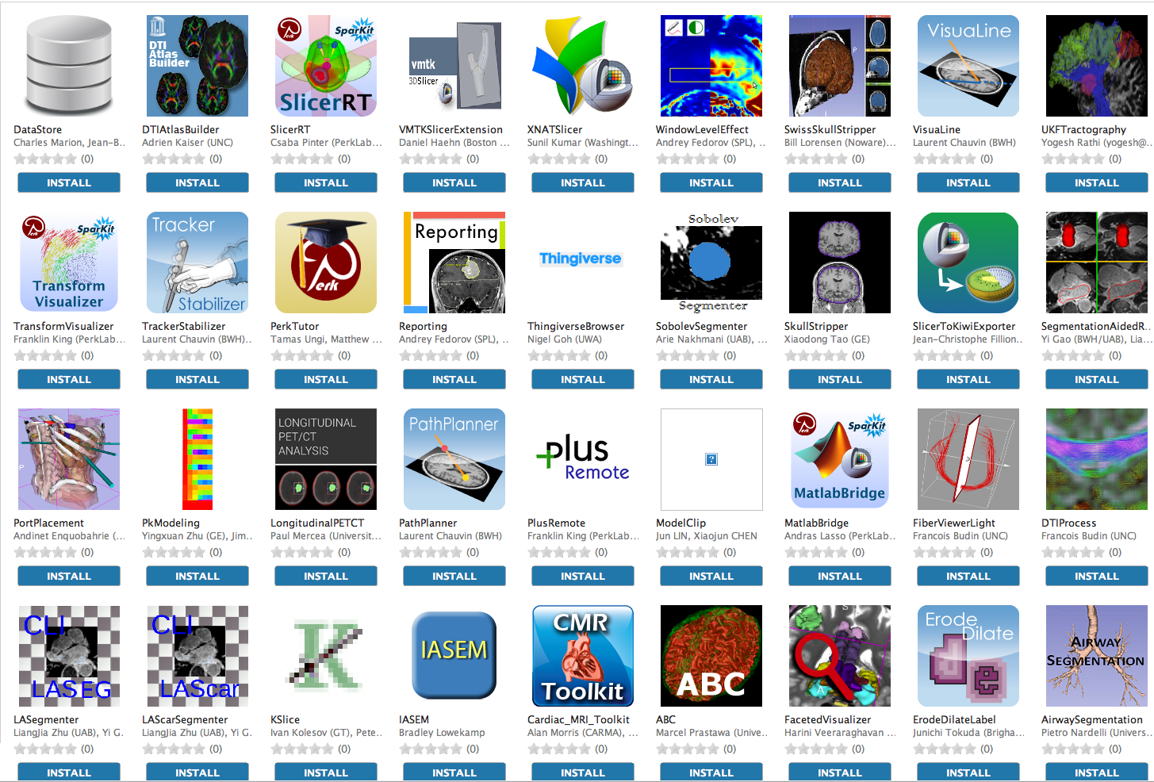
An extensible platform
3D Slicer supports plug-ins called Slicer extensions available from the Extension Manager
Allows end-users to select extensions useful to them, without having to download the entire extension archive.
Built Nightly with Slicer

Slide 15
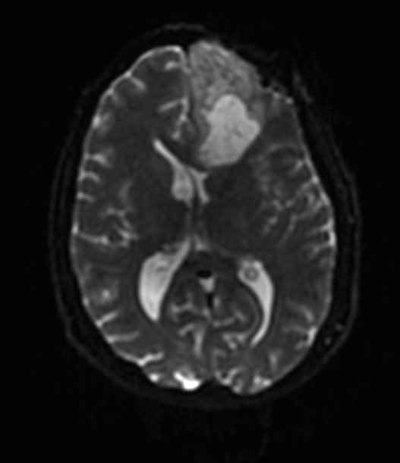
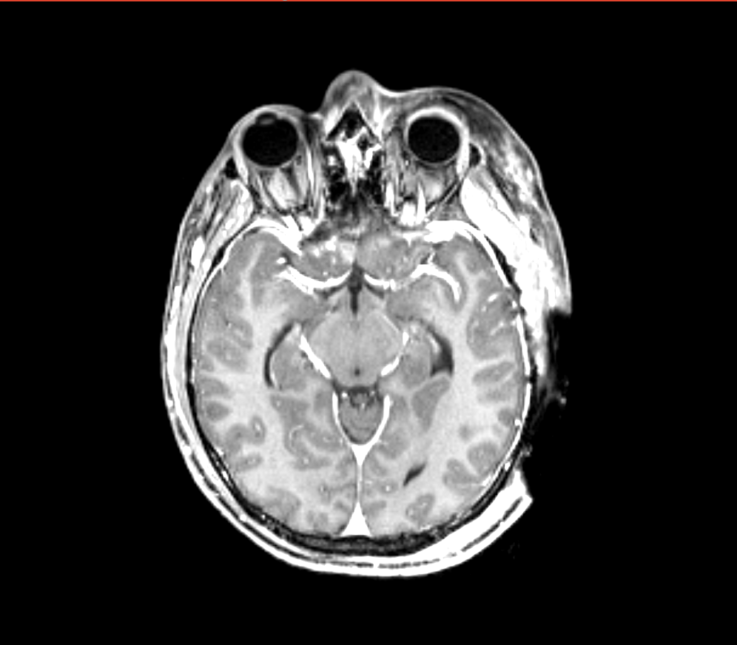
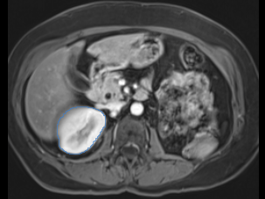
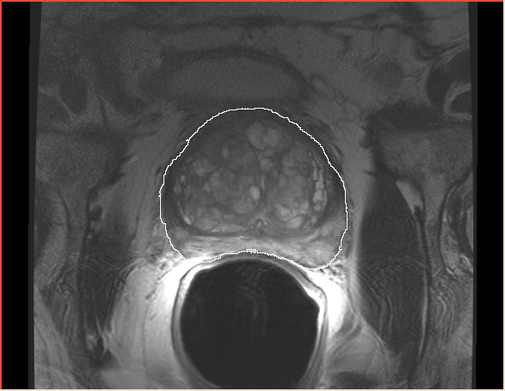
Slicer clinical applications
Driving Biological Projects leading to the development of new tools
Applied science oriented toward subject specific analysis in the presence of pathology

Slide 16
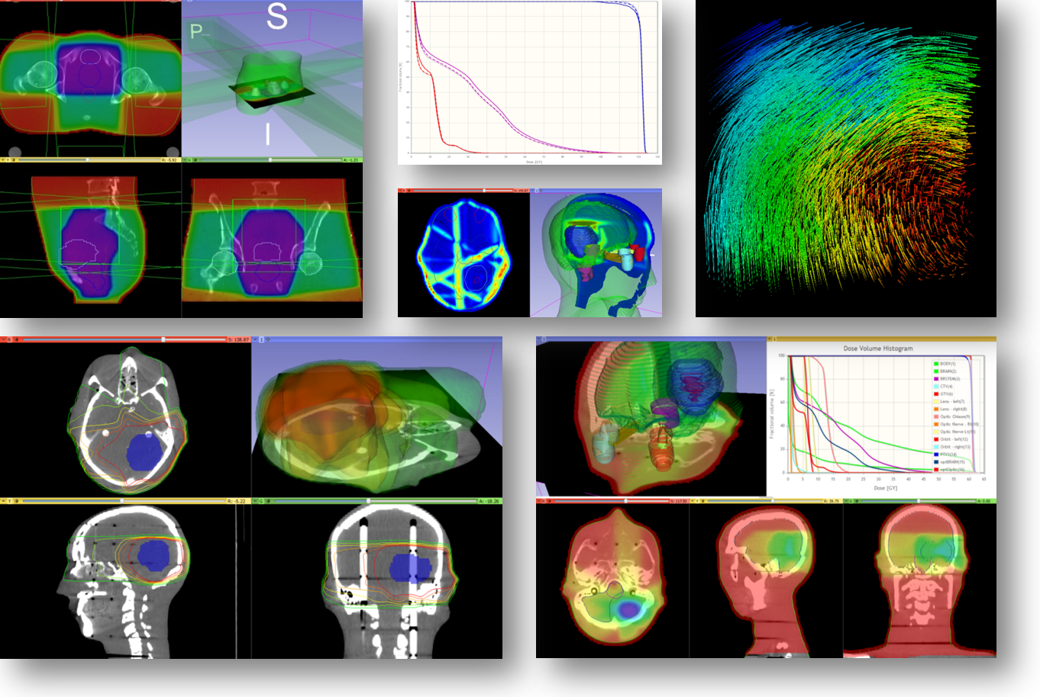
Examples of clinical applications
Radiotherapy: RT-specific analysis dose accumulation and dose comparison (G.Fichtinger et al. Queen’s University, Canada)

Slide 17
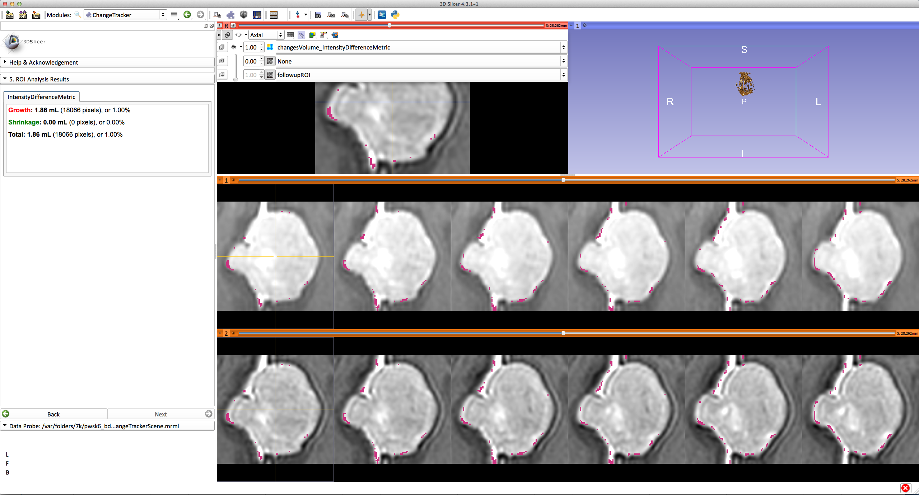
Examples of clinical applications
Measurement of volumetric changes in slow growing meningioma

Slide 18
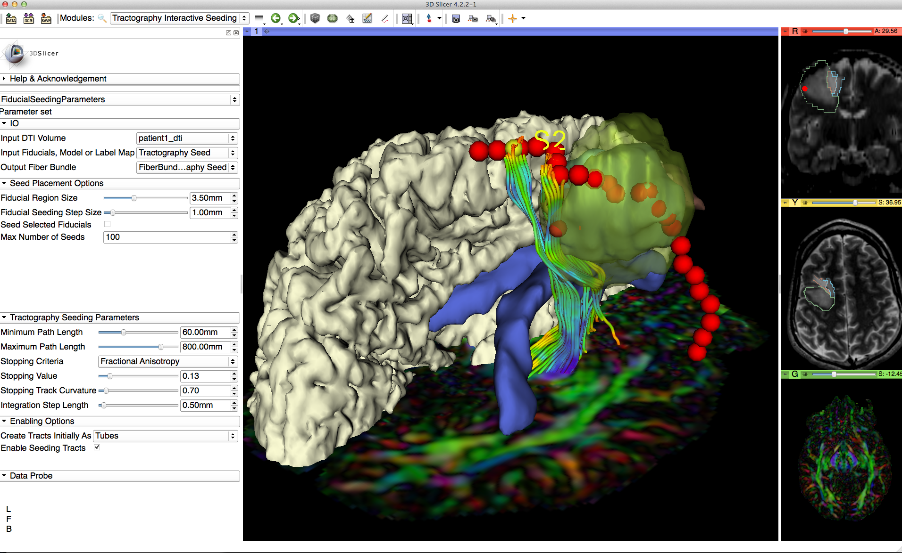
Examples of clinical applications
Diffusion Tensor Imaging tractography for neurosurgical planning

Slide 19
Overview
Part I: Introduction to the 3DSlicer software
Part II: 3D Data Loading and visualization of DICOM images
- Volume Rendering of thoraco-abdominal CT data
- Surface Rendering of MR head data
Part III: 3D interactive exploration of the anatomy
- Exploration of the Segments of the liver
- Exploration of the Segments of the lung

Slide 20
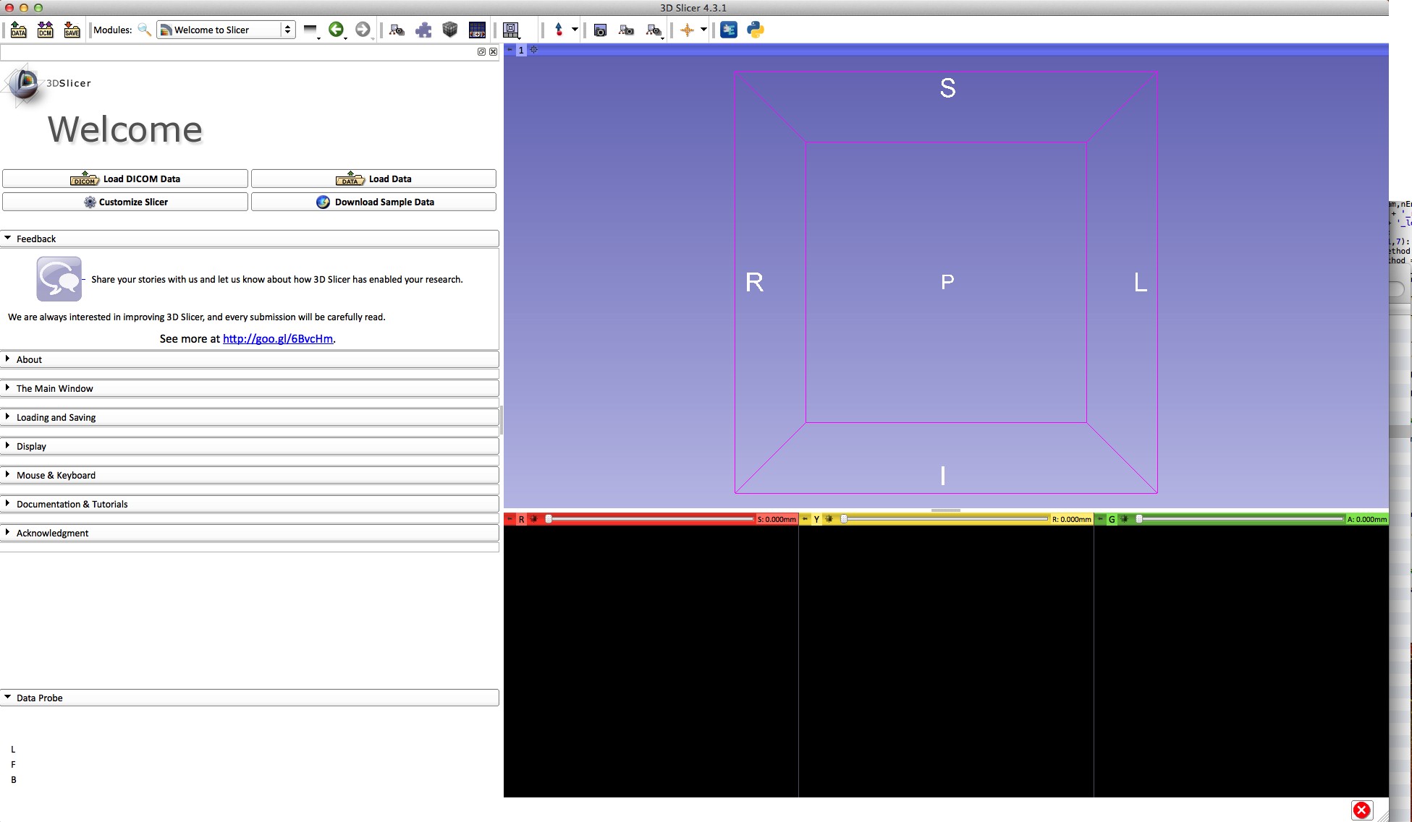
Welcome to Slicer4
To start Slicer, double-click on the Slicer icon on the Desktop

Slide 21
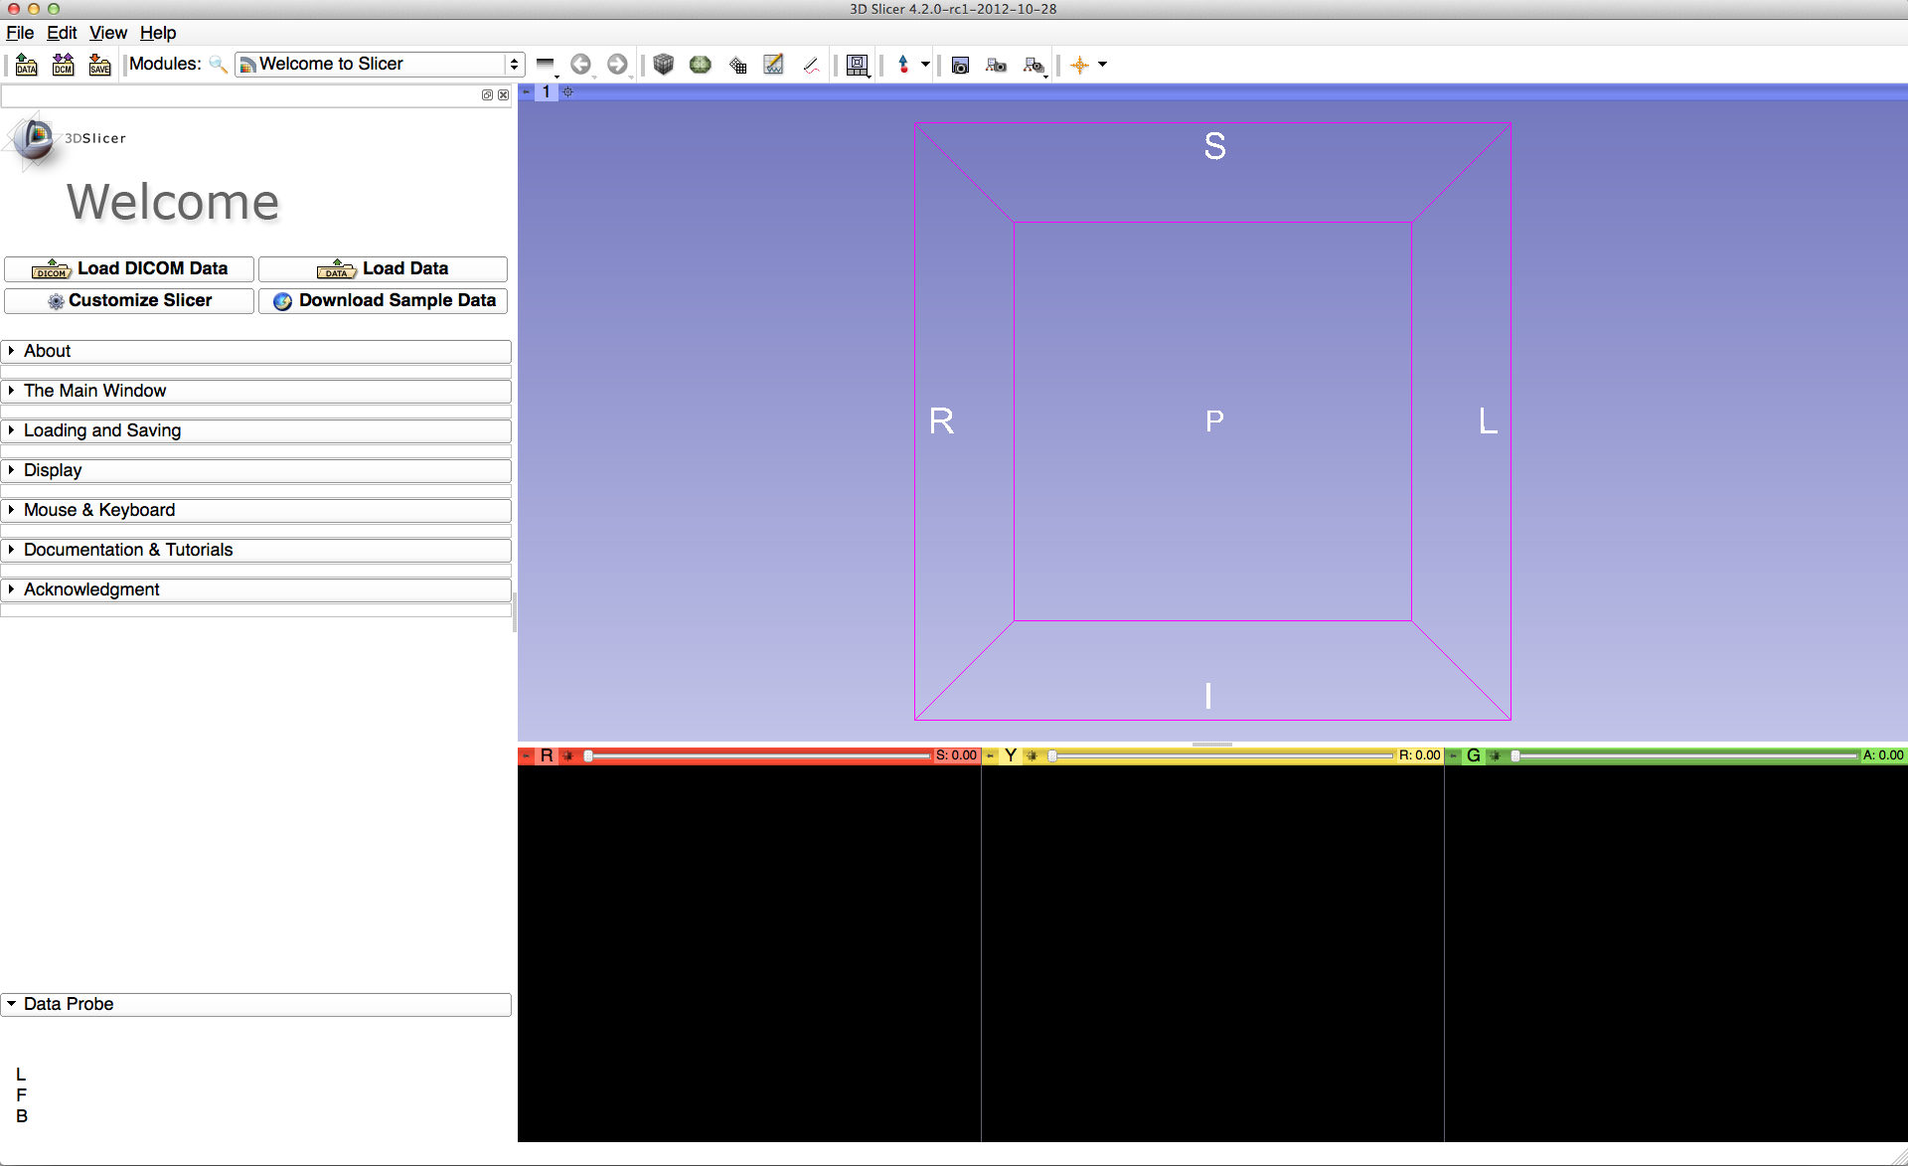
Navigating the Application GUI
Menu & Toolbar
The Graphic User Interface (GUI) of Slicer4 integrates four components:
the Menu Toolbar
the Module GUI Panel
the 3D Viewer
the Slice Viewer
3D Viewer
Module GUI Panel
Slice Viewers

Slide 22
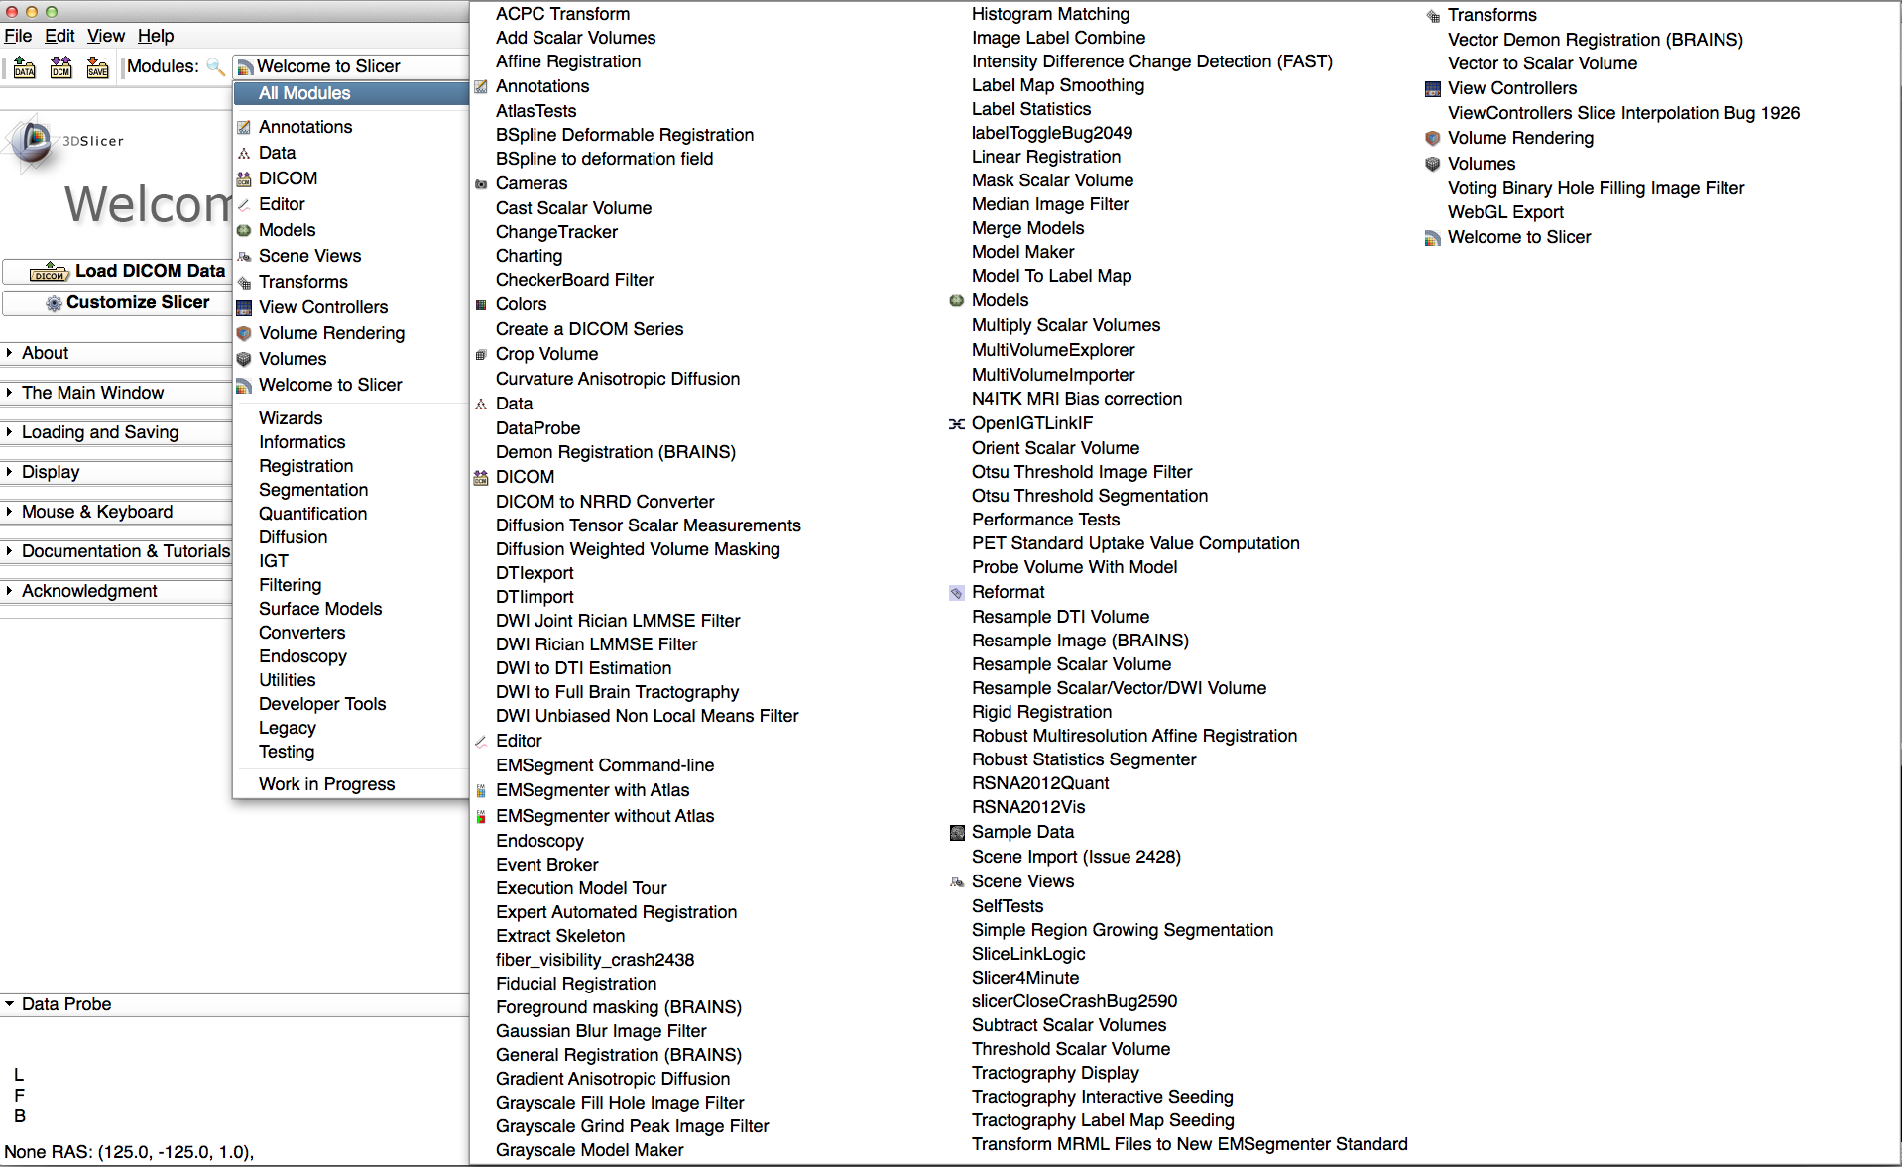
Welcome to Slicer4.3.1.1
Click on Welcome to Slicer to display the list of modules of Slicer in the Modules menu

Slide 23

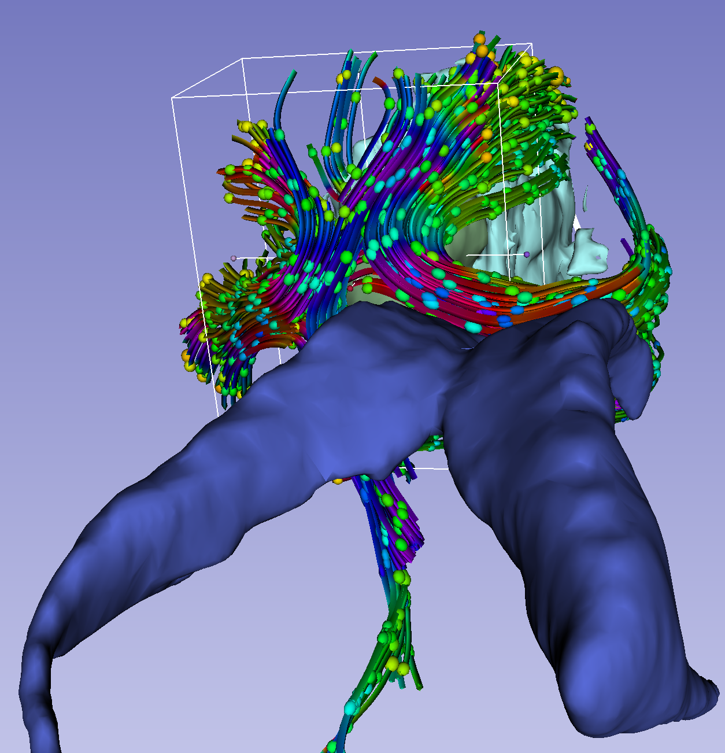
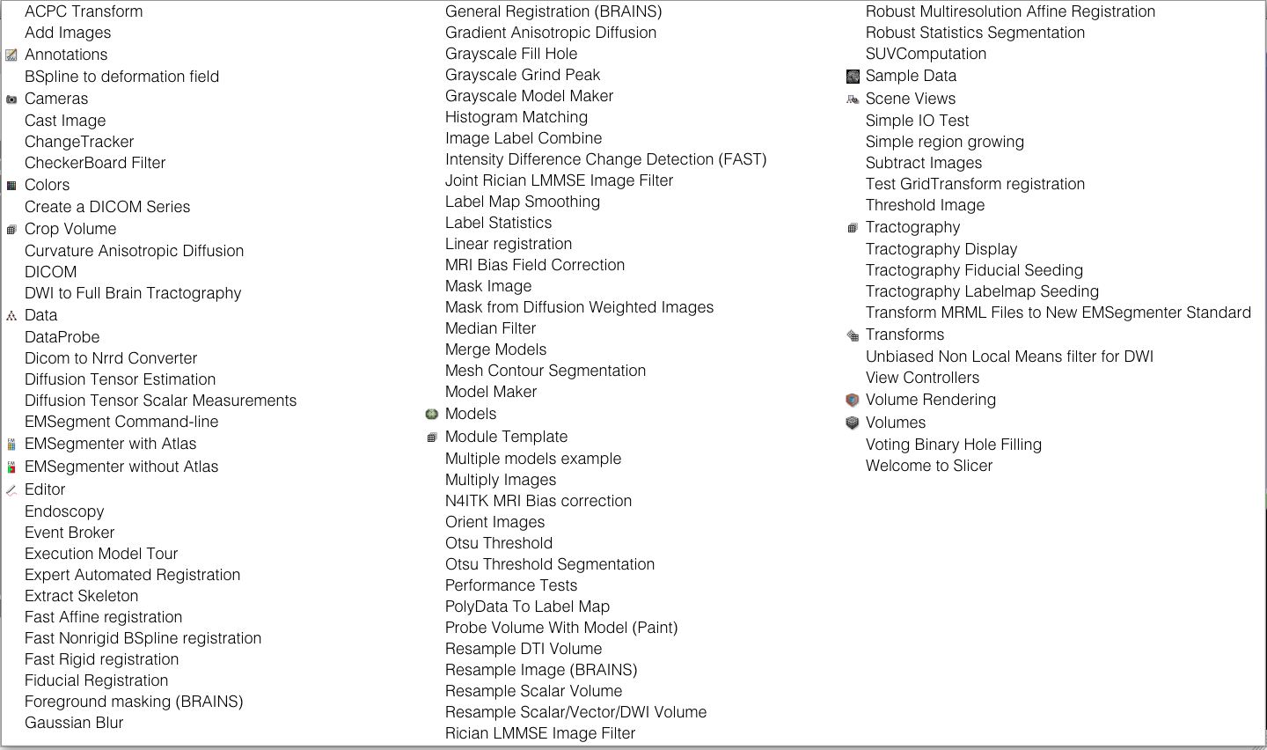
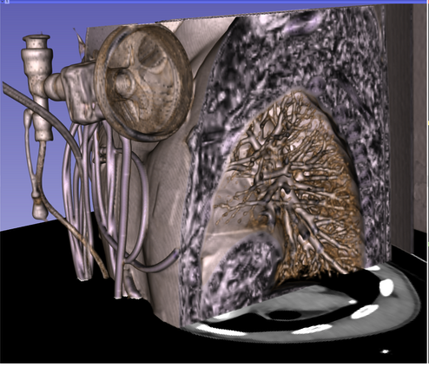
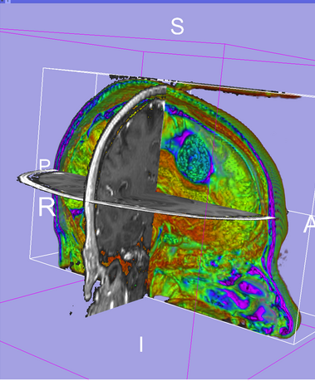
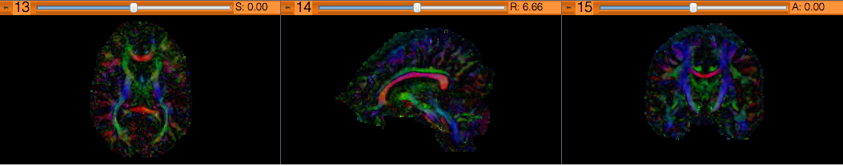
Welcome to Slicer4
Slicer4.3.1 contains more than 100 modules for image segmentation, registration and 3D visualization of medical imaging data

Slide 24
Part 1:
Loading a DICOM Volume

Slide 25
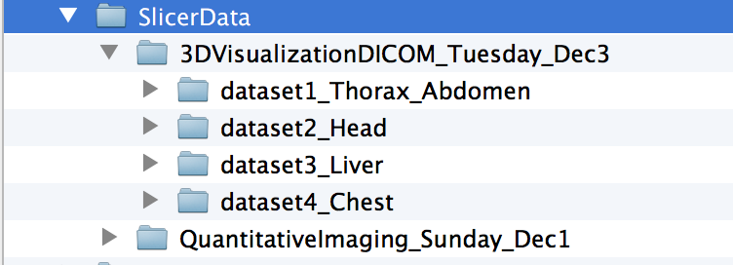
Tutorial datasets
The tutorial datasets are located in the Slicer Data directory on the Desktop, under
3DVisualizationDICOM_Tuesday_Dec3

Slide 26
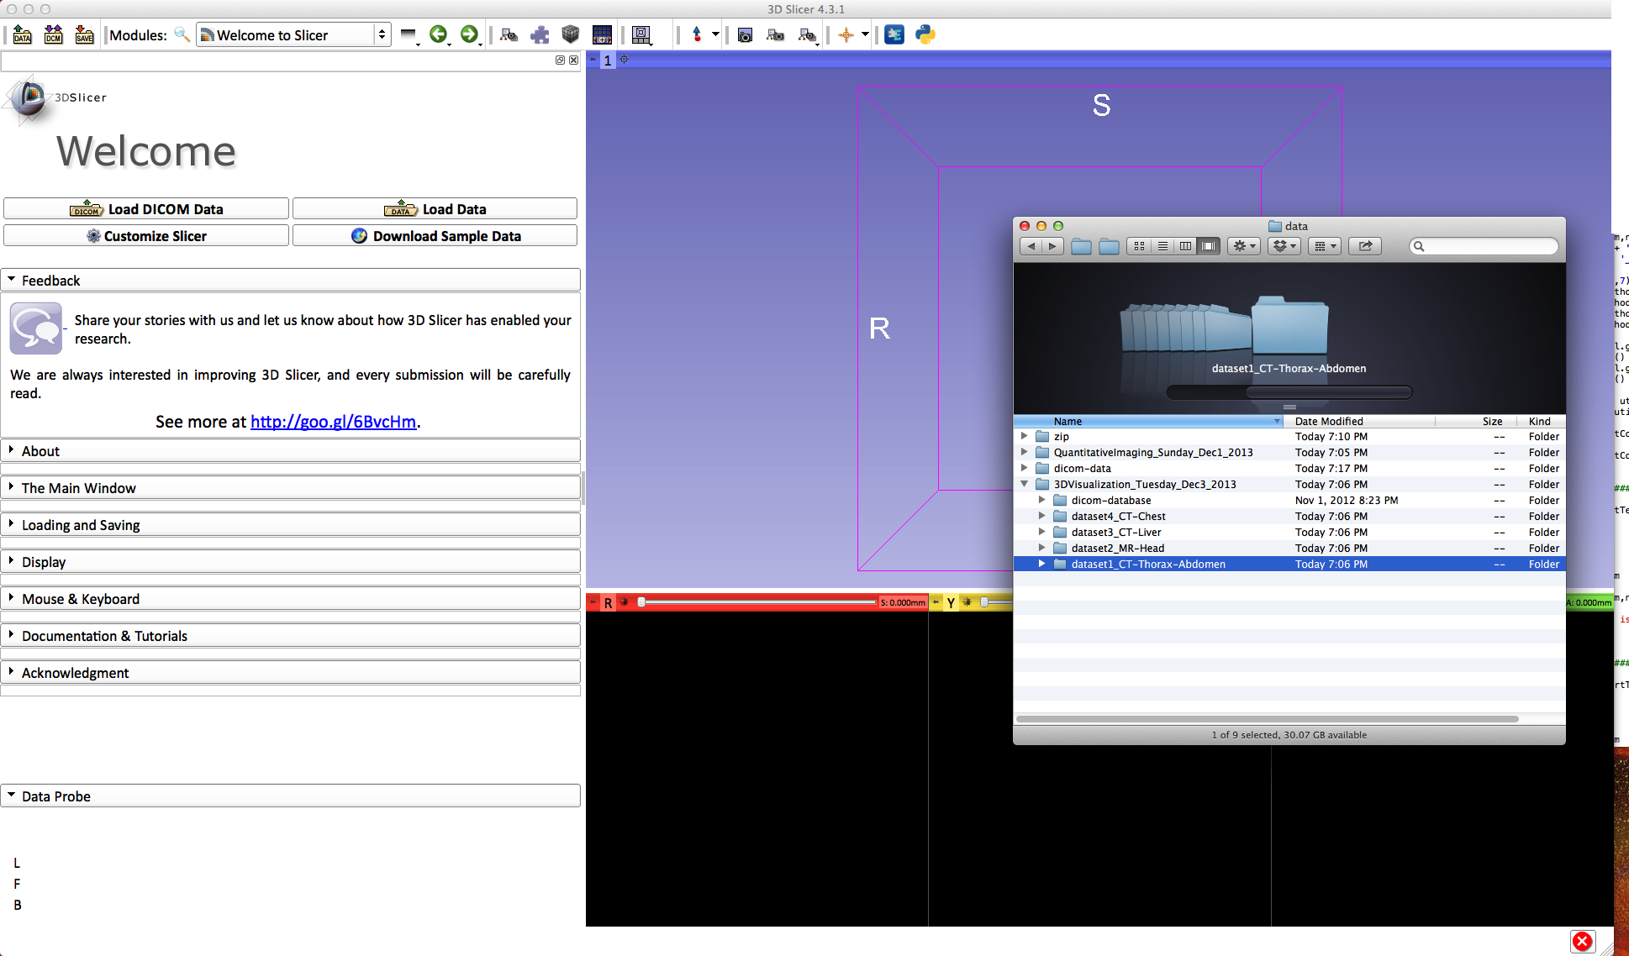
Loading a DICOM volume
Drag and drop the directory ‘dataset1_Thorax-Abdomen’ into Slicer

Slide 27
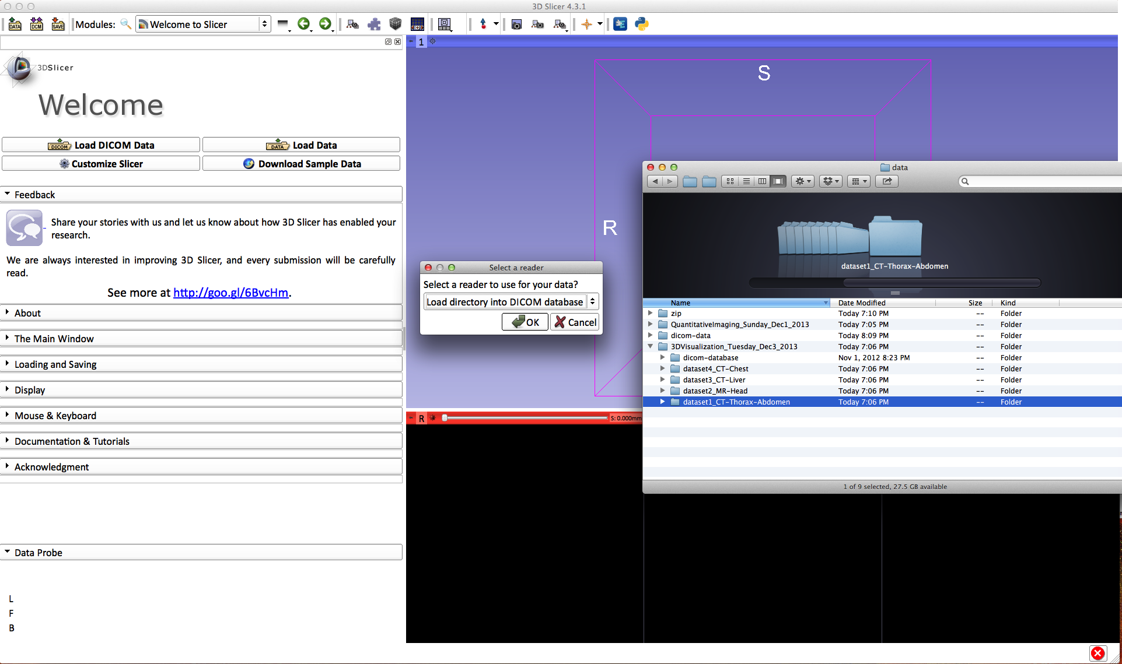
Loading a DICOM volume
A pop-up window appears:
Select Load directory into DICOM database and click on OK

Slide 28
Loading a DICOM volume
A pop-up window appears to notify the user that the DICOM database will be stored in a local directory
Click on OK

Slide 29
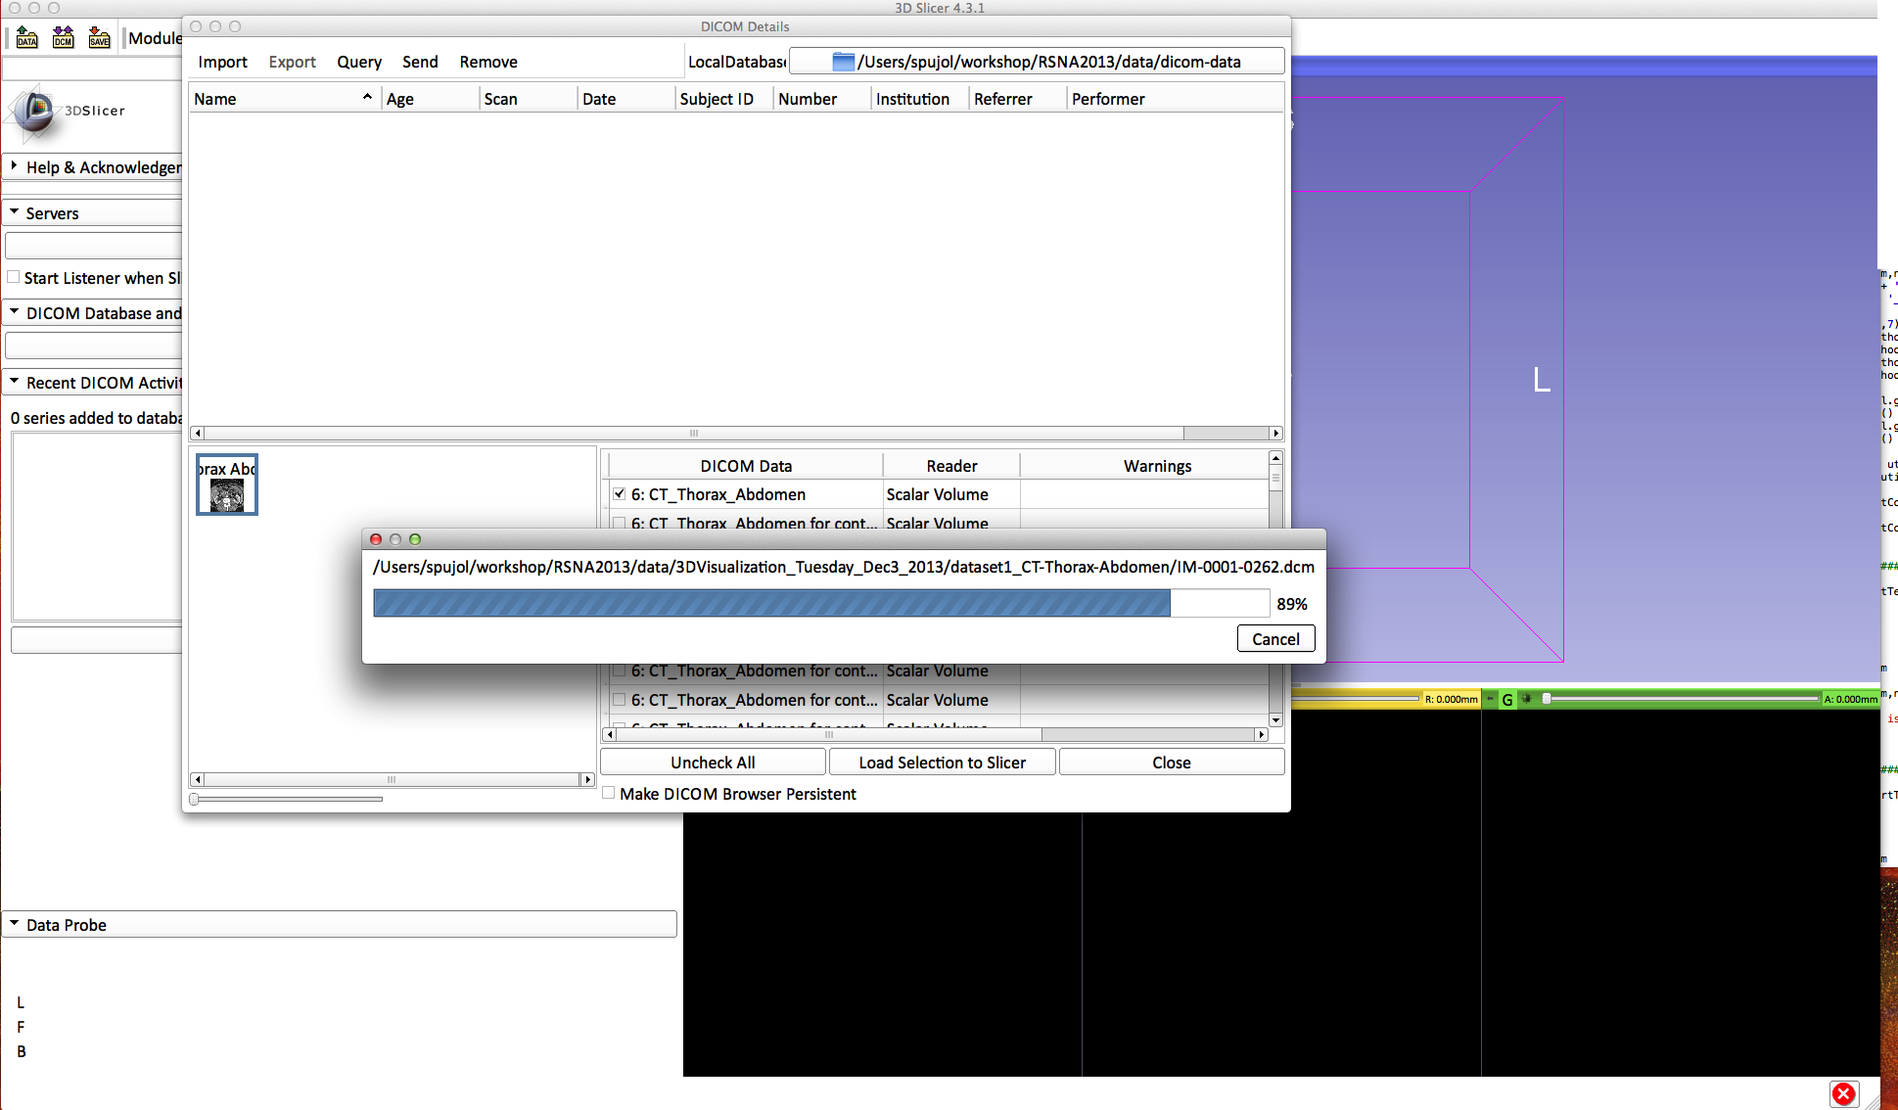
Loading a DICOM volume
Slicer starts loading the DICOM images

Slide 30
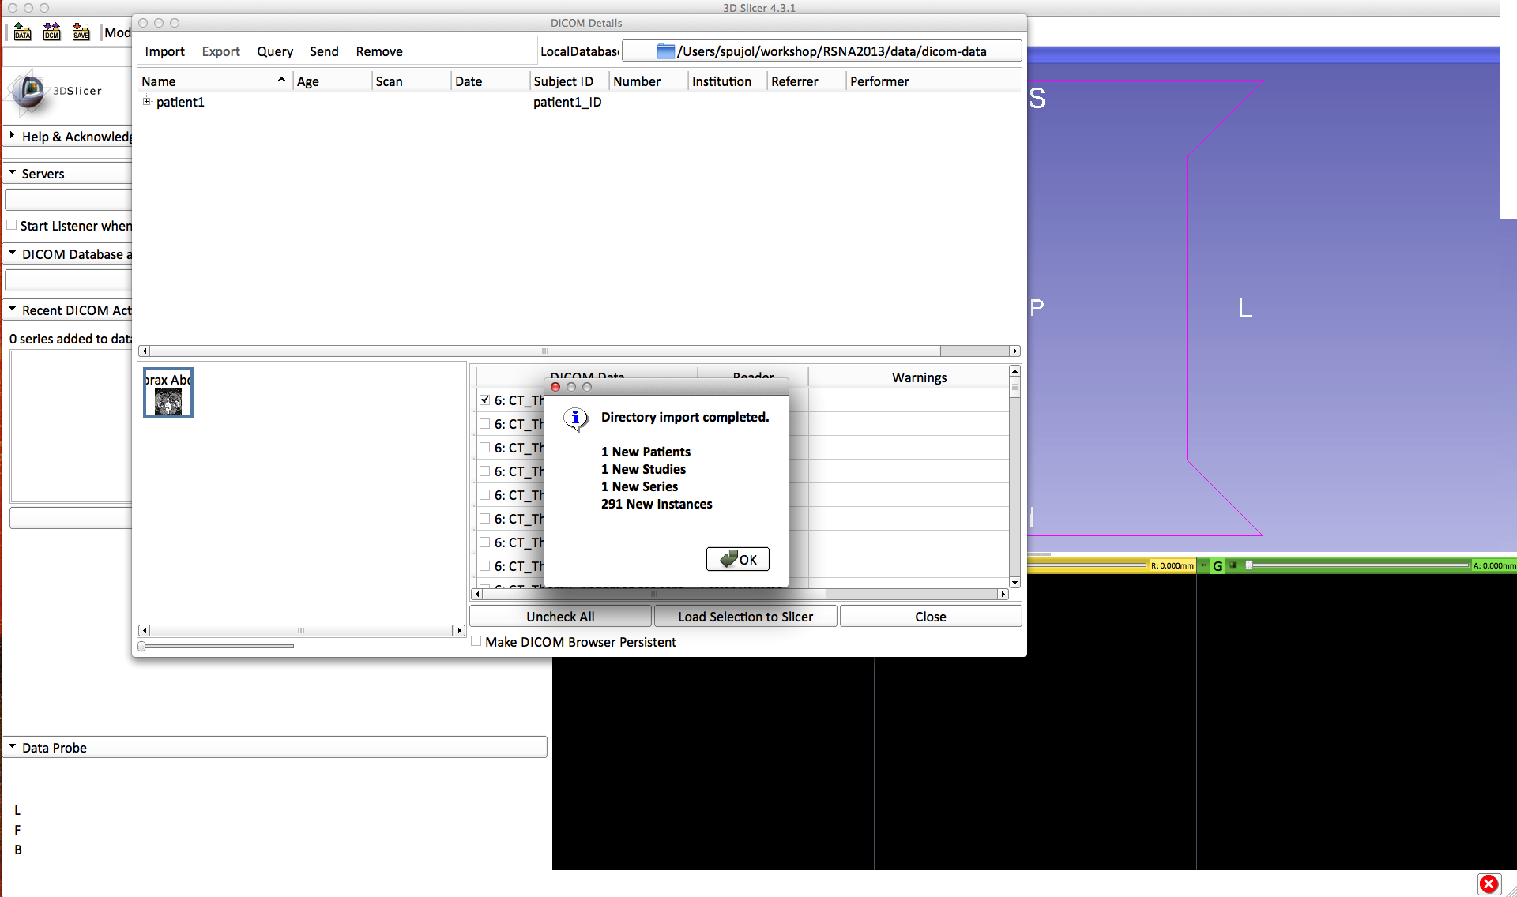
Loading a DICOM volume
Click on OK once the directory import is completed

Slide 31
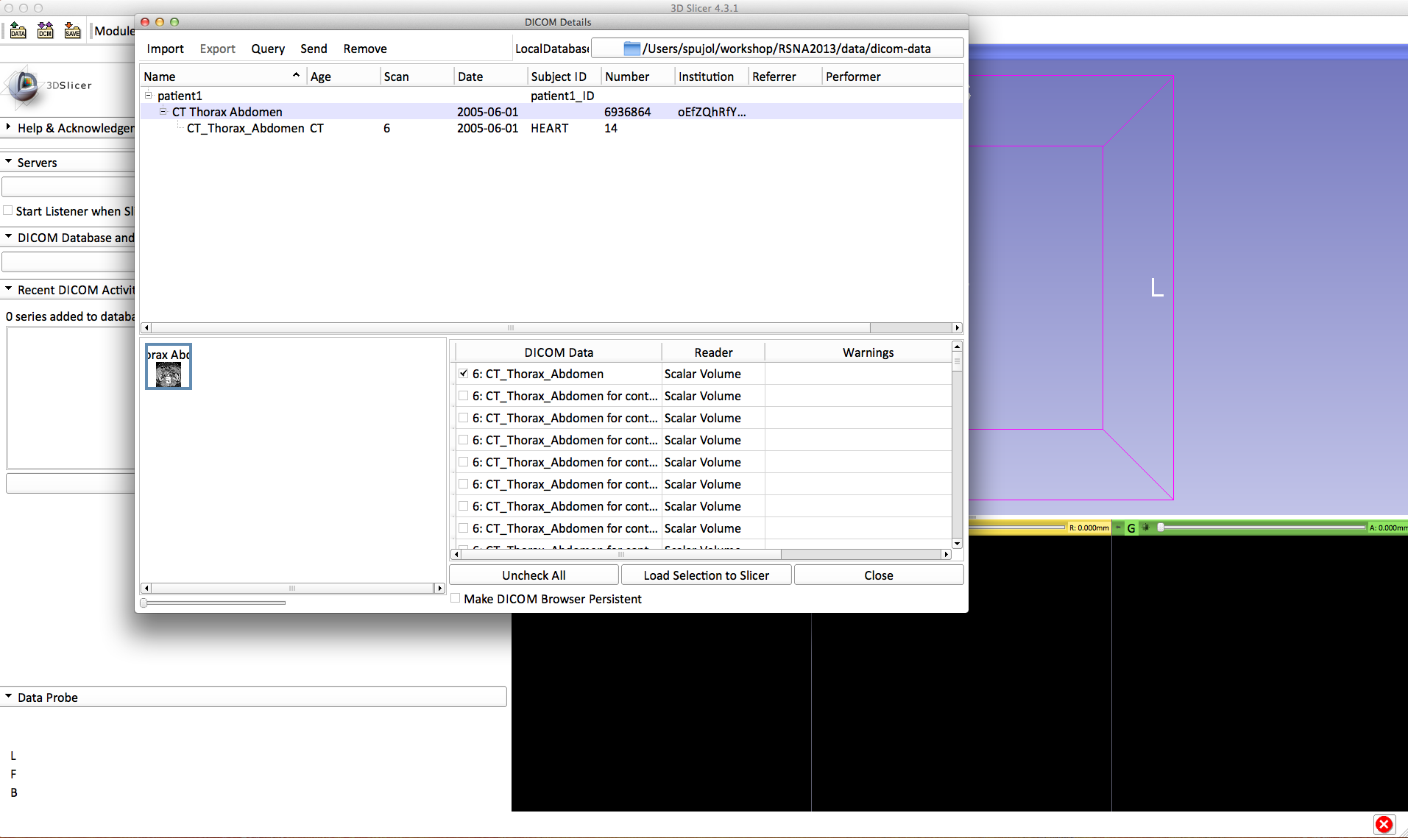
Loading a DICOM volume
The patient1 DICOM dataset appears in the DICOM browser.
Click on ‘patient1’ to display the file hierarchy, select the DICOM volume CT_Thorax_Abdomen_CT

Slide 32
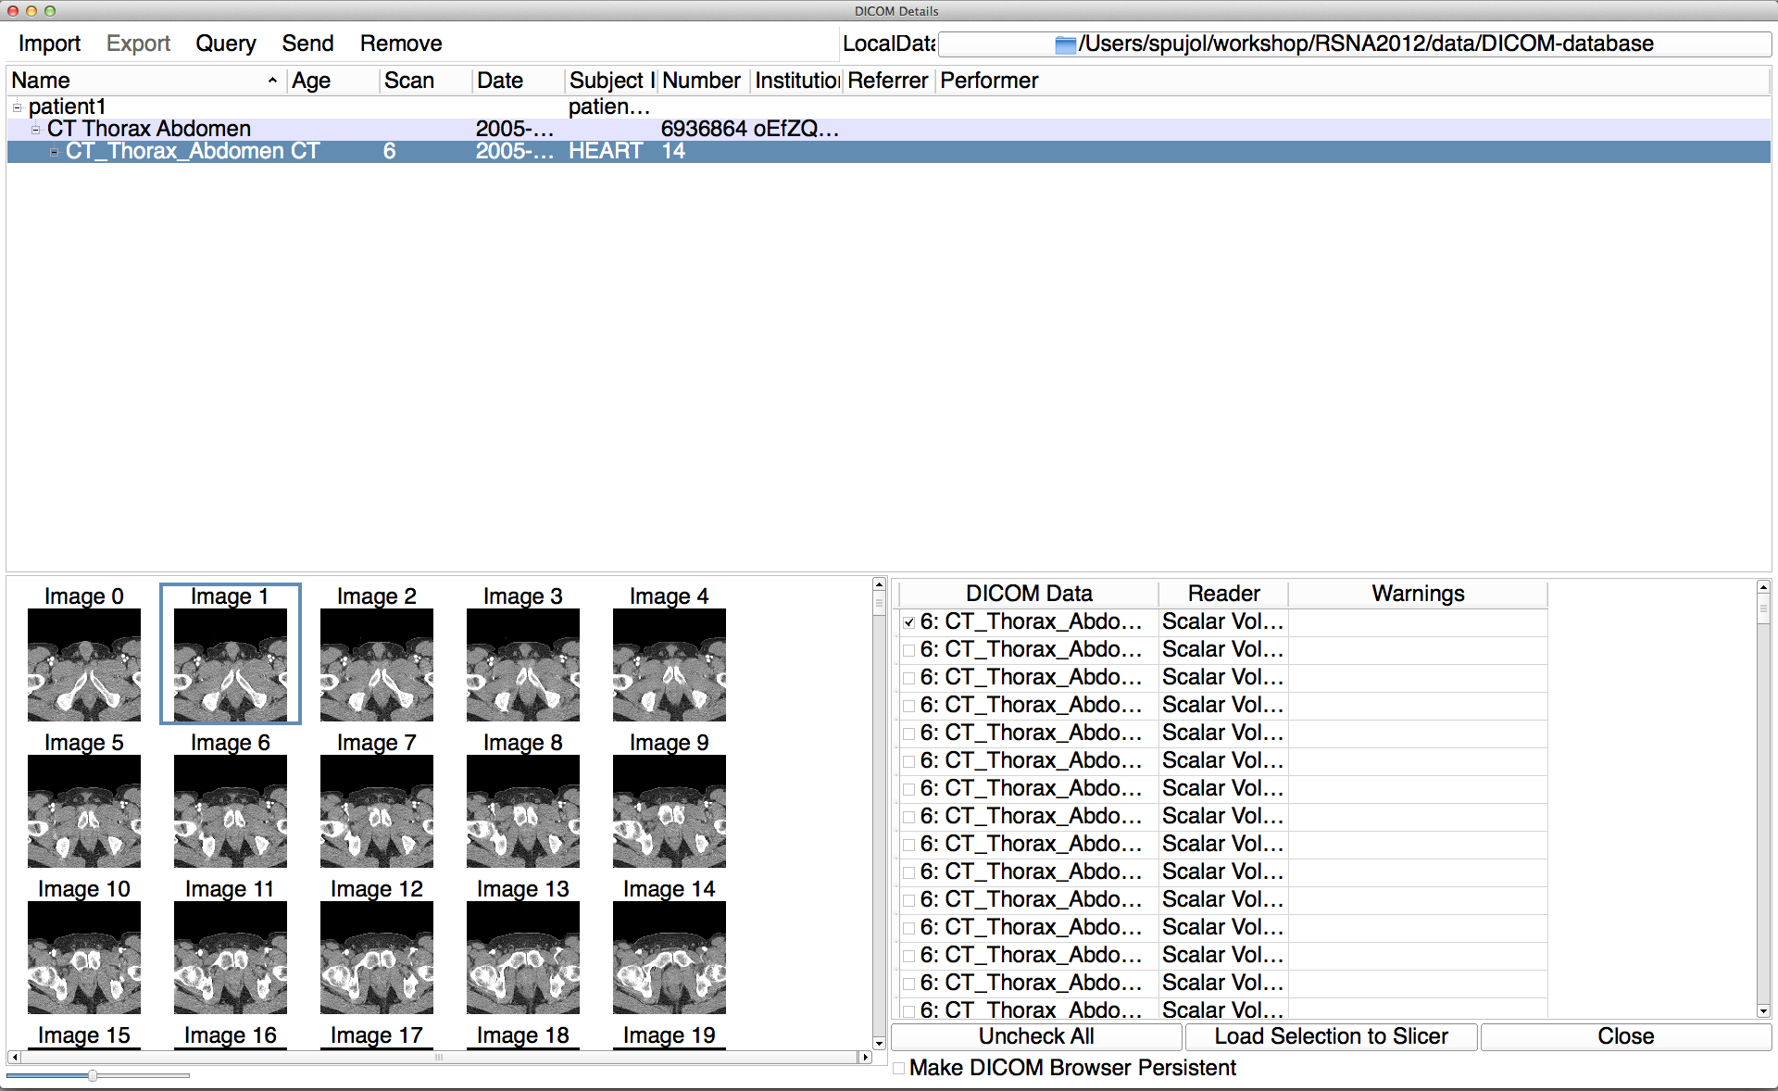
Loading a DICOM volume
Slicer displays the snapshots of the DICOM images of the CT_Thorax_Abdomen_CT dataset

Slide 33
Loading a DICOM volume
Click on Load Selection to Slicer to load the DICOM volume into Slicer
(note: this may take a few minutes)

Slide 34
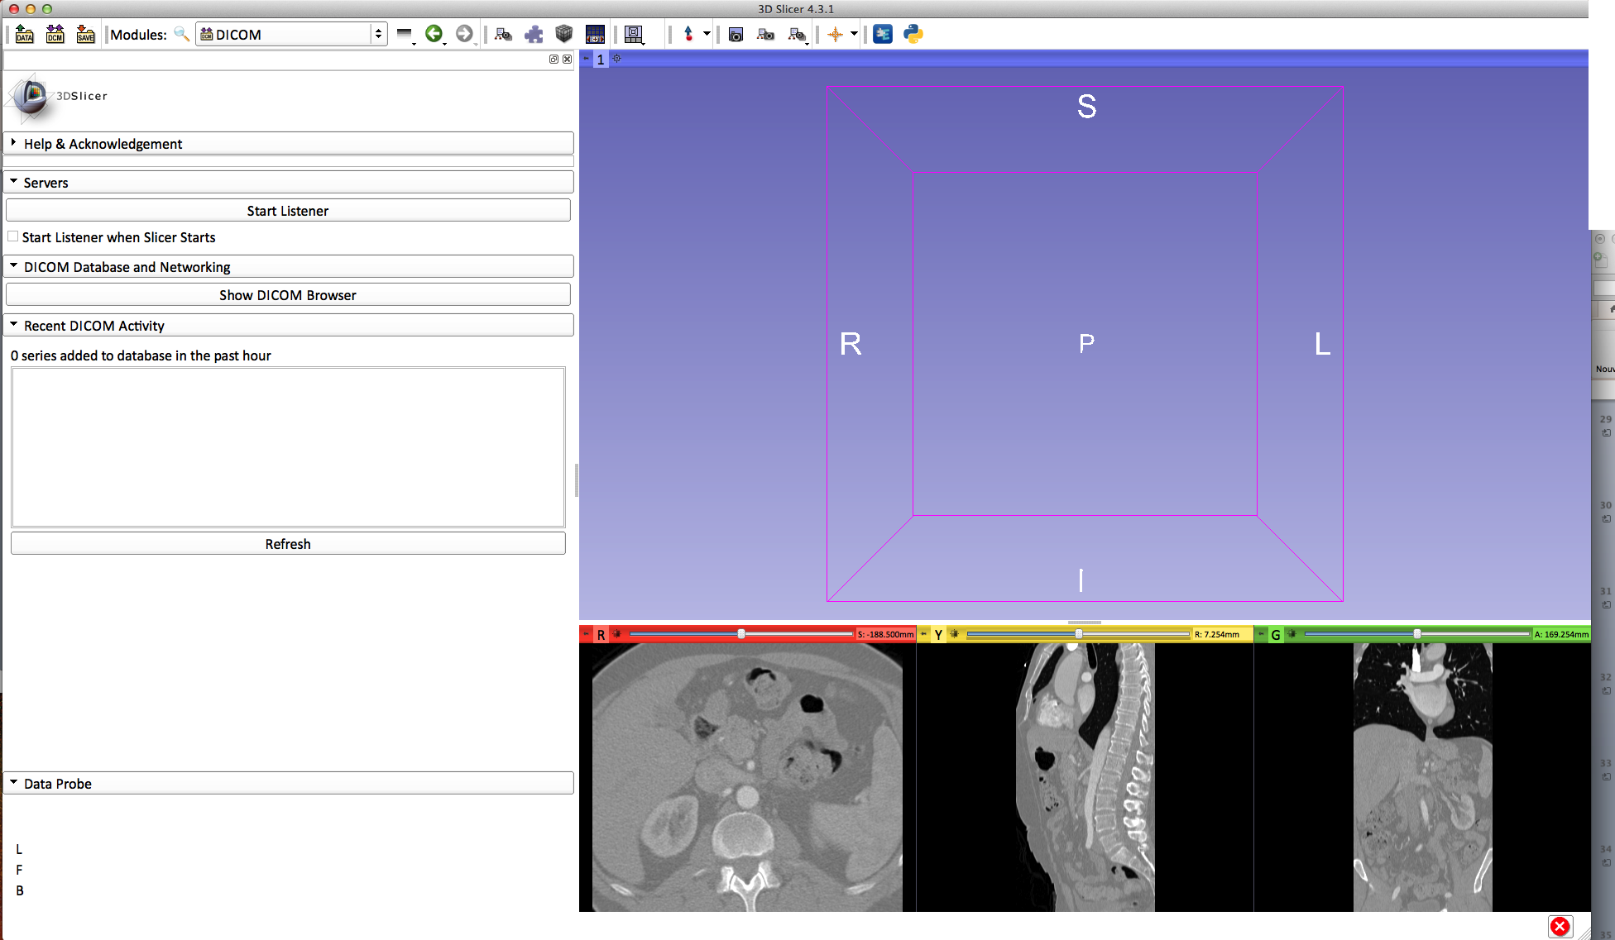
Loading a DICOM volume
Slicer displays the axial, coronal and sagittal slices of the DICOM dataset

Slide 35
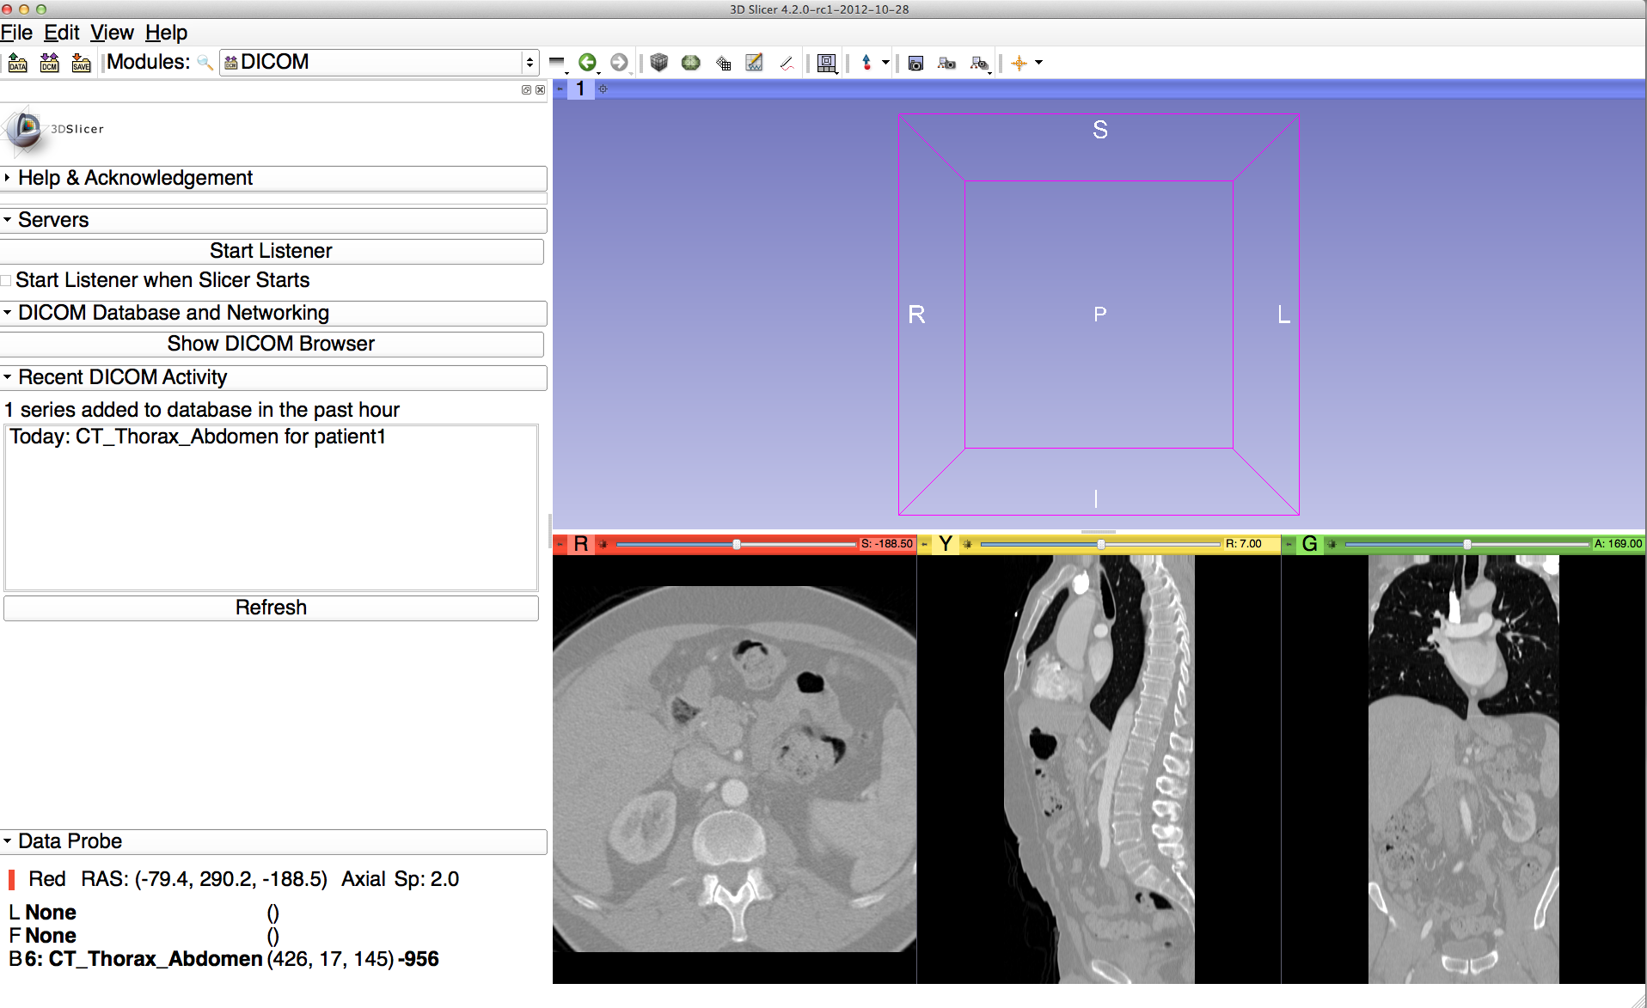
Loading a DICOM volume
Select the Volumes module in the modules menu

Slide 36
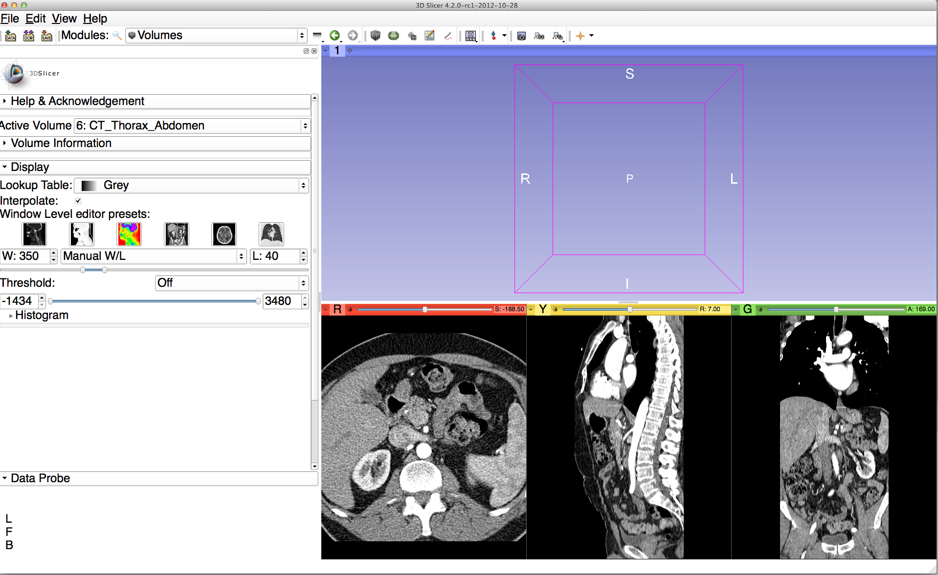
Loading a DICOM volume
Select the Active Volume 6:CT_Thorax_Abdomen
Slicer has a series of window/level presets available
Click on the Window Level Preset CT-abdomen, or adjust manually the Window and Level using the Manual W/L slider

Slide 37
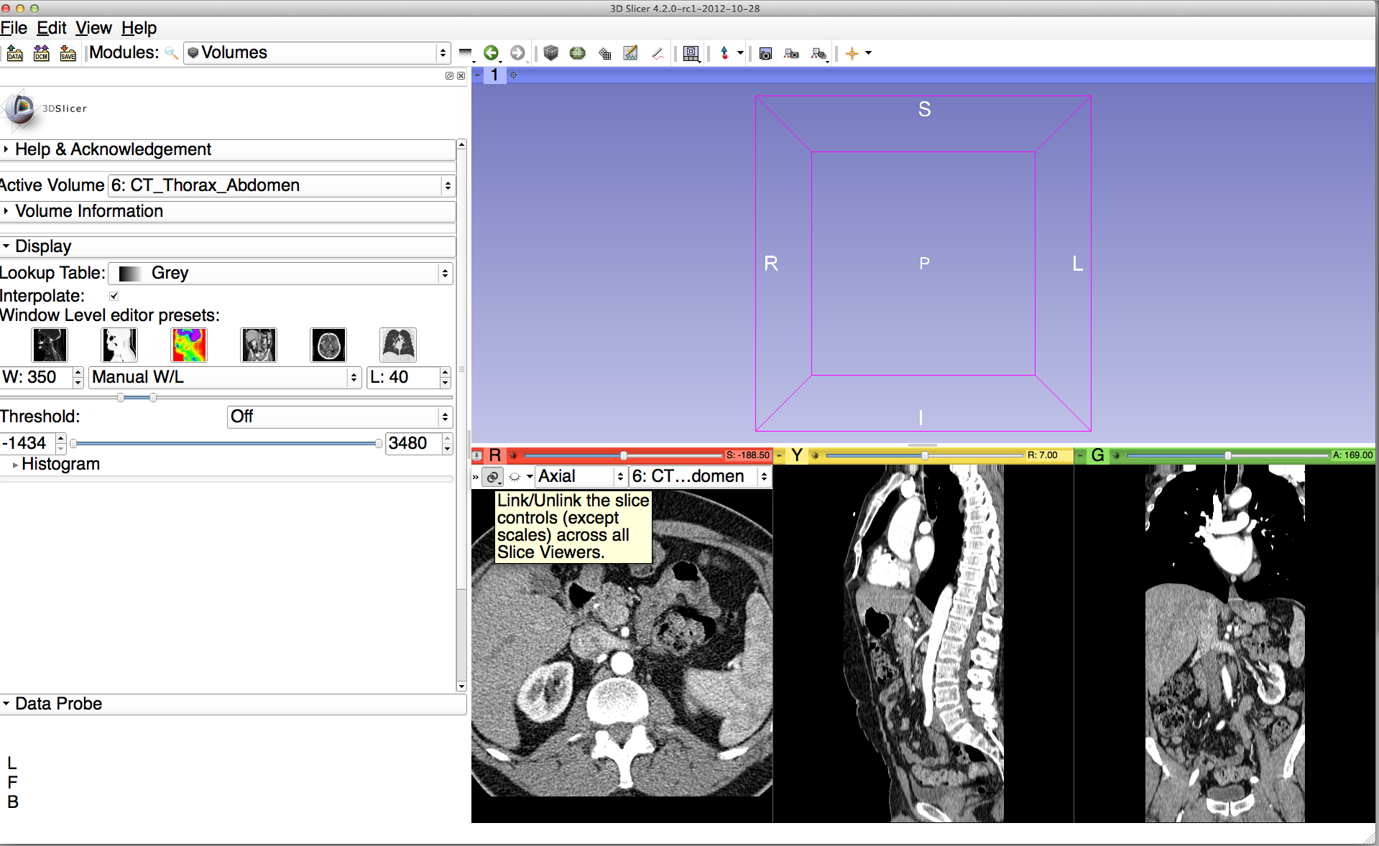
Loading a DICOM volume
Position the mouse cursor over the red banner in the Red Viewer to display the slice menu.
Click on the Links icon to link the slice controls across all Slice Viewers.
Click on the Eye icon to display the three anatomical slices in the 3D Viewer

Slide 38
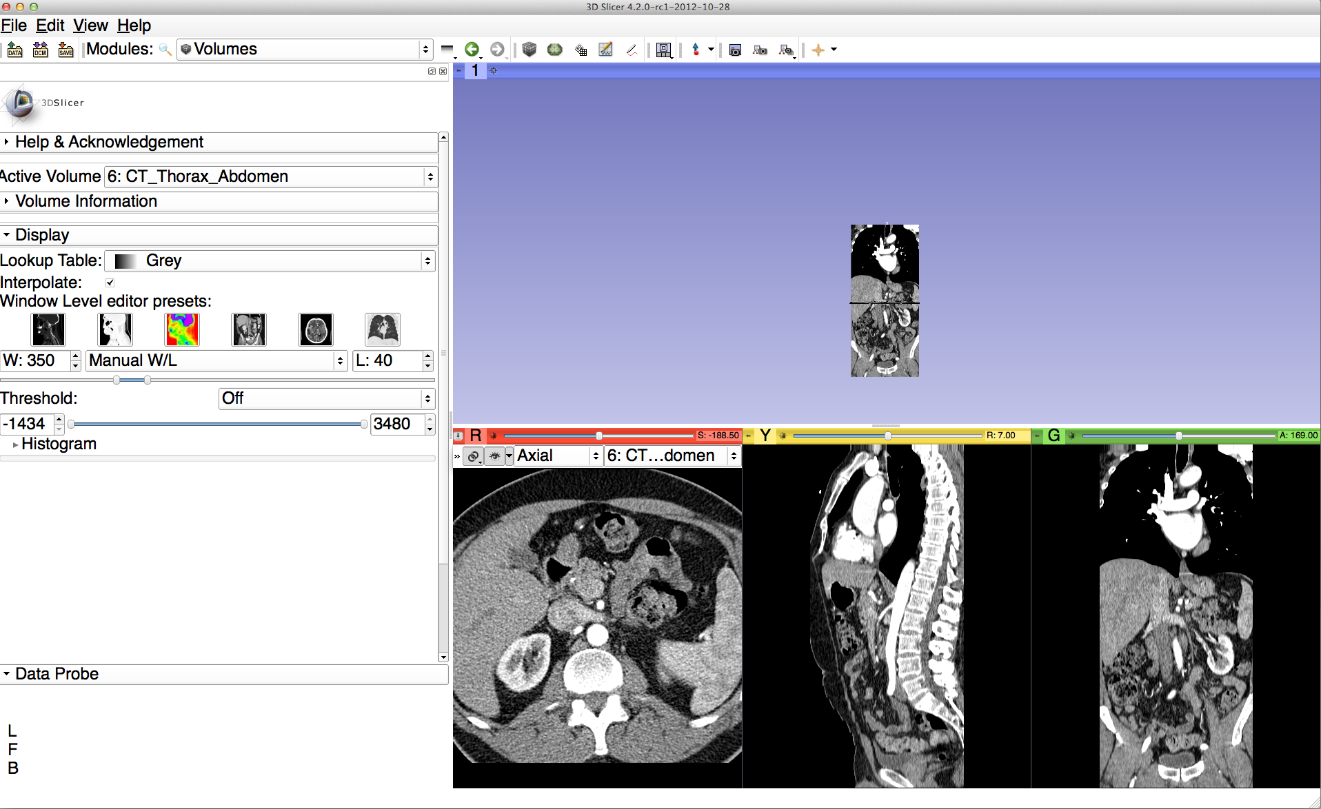
Loading a DICOM volume
The three anatomical slices appear in the 3D viewer. Use the right-mouse button in the 3D Viewer to zoom in and out

Slide 39
Loading a DICOM volume
Use the left-mouse button in the 3D Viewer to rotate the 3D volume

Slide 40
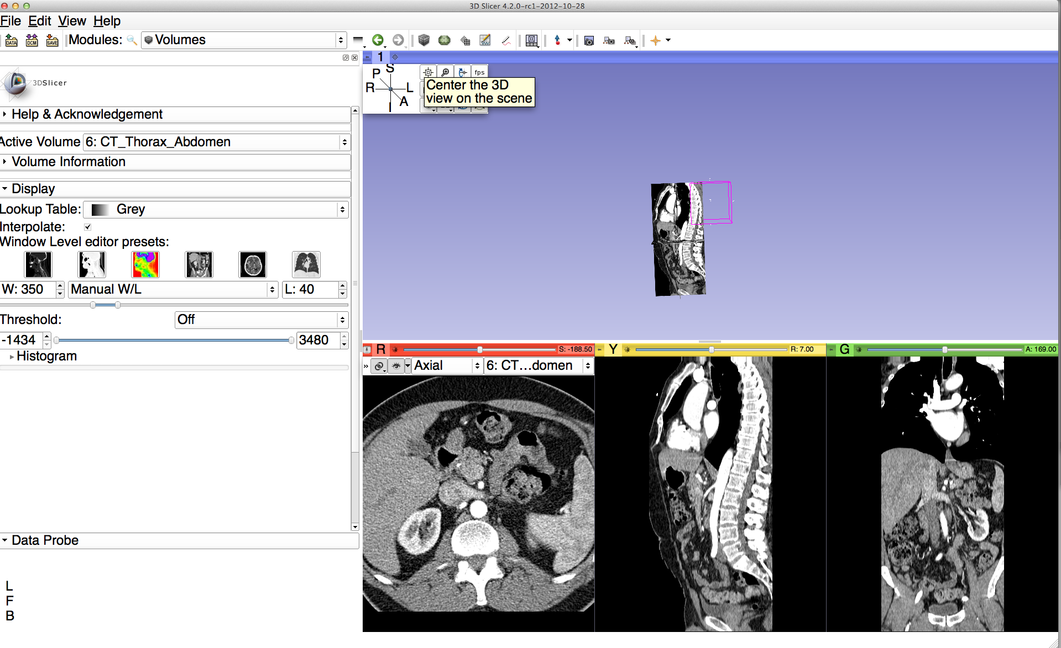
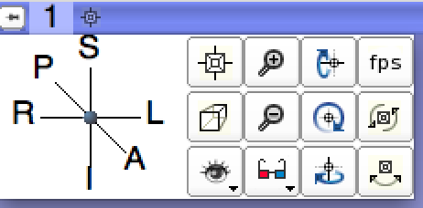

Loading a DICOM volume
Position the mouse over the blue banner in the 3D viewer window to display the 3DView controller, and click on the top left icon to center the 3D view on the scene
Note: a shortcut to this functionality is available through the icon next to the number ‘1’ in the blue banner

Slide 41
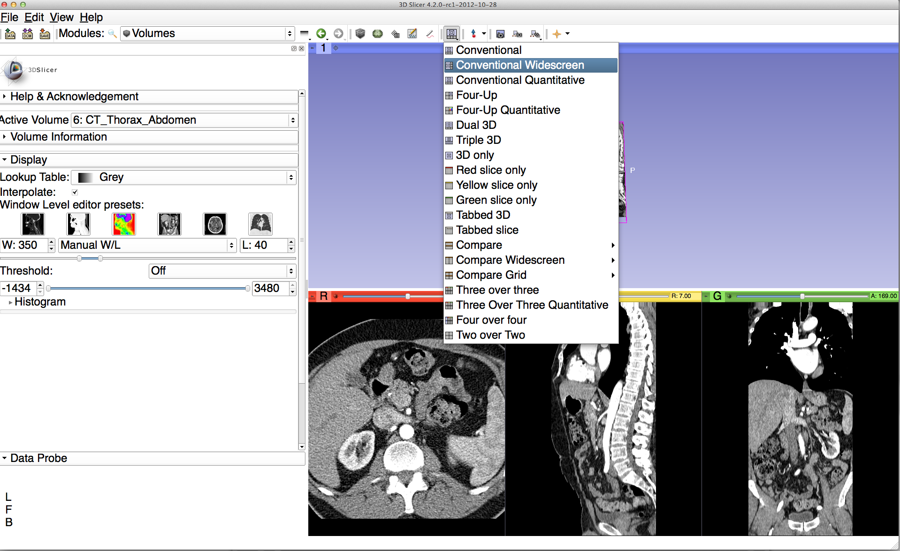
Loading a DICOM volume
Click on the Slicer layout menu icon, and select the Conventional Widescreen layout

Slide 42
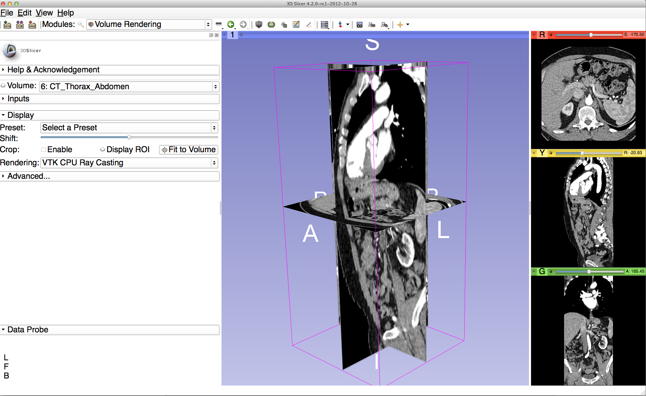
Loading a DICOM volume
Use the red slice, yellow slice and green slice sliders to slice through the volume in all three anatomical directions

Slide 43
3D Interactive exploration of thoraco-abdominal CT data using Volume Rendering

Slide 44
Volume Rendering
Select the module Volume Rendering in the modules menu

Slide 45
Volume Rendering
Select the volume 6:CT_Thorax_Abdomen

Slide 46
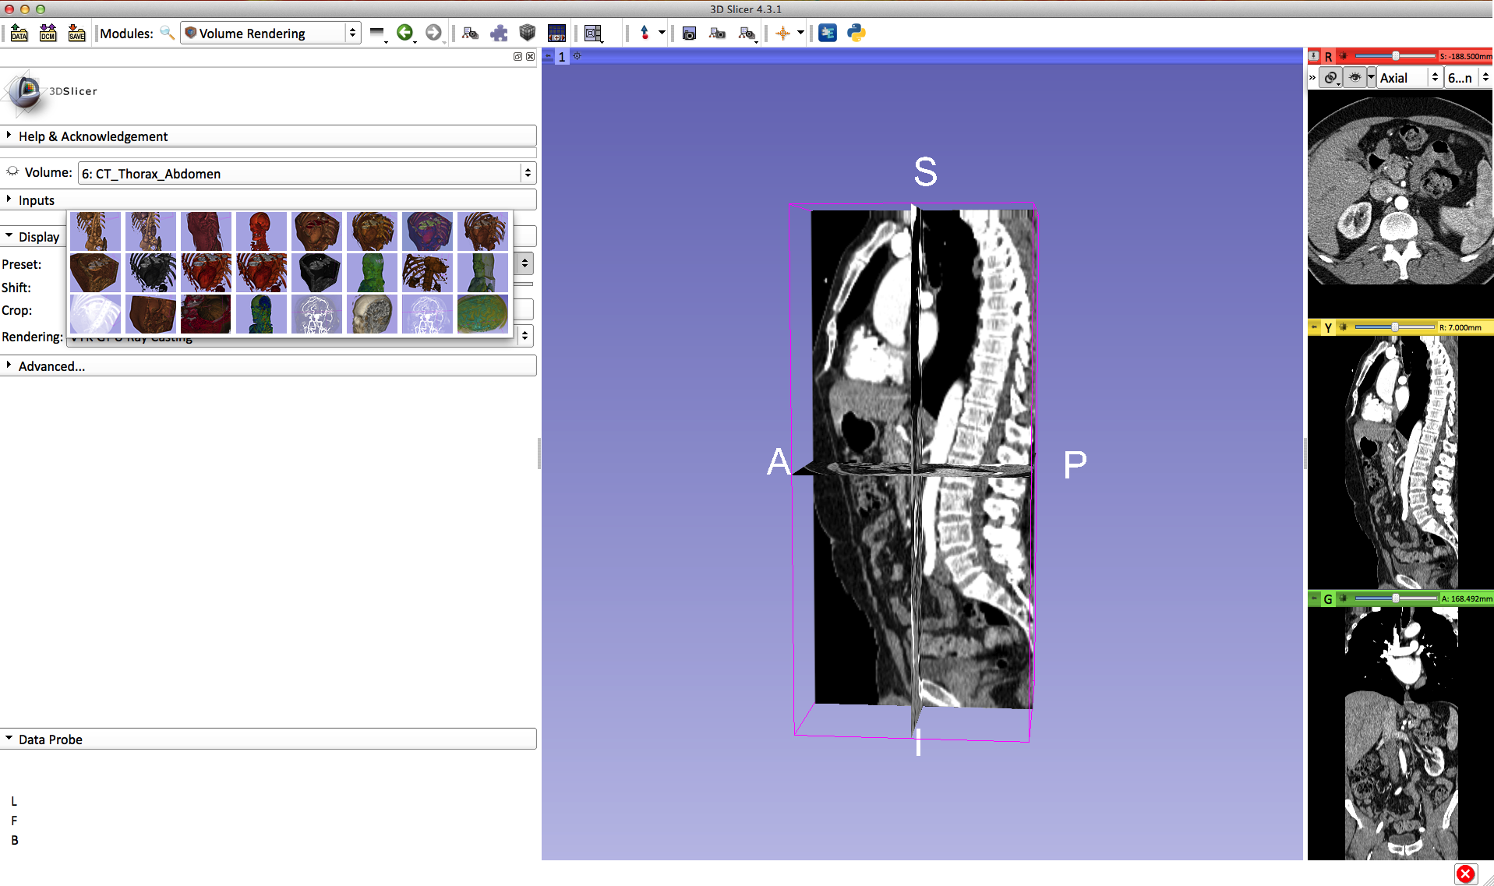
Volume Rendering
Click on Preset in the Display tab to display the list of available presets for the transfer function
Select the Preset CT-Cardiac3

Slide 47

Volume Rendering
Select the Rendering VTK CPU Ray Casting, and click on the eye icon in the Volume tab to display the Volume rendered volume in the 3D viewer

Slide 48

Volume Rendering
Slicer displays the 3D rendered volume of the CT_Thorax_Abdomen dataset

Slide 49

Volume Rendering
Move the Shift slider toward the right, to shift the transfer function and display the aorta

Slide 50

Volume Rendering
The volume rendered image of the aorta and rib cage appears in the 3D viewer

Slide 51
Volume Rendering
Click on the eye icon in the red viewer to turn off the visibility of the anatomical slices in the 3D viewer

Slide 52

Volume Rendering
Use the mouse in the 3D window to rotate the volume rendered image

Slide 53
Volume Rendering
Click on the eye icon in the volume rendering panel to remove the volume rendered image from the 3D viewer

Slide 54

Volume Rendering
Click on Display ROI to display a region of interest that we will use for cropping the dataset, and check the option Enabled

Slide 55

Volume Rendering
The region of interest appears in the 3DViewer

Slide 56

Volume Rendering
Turn on the visibility of the grayscale images in to the 3D Viewer, and position the ROI around the left and right kidneys using the ROI controls in the 2D anatomical views and in the 3D viewer

Slide 57
Volume Rendering
Click on the eye icon to display the volume rendered image of the kidney

Slide 58

Volume Rendering
Slicer displays the volume rendered image of the left kidney

Slide 59

Volume Rendering
Extend the ROI to the right kidney

Slide 60

Volume Rendering
Slicer displays the cropped volume rendered images showing the left and right kidney

Slide 61
Volume Rendering
Click on File→Close Scene to close the scene
Click on File→Exit to quit Slicer

Slide 62

Volume Rendering
Select Exit (discard modifications)

Slide 63

3D visualization of surface models of the brain

Slide 64
3D Data Loading and Visualization
The dataset is composed of an MR scan of the brain and 3D surface reconstructions of anatomical structures.
The data are part of the SPL-PNL Brain Atlas developed by Talos, Jakab, Kikinis et al. The atlas is available at:
http://www.spl.harvard.edu/publications/item/view/2037

Slide 65

3D visualization of surface models of the brain : Viewing the Scene
Open the directory dataset2_Head located in
3DVisualizationDICOM_Tuesday_Dec3
Drag and drop the file Head_Scene.mrb into Slicer

Slide 66

3D visualization of surface models of the brain : Viewing the Scene
Click on OK to load the file MRHead_Scene.mrb into Slicer

Slide 67

3D visualization of surface models of the brain : Viewing the Scene
3D Viewer
When the scene is finished loading, Slicer displays:
a 3D model of the head in the 3D Viewer, and
anatomical MR slices of the brain in the 2D Slice Viewers.

Slide 68

3D visualization of surface models of the brain : Exploring Slicer’s functionality
To access the Models module, browse through the list of modules.

Slide 69

3D visualization of surface models of the brain : Switching to the Models Module
Slicer displays the GUI of the Models module.

Slide 70
3D visualization of surface models of the brain : Basic 3D Interaction
Left-click & drag
Position the mouse in the 3D Viewer.
Hold down the left mouse button and drag to rotate the model.

Slide 71


3D visualization of surface models of the brain : Viewing Slices in the 3D Viewer
Click on the Slice Visibility icon
to display the Axial Slice in the 3D Viewer

Slide 72

3D visualization of surface models of the brain
Slicer adds a view of the Axial slice in the 3D View.

Slide 73
3D visualization of surface models of the brain : Viewing Slices in the 3D Viewer
Click on the layout menu in the toolbar, and select the Conventional layout

Slide 74

3D visualization of surface models of the brain
Select the Skin.vtk
Change the opacity of the model from 1.0 to 0.0.

Slide 75

3D visualization of surface models of the brain
skin model opacity = 0.5

Slide 76

3D visualization of surface models of the brain
The model of the skin becomes invisible in the 3D viewer.
(skin model opacity = 0.0)

Slide 77

3D visualization of surface models of the brain
Click on the Slice Visibility icon in the Green Slice Viewer
to display the Coronal Slice in the 3D Viewer.

Slide 78

3D visualization of surface models of the brain
The Axial and Coronal Slices are displayed in the 3D Viewer.

Slide 79

3D visualization of surface models of the brain
Select the 3D model skull_bone.vtk in the Model Hierarchy and turn on the Clipping option.

Slide 80

3D visualization of surface models of the brain
Browse through the coronal slices to expose the 3D model of the white matter, and the left and right optic nerves.

Slide 81

3D visualization of surface models of the brain
Now make the skull invisible.

Slide 82

3D visualization of surface models of the brain
Scroll the Coronal Slices to display the hemispheric white matter model in the context of the image data in the 3D Viewer.

Slide 83

3D visualization of surface models of the brain
Select the hemispheric white matter model called
hemispheric_white_matter.vtk
Turn off its visibility.

Slide 84

3D visualization of surface models of the brain
Slicer displays the optic nerve, optic chiasm and optic tracts overlaid on the MR images of the brain.

Slide 85

3D visualization of surface models of the brain
Windows/Linux users: Position the mouse in the 3D Viewer, hold down the right mouse button and move the mouse down to zoom in.
Mac users: Position the mouse in the 3D Viewer, hold down the apple button and the mouse button and move the mouse down to zoom in
(or use two fingers on the touch pad).

Slide 86
3D visualization of surface models of the brain
Slicer displays a closer view of 3D anatomical structures overlaid on 2D MR slices

Slide 87

Close the existing scene and all its data
Select File->Close Scene
This removes any dataset previously loaded into Slicer.
Select File→Exit to exit the software

Slide 88
Overview
Part I: Introduction to the 3DSlicer software
Part II: 3D Data Loading and visualization of DICOM images
- Volume Rendering of thoraco-abdominal CT data
- Surface Rendering of MR head data
Part III: 3D interactive exploration of the anatomy
- Exploration of the Segments of the liver
- Exploration of the Segments of the lung

Slide 89
Slicer for Radiology Education
Models completed as ‘virtual dissection’ by a medical student who is now a radiology resident

Slide 90

Part II:
Interactive 3D Visualization of the segments of the liver

Slide 91

Anatomy of the liver

Slide 92

Liver dataset
The liver dataset is
a contrast-enhanced CT
abdominal scan of a
healthy 36 year-old male.

Slide 93

3D segments of the liver
Segment IVa
Segment VII
Segment II
Segment III
Segment VI
Segment IVb
Segment V

Slide 94

3D segments of the liver
Segment I
Segment II
Segment VII
Segment III
Segment IVb
Segment VI
IVC
Segment V

Slide 95

Liver vasculature
Middle hepatic vein
Left portal vein
Left hepatic vein
Right portal
vein
Caudate vein
Main portal vein
IVC
Right hepatic vein

Slide 96

Loading the Liver Scene
Browse to the directory 3DVisualizationDICOM_Tuesday_Dec3
Select the directory dataset3_Liver
Drag and drop the file LiverSegments_Scene.mrb into Slicer
Click on OK to load the scene into Slicer

Slide 97

Loading the Liver Scene
Click on OK to load the scene into Slicer

Slide 98

Liver Segments Scene
The elements of the scene appear in the Viewer

Slide 99
3D models of the liver
Segment VIII
Segment IVa
Segment VII
Segment II
Segment III
Segment VI
Segment IVb
Segment V

Slide 100
3D models of the liver
Segment I
Segment II
Segment VII
Segment III
Segment IVb
Segment VI
IVC
Segment V

Slide 101
3D models of the liver
Middle hepatic vein
Left portal vein
Left hepatic vein
Right portal
vein
Caudate vein
Main portal vein
IVC
Right hepatic vein

Slide 102

3D Exploration of Liver Segments
Example:
What organ abuts the
left-most margin of
segment II in this
patient ?
Notes:
102

Slide 103

3D Exploration of Liver Segments
Select the module Models
Click on the Liver Structures Models Hierarchy
Notes:
103

Slide 104

3D Exploration of Liver Segments
Select the model Liver_Segment II
Turn on/off its visibility to locate
it in the 3D viewer.
Notes:
104

Slide 105

3D Exploration of Liver Segments
Position the mouse in the 3D Viewer, hold down the left mouse button and drag to orient the 3D model to a superior view.
National Alliance for Medical Image Computing
http://na-mic.org © 2010, ARR
Notes:
105

Slide 106
3D Exploration of Liver Segments
Seg II
Question 1:
What organ abuts the left-most margin of segment II in Patient 1?
Notes:
106
106

Slide 107
3D Exploration of Liver Segments
Question 1:
What organ abuts the left-most margin of segment II in this patient?
Answer 1: Stomach
stomach
Seg II
Notes:
107
107

Slide 108
3D Exploration of Liver Segments
Question 2:
Which segment would
most likely be affected by
an aggressive tumor
invading locally from the
right adrenal gland ?
Notes:
108

Slide 109

3D Exploration of Liver Segments
Question 2:
Which segment would
most likely be affected by
an aggressive tumor
invading locally from the
right adrenal gland ?
Answer 2: Segment VII
Segment VII
Notes:
109

Slide 110
3D Exploration of Liver Segments
Question 3:
Which vessel separates Segment IVb and Segment V?
Notes:
110

Slide 111

Middle Hepatic Vein
Middle hepatic vein
Segment IVb
Segment V
Question 3:
Which vessel separates Segment IVb and Segment V?
Answer 3: The middle hepatic vein
Notes:
111

Slide 112
Closing the Liver Scene
Select File → Close Scene and File→Exit

Slide 113
Interactive 3D Visualization of the segments of the lungs

Slide 114

Segments of the lung
Segmentation and 3D surface reconstruction of the lung and pulmonary vessels

Slide 115
Segments of the lung
3D parcellation of arteries and veins from original model of pulmonary vessels
Right Upper Lobe (RUL)
  RUL Pulmonary Vein
  RUL Anterior Segment
  RUL Apical Segment
  RUL Posterior Segment
Right Middle Lobe (RML)
  RML Pulmonary Vein 1 & 2
  RML Lateral Segment
  RML Medial Segment
Right Lower Lobe (RLL)
  RLL Pulmonary Vein 1,2,3
  RLL Anterior Basal Segment
  RLL Medial Basal Segment
  RLL Lateral Basal Segment
  RLL Posterior Basal Segment

Slide 116

Loading the Chest Data Scene
3DVisualizationDICOM_Tuesday_Dec3
Select the subdirectory dataset4_Chest
Drag and drop the file LungSegments_Scene.mrb into Slicer

Slide 117

Loading the Lung Scene
Click on OK to load the file into Slicer

Slide 118

Loading the Lung Scene

Slide 119

Loading the Lung Scene
Select the module Models from the modules Menu.

Slide 120

Lung Segments
Slicer displays the list of 15 surface models of pulmonary structures.

Slide 121

Lung Segments – Question 1
Q1: Why is there a gap in the vessels at the arrows?

Slide 122
Lung Segments – Answer 1
A1: Major fissure

Slide 123
Lung Segments – Question 2
Q2. Which segment would be most likely to be the source of bleeding from a depressed right clavicle fracture?

Slide 124


Lung Segments – Answer 2
RUL-Posterior
RUL-Apical

Slide 125
Lung Segments – Question 3
Q3: Which lower lobe segment would likely be involved by a tumor growing downward from the right middle lobe medial segment?

Slide 126

Lung Segments – Answer 3
RML-medial
A3: Anterior Basal
RLL-anterior basal

Slide 127

Lung Segments – Question 4
Question 4: Classify the segments of the lower lobe by size

Slide 128

Lung Segments – Question 4
A4: Smallest: Medial Basal

Slide 129

Lung Segments – Question 4
A4: Largest: Anterior / Posterior Basal

Slide 130



3D Visualization of DICOM images
Interactive user-interface to load and manipulate greyscale volumes, labelmaps and 3D models.
User-defined 3D view of the anatomy
3D Open-source platform for Linux, Mac and Windows

Slide 131

3DSlicer website

Slide 132

www.slicer.org

Slide 133
3DSlicer at RSNA 2013
  Quantitative Imaging Reading Room Exhibit
  QIRR 1028, Lakeside Center
Daily meet the experts session, 12:15-1:15 pm
3DSlicer: An Open Source Platform for Segmentation, Registration, Quantitative Imaging, and 3D Visualization of Multi-Modal Image Data.
Sonia Pujol, PhD, Steve Pieper, PhD, Andriy Fedorov, PhD, Ron Kikinis, MD,

Slide 134
Additional Related Hands-on courses
All courses are in this Advanced Imaging Classroom: S401CD
  Wed 10:30 am – Open Access Imaging Data Resources: NIH Cancer Imaging Archive (ICIA41)
  Wed 12:30 pm – Correlating Imaging with Human Genomics (ICIA42)

Slide 135

3DSlicer at RSNA
Questions: spujol@bwh.harvard.edu

Slide 136


Acknowledgments
National Alliance for Medical Image Computing (NA-MIC)
(NIH Grant U54EB005149)
Neuroimage Analysis Center (NAC)
(NIH Grant P41 RR013218)
Marianna Jakab, Surgical Planning Laboratory, Brigham
and Women’s Hospital

Slide 137

www.slicer.org
www.na-mic.org
Questions and comments: spujol@bwh.harvard.edu

