Slide 1
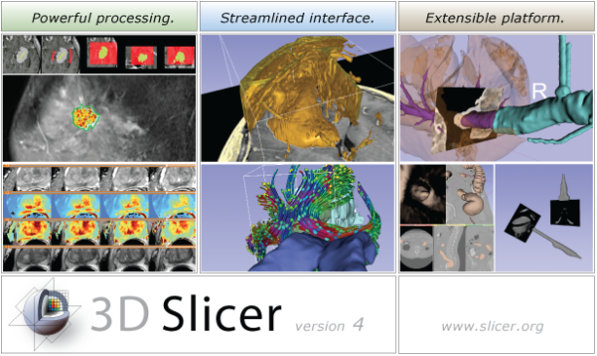
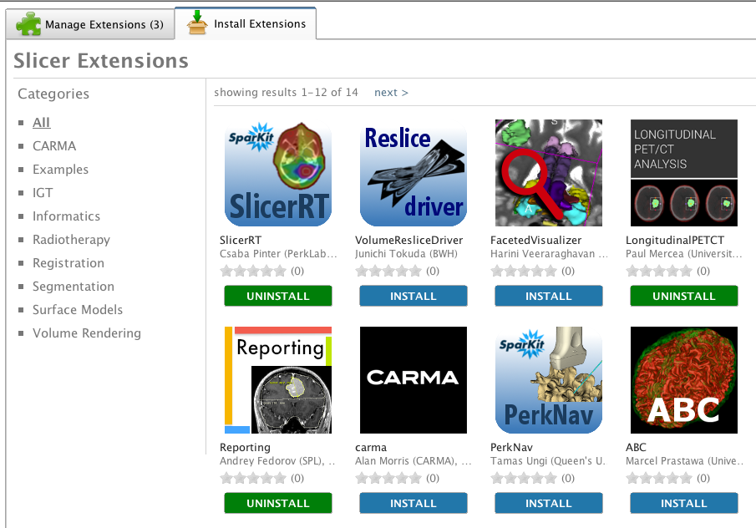
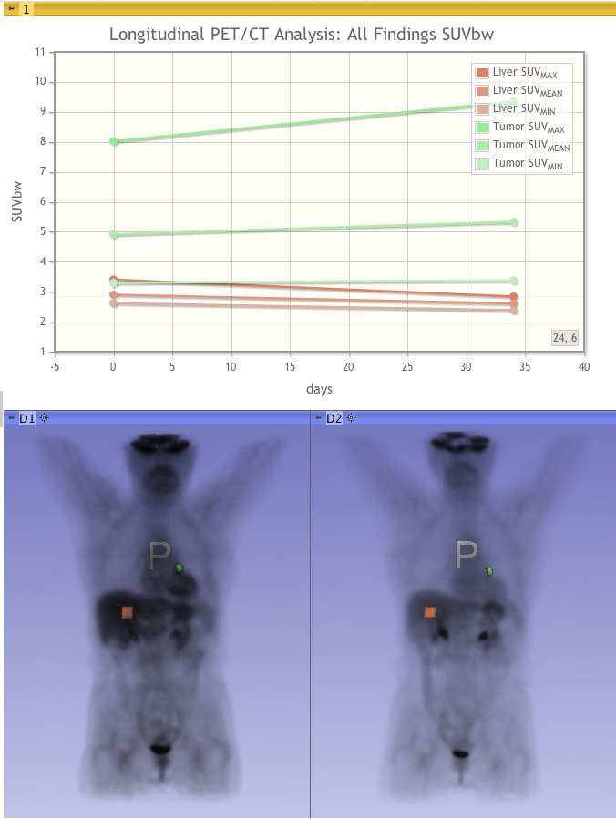
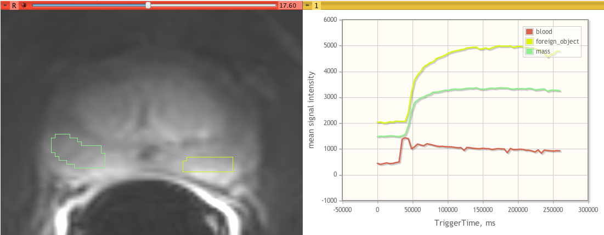
3D Slicer is free, open source software for visualization and image analysis on Windows, Linux and Mac OSX.
Segmentation
Volume Rendering
Measurement
Multi-Modality Registration
Diffusion Tractography
Compare View and Crosshairs
DICOM I/O and Networking
Image-Guided Therapy
New at RSNA 2012: Version 4.2
Slicer Extensions
Multivolume support (time series)
Charts
Improved DICOM support
Single-file scene archiving: MRB
Bug fixes and improvements

Slide 2
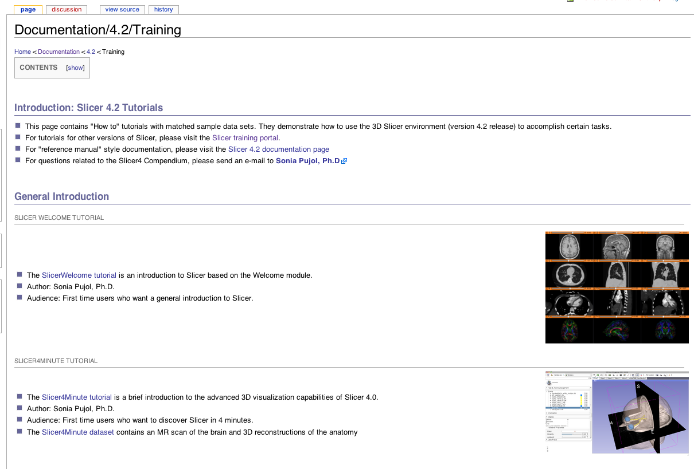
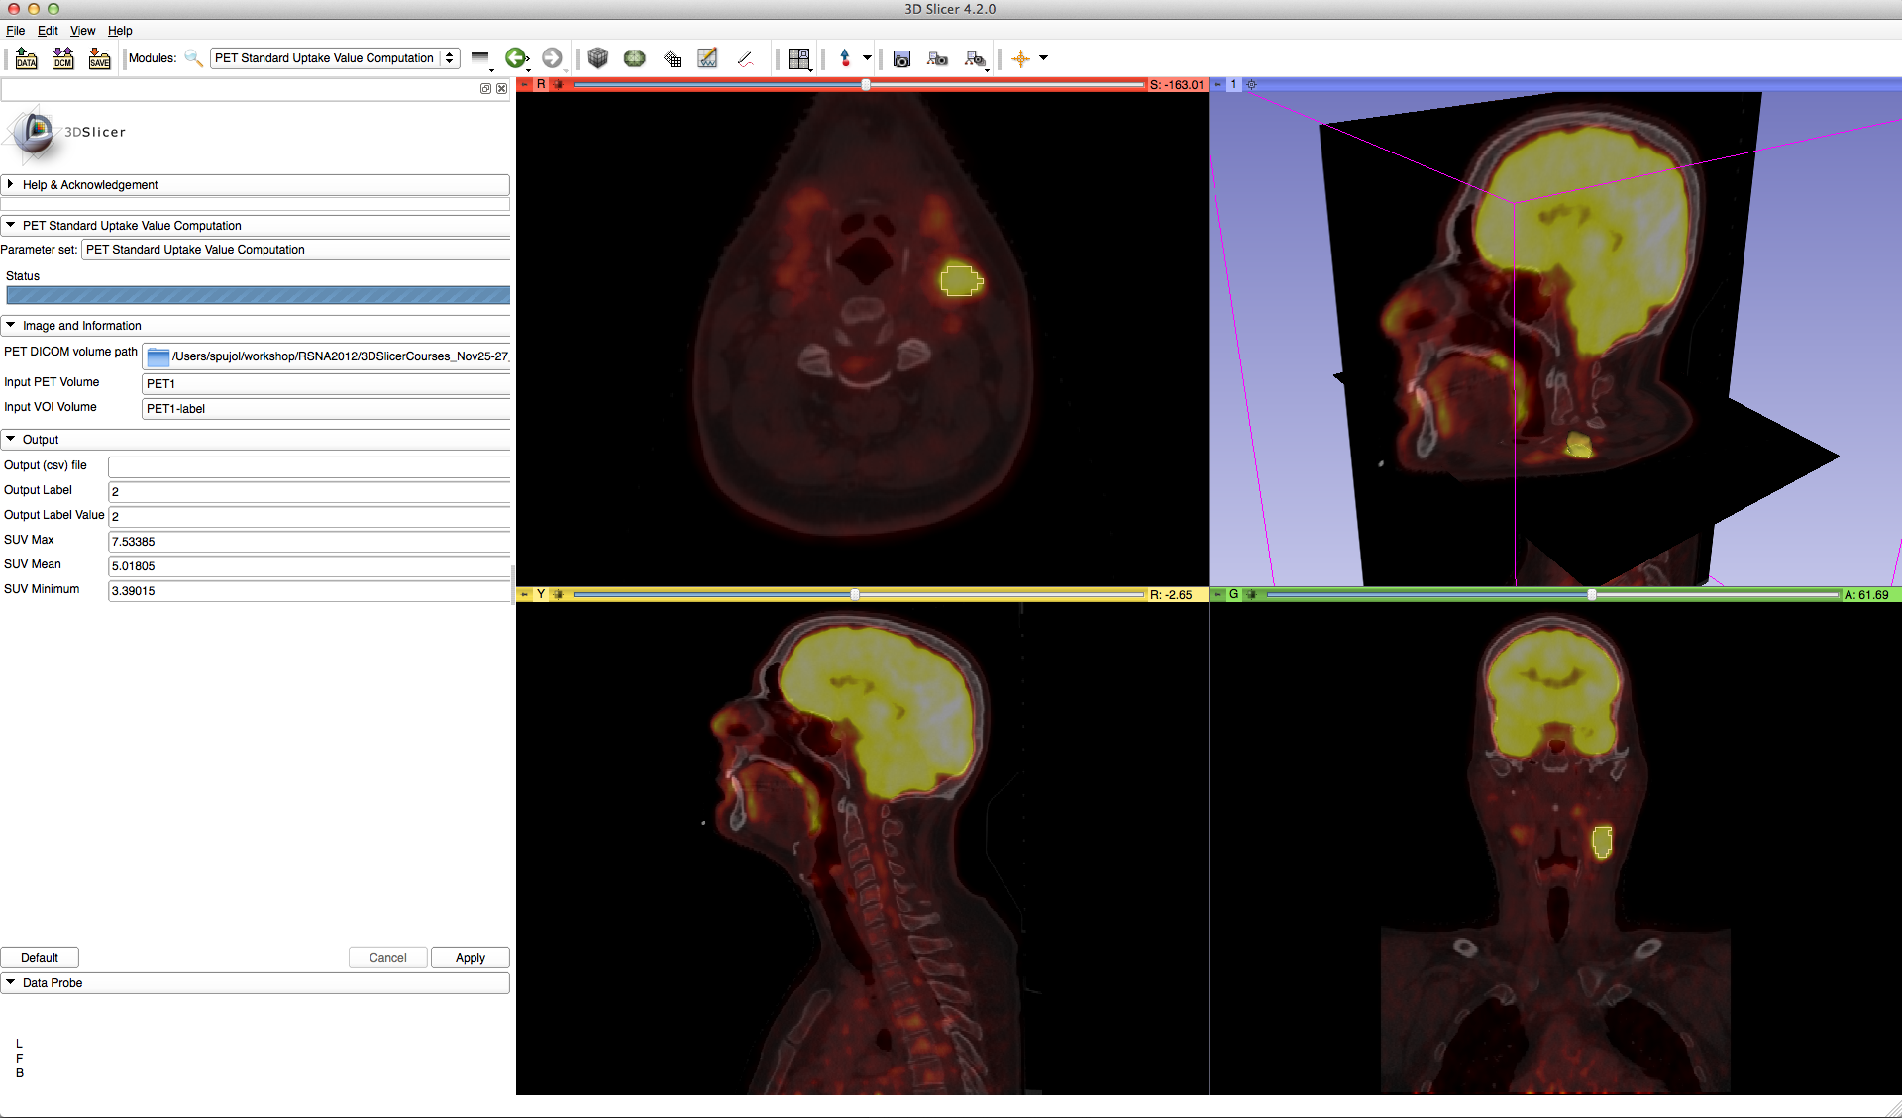
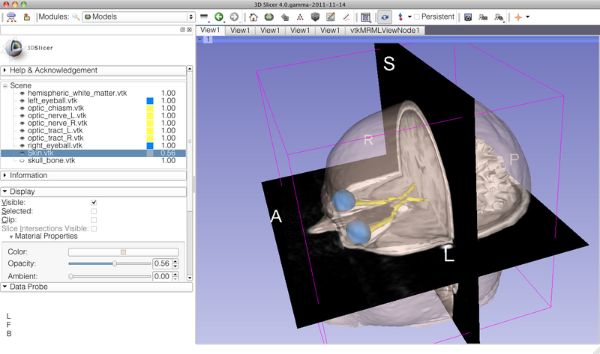
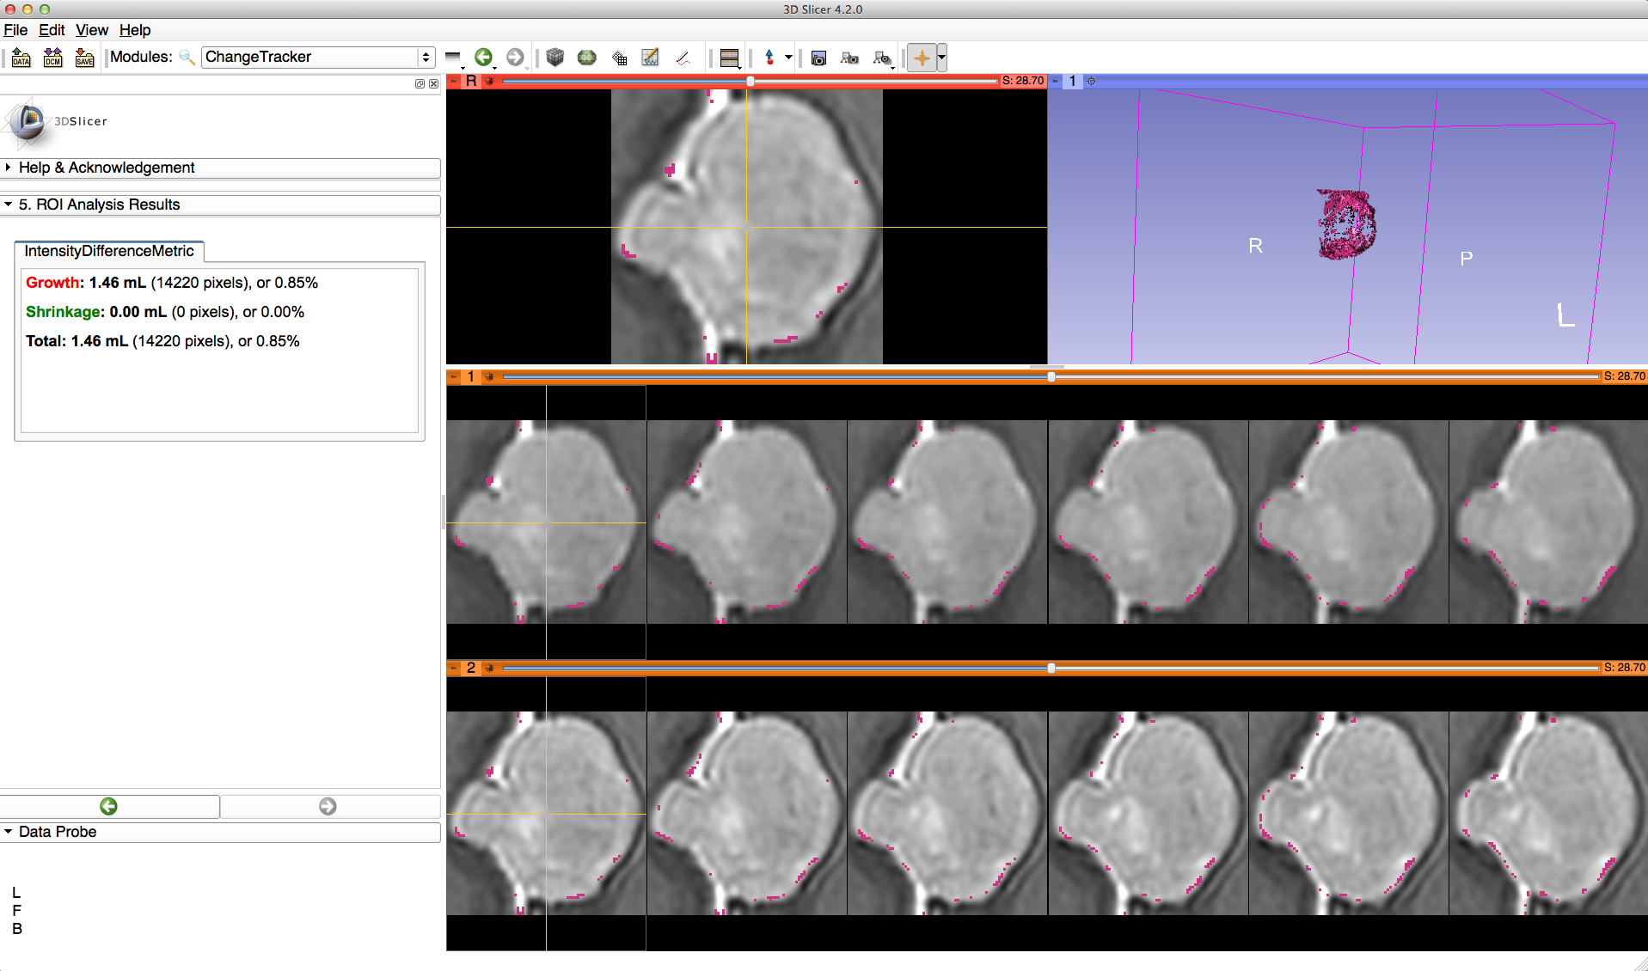
3D Slicer events at RSNA 2012

