Slide 1

Coming of age for a
NA-MIC DBP
Gabor Fichtinger, Andras Lasso, Tamas Ungi, Csaba Pinter, Tomi Heffter, Sid Vikal, David Gobbi, and Attila Tanacs
Queen’s University, Canada

Slide 2
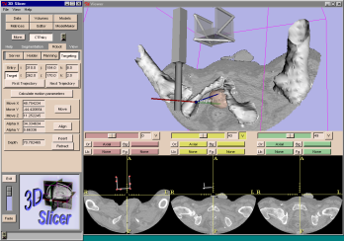
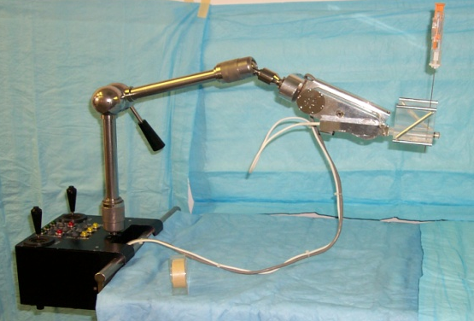
In-situ image-guided surgery
Coordinates
Imaging
scanner
CT,MRI,
US, X-ray
Planning & control computer
Patient
Robot
Digital images
Physician

Slide 3
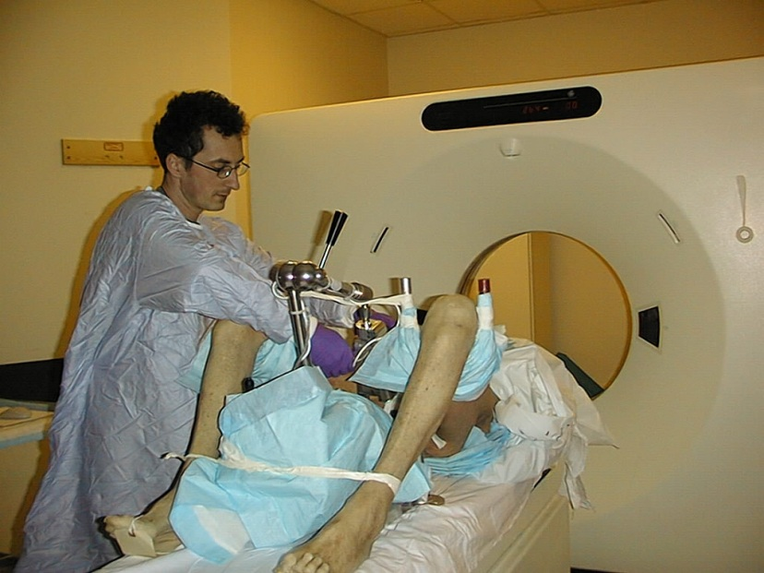
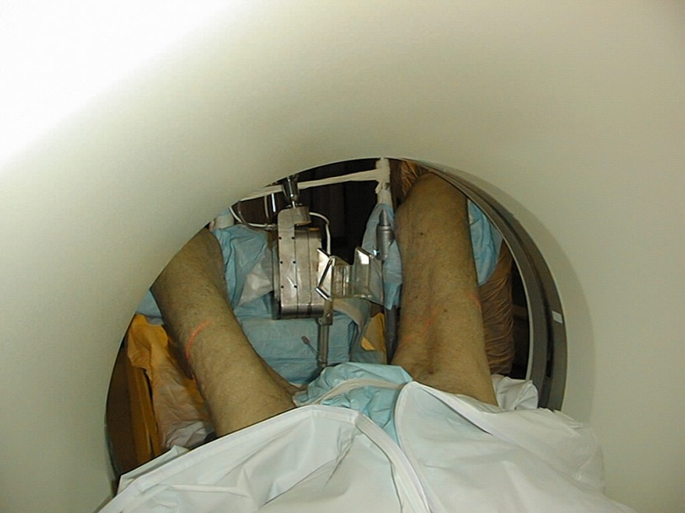
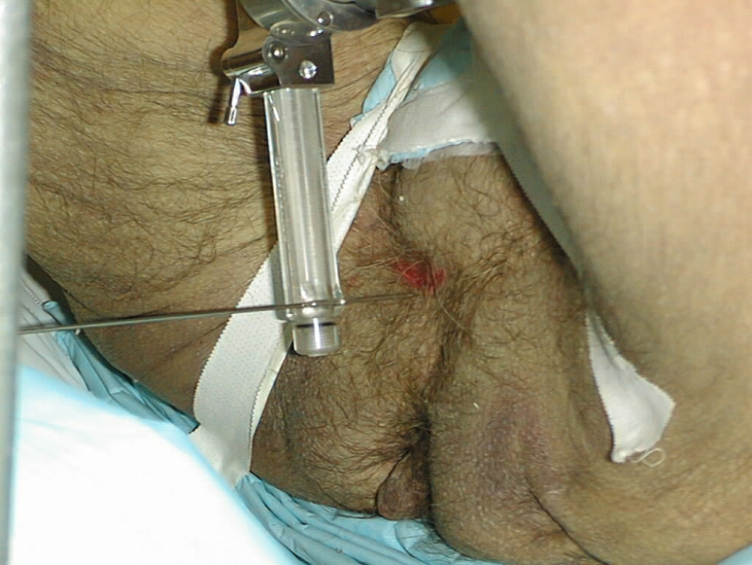
First implementation
Fichtinger et al. Acad Rad, 2002

Slide 4
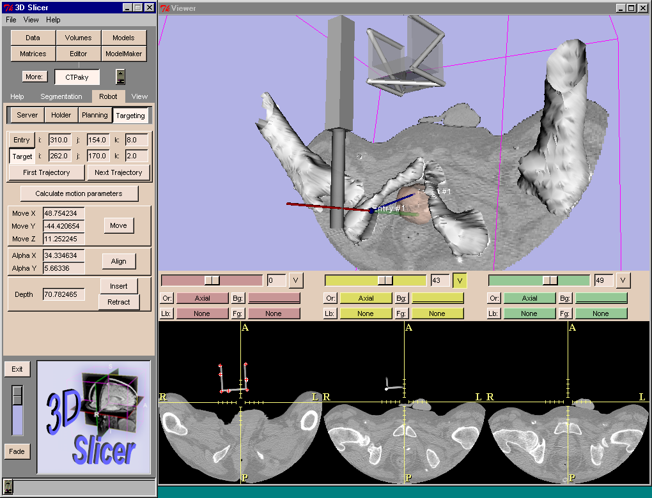
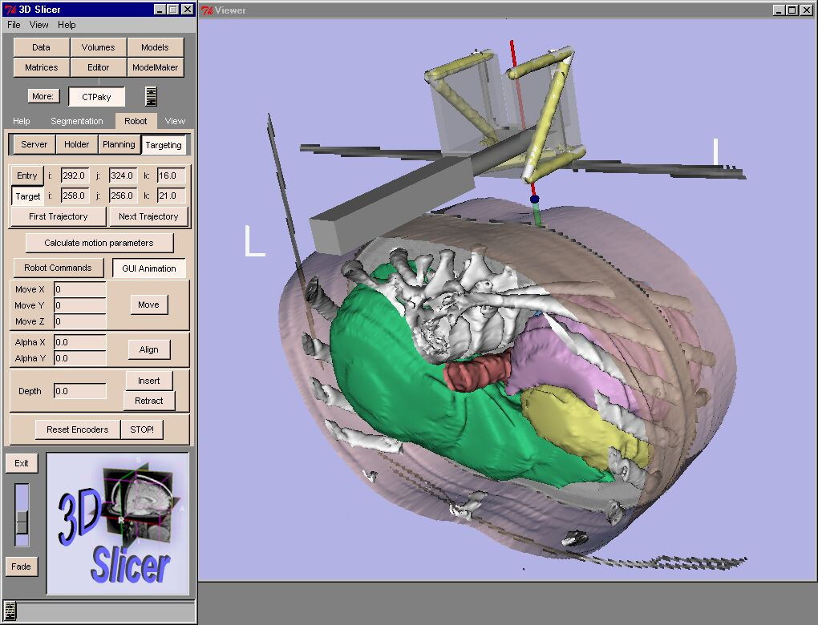
First implementation
Tanacs, 2002

Slide 5
Hypothesis
  It is possible to architect IGS systems that, to a large extent, are invariant to imaging modalities, scanners, trackers, and surgical devices, and even to anatomical sites and diseases.

Slide 6
Goals as a NA-MIC DBP
Develop generic IGS platform on Slicer
Apply it in image-guided needle surgery
    Robot-assisted prostate interventions
    Spinal interventions
  Go clinical

Slide 7
Heterogeneous human supervisory control (HHSC)
Subsystem boundary
Operator
Display
Navigation workstation
MRI scanner
Work-space
Image registration and fusion
Robot
controller
Joint
encoders
Controls
Needle guide
Lasso, 2012

Slide 8
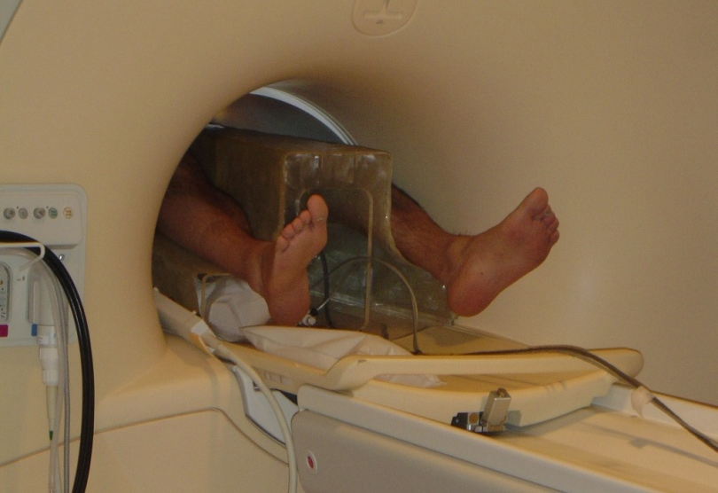
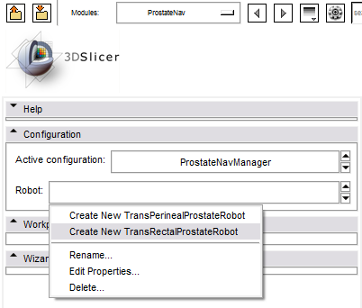
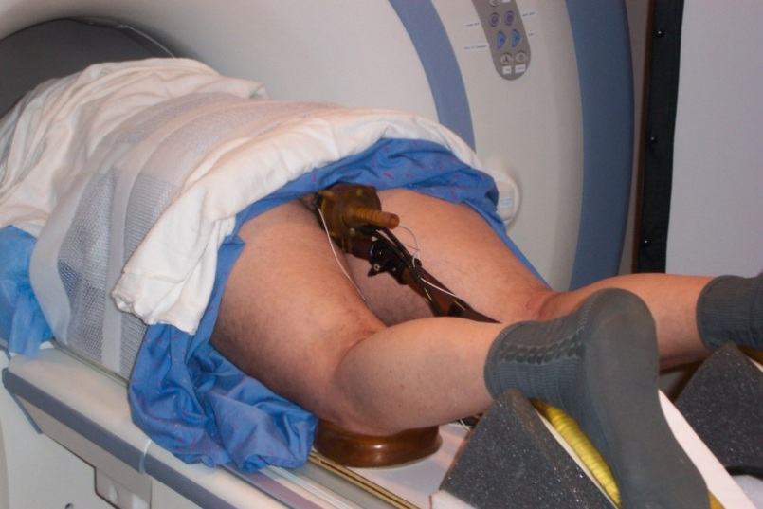
Robotic prostate biopsy in MRI
Configurable to multiple robot systems

Slide 9
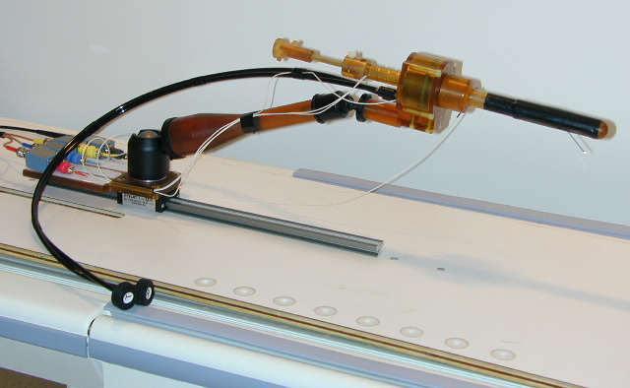
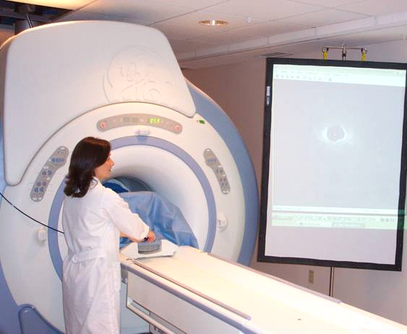
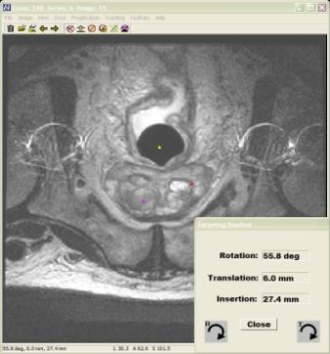

Transrectal system at JHU/NIH
Krieger et al. IEEE TMBE, 2005
(Best paper in 2005-2009)

Slide 10
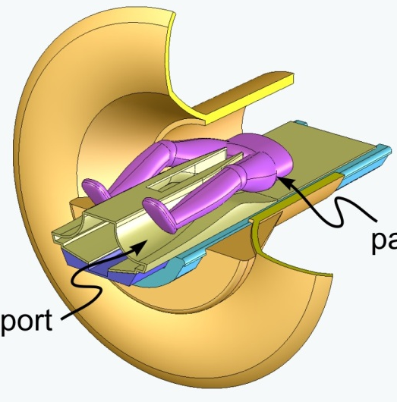
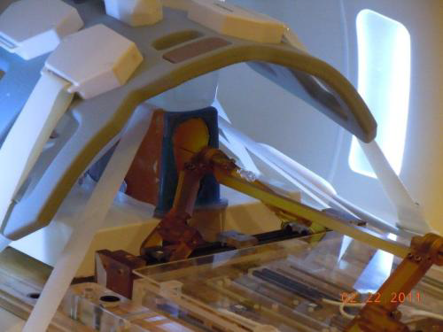
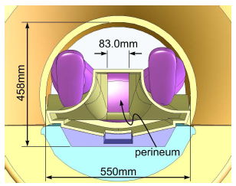
Transperineal system at BWH
Fischer et al. IEEE ASME, 2007
Song et al, IJCARS 2011

Slide 11
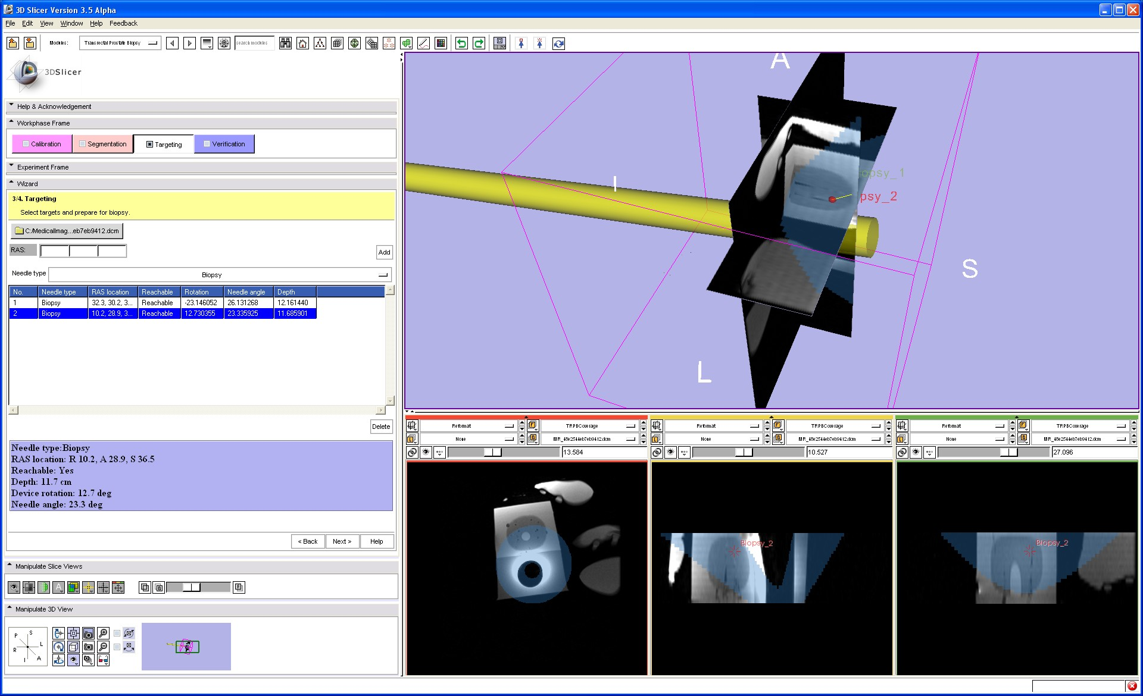
Workflow definition
  Imaging & modeling
  Planning
  Robot registration
  Targeting
  Execution & monitoring
  Verification

Slide 12
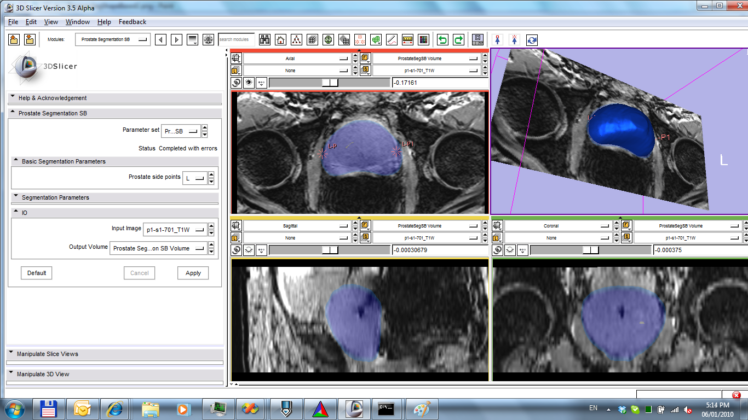
Modeling and planning
Gao, Tannenbaum et al. IEEE TMI 2010

Slide 13
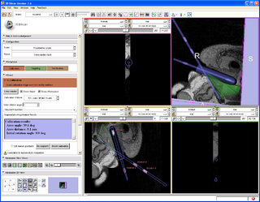
Robot registration
Lasso, 2011

Slide 14
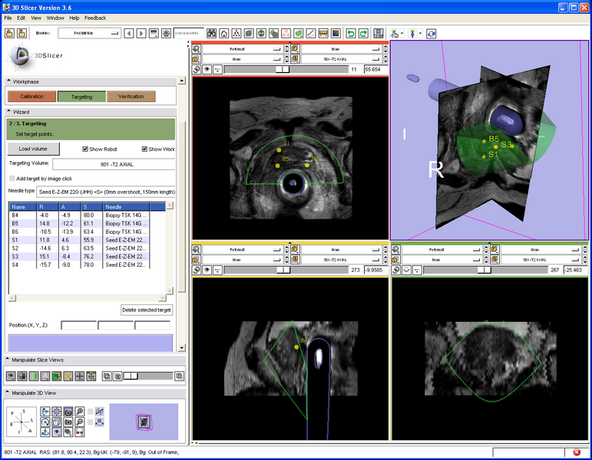
Targeting the biopsy sites
Lasso, 2011

Slide 15
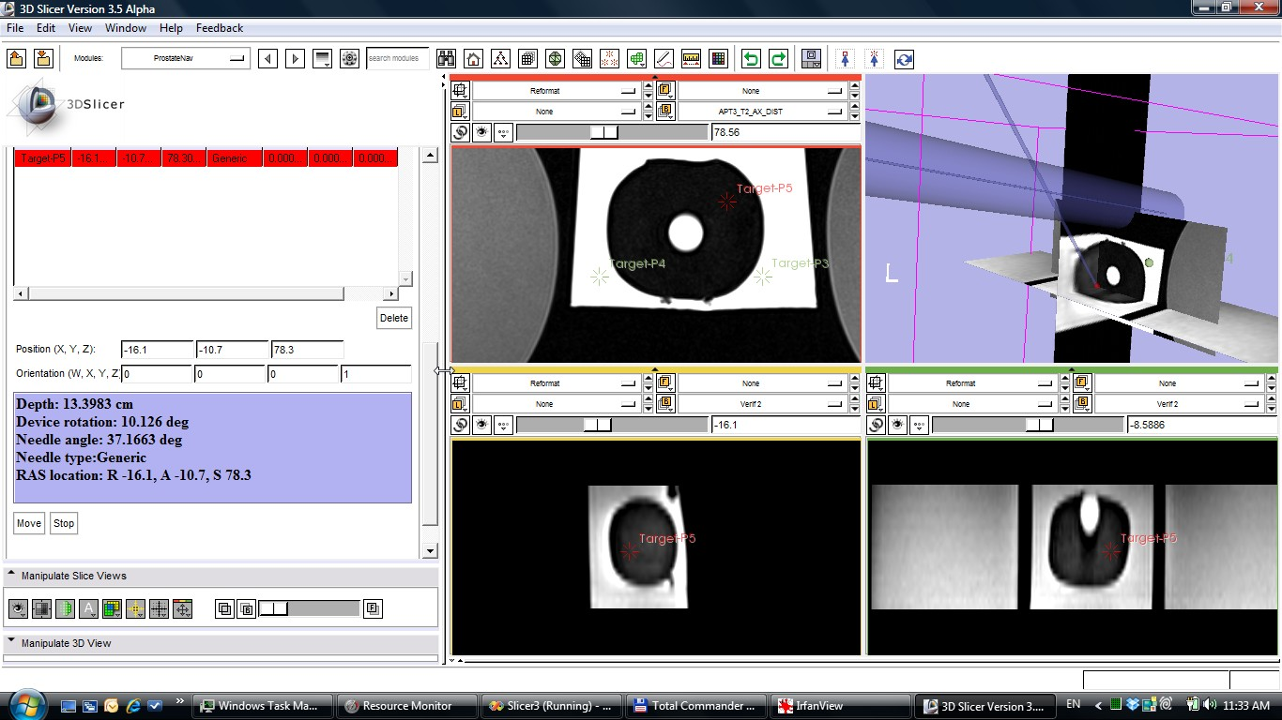
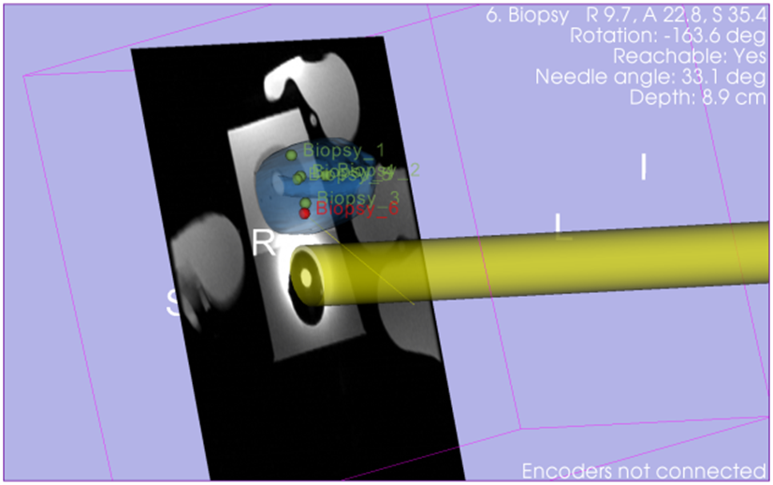
Monitoring in 2nd display
Lasso, 2011

Slide 16
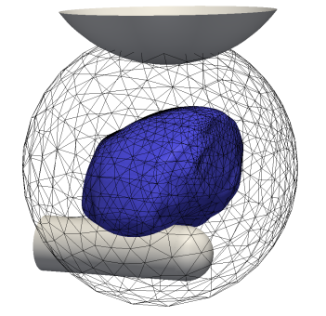
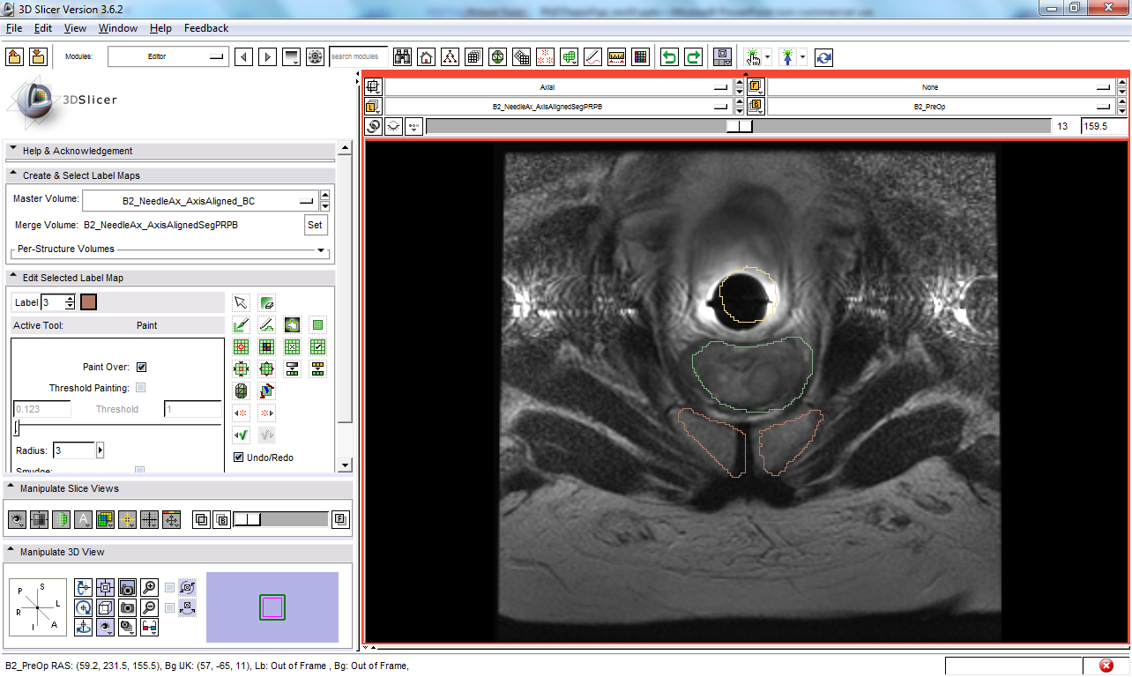
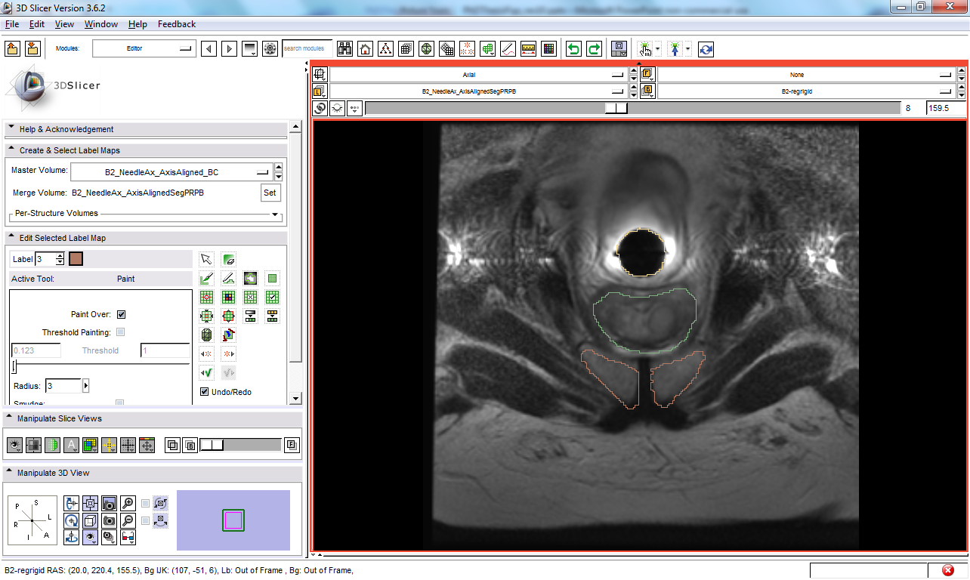

Monition tracking
Sparse volume
Stage 1
Stage 2
fixed image
fixed image
Compute metric
(MMI)
ROI: P+R+PB
Compute metric
(MMI)
ROI: P
metric value
metric value
Optimize
metric
(GD)
transformed moving image
Optimize
metric
(L-BFGS-B)
transformed moving image
transform parameters
transform parameters
Transform image
(rigid)
result
transform
Transform image
(B-spline)
Prostate motion transform
Target planning volume
moving image
moving image
Tadayyon et al. IEEE TBME 2011
Lasso 2012 (in preparation)

Slide 17
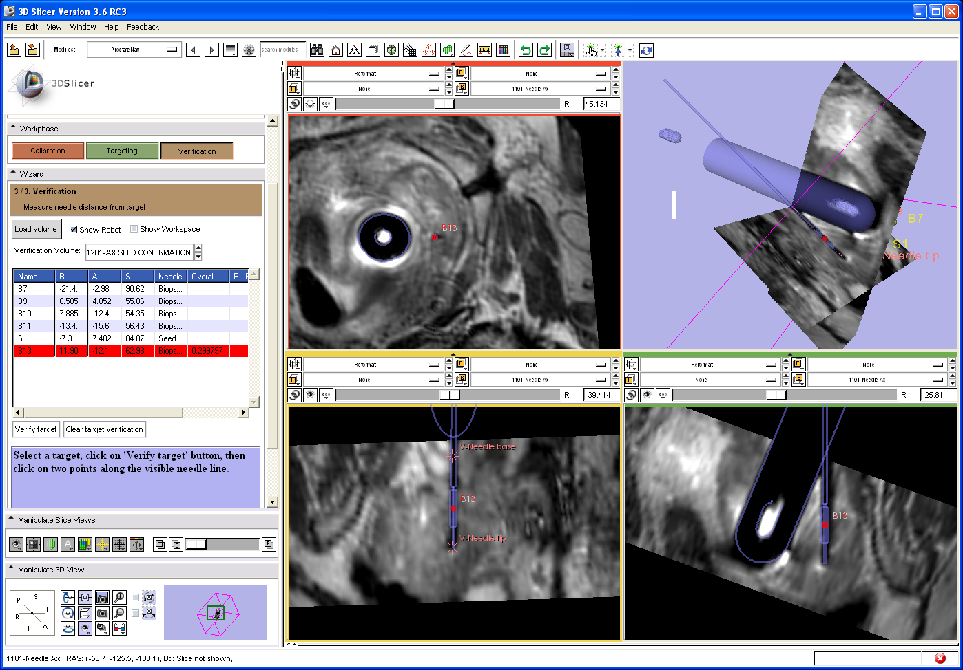
Verification
Lasso, 2011

Slide 18
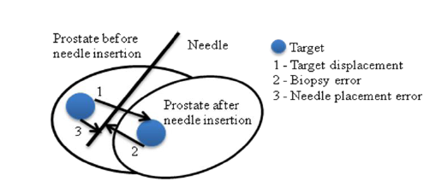
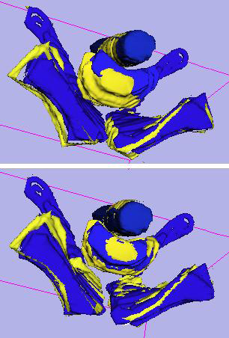
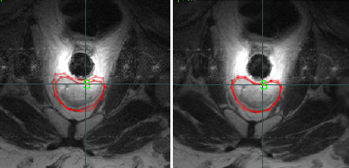
Clinical trial analysis
Xu et al. MICCAI, 2010

Slide 19
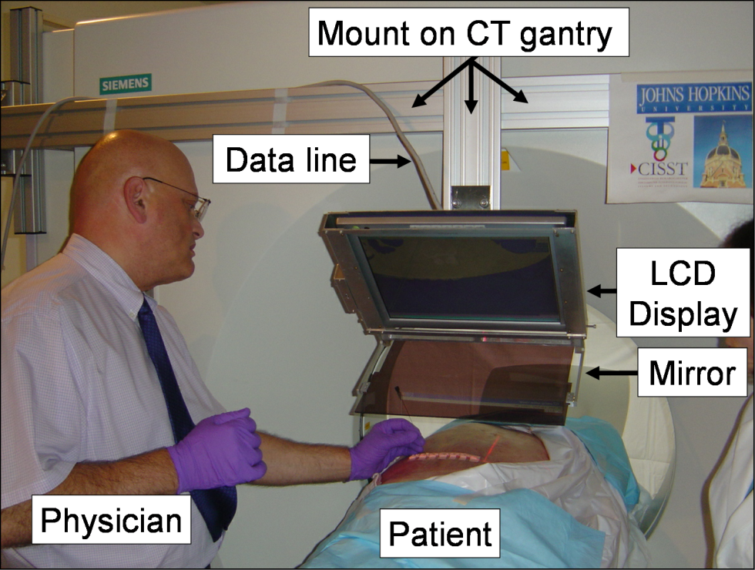
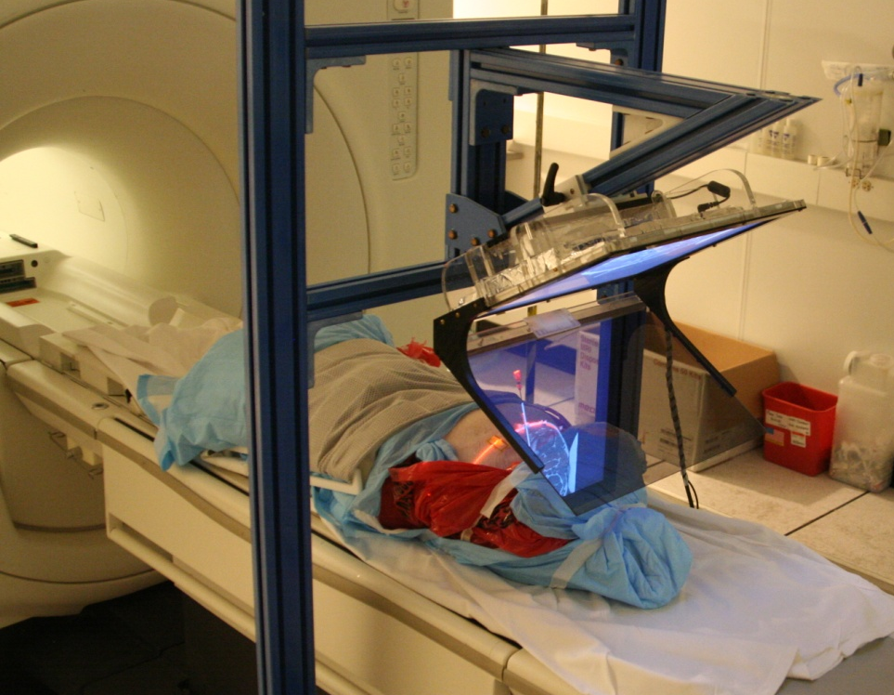
Augmented reality guidance
Fichtinger et al. IEEE TMBE, 2005
Fischer et al. JCAS, 2007

Slide 20
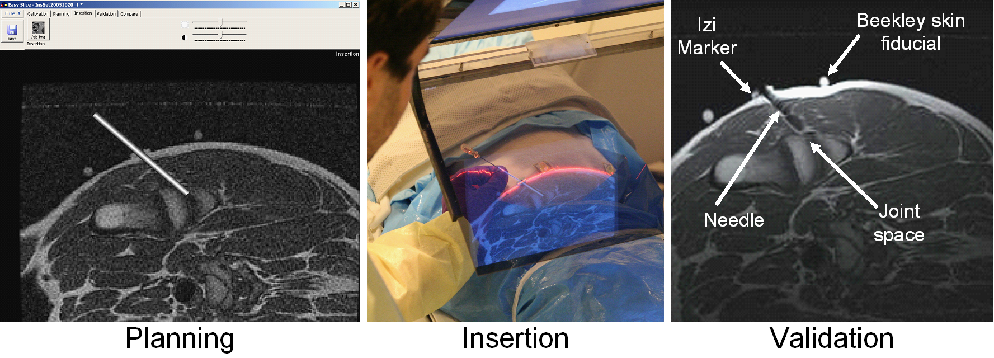
Clinical workflow
Fischer et al. JCAS, 2007

Slide 21
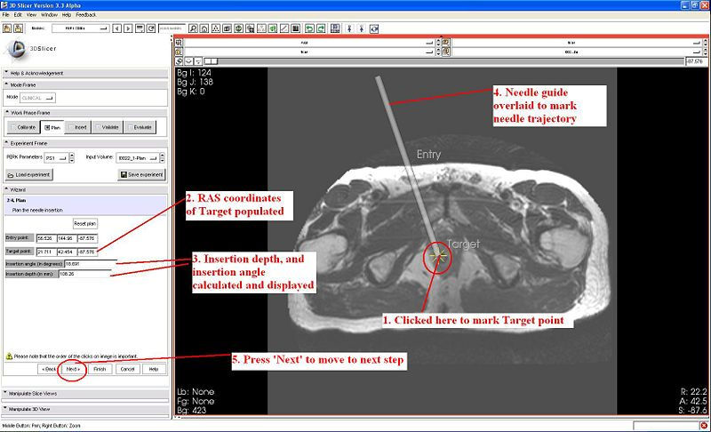
Slicer interface
Vikal et al. CMIG, 2009

Slide 22
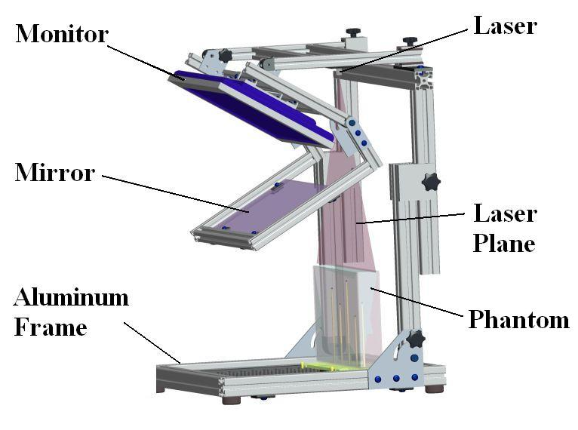
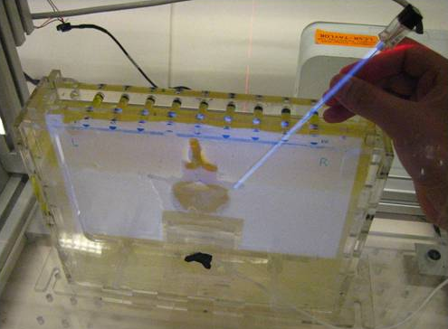
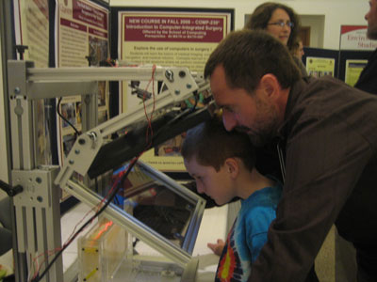
The Perk Station
Vikal et al. CMIG, 2009

Slide 23
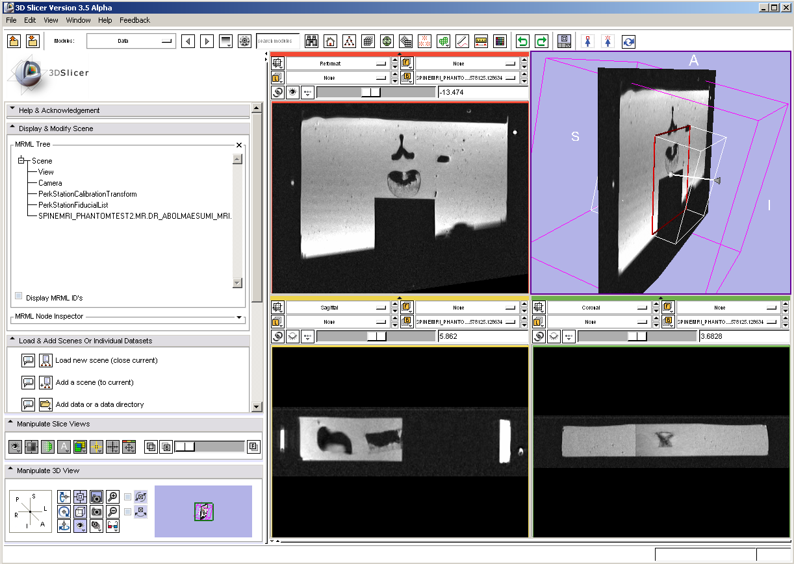
Perk Station interface
Vikal et al. CMIG, 2009

Slide 24
What we learned from NAMIC
  Open source collaborative development pays off in the end only
  It needs people of the same mind, passion and vision – very difficult to come by
  Spending NAMIC funds solely on engineering was a wise and necessary decision
  Work with your friends

Slide 25
Graduation plan
  Form the “Canadian NAMIC”
  Concentrate on IGS and translational clinical engineering
  Work with NAMIC, the older and wiser brother
  Set the rules
  Choose the right partners
  Get funded

Slide 26

SPARKit – Software Platform and Adaptive Radiotherapy Kit
  Affiliated with OCAIRO (Ontario Consortium for Adaptive Interventions in Radiation Oncology) of +20 industry-funded investigators
  Funded by Cancer Care Ontario as a Applied Cancer Research Unit
  Shared, reusable and customizable software infrastructure to assist clinical translation of experimental diagnostic and therapeutic approaches
  The scope of SPARKit is IGRT & associated IGS procedures

Slide 27
SPARKit partners & rules
  Partners
  Queen’s University, Kingston (Gabor Fichtinger, PI)
  Robarts Research Institute, London (Terry Peters)
  Princess Margaret Hospital, Toronto (David Jaffray)
  Rules
  Open to buy-in by other groups (up to our funding limit)
  All money goes to clinical application engineering
  3D Slicer is mandatory
  Trials, algorithm development etc. must be funded separately

Slide 28
SPARKit engineering staff
  Queen’s University, Kingston
  Andras Lasso, Tamas Ungi, Csaba Pinter
  Robarts Research Institute, London
  Elvis Chen
  Princess Margaret Hospital, Toronto
  Kevin Wang
  50% SPARKit & 50% other grants
  All present at AHM

Slide 29
SPARKit projects
  MRI-guided prostate interventions
  MR image overlay guidance
  Slicer Radiation Therapy
  Ultrasound calibration
  Ultrasound-guided needle placements
  Percutaneous needle placement training

Slide 30
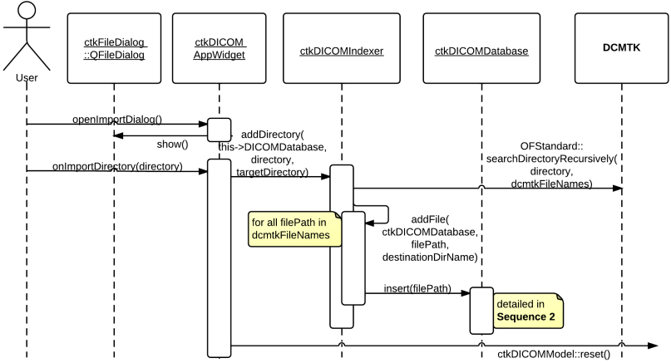
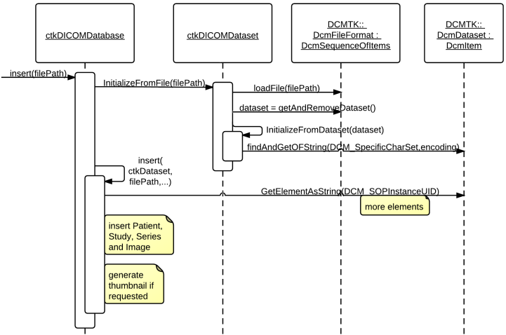
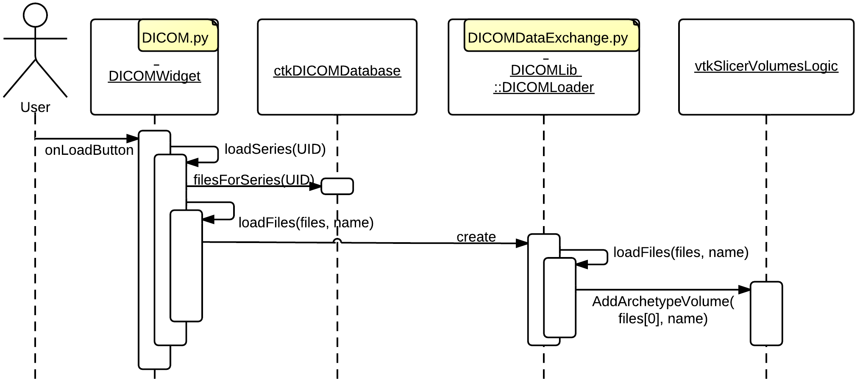
Slicer Radiation Therapy
Csaba Pinter, Andras Lasso, Kevin Wang
  Address common needs of OCAIRO investigators
  DICOM RT I/O in Slicer-4 to provide dose maps, contours, DVH…

Slide 31
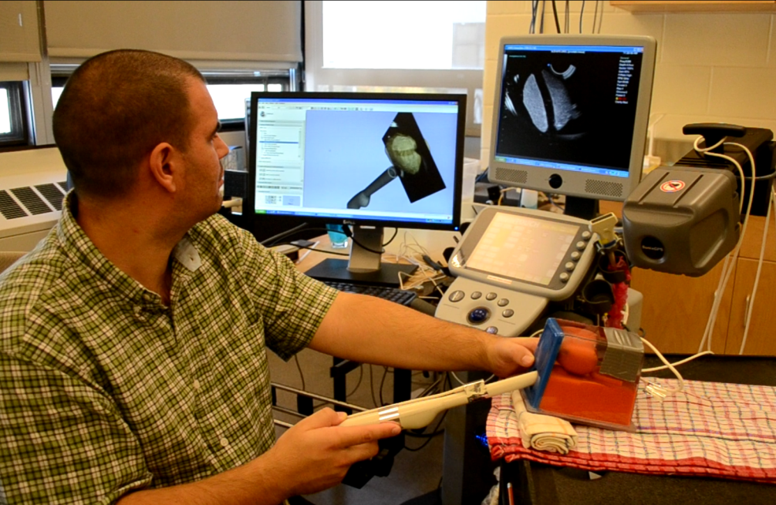
Public Library for Ultrasound
Andras Lasso, Csaba Pinter, Tamas Ungi
Goal: Facilitate rapid clinical application prototyping of ultrasound-guided interventions
Google Scholar on “tracked ultrasound” about 48,000 hits
Scope: tracked ultrasound calibration, data acquisition, processing, and streaming
Open-source (since October 2011)
BSD license, no strings attached
Users: UBC, Robarts, planned at
JHU, BWH, PTI/AMS

Slide 32
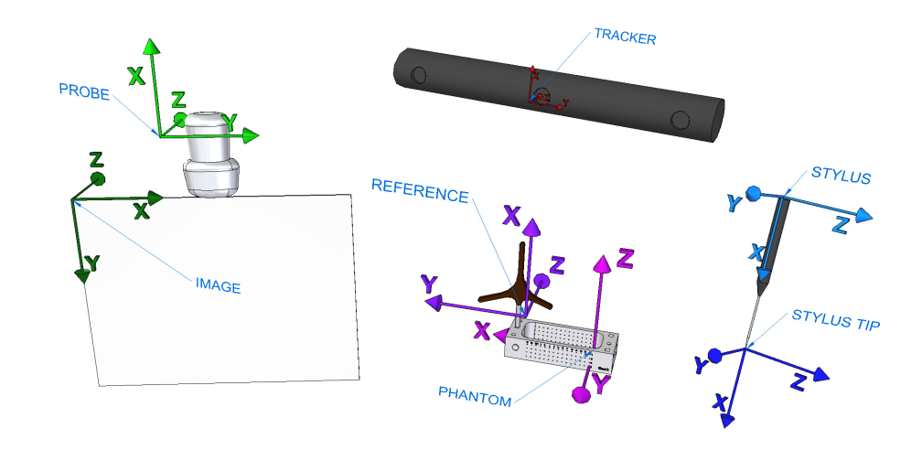
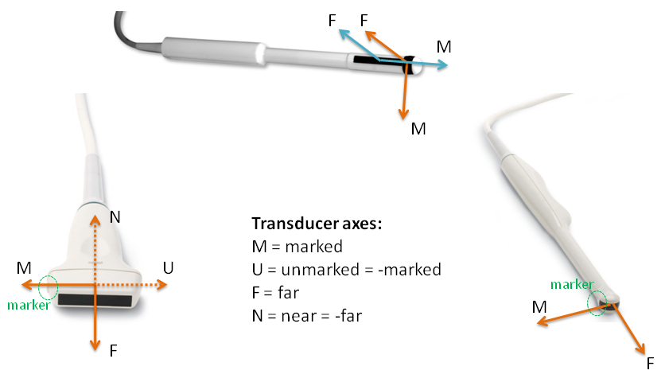
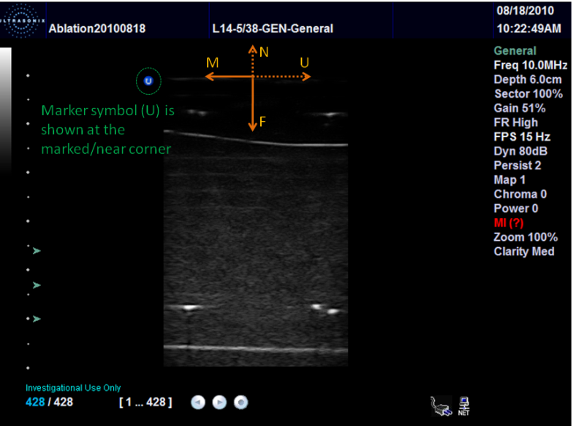
Why is ultrasound difficult?

Slide 33
PLUS architecture
Option B: PLUS application communicates with 3D Slicer through OpenIGTLink
Option A: Standalone PLUS application (not using 3D Slicer)
3D Slicer
PLUS Applications
3D Slicer plug-in modules
PLUS library
Option C: 3D Slicer plug-in directly uses PLUS library
Device SDKs and drivers
VTK
ITK
CTK
Open
IGTLink
QT

Slide 34
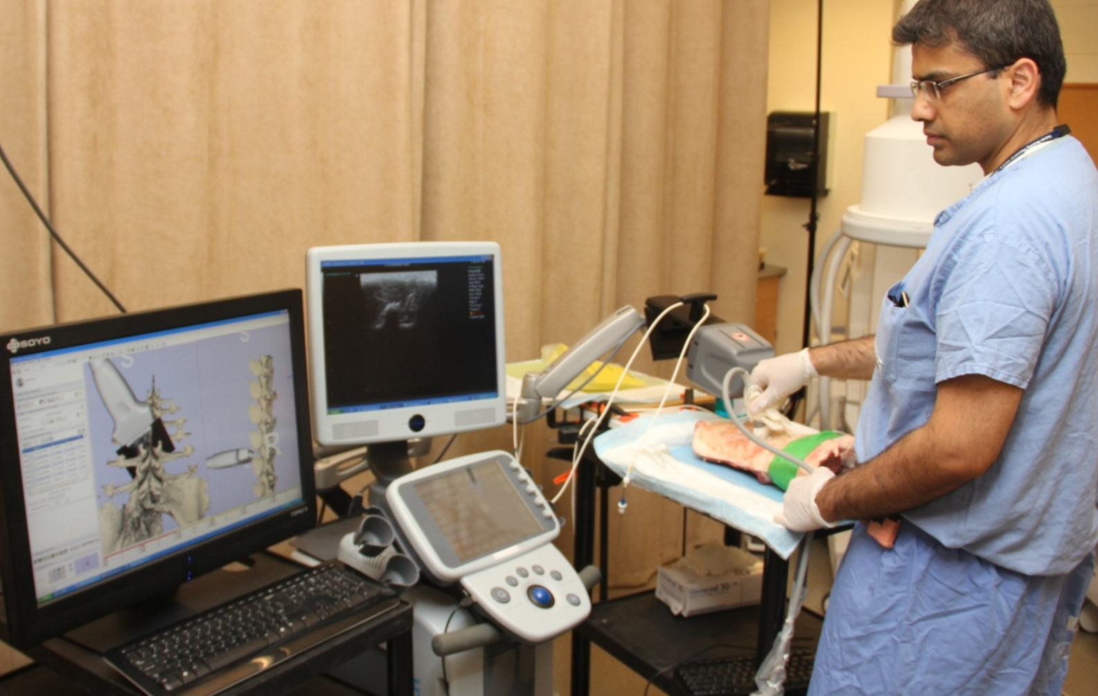
Ultrasound navigation
Tamas Ungi, Elvis Chen

Slide 35
Configurable architecture
3D Slicer
Live Ultrasound
Visualization
Transform Recorder
Registration
Segmentation
...
OpenIGTLink
PLUS
Synchronisation
...
OpenIGTLink
Ultrasonix SDK
Ascension SDK
...
Sonix Touch
Ascension DriveBay

Slide 36
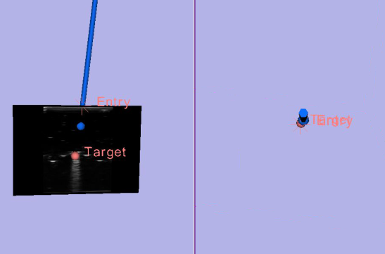
Snapshot ultrasound mode
Dual 3-D layout in 3D Slicer
Bull's-eye view
virtual camera
Tracked needle
Entry point
Progress view
virtual camera
Target point
Progress view
Bull's-eye view
Target phantom /patient
 | Tracked snapshot guidance | Plain ultrasound guidance
Number of insertions | 60 | 60
Success rate (%) | 93% * | 71%
Insertion time (s) | 117 ±19 | 138 ±34

Slide 37
Lessons learned
  Patience
  Leverage other grants
  Stick to the rules
  Choose partners from friends
  Stay in the NAMIC family

Slide 38

Thank you

